Slide 1

The Whitespace Programming Language
Made by: CsPS

Slide 2
What is Whitespace?
A Binary-Based Esoteric Programming Language (Esolang)
Only 3 character
Purpose: Humor, exploring unconventional coding
One of the „Hardest” Language

Slide 3


History
Creators: Edwin Brady, Chris Morris
Released: 2003. April. 01
Inspired by minimalism and humor
Interpreter written in Haskell
Turing-complete stack-based language

Slide 4
Features
Tabs = 1; | Space = 0;
Invisible syntax: Code relies on spaces, tabs, and linefeeds
Instruction Modification Parameters (IMP):
I/O: input => output
Stack Manipulation: push/pop values
Arithmetic: calculations
Flow control: program execution
Heap access: heap storage management for dynamic memory

Slide 5
Calculation Example
Operation: Adding two numbers
Steps:
1. Push the first number onto the stack:
Space Tab Space (Push 5)
2. Push the second number onto the stack:
Space Tab Space (Push 3)
3. Add the two numbers:
Tab Space (Add)
4. Output the result:
Tab Tab LF (Output the sum as a number)

Slide 6
Space Tab Space Push 5
Space Tab Space Push 3
Tab Space Add (3 + 5)
Tab Tab LF Output result (8)

Slide 7
Interesting Facts
Debugging: Invisible syntax makes it tricky
Popularity: Nice among hobbyists, coding competitions
Use cases: Educational, creative expression

Slide 8
FAQ
Is Whitespace practical?
No, it's more of a learning tool and for fun than practical use.
How can I debug Whitespace code?
Use specialized interpreters with debug modes or visualizations.
Is Whitespace Turing-complete?
Yes, it can perform any computation given enough resources.

Slide 9
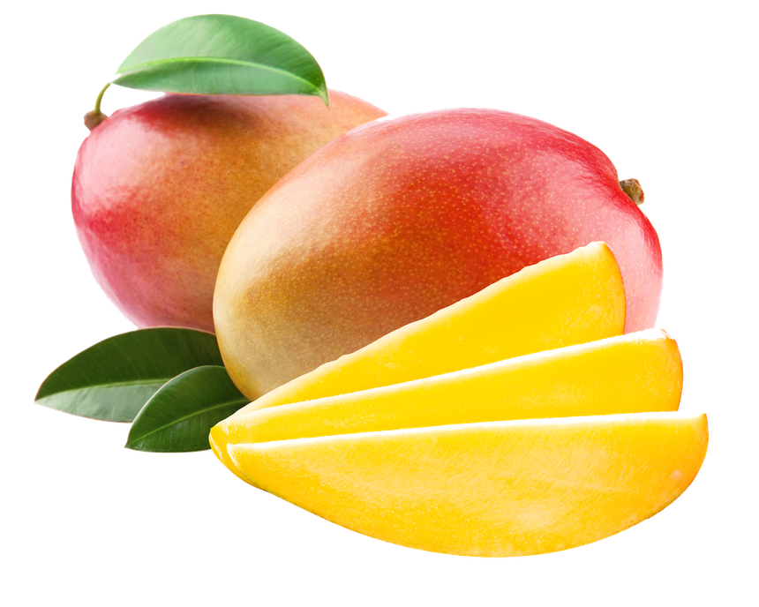
Thanks for the attention!
Sources:
Esolang
ChatGPT

