Slide 1
Csaba Toth
Full stack engineer
  Director of Product Engineering at SportsBoard (startup)
  CTO at ThruThink (startup)
Interested in AR/XR, AI/ML, lately Gen AI
GDG (Google Developer Group) Fresno lead, WTM (Women Techmakers) Fresno ambassador, tech meetup junkie

Slide 2

ThruThink® is a business budgeting on-line app to create professional budgets and forecasts
product of literally decades of experience and careful thought, and thousands of calculations
Thru-hiking, or through-hiking, is the act of hiking an established long-distance trail end-to-end continuously
There are no dedicated personnel for support chat agent roles, had a “classic” chat agent integration

Slide 3
ThruThink Customer Chat Agent
Invaluable help, given that
  It stays relatively grounded
  Won’t hallucinate* wildly
Desired abilities:
  Main goal: answer ThruThink software specific questions: “In ThruThink can I make adjustments on the Cash Flow Control page?”
  Nice to have: answer more generic questions such as: “How much inventory should I have?”

Slide 4
ThruThink Customer Chat Agent
Nice to have: “How much inventory should I have?”
The amount of inventory that you should have on hand depends on several factors, including your business type, industry, and sales volume. Here are a few considerations to keep in mind when determining the appropriate amount of inventory for your business:
Sales volume: If your business experiences high sales volume, you may need to keep more inventory on hand to meet customer demand. On the other hand, if sales are slower, you may be able to keep less inventory in stock.
Lead time: If it takes a long time to receive inventory from suppliers, you may need to keep more on hand to avoid stockouts.
Seasonality: If your business experiences seasonal fluctuations in demand, you may need to adjust your inventory levels accordingly.
Storage space: Consider how much physical space you have available to store inventory. You don't want to overstock and have inventory sitting unused and taking up valuable space.
Ultimately, the goal is to have enough inventory to meet customer demand without tying up too much capital in excess stock. As a general rule of thumb, aim to keep inventory levels at a level that allows you to cover several months of sales, while also keeping a close eye on inventory turnover rates to ensure that you are not holding onto excess inventory for too long.

Slide 5
ThruThink Customer Chat Agent
Follow up: “My turnover rate is three times a year. And my cost of goods sold is 9.5 million dollars. Do you have numbers about this?”
Based on your inventory turnover rate of three times per year and cost of goods sold of $9.5 million, we can calculate your average inventory value as follows:
Average inventory value = Cost of goods sold / Inventory turnover rate
Average inventory value = $9.5 million / 3 = $3.17 million
This means that you are carrying an average inventory of $3.17 million to support your sales volume of $2 million per year. Your inventory investment is approximately 1.58 times your annual sales.
To further optimize your inventory levels, you may want to consider implementing some of the strategies mentioned earlier, such as JIT inventory management and regular inventory audits. You could also consider working with suppliers to negotiate better lead times or explore alternative sourcing options to reduce inventory holding costs.
As always, it's important to regularly monitor your inventory turnover rate and adjust your inventory levels as needed to ensure that you are maximizing your profitability and minimizing the amount of capital tied up in excess inventory.

Slide 6
ThruThink Customer Chat Agent
The main goal needs grounding
The secondary goal might fall back to the vast knowledge of an LLM
Source documents: ThruThink’s help database / documentation
  185 help topics
  Organized into categories
  Generated HTML, markdown formats before

Slide 7
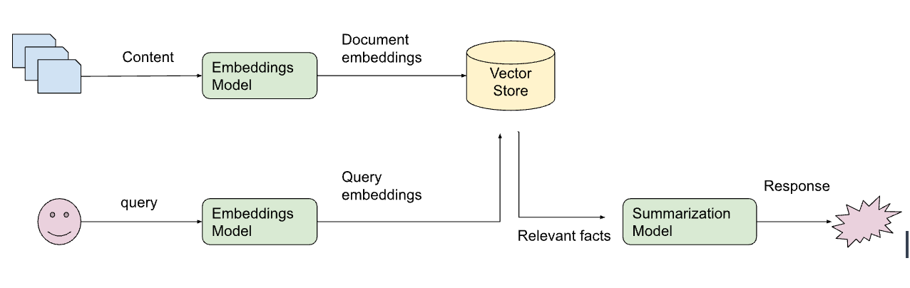
Retrieval Augmented Generation

Slide 8
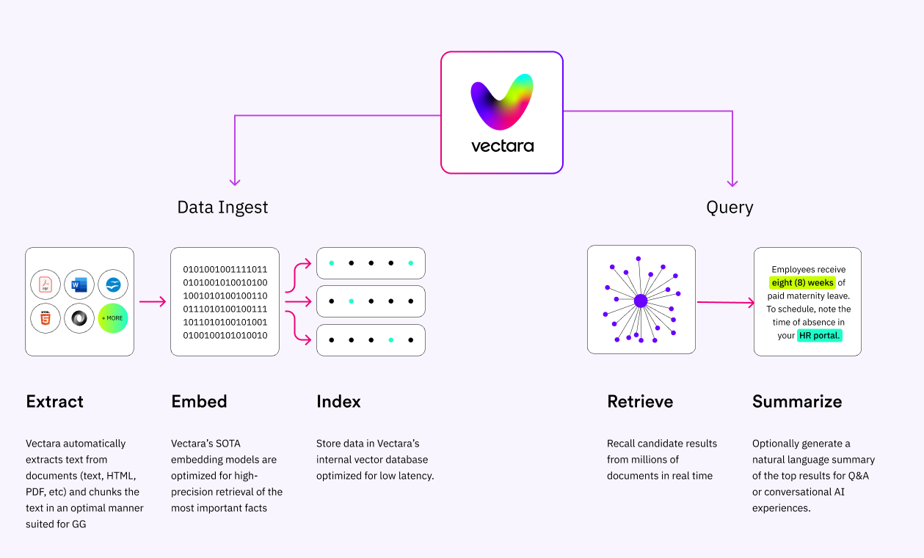
Retrieval Augmented Generation

Slide 9

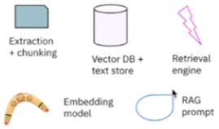
Retrieval Augmented Generation
Enterprise
Knowledge
Base
Indexing API
App Hosting
(Render, ...)
Extraction
+ chunking
Query
Response
Vector DB +
text store
Retrieval
engine
Query
API
Embedding
model
RAG
prompt

Slide 10
QBRAG: QnA Boosted RAG
QnA generation
(AnyScale Llama2)
Knowledge
Base
QnA
Enterprise
Knowledge
Base
Indexing API
App Hosting
(Render, ...)
Query
Response
Extraction
+ chunking
Query
API
Vector DB +
text store
Retrieval
engine
Embedding
model
RAG
prompt

Slide 11
QBRAG: QnA Boosted RAG
QnA generation
(AnyScale Llama2)
Knowledge
Base
QnA
Enterprise
Knowledge
Base
Common
Knowledge
(Books)
Indexing API
App Hosting
(Render, ...)
Query
Response
Extraction
+ chunking
Query
API
Vector DB +
text store
Retrieval
engine
Embedding
model
RAG
prompt

Slide 12
Accomplishments
Contributed back to https://github.com/nestordemeure/question_extractor for the QnA generation
  Check-pointing to resume generation (can take 6-7 hours)
  Export AnyScale fine tuning format
  Tone down rate limit hitting to not hammer the API as much
Script to process `question_extractor`’s `questions.json` to generate markdown QnA per help topic

Slide 13
Accomplishments – cont.
All of my document loading scripts (help markdown, QnA markdown, books, ...) are in my repository
Modified Vectara React application for my needs, also open source
Hosting the evaluation application on the Render platform (free tier might need some warm-up time) https://thruthink-support.onrender.com/

Slide 14
Considerations
Is fine tuning needed, is it beneficial? Test / measure if that would actually produce better results
Improve supporting documents even more (for example policies: ToS, AUP, ...)
Integrate the solution into ThruThink’s application (closed source):
  Will allow the invocation of help topic display when user clicks on certain document references

