Slide 1
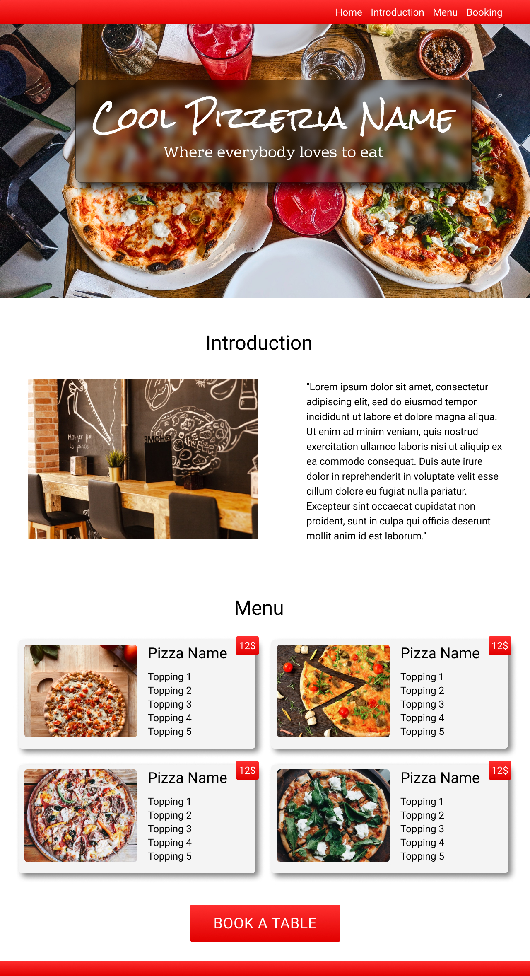
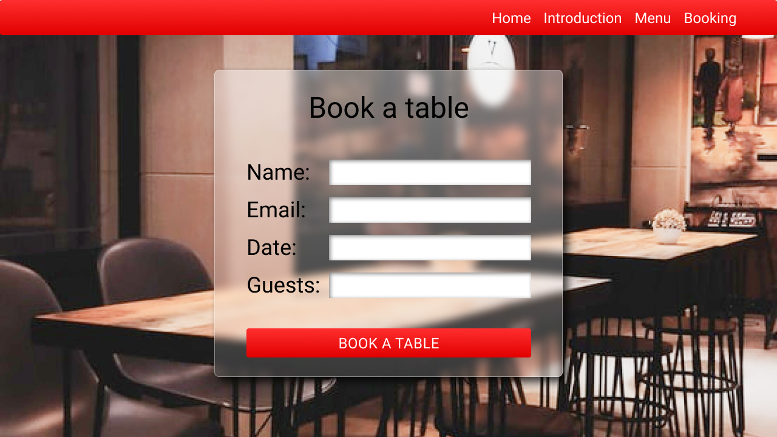
Wireframe
Book a table
team „MINDEGY”

Slide 2
Tasks
Book a table
team „MINDEGY”
Patrik
Landing page
Form
Robi
Header
Responsive structure
Sarolta
Intro img
name
Intro title
email
Intro paragraph
date
time picking
Csabi
Menu
Topping
number of persons
Price
Book a table button

Slide 3
Tasks
Book a table
team „MINDEGY”

Slide 4
Tasks
Book a table
team „MINDEGY”

