Slide 1
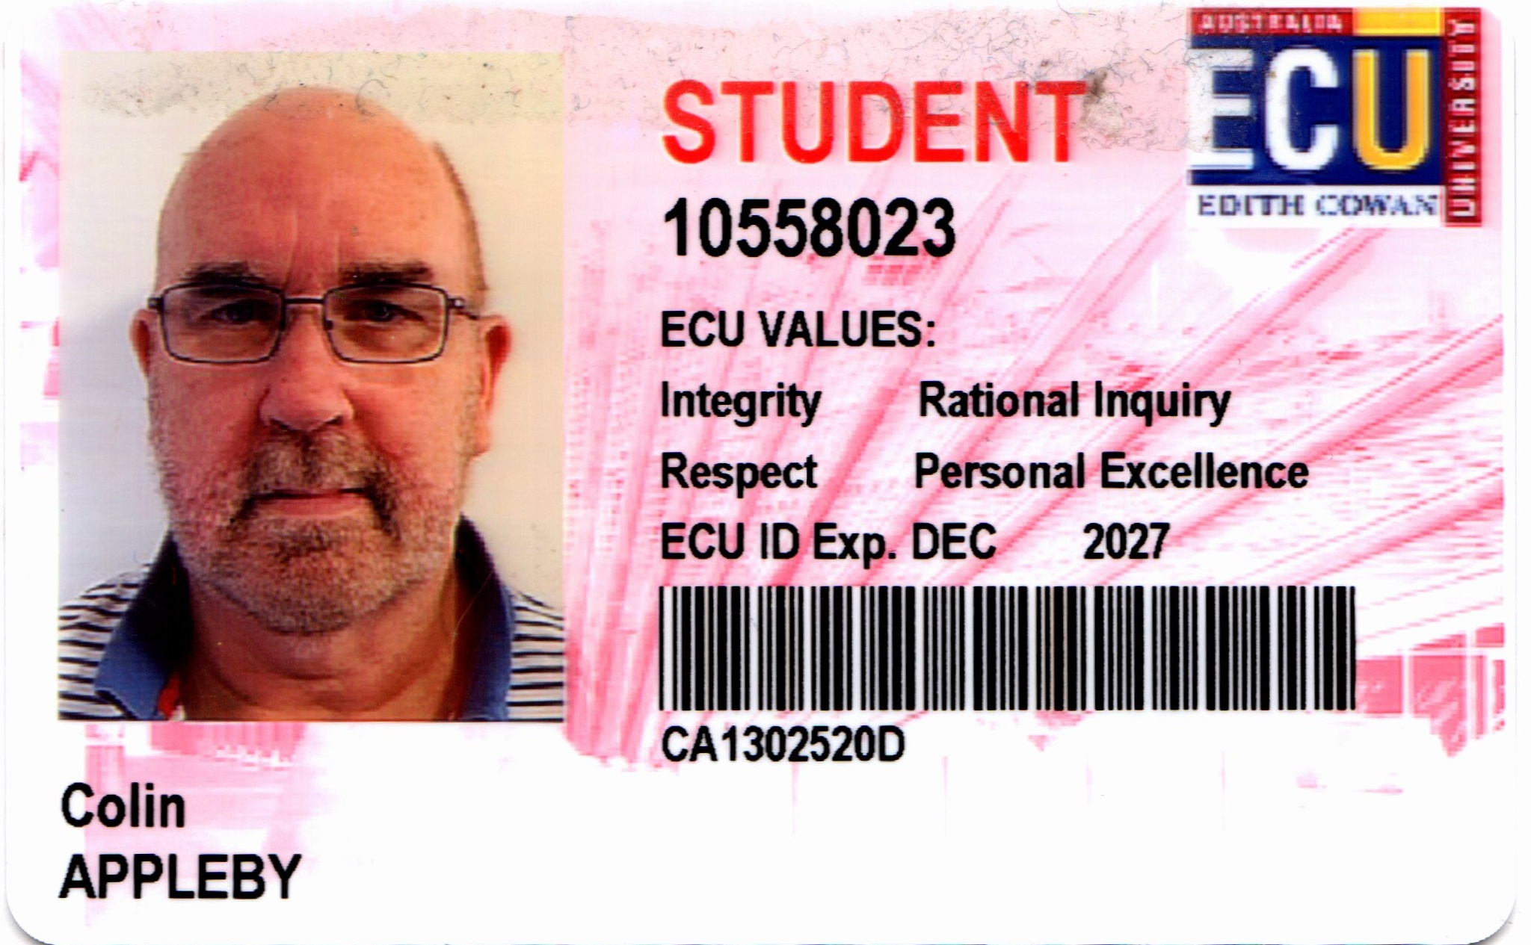
Risk Assessment of a small(ish) Company presented by Colin Appleby
Unit Code: CYB6012-23AC1
Unit Name: Cyber Project 1
Facilitator’s Name: Bazlur Rashid

