Slide 1

Youtube analysis
Tecnológico de Monterrey Data Analytics Boot Camp
Project 1
Pandas members:
Alonso Lozano
María José García
César Cruz
Marcela Maldonado
Notes:
MAJO

Slide 2

Topic relevance
For us, YouTube is the largest and most popular video platform on the internet, with billions of users and an enormous amount of content being submitted every day by millions of people worldwide. This is translated to a dataset of more than 700k data points.
Notes:
majo

Slide 3
QUESTIONS
What is the distribution of views per country?
What is the distribution of revenue per country?
What is the impact of likes in the total views?
What is the correlation between key variables?
What is the likes share per category?
What is the category preference for Great Britain?
What is the category preference for Germany?
What is the category preference for France?
Notes:
Marce

Slide 4
KAGGLE
Kaggle is an online community platform where you can find an incredible amount of datasets. Kaggle was founded in 2010 and acquired by Google in 2017.
You can upload your datasets and download other users (over 8 million) datasets.
Kaggle has competitions where you can score points and win medals as proof of you progress, start earning points gives you the chance to enter a live leaderboard.
Shining in Kaggle gives you the opportunity to find a new job.
Notes:
Cesar

Slide 5
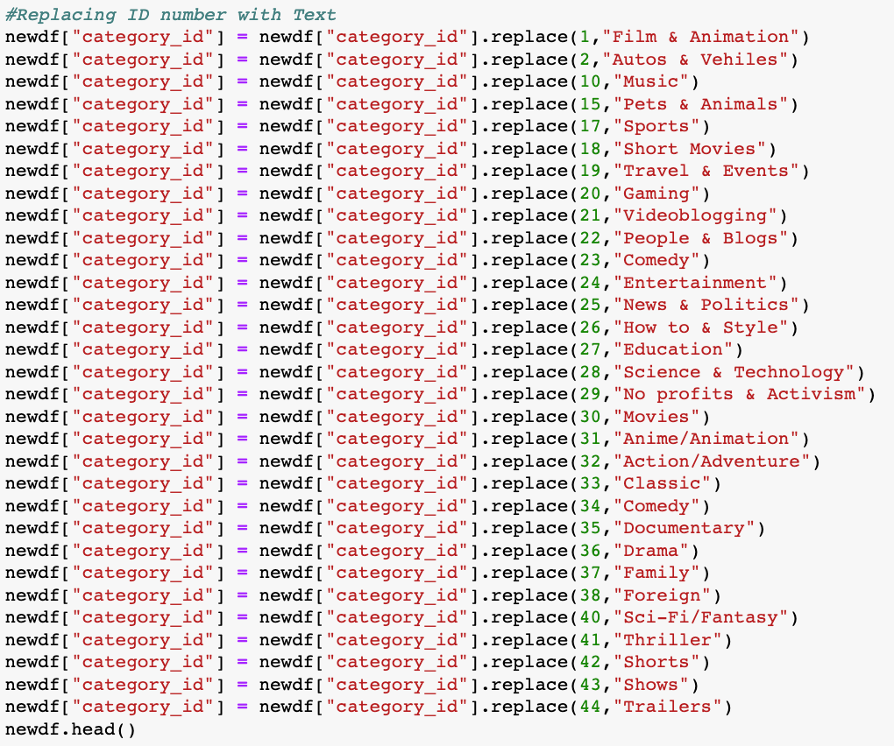
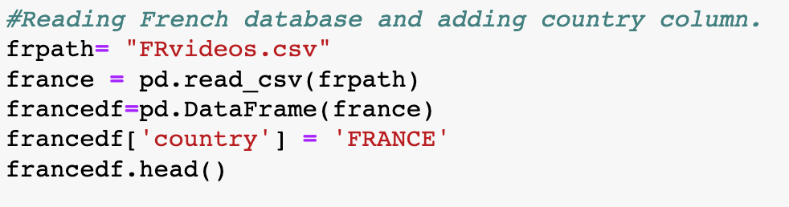
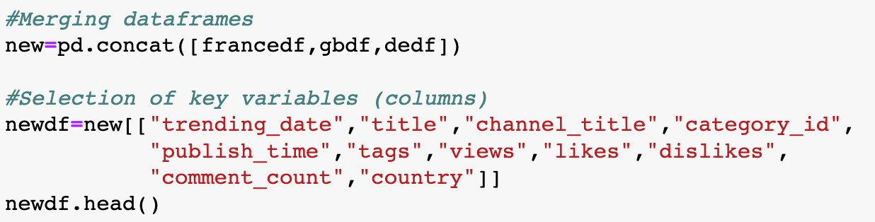

CLEANUP
Notes:
Cesar

Slide 6
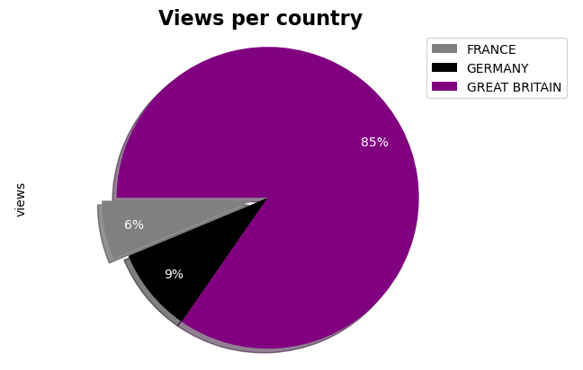
What is the distribution of views per country?
Views per country (shares, 2017-2018)
Key insights:
Regardless of the population of the countries, Great Britain represents 85% of the views, followed by Germany (9%) and France (6%).
The explanation behind could be the video offer of the same language coming from other countries.
Population by country:
Great Britain (66.1 M)
Germany (82.8 M)
France (64.2 M)
Source: Own analysis based on Youtube data and EuroStat.
Notes:
Majo

Slide 7
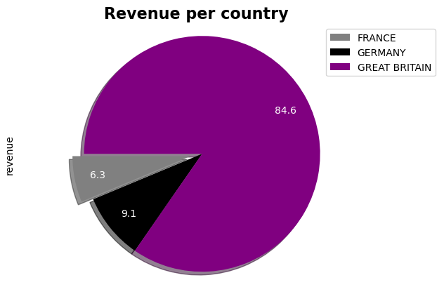
What is the distribution of revenue per country?
Revenue per country (USD $ M 2017-2018)
Key insights:
Given the distribution of the views and homologues policies in terms of the monetization of this views, the biggest market for video production is Great Britain.
This market produces USD $ 84.6 M of revenues to video producers, while Germany and France produce USD $ 9.1 M and USD $ 6.3 M, respectively.
Source: Own analysis based on Youtube data
Notes:
Loncho

Slide 8
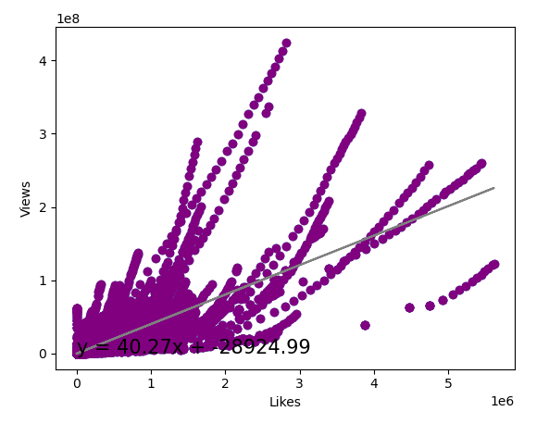
What is the impact of likes in the total views?
Linear regression (likes and views, 2017-2018)
Key insights:
Every like per video, represents and impact of 40.2 views.
This represents a USD $0.16 if revenue per like.
Without taking into account further variables, likes explains 63% of the variation in views.
Source: Own analysis based on Youtube data
Notes:
Loncho

Slide 9
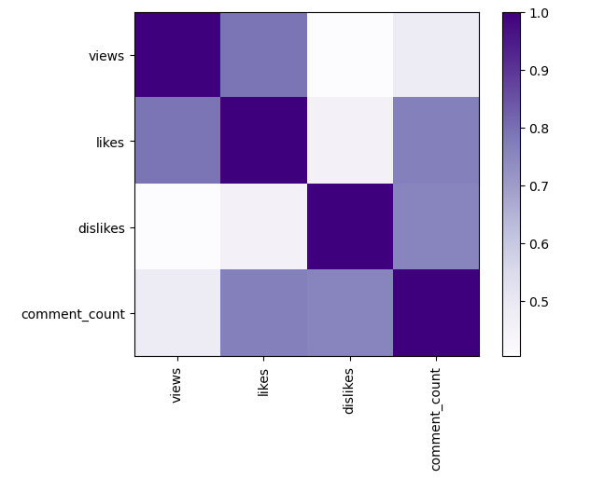
What is the correlation between key variables?
Pearson coefficient (0-1, 2017-2018)
Key insights:
The weakest correlation is presented between dislikes and views, an initial explanation could be that people that dislikes the videos don't interact with them.
If a users decides to interact with the video, usually leaves comments.
Source: Own analysis based on Youtube data
Notes:
Marce

Slide 10
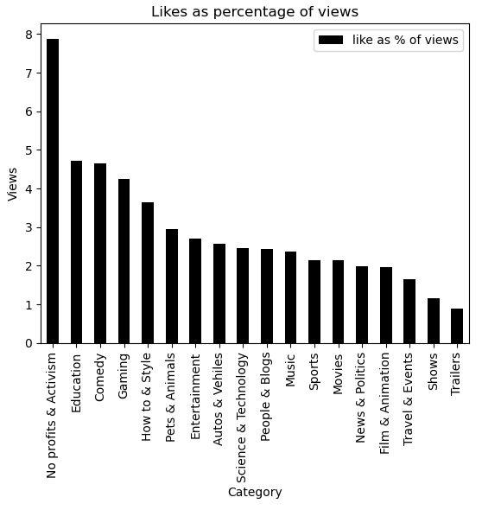
What is the likes share per category?
Likes (%, 2017-2018)
Key insights:
Categories that depends on a proactively search by the user have highers shares of likes in relation of the views.
Categories that may depend on a query and advertisement may have lower likes in relation of views.
Opportunistic categories
Proactively categories
Source: Own analysis based on Youtube data
Notes:
Loncho

Slide 11
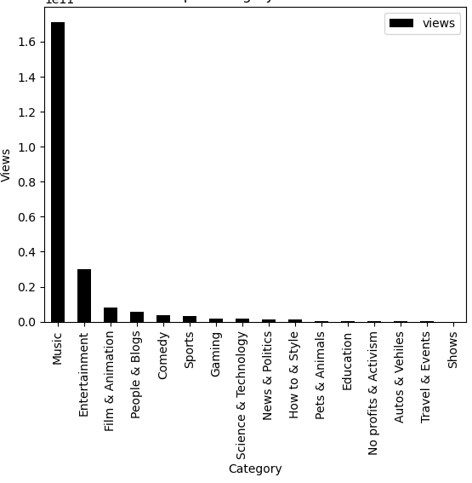
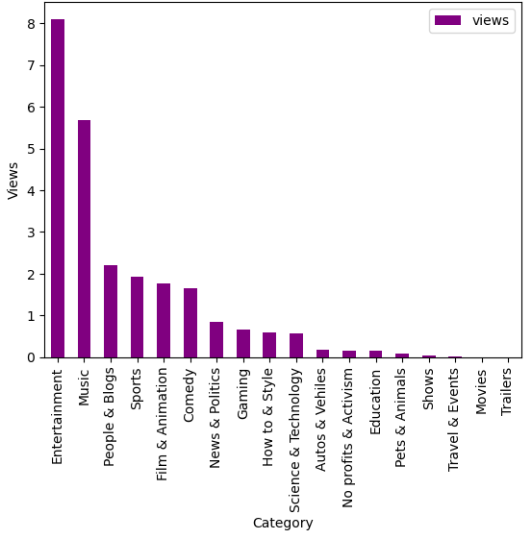
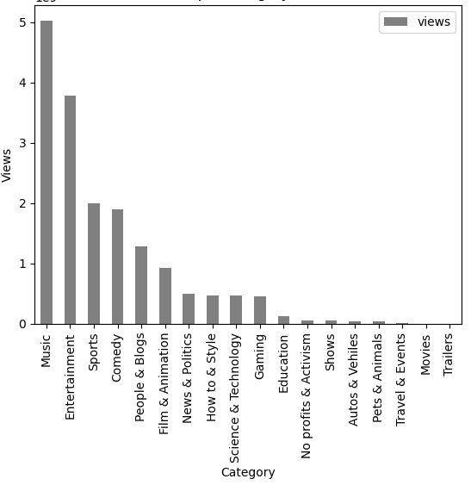
What is the category preference for each country?
Views (Hundred billions, 2017-2018)
Great Britain
Germany
France
The top 2 categories for the countries in the sample are Music and Entertainment.
Great Britain has a notably concentration in music videos (74.3% of the views).
Germany is the only country in which entertainment is the main category (32.8% of views).
France has a more homogeneous distribution in the top 5 categories (81.4% of views) compared to Great Britain and France
Source: Own analysis based on Youtube data
Notes:
11 ceros - Marce

Slide 12
Final conclusions after analysing 720k data points
1
Great Britain represents the biggest market for video production (In terms of views and revenues)
2
63% of the variation of views is explained by the variation of likes, where one like is translated to 40.2 views and USD $ 0.16 of revenue.
3
When a user interacts with a video, usually they leave a comment
4
User-initiated categories tend to have higher like-to-view ratios compared to categories that rely on queries and ads.
5
France and Great Britain prefer music videos in comparison with Germany that watches more entertainment videos.
Notes:
Cesar

Slide 13
Thanks for your attention!

