Slide 1
H.api-Group
Simon, Ovidiu, Adam, Clifford & Sarah

Slide 2

<Introduction>
Crises seem to be an unavoidable part of our global economic system, affecting our society in unpredictable ways. We were motivated by the current health and financial crisis, to create a project that studies and analyses a critical part of everyone's lives: housing.

Slide 3
<Questions proposed>
What trends have the UK housing prices and sales followed for the past 12 years?
How have they been affected by the 2008 financial crash and Covid-19?
Where are housing prices and sales volume highest in the UK?
Using the most recent data from July 2021
Where is the highest sales volume and house price within the West Midlands?
How does the West Midlands compare with the other regions of England when it comes to housing prices and purchase volume?
A comparison between Birmingham, Coventry, Dudley, Sandwell, Solihull, Walsall, Wolverhampton, using the most recent data (July 2021)

Slide 4


<Data used>
A collection of data of the UK housing market starting from 2005.

Slide 6
<Average house price in the uk > (Over the past 12 years)

Slide 7
Adams Description

Slide 8
<Sales Volume>

Slide 9
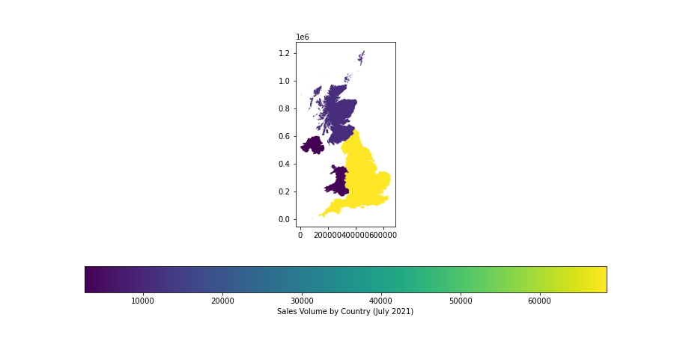
<In the uk>

Slide 10
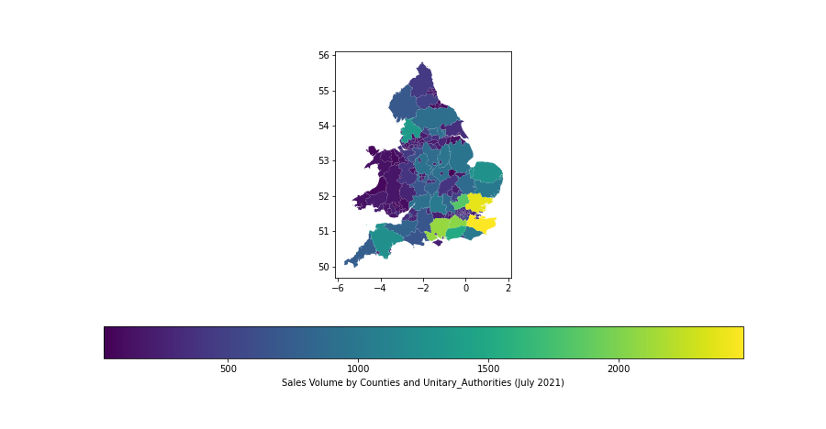
<by counties>

Slide 11
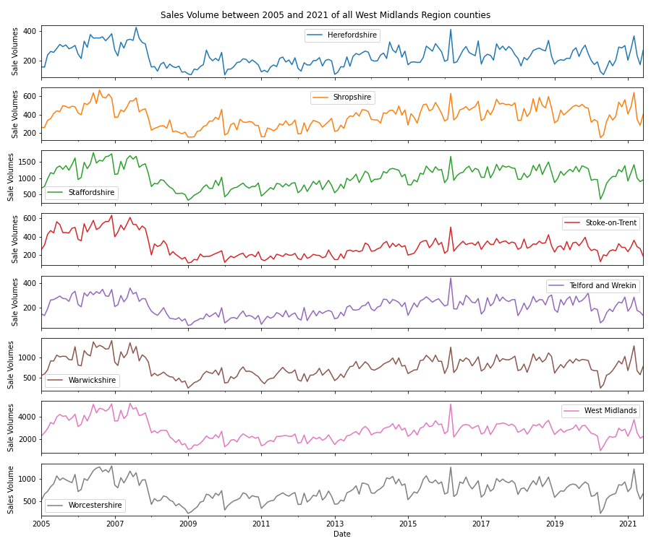
<Within The West Midlands>
Sales Animation

Slide 12
Ovis description

Slide 13
< Cities within the West Midlands>

Slide 14
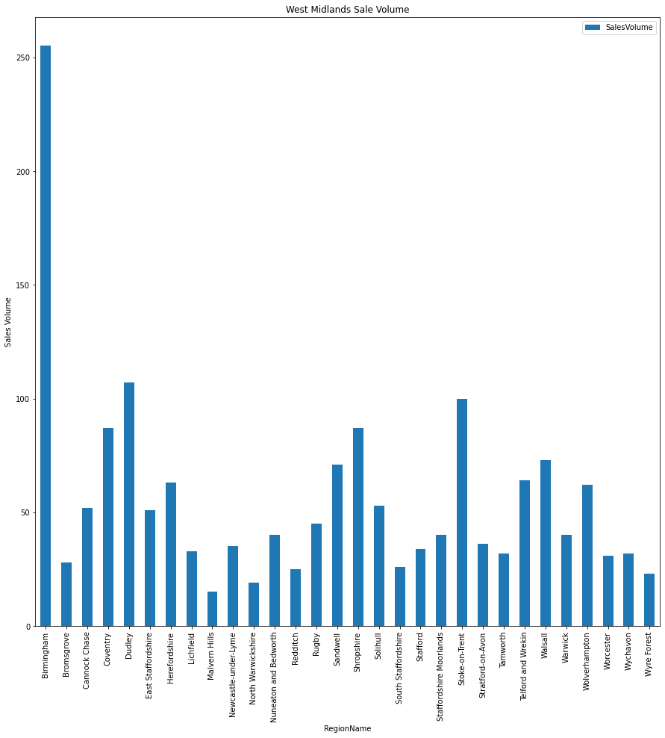
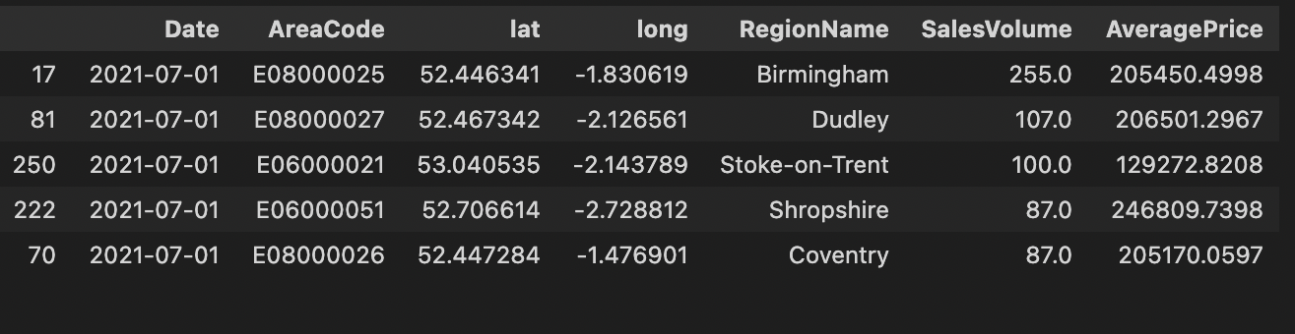
<Top Sales Volume Within West Midlands Cities>
July 2021
Sales volume in the West Midlands is highest in the City of Birmingham with 255 houses sold in July 2021 and an average price of £205450.50

Slide 15
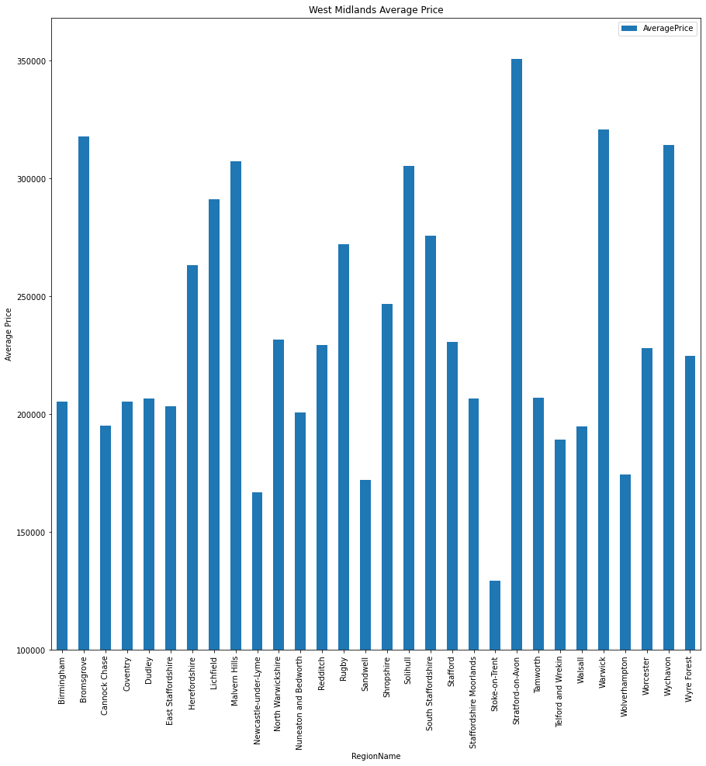
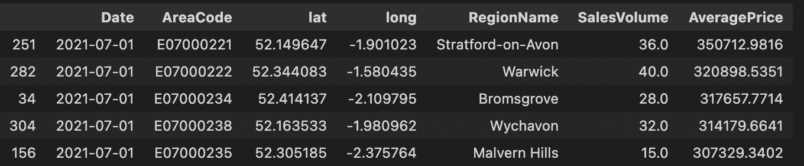
<Top Average Pricing Within West Midlands Cities> July 2021
Whereas Average Price is highest in Stratford Upon Avon £350712.98 with only 36 houses sold in July 2021

Slide 16
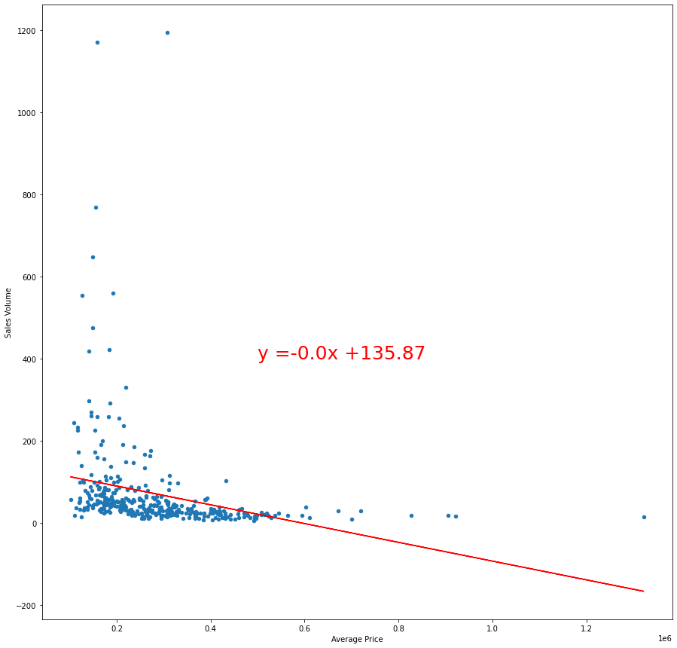
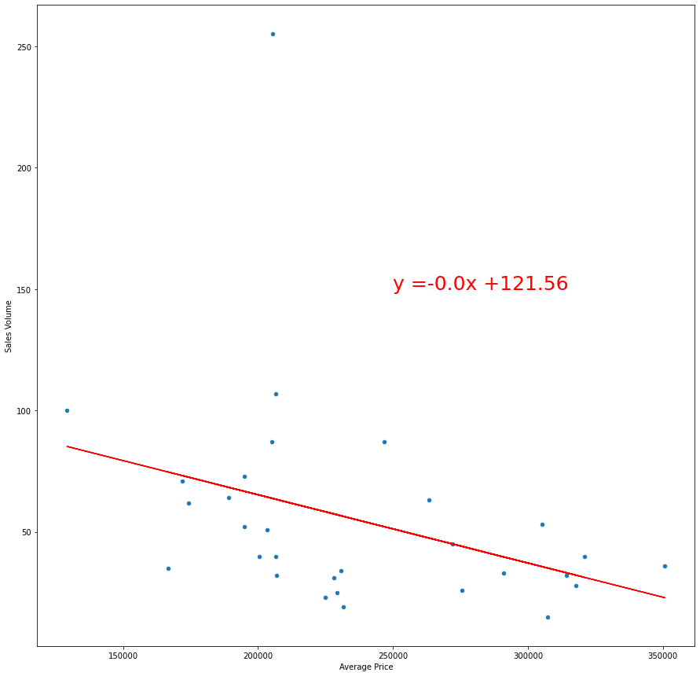
<Does The Increase In House Pricing Affect Sales Volume?>
<UK>
<Cities in West Midlands>
The UK has a negative correlation; however, it has an r-value of 0.069 and a p-value of 1.32.
Birmingham has a negative correlation; however, it has an r-value of 0.12 and a p-value of 1.75

Slide 17
Simon’s Description
The top UK Sales volume has been seen in the City of Edinburgh with 1194 houses sold in July 2021 this month with an average price of £306,911.32
The top UK Average price has been seen in Kensington and Chelsea £1,321,924 with average sale volume of 15 houses sold houses sold in July 2021

Slide 18
Clifford’s Part & Description

Slide 19
Conclusions and findings

Slide 20
<Dependencies used>
Matplotlip
Pandas
Plotly.express
Geopandas
Scipy.stats
Numpy
Requests
Gmaps
OS

