Slide 1
Numeric Ruby includes five classes for representing numbers.
Today's Topic

Slide 2
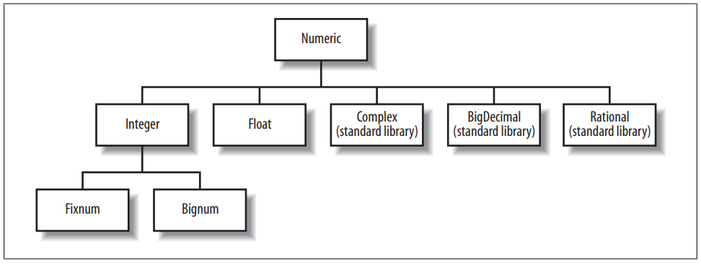
Numeric class hierarchy

Slide 3
If an integer value fits within 31/62 bits , it is an instance of Fixnum. Range of Fixnum is normally ( −2 ³⁰ to 2 ³⁰ − 1 or −2 ⁶² to 2 ⁶² − 1) Integers outside this range are stored in objects of class Bignum. Fixnum: 81 Fixnum: 6561 Fixnum: 43046721 Bignum: 1853020188851841 Bignum: 3433683820292512484657849089281 Bignum:117901845777385831715208728614125186656782446556
Fixnum & Bignum

Slide 4
A numeric literal with a decimal point and/or an exponent is turned into a Float object. An exponent begins with the letter e or E, and is followed by an optional sign and one or more decimal digits. Example:-- 6.02e23 # This means 6.02 × 10²³
Float

Slide 5
Rational numbers are the ratio of two integers—they are fractions—and hence have an exact representation (unlike floats). Example:-- Rational(3, 4) , Rational("3/4") Complex numbers represent points on the complex plane. They have two components, the real and imaginary parts. Example:-- Complex(1, 2) , Complex("1+2i")
Rational & Complex

Slide 6
Most floating-point representations are binary representations. Binary floating-point representations cannot exactly represent numbers as simple as 0.1. One solution to this problem is to use a decimal representation of real numbers rather than a binary representation.
Binary Floating-Point and Rounding Errors

Slide 7
Q1. What is the size of an integer data type in ruby? a) -2³⁰ to 2³⁰ b) -2³⁰ to 2⁽³⁰⁻¹⁾ c) -2²⁹ to 2³⁰ d) -2⁶⁰ to 2⁶¹
qUIZ TIME

Slide 8
Q2..Ruby can deal with both numbers and floating point values. a) True b) False
qUIZ TIME

Slide 9
Q3..Objects of which class does the integer from the range -2^30 to 2^(30-1) belong to? a) Bignum b) Octal c) Fixnum d) Binary
qUIZ TIME

