Slide 1
Mix and Dispence Protocols

Slide 2
Liquidhandling Robot Deck

Slide 3
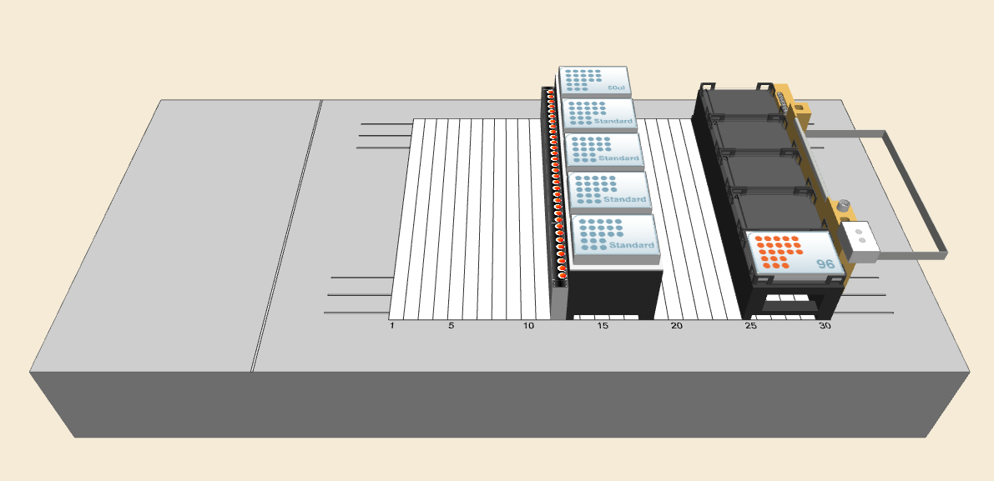
Liquidhandling Robot Deck:
Plate for Dispence Step
Pipette Tip Rack
Tube Rack for Mixing Step

Slide 4
Recipe File (xlsx)

Slide 5
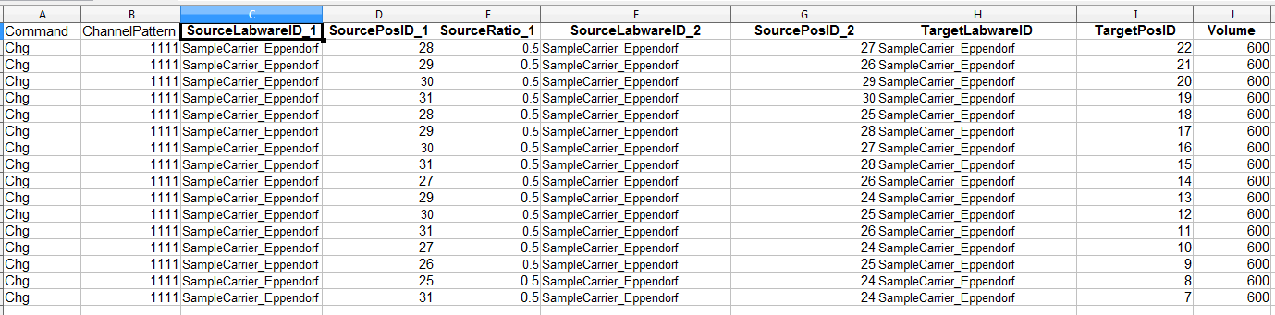
Recipe File for Mixing:
Workbook Name: Mix
Source Tube Position
1. Component
Source Tube Carrier
1. Component
Source Tube Carrier
1. Component
Source Tube Carrier
1. Component
Final Volume
Mixing Ratio
Disable Tip Exchange
FOR TESTING ONLY
Source Tube Carrier
2. Component
Target Tube
Carrier
Target Tube
Position
Source Tube Position
2. Component

Slide 6
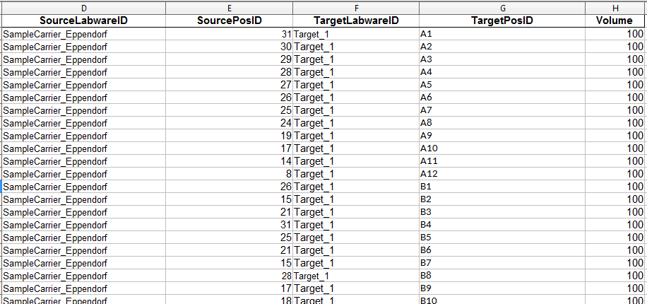
Recipe File for Dispence Step:
Workbook Name: Dispence
Volume
Source Tube Position
Target Tube Carrier
Target Tube Position
Source Tube Carrier

Slide 7
GUI Overview

Slide 8
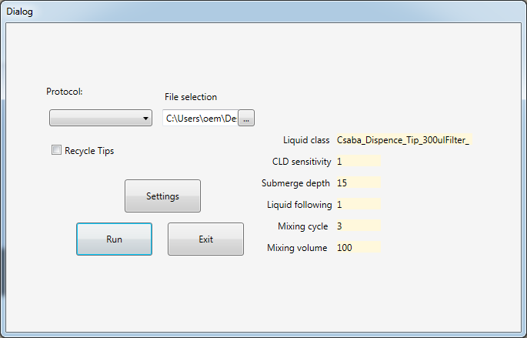
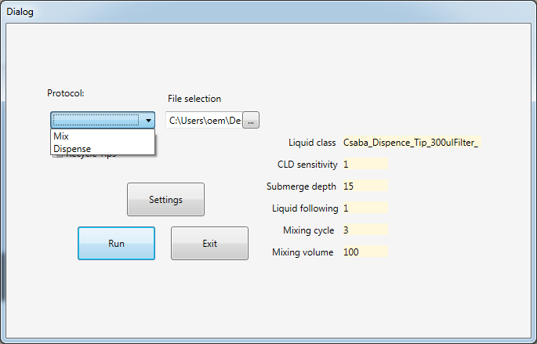
Protocol Selecton (Main Dialog)
Recipe File Path
Select Recipe Path
Select Protocol
Open Settings Dialog
Current Liquidhandling Settings
Run Protocol
Close Protocol

Slide 9
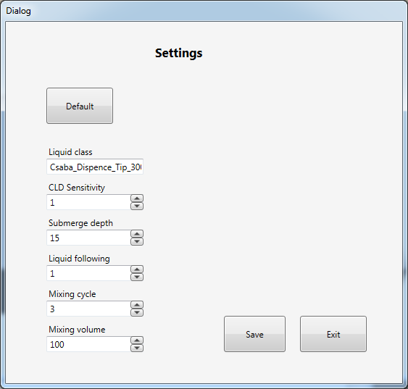
Liquid Handling Settings (Settings Dialog)

