Slide 1
Pinnig Protocol

Slide 2
Liquidhandling Robot Deck

Slide 3
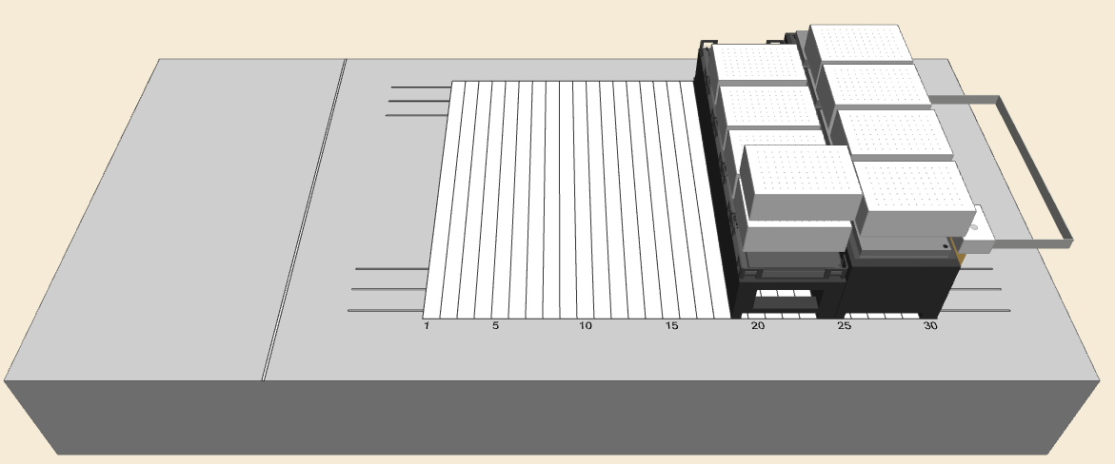
Liquidhandling Robot Deck:
Stamping Positios (1-3)
Washing Positions (1-3)
Drying Position
Parking Position
Source Plate

Slide 4
GUI Overview

Slide 5
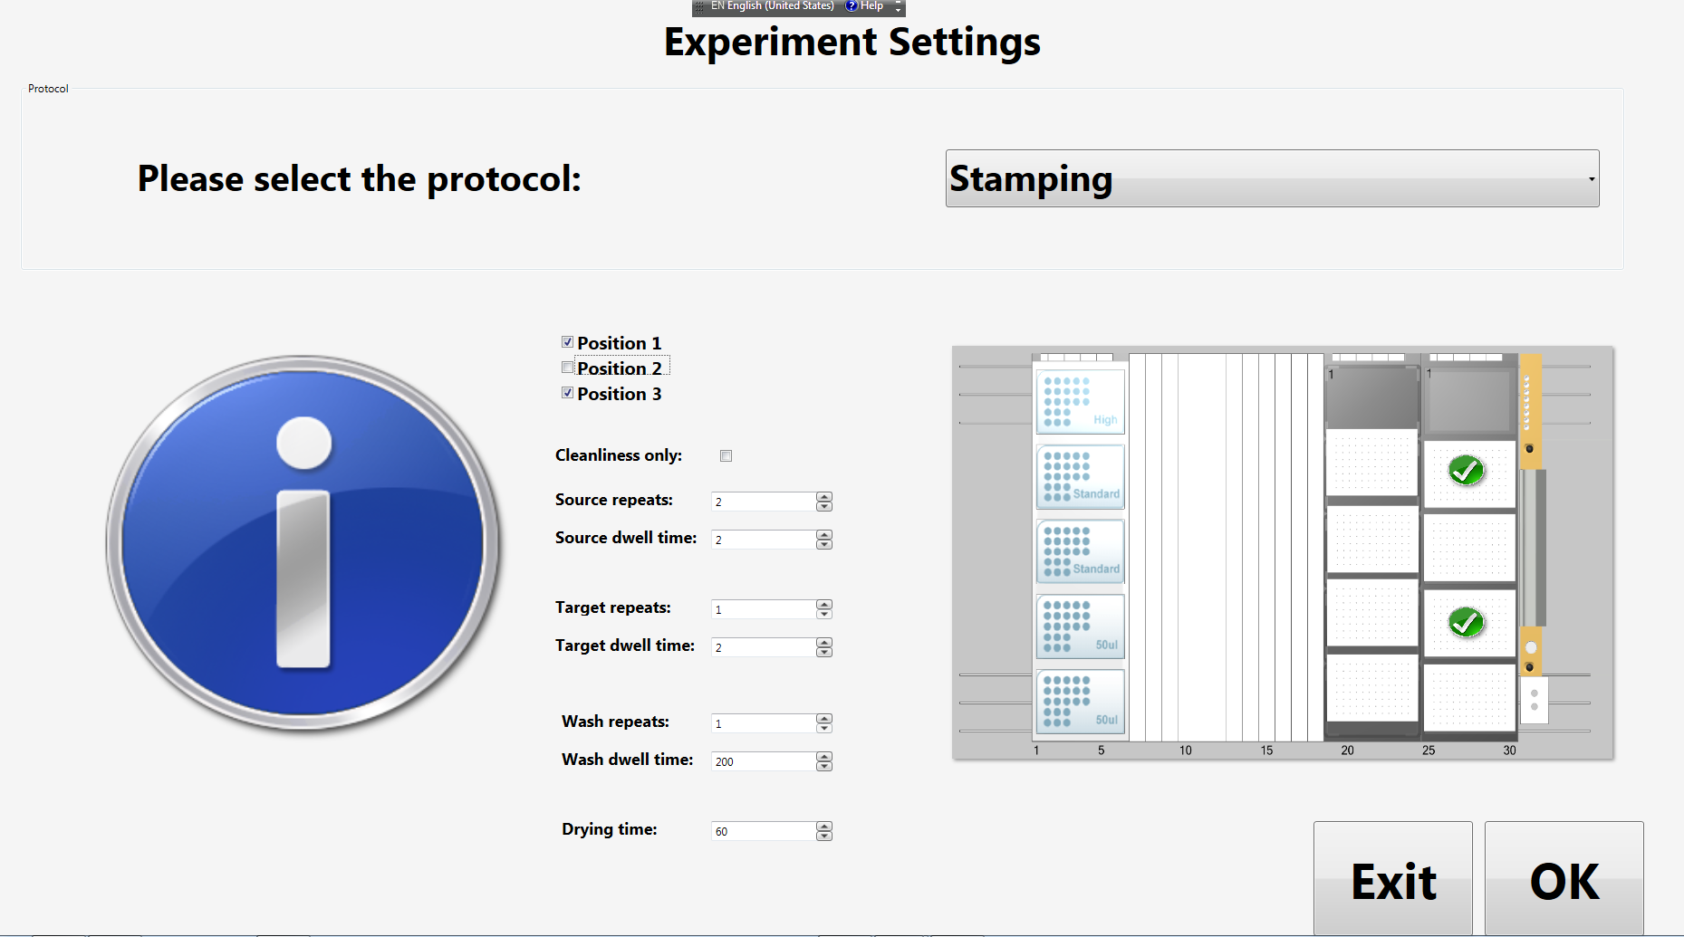
Protocol Selecton (Main Dialog)
Protocol Selection
(Stamping/Washing)
Select Target Position
Stamping
Settings
Washng
Settings
Run Protocol

