Slide 1
London Network Automation Meetup
Jason Edelman
@jedelman8

Slide 2
Agenda
Who is this American?
Intent-Based Networking
SDN
Model Driven Automation
YANG
DevOps
Chat Ops

Slide 3
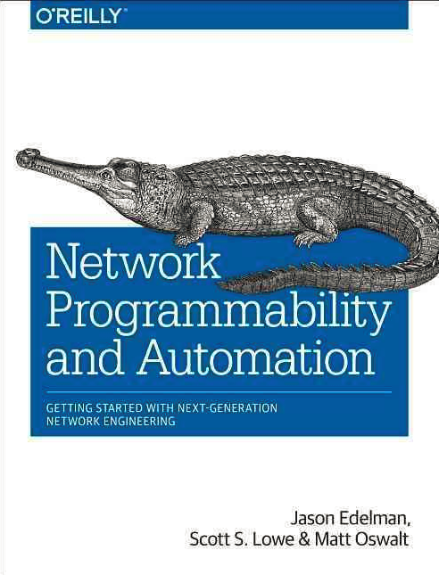
Who is this American?
Jason Edelman
Work out of NYC…
Traditional CCIE who only did R/S/Sec and converted to full-time network automation over the past few years
Work at Network to Code – network automation solution provider (services & training)

Slide 4
the [real] agenda
Advertisement (before demos)
Data Models – say what?
Consuming Network Automation

Slide 5
Advertisement
Network to Code has a public 5 Day Network Automation training course in May.
networktocode.com
Use the promo code london50 for 50% off
ONLY 2 AVAILABLE
Use the promo code london20 for 20% off
ONLY 4 AVAILABLE
ACTIVE TOMORROW
2/21

Slide 6
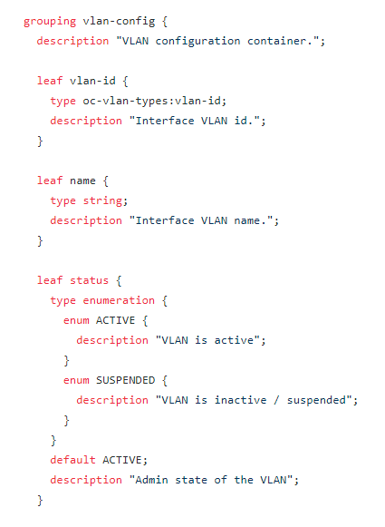
Data Models
YANG
VLAN 5000
Can you configure it?
Why not?
openconfig-vlan.yang

Slide 7
Data Structures…Data
[
{
"id": "10",
"name": "web"
},
{
"id": "20",
"name": "app"
},
{
"id": "30",
"name": "db"
}
]
vlans:
10:
name: web
state: down
20:
name: app
state: up
30:
name: db
state: up
The model or schema defines what you can do
Structure, keys, valid values, semantics….

Slide 8
Data that adheres to a model
Devices can support multiple models…
…so they support different data structures– more flexibility and hopefully they are vendor neutral
This is how you “use” the data. More important.
How (YANG) it’s modeled is less important.
Let’s see it in action.

Slide 9
Demo
#!/usr/bin/env python
import json
import argparse
import requests
from requests.auth import HTTPBasicAuth
requests.packages.urllib3.disable_warnings()
auth = HTTPBasicAuth('ntc', 'ntc123')
headers = {
"Content-Type": "application/yang-data+json",
"Accept": "application/yang-data+json"
}
if __name__ == "__main__":
parser = argparse.ArgumentParser(description='IOS-XE Model Testing')
parser.add_argument('-m', '--model', help='Enter name of the model', choices=['native', 'openconfig', 'ietf']),
parser.add_argument('-d', '--device', help='Enter device hostname or IP', default='csr1')
args = parser.parse_args()
if args.model == "native":
url = 'https://{}/restconf/data/Cisco-IOS-XE-native:native/interface=GigabitEthernet/3'.format(args.device)
elif args.model == "ietf":
url = 'https://{}/restconf/data/ietf-interfaces:interfaces/interface=GigabitEthernet3'.format(args.device)
elif args.model == "openconfig":
url = 'https://{}/restconf/data/openconfig-interfaces:interfaces/interface=GigabitEthernet3'.format(args.device)
response = requests.get(url, headers=headers, auth=auth, verify=False)
print response.text
Python
Postman

Slide 10
Consuming Network Automation
Set yourself up for success
Engage the team
Understand what works and doesn’t work
Self Service Portals
Editing files and issuing Pull Requests
Using Slack ☺

Slide 11
Demo Scenarios
Real-Time Alerts on a Configuration Change
With ability to revert change from Slack
Verify the configuration intent of a device
Check to see a given FW policy exists

Slide 12
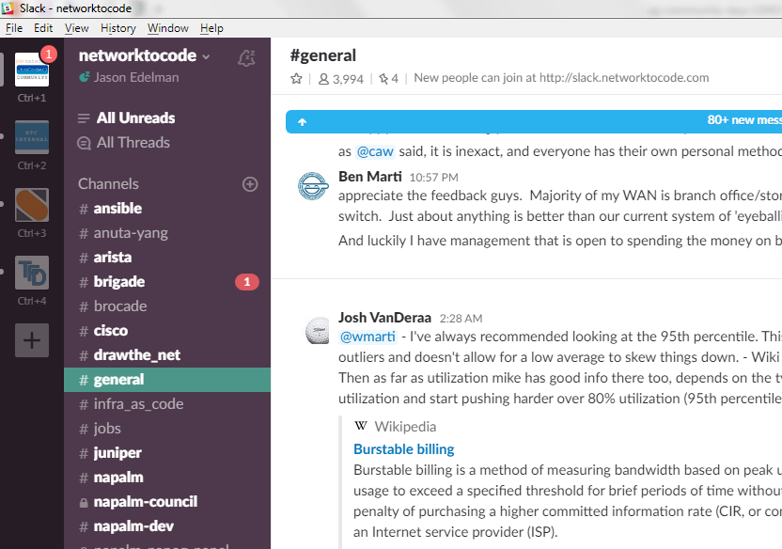
Demo Architecture
Network to Code
DMZ
NTC Web Server (Flask)
Humans
Slack
Network Devices
Internal Network

Slide 13
4
And asks for Action
Send message to Slack
3
POST /v1/syslog/listener
Final Message
View Diff
Do Nothing
Revert Back
Keep as-is
9
5
2
Ask User for Action
napalm-logs
8
NAPALM
7
Send Diffs
NAPALM
Generate Diffs
6
1
Network Devices

Slide 14
Closing Thoughts…
Be the Automator, not the automated
Automate when you can, Code when you must
Automate All the Networks
Always be Learning
Why wouldn’t you want to do your more job more efficiently and effectively?

