Slide 1
Paul Prisecaru
My Project

Slide 2

How it all started
LAN/WAN refresh 500+ sites
No pre-stage – in country delivery to site
OOB modem to limited number of sites
Field engineer – Webex/Teamviewer (not efficient)
SDN? / ZTP? - Not yet, not this time!

Slide 3
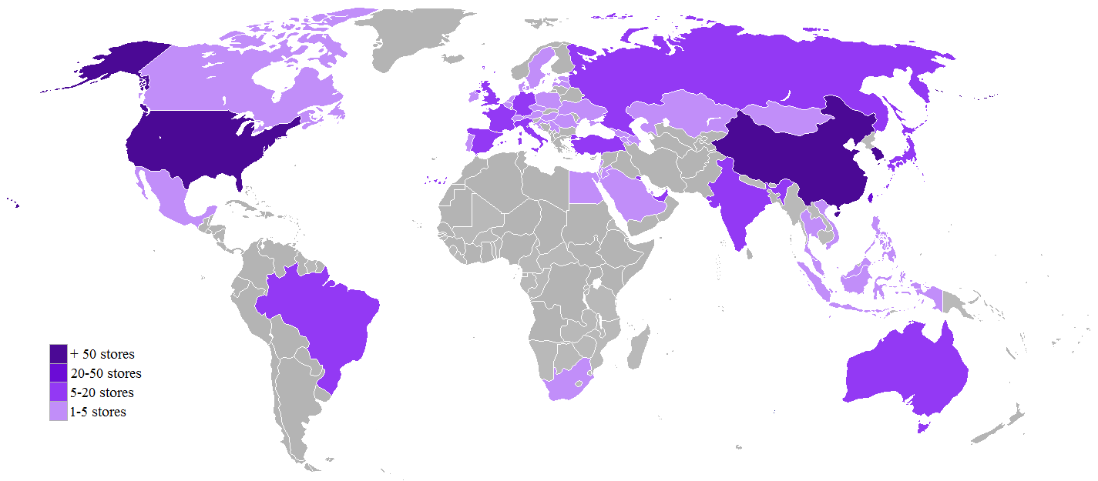
My project

Slide 4
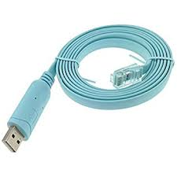
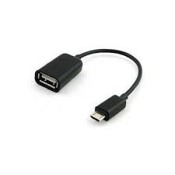

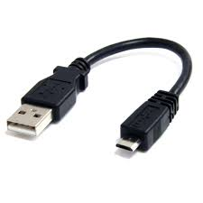
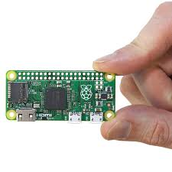

Equipment used

Slide 5
Software used
Ser2net
Python - Telnet Lib
OpenVPN

Slide 6
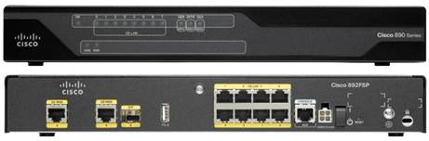

Setup

Slide 7

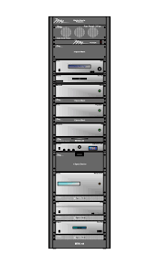


Alternative Setups

Slide 8
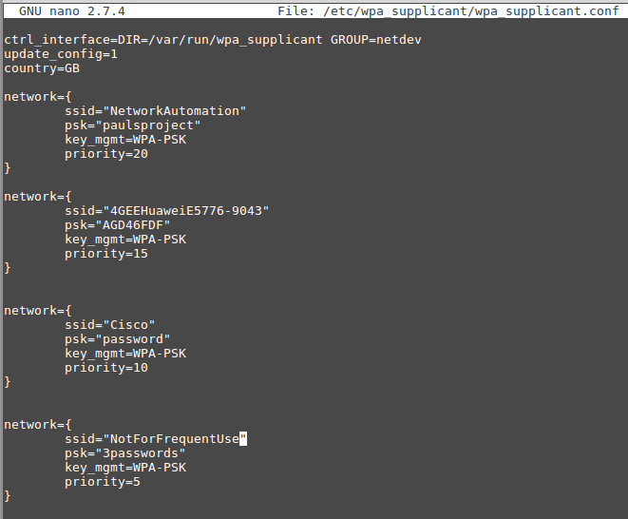
Wifi Priority

Slide 9

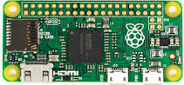



The Automation Piece
Management PC
python ser2net_project.py
3G/4G
Internet
Connect to Console Port
Read hostname and SN
Search for file on MGMT PC
Apply commands from file
Show ouput

Slide 10
Demo!
Demo!

Slide 11
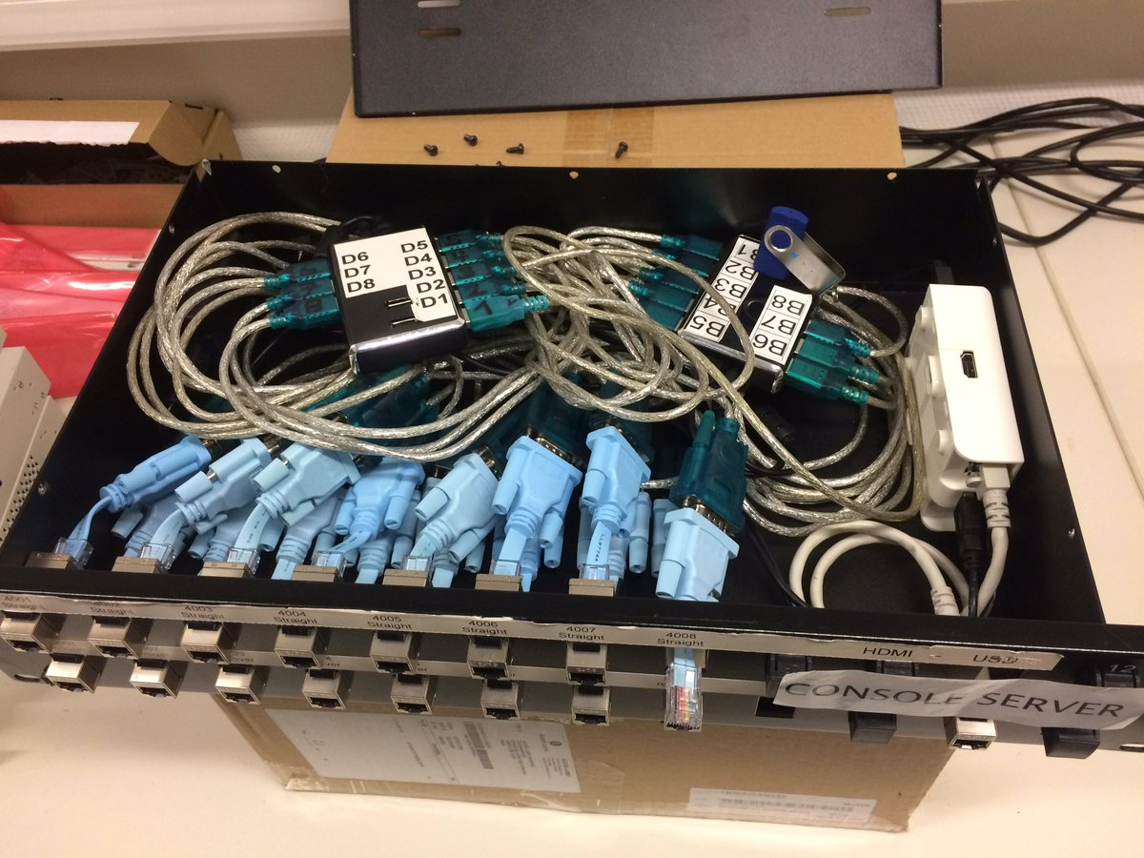
Oh Yeah!

Slide 12
Questions ?
Questions?

