Slide 1
Testing network protocol software
And how automation helps
David Parker 9 Oct 2019

Slide 2

Network Protocols

Slide 3

You might have used our software

Slide 4


Slide 5


Testing
Management Layer
Unit testing of individual components
System level testing
Real router hardware
Linux based routers
P4 programmable data plane
BGP
OSPF
EVPN
IS-IS
SR
…
Hardware Abstraction Layer
Hardware data plane
P4 / BMV2 software data plane

Slide 6




Network level testing with containers
Host
E
VM
VM
Docker Container
Docker Container
Docker Container
Docker Container
Docker Container
Docker Container
Docker Container
VM
VM
Docker Container
Docker Container
Docker Container
Docker Container
Docker Container
Docker Container
Docker Container
Docker Container

Slide 7


Automation
Exploratory testing using CLI
Build virtual networks as defined in the test
Configure via NETCONF/YANG
Python automation framework using ncclient
Test scripts
configure network nodes
verify state and connectivity
modify network
Perturbation testing

Slide 8
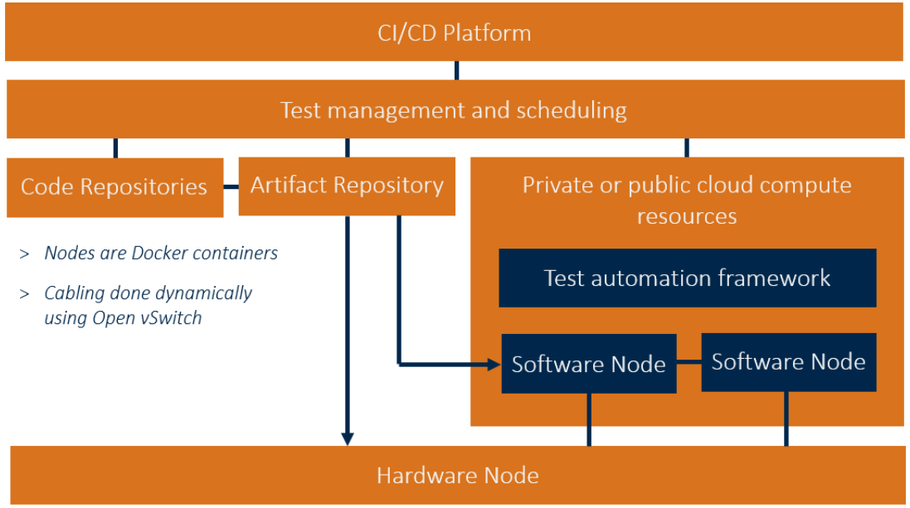

Continuous Delivery
CI framework builds code, runs UTs, static analysis and network level tests
7000 network level tests
If pipeline passes code goes into release branch
Able to continuously change protocol code and deliver weekly to customers without regressions
Deployment using Ansible

Slide 9
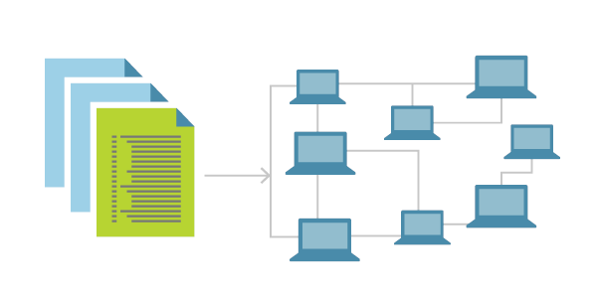
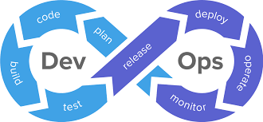
Are you using / could you use the same techniques?

Slide 10


Can you help?

Slide 11


