Slide 1

Getting started with - LINKEDIN
Full stack Skills Bootcamp

Slide 2
Level Up Your Tech Job Hunt with LinkedIn
Lesson Overview:
In this lesson, we will be introduced to:
What LinkedIn is and why it matters
Key profile tips
Using LinkedIn to stand out
Smart posting, networking, and job-hunting hacks

Slide 3
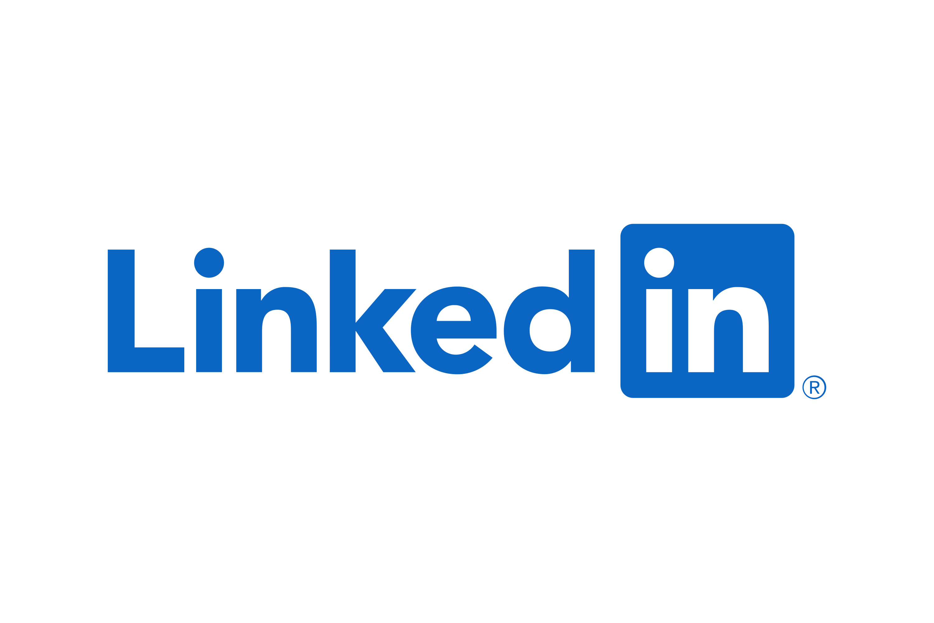
What is linkedin?
A professional social networking platform
Think of it as your digital resume + networking space
Used to connect, learn, and get hired

Slide 4
A Short History
Launched in 2003
Bought by Microsoft in 2016
Now over 1 billion users globally
#1 platform for B2B and professional recruitment

Slide 5
Who Uses LinkedIn?
Recruiters & Hiring Managers
Job Seekers
Professionals across all industries
Developers, designers, PMs, data scientists
Companies sharing updates, posting jobs

Slide 6
Why Should I care?
87% of recruiters use LinkedIn regularly
Hiring often happens via warm connections
You can be found instead of always applying
Build a tech-focused personal brand

Slide 7
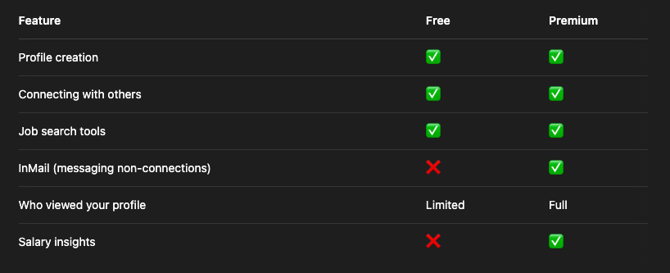
Free vs Paid (Premium

Slide 8
Myths About LinkedIn (And Why They’re Wrong)
Myth #1: “I need a paid account to actually get noticed.” Truth: The free version is powerful. You can build a great profile, connect with people, and get hired—all without paying. Paid is helpful, but not necessary, especially early on.

Slide 9
Myths About LinkedIn (And Why They’re Wrong)
Myth #2: “LinkedIn is only for corporate types and boring suits.” Truth: LinkedIn has evolved. It’s full of devs, designers, startup folks, creators, and career-changers. You’ll see memes, hot takes, tech rants, and legit career advice.

Slide 10
Myths About LinkedIn (And Why They’re Wrong)
Myth #3: “It’s just for older professionals.” Truth: Nope. Gen Z and Millennials are driving huge engagement. A lot of bootcamp grads and young devs are using it to land jobs and build personal brands.

Slide 11
Myths About LinkedIn (And Why They’re Wrong)
Myth #4: “I don’t have experience, so I shouldn’t be on LinkedIn yet.” Truth: LinkedIn is where you build your presence—not just show it off. Share your journey, post your projects, and grow your network as you learn.

Slide 12
Myths About LinkedIn (And Why They’re Wrong)
Myth #5: “Nobody actually reads posts or articles.” Truth: The algorithm favours good content. If you post consistently with value, people do notice—and opportunities can come from it.

Slide 13
Myths About LinkedIn (And Why They’re Wrong)
Myth #6: “It’s too formal—I don’t know how to sound ‘professional.’” Truth: Just be authentic and respectful. You don’t have to sound like a robot. Real stories and genuine thoughts work best.

Slide 14
Building a Strong Profile
Profile Photo: Friendly, professional
Headline: Not just “Bootcamp Learner” → e.g., “Junior Full Stack Dev | Passionate about building scalable web apps”
About Section: Tell your story (Who you are + What you’re looking for)
Experience & Projects: Include bootcamp, personal projects, GitHub links
Skills: Add relevant tech and soft skills
Custom URL: linkedin.com/in/yourname

Slide 15
Endorsements
Others can endorse your listed skills
Increases your profile credibility
Tip: Endorse others → they’ll often endorse you back

Slide 16
Recommendations
Short written testimonials from colleagues, mentors, instructors
Ask for 2-3 quality recommendations (bootcamp peers, instructors, freelance clients)
Offer to write one in return

Slide 17
What to Post About
Project walkthroughs or demos
Lessons learned during coding
Coding tips or challenges you overcame
Industry news + your take
Bootcamp milestones
Job search updates or wins

Slide 18
Writing Articles
Great for long-form content & SEO
Examples:
“What I Learned Building My First Full Stack App”
“Why I Switched Careers to Tech”
Establishes expertise, builds your brand

Slide 19
Engage with Others
Comment on posts with insightful takes
Share posts from tech leaders with your thoughts
Follow people in your niche (devs, recruiters, companies)
Join relevant LinkedIn Groups (e.g., "Junior Developers", "Tech Career Changers")

Slide 20
Responding to Open Questions
Many people post job-related or technical questions
Add value with helpful, respectful responses
Builds visibility + shows you know your stuff

Slide 21
Top LinkedIn Tips
Set a consistent posting schedule (1-2x/week)
Use keywords recruiters search for (React, REST, SQL, etc.)
Follow companies you're interested in
Turn on “Open to Work”
Don’t be afraid to DM people politely
Treat your profile like a landing page

Slide 22
Questions?

