Slide 1
Final assigment - Capstone project
Created by Csaba Csorba
Budapest, 2019-03-01

Slide 2
Introduction
My project is about finding a proper way to buy a house in London
Using Python and Foursquare api
We have preferences, like
least populated area where
the average price is lower then £350.000
it should be safe for sure, and
it would be just nice if the poeple around were not too old

Slide 3
Data 1
Administraive areas
The table (requested from https://www.doogal.co.uk/AdministrativeAreas.php ) conatains the postcode data filtered by administrative area that is Districts. The dataset contain the codes of every districts and their geographical data i.e. Latitude and Longitude

Slide 4
DATA 2
London postcodes
The table requested from https://www.doogal.co.uk/london_postcodes.php
This is a complete list of London postcode districts with their Ordnance Survey coordinates and longitude and latitude. It seems cool but notice the Latitude and Longitude data are go with the Postcode which is a bit deep level for this examination.
On the other hand it contains the data of District Code, Ward Code, District, Ward, Rural/urban. Those data would be useful:
• District Code and the Ward Code for merging with other datasets,
• Rural/urban for the analysis

Slide 5
DATA 3
Ward level geographical data
The table requested from http://geoportal.statistics.gov.uk/datasets/wards-december-2018-full-clipped-boundaries-gb/data
To get geographical data about wards. It does not contains ward level data so I could merge it with the London postcodes dataset

Slide 6
DATA 4
London borough profile
The table requested from https://data.london.gov.uk/dataset/london-borough-profiles
Borough profile displays data for that borough, plus either Inner or Outer London, London and a national comparator (usually England where data is available). The data is set out across 11 themes covering most of the key indicators relating to demographic, economic, social and environmental data.
I would mainly use GLA Population Estimate 2017, GLA Household Estimate 2017, Population density (per hectare) 2017, Average Age, 2017 columns to help me to get closer to the desirable new House.

Slide 7
DATA 5
Recorded crime summary
The table requested from https://data.london.gov.uk/dataset/recorded_crime_summary
This data counts the number of crimes at three different geographic levels of London (borough, ward, LSOA) per month, according to crime type. I will not show all the data provided, because I will summarize them i.e. I need only one number per wards to help me compare the safety of wards

Slide 8
DATA 6
House Price Index - HPI
The table requested from https://data.london.gov.uk/dataset/uk-house-price-index
The UK House Price Index (UK HPI) captures changes in the value of residential properties.
The UK HPI uses sales data collected on residential housing transactions, whether for cash or with a mortgage.
The Average price and the Sales volume are available from this table which I definitely need to solve the problem

Slide 9
Methodology
In this project I am going to make my effort to detecting the correspondent area of London with relatively low crime volume, populated mostly with youth and for sure with a convinient price. I am using Foursquare to find a family friendly Ward with regarding venues.
I will limit the analysis to area ~1km around the Ward I found.
In first step I have collected the required data: Location data (Postcodes, Latitude, Longitude), Borough profile, Crime data and House Price Index.

Slide 10
Analysis / Exploration
GLA Population Estimate 2017: Urban city is the most populated one however surprise surprise, not the rural site is the least populated but, the conurbation
Population density (per hectare) 2017: However the hamlets are the least crowded area
Average Age, 2017: Conurbation again. Those areas have the youth
Crime volume in 2017: The most of the crimes are committed in the conurbation area.
AVG price on 2017-12-01: I assume that a lot of people move to conurbation recently. This can be the explanation of the high average price, also it can explain the density
Sales volume on 2017-12-01: Despite the comments above the conurbation has the least sales volume

Slide 11
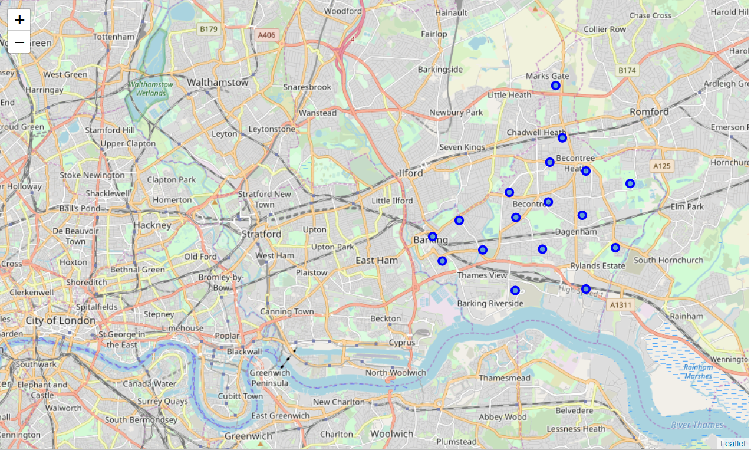
Mapping London

Slide 12
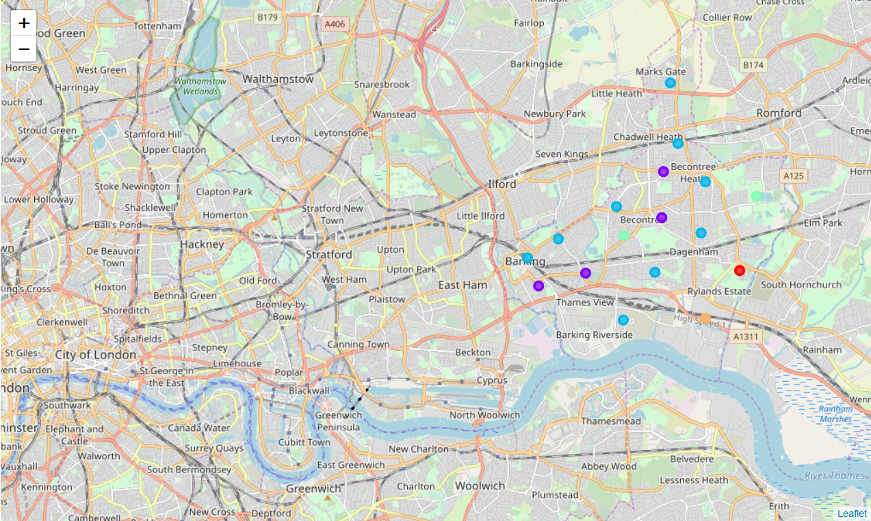
Mapping clusters

Slide 13
Results and Discussion
the most populated areas are Cities, however the conurbation is the least which was against my expectations. I expected to the rural site would be the least populated areas. There is a chance that country people are moving closer to the cities but the city itself is already to crowded or expensive to them
that can be the reason why my other expectation was wrong again. Not the City is which have the highest population density among the observed areas. Maybe they are too expensive to live maybe it has another reason, the finf the reason was not part of this project. Hamlets are still the least crowded area, no surprise on this.
When it comes the average age of the observed areas I found something which can reinforce my assumption taken before. The conurbation area have the youth. So it can mean that the younger generation is moving there from the rural.
No surprise: a lot of poeple are out there in the conurbation so the most of the crimes are commited in here. The presence of the police might have more patrol in the inner city or maybe the conurbation area is just too big to supervise.
I assume that a lot of people move to conurbation recently. This can be the explanation of the high average price, also it can explain the density

Slide 14
Conclusion
Based on the data and the clusters information I would check Cluster 1 and Cluster 2. According the data and the venues information they seem work to me.
They both approachable with public transport which is neccessary to me. Also they have places which can make the weekdays easier.
I would check Cluster 1 at first

