Slide 1
Linux Architecture
UNIX History Intro and Overview

Slide 2
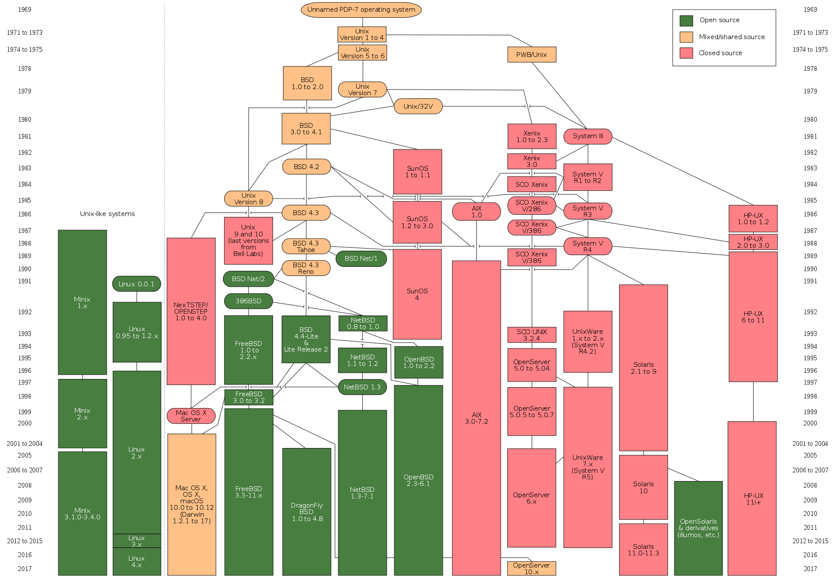
Unix
1969 UNIX
1973 rewritten in the higher language C
1980s SUN, AT&T, Bell Labs, BSD, HP
1990s FreeBSD, NetBSD, OpenBSD
1990s Linux
2000 Mac OS X
POSIX

Slide 3
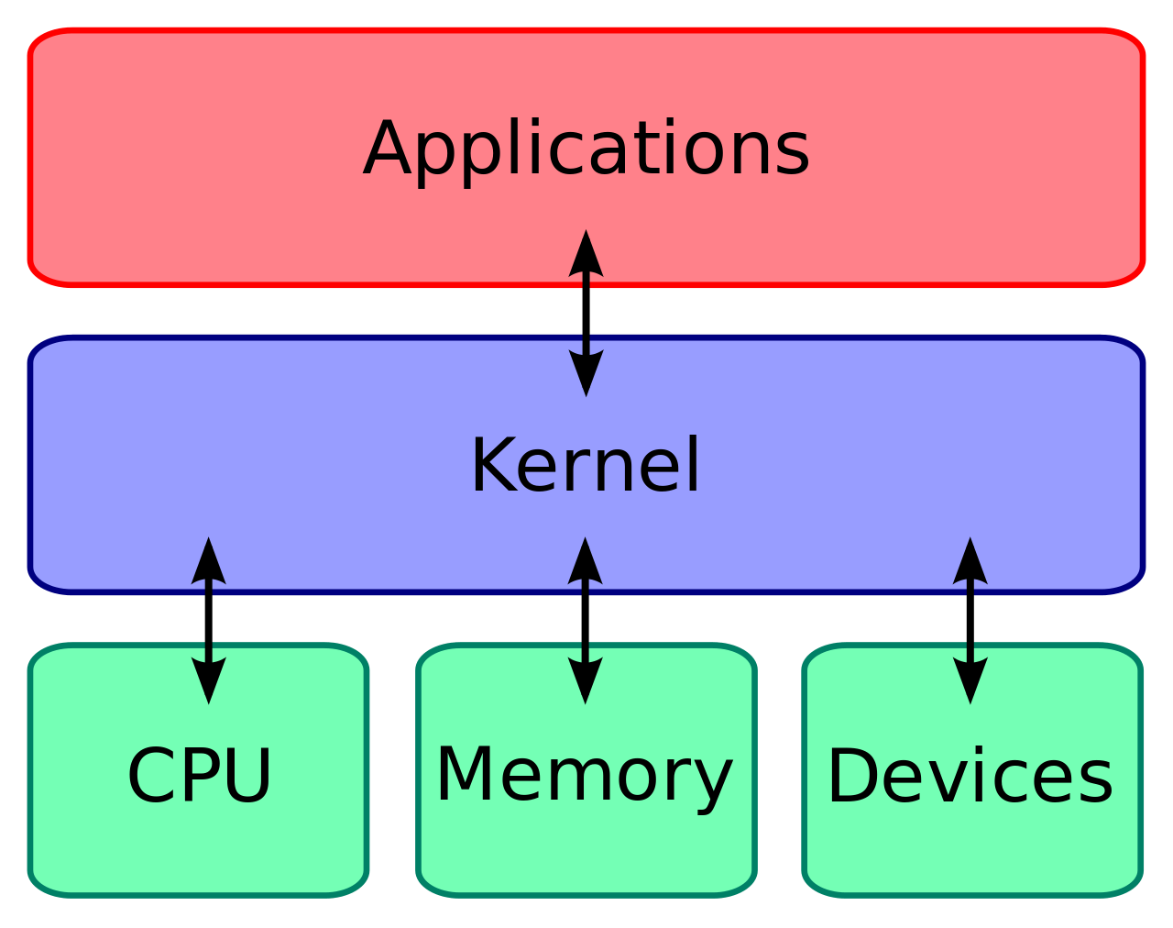
Kernel
Kernel
Userspace
API – syscalls
CLI, GUI

Slide 4

BSD
BSD 1974 (AT&T)
FreeBSD 1993
NetBSD 1993 (portability)
OpenBSD 1995 (clean and secure)
OpenSSH, OpenBGPD, ssl
FreeBSD. Архитектура и реализация МакКузик
FreeBSD. Подробное руководство Лукас
Absolute FreeBSD/OpenBSD Lukas

Slide 5
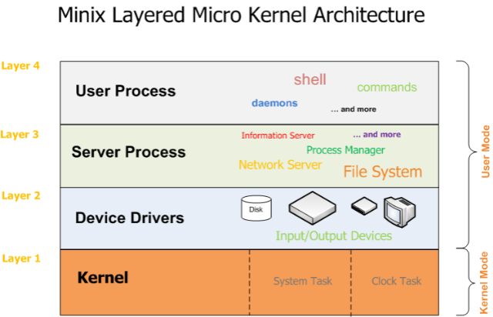
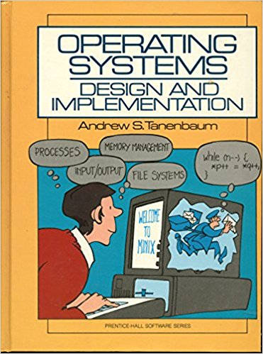
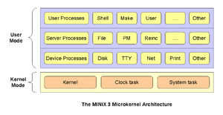
Minix
1987
Early versions of MINIX were created by Andrew S. Tanenbaum for educational purposes. Starting with MINIX 3, the primary aim of development shifted from education to the creation of a highly reliable and self-healing microkernel OS. MINIX is now developed as open-source software.

Slide 6
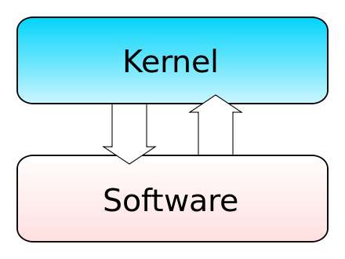
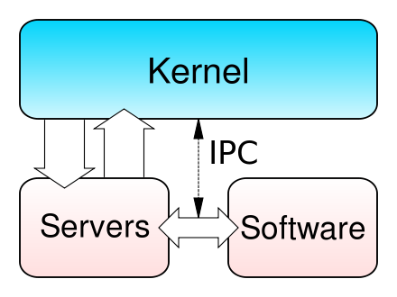
Linux
Linus Torvalds used and appreciated Minix,^{[19]} but his design deviated from the Minix architecture in significant ways, most notably by employing a monolithic kernel instead of a microkernel. This was disapproved of by Tanenbaum in the Tanenbaum–Torvalds debate. Tanenbaum explained again his rationale for using a microkernel in May 2006.^{[20]}
Early Linux kernel development was done on a Minix host system, which led to Linux inheriting various features from Minix, such as the Minix file system.

Slide 7
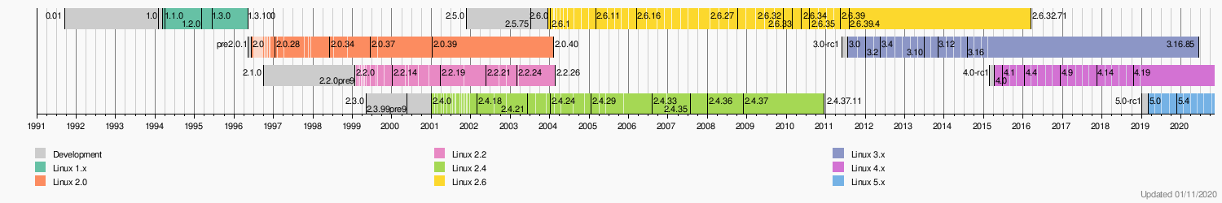
Linux versions history
uname -r

Slide 8
Linux kernel components

Slide 9
Linux kernel components

Slide 10
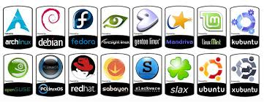
Different distributions Distro=Linux+GNU+Additional Programs
Debian
Ubuntu
Red Hat
CentOS
Gentoo
Arch
LFS - Linux From Scratch

Slide 11
GNU – GNU is not UNIX
GNU - is an extensive collection of free software, which can be used as an operating system or can be used in parts with other operating systems. The use of the completed GNU tools led to the family of operating systems popularly known as Linux.
FreeBSD uniq – BSD Linux uniq – GNU FreeBSD guniq – GNU Linux == GNU/Linux == GNU utils + Linux kernel

Slide 12
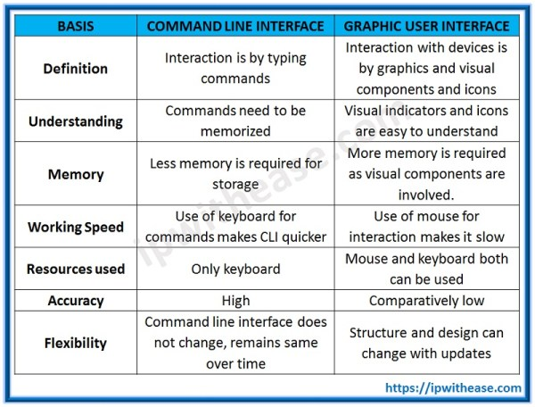
GUI CLI
UNIX, linux, xBSD
Windows, Mac OS

Slide 13
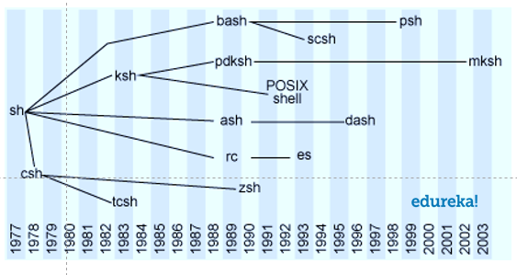
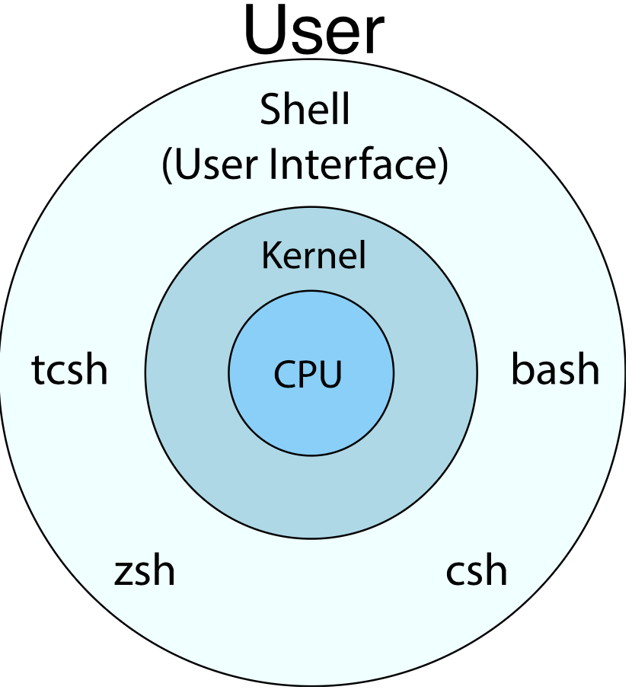
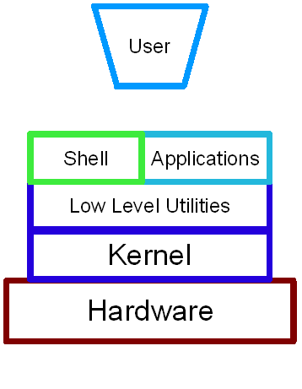
Shells
UNIX, linux, xBSD
Windows, Mac OS

Slide 14
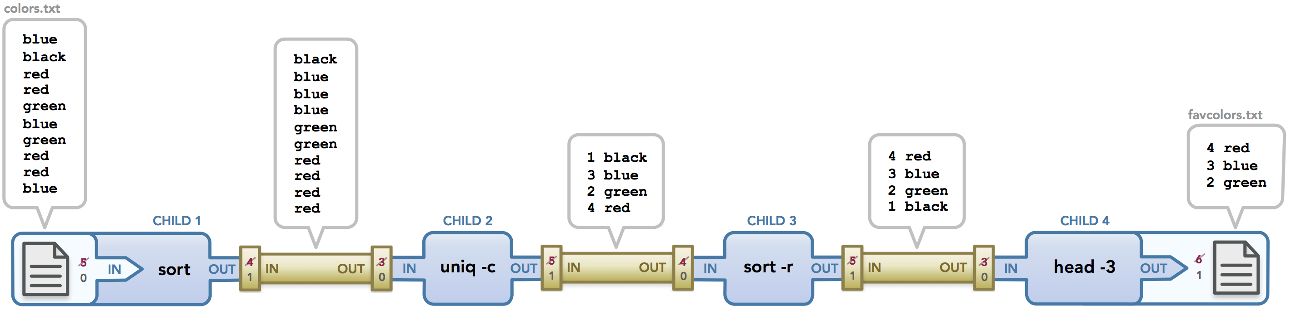
pipelines

Slide 15
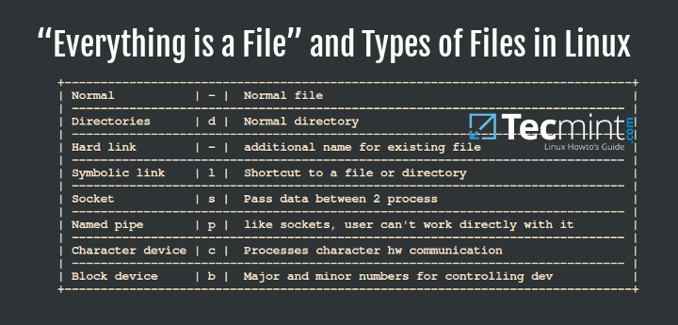
files

Slide 16
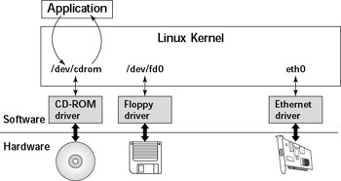
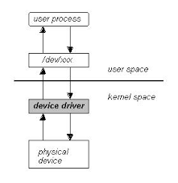
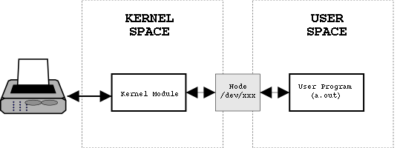
devicefiles

Slide 17
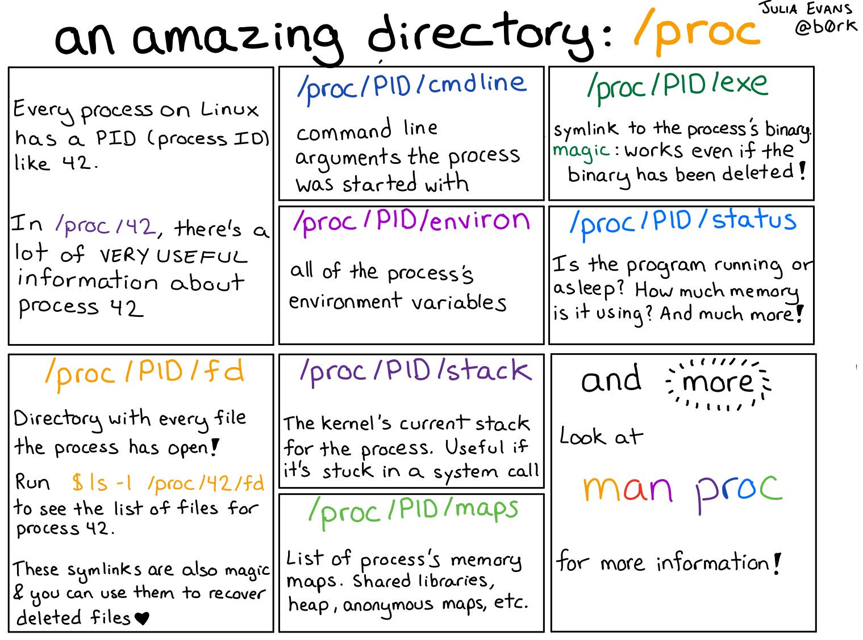
proc files

Slide 18
vi vim emacs
https://github.com/fliptheweb/bash-shortcuts-cheat-sheet
vimtutor

