Slide 1
Linux Architecture
User ENV, hier, man

Slide 2
Shell
$ command -w --with-long-args -h --help -n 4 --verbose myfile reply
$
- options -- longoptions options with parameters parameter

Slide 3
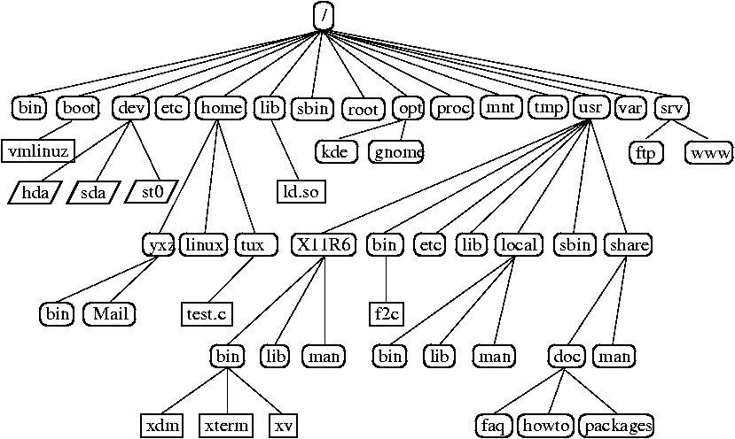
HIER
/etc – system configuration files
/bin – “binary”, executable files
/sbin – same as /bin, but for super user
/tmp – temporary files
/root – homedir for root user
/home – homedir for other users (/home/ubuntu)
/dev* – device files
/lib – libraries, binary files without main()
/boot – kernel, initrd (drivers), configuration.
/var – DATA
/proc* – information about running process
/mnt – mount point for external block devices
/usr/{bin,sbin,lib} – additional files, which shouldn’t be in root
/usr/local/{bin,sbin,lib,etc} - additional files, which shouldn’t be in root

Slide 4
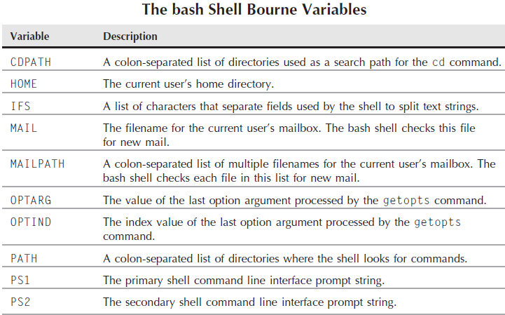
SHELL env variables

Slide 5
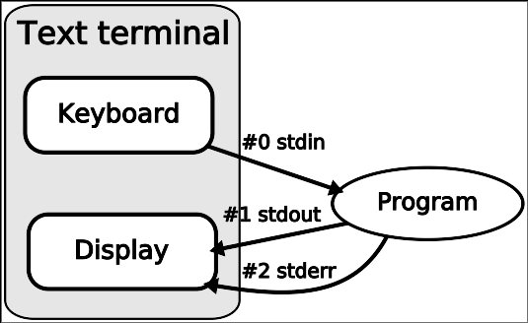
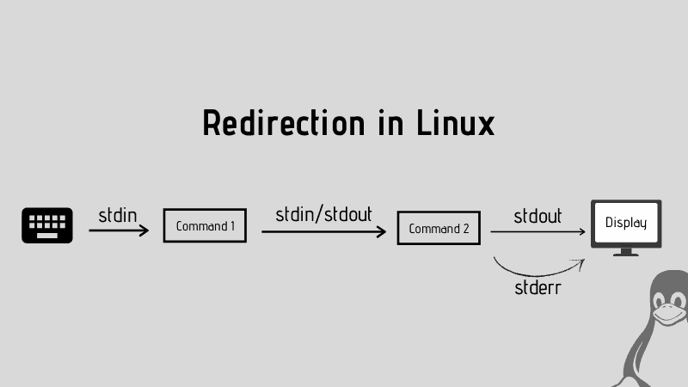
stdin stdout stderr
| > >> &2 &9 < <<

Slide 6
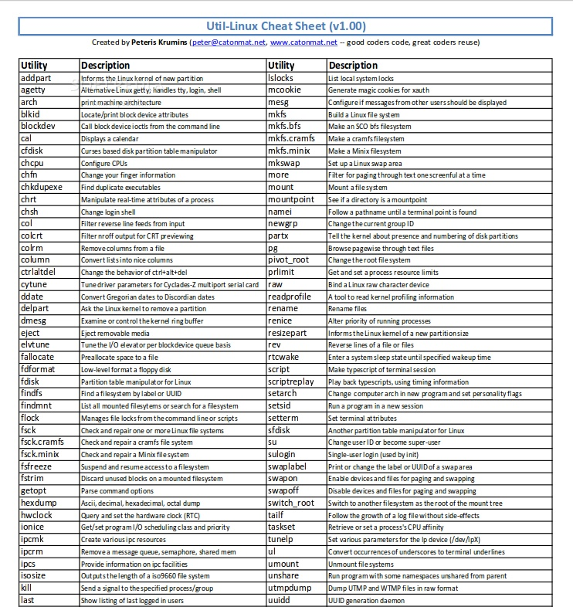
util-linux
https://ru.wikipedia.org/wiki/Util-linux

Slide 7
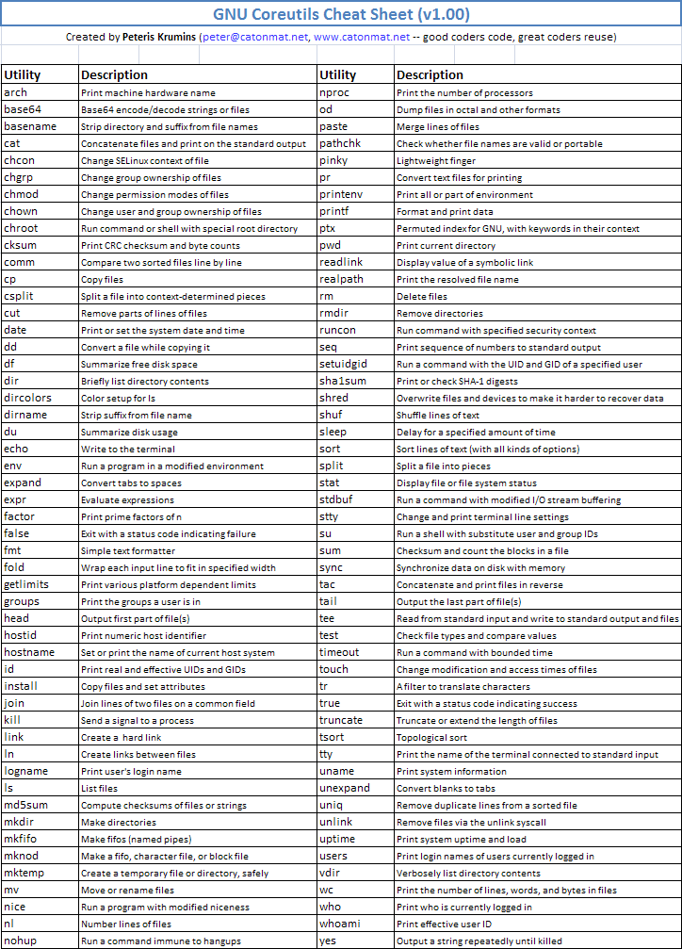
core-utils
https://ru.wikipedia.org/wiki/GNU_Coreutils
https://en.wikipedia.org/wiki/List_of_GNU_Core_Utilities_commands

Slide 8
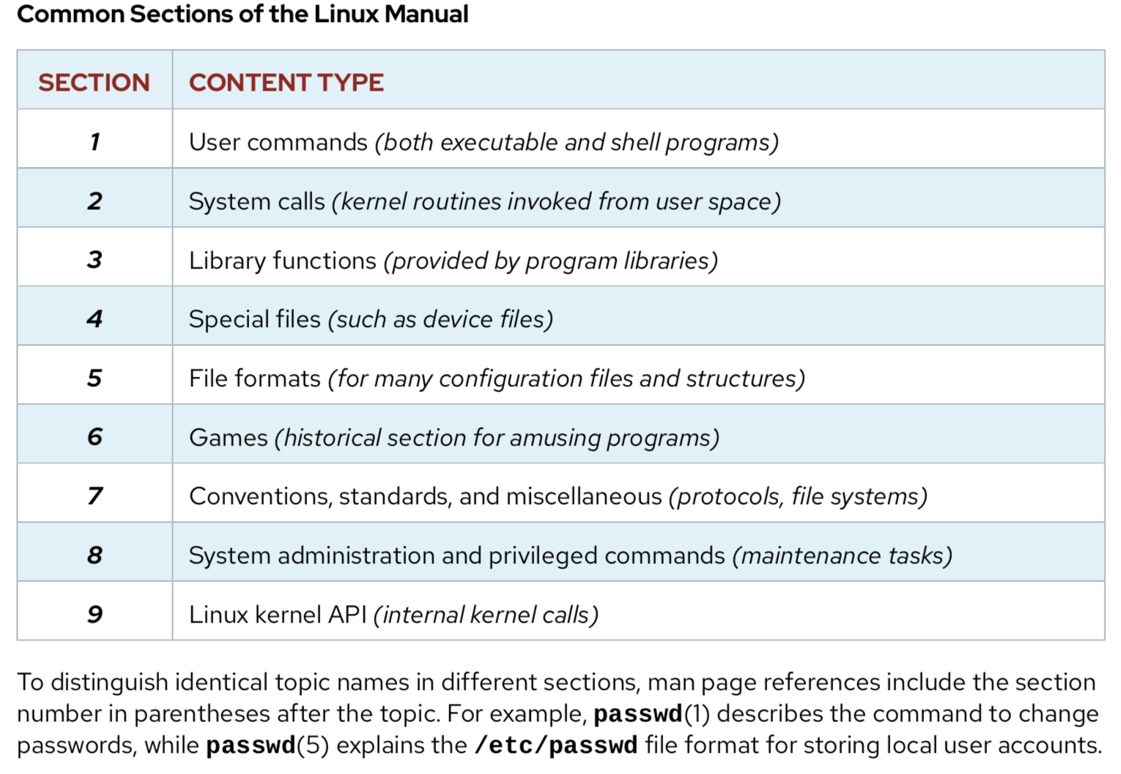
man info apropos which whereis type

