Slide 1
Linux Administration
Logging, Debugging, Troubleshooting, Monitoring

Slide 2
List of base daemons
init, systemd – init PID=1
syslogd, rsyslogd – Logging service
crond, anacron – Timetable services
atd – execute commands at a later time
logrotate – log files rotating service
inet, xinet – simple services management superdaemons
rlogind, telnetd – not secure remote login services
sshd – OpenSSH secure shell service
fingerd – obsolete information sharing service
httpd – web servers http protocol service
smtpd – mail transport protocol service
dhcpd – ip and other protocols configuration service
lpt – printers queue service
nfsd– network file system | smbfs/cifs
https://en.wikipedia.org/wiki/List_of_Unix_daemons

Slide 3
syslogd, rsyslogd
severity: debug, info, notice, warning, error, critical, alert, emergency - Level facility: kern, info, mail, authpriv, cron, etc. – Who
/etc/rsyslog.conf
facility:severity destination
kern.info /var/log/kern_info.log
mail:* /var/log/maillog
kern:error @main_server

Slide 4
crond
/etc/crontab
/etc/cron.d
/var/spool/cron/
# Example of job definition:
# .---------------- minute (0 - 59)
# | .------------- hour (0 - 23)
# | | .---------- day of month (1 - 31)
# | | | .------- month (1 - 12) OR jan,feb,mar,apr ...
# | | | | .---- day of week (0 - 6) (Sunday=0 or 7) OR sun,mon,tue,wed,thu,fri,sat
# | | | | |
# * * * * * user-name command to be executed

Slide 5
atd
1. This sequence can be used at a terminal:
at -m 0730 tomorrow
sort < file >outfile
EOT
2. This sequence, which demonstrates redirecting standard error to a pipe, is useful in a command procedure (the sequence of output redirection
specifications is significant):
at now + 1 hour <<!
diff file1 file2 2>&1 >outfile | mailx mygroup
!
3. To have a job reschedule itself, at can be invoked from within the at-job. For example, this daily processing script named my.daily runs every
day (although crontab is a more appropriate vehicle for such work):
# my.daily runs every day
daily processing at now tomorrow < my.daily
4. The spacing of the three portions of the POSIX locale timespec is quite flexible as long as there are no ambiguities. Examples of various
times and operand presentation include:
at 0815am Jan 24
at 8 :15amjan24
at now "+ 1day"
at 5 pm FRIday
at ’17
utc+
30minutes’

Slide 6
logrotated
/var/log/messages {
rotate 5
weekly
postrotate
/usr/bin/killall -HUP syslogd
endscript
}
"/var/log/httpd/access.log" /var/log/httpd/error.log {
rotate 5
mail www@my.org
size 100k
sharedscripts
postrotate
/usr/bin/killall -HUP httpd
endscript
}
/var/log/news/* {
monthly
rotate 2
olddir /var/log/news/old
missingok
postrotate
kill -HUP ‘cat /var/run/inn.pid‘
endscript
nocompress
}

Slide 7
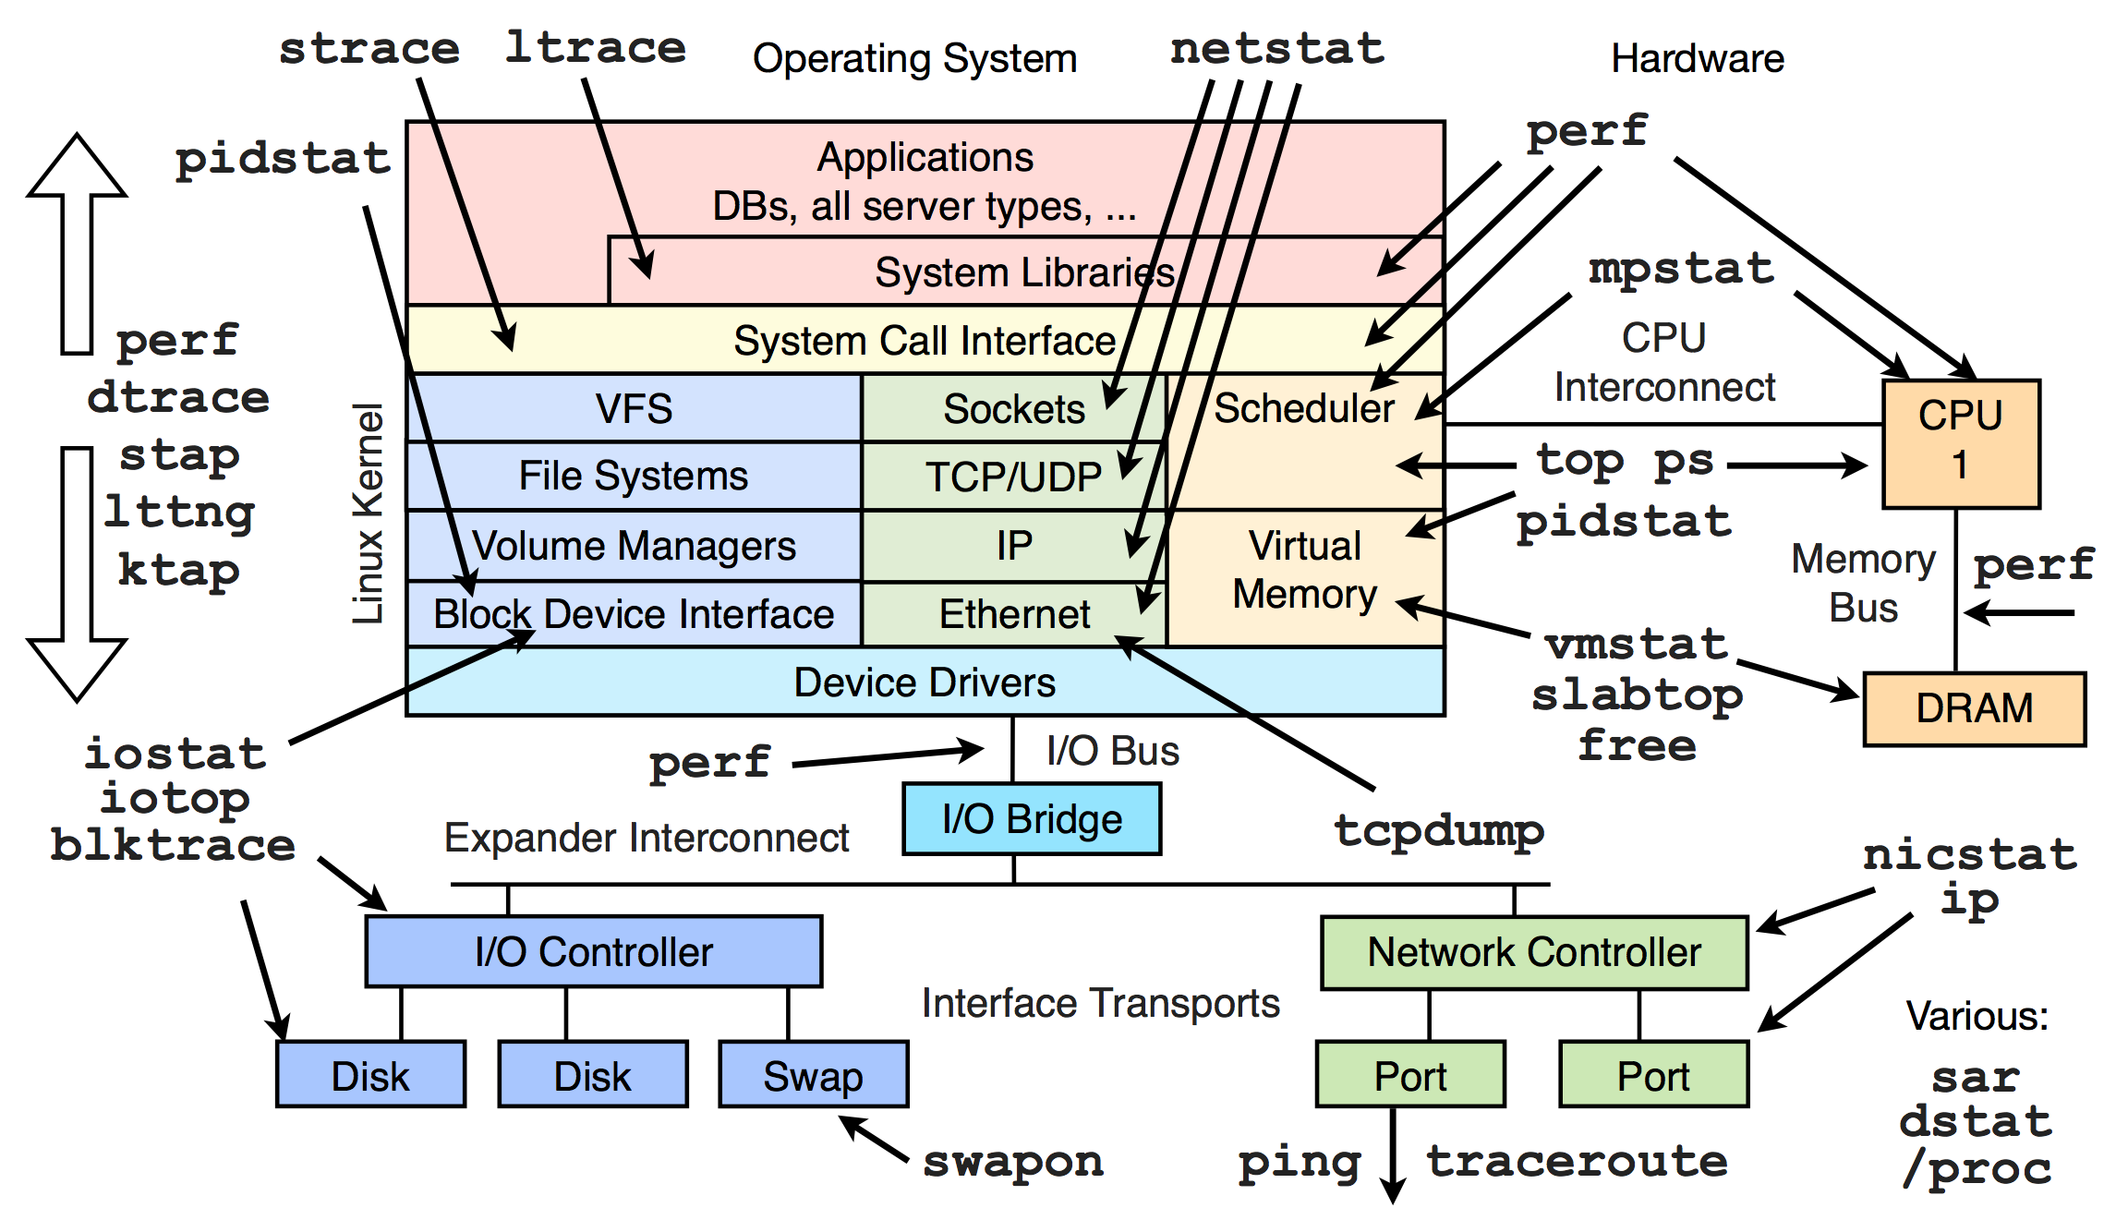
Linux kernel components

Slide 8
ifconfig, route, netstat
https://ru.wikipedia.org/wiki/Ifconfig

Slide 9
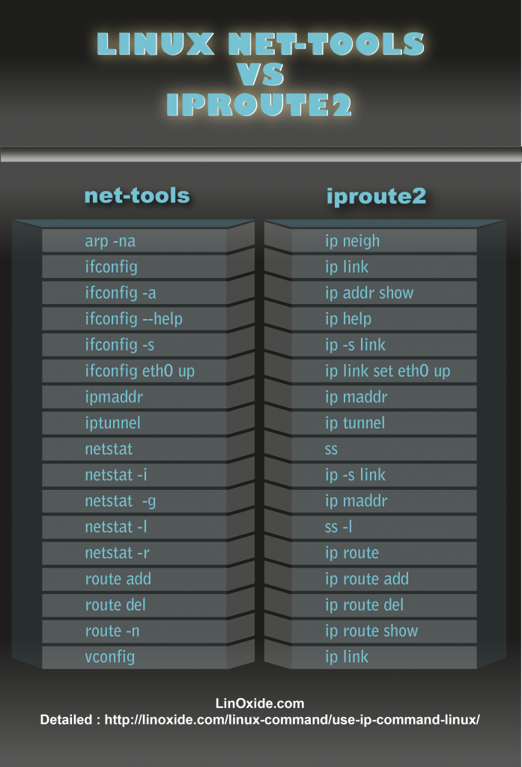
ip route 2

Slide 10
network-scripts
/etc/sysconfig/network-scripts/ifcfg-eth0

Slide 11
Network Manager

Slide 12
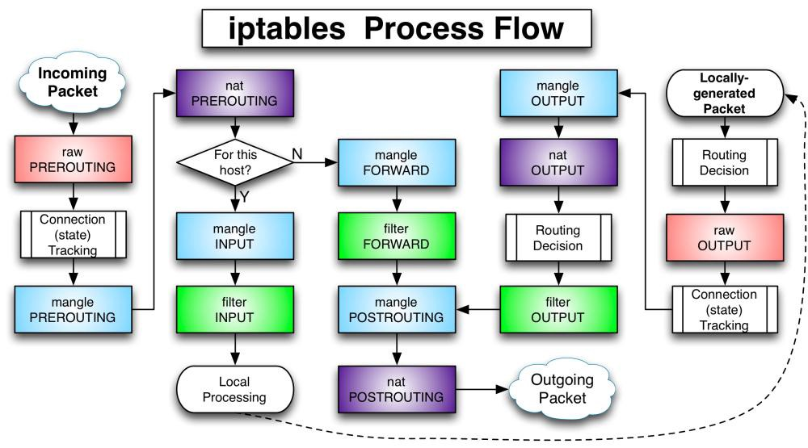
iptables – firewall, nat/pat, traffic

Slide 13
strace, ptrace, ltrace

Slide 14
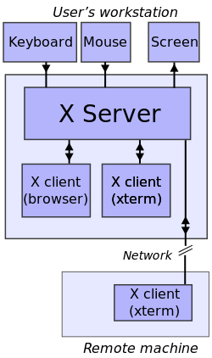
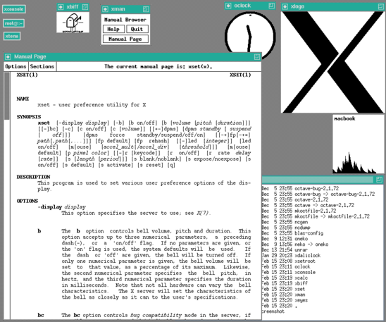
X server
https://ru.wikipedia.org/wiki/X_Window_System
The X Window System (X11, or simply X) is a windowing system for bitmap displays, common on Unix-like operating systems.

Slide 15
SELinux – security enhanced linux
getenforce
setenforce 0

