Slide 1
Linux Administration
Users, Network, modules, sysctl, etc.

Slide 2
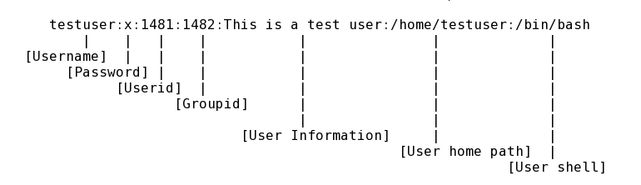
/etc/passwd

Slide 3
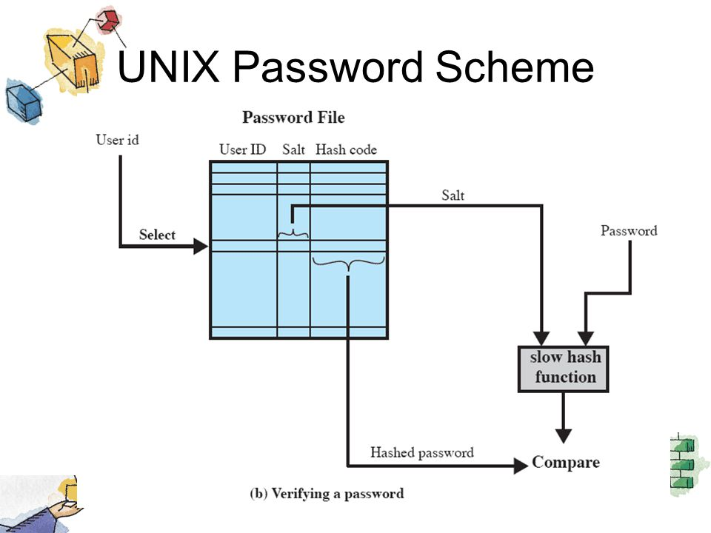
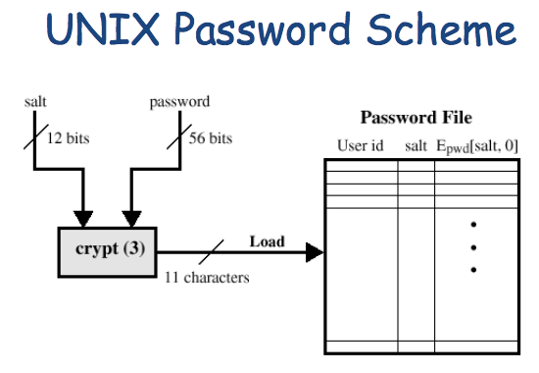
Password

Slide 4
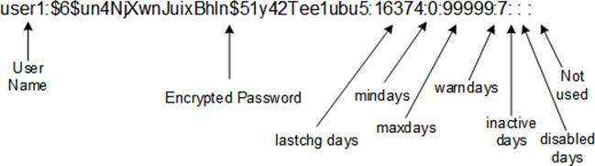
/etc/shadow

Slide 5
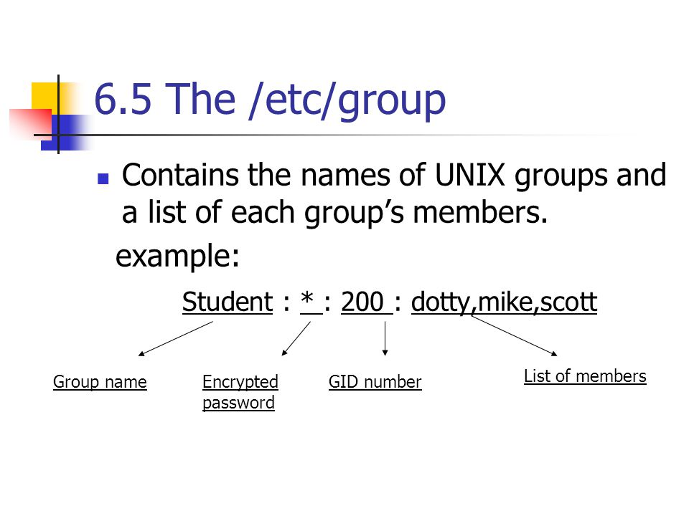
/etc/group

Slide 6
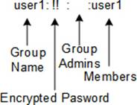
/etc/gshadow ????

Slide 7
Users management
useradd
usermod
userdel
groupadd
groupmod
groupdel

Slide 8
Users management
adduser
deluser
addgroup
delgroup
/etc/adduser.conf
/etc/deluser.conf
…

Slide 9
Users management
newusers
newgroup

Slide 10
Users management
passwd
chpasswd
chage
gpasswd
chfn
finger

Slide 11
Users management
vipw
vigr
pwck
grpck

Slide 12
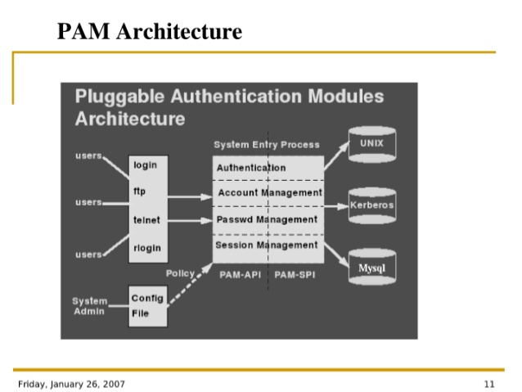
PAM Pluggable Authentication Module
A A A
Authenticity
Authority
Accounting
Authentic – подлинный, достоверный, аутентичный

Slide 13
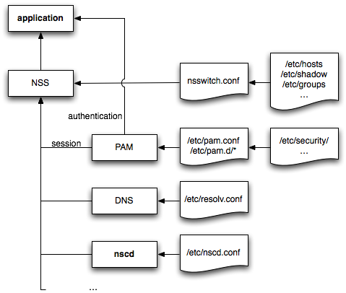
nsswitch getent

Slide 14
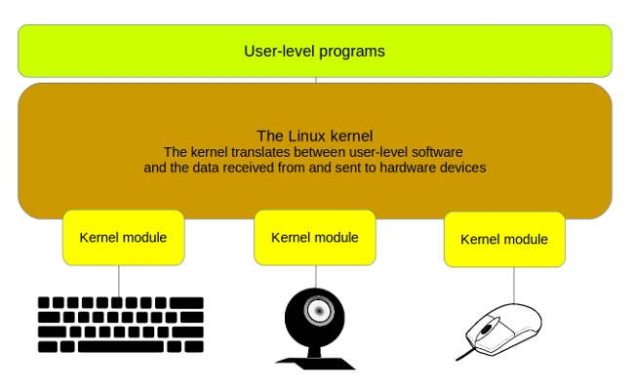
Kernel modules

Slide 15
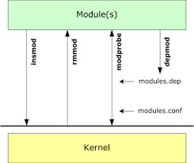
Modules management
lsmod
insmod
rmmod
modprobe
depmod
modinfo

Slide 16
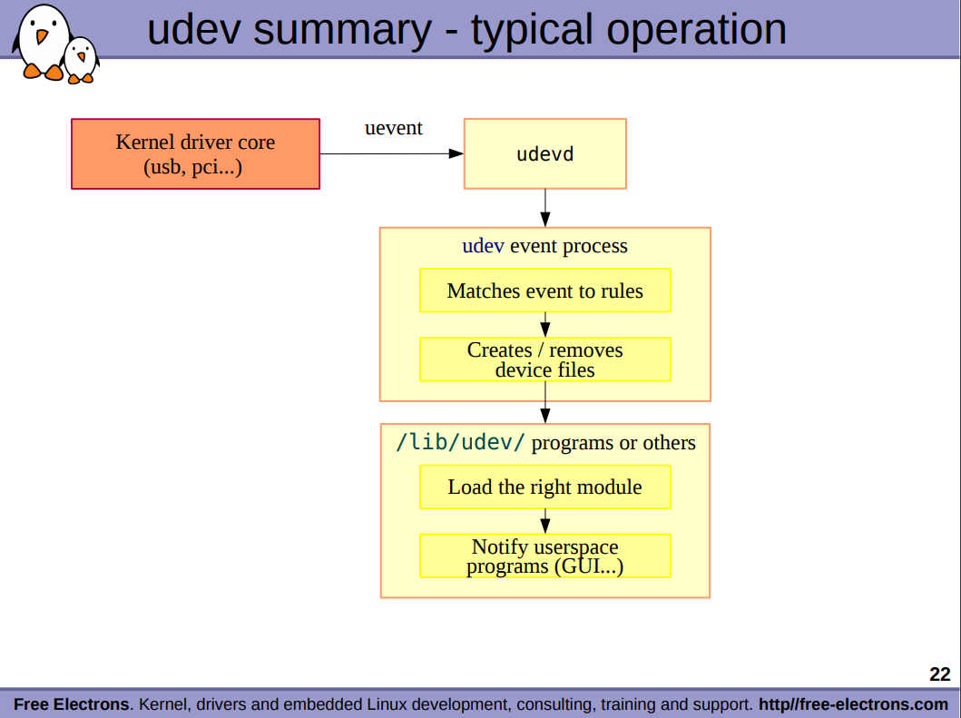
udevd

Slide 17
kernel tuning
sysctl
/proc/sys
/etc/sysctl.conf

Slide 18
kernel build
Grab the latest kernel from kernel.org
Verify kernel
Untar the kernel tarball
Copy existing Linux kernel config file
Compile and build Linux kernel
Install Linux kernel and modules (drivers)
Update Grub configuration
Reboot the system
https://www.cyberciti.biz/tips/compiling-linux-kernel-26.html
https://www.linux.com/topic/desktop/how-compile-linux-kernel-0/

