Slide 1
Iterators
Iteration protocol, iterable, iterator, generator, itertools, functools

Slide 2
Python interview questions
Junior level: dict vs list; list vs tuple; mutable vs immutable; ref count, etc…
Middle level (or even senior level):
Decorator ( FP )
Iterator
Descriptor ( OOP )
Iterators are everywhere
Language reference

Slide 3
David Beazley lecture
http://www.dabeaz.com/generators/ 2008, 2018
http://www.dabeaz.com/coroutines/ 2009
http://www.dabeaz.com/finalgenerator/ 2014

Slide 4
Python2 vs Python3
In python2 iterators – where explicitly specified.
In python3 everywhere if possible.

Slide 5
Python3
range
map
filter
zip
…
…

Slide 6
Iteration is a general term for taking each item of something, one after another.
for loop
list comprehension
dict comprehension
manually using next function (.__next__() method)

Slide 7
Iterator – lazy collection of elements
a = [ 1/(x-5) for x in range(10) ]
b = ( 1/(x-5) for x in range(10) )

Slide 8
iterable vs iterator
.__iter__() method (list, range, tuple, etc.)
.__iter__() and .__next__() method (iter(any_iterable), map, filter, zip, etc.)

Slide 9
class iterator
class myiter:
def __init__(self):
pass
def __iter__(self):
return self
def __next__(self):
return 1

Slide 10
iterator vs generator
.__iter__() and .__next__() method
.__iter__() and .__next__() method (either generator expression, or function with yield statement)

Slide 11
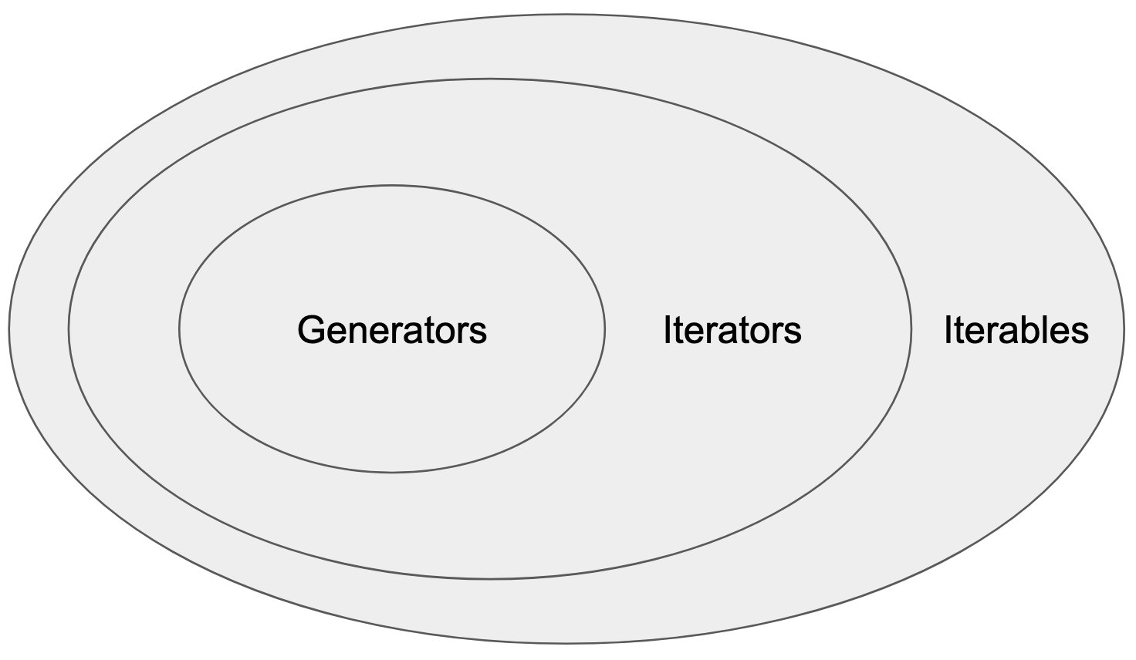
iterable vs iterator vs generator

Slide 12
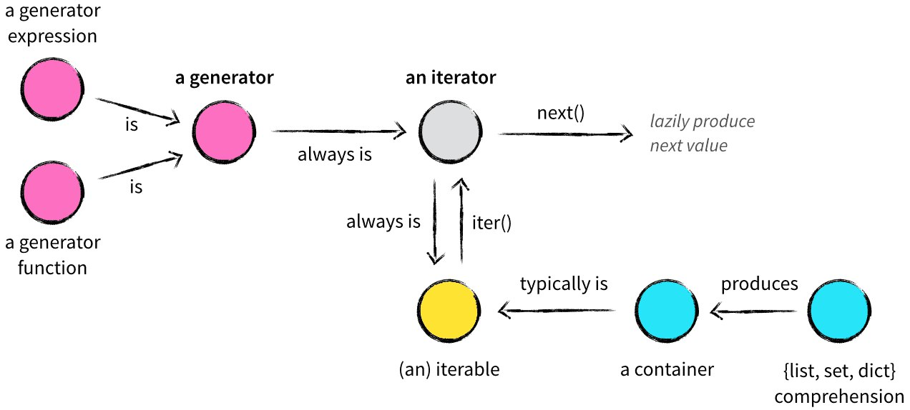
iterable vs iterator vs generator

Slide 13
for loop
for i in lst:
f(i)
lst_iter = iter(lst)
while True:
try:
i = next(lst_iter)
f(i)
except StopIteration:
break

Slide 14
list index
lst.index(element)
next(el[0] for el in enumerate(lst) if el[1] == element )

Slide 15
generator
gen_100 = ( x for x in range(100) )
def gen_100():
for x in range(100):
yield x
end of cycle is return (implicit or explicit)

Slide 16
generator is disposable, iterator too
lst = [1,2,3]
it1 = iter(lst)
it2 = it1
for x in it1: print(x)
for x in it2: print(x)
next(it1) , next(it2), next(it1)
a = (x for x in range(3))
next(a) , next(a) , list(a), list(a)

Slide 17
generator is finite or infinite
def fib_gen():
a, b = 1, 1
while True:
yield a
a, b = b, a+b
def fib(n):
for i,f in zip(range(n),fib_gen()): pass
return f
def fib_gen(n):
a, b, i = 1, 1, 0
while i<n:
yield a
a, b, i = b, a+b, i+1

Slide 18
David Beazley
with open("access-log") as wwwlog:
total = 0
for line in wwwlog:
bytes_sent = line.rsplit(None,1)[1]
if bytes_sent != ‘-’:
total += int(bytes_sent)
print("Total", total)
with open("access-log") as wwwlog:
bytecolumn = (line.rsplit(None,1)[1] for line in wwwlog)
bytes_sent = (int(x) for x in bytecolumn if x != '-’)
print("Total", sum(bytes_sent))

Slide 19
yield
“yield” next element
“yield” from sequence (iterable)
“yield() and send()” - coroutines

Slide 20
itertools
https://docs.python.org/3/library/itertools.html – official documentation
https://realpython.com/python-itertools/ - pictures and motivation

Slide 21
Functional programming
Since Python is a multi-paradigm programming language, it provides some tools that support a functional programming style:
Functions as first-class objects
Recursion capabilities
Anonymous functions with lambda
Iterators and generators
Standard modules like functools and itertools
Tools like map(), filter(), reduce(), sum(), len(), any(), all(), min(), max(), and so on

Slide 22
Other modules
https://docs.python.org/3/library/functools.html - functools
https://toolz.readthedocs.io/en/latest/index.html - toolz and functoolz
https://more-itertools.readthedocs.io/en/stable/api.html - more itertools
https://github.com/sfermigier/awesome-functional-python - interesting links
https://github.com/kachayev/fn.py - functional module

