Slide 1
Linux Administration
Volumes, Filesystems

Slide 2
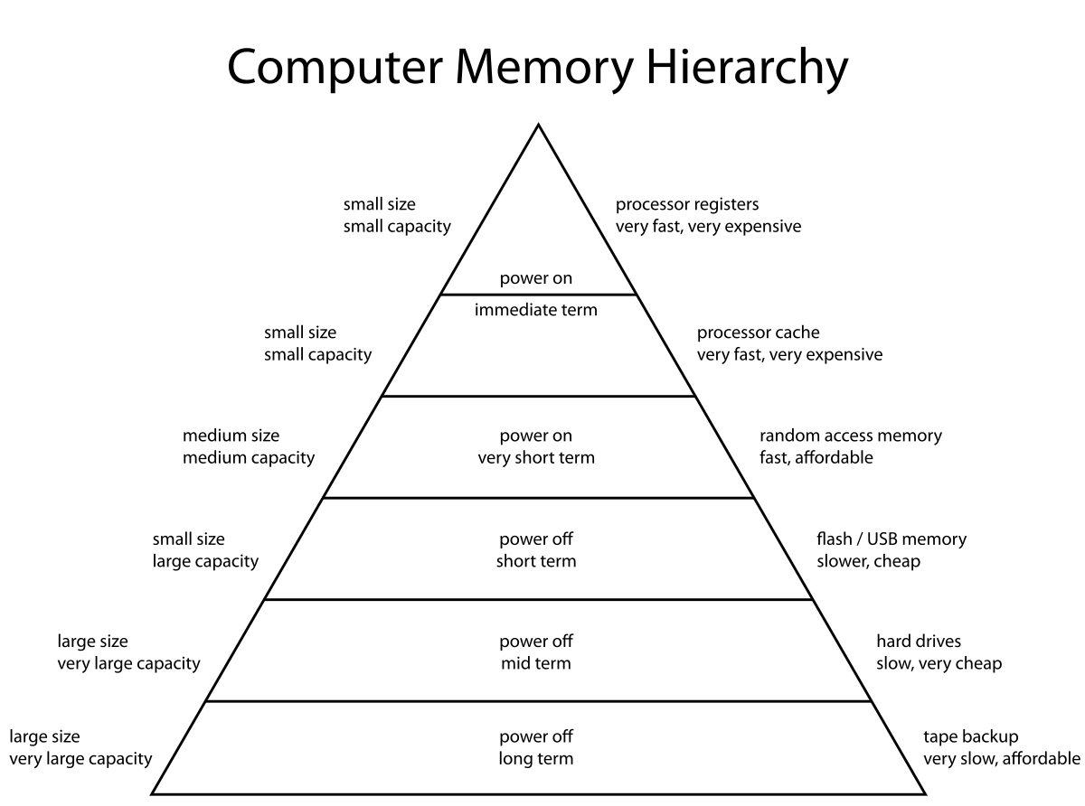
Hardware Storages
Punch Card
Floppy Disk
Tape
Hard Drive Disk
Solid State Drive (SSD)
Compact Disc (CD)
DVD and Blu-ray Discs
USB Flash Drive
Secure Digital Card (SD Card)
Total IOPS
Random Read IOPS
Random Write IOPS
Sequential Read IOPS
Sequential Write IOPS
MB/s

Slide 3
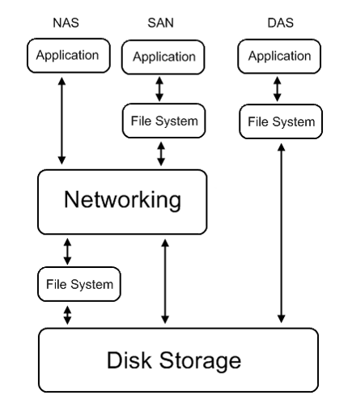
NAS SAN DAS
Storage Area Network
SCSI
FibreChannel Protocol
FC over Ethernet
SCSI over Ethernet
SCSI over IP (iSCSI)
ATA over Ethernet
Network Attached Storage
NFS
SMB/CIFS
AFP
NCP
FTP
HTTP
SSHFS
Over TCP/IP
Direct Attached Storage
ATA
SATA
NVMe
SCSI
SAS
USB
IEEE 1394
FibreChannel
PCI/PCIe

Slide 4
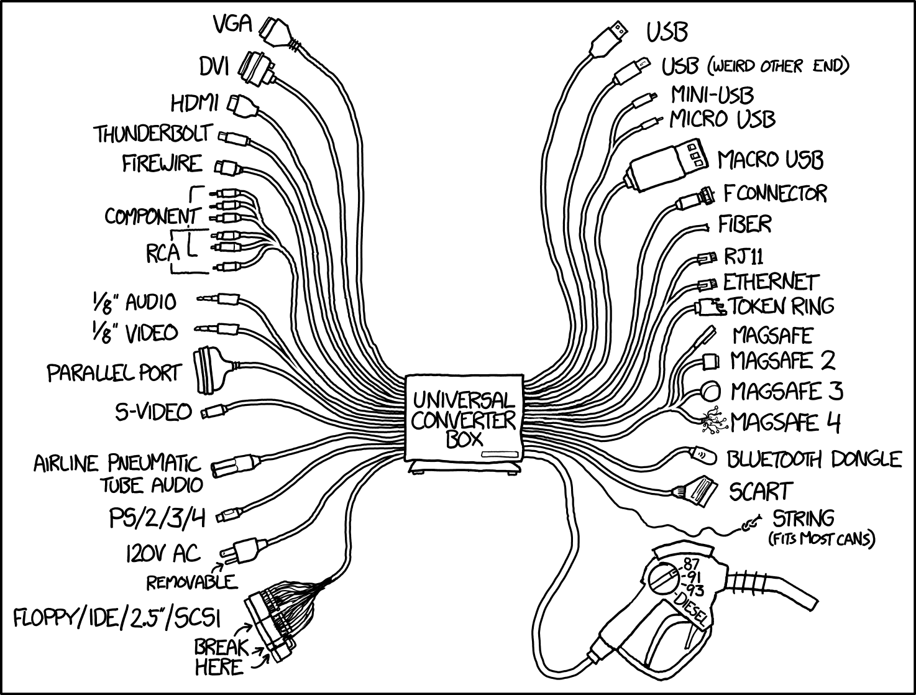
Block Devices Storage interfaces, Block level protocols
IDE
SCSI
USB
SATA
SAS
FibreChannel
Infiniband
Thunderbolt
iSCSI
ATA over Ethernet
FibreChannel over Ethernet

Slide 5
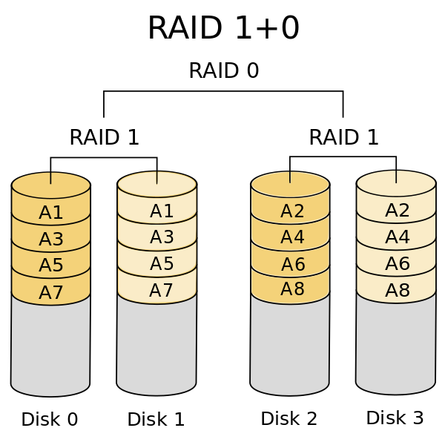
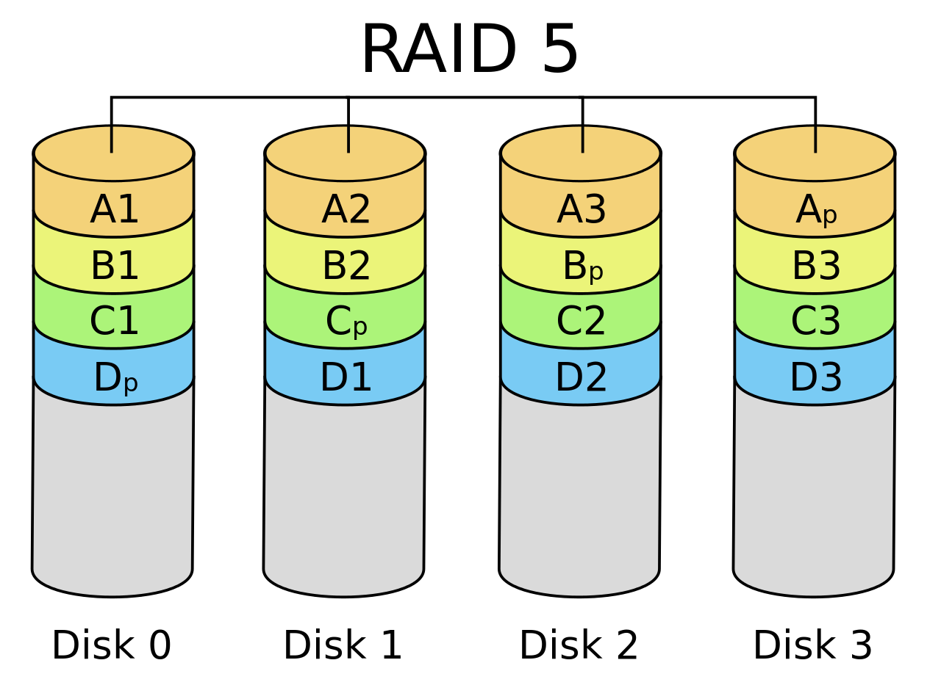
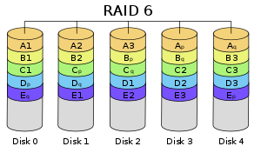
Virtual Block Devices, RAID
RAID controller
MDADM
LVM
Windows NT Dynamic Disk
RAID 0
RAID 1
RAID 2
RAID 3
RAID 4
RAID 5
RAID 6
RAID 10

Slide 6
FileSystems
Disk File Systems:
FAT 8/16/32
NTFS
Ext2/3/4
xfs
jfs
reiserfs
zfs
btrfs
Shared Disk File Systems:
GPFS (IBM)
Xsan (Apple)
VMFS (VMware)
GFS2 (Red Hat)
Distributed File Systems:
9P (Plan 9)
Lustre
NFS
SMB/CIFS
Distributed Parallel Fault-Tolerant File Systems:
CephFS
glusterFS
MooseFS
GFS (google)
HDFS (Hadoop)
Lustre
GPFS
Exotic File Systems:
pingfs
pifs
IPFS
Gmail fs
Pseudo File Systems:
procfs
sysfs
devfs

Slide 7
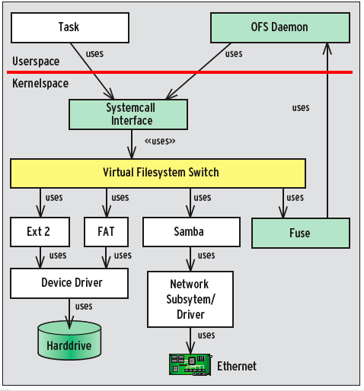
Mount VFS
Kernel space vs user space
Kernel mount
FUSE mount
Mount options
ro, remount, bind
slave, shared, private, unbindable
FILESYSTEM-INDEPENDENT MOUNT OPTIONS
async/sync, dev/nodev, exec/noexec, suid/nosuid, ro/rw,
FILESYSTEM-SPECIFIC MOUNT OPTIONS
autodefrag, commit=seconds, fatal_errors=bug/panic, blocksize={512|1024|2048}, max_dir_size_kb=n
https://www.stavros.io/posts/python-fuse-filesystem/

Slide 8
LVM MDADM
Physical Volume
pvcreate
pvdisplay
pvchange
pvmove
Volume Group
vgcreate
vgdisplay
vgscan
vgextend
vgreduce
Logical Volume
lvdisplay
lvcreate
lvremove
lvextend
lvreduce
lvchange
mdadm --create --verbose /dev/md0 --level=5 --raid-devices=3 /dev/hde1 /dev/hdf2 /dev/hdg1
cat /proc/mdstat
mdadm --detail --scan –verbose
mdadm /dev/md0 --fail /dev/hde1
mdadm /dev/md0 --remove /dev/hde1
mdadm /dev/md0 --add /dev/hde1
mdadm --assemble /dev/md0 /dev/hde1 /dev/hdf2 /dev/hdg1
mkfs
mkfs.ext3
mkfs.ext4
mkfs.xfs
tunefs
resizefs
extfs
fsck

