Slide 1
Сетевые технологии.
TCP/IP
TCP UDP NAT Firewall

Slide 2
Wikipedia
Transmission Control Protocol (TCP, протокол управления передачей) — один из основных протоколов передачи данных интернета, предназначенный для управления передачей данных. Пакеты в TCP называются сегментами.

Slide 3
Wikipedia
UDP (англ. User Datagram Protocol — протокол пользовательских датаграмм) — один из ключевых элементов набора сетевых протоколов для Интернета. С UDP компьютерные приложения могут посылать сообщения (в данном случае называемые датаграммами) другим хостам по IP-сети без необходимости предварительного сообщения для установки специальных каналов передачи или путей данных.

Slide 4
Socket
A network socket is a software structure within a network node of a computer network that serves as an endpoint for sending and receiving data across the network. The structure and properties of a socket are defined by an application programming interface (API) for the networking architecture. Sockets are created only during the lifetime of a process of an application running in the node.

Slide 5
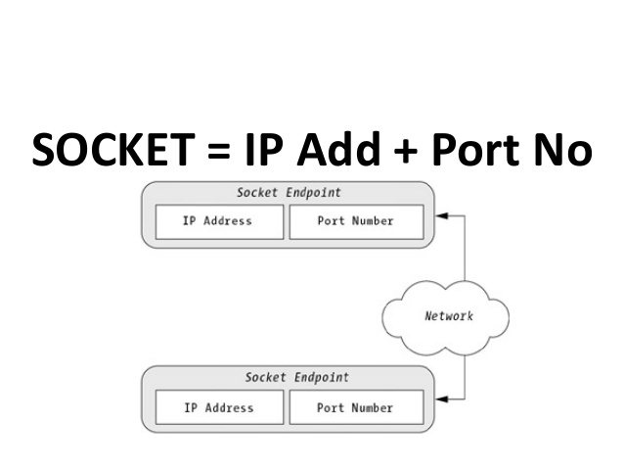
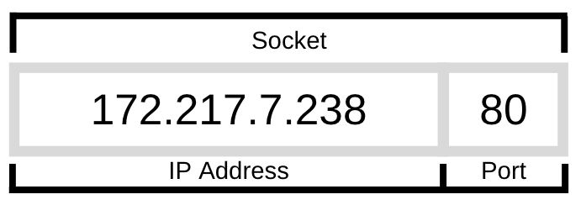
Port
In computer networking, a port is a communication endpoint. At the software level, within an operating system, a port is a logical construct that identifies a specific process or a type of network service. A port is identified for each transport protocol and address combination by a 16-bit unsigned number, known as the port number. The most common transport protocols that use port numbers are the Transmission Control Protocol(TCP) and the User Datagram Protocol (UDP).

Slide 6
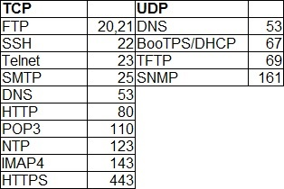
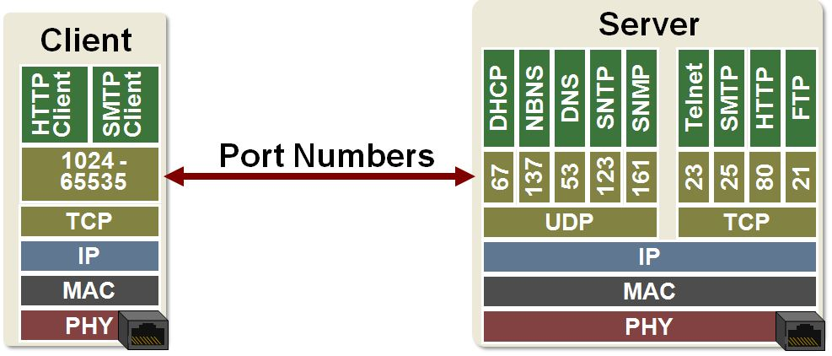
Sockets, ports.
Well known ports: 1-1023
Registered ports: 1024-49151
Dynamic, private or ephemeral ports: 49152-65535

Slide 7
TCP UDP
Protocol | TCP | UDP
Connection | Established SYN, ACK, FIN | Connectionless
Usage | High reliability | Efficient Transmission, Huge number of clients
Ordering of data | Rearranges packets in order | no order
Reliability | yes | no
Streaming | Byte stream with congestion control | Individual datagrams
Error Checking | error checking and recovery | checksum - drop datagrams if error
Acknowledgement | Segments acknowledgements | -

Slide 8
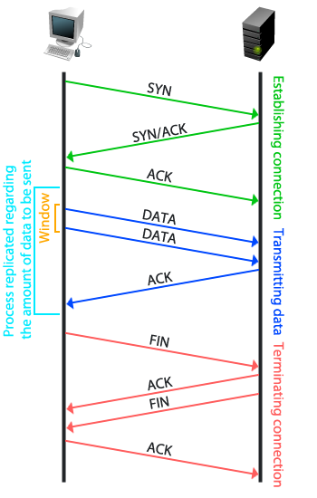
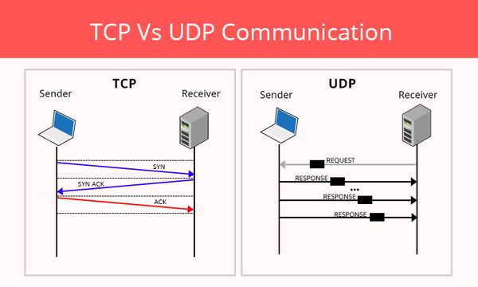
TCP UDP

Slide 9
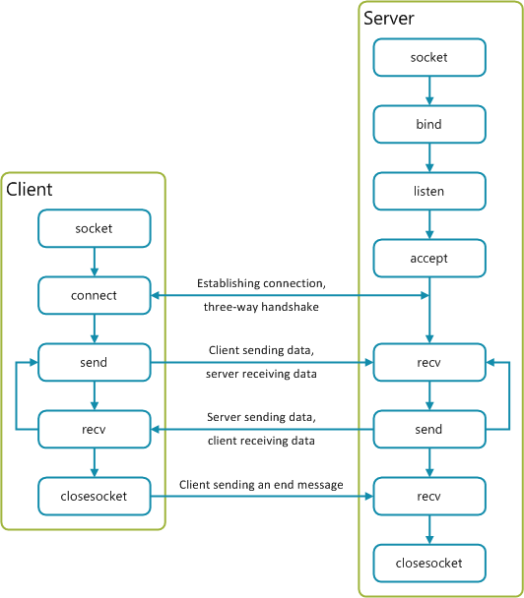
TCP sockets

Slide 10
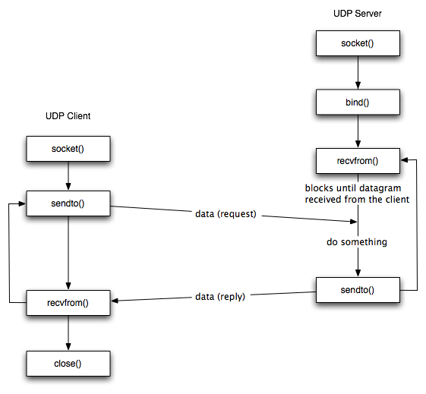
UDP sockets

Slide 11
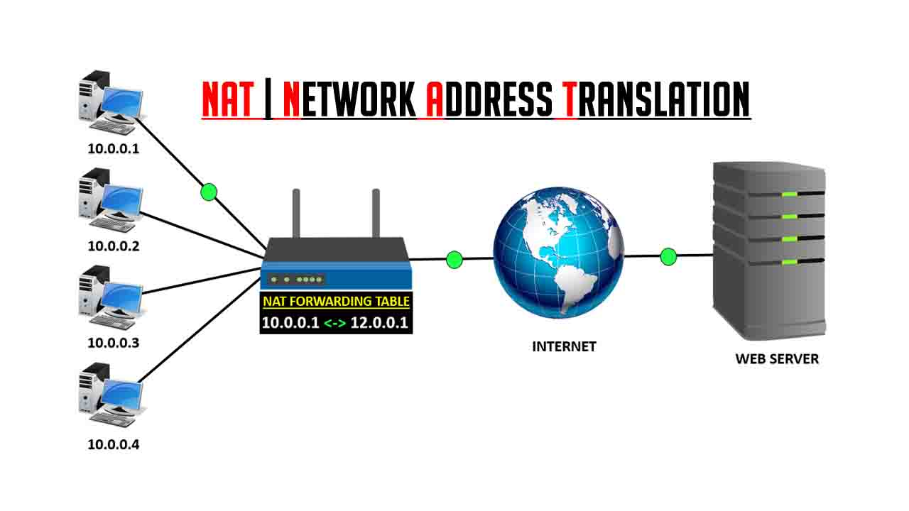
NAT
Network address translation (NAT) is a method of remapping an IP address space into another by modifying network address information in the IP header of packets while they are in transit across a traffic routing device.^{[1]} The technique was originally used to avoid the need to assign a new address to every host when a network was moved, or when the upstream Internet service provider was replaced, but could not route the networks address space. It has become a popular and essential tool in conserving global address space in the face of IPv4 address exhaustion. One Internet-routable IP address of a NAT gateway can be used for an entire private network.

Slide 12
NAT

Slide 13
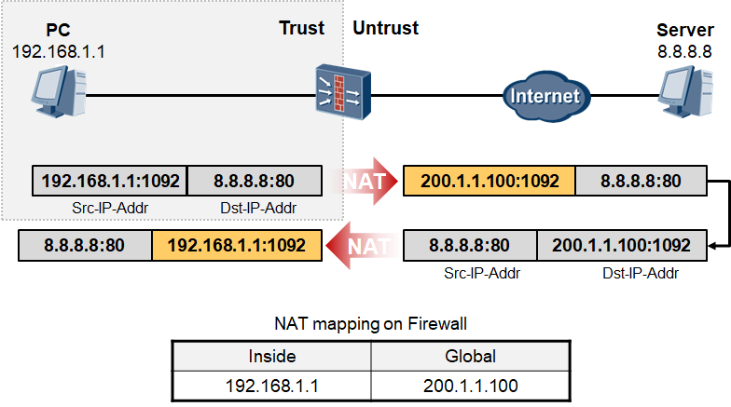
NAT

Slide 14
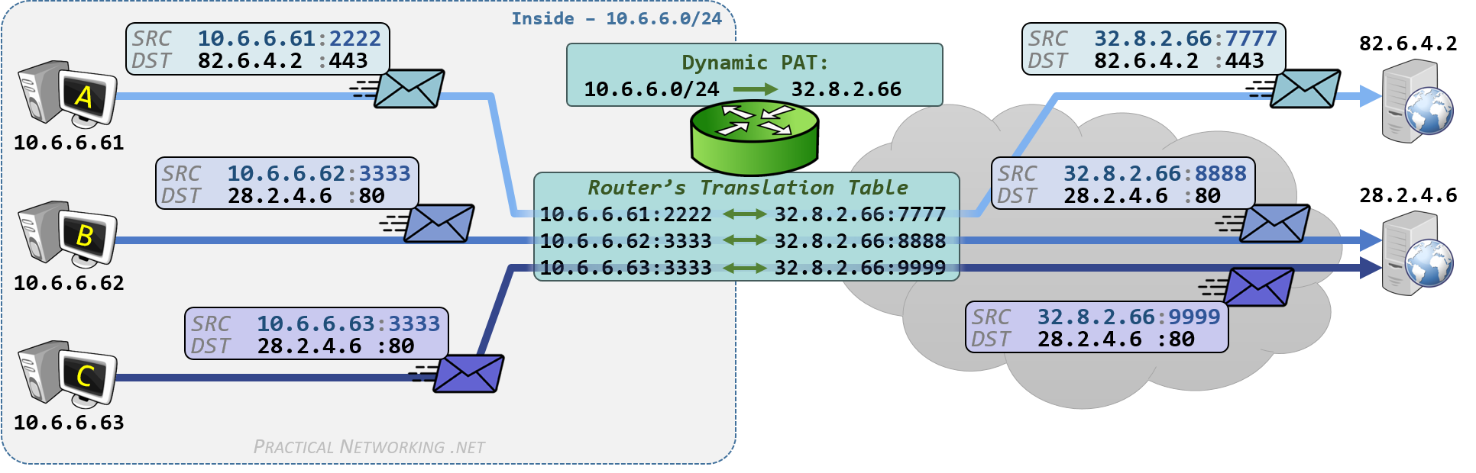
NAT PAT

Slide 15
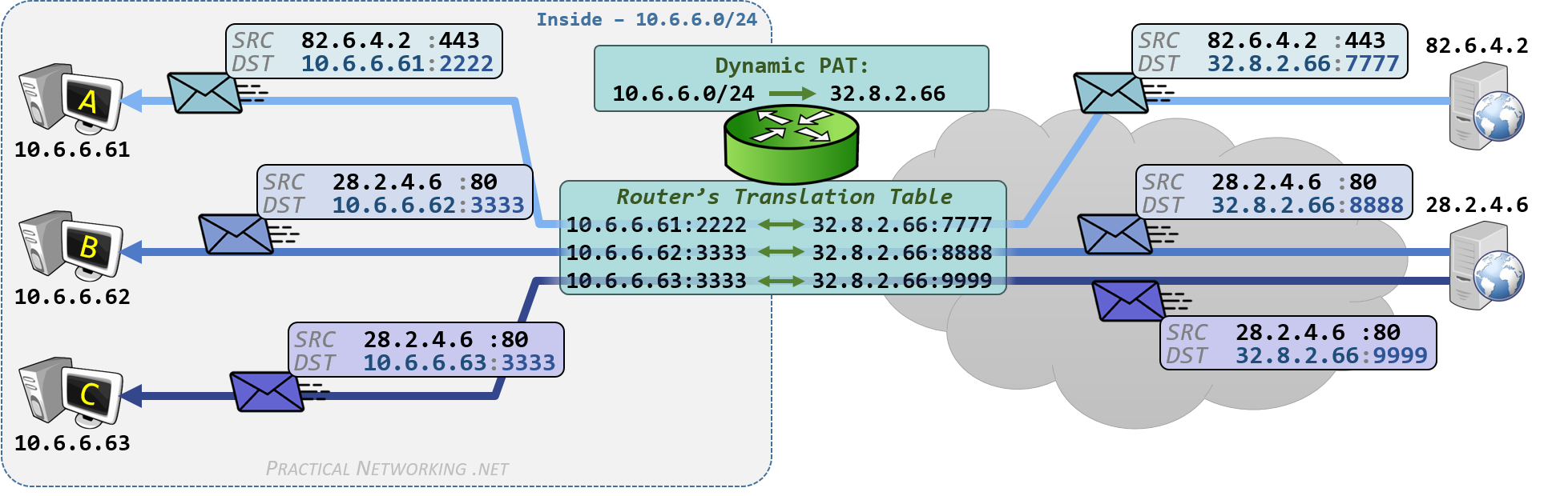
NAT

Slide 16
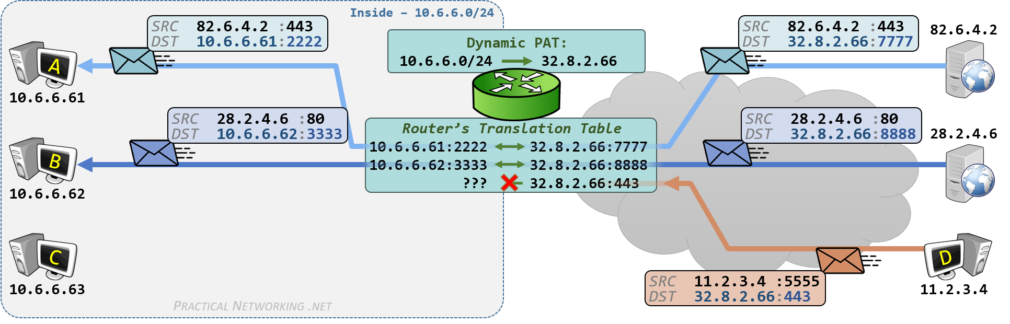
NAT

Slide 17
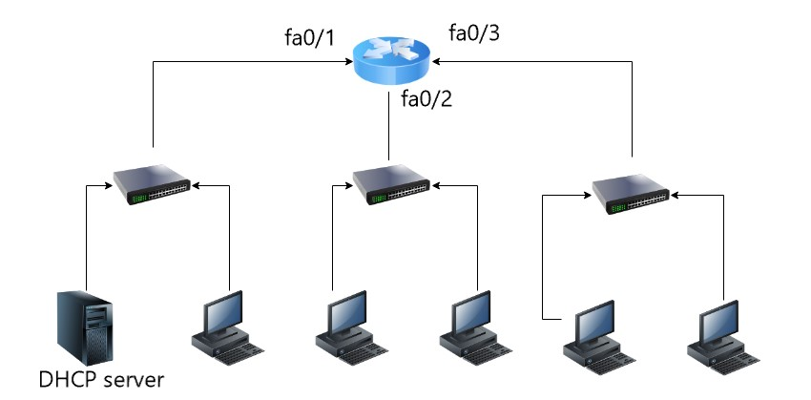
IP routing table:
http://jodies.de/ipcalc

Slide 18
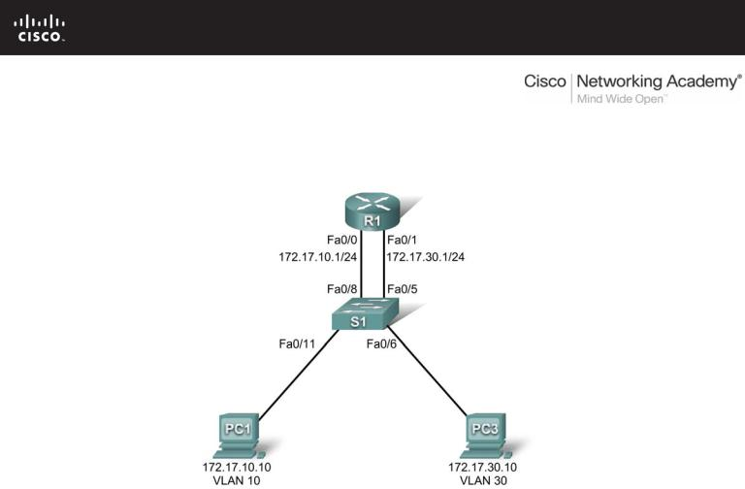
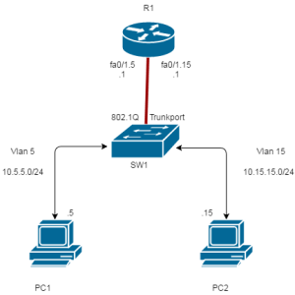
Inter-vlan routing.

