Slide 1
Сетевые технологии.
TCP/IP
Application Layer Protocols: SMTP, HTTP. DNS

Slide 2
Высокоуровневые протоколы
SSH
RDP
FTP
DNS
HTTP
SMTP
POP3
NFS
IMAP
LDAP
SNMP
telnet
NTP
finger
BGP
RIP
SIP
OSPF
IS-IS
EIGRP

Slide 3
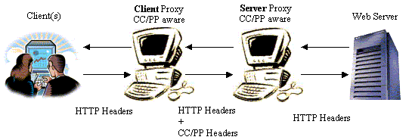
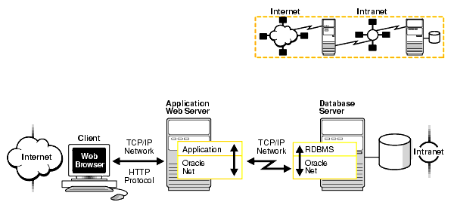
HTTP
Request-response protocol in the client–server computing model
Send Files
Generate Files and Send them

Slide 4
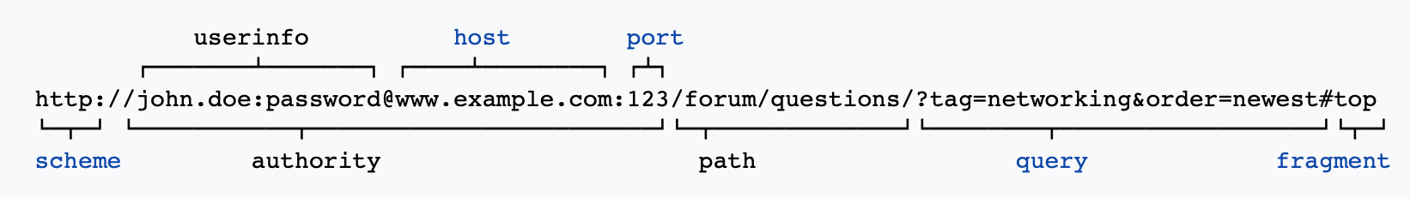
URL unified resource locator / identifier
scheme
host
port
Path
query
anchor
>>> urllib.parse.urlparse("https://yandex.ru:8443/mypath/?var1=val1&var2=val2#paragraph1")
ParseResult(scheme='https', netloc='yandex.ru', path='/mypath/', params='', query='var1=val1&var2=val2', fragment='paragraph1')
https -> 443 ; http -> 80

Slide 5
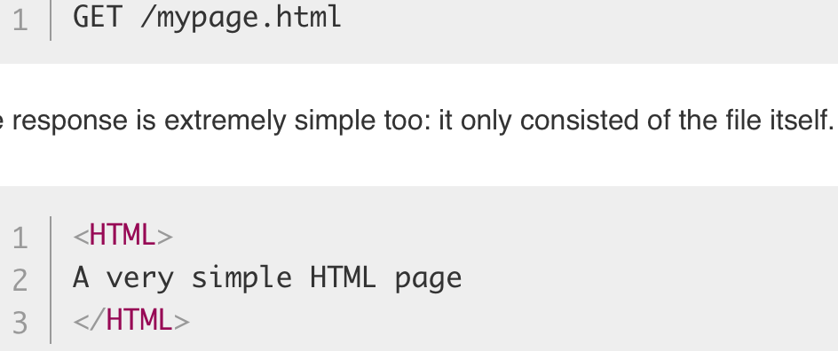
HTTP 0.9
simple client-server, request-response, telnet-friendly protocol
single-line (method + path for requested document)
GET only
hypertext only
single document only
No HTTP headers
No status/error codes
No URL

Slide 6
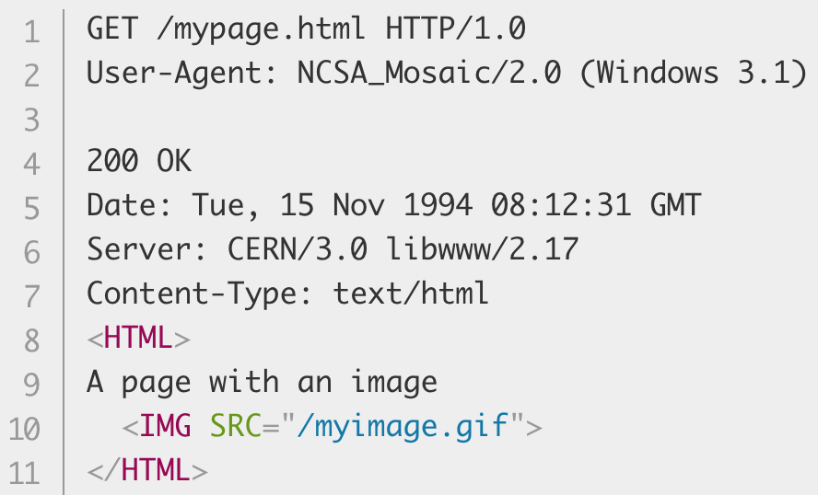
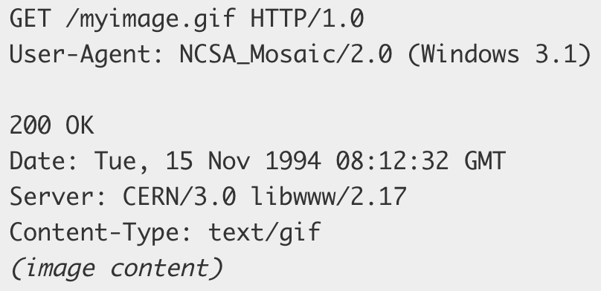
HTTP 1.0
HTTP version
Status Codes
GET HEAD POST
Headers
Content-Type header (any file types)

Slide 7
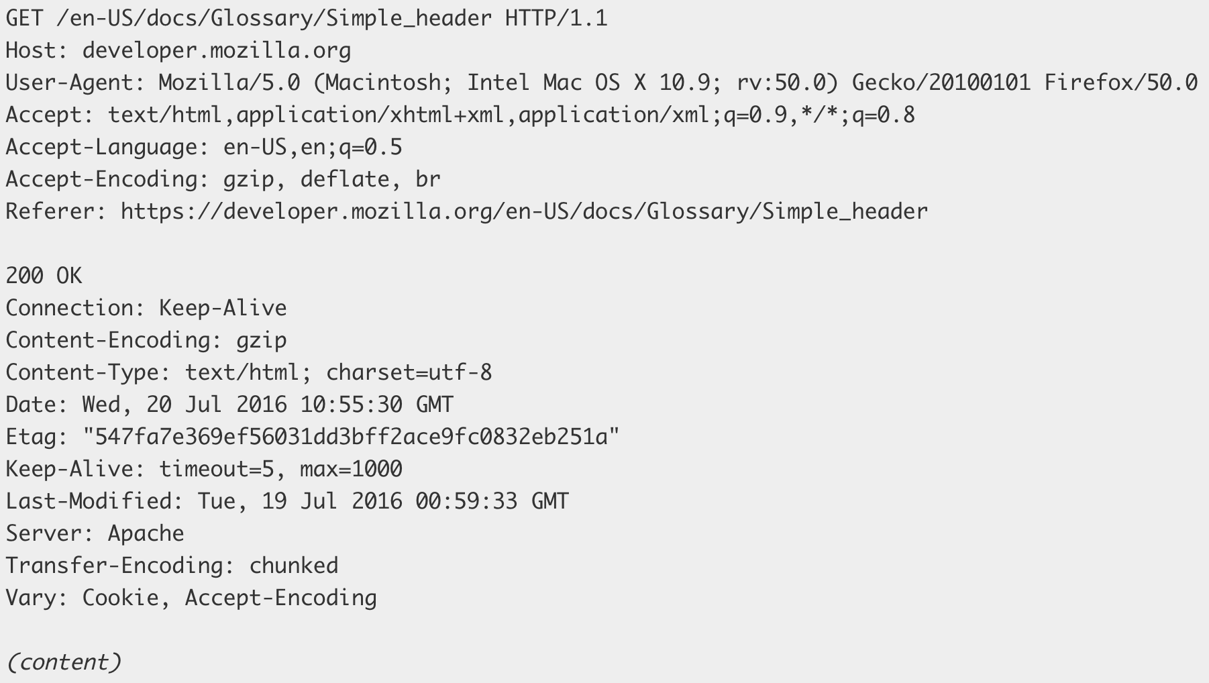
HTTP 1.1
connection can be reused
Pipelining
chunked transfers
compression/decompression
GET , HEAD , POST , PUT , DELETE
TRACE , OPTIONS
Long-lived connection Keep-Alive
Host header (multiple hosts on one IP)

Slide 8
HTTP 2.0
Server push
Binary optimization
Multiplexing
Most of features related to data transfer optimizations.

Slide 9
HTTP 3.0
Based on UDP

Slide 10
HTTPS - SSL
TLS
SSL
PKI
Asymmetric Cryptography vs Symmetric Cryptography

Slide 11
Cookie https://developer.mozilla.org/en-US/docs/Web/HTTP/Cookies
Set-Cookie: <cookie-name>=<cookie-value>
Set-Cookie: id=a3fWa; Expires=Wed, 21 Oct 2015 07:28:00 GMT; Secure; HttpOnly
Set-Cookie: key=value; SameSite=Strict
Set-Cookie: CSRF=e8b667; Secure; Domain=example.com
Cookie: yummy_cookie=choco; tasty_cookie=strawberry

Slide 12
HTTP Methods
OPTIONS
GET
HEAD
POST
PUT
PATCH
DELETE
TRACE
CONNECT

Slide 13
Status Codes
1xx: Informational
2xx: Success 200 201
3xx: Redirection 301 304
4xx: Client Error 401 403 404 405 418
5xx: Server Error 500 502 503 504

Slide 14
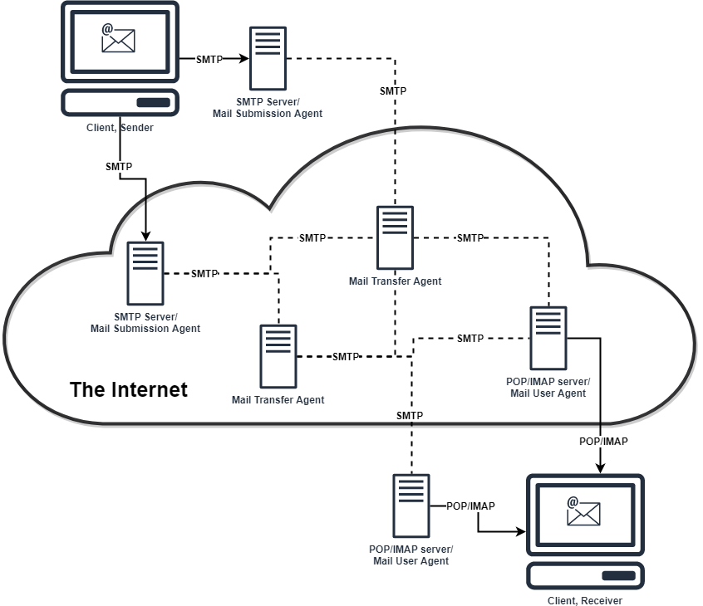
SMTP
MTA
MDA
MUA

Slide 15
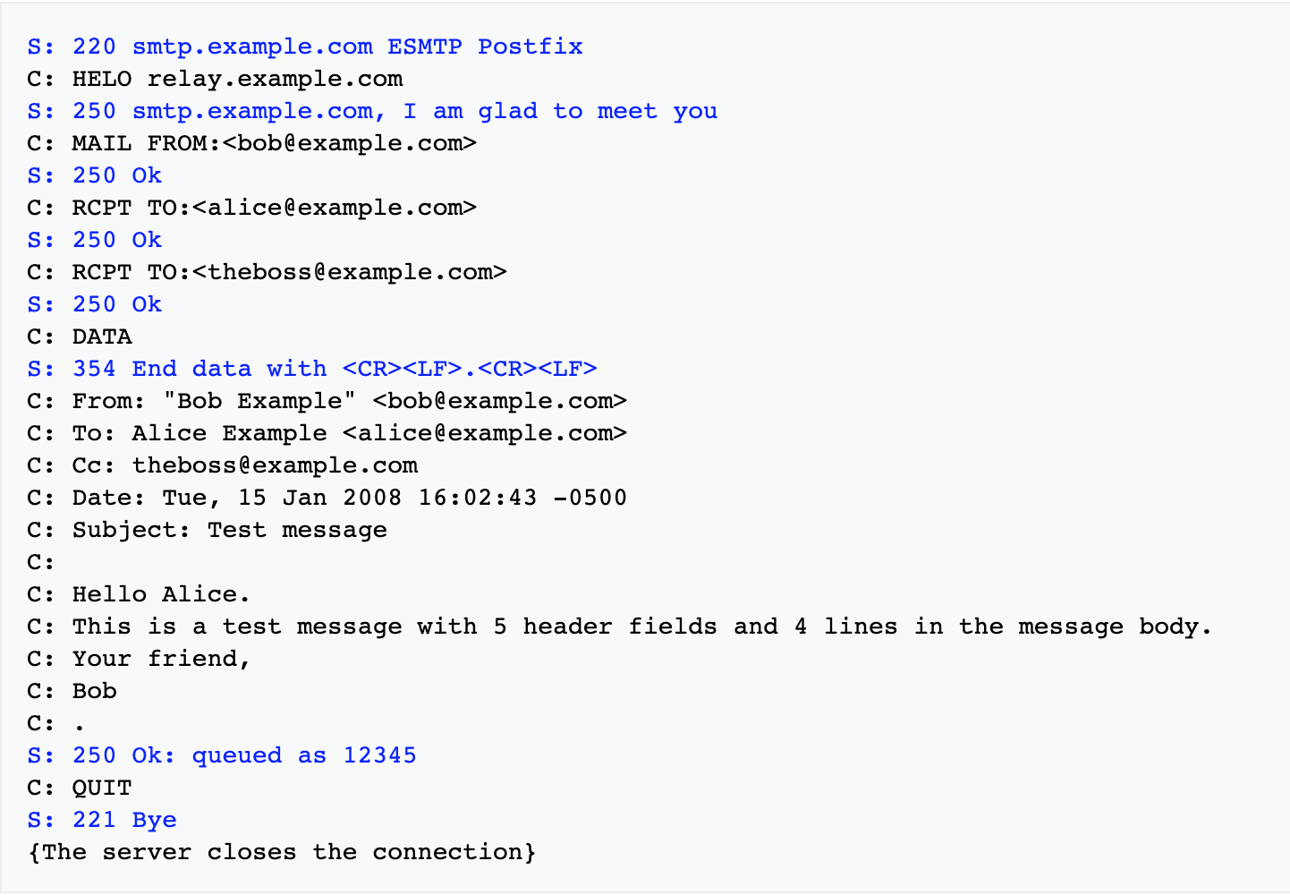
SMTP

Slide 16
Postfix Sendmail Exim
http://www.postfix.org/postconf.5.html

Slide 17
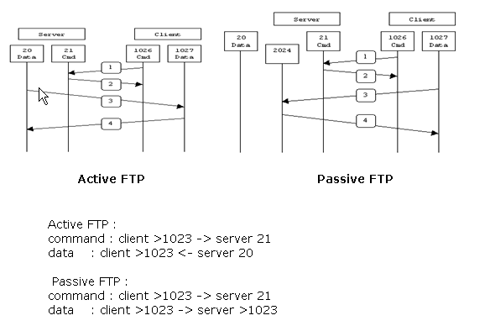
FTP file transfer protocol

