Slide 1
Linux Administration
Boot process, initialization

Slide 2
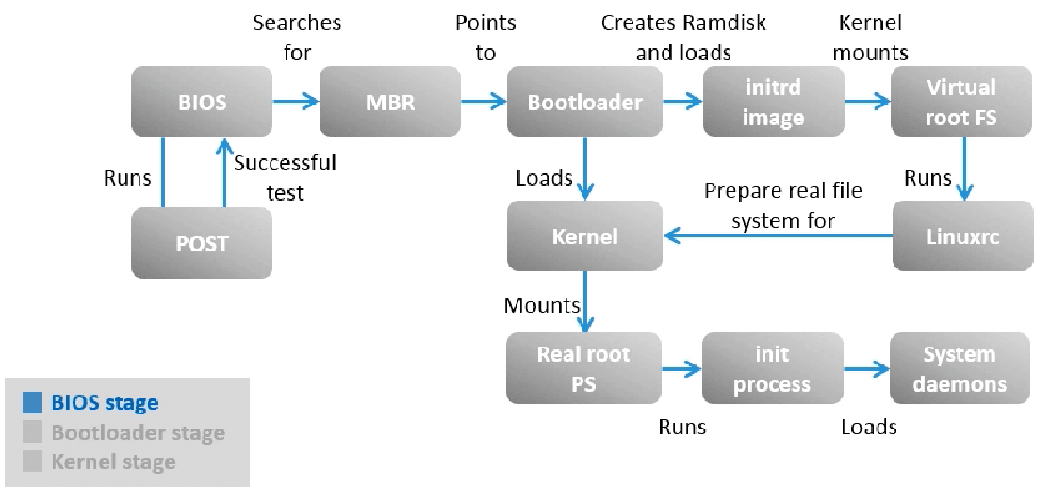
Boot process
https://www.golinuxcloud.com/linux-boot-process-explained-step-detail/

Slide 3
Boot process components
kernel - /boot/vmlinuz-*
initrd (fs), initramfs (cpio archive) - /boot/initramfs-* - initial ramdisk
init - /sbin/init or other – main process
root fs /dev/sda|/dev/mapper/lv-root|….

Slide 4
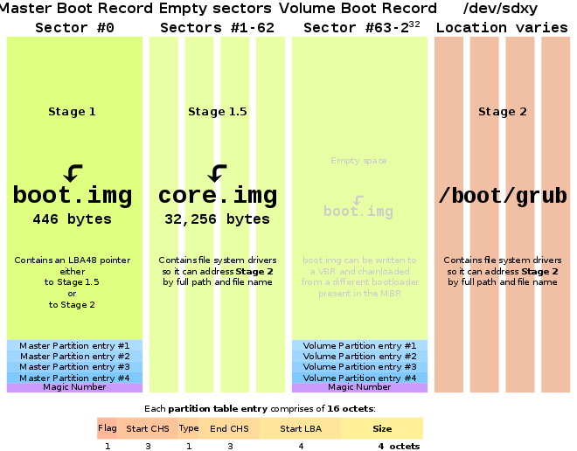
grub lilo (linux loader), syslinux…
https://en.wikipedia.org/wiki/GNU_GRUB

Slide 5
/proc/1
adopt orphaned processes
initialize os:
mount fs (except root) /etc/fstab
network configuration
start daemon processes / services
manage start/stop/reboot/etc (runlevels)
BSD init (rc scripts, run command, /sbin/rc)
AT&T UNIX System III -> UNIX System V (runlevels, /etc/init.d, /etc/rcN.d, /sbin/init, /etc/inittab)
Upstart (parallel startup, events, around sysV)
Systemd (!!!) parallel, units, dependencies, sockets/services/etc…, events, dependency independent

Slide 6
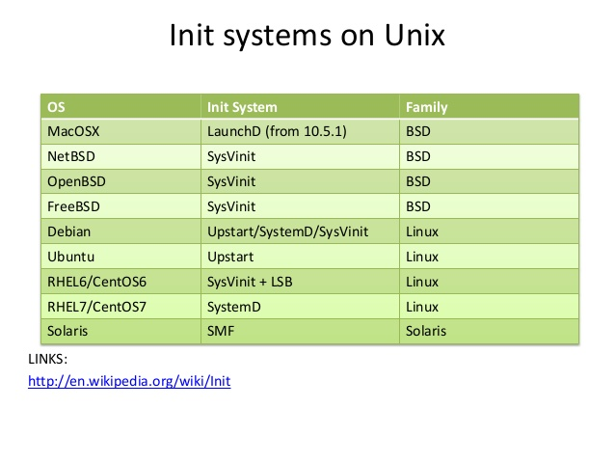
init
In Unix-based computer operating systems, init (short for initialization) is the first process started during booting of the computer system. Init is a daemon process that continues running until the system is shut down. It is the direct or indirect ancestor of all other processes and automatically adopts all orphaned processes. Init is started by the kernel during the booting process; a kernel panic will occur if the kernel is unable to start it. Init is typically assigned process identifier 1.

Slide 7
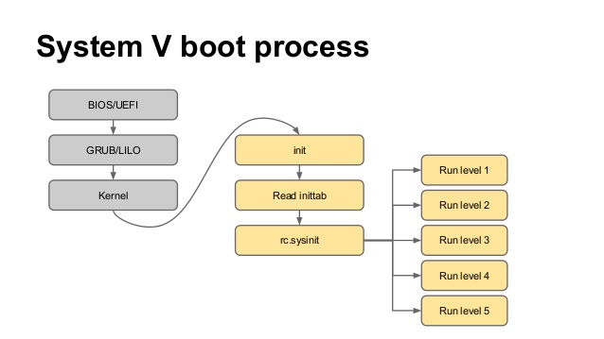
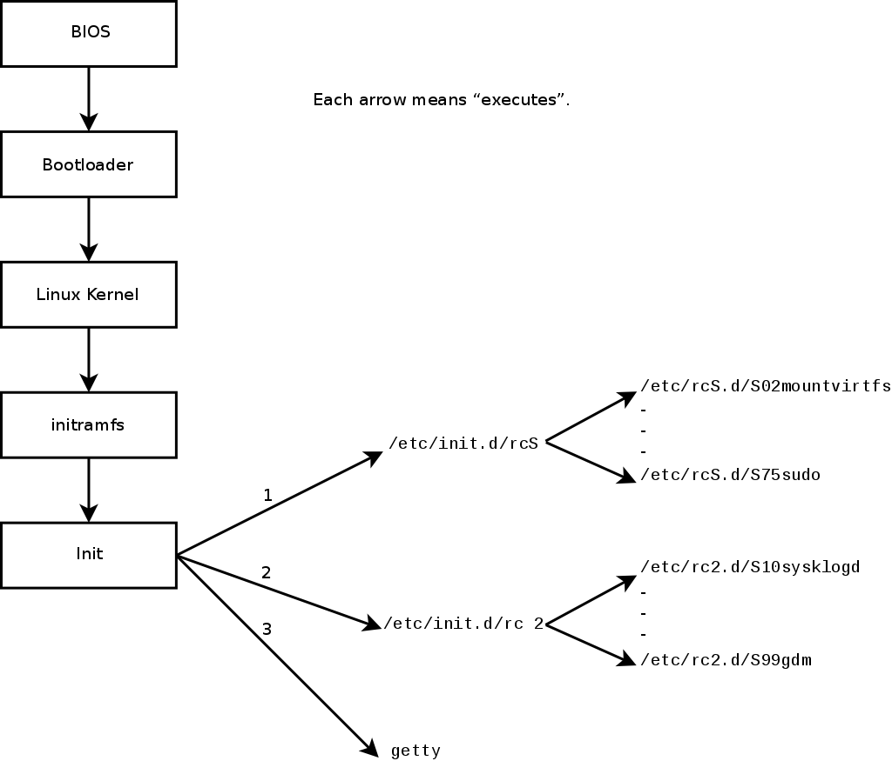
sys V init

Slide 8
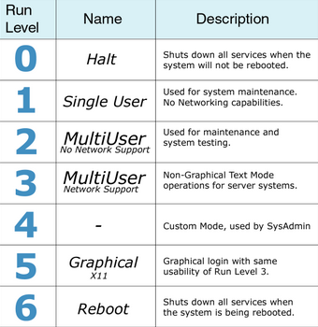
runlevel

Slide 9
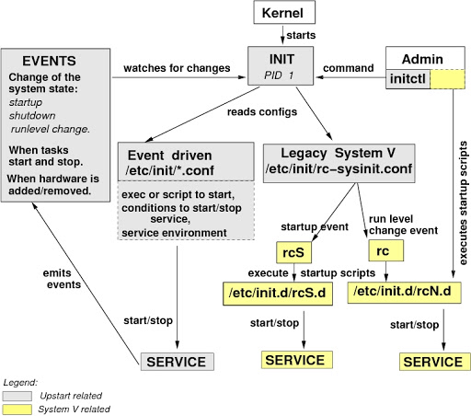
upstart

Slide 10
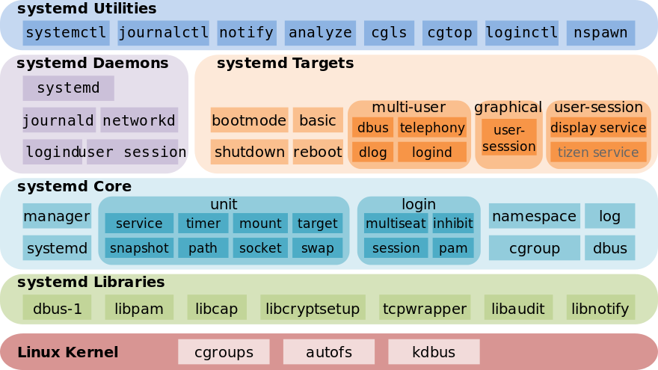
systemd
https://access.redhat.com/documentation/en-us/red_hat_enterprise_linux/8/html/configuring_basic_system_settings/managing-services-with-systemd_configuring-basic-system-settings

Slide 11
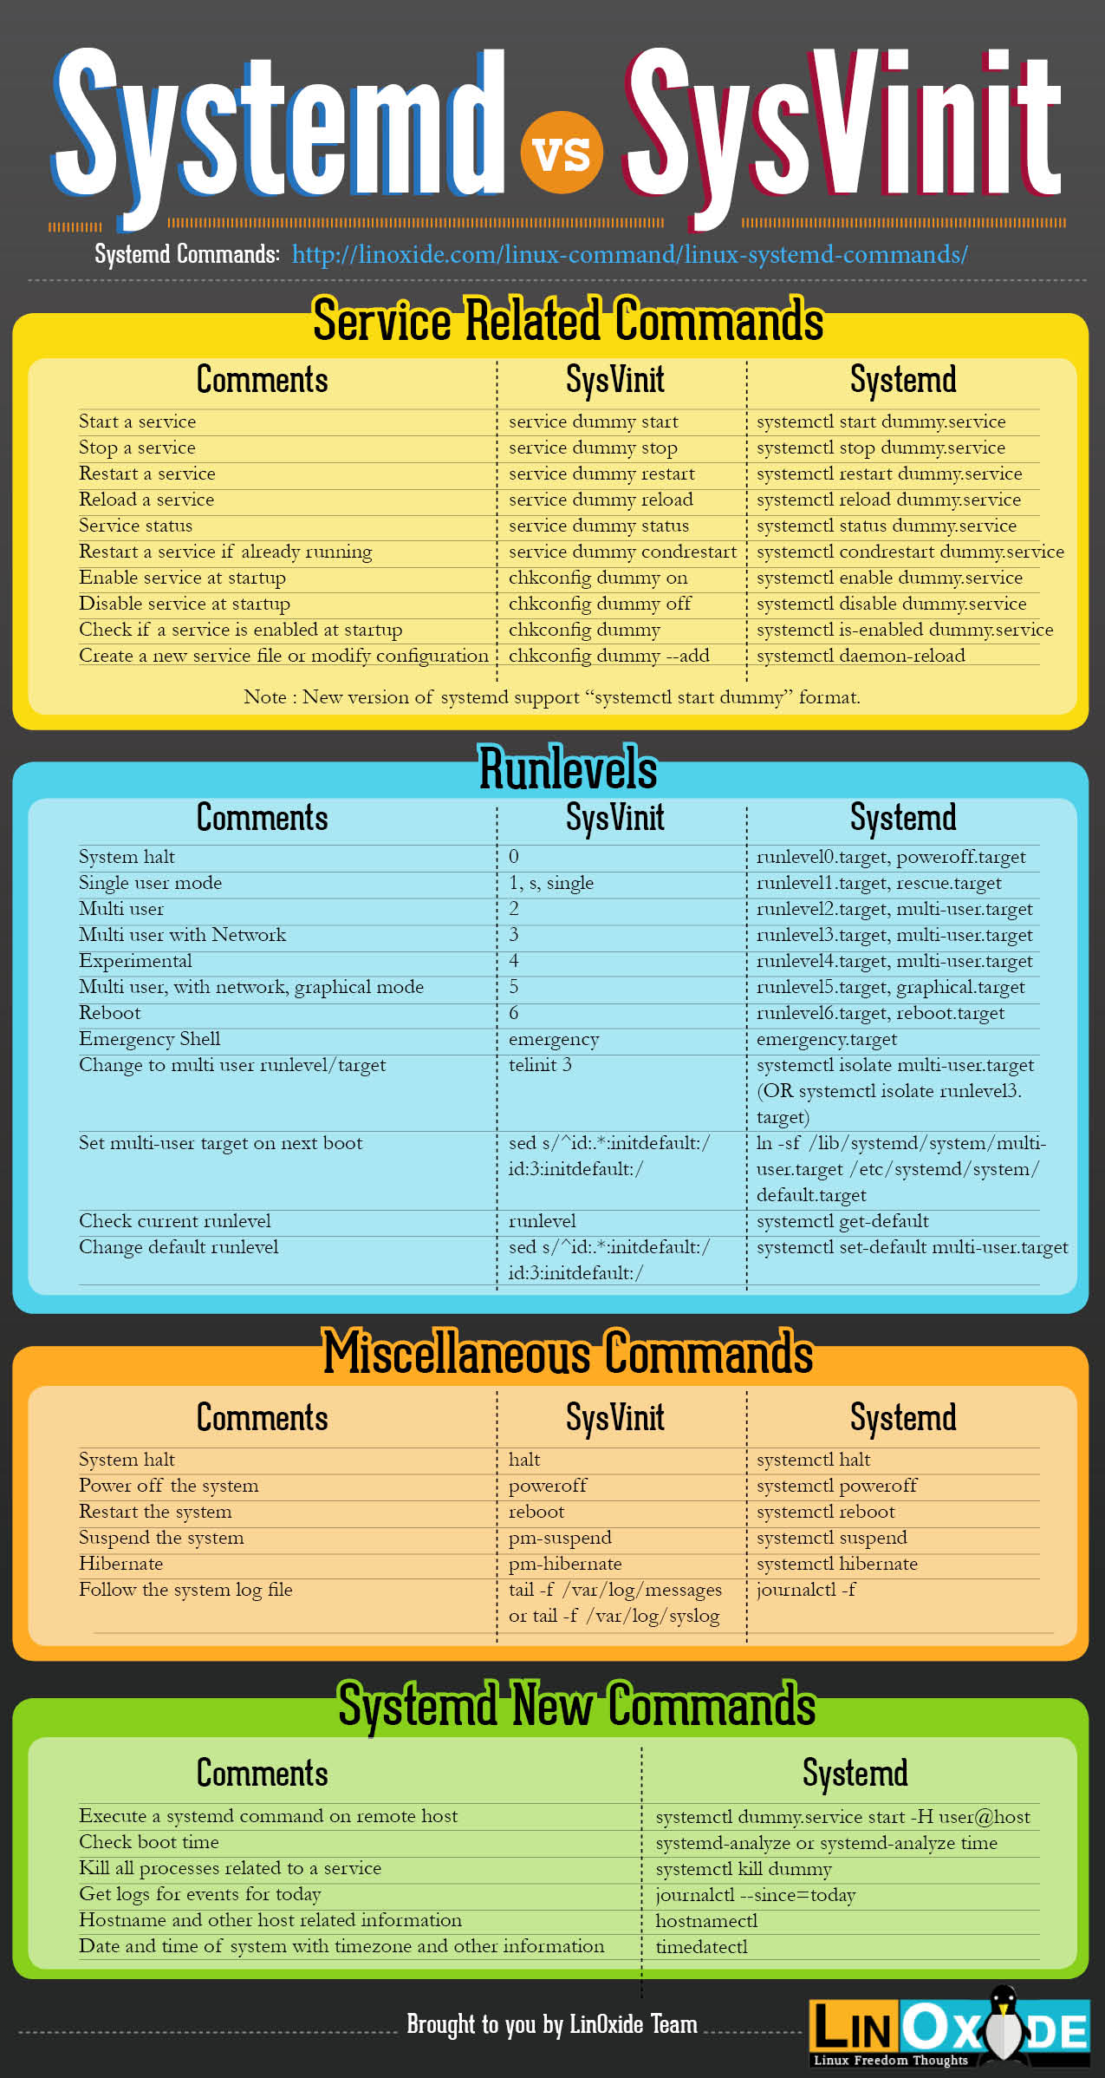
system and sys V init
https://lamiradadelreplicante.com/wp-content/uploads/2014/09/systemd-vs-sysVinit-chuleta.jpg
https://linoxide.com/linux-command/systemd-vs-sysvinit-cheatsheet/
https://habr.com/ru/post/307958/

Slide 12
system unit
[Unit]
Description=OpenSSH server daemon
Documentation=man:sshd(8) man:sshd_config(5)
After=network.target sshd-keygen.target
Wants=sshd-keygen.target
[Service]
Type=notify
EnvironmentFile=-/etc/crypto-policies/back-ends/opensshserver.config
EnvironmentFile=-/etc/sysconfig/sshd
ExecStart=/usr/sbin/sshd -D $OPTIONS $CRYPTO_POLICY
ExecReload=/bin/kill -HUP $MAINPID
KillMode=process
Restart=on-failure
RestartSec=42s
[Install]
WantedBy=multi-user.target
A unit file is a plain text ini-style file that encodes information about a service, a socket, a device, a mount point, an automount point, a swap file or partition, a start-up target, a watched file system path, a timer controlled and supervised by systemd(1), a resource management slice or a group of externally created processes. See systemd.syntax(5) for a general description of the syntax.

