Slide 1
Введение
История и особенности Python, инструменты разработчика

Slide 2
Programming languages
1957 Fortran
1958 Lisp
1968 Logo
1972 C
1978 SQL
1980 C++
1984 Common Lisp
1984 MatLab
1986 Objective-C
1986 Erlang
1987 Perl
1988 Wolfram
1990 Haskell
1990 Python
1991 Visual Basic
1993 R
1995 Ruby
1995 Java
1995 JavaScript
1995 PHP
2001 C#
2003 Scala
2006 PowerShell
2009 Go

Slide 3
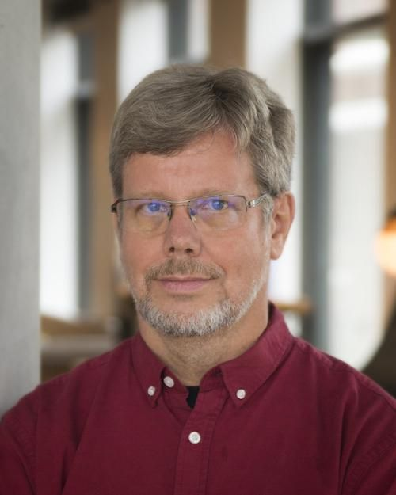
Guido Van Rossum
Author 1991 Benevolent dictator for life - till 2018
Worked at Google, Dropbox, Microsoft, etc.

Slide 4
Python:
Open source general-purpose language.
Easy to interface with C/ObjC/Java/Fortran Easy-ish to interface with C++
Great community, popularity.
Web site: http://www.python.org
Documentation: http://www.python.org/doc/ http://docs.python.org
Free book: http://www.diveintopython.org
Translators (interpretators) (CPython, Jython, PyPy)
Supports multiple paradigms: Object Oriented, Procedural, Functional, etc.
Brief syntax
Broad adoption: software development, data analysis, devops, tests, etc.

Slide 5
Python 2 vs. Python 3
Python 3 started in 2008.
Python 2 – support ended 2020, Python 3 – actively developed.
Difference: - strings vs bytes - classes hierarchy - many standard functions, methods differ
Python 2 helps to understand Python 3 better

Slide 6
Coding
Edit
Run
Debug
Multiple files, folders tracking
git integration

Slide 7
IDE - integrated development environment
UNIX
PyCharm from Jetbrains
Notepad++
IDLE
Sublime Text
Pydev
Visual Studio Code
Atom

Slide 8
Features
Brief syntax
Batteries included
dynamic typization
auto memory management
exceptions
multithreading
complex data structures
Structured
Generic
Object Oriented
Functional
Modules

Slide 9
Where is used
Google
Facebook
Linux
NASA
…
…
Everywhere

Slide 10
Python jobs
Software Development:
Application Development
Web Development (backend)
Systems Development
QA engineering
DevOps/Automation/Scripting (ruby, perl, shell)
Data Science Jobs:
Data Science ML
Data Engineering
Data Operations +/- DevOps

Slide 11
Lectures list:
Introduction
Basic Data types
Flow Control
Functions
Classes
Modules
Network Programming
Http
Iterators

Slide 12
Books
Learning Python, Mark Lutz
Hitchhikers guide to Python (https://docs.python-guide.org/)
Python Cookbook, David Beazley
https://www.dabeaz.com/
https://realpython.com
Fluent python, Luciano Ramalho
Python tricks, Dan Baden

