Slide 1
基于Arduino 技术
的蓝牙手势动作玩具
13061155 余帆
13061019 王一珺
13061111 杨志浩

Slide 2


Introduce
1. 动态UI设计
2. 蓝牙信号传送
3. 3D打印动作手
U choose what I do

Slide 3
UI
页面切换
色彩搭配
组件利用

Slide 4
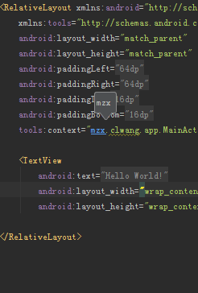
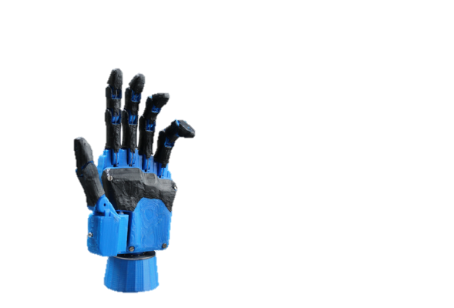
Function
Amarino
Android
BlueTooth
Open Source Hand
Arduino

Slide 5



BlueTooth
Amarino Libraray
connect()
disconnect()
sendDataToArduino()

Slide 6
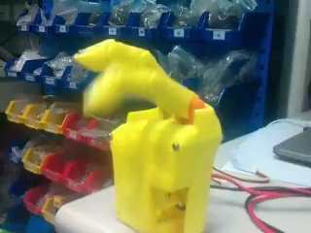
Open Source Hand
Hardware

Slide 7
Arduino
略

Slide 8




Predict && Reality
Finished
U choose what I do
Unfinished
U do what I do
手势识别

Slide 9



余帆
王一珺
杨志浩
Workload
20%
30%
50%
50%
80%
70%
Function
Hardware
UI

Slide 10
THANK YOU

