Slide 1
Using GNN for refactoring P4 programs
Benedek Csüllög – Máté Tejfel
FMF-AI 2025
Notes:
Welcome everyone! We’re Benedek Csüllög and Máté Tejfel, and today we’ll show how Graph Neural Networks can refactor P4 programs.

Slide 2
Content
Introduction to the P4 Programming Language
The P4Query Framework
Motivation
Basics of GNNs and Their Training
Current GNN Models and Their Capabilities
Possible Future Work
Summary
FMF-AI 2025
Notes:
Here’s our roadmap: a quick P4 primer, an intro to the P4Query framework, GNN basics, our trained models, results, and some ideas for future work.

Slide 3
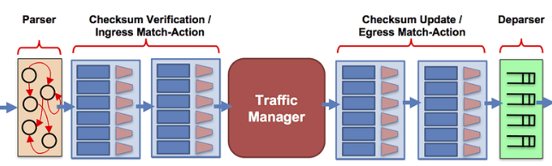
Programming Protocol-independent Packet Processors - P4
Domain-specific programming language for data-plane packet processing. – P4 lets you define how network devices process packets.
P4 is particularly useful when Custom Protocol Implementation is required.
Specify the structure of packet Headers, including both standard (e.g., Ethernet, IPv4) and custom protocols. During program execution Headers and metadata can be updeted.
Source: P4 architecture - P4 Programming Language
FMF-AI 2025
Notes:
P4 is a data-plane DSL: packets pass through match/action tables that use header fields and metadata to rewrite or add headers— all at line rate.

Slide 4
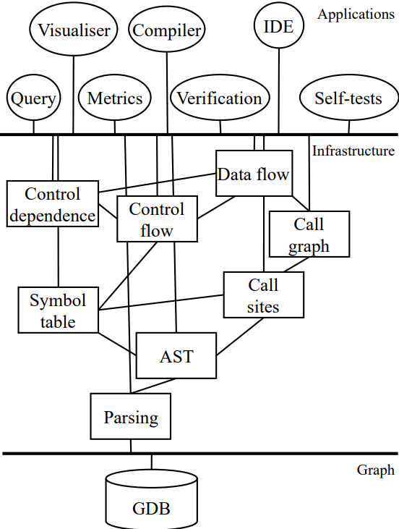
P4 Query
Static analysis framework for P4.
Contains an internal Gremlin graph representation.
Ensures a consistent and standardized representation of P4 programs.
P4 programs can naturally be represented as abstract syntax trees (ASTs), generated by the framework.
FMF-AI 2025
Notes:
P4Query runs static analysis: it converts code into a Gremlin graph, giving us a uniform AST representation ready for learning.

Slide 5
Motivation
Abstract Syntax Trees (ASTs) can be naturally represented as directed graphs.
Given this structure, a key question arises:
Can machine learning models learn from both the topology of such graphs and the semantic attributes of their nodes?
Recent advances in deep learning provide a positive answer.
Graph Neural Networks (GNNs) have proven highly effective in learning from graph-structured data, making them suitable for various code understanding and transformation tasks, including refactoring.
FMF-AI 2025
Notes:
Because an AST is a directed graph, we ask: can a model learn from both topology and semantic node info? GNNs answer with a resounding yes.

Slide 6
Basics of GNNs
Graph Neural Networks are designed to work with graph data structure.
GNNs learn node (or graph-level) representations by iteratively aggregating information from neighboring nodes.
The input is a graph, and the output is either:
a modified graph (e.g., refactored),
or a prediction (e.g., classification or embedding).
GNNs are well-suited for tasks involving structural understanding, such as code refactoring.
FMF-AI 2025
Notes:
GNNs work via message passing: nodes aggregate neighbour info, producing embeddings we can use to output a transformed graph or a prediction.

Slide 7
Training GNNs
The model incrementally learns the structure of the AST across multiple training epochs.
In each epoch, specific portions of the graph are selectively removed to enhance the model’s ability to generalize its understanding of the structure.
Initially, the training may involve the deletion of leaf nodes, which represent the terminal elements of the AST.
By starting with these simpler nodes, the model is encouraged to focus on the relationships and interactions among the remaining nodes.
This leads to a deeper understanding of the overall tree structure.
As the training advances, the strategy can adapt to remove more complex nodes or entire subtree.
FMF-AI 2025
Notes:
Across epochs the model sees larger graph slices; we start by masking leaves to force generalisation, then expose finer structure for refinement.

Slide 8
Current models
Variable renamer
Renames every instance of a given variable in the AST (declaration, initialisation etc.). During running the model the variable to be renamed comes as parameter. Modifies the AST node attributes.
Parameter reorderer
Able to reorder parameter declarations in a function declaration. Modifies the AST’s structure.
Empty ’else’ block detector
Able to recognize an empty ’else’ block in an AST.
FMF-AI 2025
Notes:
We trained three refactorings: a variable renamer, a parameter reorderer, and an empty-else detector, all operating directly on the P4 AST.

Slide 9
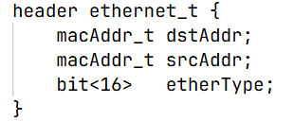
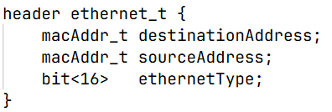
Trained models – Variable renamer
Goal
Rename a variable and all of its occurrences in the AST graph.
Useful for improving readability or resolving naming conflicts.
Training
A 2-layer GNN is trained to classify node attributes (e. g. ’class’).
FMF-AI 2025
Notes:
Goal: rename every instance consistently. A two-layer GNN classifies node labels to pinpoint where the rename should happen.

Slide 10
Trained models – Variable renamer
Outcome
The model learns structural and contextual patterns for variable usage.
Able to reliably rename all instances of a given variable in the graph.
FMF-AI 2025
Notes:
The model captures usage patterns and reliably renames variables, avoiding name collisions.

Slide 11
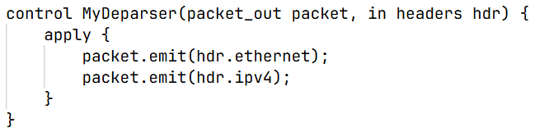
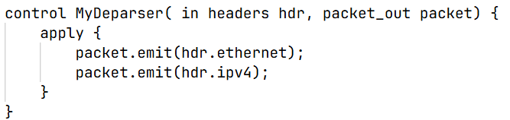
Trained models – Parameter reorderer
Goal
Reorder function parameters to improve consistency or readability.
Training
Match parameters based on (type, name) signatures.
Learn graph embeddings and use a feedforward neural network to predict standardized parameter order.
FMF-AI 2025
Notes:
We order parameters by their (type, name) signature; after GNN embeddings, a small MLP predicts the target permutation.

Slide 12
Trained models – Parameter reorderer
Outcome
The model predicts a parameter order for a given function.
Modifies the AST graph based on the predicted permutation.
Improve readability to standardized the structure of the source code.
FMF-AI 2025
Notes:
Output: a consistent, readable parameter order, directly patched back into the AST.

Slide 13
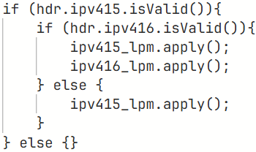
Trained models – Empty ’else’ block detector
Goal
Detect empty 'else' blocks in P4 abstract syntax trees. Identify non-functioning subtrees.
Training
Extract ’else’ nodes and label them as empty or non-empty.
Node features include class and token value encodings.
2-layer GNN performs binary classification, focusing only on ’else’ nodes.
FMF-AI 2025
Notes:
We extract else nodes with binary labels; the two-layer GNN focuses solely on those nodes for classification.

Slide 14
Trained models – Empty ’else’ block detector
Outcome
Learns to classify ’else’ blocks based on structural patterns.
During inference, outputs predicted class and confidence for each ’else’ node.
FMF-AI 2025
Notes:
The model outputs a prediction and confidence for each else, allowing us to strip empty branches automatically.

Slide 15
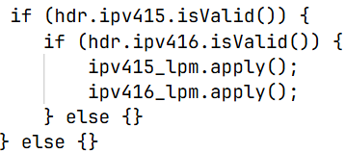
Possible future work
Recognize nested ’if’ statements that can be collapsed.
Extending the AST with parser representations which fulfills specific Header fields automatically.
FMF-AI 2025
Notes:
Next we could collapse nested if chains or add new refactorings like dead-code elimination.

Slide 16
Summary
Unified graph representation of P4 programs using the P4Query framework.
3 GNN-based model for refactoring:
Variable renamer
Parameter reorderer
Empty ’else’ block detector
The models learn different aspects of the ASTs and try to do modifications or predictions.
FMF-AI 2025
Notes:
To sum up: we built a unified graph representation, trained three lightweight GNNs, and showed fully automatic, semantics-preserving edits for P4.

Slide 17
Thank you for you attention!
FMF-AI 2025
Notes:
Thank you for listening! We’re happy to take questions.

