Slide 1

Testing Prop Directions [Instructor Edition]
July 01, 2025

Slide 2
Testing Propeller Directions
MAKE SURE NO PROPELLERS ARE ATTACHED TO ANY MOTORS!!!
FAILURE TO DO SO WILL RESULT IN INJURY OF PEOPLE AROUND YOU!!!
After making sure that NO propellers are attached, connect the flight battery to the drone. You should hear the buzzer play a tune and the motors also buzz three times, with a fourth long buzz
Plug in the computer telemetry unit, run QGround Control, and wait for the connection to the drone

Slide 3
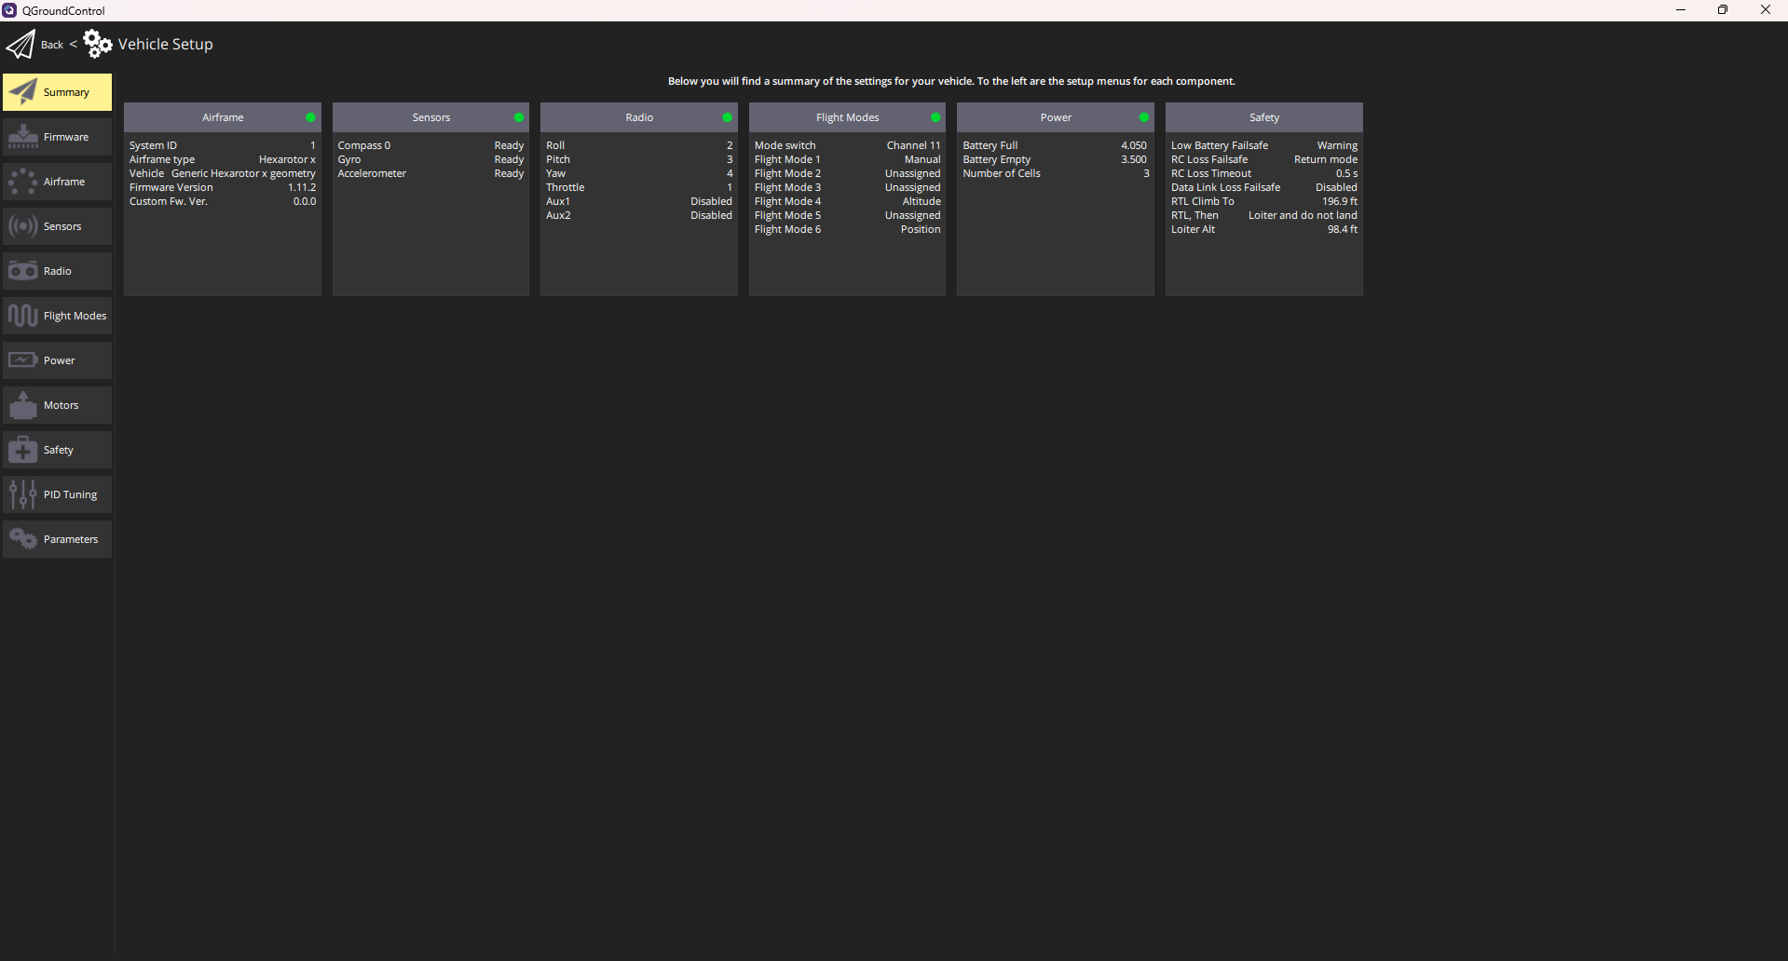
Testing Propeller Directions (continued)
Navigate to the QGC icon on the top left corner of the screen, then Vehicle Setup. You should see the screen below

Slide 4

Testing Propeller Directions (continued)
Go to the Motors tab, and you should see this screen
Click the switch to confirm that there are no propellers on the vehicle (RIGHT?)
Bring up the slider of each motor one at a time, making sure that the motor is spinning in the right direction. Use the chart on the following slide as reference

Slide 5
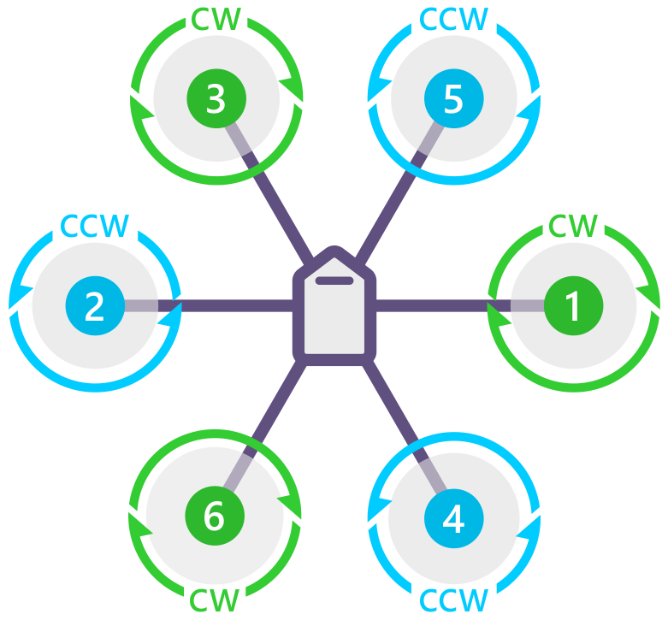
Testing Propeller Directions (continued)
Pixhawk Facing Up (Arrow Pointing Up
If a motor isn’t spinning the correct way, take any two of the three motor wires out of the ESC and swap them

