Slide 1

Notes:
============================================================ COVER ============================================================

Slide 2
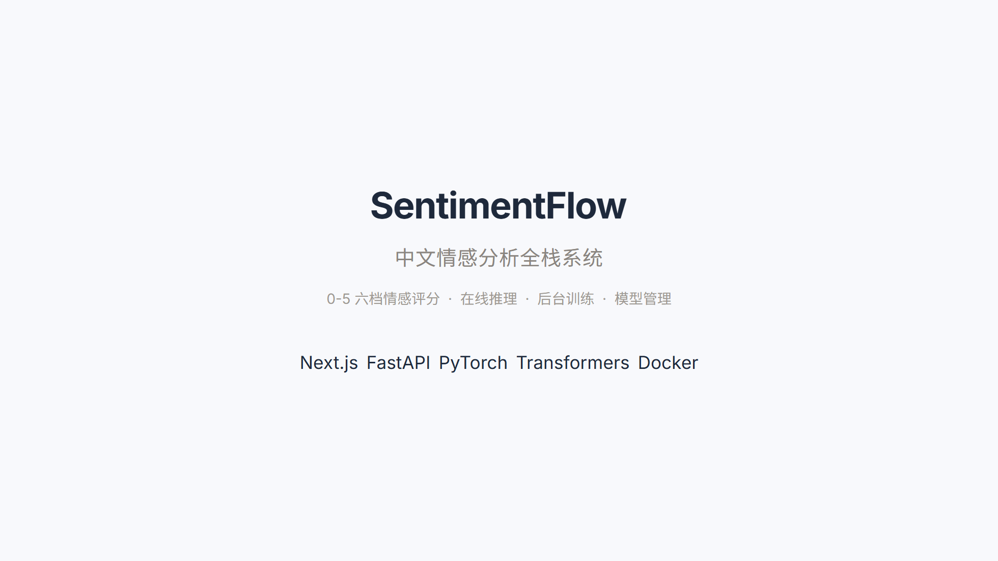
Notes:
============================================================ TOC ============================================================

Slide 3
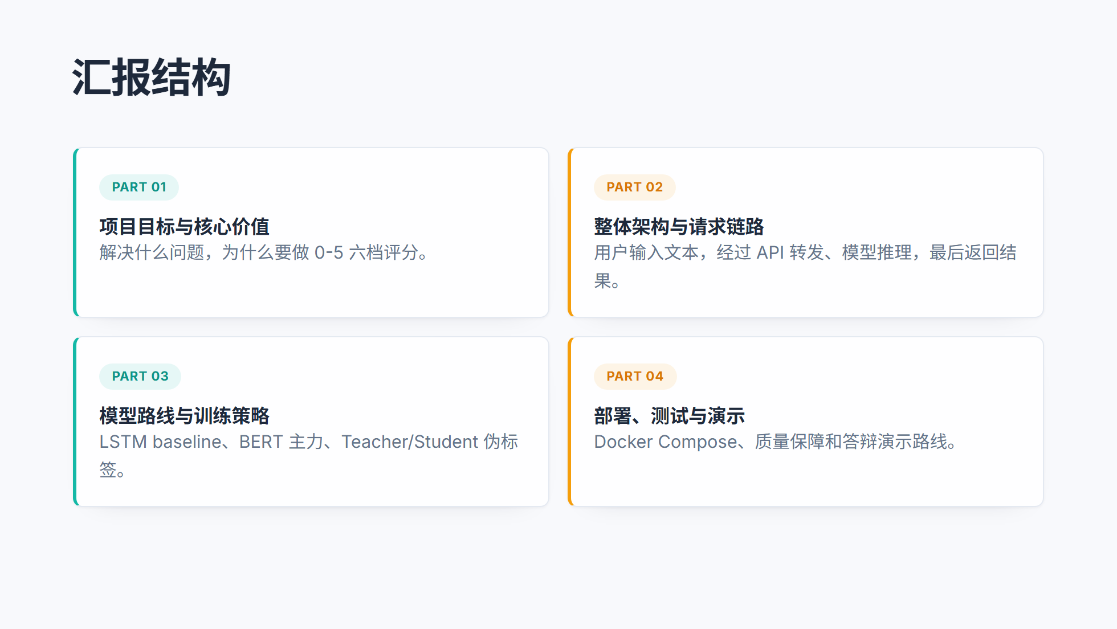
Notes:
============================================================ SECTION 01 ============================================================

Slide 4
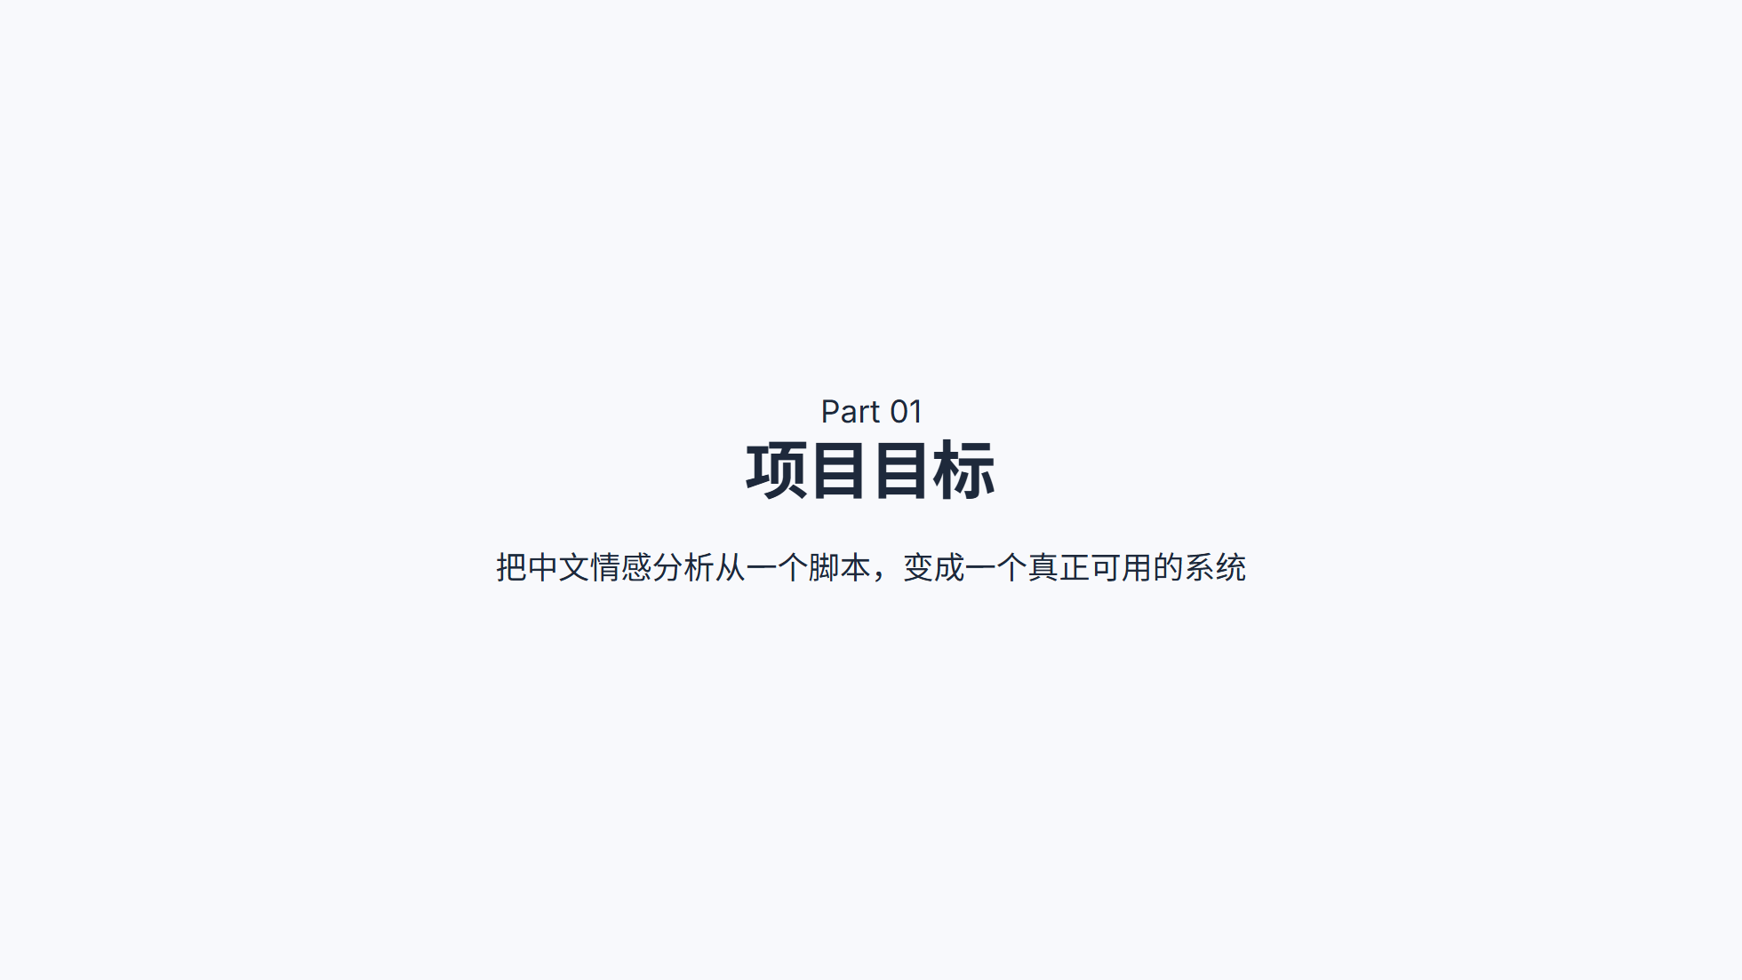
Notes:
============================================================ WHY ============================================================

Slide 5
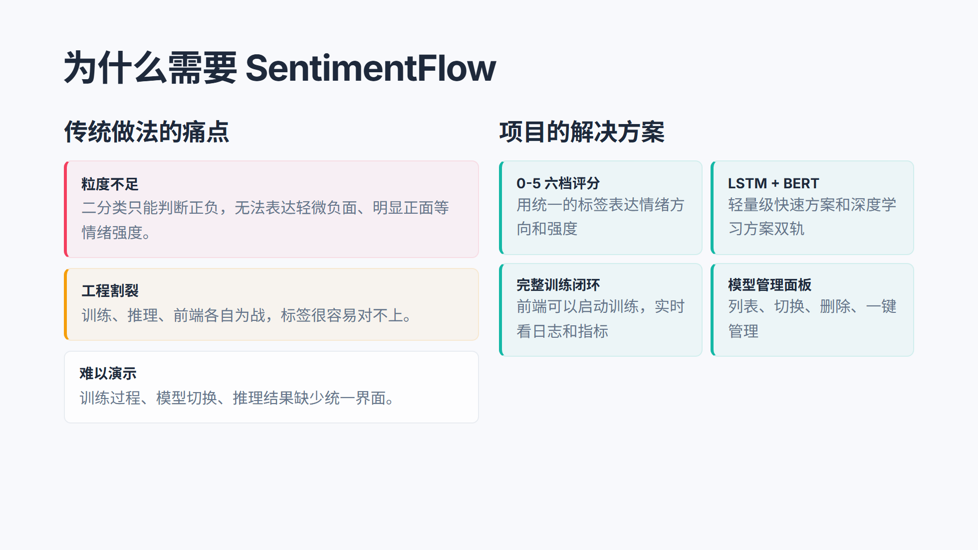
Notes:
============================================================ DELIVERY ============================================================

Slide 6
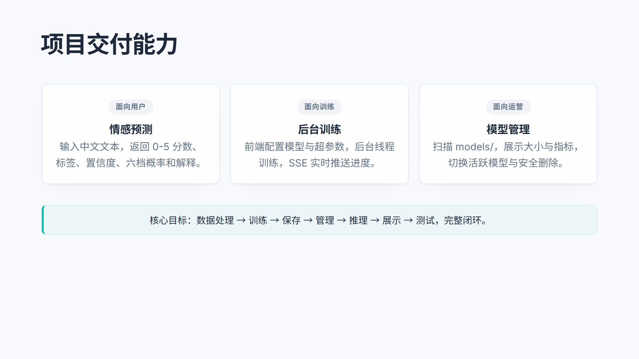
Notes:
============================================================ SECTION 02 ============================================================

Slide 7
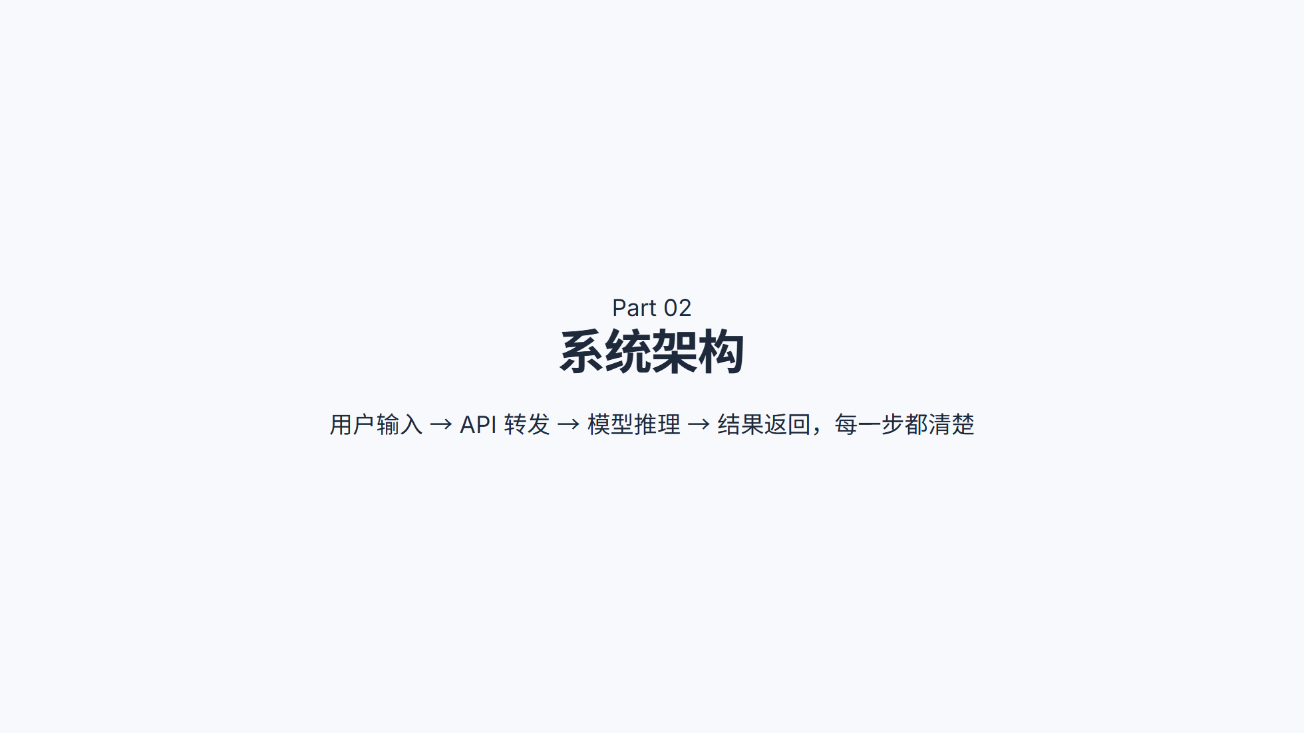
Notes:
============================================================ ARCHITECTURE ============================================================

Slide 8
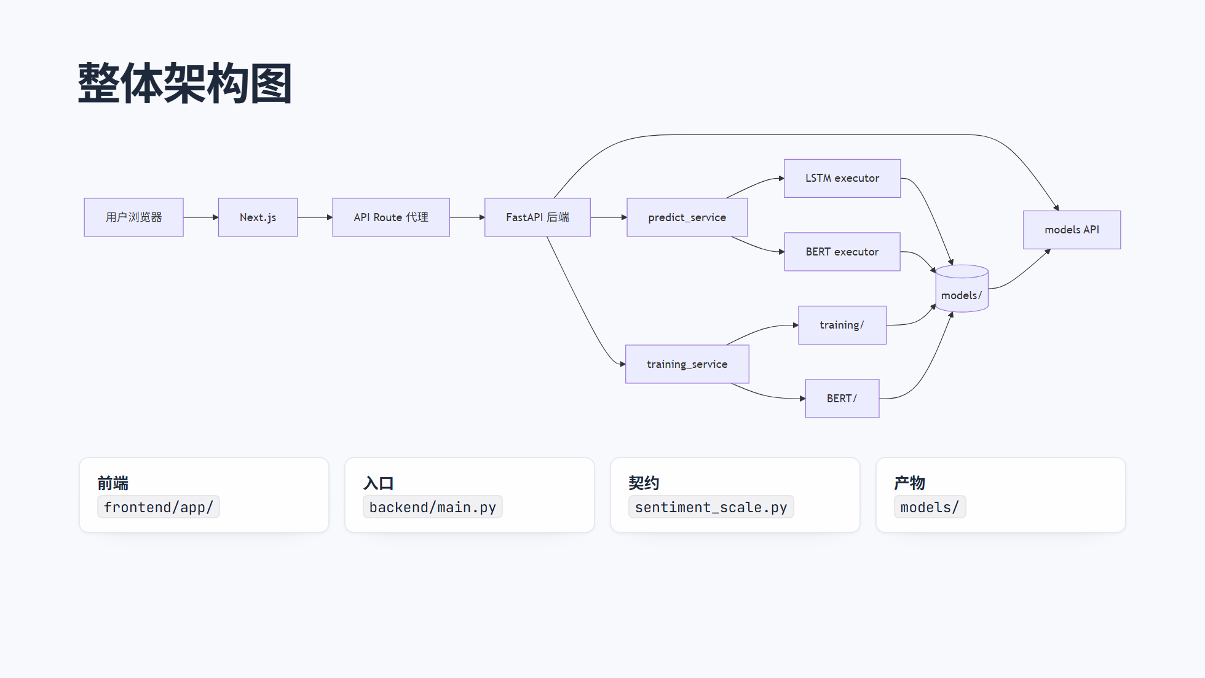
Notes:
============================================================ 0-5 CONTRACT ============================================================

Slide 9
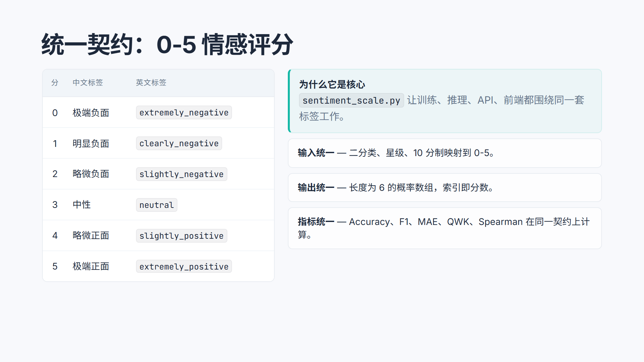
Notes:
============================================================ TWO FLOWS ============================================================

Slide 10
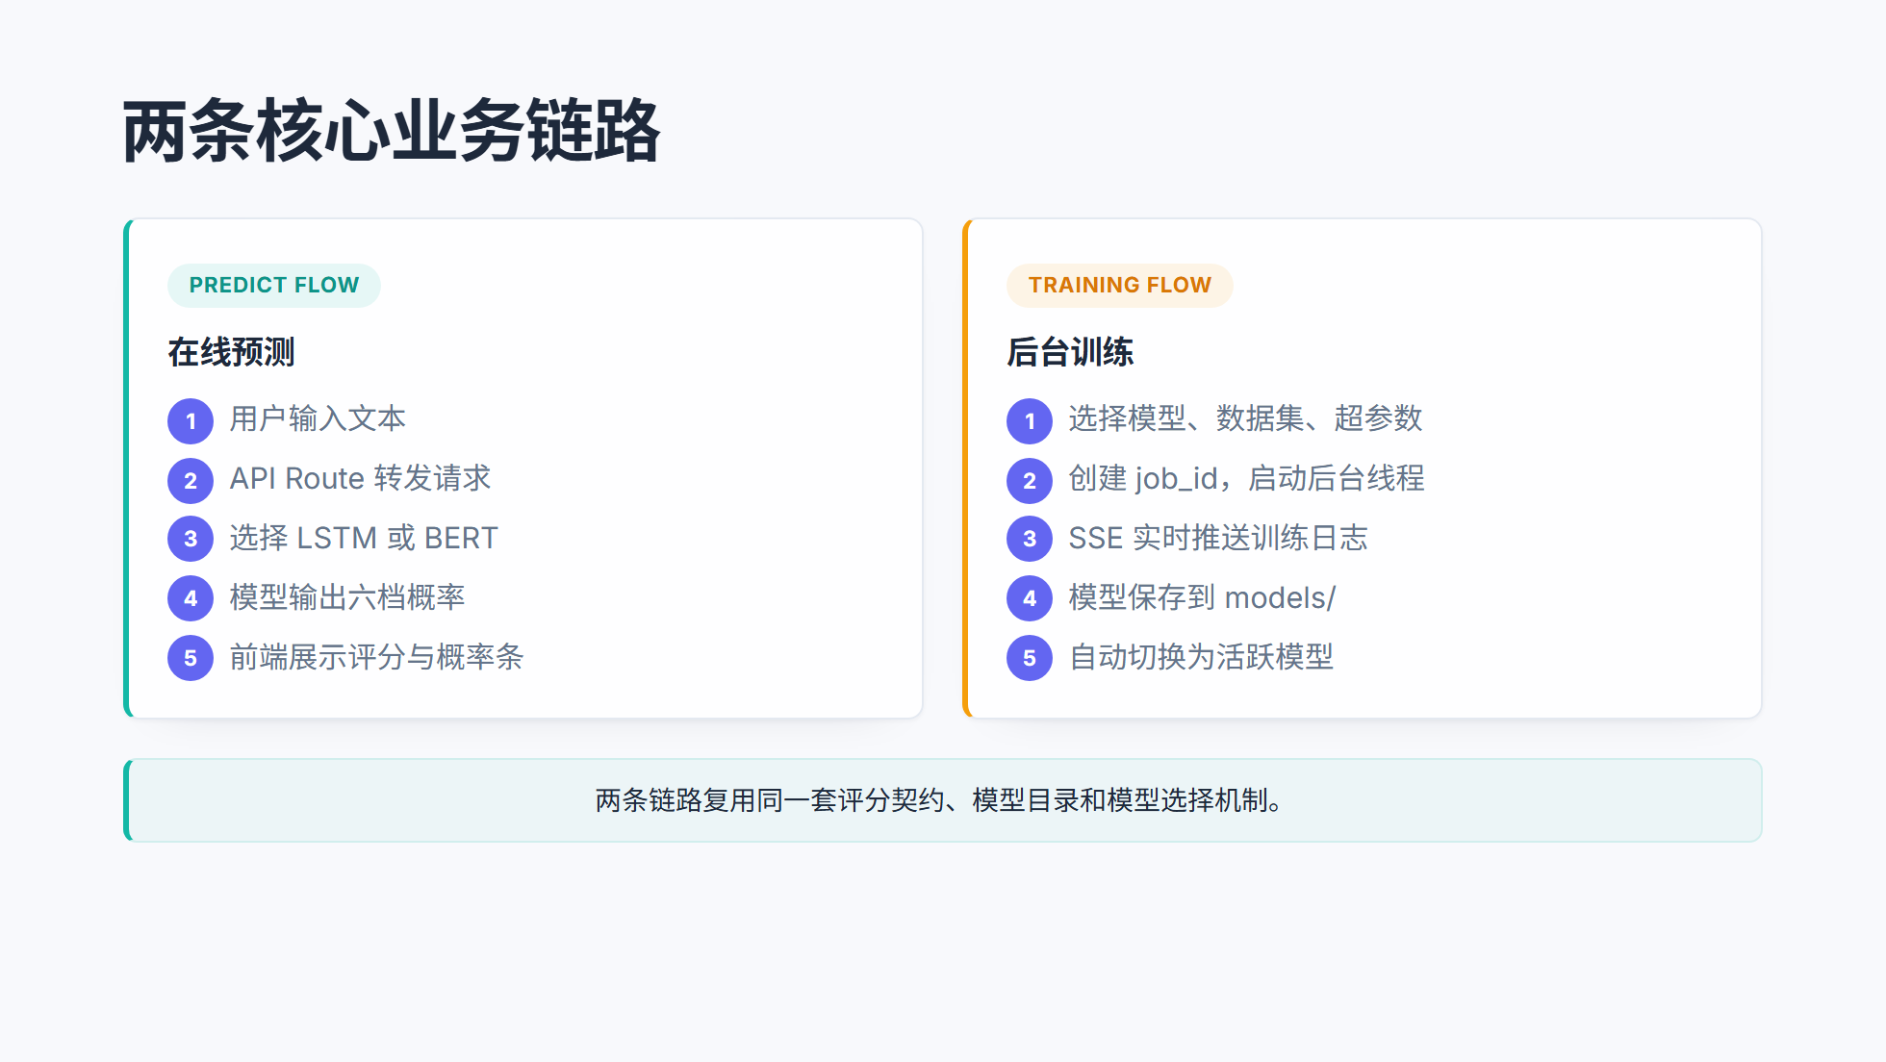
Notes:
============================================================ PREDICT PATH ============================================================

Slide 11
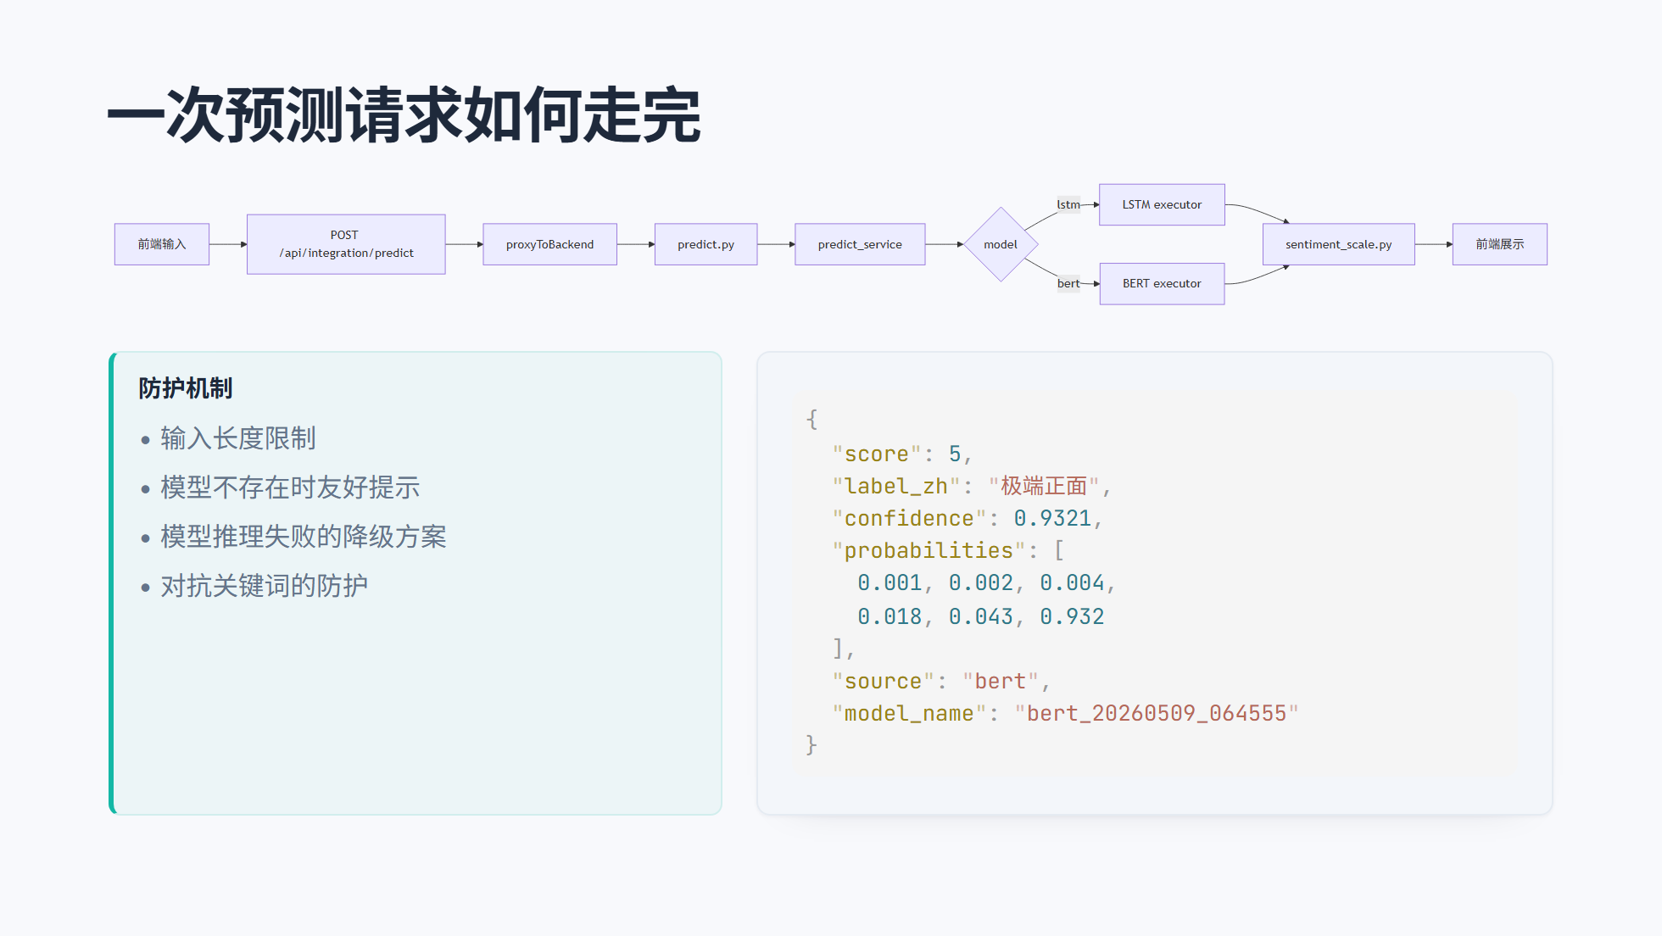
Notes:
============================================================ SECTION 03 ============================================================

Slide 12
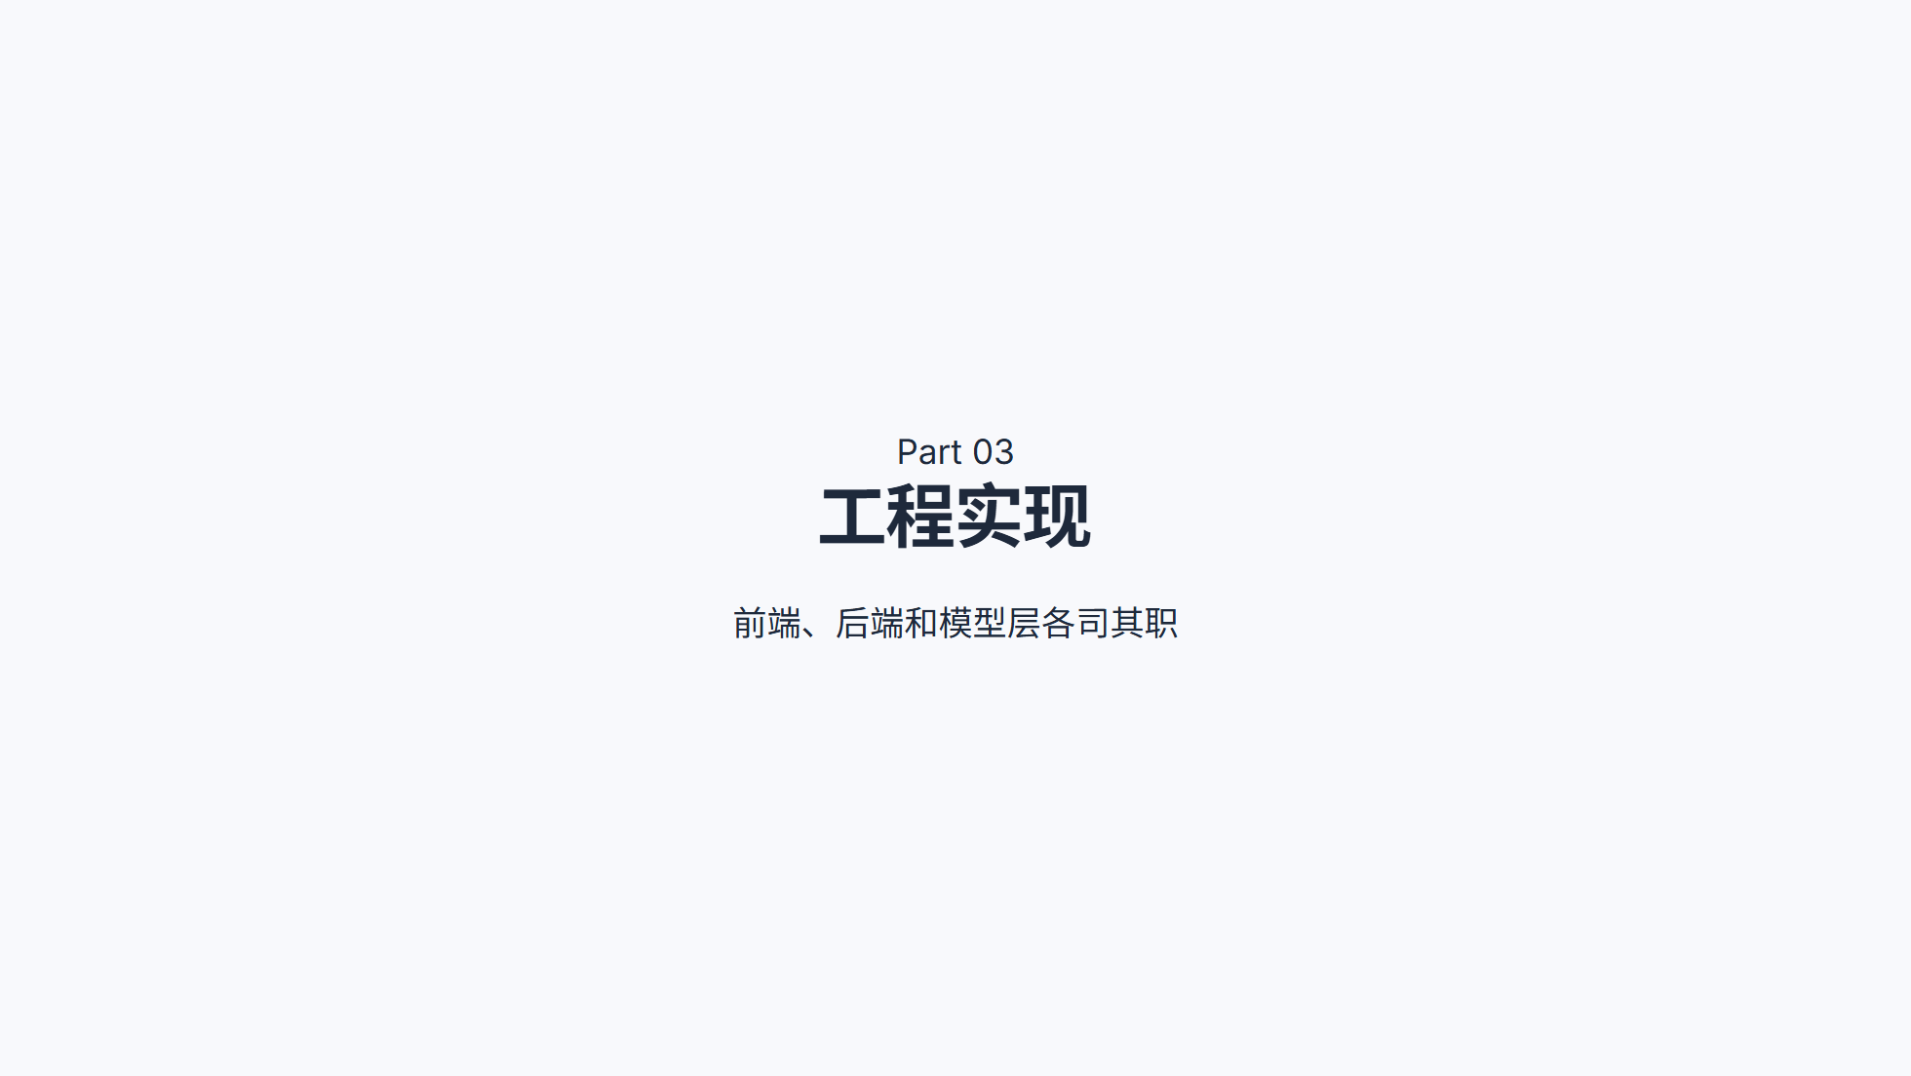
Notes:
============================================================ FRONTEND ============================================================

Slide 13
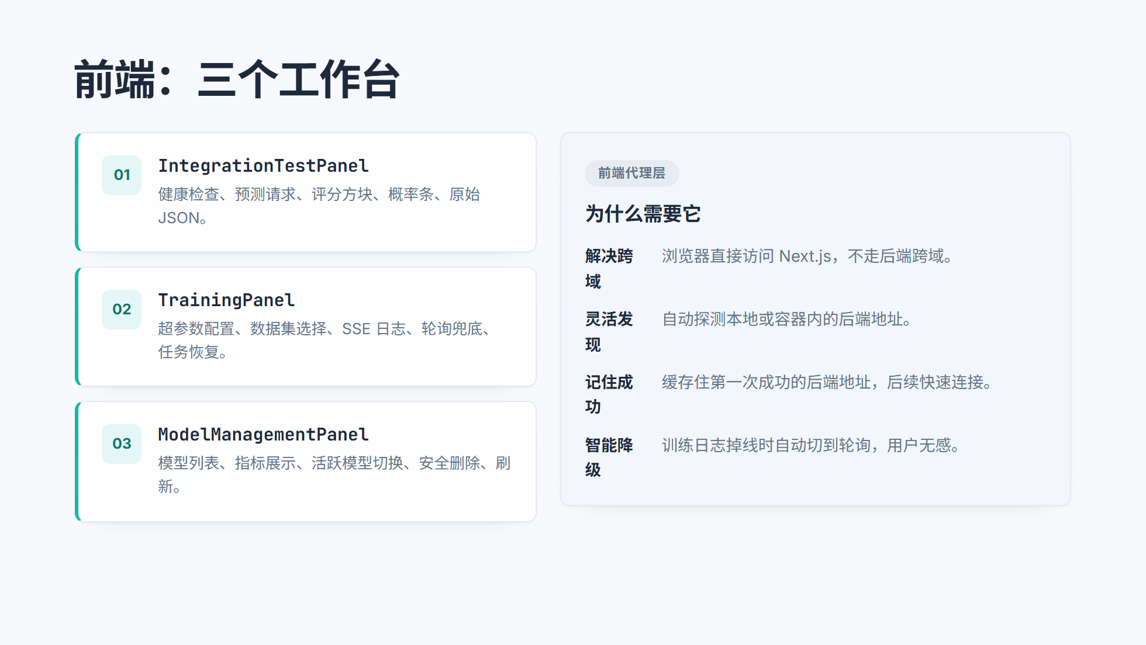
Notes:
============================================================ BACKEND ============================================================

Slide 14
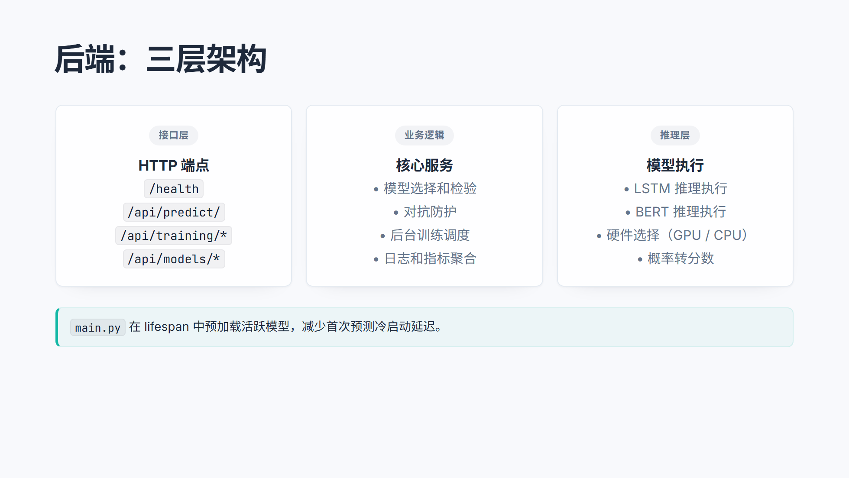
Notes:
============================================================ MODEL MANAGEMENT ============================================================

Slide 15
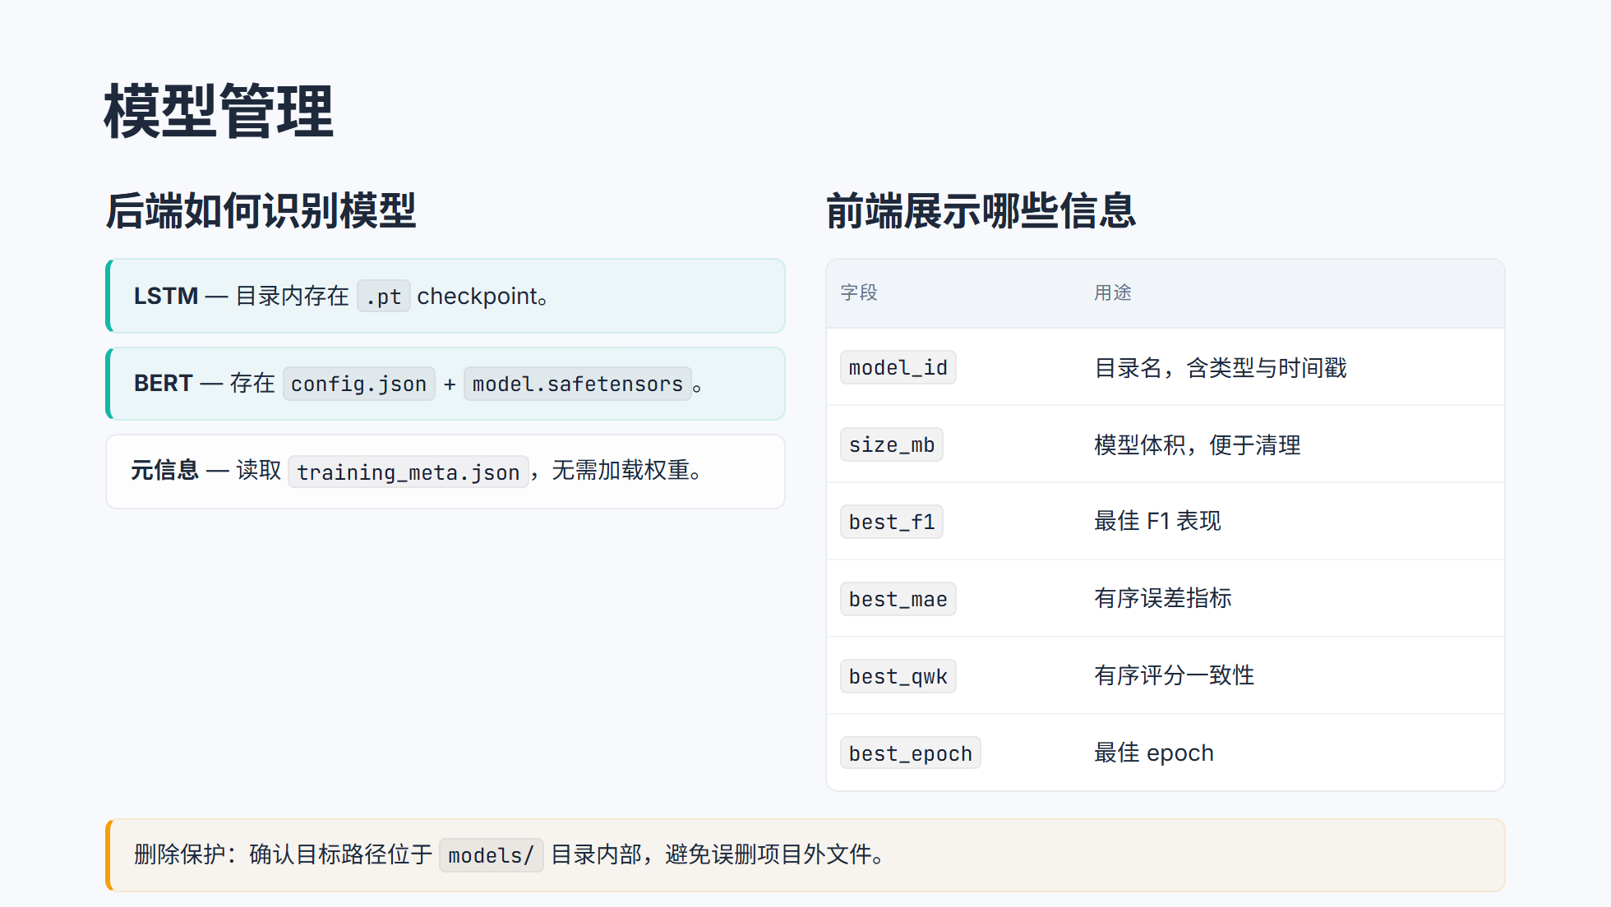
Notes:
============================================================ SECTION 04 ============================================================

Slide 16
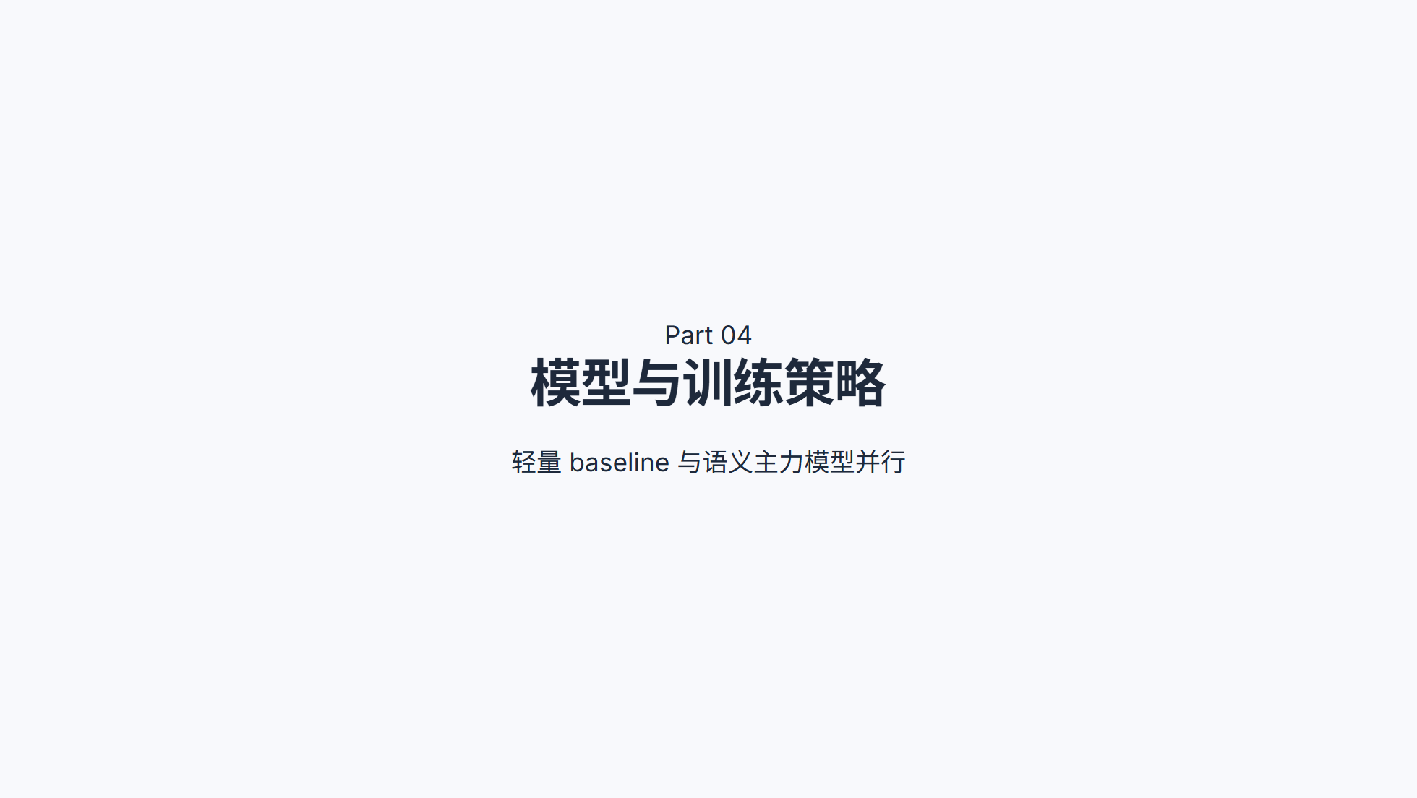
Notes:
============================================================ LSTM ============================================================

Slide 17
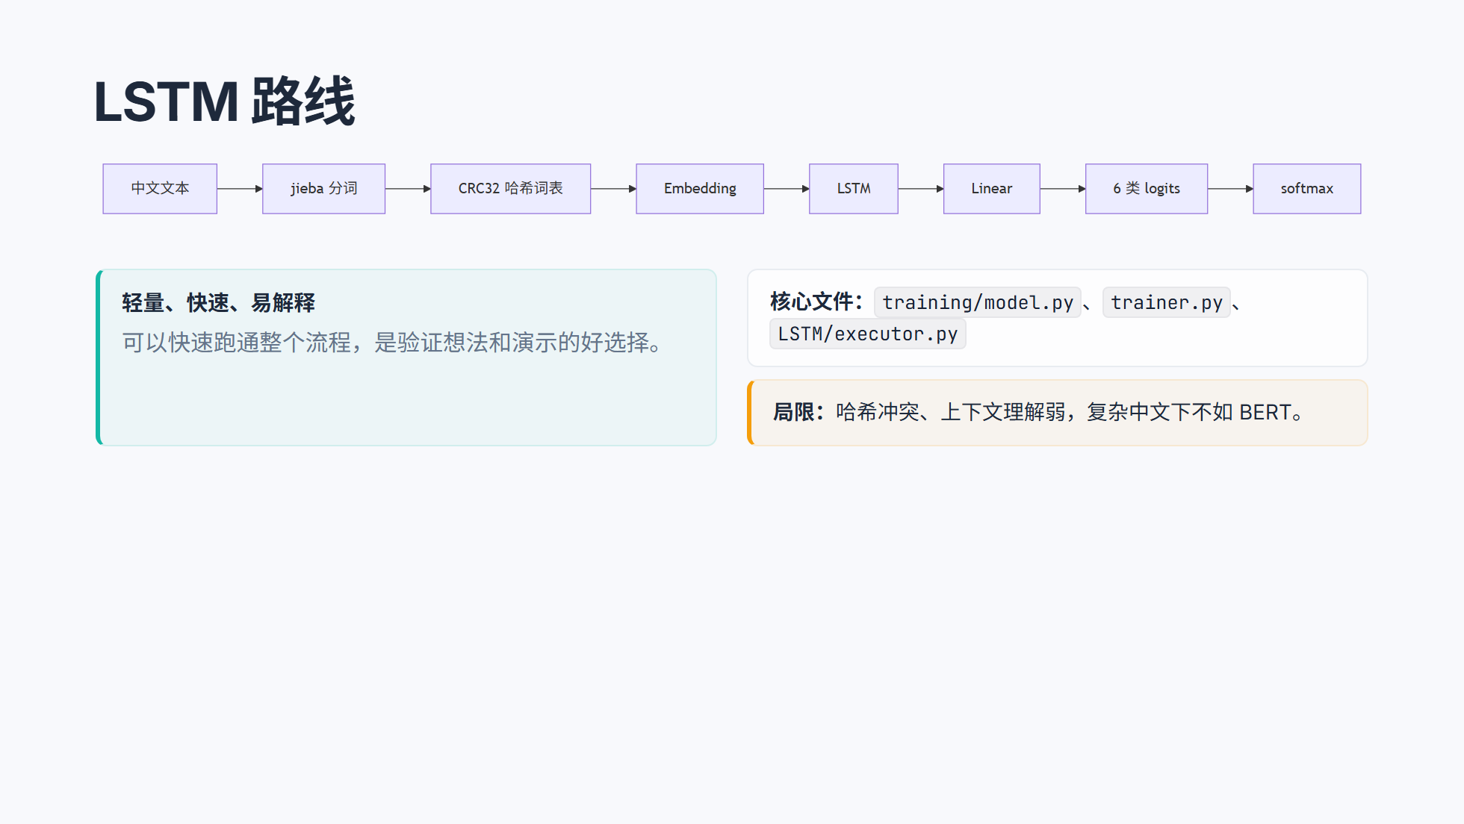
Notes:
============================================================ BERT ============================================================

Slide 18
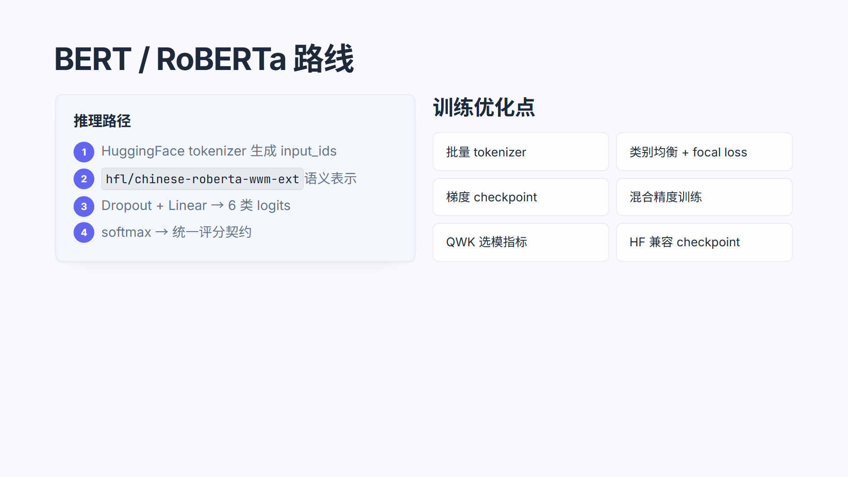
Notes:
============================================================ TEACHER / STUDENT ============================================================

Slide 19
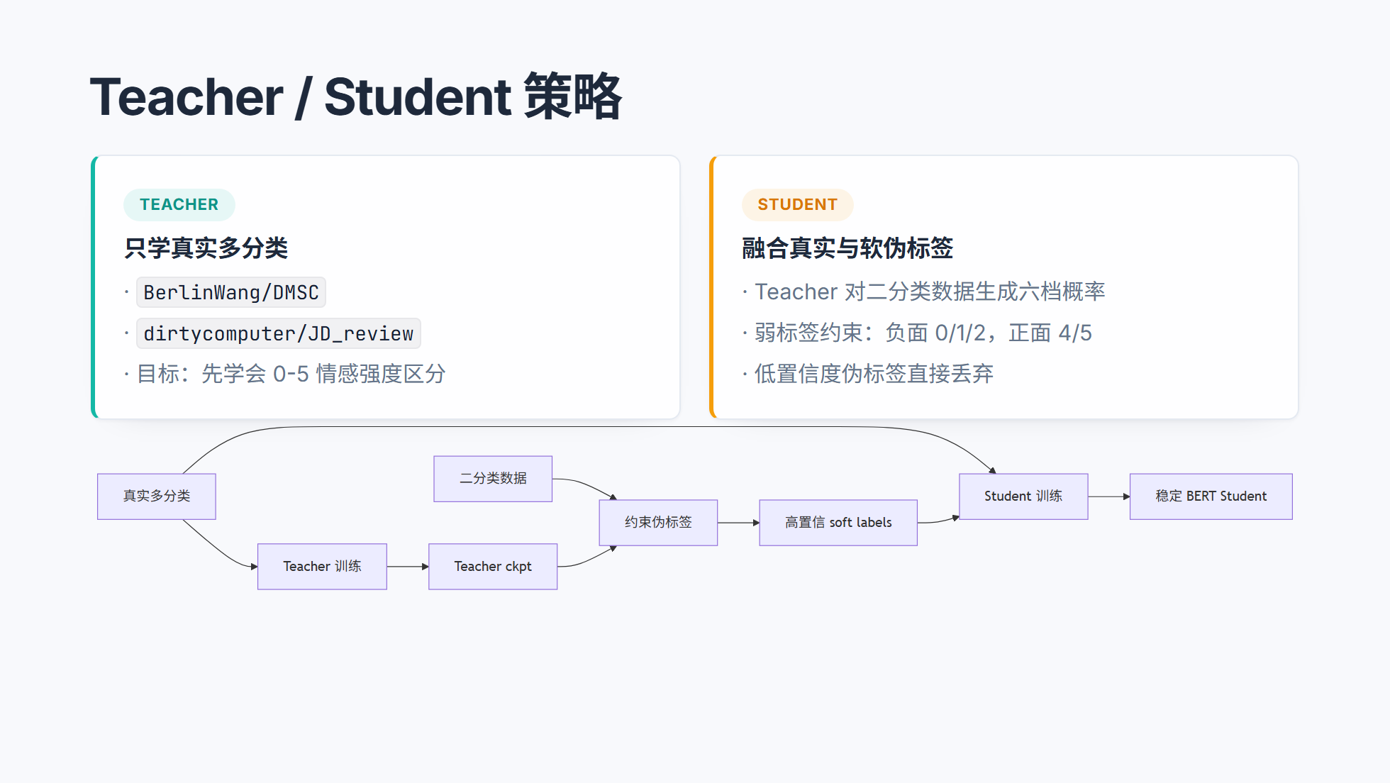
Notes:
============================================================ LOSS & METRICS ============================================================

Slide 20
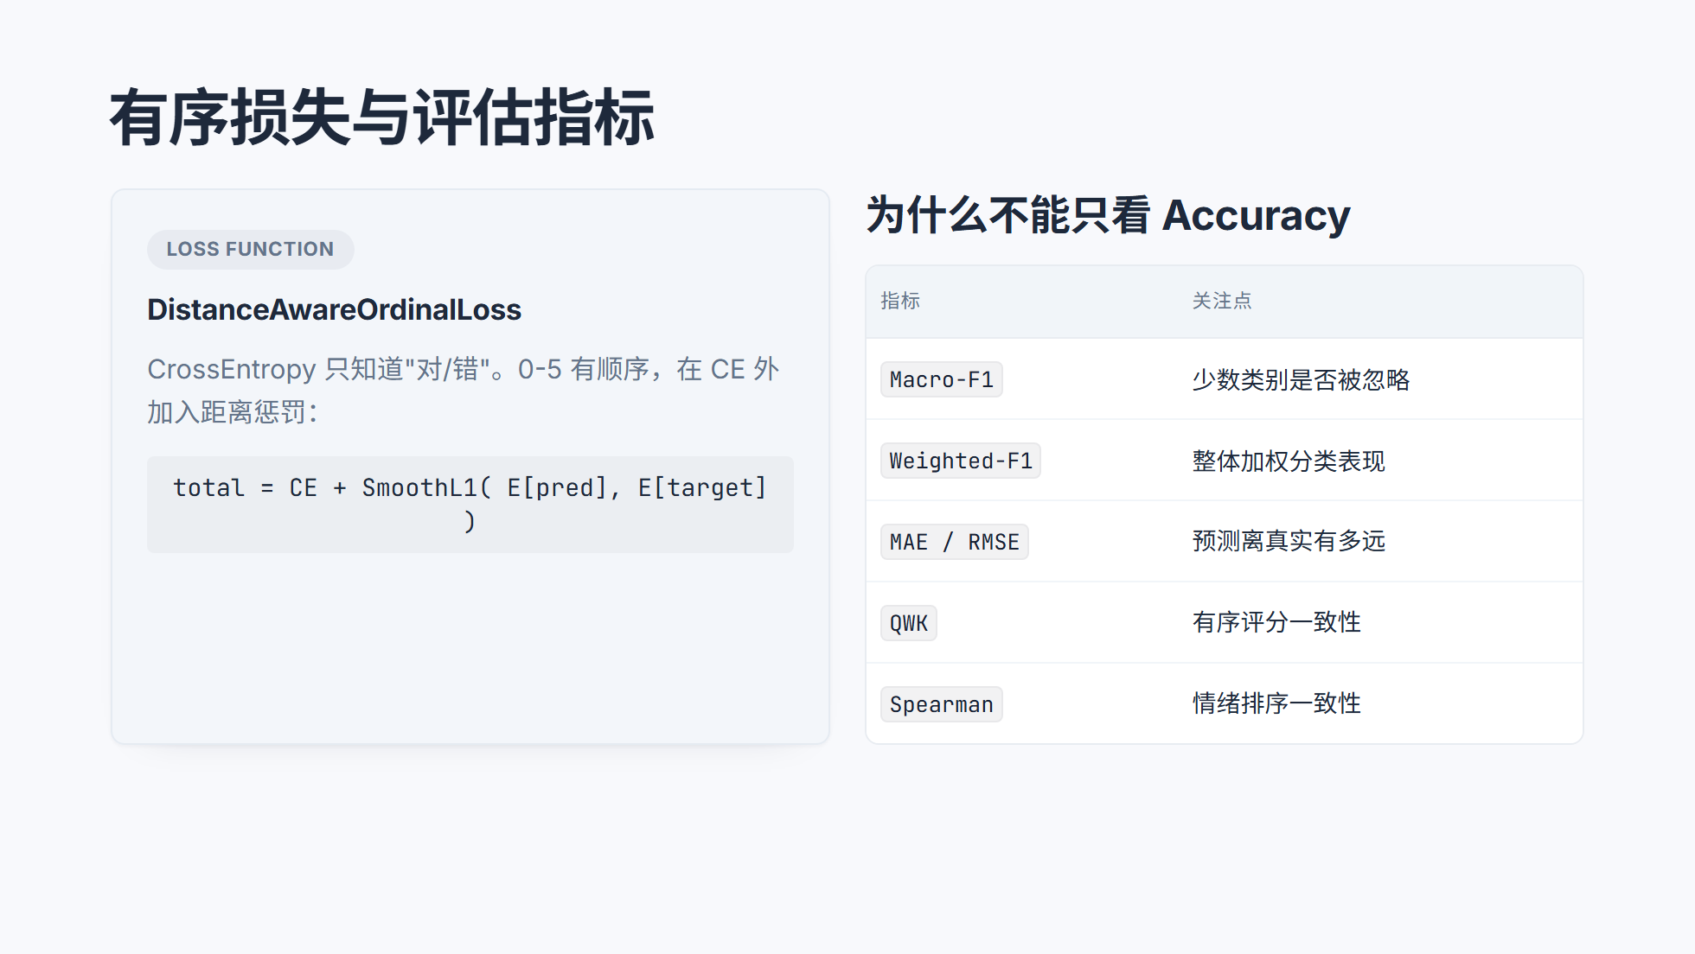
Notes:
============================================================ SECTION 05 ============================================================

Slide 21
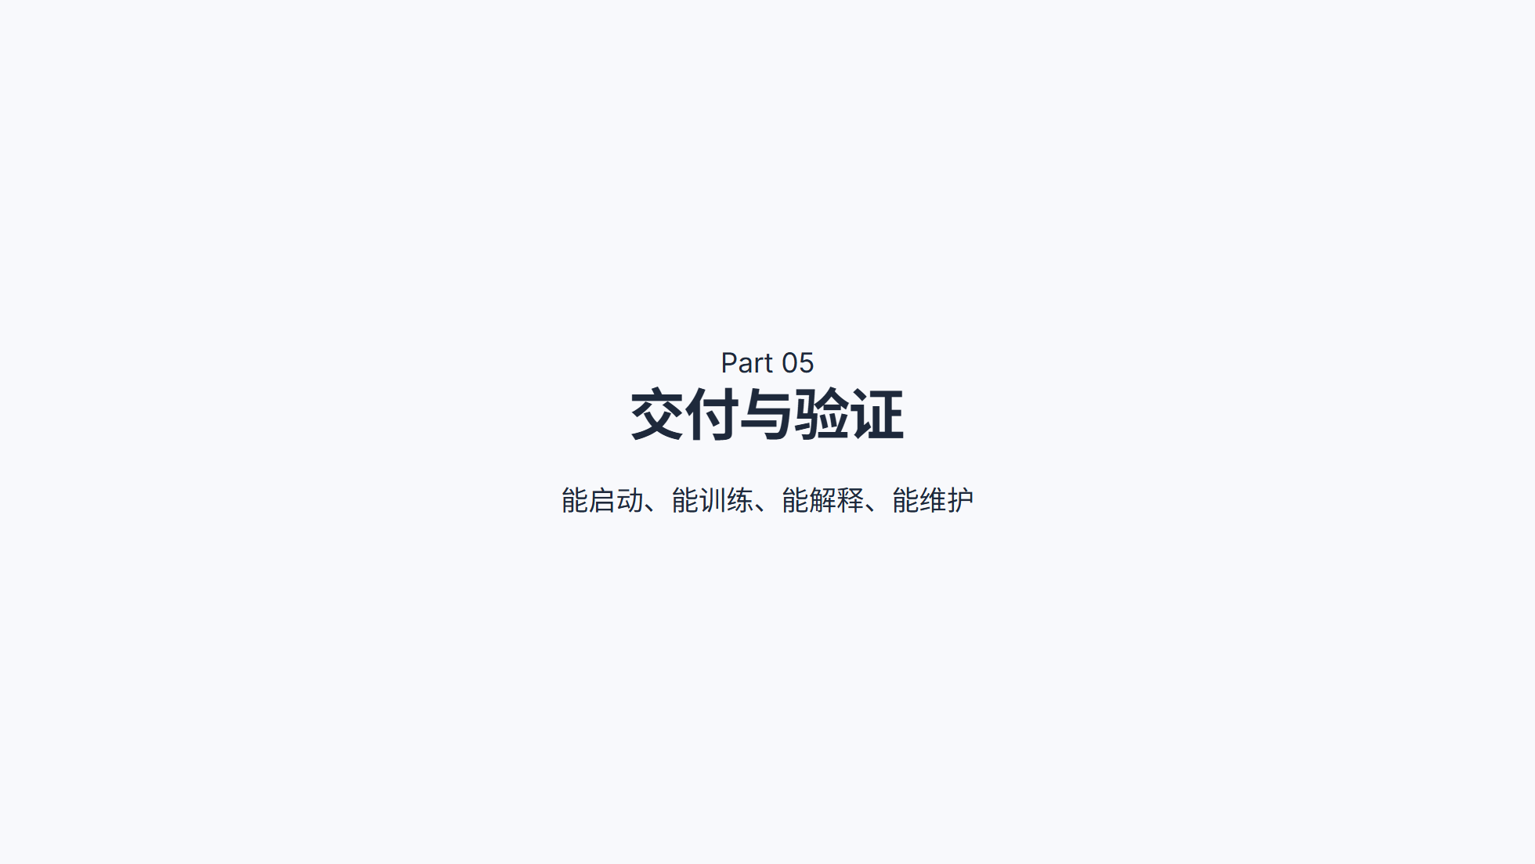
Notes:
============================================================ DEPLOYMENT ============================================================

Slide 22
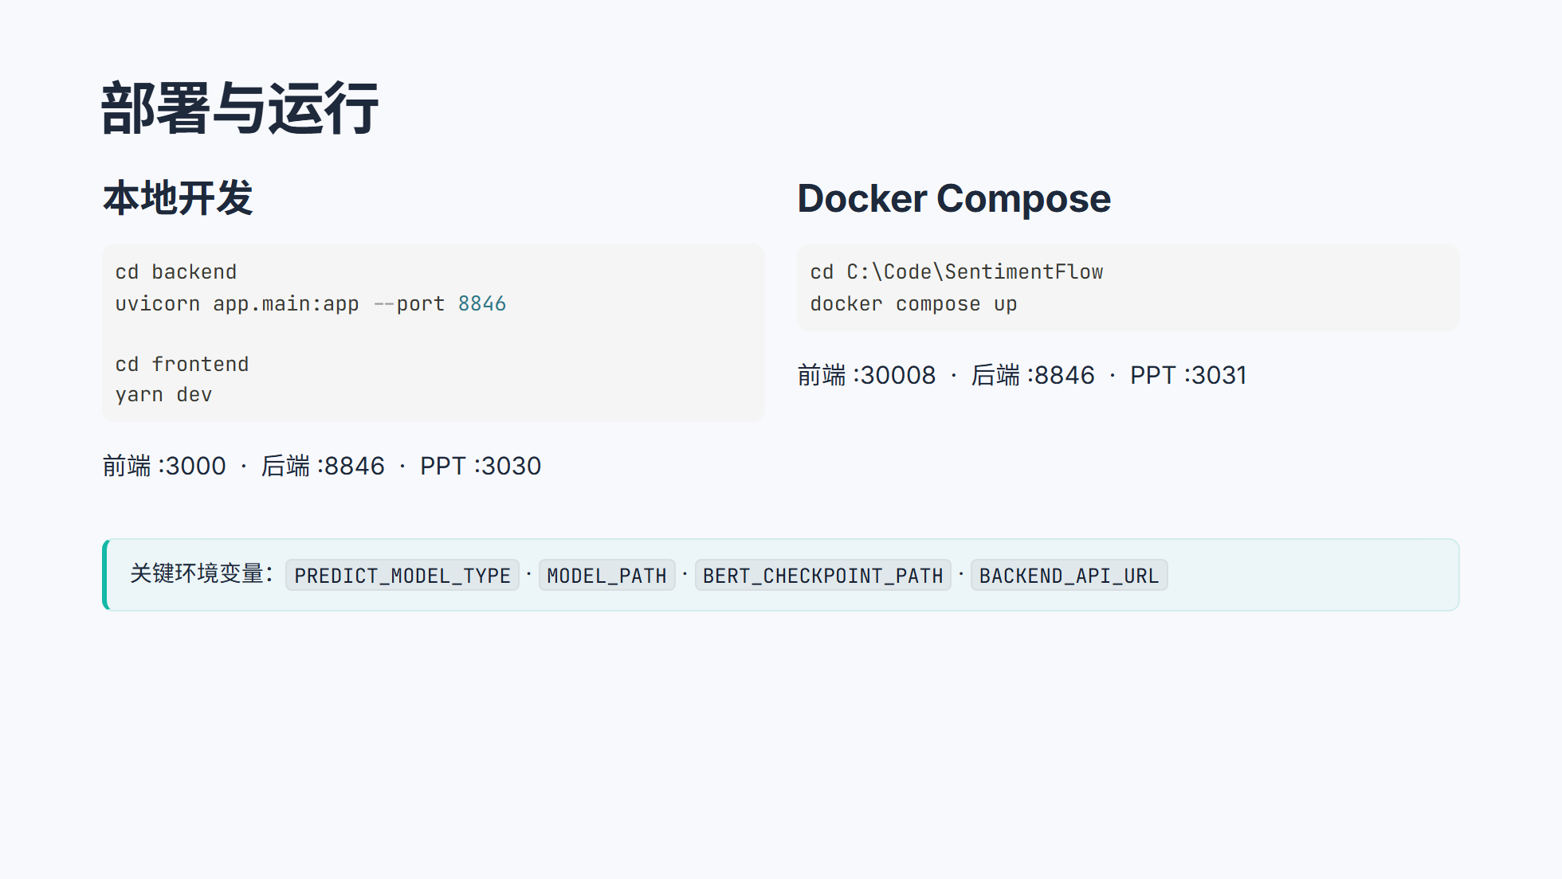
Notes:
============================================================ TESTING & DEMO ============================================================

Slide 23
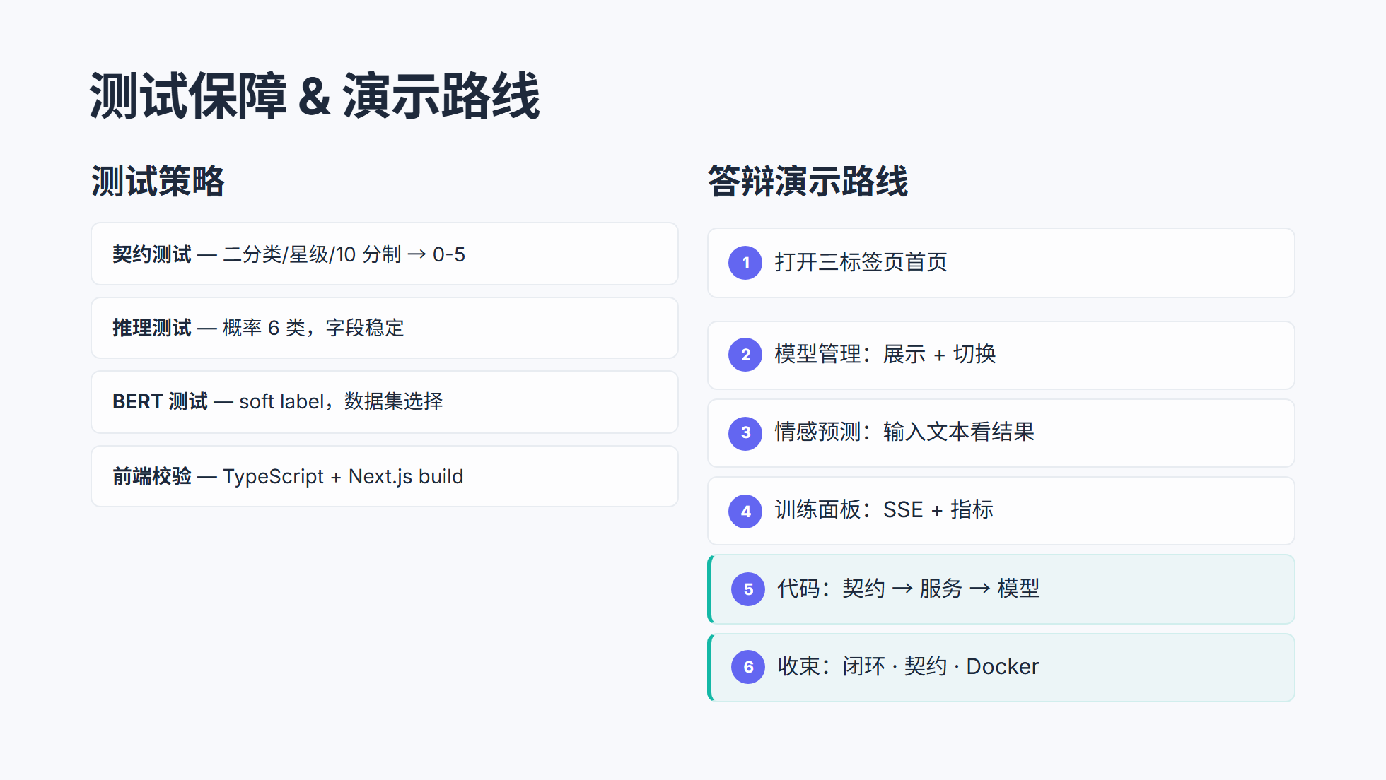
Notes:
============================================================ INTERACTIVE ============================================================

Slide 24
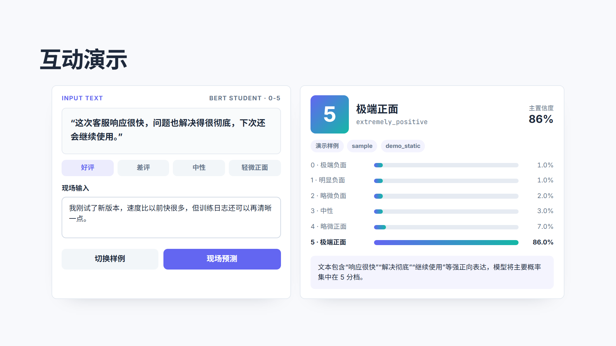
Notes:
============================================================ QUOTE ============================================================

Slide 25
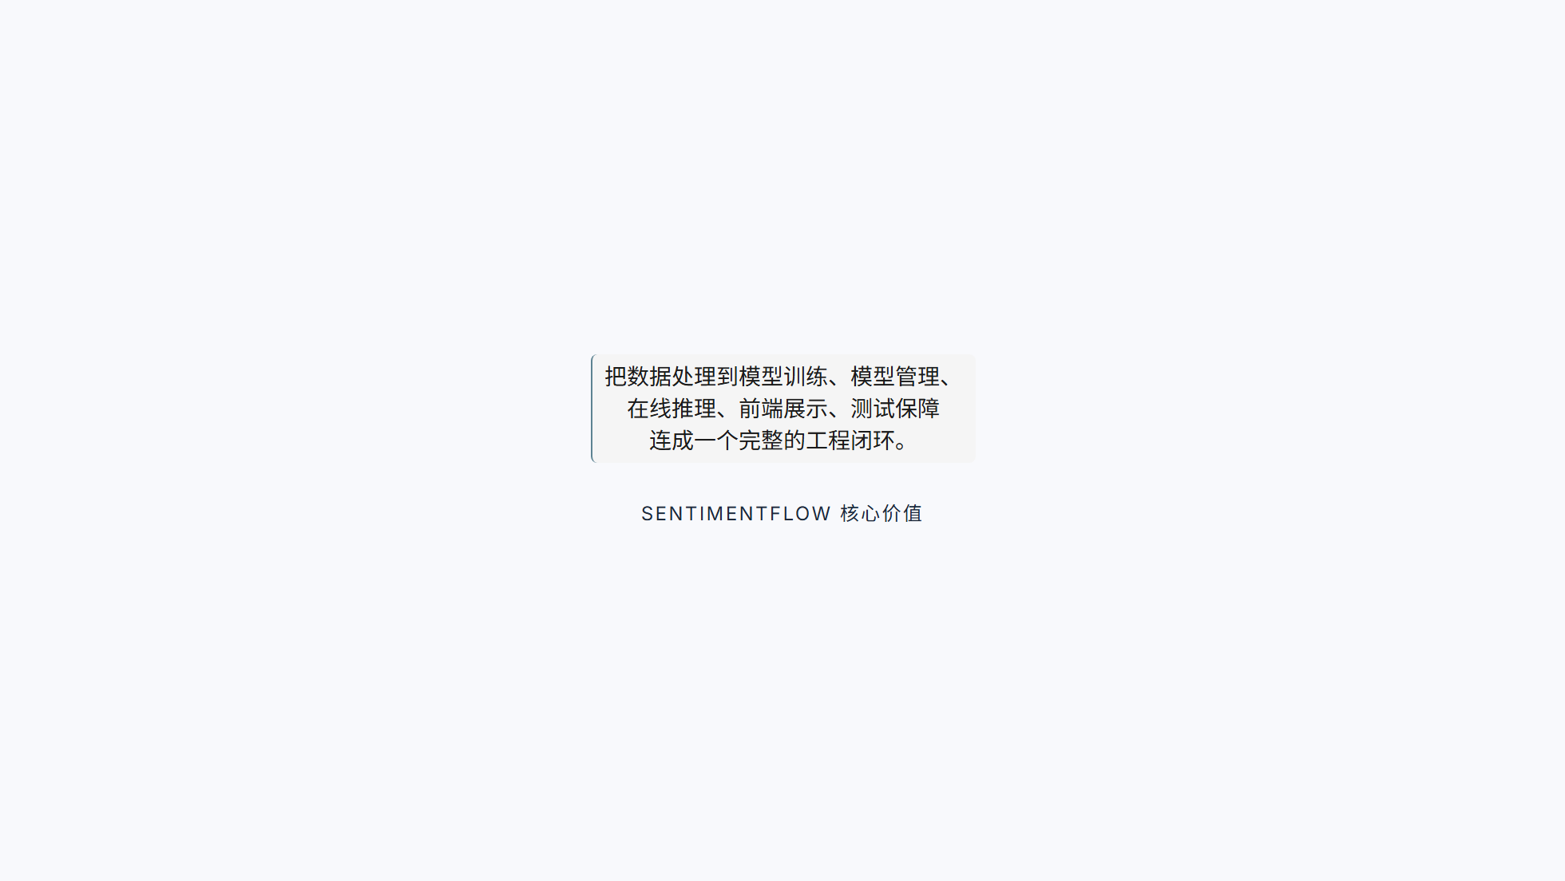
Notes:
============================================================ FUTURE ============================================================

Slide 26
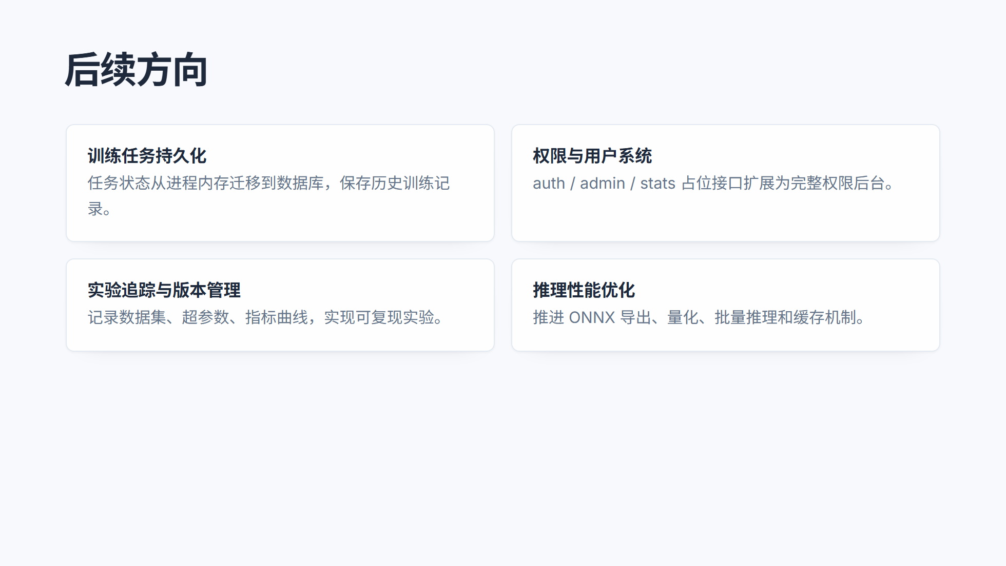
Notes:
============================================================ CLOSING ============================================================

Slide 27


