Slide 1
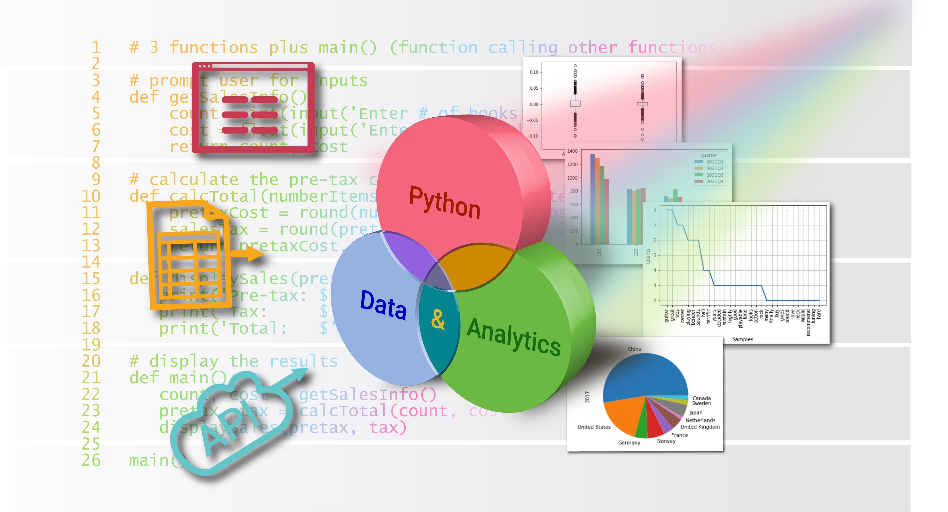
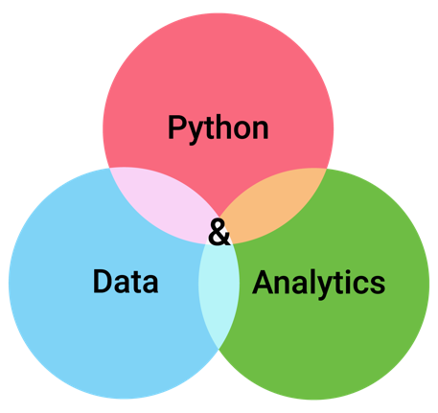

Handling Errors with Exceptions
Appendix D
Python for Data & Analytics
A Business-Oriented Approach
© 2023 Rose River Software, LLC

Slide 2
Topics
About Exceptions
try / except
Exception Types and Multiple Error Handling
finally
Exceptions and Functions

Slide 3
About Exceptions
A Python program may have valid syntax, but hit an error when running
Python Exception framework provides a standard way to generate and handle errors of different kinds
A simple example – what happens if the user enters a word instead of a number in response to the prompt in the below program?
The float() function cannot convert a word to a number, so generates an Exception
Program D-1
userInput = input('Please enter a number: ')
value = float(userInput)
print('Your value was', value)

Slide 4
About Exceptions
Program D-1
userInput = input('Please enter a number: ')
value = float(userInput)
print('Your value was', value)
Please enter a number: Hi
Traceback (most recent call last):
File "/Users/jsmith/Documents/John/program/EnterNumber.py", line 2, in <module>
value = float(userInput)
ValueError: could not convert string to float: 'hello'
The error message indicates the issue occurred on line 2, since the float() function is not able to convert 'Hi' to a number
Since the program does not handle the error, it stops running

Slide 5
try / except
Python keywords try and except let you anticipate a runtime error and handle it if it occurs
In the program below, if the user enters non-numeric input, the program will jump from the call to float to the code under except
Program D-2
userInput = input('Please enter a number: ')
try:
value = float(userInput)
print('Your value was', value)
except:
print('Error: non-numeric value entered')

Slide 6
Exception Types and Multiple Error Handling
An exception has a specific type
There are over 50 different built-in exception types
You can indicate a specific exception type in the except statement
Program D-3
userInput = input('Please enter a number: ')
try:
value = float(userInput)
print('Your value was', value)
except ValueError:
print('Error: non-numeric value entered')
except Exception as err:
print('Error:', err)

Slide 7
finally
To provide statements that execute whether or not there was an error in the try block, use finally
Can use for "clean-up" logic, for example when working with files or databases
Program D-4
userInput = input('Please enter a number: ')
try:
value = float(userInput)
print('Your value was', value)
except:
print('Error: non-numeric value entered')
finally:
print('Program ends')

Slide 8
Exceptions and functions
The raise keyword is used to indicate an error has occurred, by generating an Exception
This is done in built-in functions (e.g., float())
You can use raise in functions you write
Functions provide:
normal results via return
error results via raise
def mathFunc(numParam):
if not isinstance(numParam, (int, float)):
raise ValueError("mathFunc parameter must be a number")
# additional processing below (not shown)

Slide 9
Topic Recap
About Exceptions
try / except
Exception Types and Multiple Error Handling
finally
Exceptions and Functions

Slide 10
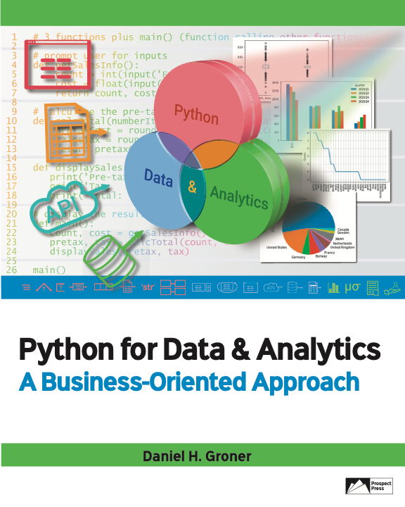
© 2023 Rose River Software, LLC
All rights reserved. This material may not be copied or distributed without permission from Prospect Press

