Slide 1
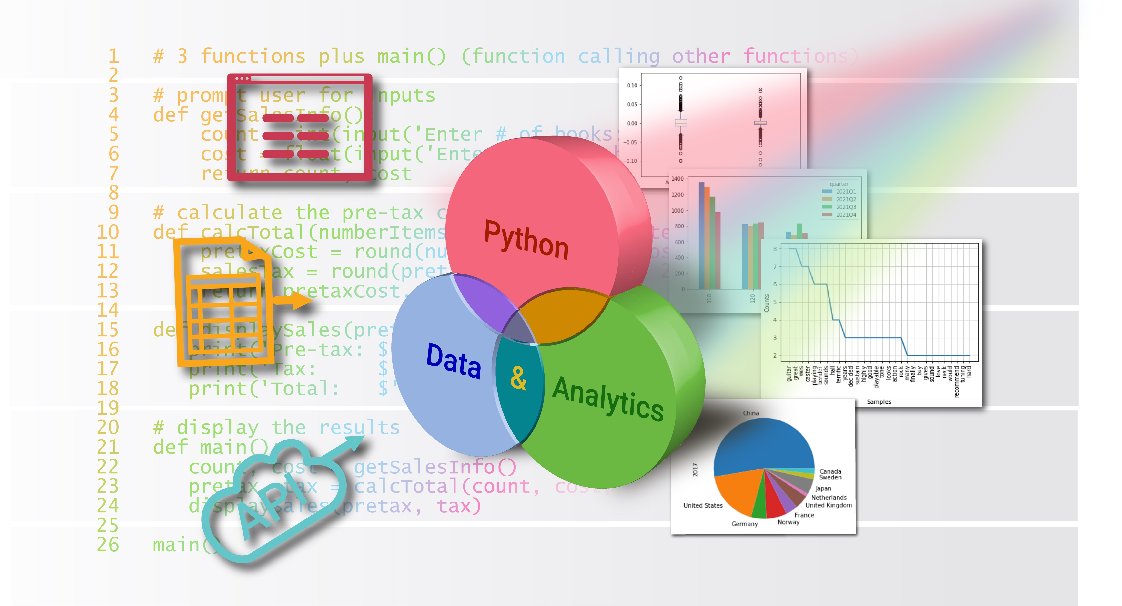
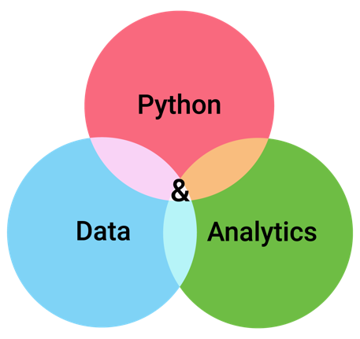
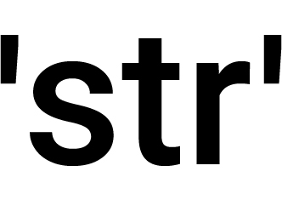

Strings in Detail
Chapter 8
Python for Data & Analytics
A Business-Oriented Approach
© 2023 Rose River Software, LLC

Slide 2
Topics
String basics recap
Substrings (slicing)
Searching parts of strings
Methods that return string variations
Checking strings

Slide 3
Topics
String basics recap
Substrings (slicing)
Searching parts of strings
Methods that return string variations
Checking strings

Slide 4
String basics recap
name = input('Please enter your name: ')
print('Hi', name)
A string constant (string literal), in above: 'Hi'
A string variable in above is name
A string contains a sequence of characters
Square brackets can be used to access a character
if s = 'Hello' then s[0] is 'H'
Strings are immutable, you can't use s[0] = 'h'
But you can reset a string variable, e.g., s = 'hello'
The empty string is a string with no characters
s = '' # two adjacent apostrophes
The input() function always returns a string

Slide 5
String basics recap
+ can be used to join (concatenate) strings
+= can be used to append one string to another
int() and float() can convert strings containing numbers to numbers
str() can be used to convert numbers (and other types) to strings
Useful for concatenating numbers with strings
format() can be used to convert a number to a formatted string

Slide 6
String basics recap
Strings can be compared for equality (same sequence of characters) with ==
Compare for inequality with !=
Other string comparisons: < > <= >=
Strings have an order based on the ASCII table values
range | characters
0-31 | special characters: e.g., tab, backspace
32 | space
33-47 | symbols1: ! “ # $ % & ' ( ) * + , - . /
48-57 | digits: 0, 1, …, 9
58-64 | symbols2: : ; < = > ? @
65-90 | uppercase letters: A, B, …, Z
91-96 | symbols3: [ \ ] ^ _ `
97-122 | lowercase letters: a, b, …, z
123-126 | symbols4: { | } ~
127 | DEL

Slide 7

String basics recap
Program 8-1
# Simple text processor with assignment and concatenation
text = '' # initialize as empty string
entry = input('> ') # input() returns a string
while entry != '': # string compare
command = entry[0] # character access
if command == '=': text = input('>> ') # assignment
elif command == '+': text += input('>> ') # concatenation
elif command == '-': text = '' # reset to empty string
print(text)
entry = input('> ')
> =
>> Python is great
Python is great
> +
>> for working with strings.
Python is great for working with strings.
>

Slide 8
String basics recap
Spreadsheet Compare/Contrast: Spreadsheet Text
In spreadsheets, text can be entered in cells, and these are similar to string literals in programs
As well, spreadsheets have built-in functions for working with text, and these are similar to some of the string methods that will be covered in this chapter
As we'll see, Python can be more concise when working with strings

Slide 9
Topics
String basics recap
Substrings (slicing)
Searching parts of strings
Methods that return string variations
Checking strings

Slide 10
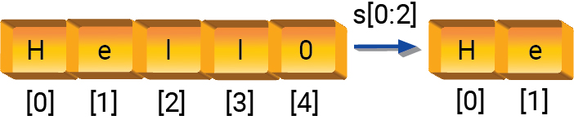
Substrings (slicing)
Python slicing generates substrings
Slicing syntax same as lists: s[i:j] will create a string starting at the i'th character and ending with the character just before the j'th character
Slicing doesn't alter the original string
If the slice position before the colon is omitted, then 0 is used
s[:j] creates a string from the substring of s starting at its beginning and up to position j-1
s[i:] creates a string from the substring of s, starting at i and up to end

Slide 11
Substrings (slicing)
Program 8-2
# Simple text processor with slicing
text = ''
entry = input('> ')
while entry != '':
command = entry[0]
if command == '+': text += entry[1:] # slice and concatenate
elif command == '-': text = ''
else: text = entry
print(text)
entry = input('> ')
Slice of a string
> =
>> Python is great
Python is great
> +
>> for working with strings.
Python is great for working with strings.
>

Slide 12
Topics
String basics recap
Substrings (slicing)
Searching parts of strings
Methods that return string variations
Checking strings

Slide 13
Searching parts of strings
expression | description
s.startswith(t) | returns True if s starts with the string t
s.endswith(t) | returns True if s ends with the string t
s.find(t) | returns the position of the first occurrence of t in s, or -1 if there is none
s.rfind(t) | return the position of the last occurrence of t in s, or -1 if there is none
s.count(t) | return the number of occurrences of t in s
t in s | returns True if t occurs in s
t not in s | returns True is t does not occur in s

Slide 14
Searching parts of strings
Program 8-3
# Simple text processor to demonstrate some string features
text = ''
entry = input('> ')
while entry != '':
display = False
command = entry[0]
if command == '+':
text += entry[1:] # slice and concatenate
display = True
elif command == '-':
text = '' # reset to empty string
elif command == '?':
print(entry[1:] in text) # search
elif command == '#':
print(text.count(entry[1:])) # count
else:
text = entry
if display:
print(text)
entry = input('> ')
These are example statements that search for parts of strings
> =
>> Python is great
Python is great
> +
>> for working with strings.
Python is great for working with strings.
>
> ?Python
True
> #in
2
>

Slide 15
Topics
String basics recap
Substrings (slicing)
Searching parts of strings
Methods that return string variations
Checking strings

Slide 16
Methods that return string variations
These methods return a new string (doesn't change the original string)
category | method | description
strip | s.strip() | Remove leading and trailing whitespace
 | s.lstrip() | Remove leading whitespace
 | s.rstrip() | Remove trailing whitespace
case | s.upper | Convert letters to uppercase
 | s.lower() | Convert letters to lowercase
first letter | s.title() | Capitalize the first letter of each word
 | s.capitalize() | Capitalize the first letter
justification | s.center() | Center the string
 | s.ljust() | Left justify
 | s.rjust() | Right justify
replace | s.replace(old, new) s.replace(old, new, count) | Replace occurrences of old with new; if count is provided, limit to that many replacements

Slide 17
Methods that return string variations
Program 8-4
# Simple text processor to demonstrate some string features
text = ''
entry = input('> ')
while entry != '':
display = False
command = entry[0]
if command == '+':
text += entry[1:] # slice and concatenate
display = True
elif command == '-':
text = ''
elif command == '?':
print(entry[1:] in text) # search
elif command == '#':
print(text.count(entry[1:])) # count
elif command == '^':
text = text.upper() # uppercase and reset
display = True
elif command == '/':
fields = entry.split('/') # parse entry from string to list of strings
if len(fields) == 3:
text = text.replace(fields[1], fields[2]) # replace
display = True
else:
text = entry
if display:
print(text)
entry = input('> ')
These are example methods that return variations
> Python is great for working with strings.
> /great/excellent
Python is excellent for working with strings.
> ^
PYTHON IS EXCELLENT FOR WORKING WITH STRINGS.
>

Slide 18
Methods that return string variations
Methods don't directly change strings
The Python string methods covered in this section return a variation of the string
However, these methods don't directly change the string
If you use a statement like
s.lower()
the value of s is unchanged, even though you intended for the string to be changed to lowercase
Instead, make sure you use a statement like:
s = s.lower()
in order to update the variable

Slide 19
Topics
String basics recap
Substrings (slicing)
Searching parts of strings
Methods that return string variations
Checking strings

Slide 20
Checking strings
There are several methods to check if a string fits a certain pattern
Each of these return True or False
method | description
isalnum() | are all characters letters or digits?
isalpha() | are all characters letters?
isdigit() | are all characters digits (0, 1, …, 9)?
isidentifier() | is the string a valid Python identifier, e.g., could it be used as a variable name?
islower() | are the characters lowercase letters (a, b, …, z)?
isspace() | are the characters all whitespace characters?
isupper() | are the characters uppercase letters (A, B, …, Z)?

Slide 21
Topic Recap
String basics recap
Substrings (slicing)
Searching parts of strings
Methods that return string variations
Checking strings

Slide 22
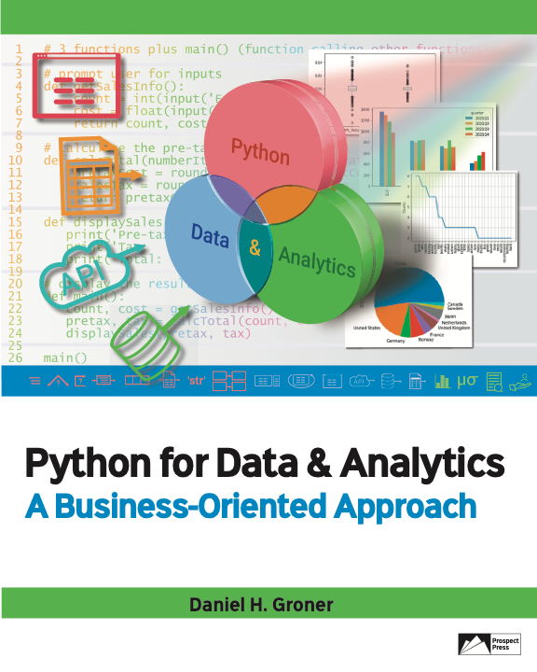
© 2023 Rose River Software, LLC
All rights reserved. This material may not be copied or distributed without permission from Prospect Press

