Slide 1
Types of Programs
Compile once, run once
Code
Compiler
Machine Code
Specific OS & Hardware
C/C++
Produces executable
01010010101001010
Compile once, run anywhere
Java/C# .Net
Code
Compiler
Intermediate Language
Run Time
Operating System
Byte Code/MSIL
No compiler!
JavaScript
Code
Interpreter
JavaScript Engine
Operating System

Slide 2
Types of Languages
Languages
Strongly Typed
Weekly Typed
Java/C# .Net
JavaScript

Slide 3

JavaScript History
Created in 1995 for Netscape 2
Handed off to ECMA (European Computer Manufacturer's Association)
Created in 10 days
AKA ECMA Script

Slide 4
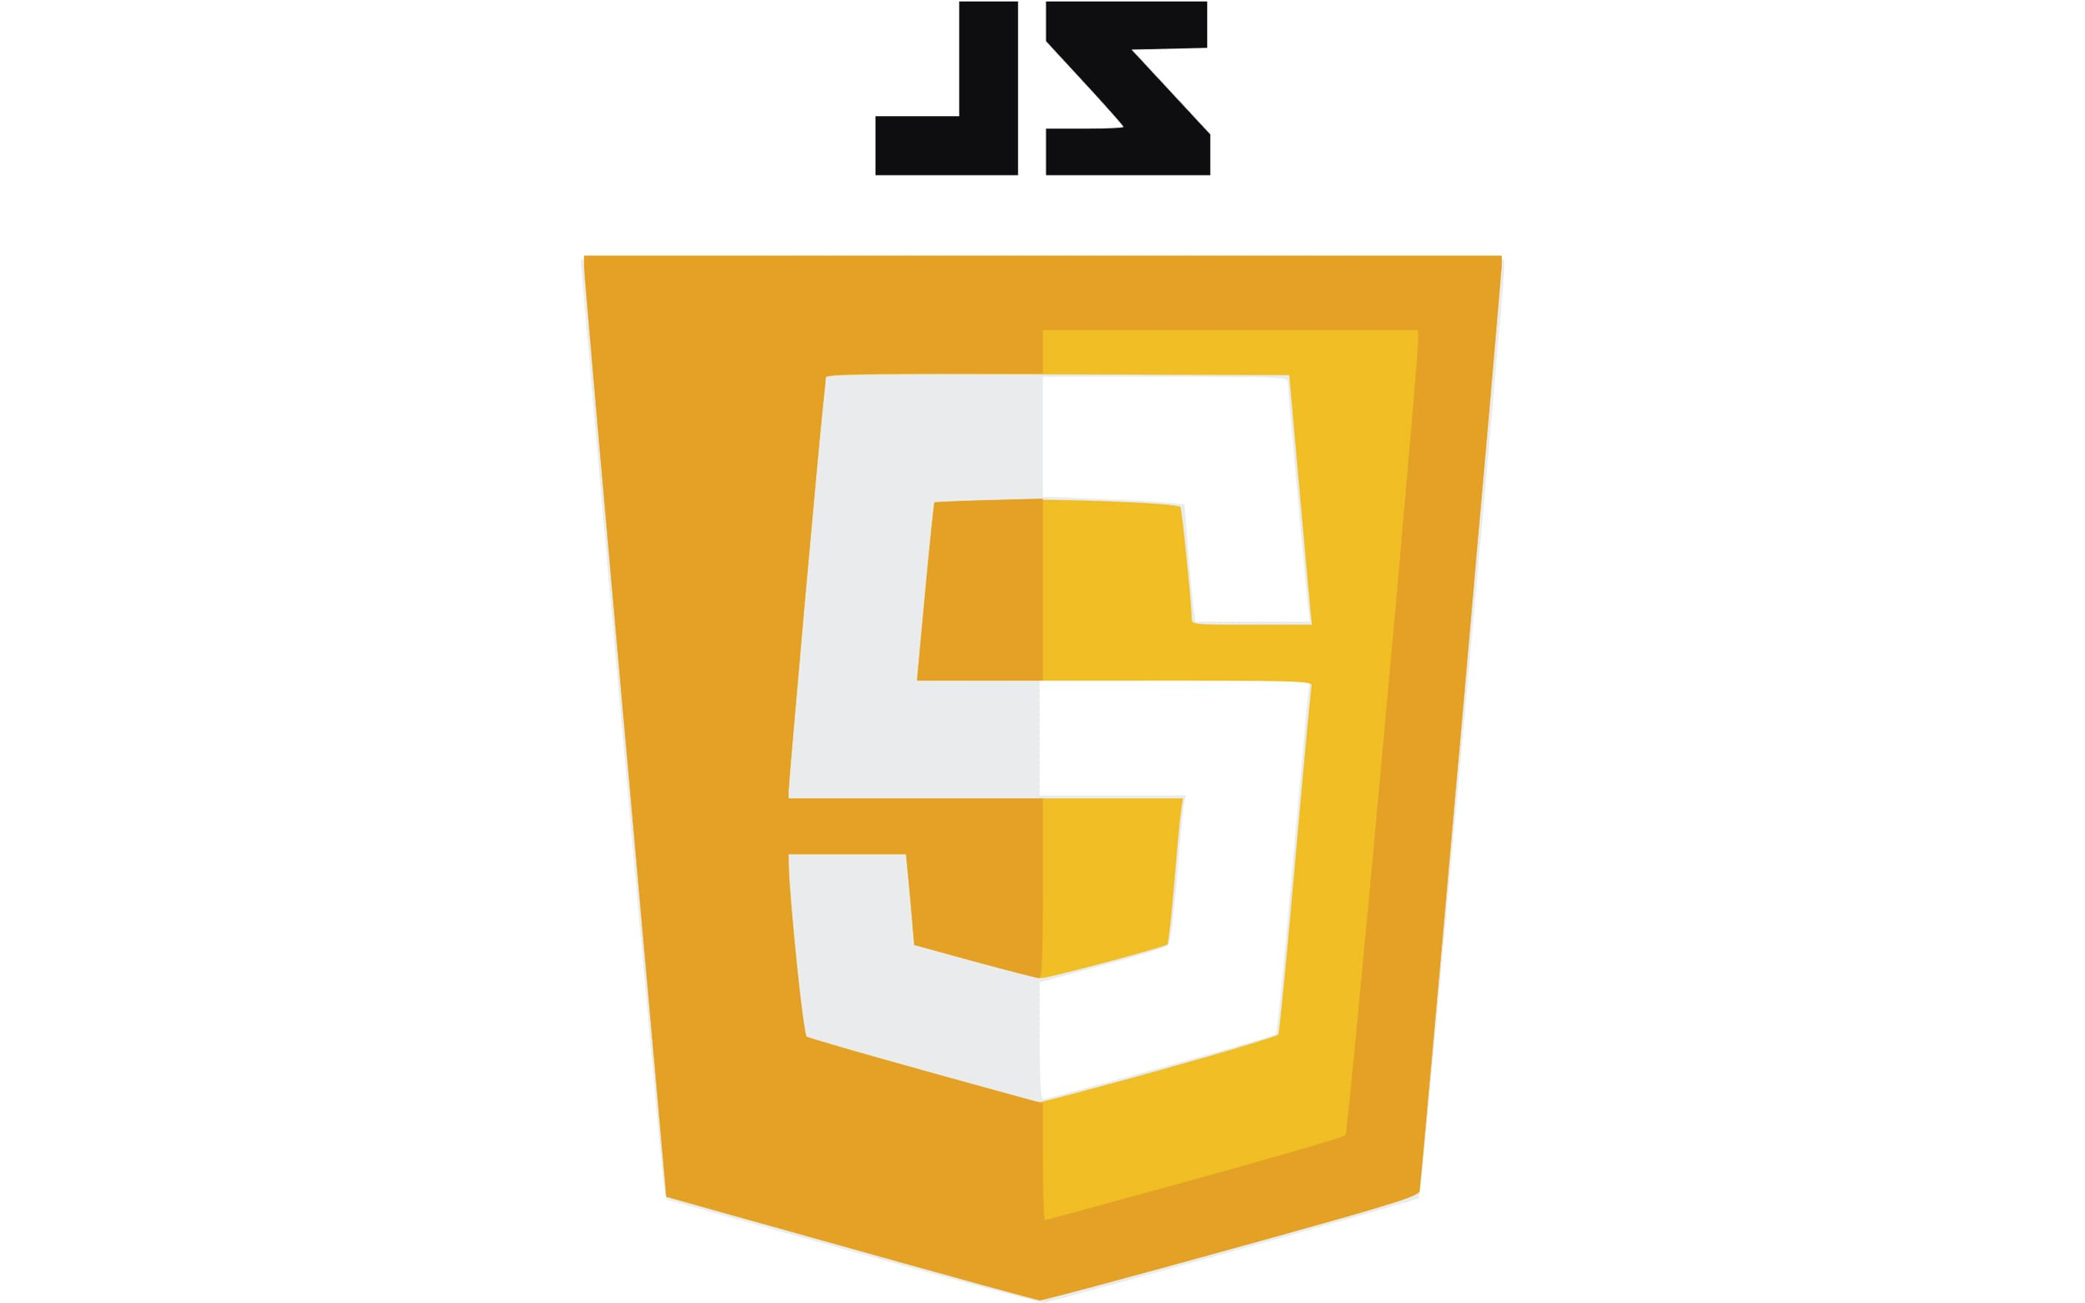
JavaScript Latest Version
ES 6 (ECMA Script 6) is GOOD
8 Reasons to strongly consider JavaScript:
Let keyword
Const keyword
Arrow Functions
For/of
Map Objects
Set Objects
Classes (OOP)
Promises
ES 6

Slide 5
The JavaScript Problem
Previous versions of JavaScript are BAD
JavaScript is the most popular language on the planet
It is 27 years old
It was created in 10 days
The Internet doesn’t forget stuff
JavaScript can be extremely hard to learn

Slide 6
JavaScript Other Thoughts
JavaScript ES6 can be used to create elegant simple solutions
JavaScript ES6 can be used to create a giant mess
JavaScript enables more career opportunities: Frontend/Backend
Integrates nicely into AWS
It is not too bad once you get used to it ☺

Slide 7
JavaScript and the Browser
Web Page HTML
Style
<link href="style.css" />
Manipulate the DOM
<link href="myScript.js" />
CSS
JavaScript
getElementById()

Slide 8
JavaScript and React
Web Page
(HTML)
React/Angular Components
Manipulate the DOM
Style
CSS
JavaScript

Slide 9
JavaScript and React
Web Page
(HTML)
React/Angular Components
Manipulate the DOM
Style
CSS
JavaScript
BAD!!!
Manipulate the DOM
getElementById()

