Slide 1

Deckware Project Pitch
Resolv LLC

Slide 2
Restatement of the Problem
The customer owns a port in Long Beach and wants to optimize the time it takes for their crane operator employees to solve balancing and load/unloading tasks for cargo ships
The customer makes money based off the number of containers moved and the number of ships are serviced
The main goal of this program is to simplify the tasks by automatically solving the balancing and load/unloading problems and display the solution to the operator in a way that is easy to understand
As a result, more ships will be serviced, meaning more money for the customer

Slide 3
System Understanding
Application is capable of running 24/7, whether it is active or not
Blackouts are expected, but as of our meeting on 10/20 at 4pm, there will be gasoline backup generators capable of being ran 2 minutes after blackout
Application will be running on cheapest “Costco” All-in-One, running the latest version of Windows 11
Assuming the following PC will be purchased: HP 23.8" Touchscreen All-in-One Desktop - AMD Ryzen 3 7320U - 1080p - Windows 11 | Costco
PC will only have the work application, a calculator, notepad, and google chrome for GMail installed/active.
Otherwise, just an empty desktop besides inbound/outbound manifests
Off-site backup is fine, but the datastore must be located somewhere in the U.S.
This is in accordance with our requirements elicitation meeting on October 20, 2023

Slide 4
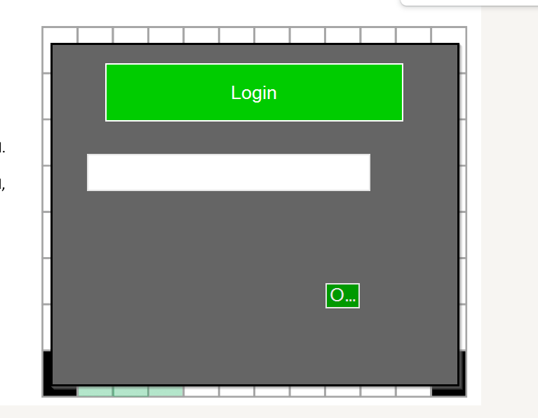
System (Cont.)
An Operator will be able to “clock in” by typing their name into a window, and pressing a submit Button
Once signed in, any further action done on the application will be considered the responsibility of the current operator until the next person clocks in
Administrative account will be protected via password, rest log right in
Assuming Operators all have basic computer skills
Employees work 8 hour shifts
12am-8am, 8am-4pm, 4pm-12am
Even if there are no active ships tasks during a shift, the operator will still be paid for the duration of their shift.
But the goal of a faster ship turnaround time is to take in more ships to handle anyway.
Colors of application must be easy to see in direct sunlight, but not blinding in dim lighting
Assuming colorblindness or any other visual impairment not taken into account (As of meeting on 10/20)
The application will await for an input file (the manifest) from the operator.

Slide 5
System (Cont.)
Manifests are Emailed from the ship captain to the computer, handled by the application, and then the operator sends the outbound manifest back manually via Email
Assuming Gmail on Google Chrome will be used to download manifests and view data
Only one ship is handled at a time
Operator will load manifest into application via file browser
Application -> open file -> browse dialog box -> choose file -> load file
Once manifest is loaded, manifest data will be displayed and operator will choose between a load/unload task and a balancing task.
“Displayed” meaning a visual representation of the manifest
Loading/Unloading and Balancing are mutually exclusive tasks
This means there will be no loading/unloading in a balancing operation and vice-versa

Slide 6
System (Cont.)
Optimization/Computation of this task is our main goal when creating this software
If Balancing task is chosen, no further input is needed and application will continue on to solve the problem
If Loading/Unloading is chosen, the screen will allow the operator to “create” containers to load and unload existing containers
After a container to be loaded is created, the program will ask if the operator wants to add another container or if they are done
If Done, application will now compute the solution
* Details regarding the manifest and creating containers will be addressed later in this slide deck

Slide 7
System (Cont.)
After computing a solution, an “animation” will be shown in a slideshow-like fashion
Operator will be shown time per move, and time remaining
Time calculated will assume every operator will move containers at the same rate as stated in requirements slide
An operators are allowed to switch in the middle of the animation slides.
Once a move is finished in the actual environment, the operator will move to the next slide displaying a new animation
Progress will be represented visually on the side of the current move, in addition to a #/# counter
Operator will have availability to go back a move if they moved forward by mistake
Application will log the occurrence of this

Slide 8
System (Cont.)
Once done, operator will see the finishing state of the cargo environment.
Application will assume task is done at this point, but will allow backtracking from here as well
Once the task is done, the a new manifest will be created and sent to the desktop, with “OUTBOUND” being attached to the end of the name before the .txt extension
The Operator will see a window reminding them to send the manifest back to the ship captain, notifying them of a finished task and allowing them to leave the port
The application will return to the “idle” state, awaiting for the next manifest to be loaded

Slide 9
Manifest Understanding
Software will read and write task data directly from/to the manifest file.
The manifest will be sent from a ship captain (customer) hours ahead of time via email
The head office also sends a corresponding transfer list, but this is for the operator to input into the application manually.
This file will never be edited directly by the operator
Manifest will represent an X2-class cargo ship bay, containing 8 rows and 12 columns in the X and Y directions, respectively.
Certain areas may be “NAN” depending on the ship size, meaning they cannot be used.
“Unused” tiles are empty, and the program can place a container there.
An “NAN” spot will never be over (Y < Y_{NAN}) an “Unused Spot” or other container spot
Manifests are symmetrical around the y axis (visually).

Slide 10
Manifest Understanding (Cont.)
The origin of the manifest file will be the lower left corner
“Origin” being the {01, 01} coordinate
Raw manifest container data will be represented like so: [XX, YY], {Weight}, “Name”
Name range is 1-256 characters
‘NAN”, ‘UNUSED’ and ‘ ’ are restricted container descriptions
Names are case sensitive, and allow any english character and number combination
Existing names on a manifest cannot be edited by the application or operator (legal)
Container mass can range from 0-99,999kg, not including the mass of the container
So 0kg would be an empty container
When computing a solution, the original Manifest will be preserved while a new Manifest with “OUTBOUND” in its name will be created from a copy and put on the desktop.
Containers with identical names will also always have the same mass value.
If any manifest standards are beached, then file will fail to load.

Slide 11
Log Understanding
Logs are to be “hidden” from the operator, and not to be edited or viewed directly by the operator
Actions Logged include:
Loads/Unloads
Clock ins/Clock Outs
Manifest loads/edits/creations
Custom Logs
Custom logs can be made by the operator at any point when clocked in
Operator will only have to put in a message, as time is taken from the system OS and the name being used will be the name of the clocked-in user
Custom logs cannot be deleted. If a mistake is made, another log must be made to clarify the mistake.

Slide 12
Log (Cont.)
One log file is created and used over the span of a year. (One log file represents an entire year)
Even after reboots or other interruptions
Application moves to another log file after December 24th
Time and date for the log is taken from the system (OS)
This will be in military time/24hr time
Time Zone will be PDT, as
Format for a log-line will be as follows:
Month, DD, YYYY: HH:MM <Message>

Slide 13
Performance Understanding
There is a buffer available with a 4x24 grid
When moving containers, the manhattan distance is used to calculate cost from gridspot to gridspot
Each move is 1 minute
Buffer -> Ship and vice-versa is 4 minutes
Truck -> Ship/Buffer is 2 minutes
Container will always enter a “spot” above the most upper-right section of the buffer and upper-left section of the ship
Containers can be temporarily stacked in the cargo ship 1 above max, but solution must fall within 12x8 grid
Containers can be “moved around” a max stack of containers with no extra cost
Containers will all be of the same size, 1 grid spot

Slide 14
Performance Understanding (Cont.)
A container can temporarily be placed 1 spot above the max height of the manifest to reduce moving time
However, the solution must all fit within the cargo ship.
The containers may go around a max stack of containers if need be, with no extra time cost

Slide 15
Balance Understanding
The definition of a “balanced” ship is to have one side of the ship weigh no more than 1.1x that of the other side
This is the legal definition from Maritime Law.
SIFT can be used to represent a goal state that will count as “passing”.
If the program finds that differing to SIFT than true balancing would be a faster operation, then the program should use it.
Though, it is mainly used in situations where it is “impossible” to reach the legal definition of a balanced cargo ship

Slide 16
Load/Unload Understanding
Operator will get to choose what gets loaded and unloaded, based on the info from a transfer list
Transfer list comes from the head office
Transfer list is human readable, and operator will input data themselves. The application will never interact with this info directly.

Slide 17
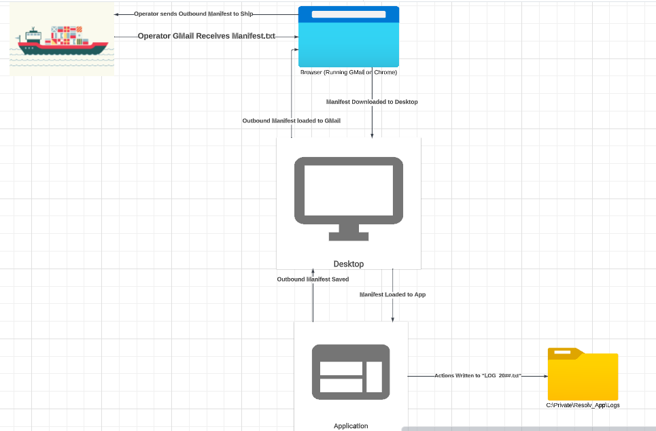
General Overview

Slide 18
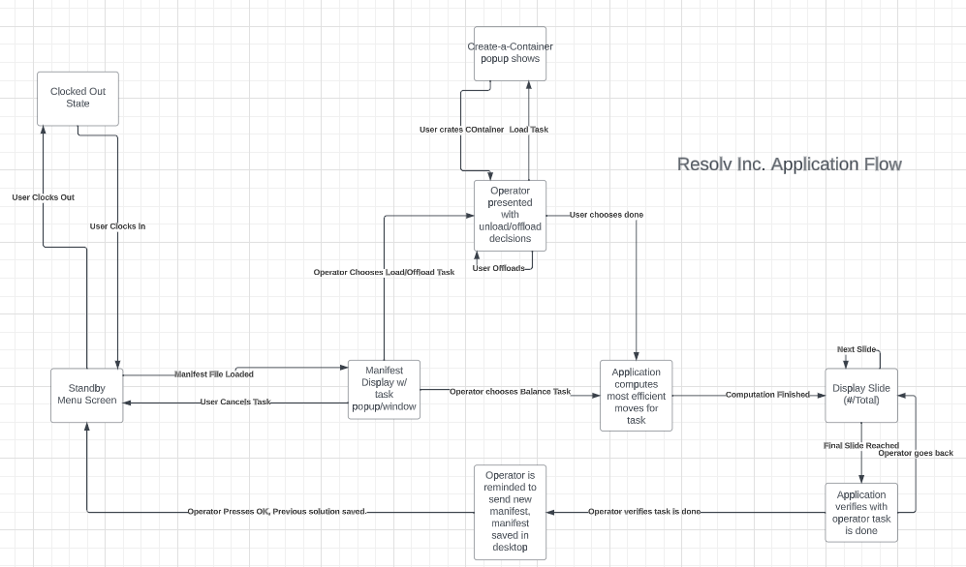
Application Flow

Slide 19
Inputs
The manifest, a file retrieved from email which will be available on the desktop
Format of manifest:
ASCII text
One line per container
Fields are comma-separated
Fields are:
Grid position of container as a two digit, comma-separated, x-position and y-position surrounded by brackets
Weight of container in kilos as a five-digit number surrounded by curly brackets
English section containing description of container contents as well as indicating an unused slot with “UNUSED” or an nonexistent slot with “NAN”

Slide 20
Inputs
The system time from the Windows API
SYSTEMTIME structure:
wYear
wMonth
wDay
wHour
wMinute
wSecond
The keyboard input
Roman alphabet
QWERTY layout
ASCII text as binary data corresponding to individual key presses

Slide 21
Inputs
The mouse input
Pointer motion corresponding to mouse motion
Selection corresponding to left button click
System power from the Windows event log
Events:
Boot
Shutdown

Slide 22
Outputs
An outbound manifest. This is placed on the desktop after balancing, loading, and/or unloading are completed.
It reflects the new state of the bay after all requested operations have been performed
Format of manifest:
ASCII text
One line per container
Fields are comma-separated
Fields are
Grid position of container as a two-digit, comma-separated, x-position and y-position surrounded by brackets
Weight of container in kilos as a five-digit number surrounded by curly brackets
English section containing description of container contents as well as indicating an unused slot with “UNUSED” or a nonexistent slot with “NAN”

Slide 23
Outputs
GUI
Displayed to the all-in-one PC monitor
Operator sign in
Text box
Submit button
Manifest file upload
Windows file explorer
Manifest data display
Load/unload and balancing selection buttons
Create container button
Animation of operator moves
Send updated manifest to captain reminder window

Slide 24
Outputs
Logs, a .txt file located in an area hidden from the operator
Format of logs
ASCII text
One line per log
Fields are
Month in plain english
Day as a 1-2 digit ordinal number
Year as a 4 digit number
Hour out of 24 as a 2 digit number
Minute as a 2 digit number
Message in plain english
Loads/Unloads
Clock ins/Clock Outs
Manifest loads/edits/creations
Custom message by operator

Slide 25
Stakeholders
Operators
Truck Drivers/Owners
Shipyard Owner
They should not be affected in a negative manner.
Their job should now be a lot easier and faster.
More possible idle time, if flow of ships stays the same
Application will reduce total waiting time at dock ideally
Truck Owners do not need to send more trucks than needed
Benefits from the optimization and automation of the best route
Will only stand to profit from this
Will be able to serve more ships
Easier access/documentation of logs
Notes:
More information needed about the relationship between the shipyard owner and the truck drivers/owners
Truckers make money when they are moving
Truck driver should reduce waiting time
Should we take into account the wait time of trucks

Slide 26
Stakeholders
Ship Owners
Ship Captains
Both of these groups need the program to be accurate and efficient, otherwise they lose money and time
Will not be negatively affected by the change
Will lose less profit from being ported
They don't need to worry about the manifest being wrong
Program will be accurate to allow the ship owners to know what they have
This group of individuals will not be negatively affected by the integration of the program
They will only stand to gain from it by not wasting time in the port.
Main goal is to be “Fast in Fast out”
The program will allow them to have an accurate manifest
Notes:
Not sure if we will be needing the other section for stakeholders.
Ship: Fast in and fast out
Responsible for manifest structure
Security guards can be ignored in scope of the program (Remove)

Slide 27
Stakeholders
Lawyers
Federal/Local Authorities
Both of these groups need to get a hold of the logs in rare occasions. Regardless if they are rare, we need to keep them in mind
This group of individuals rarely use this program
Most of their interactions with the program would be checking the log file
The owner will more than likely give them this information, so their interaction with the program may be NULL
This group of individuals may interact with the program
They can subpoena the log files
Similar to the lawyers, their interactions with the program will be minimal and rare
They can access the files through Mr. Keogh or the company’s lawyer

Slide 28
Scenario I: 1/10
*Disclaimer: The following UI prompts are used as example only and do not represent the final product
David Smith is a seasoned crane operator employee at the Long Beach shipyard
He works full time, Sunday through Thursday, usually taking the normal 8am-4pm shifts.
He has a GED, and does not have any visual or physical impairments that would keep him from doing his job
On January 5th, 2024 he arrives at work at 7:55am climbs up the crane and signals to the graveyard employee Sam Woodward that it is time to switch.

Slide 29
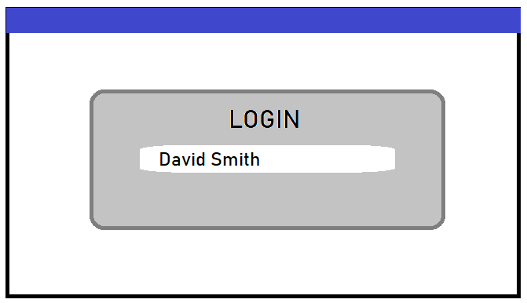
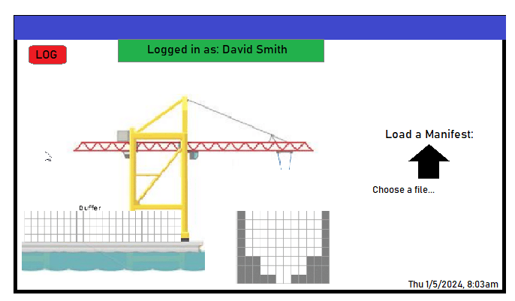
Scenario I: 2/10
*Disclaimer: The following UI prompts are used as example only and do not represent the final product
David gets settled into his cabin, and is greeted by a simple login screen for deckware.
To log in, David simply types in his name and is greeted by a welcome message, followed by an empty manifest grid and an option to load a new manifest
Notes:
We can add a scenario where the operator uses the “Note” function, its a freebee but should work in our favor

Slide 30
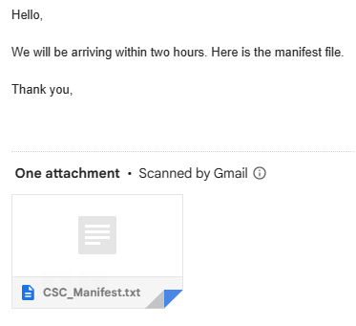
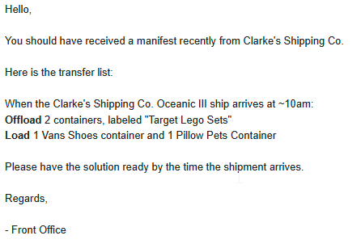
Scenario I: 3/10
*Disclaimer: The following UI prompts are used as example only and do not represent the final product
David does not have any active ships at the time of clock in. He stays on standby until 8:17am, where he receives an email on the company gmail account from a ship captain with an attached manifest file
Minutes later, David receives instructions on a transfer list, telling him to offload 2 Target Lego Set containers, and load 1 Vans container and 1 Pillow Pets container
Notes:
We can add a scenario where the operator uses the “Note” function, its a freebee but should work in our favor

Slide 31
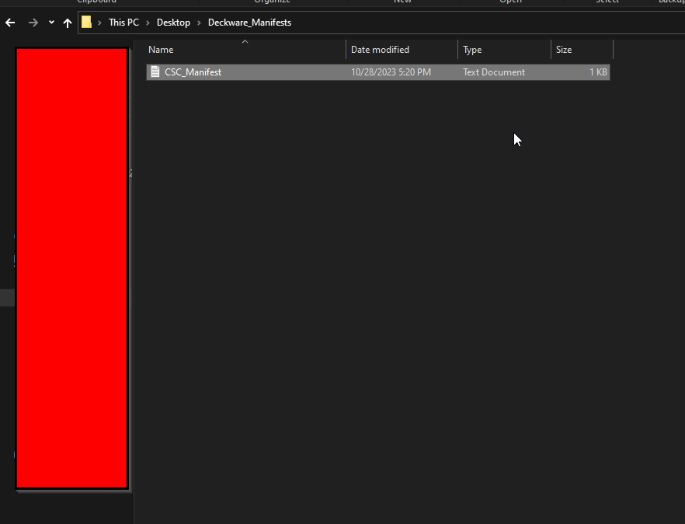
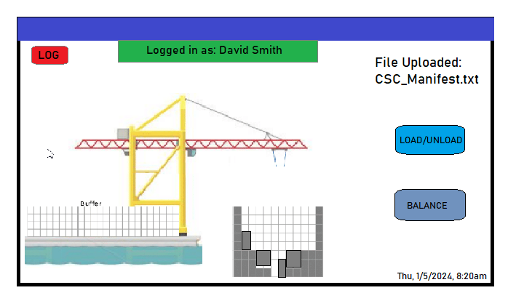
Scenario I: 4/10
*Disclaimer: The following UI prompts are used as example only and do not represent the final product
With the manifest file and the transfer list, David can now use the application to solve his task.
David downloads the manifest file to the computer desktop
He uploads the manifest to the application file via file browser, and is greeted with an option to load/unload or balance the ship

Slide 32
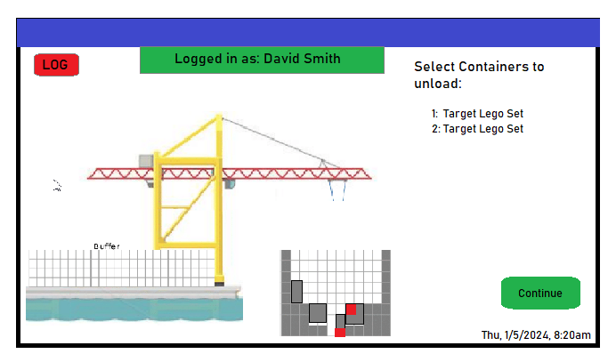
Scenario I: 5/10
*Disclaimer: The following UI prompts are used as example only and do not represent the final product
David chooses the load/unload task. He is prompted to first choose the containers to unload from the ship.
The containers he selects from the manifest are highlighted in red
Once done, David presses continue to move to loading task

Slide 33
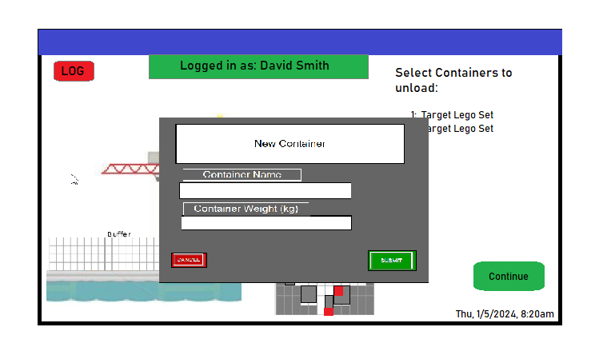
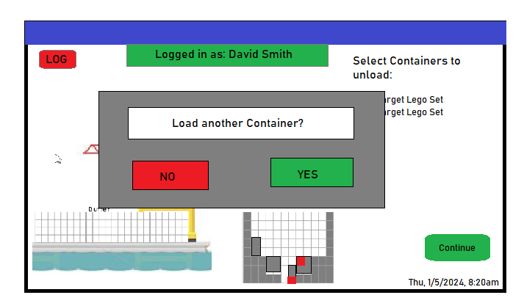
Scenario I: 6/10
*Disclaimer: The following UI prompts are used as example only and do not represent the final product
When loading, David will “create” containers to load by specifying their name and weight
Position is set by the application
Once David has added the Vans container, the program will ask if there is a second container to load. He presses yes and loads the Pillow Pets container

Slide 34
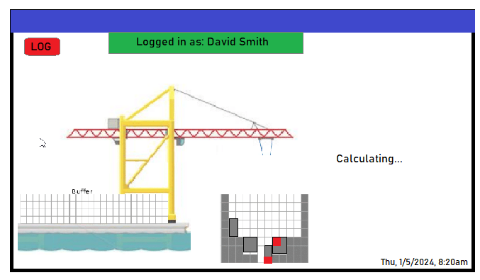
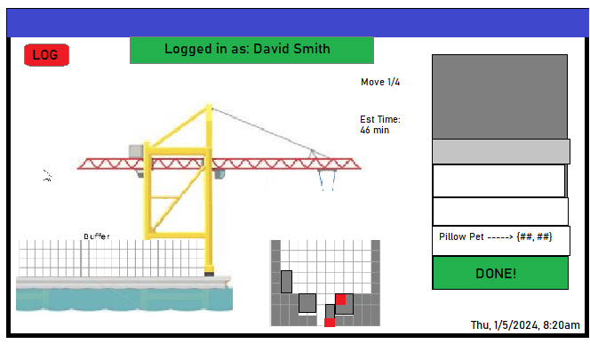
Scenario I: 7/10
*Disclaimer: The following UI prompts are used as example only and do not represent the final product
When David is done adding containers, he will press “no”. The application will then calculate an efficient task sequence to reach the goal state of the load/unload. A new manifest tagged “CSC_Manifest_OUTBOUND.txt” is created
When done, the first move animation will be shown along with an overview list of all/upcoming moves. David will not begin until the ship arrives at 10am.
Additionally, the screen what move David is currently on, as well as the estimated time

Slide 35
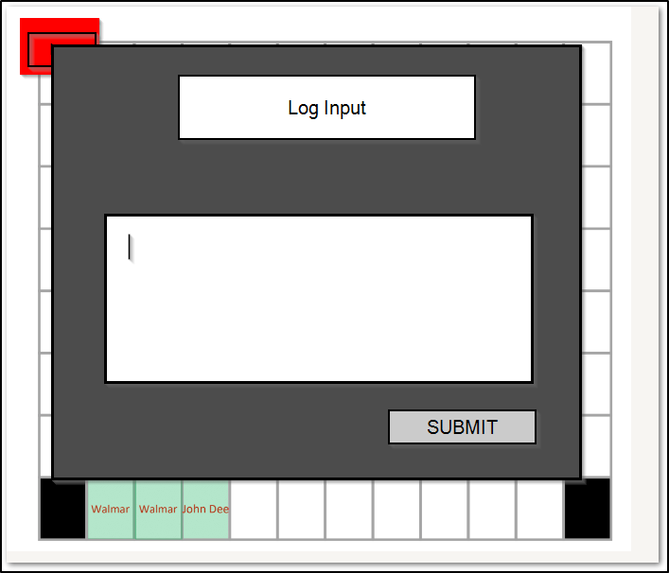
Scenario I: 8/10
*Disclaimer: The following UI prompts are used as example only and do not represent the final product
David will press the spacebar to move forward to the next move.
However, when loading the Vans shoes container, he notices that it has minor damage. He reports this by emailing the front office, as well as creating a quick log note using the log button.
David then continues with the next step

Slide 36
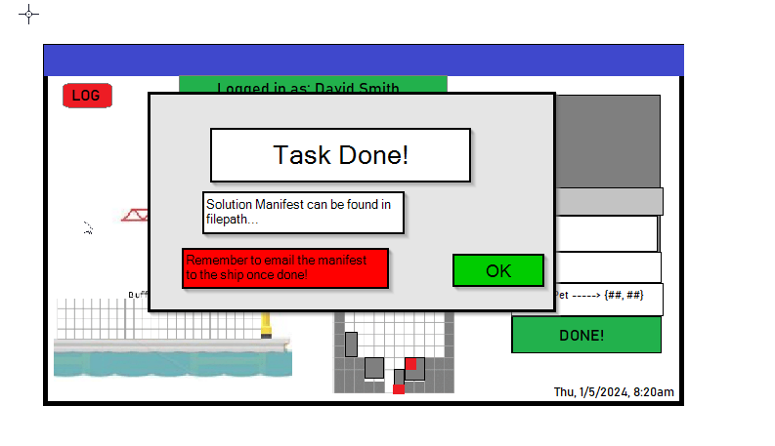
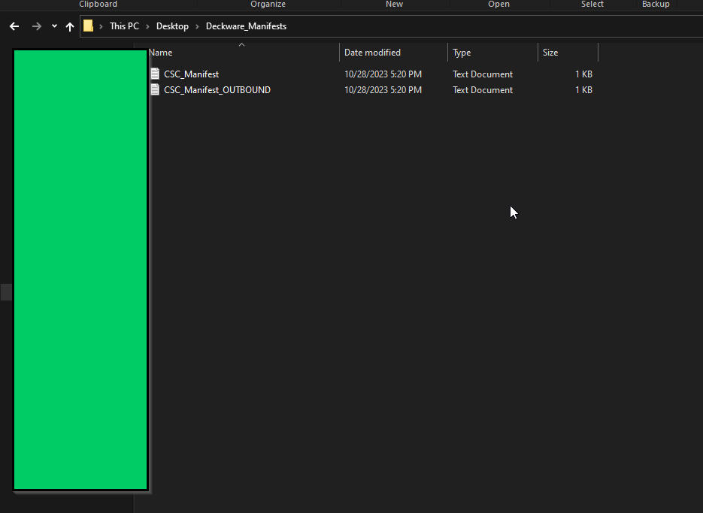
Scenario I: 9/10
*Disclaimer: The following UI prompts are used as example only and do not represent the final product
Once done, the application will prompt David to ensure all moves are done.
Once he confirms, the application will send a reminder of where the OUTBOUND manifest file is, as well as to email said manifest file to the ship once the physical action is done

Slide 37
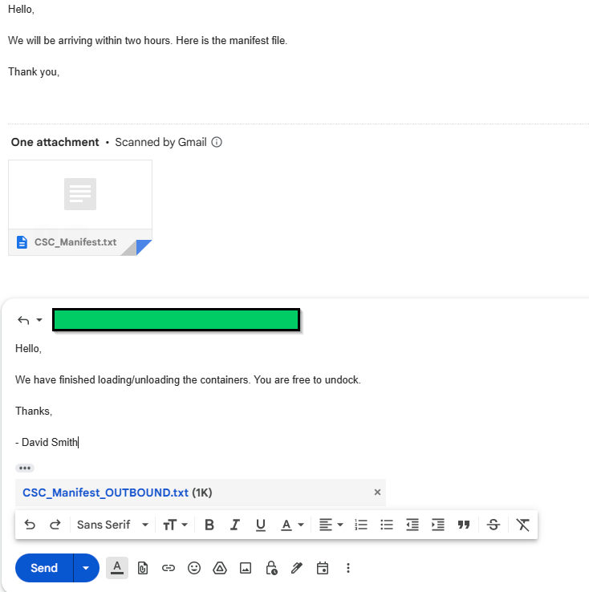
Scenario I: 10/10
*Disclaimer: The following UI prompts are used as example only and do not represent the final product
The application returns to an idle state, awaiting the next manifest file to be loaded
David now emails the ship captain back with the new manifest through the company gmail, signalling to them that the task is done, and they are free to undock.

Slide 38
Scenario II: 1/9
*Disclaimer: The following UI prompts are used as example only and do not represent the final product
Riley Radricks is a trusted crane operator at the Long Beach shipyard.
His dedication to his job is evident in his work schedule. He maintains it working form Sunday through Thursday with his usual shifts running from 8 a.m. to 4 p.m.
Ernesto Eccentrico is a passionate crane operator at the Long Beach shipyard. His usual shifts run from 4 p.m to 12 a.m. and showcase his flexibility to work during the night.
On February 11th 2024, Ernesto is set to take over after Riley’s shift.

Slide 39
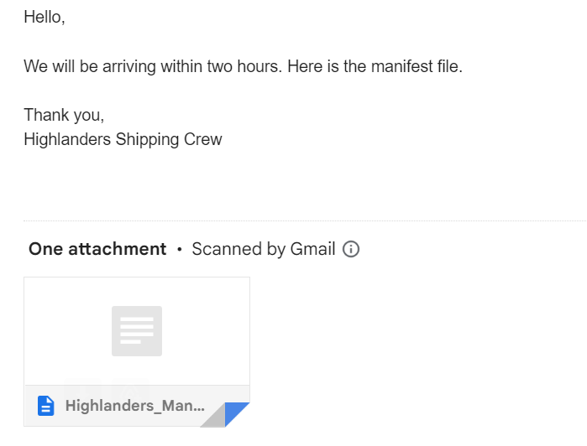
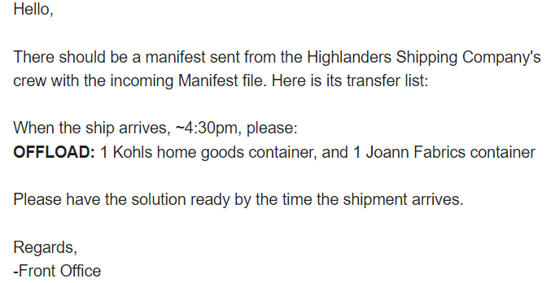
Scenario II: 2/9
*Disclaimer: The following UI prompts are used as example only and do not represent the final product
Riley logs in the application at 8 a.m. and goes on about the day’s operations, mostly offloading containers.
At 3:30 p.m. Riley notices an email from a ship captain from Highlanders Shipping Company with an attached manifest file.
He also receives the needed transfer list, telling him to offload 1 Kohls home goods container and 1 Joann Fabrics container.
Riley Radricks

Slide 40
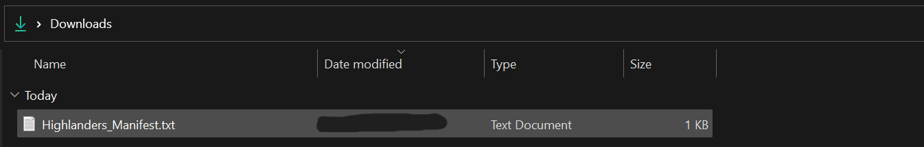
Scenario II: 3/9
*Disclaimer: The following UI prompts are used as example only and do not represent the final product
Riley then embarks on this task with the provided manifest and transfer list.
He downloads the inbound manifest, and uploads it to the application file via a file browser, and chooses the “load/unload” option.
Riley Radricks
Highlanders_Manifest.txt
Sun, 2/11/2024, 3:52

Slide 41
Scenario II: 4/9
*Disclaimer: The following UI prompts are used as example only and do not represent the final product
He is then prompted to choose the containers to unload from the ship.
Then press continue
The containers he selects from the manifest are highlighted in red
Riley Radricks
1: khols Home Goods
2: Joaan Fabrics
Sun, 2/11/2024, 3:55

Slide 42
Scenario II: 5/9
*Disclaimer: The following UI prompts are used as example only and do not represent the final product
The application begins to calculate an efficient sequence for offloading.
While mid-operation in the application, Ernesto knocks on the cabin to alert Riley that it's time for a shift change.
Riley gathers his belongings and heads out the cabin at 3:59, Ernesto enters the cabin and logs into the application at 4:00pm
Riley Radricks
Sun, 2/11/2024, 3:58

Slide 43
Scenario II: 6/9
*Disclaimer: The following UI prompts are used as example only and do not represent the final product
Riley’s shift change does not need to account for a clock out
The login system is a separate button/action, therefore the previous actions will not be altered or stopped
Shift change from Riley to Ernesto occurs seamlessly without any need to stop the task at hand.
Riley Radricks
Ernesto Eccentrico
Ernesto Eccentrico
Sun, 2/11/2024, 3:59
Sun, 2/11/2024, 4:00

Slide 44
Scenario II: 7/9
*Disclaimer: The following UI prompts are used as example only and do not represent the final product
Once the application is done calculating, a new outbound manifest is created.
The first move animation will be shown along with an overview list of all/upcoming movies. Ernesto will not begin until the ship arrives at 4:30 p.m.
Ernesto Eccentrico
Joann Fabrics
Sun, 2/11/2024, 5:03

Slide 45
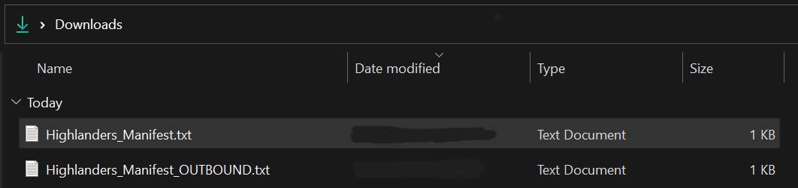
Scenario II: 8/9
*Disclaimer: The following UI prompts are used as example only and do not represent the final product
Ernesto uses the spacebar to go from one move to another.
Once done, the application will prompt Ernesto to ensure all the moves are done
After he confirms, application will send a reminder of where the OUTBOUND manifest file is, as well as to email said manifest file to the ship once the physical action is done
Sun, 2/11/2024, 5:32

Slide 46
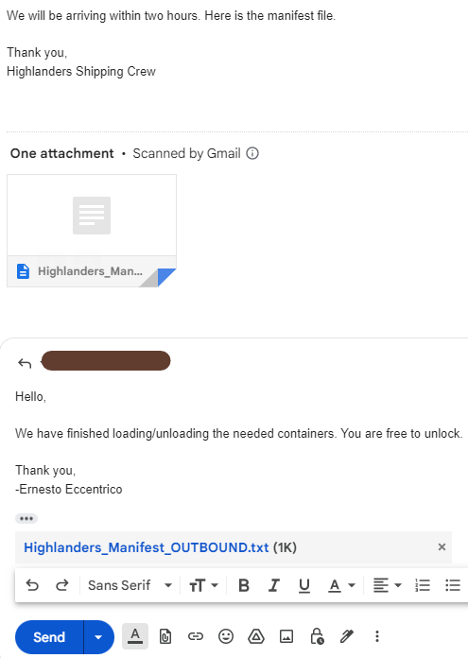
Scenario II: 9/9
*Disclaimer: The following UI prompts are used as example only and do not represent the final product
The application returns to an idle state, awaiting the next manifest file to be loaded
Ernesto now emails the ship captain back with the new manifest through the company gmail, signalling to them that the task is done, and they are free to undock.
Ernesto Eccentrico
Sun, 2/11/2024, 5:45

Slide 47
Documentation For Program
Currently, the method of documentation for the program will be done through a docs file and through the logs file of our system (github)
This documentation will be posted onto the server where the client and company can access the information
Further information will be provided upon completion by our company to your current contact email

Slide 48
Training For Operators
Currently we have planned to create two training methods of using the software
Through PDF manual (written manual)
For operators that take their time to read and understand what they are doing
Through Video walkthrough (visual manual)
For the operators that learn from visual stimulus
We want to give both of these options because it allows more individuals to learn how to use our program effectively

Slide 49
Scenario First Experience: Background
Jeremiah Gutierrez is a newly hired employee at Long Beach Shipyard
He is a 30 year old hire from Florida and has minimal experience with computers
He knows how to open PDFs and emails
His current education level is a High-School Diploma with some college experience
He is used to problem solving using pen and paper from his previous job
His shifts start from 12 am to 8 am from Sunday to Friday
Today’s date: May 12, 2025

Slide 50
Scenario First Experience: 1/6
Jeremiah starts his shift a bit early to attempt to understand the system he is going to be using
He goes up a ladder to reach the crane’s cabin around 11:55 PM and signals to the operator occupying the that it is time to switch operators
There is currently no ship waiting for him to work on so now he gets to learn how to use the company’s computer and program
Jeremiah prefers to learn something new through articles or some sort of reading material

Slide 51

Scenario First Experience: 2/6
* Disclaimer: Current Training Manual is not final, all contents are subject to change *
He opens a PDF on his desktop titled “Deckware Manual” and starts to read the contents

Slide 52
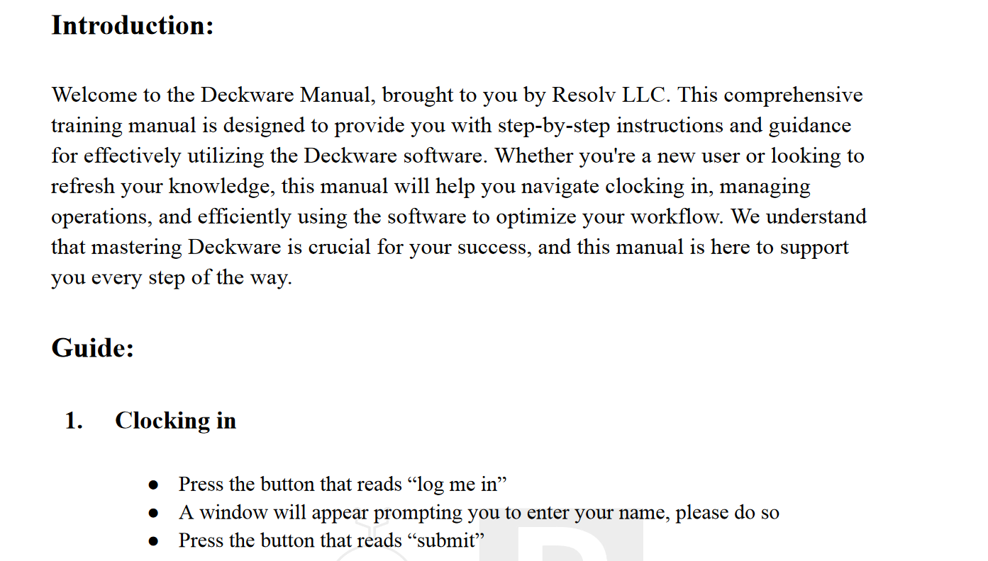
Scenario First Experience: 3/6
* Disclaimer: Current Training Manual is not final, all contents are subject to change *
The manual starts off with an introduction and informs the reader (Operator) how to clock in.

Slide 53
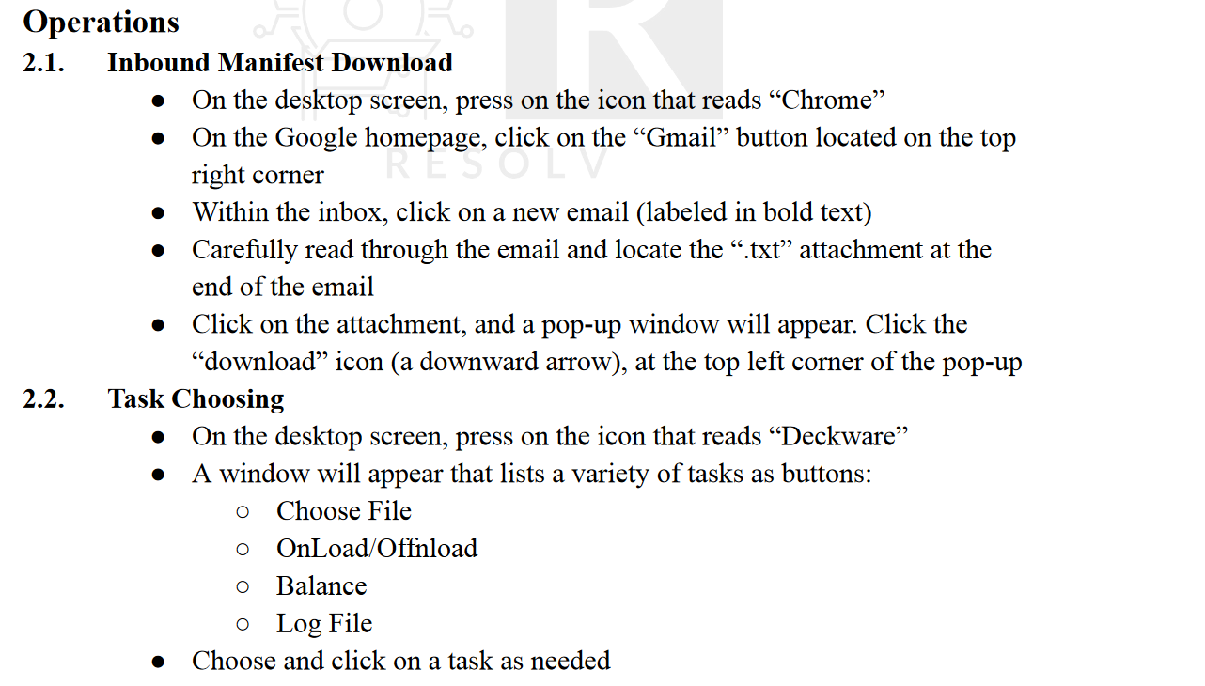
Scenario First Experience: 4/6
* Disclaimer: Current Training Manual is not final, all contents are subject to change *
He signs into the program and continues reading
The manual then sets up the description of the different operations and how they will in theory be performed
The manual goes step by step in how to get the Manifest and how to load it into the program

Slide 54
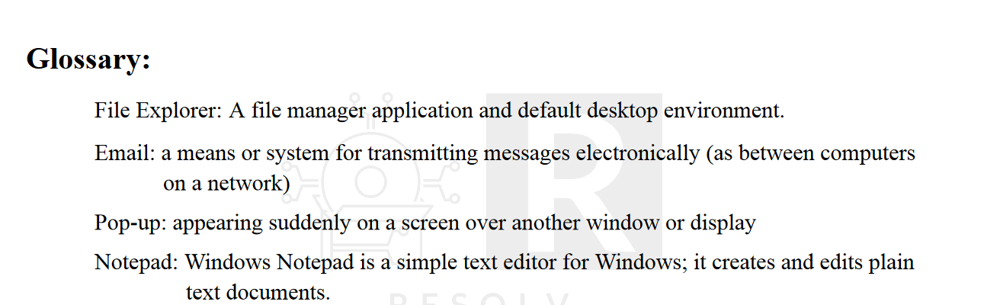
Scenario First Experience: 5/6
* Disclaimer: Current Training Manual is not final, all contents are subject to change *
The manual goes through each operation the operator may do in detail, step by step until they have to resend the file back to the Ship’s Captain.
Jeremiah, understands what he must do, but some words are not registering in his mind. He wants figure out what these words mean. So he now checks the glossary found in the back of the manual where it defines all important words/phrases.

Slide 55
Scenario First Experience: 6/6
* Disclaimer: Current Training Manual is not final, all contents are subject to change *
Jeremiah, now equipped with this new information is now fully able to use the program correctly and operate the crane with great efficiency
We do acknowledge that new operators may take a bit of time to learn how to use the program quickly
We have created a few options to get them up and running, but these will be up to their learning style and uptake.
We have attempted to minimize the amount of time it takes to learn the program
Currently, do not have an option for audio only manuals, this can be added later on within the maintenance phase

Slide 56
Compliance With Current Regulations
Deckware will comply with the regulations and which were noted from Mr. Keogh and his company.
Deckware will comply with current California and federal regulations of security and privacy
Deckware will comply with current California regulations in business practice and ethics

Slide 57
Backup Solutions
We have some backup solutions for your company:
UPS (CyperPower CP900AVR)
Stays active for 17 minutes
Allows Backup Generators to come in
Backup Solution Hardware:
System turns off on a set date and time
Allows the system not to crash and refresh its system resources
Cloud Solutions:
Threatlocker
Amazon Web Services

Slide 58
Scenario Power Outage: Background
Jeremiah Gutierrez is now a seasoned worker at the Long Beach Shipyard
He has figured out how to use important features of the company’s computer
He also rechecks the programs manual when he forgets how to do certain operations
One day the power in the shipyard go out while on his shift
He can't see without the lights

Slide 59
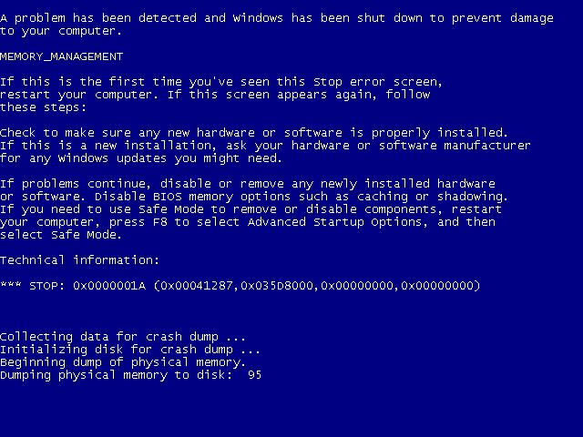
Scenario Power Outage: No UPS
The Long Beach Shipyard does not have a UPS system in place
The computer turns off as the power goes out
Jeremiah waits until the power comes back up before attempting to turn back on the computer
Once the power comes back online, the computer is turned on and leads to an error message.
Worst case scenario
The other case would be no information was saved
Would require a restart of the process if autosave did not kick in on time

Slide 60
Scenario Power Outage: UPS
The Long Beach Shipyard has a UPS system installed
Once the power goes out Jeremiah notices that the computer does not turn off
The program continues running
Once the power is back up due to the generators, Jeremiah continues to work
With this scenario, we can see how the addition of the UPS can save minutes to hours on certain applications

Slide 61
Maintenance Phase Information
While working on your program, we have come to discuss a plan for the Maintenance Phase.
We have some companies which would love to work with your company which are based in the United States
During these slides, we will be discussing some ways we will maintain your system during this phase
Notes:
https://softwareengineering.stackexchange.com/questions/241018/what-is-software-maintenance

Slide 62
Cloud Regulations
From our elicitation we were discussing if Mr. Keoghs company was interested into using a cloud solution for a backup
We have received a specific issue which we can work with
The cloud company has to be based in the United States
There are many companies that have their main base of operations in the united states
Though a few with encryption or security
We have looked through the companies and have evaluated their status

Slide 63
Cloud Solution
We have a couple of options for cloud solutions
These companies are available to work with and will continue working with you even after the maintenance phase of the program is over
We picked these companies which have a good response to breaches and data leaks
Choices:
Threatlocker (link)
While researching this company, we found that it follows the regulations set by your company
Amazon Web Services (link)
Amazon’s answer to web services not listed by many other companies
Its service is responsible for 32% of the market

Slide 64
Future Support
Current Plan:
The support time we can give:
7 years
Maintenance Phase:
Bugs and Problems
We will process these items through our customer support line
Solutions and fixes to these problems will be pushed through an update
New Features Needed?
Minor features Implementation
Items that do not require the change of the entire system
These features can be revision of the UI
Addition of Color Blind Support or Language Support
Changes due to Federal Regulations
Major feature Implementation:
Needs new contract
Example: System now controls crane, implementation of new systems, external interactions

Slide 65
Future Support Cont.
Maintenance Phase Cont…:
Improvement in program performance
Within this phase, we might be able to find some alternative algorithm which can improve the performance ever so slightly
From here we would change the programs algorithm without affecting the external interactions with the user
Improvement in design:
Possible changes in the UI to adapt to changes within the company
If you start using the color “red” for danger, we can either avoid using it or integrate it to our system. (example)

Slide 66
Future Market
The current Operating system being sold with pre-built computers is Windows 11
However, we are hearing rumors that there might be a change to Windows 12
If this change occurs within our maintenance phase, we will work to upgrade the program to become compatible with it
If it comes out on the last day of this phase, we will continue through the upgrade (no future charge regardless of support ending)
This is of course if your company does end up upgrading to the newest operating system (which is recommended as it has more support and better security)

Slide 67
References Maintenance
What is Maintenance? (stack exchange)
Average Maintenance time (stack exchange)
Cloud Solution
Threatlocker (link)
Amazon Web Service (link)
Coverage Percentage (link)
UPS (CyperPower CP900AVR)
UPS Information (techTarget)
Windows 12 (XDA Devs)

Slide 68
User Acceptance Testing
In order to be considered acceptable by the customer, the following criteria must be met before the final deliverable date of December 8th, 2023:
When the operator is logged in, they will be able to load a manifest file and display a ship environment on the application within 5 minutes
If the system goes down in the middle of a task, the application will be able to resume execution of said task from where it last started.
No normal user will be able to view the application logs. Only the administrator will be able to access them.

Slide 69
Acceptance Testing (Cont.)
The calculation time of a task solution will be faster than or within 10% of the current best employee using a paper and pencil.
The solution to be provided by the application will be near optimal or optimal.
Given the Manifest restrictions stated in the System Understanding section of the project pitch if any one of these rules are breached in a given manifest, then the application will refuse to load the manifest.
While computing the solution to a task, the original manifest will not be manipulated by the application in any way.
Application is capable of being on standby and/or active for long periods of time without crashing.

Slide 70
Acceptance Testing (Cont.)
In order to test the previous general acceptance criteria, we will follow the following testing procedures in order to prove our application is able to satisfy the requirements:
After reviewing the training log, an operator will be able to load a manifest file into the application and get visual detail of the environment within 5 minutes
While executing a task on a manifest file, we will force shut down the system. We will then turn the pc back on and the application, once opened, will remember who is logged in and what state the task was in.
The application will be kept open in standby mode for 3 days, while occasionally being used for a task.
We will attempt to type in errors into a test manifest file, and load it into the application.
We will be allowed one current operator (or manager) to review our manual for training. After a short review, we will have the user load a manifest into the application and have it solve a load/unload solution.

Slide 71
Acceptance Testing (Cont.)
The following tests are proposed in order to test the competency of the Deckware software product:
As soon as possible, we will be given 1-2 initial manifests and transfer scripts in order to develop our base program
One load/unload, one balancing
~2 weeks before the final deliverable, the customer will send up to 6 different scenarios.
During the final deliverable, the customer will be able to pick any 2 of these and test them live
During the final deliverable presentation, the customer will be allowed to pick 3 scenarios never seen by the developers, and test them live

Slide 72
User Acceptance References
Structure: Acceptance Criteria: Everything You Need to Know Plus Examples
Full Acceptance Testing Agreement: Resolv_Acceptance_Testing.doc

Slide 73
Q/A Session
Any questions, comments or concerns? - All concerns, comments, or questions will be written and added to our database.
For future reference

