Slide 1
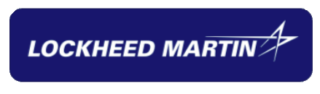
AI Code Converter
Team: The Control Alt Converters Sponsor:
Notes:
Person 1 - Vandoran

Slide 2
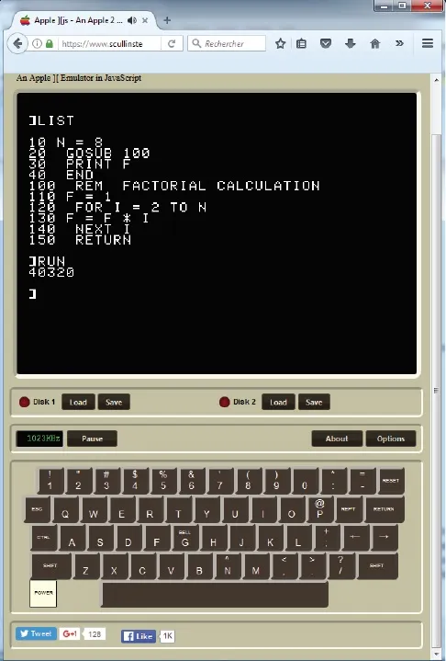
Problem Statements
Legacy code is hard to maintain
Manual Modernization is slow and error-prone
Deprecated Libraries & APIs Break Systems
Lack of Skilled Developers for older languages
Security Vulnerabilities in Outdated Libraries
Notes:
Person 1 - Vandoran

Slide 3
Goals & Objectives
Develop an AI tool to modernize legacy code and applications
Convert Legacy Code
Automate Build Processes
Documentation & Artifacts
Functional Parity
Notes:
Person 2 - Alex
To develop an AI-powered tool that not only modernizes legacy code but also automates the build, testing, and documentation process—producing production-ready applications and technical documentation.
The Objectives
To do that, we have four specific objectives:
Conversion: First, we use the AI model to handle the actual language transformation from [Legacy Language] to [Target Language].
Automation: But code is useless if it doesn't run. We are automating the build processes to ensure the new code compiles immediately.
Documentation: We generate the necessary technical artifacts and docs automatically, so the new codebase is maintainable from Day 1.
Parity: Finally, and most importantly, we validate that the new system behaves exactly like the old one—preserving functional parity.

Slide 4
Team Process
Team communication tools:
Discord
Email
Jira
Time tracking
Jira work logs
Meeting agenda
Team meetings 5pm tuesdays
Sprint planning
Story pointing
PR discussion
Story Grooming
Metrics Tracked
Product Metric: Manual Intervention Rate (MIR)
Process Metric: Sprint Velocity
Notes:
Person 2 Alex
A little insight into how our team operates:
Jira manages tasks/stories/sprints
Primary team communication (sprint planning, meetings, pair programming) is done on discord
Email artifacts to sponsors and such

Slide 5
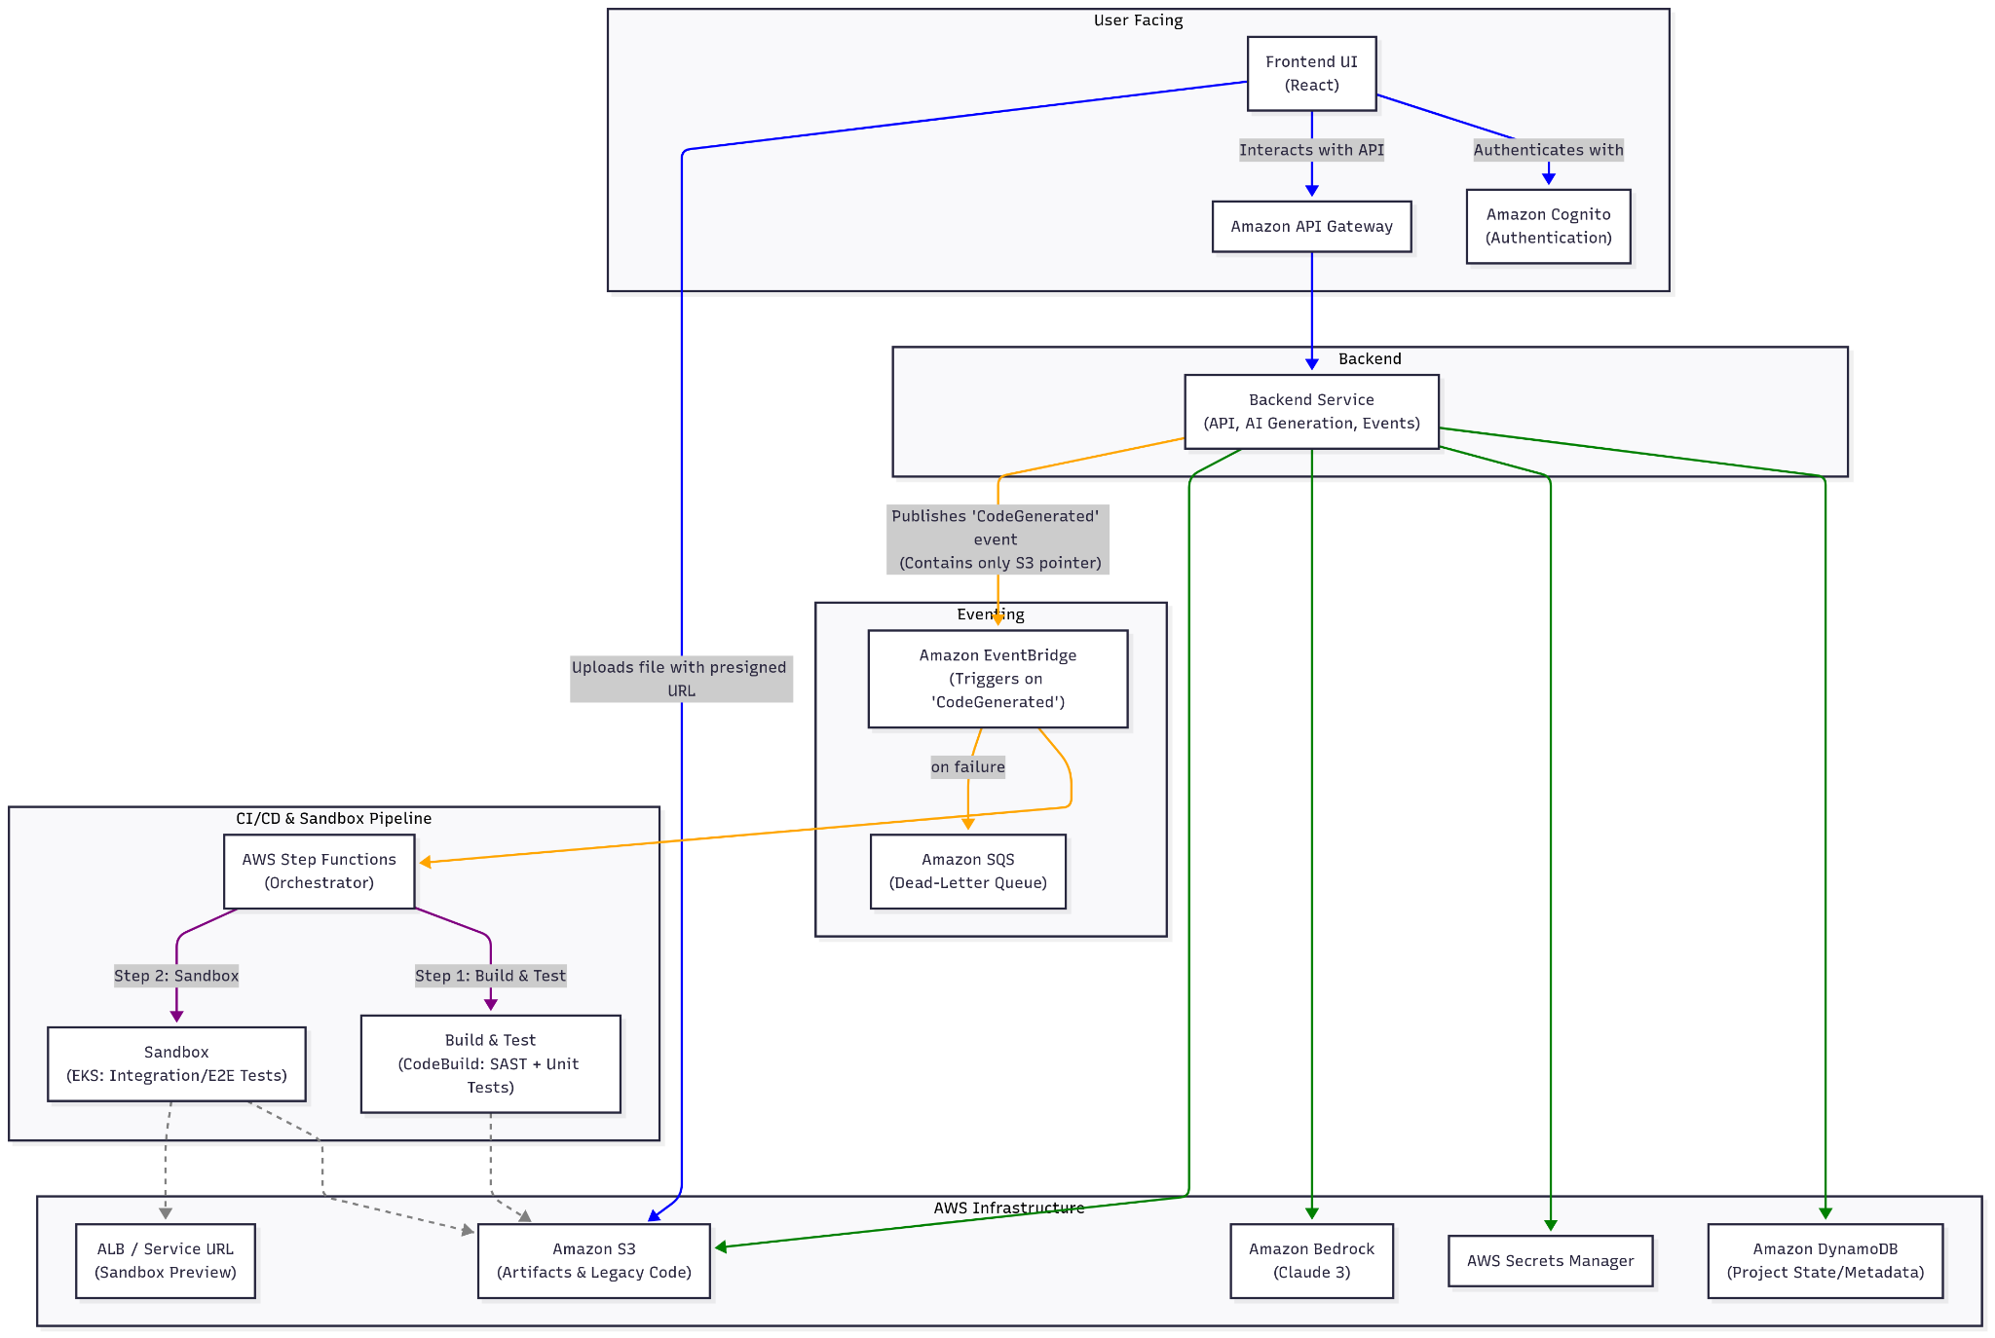
Original Service Diagram

Slide 6
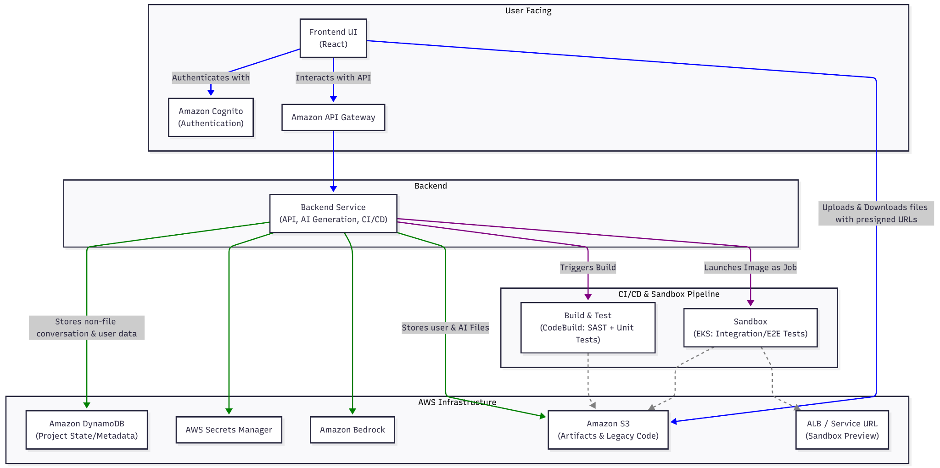

Slide 7
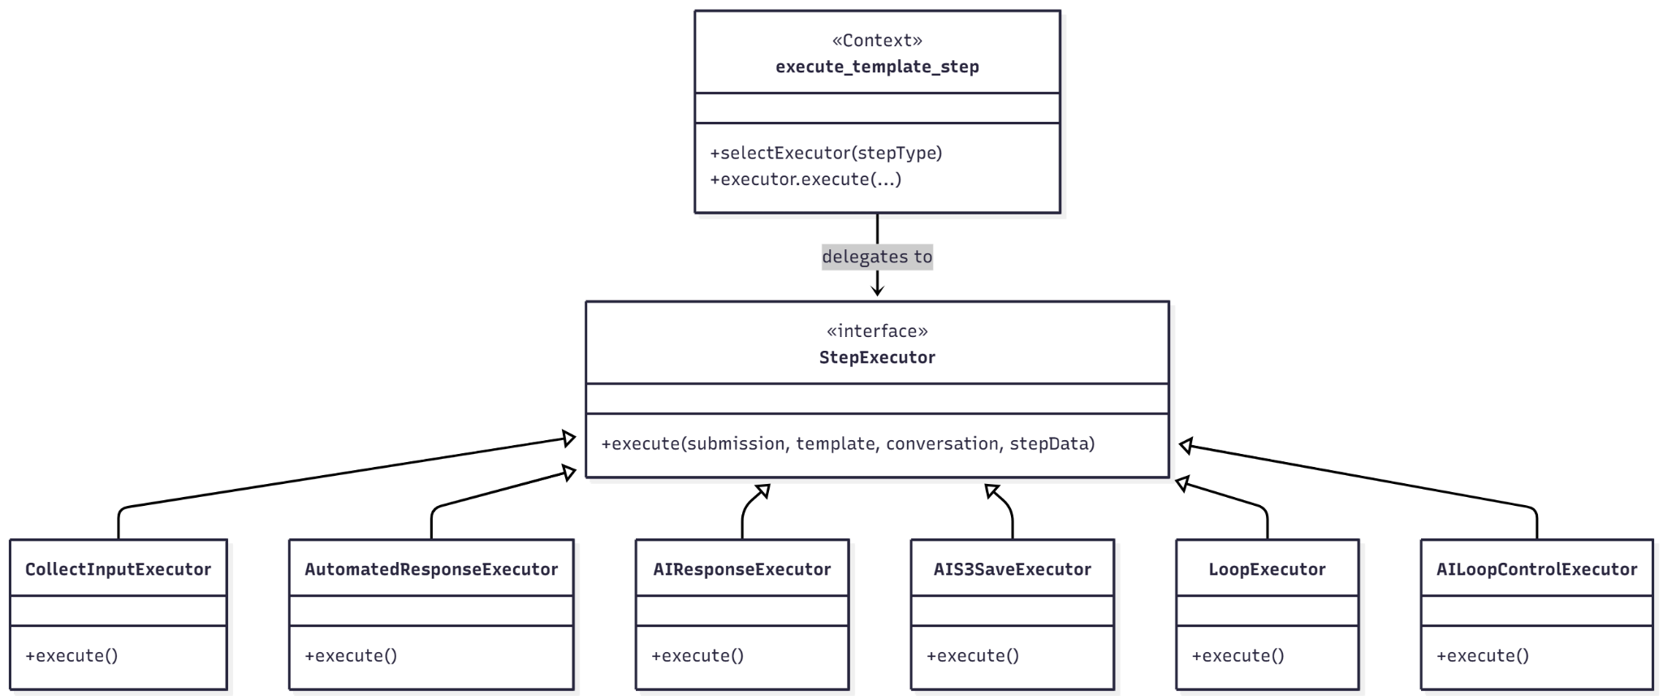
Expandable & Modular

Slide 8

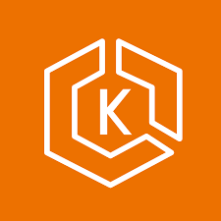












System Architecture Overview
Backend (FastAPI (EKS Hosted)
Runs API business logic (chat, templates, files, users)
Sends requests to Bedrock
Stores meta data to DynamoDB
Manages s3 file buckets & provides pre signed URLs
Configuration
AWS Secret Manager
Frontend UI (React + Next.js)
Utilizing Cloudfront (via s3) for website hosting
Interacts w/ Backend via. API Gateway
Users Authenticate with AWS Cognito
Uploads & downloads files using pre signed URLs S3
CI/CD Integration
CodeBuild (SAST + UnitTest)
Sandbox (EKS)
ALB / Sandbox Preview
Notes:
Person 3 - Vitaliy Sviridyuk
So, I'm going to go over our system architecture. I will be skipping over the diagram for now to get through this in a reasonable amount of time. I’ll be starting with the backend here given it is the core of our application. Our backend utilizes a Python based FastAPI framework. This is to allow for asynchronous endpoint calls which is needed to effectively queue a large number of long running tasks like from AWS bedrock in our case. This backend would be hosted on a long running EKS cluster. We are utilizing EKS due to the want to utilize core Kubernetes features (custom jobs, secure networking between backend and sandbox nodes) and want to reduce extreme reliance on AWS infrastructure. So that leads us into the first AWS service used by our backend which is AWS bedrock. Bedrock is the preconfigured ai service provided by AWS. This is the core service used in our application for obvious reasons. Next we have our use of dynamodb which is to store our user data, conversation history and file storing s3 pointers. As mentioned just now we’re using s3 for file storage. This file storage includes both the user files but also any ai generated files which you’ll see in the demo later. The backend provides the frontend with presigned upload and download urls for user file usage. Now going into the frontend, we are using cloudfront via s3 integration to host the website content
Then we’re interacting with the backend via API gateway. The reason for this is for future integration w/ aws cognito for user auth and to be able to route traffic with a preconfigured network load balancer to our eks hosted backend. And as I mentioned before the frontend utilizes presigned s3 urls to provide file access to the end user. Finally is our planned use of aws codebuild and EKS to allow for automated ai testing of generated code not only unit tests but also integration testing via a sandbox docker environment hosted in our EKS cluster. We also have a goal of providing the end user access to this preview test environment post testing until it gets automatically torn down after a set period. .

Slide 9





Foundational Tools & Technologies
LocalStack (Local AWS development)
Docker (containerized deployments)
Gradle (Backend build tasks)
Terraform (Infrastructure as code)
VSCode (IDE)
Notes:
Person 3
Next, going into some of the tools and technologies we used throughout development beyond our aws software stack. Starting off to allow for cost savings and faster development we utilized a Localstack dockerimage to locally host our s3 and dynamodb setup on device to allow for quicker testing and development time without the need to spin up the terrafrom created infrastructure.
On the same note we also used a large amount of docker for building the backend into deployable images for EKS and as mentioned hosting localstack for local development. As well on the same note we use Gradle for automatically building our backend docker images and running our unit testing suite
We utilized a large amount of terraform to fully create our AWS setup as infrastructure as code, we managed to include every aws service we’ve used so far as part of the terrafrom script. This includes our eks cluster to our s3 buckets. Finally our team’s IDE of choice was vscode given the wide language and extension support

Slide 10
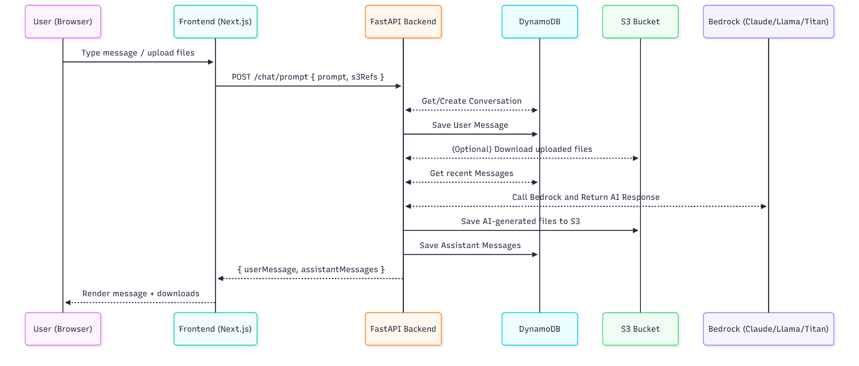
Notes:
Person 3
Finally to see this all in action lets look at this sequence diagram of a user utilizing the default free chat endpoint. Which is utilizing the file features of our platform while directly talking with aws bedrock. So starting off you can see the user send a message and perhaps a file via a presigned upload url Then the frontend calls the chat prompt endpoint on the backend which 1. Creates or gets the conversation
2. Next saves the user message in dynamo db 3. Then creates presigned download urls for any existing files in the conversation history
4. Proceeds to get all recent messages outside of the files and combines them all into a single prompt 5. Finally calls bedrock to get an ai response given the current conversation state and new message 6. Then if the AI response contains the appropriate custom json our system detects it stores the file content in s3 with the appropriate file name and extension
7. Finally the backend stores the remaining assistant messages and any s3 file pointers in dynamodb 8. The backend then sends the whole conversation back to the frontend and that is displayed on the user’s device This gets decently more complicated when utilizing our template system but this is the basic workflow for freechat. I won’t be going into the sequence complexity of the template system. I’ll pass this off to Liang

Slide 11
Challenges Limitations
DynamoDB schema design
AWS Infrastructure
Terraform Setup
AI Templates
Routing organization
AWS lacking support
Consistent Testing Coverage
Trello to Jira
Large file context limitation (Depends on model selection)
AWS credit usage
No User Authentication
Notes:
Person 4 - Liang
(DynamoDB Schema design)
One of the earliest and most persistent challenges was our DynamoDB design.
Since DynamoDB is a NoSQL database, it forced us to rethink how we structure relationships, meta data, access pattern. Getting the PK/SK model right required many iteration to ensure scalability and low cost.
(AWS Infrastructure, Terraform Setup, AWS Credit usage)
Next is our AWS infrastructure itself. At first we were working with multiple AWS services, Lambda, StepFunctions, EKS, S3, and more. Especially with Step Functions and Lambda running together. On top of that, having everything deployed directly and running 24/7 on AWS was draining our credits. That’s why we introduced Terraform as a way to control and rebuild our infrastructure more efficiently. But it also became its own challenge, because we had to set everything up from scratch — VPCs, subnets, EKS, EC2, and all the other pieces (AWS AI templates, Routing organization) We also faced challenges with both our AI templates and our routing setup. Each conversion task needed a different prompt structure, so we had to build a modular template executor while still keeping everything consistent and easy to maintain. Routing was another challenge because we don’t have Cognito(authentication feature) fully implemented yet. By hosting our frontend on CloudFront, our backend ends up being exposed publicly, so for now we rely on API Gateway as the layer between the frontend and backend.
(AWS Lacking Support)
Another difficulty was dealing with AWS support limitations. In our case, this mainly showed up when we tried to use Step Functions to pull an image from ECR and trigger a job on EKS. There was almost no solid documentation on how to do this, and the examples we did find used different versions of JSON formats that didn’t match what AWS currently supports. Because of that, a lot of tutorials were incompatible, which slowed us down and forced us to troubleshoot through trial and error (Consistent Testing Coverage) We also struggled with maintaining consistent testing coverage. A lot of our exception handling wasn’t fully tested, and on the frontend we ran into issues with element IDs and having too much logic packed into a single file, which made writing reliable tests more difficult. Planning to break it into components next semester. (Trello to Jira) We also experimented with using Trello, but the time-tracking features didn’t work well for our workflow. Because of that, we eventually switched to Jira, which gave us better tracking and organization for our tasks. (Large file context limitation) The biggest technical limitation is the large file context constraint, which depends on the model we use. Some LLMs can handle big files well, others cannot, so we have to be mindful of the model’s token limits when processing large codebases. (AWS Credit Usage) As stated before another issue is the AWS credit usage. Because we rely on many AI and AWS services, costs add up quickly, so we’ve had to limit how much we run in the cloud. To manage this, we now test most components locally using LocalStack, which helps us avoid unnecessary charges while still being able to simulate AWS services
(No user Authentication) Our main priority was getting the AI functionality working first, so authentication wasn’t the immediate focus. Now that the core AI features are stable, implementing secure auth will be one of our next major steps

Slide 12
Progress & Results
Complete:
Working chat system with Bedrock integration ✅
Full template engine ✅ (November 07, 2025)
File uploads with S3 pre-signed URLs ✅ (November 06, 2025)
Conversation/message persistence and saved to DynamoDB ✅ (October 27, 2025)
Improved architecture design ✅ (November 12, 2025)
Planned:
Full automation of code conversion
Automated code building & testing
Improving UI & User experience
Infrastructure Enhancement (will be on next slide)
Gitlab integration
Github repo link file pull
Cross Region Replication
Tree Sitter
Notes:
As the last presenter, I want to wrap everything together by talking about what this project has actually produced. not just the challenges we faced, but the tangible system we now have and where it’s headed.
When we started, the idea of an AI code converter sounded simple: give it some source code, pick a target language, and let the model handle the rest. But what we realized very quickly is that converting code reliably isn’t a prompt problem — it’s a systems problem. It requires storage, context management, execution, testing, and a controlled environment where the AI can reason about entire files, not just isolated snippets.
Over the last few months, we turned that into a working endtoend platform. We built a full chat system infrastructure by AWS, where the AI can hold stateful conversations, remember previous messages, and guide the user through structured templates. We didn’t just let users ask the model questions — we created a reusable template engine so different workflows, different source languages, and different output formats can all be driven by the same logic.
From there, we integrated file uploads to S3 buckets using presigned URLs, so users can provide real codebases without size limits or blowing through memory on the frontend. Conversations and message histories are persisted in DynamoDB, so the system has continuity, and any future user authentication layer can plug directly into it.
If you look at our architecture diagram, this is where it all comes together. The frontend is lightweight — React just controls user interaction and hands everything off to API Gateway. The backend then becomes the control plane. It orchestrates AI generation, handles template execution, stores metadata, and manages files. That’s where the intelligence lives — not in the UI, but in the workflow engine we created.
So where do we go from here?
The biggest next step is full automation. Right now, the AI produces conversion plans and generates source files, but execution still stops at generation. Our longterm goal is a pipeline where a legacy project goes in, and a runnable, tested, modern codebase comes out.
We want The moment files hit S3, to have the opportunity to go beyond conversation. Our architecture is tee’d up to support triggering a CI/CD pipeline, which means the converted code can eventually be compiled, scanned, tested, and even deployed inside a sandboxed environment on EKS. That’s a major distinction: lots of tools can generate code almost none validate that it actually works. Our system will be designed to close that loop.
To get there, we need two major enhancements:
First, parsing. Right now, we rely on models to infer structure from raw text. Adding a parser like TreeSitter lets us understand code semantically not just linebyline. That opens the door for dependency extraction, refactoring across files, and more deterministic conversions instead of purely generative ones.
Second, richer templates. Templates are the DNA of this system. They define how the AI thinks about the task. Adding domainspecific templates think aerospace libraries, embedded firmware patterns, cloud infrastructure scaffolding is how Lockheed could turn this from a general tool into an internal capability, tailored to their tech stack.
There are other roadmap items automated builds, Git integration, repobased ingestion but they all support the same end goal: turning AIassisted conversion from a clever demo into a repeatable pipeline.
To summarize: we now have a functioning architecture, a persistent conversation system, a template engine, file handling, cloud deployment, and a clear path forward. What started as “convert this code for me” is evolving into a platform that can modernize entire systems, not just rewrite syntax.
And the most exciting part is that the foundation is already in place. From here, it’s not about whether this can scale it’s about how far we want to take it

Slide 13


Progress & Strategic Roadmap
PHASE 1: FOUNDATION (COMPLETE)
Conversation persistence & DynamoDB
S3 File uploads (Presigned URLs)
Full template engine integration
Improved architecture & design
CURRENT: CHAT & BEDROCK
Working chat system with seamless Bedrock integration
PHASE 2: AUTOMATION & SCALING (PLANNED)
Code conversion & build automation
Gitlab/Github integration & file pull
Infrastructure: Cross Region Replication
UI/UX Improvements & Tree Sitter
Infrastructure Enhancement (Next Slide)
Notes:
As the last presenter, I want to wrap everything together by talking about what this project has actually produced. not just the challenges we faced, but the tangible system we now have and where it’s headed.
When we started, the idea of an AI code converter sounded simple: give it some source code, pick a target language, and let the model handle the rest. But what we realized very quickly is that converting code reliably isn’t a prompt problem — it’s a systems problem. It requires storage, context management, execution, testing, and a controlled environment where the AI can reason about entire files, not just isolated snippets.
Over the last few months, we turned that into a working endtoend platform. We built a full chat system infrastructure by AWS, where the AI can hold stateful conversations, remember previous messages, and guide the user through structured templates. We didn’t just let users ask the model questions — we created a reusable template engine so different workflows, different source languages, and different output formats can all be driven by the same logic.
From there, we integrated file uploads to S3 buckets using presigned URLs, so users can provide real codebases without size limits or blowing through memory on the frontend. Conversations and message histories are persisted in DynamoDB, so the system has continuity, and any future user authentication layer can plug directly into it.
If you look at our architecture diagram, this is where it all comes together. The frontend is lightweight — React just controls user interaction and hands everything off to API Gateway. The backend then becomes the control plane. It orchestrates AI generation, handles template execution, stores metadata, and manages files. That’s where the intelligence lives — not in the UI, but in the workflow engine we created.
So where do we go from here?
The biggest next step is full automation. Right now, the AI produces conversion plans and generates source files, but execution still stops at generation. Our longterm goal is a pipeline where a legacy project goes in, and a runnable, tested, modern codebase comes out.
We want The moment files hit S3, to have the opportunity to go beyond conversation. Our architecture is tee’d up to support triggering a CI/CD pipeline, which means the converted code can eventually be compiled, scanned, tested, and even deployed inside a sandboxed environment on EKS. That’s a major distinction: lots of tools can generate code almost none validate that it actually works. Our system will be designed to close that loop.
To get there, we need two major enhancements:
First, parsing. Right now, we rely on models to infer structure from raw text. Adding a parser like TreeSitter lets us understand code semantically not just linebyline. That opens the door for dependency extraction, refactoring across files, and more deterministic conversions instead of purely generative ones.
Second, richer templates. Templates are the DNA of this system. They define how the AI thinks about the task. Adding domainspecific templates think aerospace libraries, embedded firmware patterns, cloud infrastructure scaffolding is how Lockheed could turn this from a general tool into an internal capability, tailored to their tech stack.
There are other roadmap items automated builds, Git integration, repobased ingestion but they all support the same end goal: turning AIassisted conversion from a clever demo into a repeatable pipeline.
To summarize: we now have a functioning architecture, a persistent conversation system, a template engine, file handling, cloud deployment, and a clear path forward. What started as “convert this code for me” is evolving into a platform that can modernize entire systems, not just rewrite syntax.
And the most exciting part is that the foundation is already in place. From here, it’s not about whether this can scale it’s about how far we want to take it

Slide 14
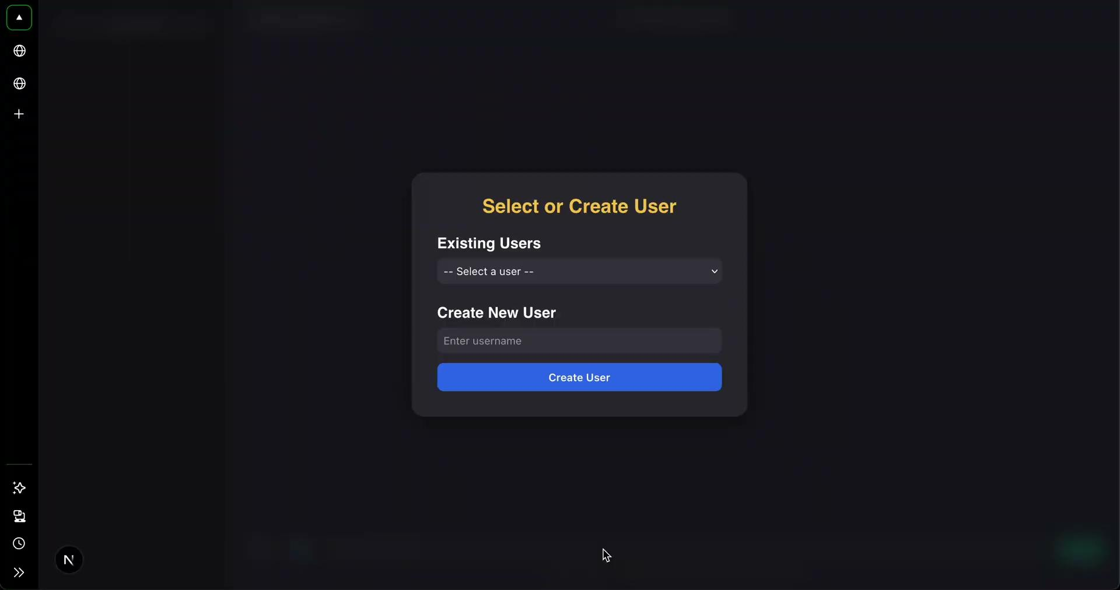
Feature Demo?
User Selection
Template demo
Feedback loops
Target language selection
Automated responses
Free chat
File by file Template
Model switch
Backend docs page (OpenAPI)
Notes:
Person 4 - Liang

Slide 15
Q&A
Notes:
Person 5

Slide 16
Thank You for Watching
Notes:
Person 5

