Slide 1
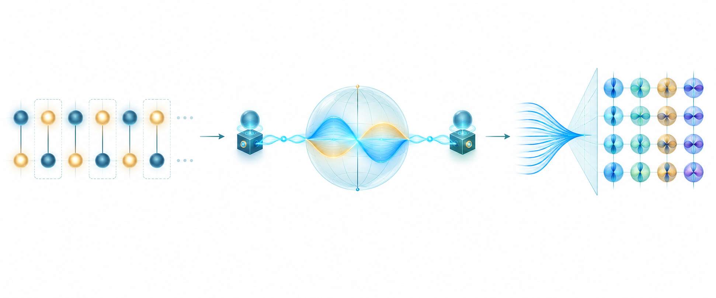
Simon’s Periodicity, Quantum Teleportation, DFT & QFT
From hidden XOR structure → transfer of an unknown quantum state → Fourier basis change

Slide 2
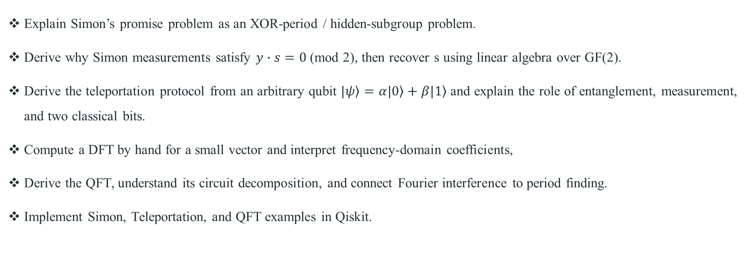
Week 9 Learning Objectives
Explain Simon’s promise problem as an XOR-period / hidden-subgroup problem.
Derive why Simon measurements satisfy $y∙s=0$ (mod 2), then recover s using linear algebra over GF(2).
Derive the teleportation protocol from an arbitrary qubit $\left.|ψ\right\rangle =α\left.|0\right\rangle +β\left.|1\right\rangle$ and explain the role of entanglement, measurement, and two classical bits.
Compute a DFT by hand for a small vector and interpret frequency-domain coefficients,
Derive the QFT, understand its circuit decomposition, and connect Fourier interference to period finding.
Implement Simon, Teleportation, and QFT examples in Qiskit.

Slide 3
Road map
Part I — Simon
Parts II–III
Periodicity as XOR symmetry
Teleportation: full derivation + Qiskit
State evolution and interference
DFT: explicit N=4 calculation
GF(2) equations + worked example
QFT: formula, circuit, N=4 example
Complexity and Qiskit
DFT vs QFT and period finding

Slide 4
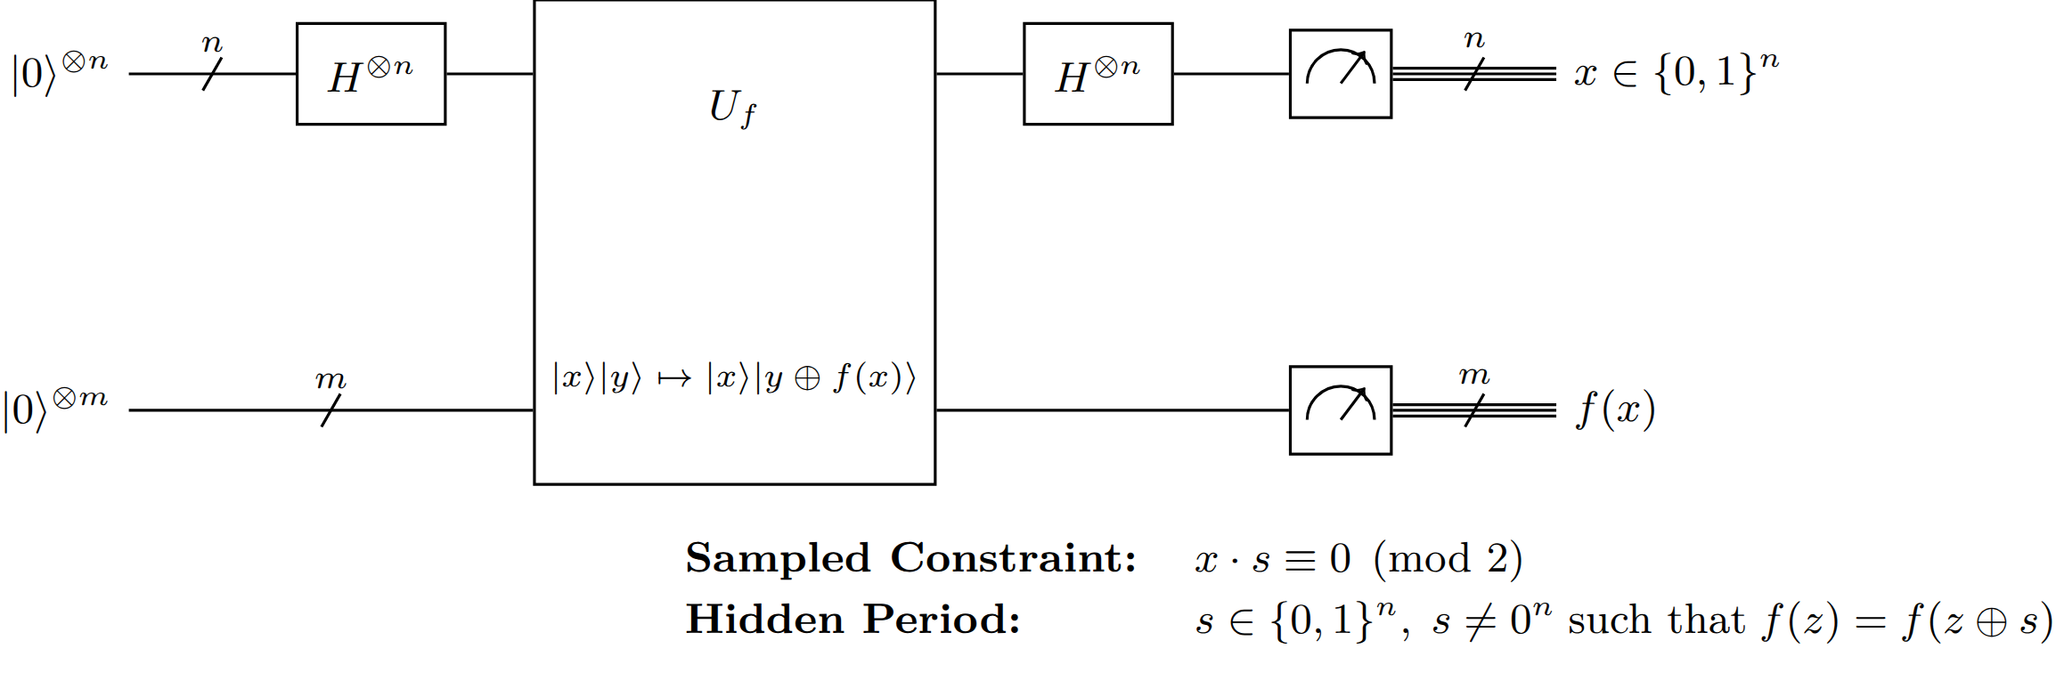
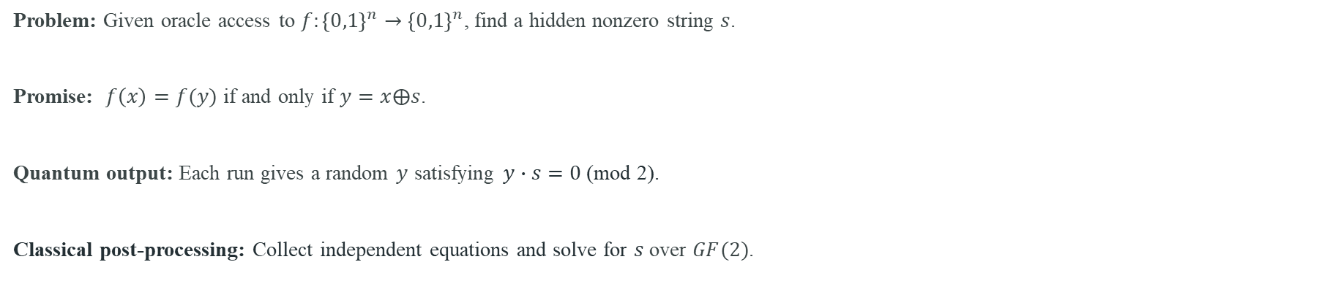
Simon: very brief recap
Problem: Given oracle access to $f:{\left\{0,1\right\}}^{n}→{\left\{0,1\right\}}^{n}$, find a hidden nonzero string $s$.
Promise: $f\left(x\right)=f(y)$ if and only if $y=x⨁s$.
Quantum output: Each run gives a random $y$ satisfying $y∙s=0$ (mod 2).
Classical post-processing: Collect independent equations and solve for $s$ over $GF(2)$.

Slide 5
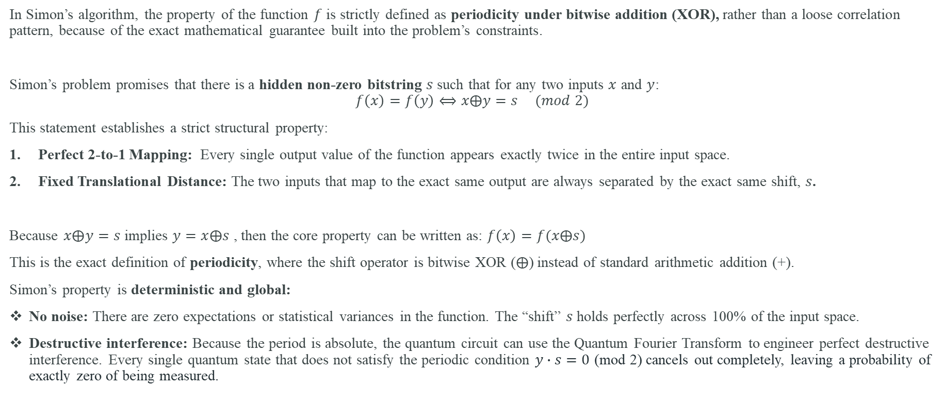
Simon’s algorithm: the promise is exact xor periodicity
In Simon’s algorithm, the property of the function $f$ is strictly defined as periodicity under bitwise addition (XOR), rather than a loose correlation pattern, because of the exact mathematical guarantee built into the problem’s constraints.
Simon’s problem promises that there is a hidden non-zero bitstring $s$ such that for any two inputs $x$ and $y$:
$$f\left(x\right)=f\left(y\right)⟺x⨁y=s (mod 2)$$
This statement establishes a strict structural property:
Perfect 2-to-1 Mapping: Every single output value of the function appears exactly twice in the entire input space.
Fixed Translational Distance: The two inputs that map to the exact same output are always separated by the exact same shift, $s$.
Because $x⨁y=s$ implies $y=x⨁s$ , then the core property can be written as: $f\left(x\right)=f(x⨁s)$
This is the exact definition of periodicity, where the shift operator is bitwise XOR ($⨁$) instead of standard arithmetic addition (+).
Simon’s property is deterministic and global:
No noise: There are zero expectations or statistical variances in the function. The “shift” $s$ holds perfectly across 100% of the input space.
Destructive interference: Because the period is absolute, the quantum circuit can use the Quantum Fourier Transform to engineer perfect destructive interference. Every single quantum state that does not satisfy the periodic condition $y∙s=0$ (mod 2) cancels out completely, leaving a probability of exactly zero of being measured.

Slide 6
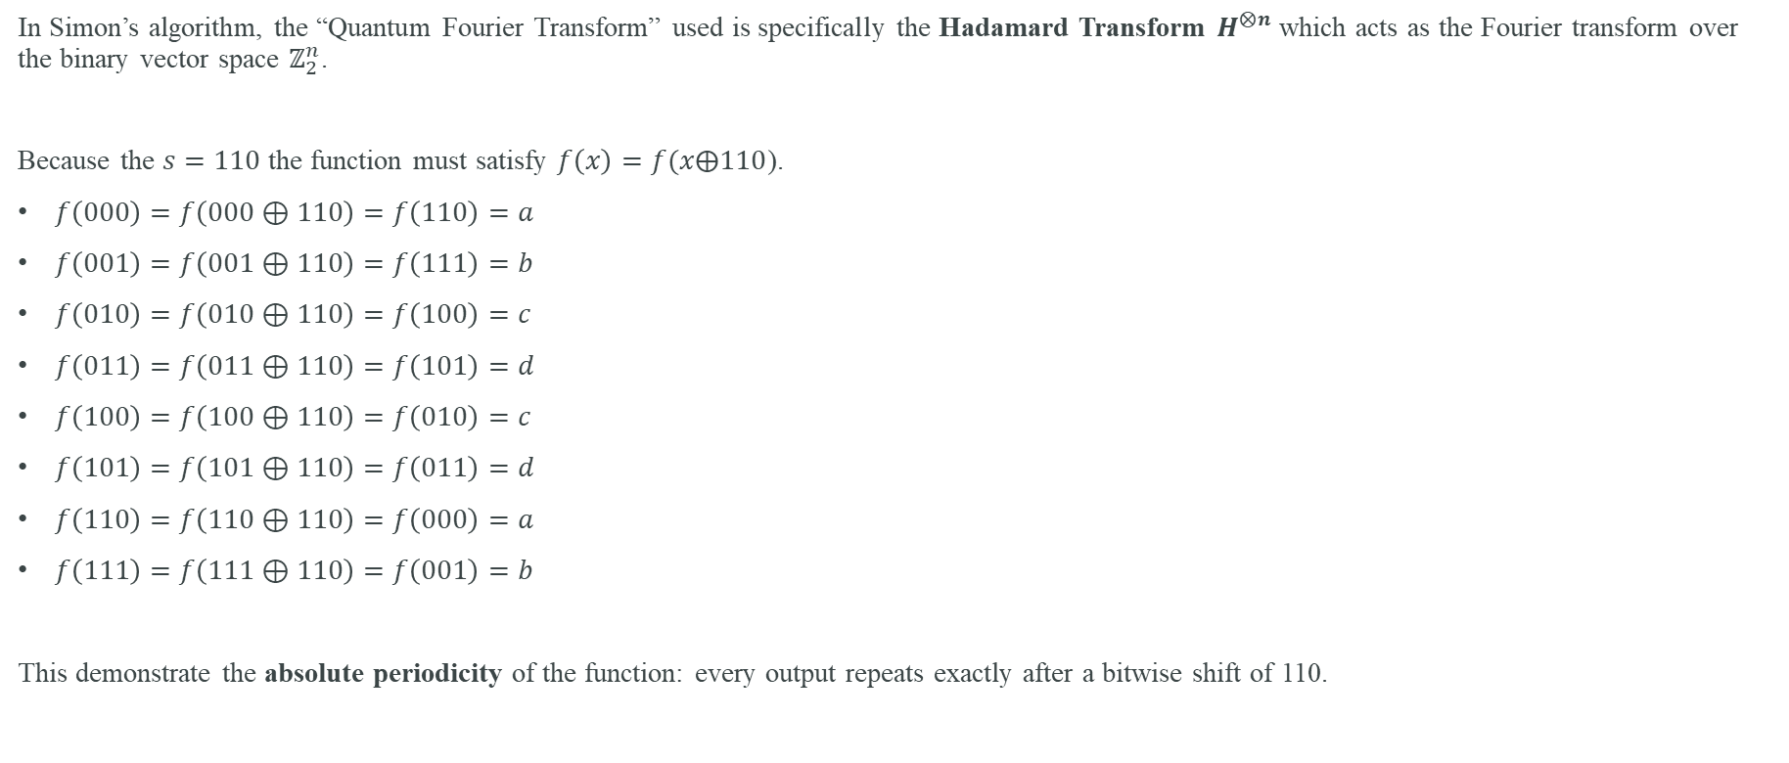
Simon’s Algorithm a 3-qubit example with the hidden period $s=110$
In Simon’s algorithm, the “Quantum Fourier Transform” used is specifically the Hadamard Transform $H^{⨂n}$ which acts as the Fourier transform over the binary vector space $ℤ_{2}^{n}$.
Because the $s=110$ the function must satisfy $f\left(x\right)=f(x⨁110$).
$f\left(000\right)=f\left(000⊕110\right)=f\left(110\right)=a$
$f\left(001\right)=f\left(001⊕110\right)=f\left(111\right)=b$
$f\left(010\right)=f\left(010⊕110\right)=f\left(100\right)=c$
$f\left(011\right)=f\left(011⊕110\right)=f\left(101\right)=d$
$f\left(100\right)=f\left(100⊕110\right)=f\left(010\right)=c$
$f\left(101\right)=f\left(101⊕110\right)=f\left(011\right)=d$
$f\left(110\right)=f\left(110⊕110\right)=f\left(000\right)=a$
$f\left(111\right)=f\left(111⊕110\right)=f\left(001\right)=b$
This demonstrate the absolute periodicity of the function: every output repeats exactly after a bitwise shift of 110.

Slide 7
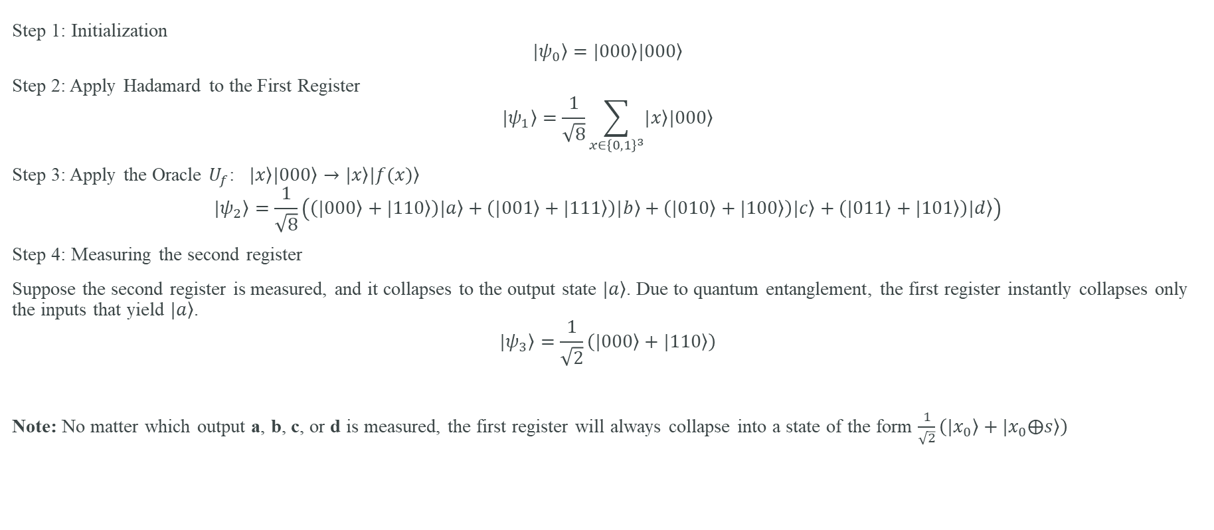
Simon’s Algorithm: Quantum Circuit Step-by-Step
Step 1: Initialization
$$\left.|ψ_{0}\right\rangle =\left.|000\right\rangle \left.|000\right\rangle$$
Step 2: Apply Hadamard to the First Register
$$\left.|ψ_{1}\right\rangle =\frac{1}{\sqrt{8}}\sum_{x∈{\left\{0,1\right\}}^{3}}{\left.|x\right\rangle \left.|000\right\rangle }$$
Step 3: Apply the Oracle $U_{f}$: $\left.|x\right\rangle \left.|000\right\rangle →\left.|x\right\rangle \left.|f(x)\right\rangle$
$$\left.|ψ_{2}\right\rangle =\frac{1}{\sqrt{8}}\left(\left(\left.|000\right\rangle +\left.|110\right\rangle \right)\left.|a\right\rangle +\left(\left.|001\right\rangle +\left.|111\right\rangle \right)\left.|b\right\rangle +\left(\left.|010\right\rangle +\left.|100\right\rangle \right)\left.|c\right\rangle +\left(\left.|011\right\rangle +\left.|101\right\rangle \right)\left.|d\right\rangle \right)$$
Step 4: Measuring the second register
Suppose the second register is measured, and it collapses to the output state $\left.|a\right\rangle$. Due to quantum entanglement, the first register instantly collapses only the inputs that yield $\left.|a\right\rangle$.
$$\left.|ψ_{3}\right\rangle =\frac{1}{\sqrt{2}}\left(\left.|000\right\rangle +\left.|110\right\rangle \right)$$
Note: No matter which output a, b, c, or d is measured, the first register will always collapse into a state of the form $\frac{1}{\sqrt{2}}\left(\left.|x_{0}\right\rangle +\left.|x_{0}⨁s\right\rangle \right)$

Slide 8
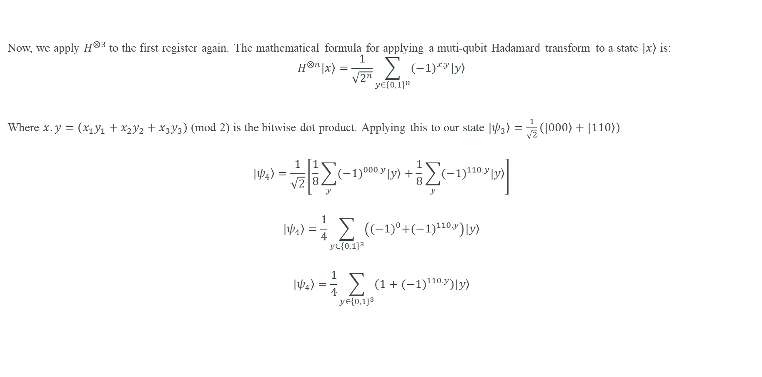
The Walsh-Hadamard Transform (QFT over $ℤ_{2}^{n}$)
Now, we apply $H^{⨂3}$ to the first register again. The mathematical formula for applying a muti-qubit Hadamard transform to a state $\left.|x\right\rangle$ is:
$$H^{⨂n}\left.|x\right\rangle =\frac{1}{\sqrt{2^{n}}}\sum_{y∈{\left\{0,1\right\}}^{n}}{{(−1)}^{x.y}\left.|y\right\rangle }$$
Where $x.y=\left(x_{1}y_{1}+x_{2}y_{2}+x_{3}y_{3}\right)$ (mod 2) is the bitwise dot product. Applying this to our state $\left.|ψ_{3}\right\rangle =\frac{1}{\sqrt{2}}\left(\left.|000\right\rangle +\left.|110\right\rangle \right)$
$$\left.|ψ_{4}\right\rangle =\frac{1}{\sqrt{2}}\left[\frac{1}{8}\sum_{y}{{(−1)}^{000.y}\left.|y\right\rangle }+\frac{1}{8}\sum_{y}{{(−1)}^{110.y}\left.|y\right\rangle }\right]$$
$$\left.|ψ_{4}\right\rangle =\frac{1}{4}\sum_{y∈{\left\{0,1\right\}}^{3}}{\left({(−1)}^{0}+{(−1)}^{110.y}\right)\left.|y\right\rangle }$$
$$\left.|ψ_{4}\right\rangle =\frac{1}{4}\sum_{y∈{\left\{0,1\right\}}^{3}}{\left(1+{(−1)}^{110.y}\right)\left.|y\right\rangle }$$

Slide 9
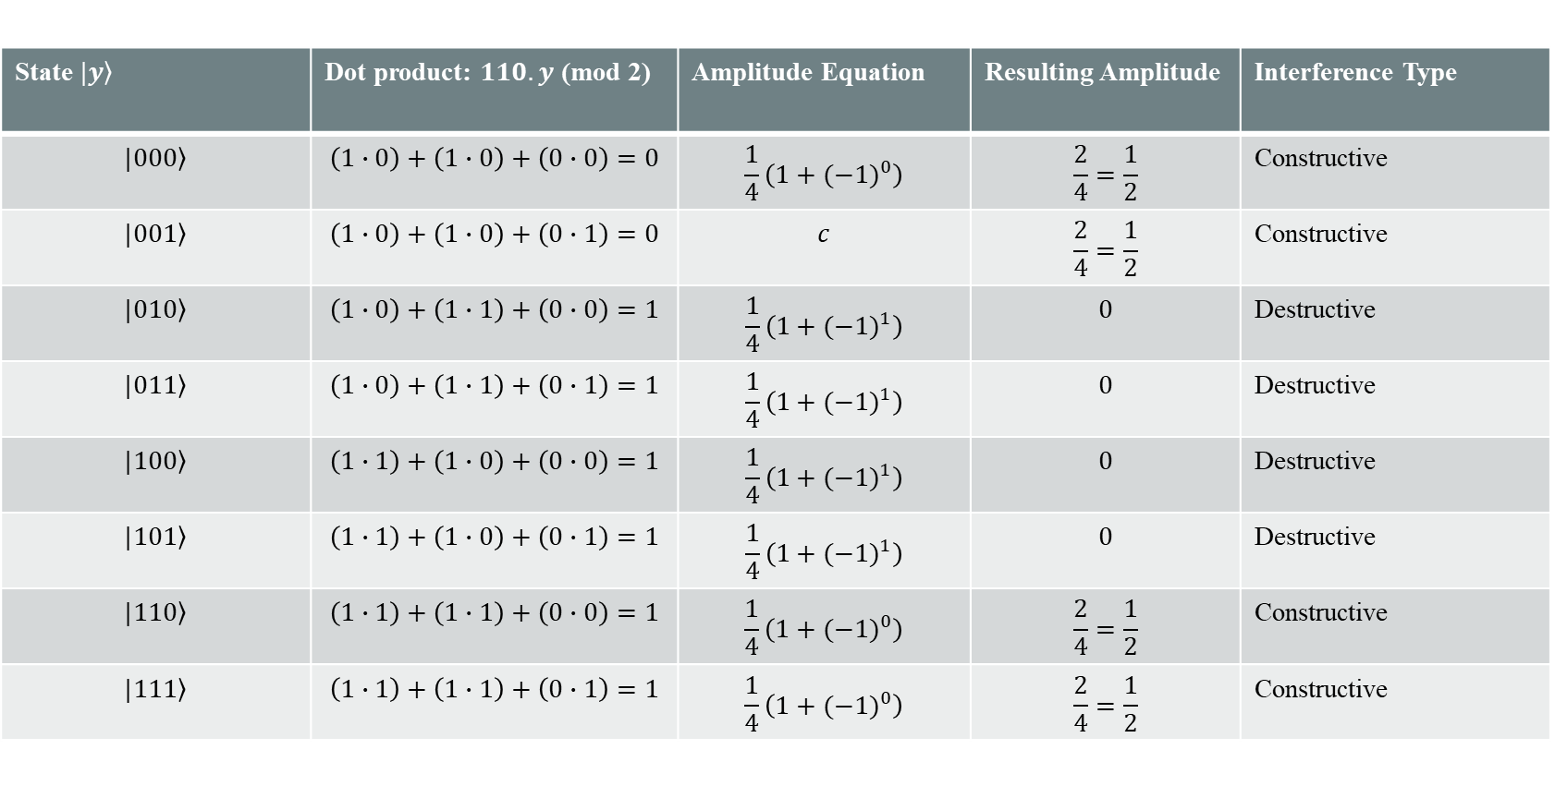
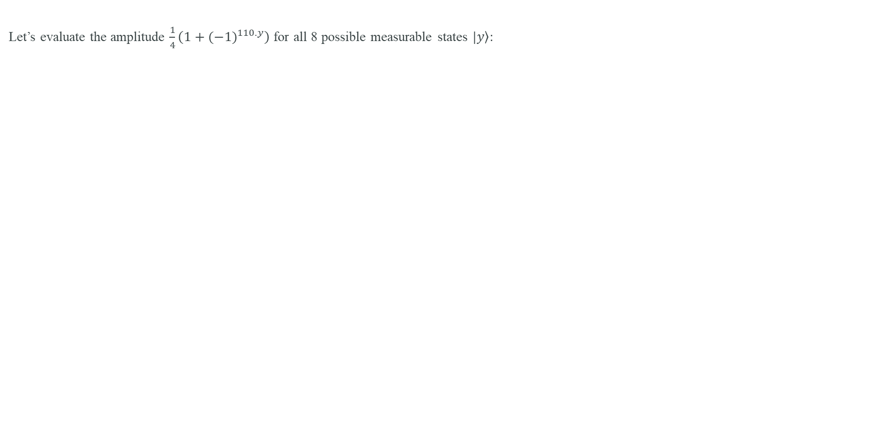
Destructive vs. Constructive Interference
Let’s evaluate the amplitude $\frac{1}{4}\left(1+{(−1)}^{110.y}\right)$ for all 8 possible measurable states $\left.|y\right\rangle :$
State $\left.|y\right\rangle$ | Dot product: $110.y$ (mod 2) | Amplitude Equation | Resulting Amplitude | Interference Type
$$\left.|000\right\rangle$$ | $$\left(1∙0\right)+\left(1∙0\right)+\left(0∙0\right)=0$$ | $$\frac{1}{4}\left(1+{(−1)}^{0}\right)$$ | $$\frac{2}{4}=\frac{1}{2}$$ | Constructive
$$\left.|001\right\rangle$$ | $$\left(1∙0\right)+\left(1∙0\right)+\left(0∙1\right)=0$$ | $$c$$ | $$\frac{2}{4}=\frac{1}{2}$$ | Constructive
$$\left.|010\right\rangle$$ | $$\left(1∙0\right)+\left(1∙1\right)+\left(0∙0\right)=1$$ | $$\frac{1}{4}\left(1+{(−1)}^{1}\right)$$ | $$0$$ | Destructive
$$\left.|011\right\rangle$$ | $$\left(1∙0\right)+\left(1∙1\right)+\left(0∙1\right)=1$$ | $$\frac{1}{4}\left(1+{(−1)}^{1}\right)$$ | $$0$$ | Destructive
$$\left.|100\right\rangle$$ | $$\left(1∙1\right)+\left(1∙0\right)+\left(0∙0\right)=1$$ | $$\frac{1}{4}\left(1+{(−1)}^{1}\right)$$ | $$0$$ | Destructive
$$\left.|101\right\rangle$$ | $$\left(1∙1\right)+\left(1∙0\right)+\left(0∙1\right)=1$$ | $$\frac{1}{4}\left(1+{(−1)}^{1}\right)$$ | $$0$$ | Destructive
$$\left.|110\right\rangle$$ | $$\left(1∙1\right)+\left(1∙1\right)+\left(0∙0\right)=1$$ | $$\frac{1}{4}\left(1+{(−1)}^{0}\right)$$ | $$\frac{2}{4}=\frac{1}{2}$$ | Constructive
$$\left.|111\right\rangle$$ | $$\left(1∙1\right)+\left(1∙1\right)+\left(0∙1\right)=1$$ | $$\frac{1}{4}\left(1+{(−1)}^{0}\right)$$ | $$\frac{2}{4}=\frac{1}{2}$$ | Constructive

Slide 10
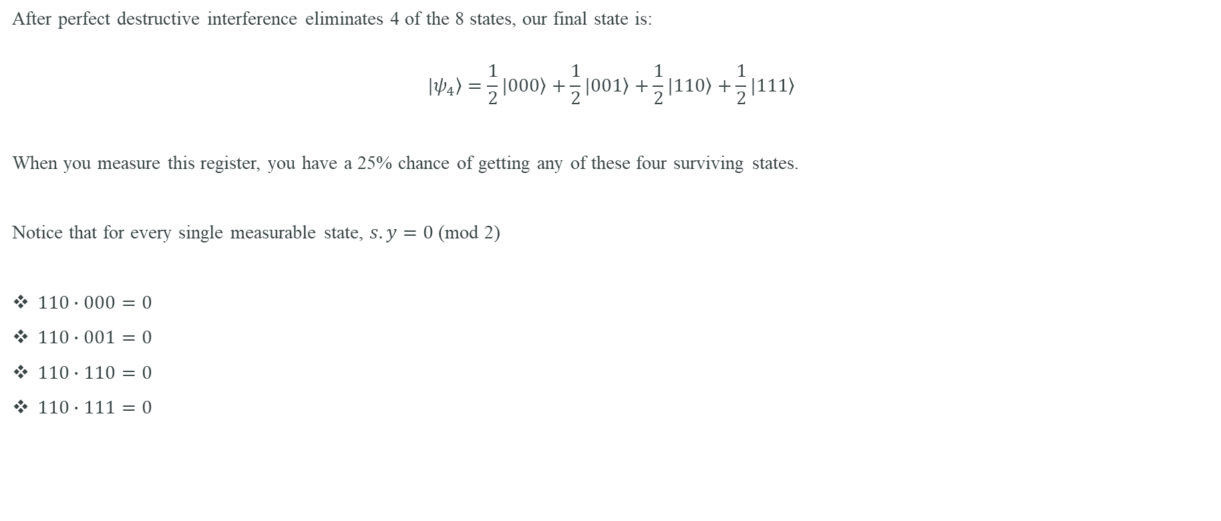
Final State and Measurement
After perfect destructive interference eliminates 4 of the 8 states, our final state is:
$$\left.|ψ_{4}\right\rangle =\frac{1}{2}\left.|000\right\rangle +\frac{1}{2}\left.|001\right\rangle +\frac{1}{2}\left.|110\right\rangle +\frac{1}{2}\left.|111\right\rangle$$
When you measure this register, you have a 25% chance of getting any of these four surviving states.
Notice that for every single measurable state, $s.y=0$ (mod 2)
$110∙000=0$
$110∙001=0$
$110∙110=0$
$110∙111=0$

Slide 11
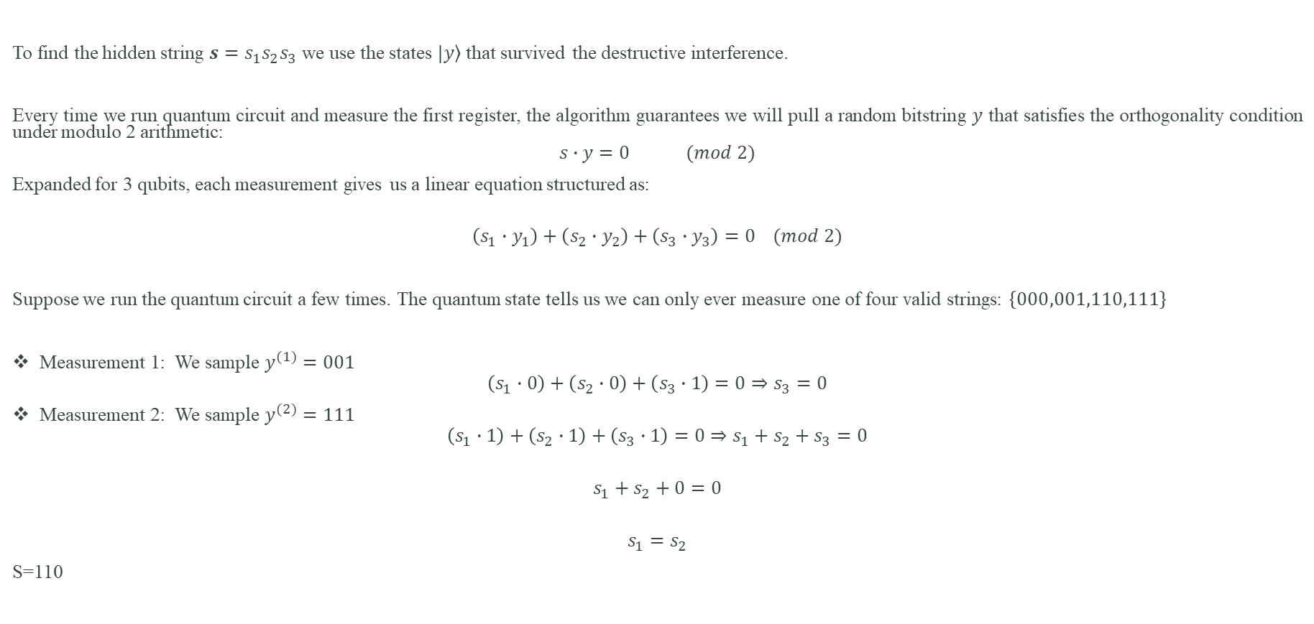
Classical post-processing to find $s$ string
To find the hidden string $s=s_{1}s_{2}s_{3}$ we use the states $\left.|y\right\rangle$ that survived the destructive interference.
Every time we run quantum circuit and measure the first register, the algorithm guarantees we will pull a random bitstring $y$ that satisfies the orthogonality condition under modulo 2 arithmetic:
$$s∙y=0 (mod 2)$$
Expanded for 3 qubits, each measurement gives us a linear equation structured as:
$$\left(s_{1}∙y_{1}\right)+\left(s_{2}∙y_{2}\right)+\left(s_{3}∙y_{3}\right)=0 (mod 2)$$
Suppose we run the quantum circuit a few times. The quantum state tells us we can only ever measure one of four valid strings: $\left\{000,001,110,111\right\}$
Measurement 1: We sample $y^{(1)}=001$
$$\left(s_{1}∙0\right)+\left(s_{2}∙0\right)+\left(s_{3}∙1\right)=0⇒s_{3}=0$$
Measurement 2: We sample $y^{(2)}=111$
$$\left(s_{1}∙1\right)+\left(s_{2}∙1\right)+\left(s_{3}∙1\right)=0⇒{s_{1}+s_{2}+s}_{3}=0$$
$$s_{1}+s_{2}+0=0$$
$$s_{1}=s_{2}$$
S=110

Slide 12
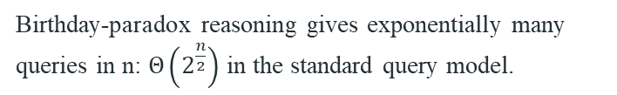
Complexity: what the speedup statement means
Quantum
Classical randomized oracle model
O(n) oracle samples are sufficient to obtain enough independent equations with high probability.
Finding s requires discovering a collision.
Polynomial-time GF(2) elimination recovers s.
Birthday-paradox reasoning gives exponentially many queries in n: $Θ\left(2^{\frac{n}{2}}\right)$ in the standard query model.
Total idealized algorithm is polynomial in n.
Simon therefore gives an exponential query separation.

Slide 13
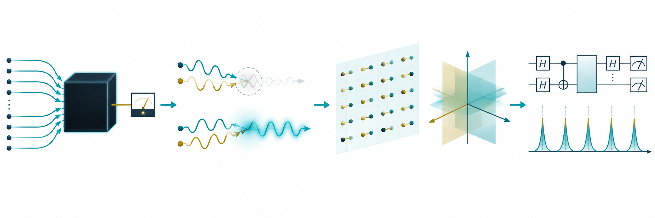
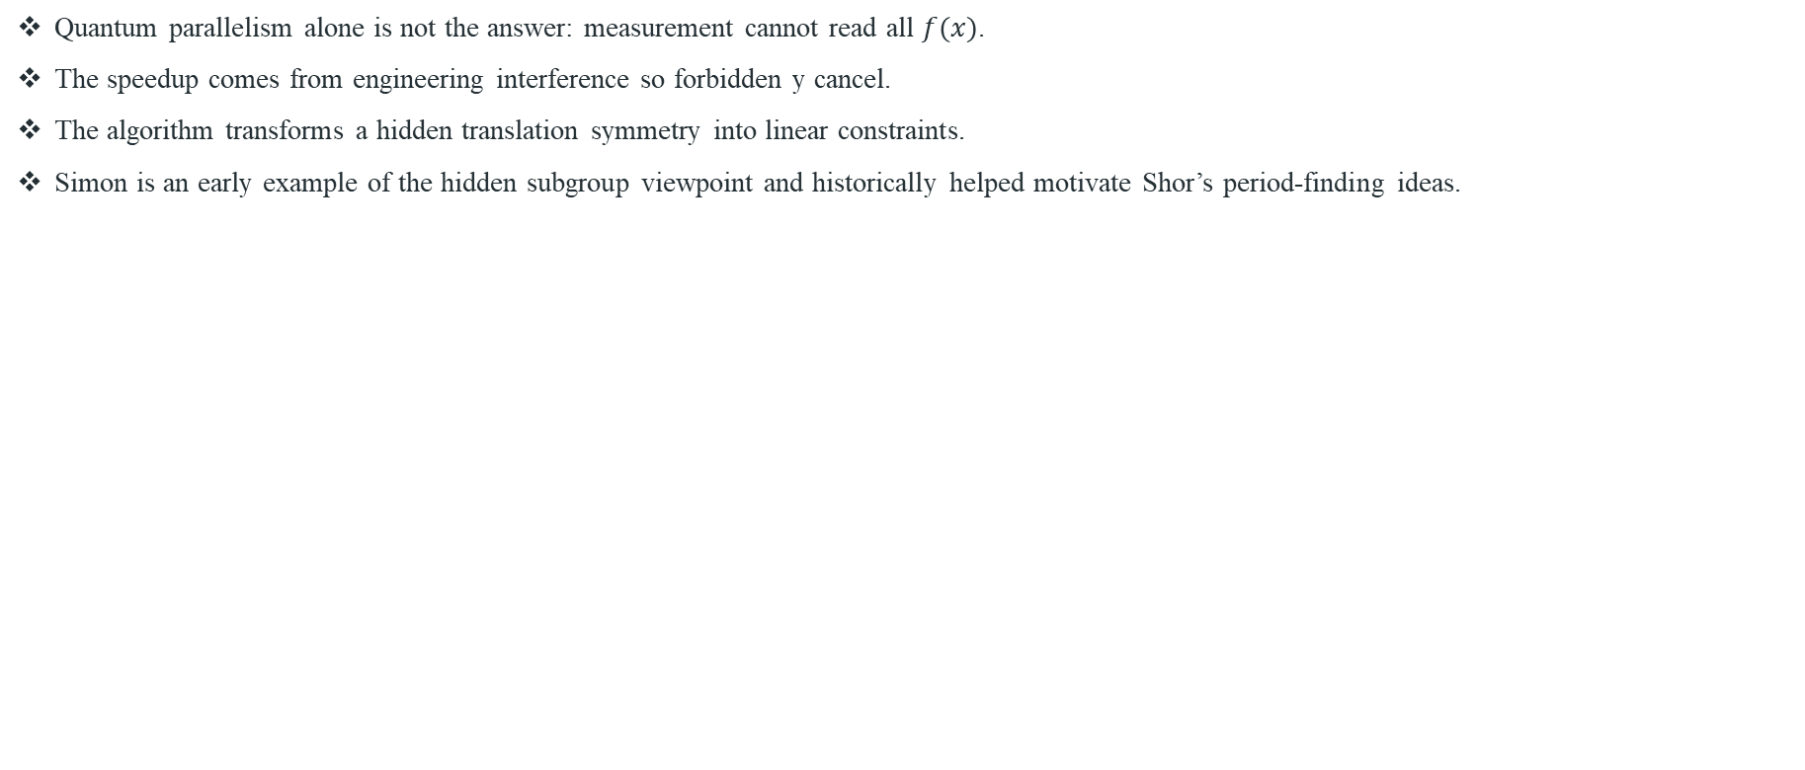
Simon: conceptual lessons
Quantum parallelism alone is not the answer: measurement cannot read all $f(x)$.
The speedup comes from engineering interference so forbidden y cancel.
The algorithm transforms a hidden translation symmetry into linear constraints.
Simon is an early example of the hidden subgroup viewpoint and historically helped motivate Shor’s period-finding ideas.

Slide 14
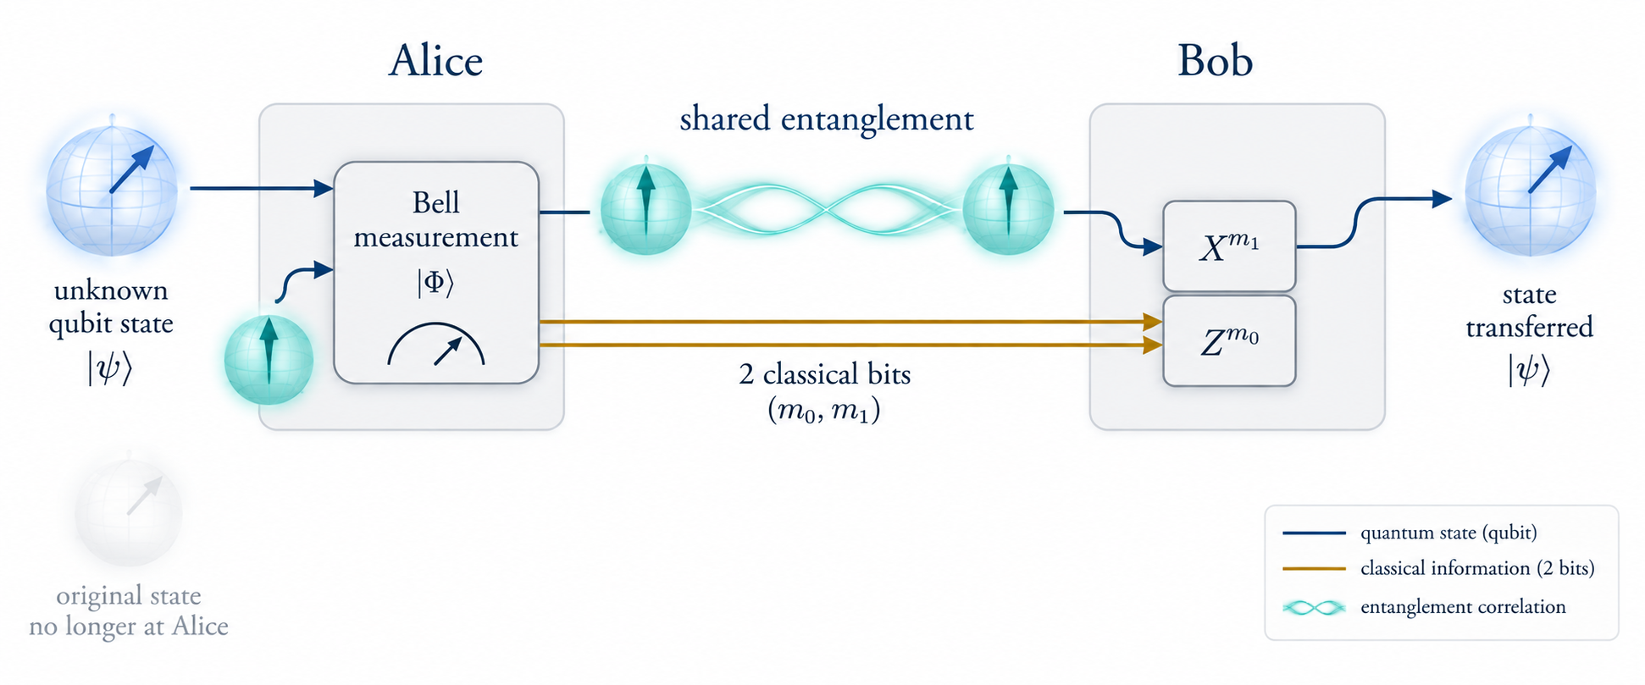
Quantum teleportation
Quantum teleportation is a protocol that allows you to transfer an unknown quantum state (a qubit) from one location to another using a shared pair of entangled qubits and classical communication.
In quantum teleportation no matter or energy is physically teleported.
The information that describes the quantum state is transferred.
because it relies on sending classical bits (by a phone call, text, or internet packet), quantum teleportation cannot happen faster than the speed of light.

Slide 15
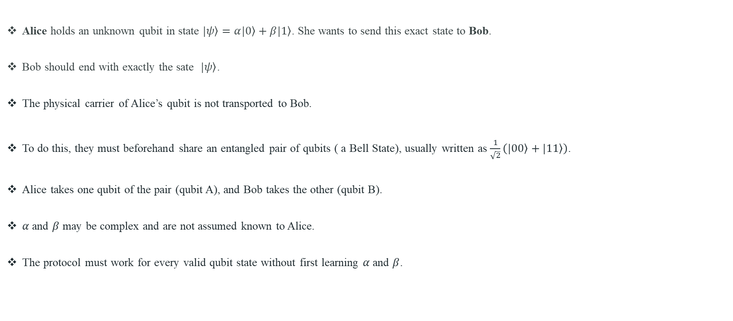
The Scenario: Alice and Bob
Alice holds an unknown qubit in state $\left.|ψ\right\rangle =α\left.|0\right\rangle +β\left.|1\right\rangle$. She wants to send this exact state to Bob.
Bob should end with exactly the sate $\left.|ψ\right\rangle$.
The physical carrier of Alice’s qubit is not transported to Bob.
To do this, they must beforehand share an entangled pair of qubits ( a Bell State), usually written as $\frac{1}{\sqrt{2}}\left(\left.|00\right\rangle +\left.|11\right\rangle \right)$.
Alice takes one qubit of the pair (qubit A), and Bob takes the other (qubit B).
$α$ and $β$ may be complex and are not assumed known to Alice.
The protocol must work for every valid qubit state without first learning $α$ and $β$.

Slide 16
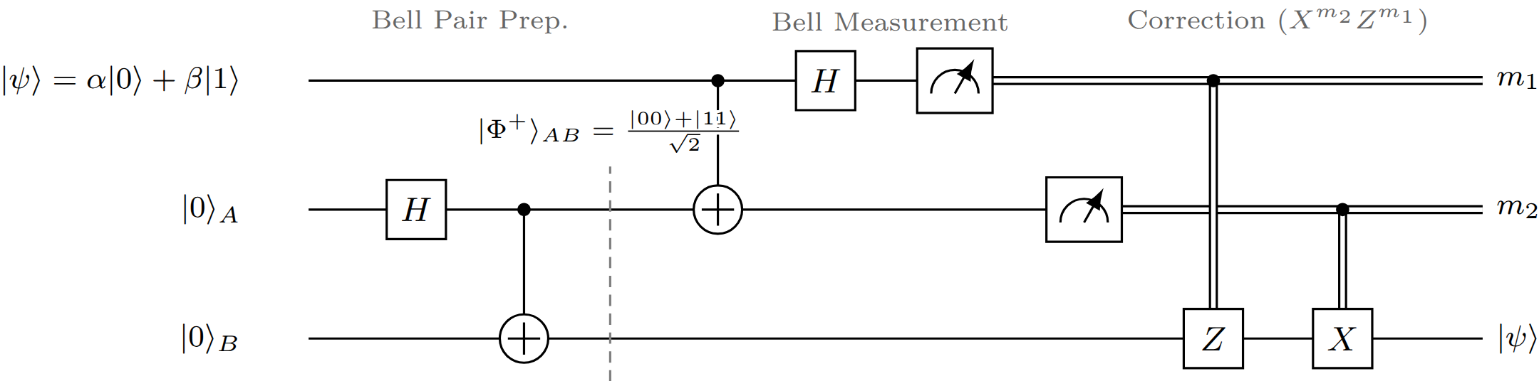
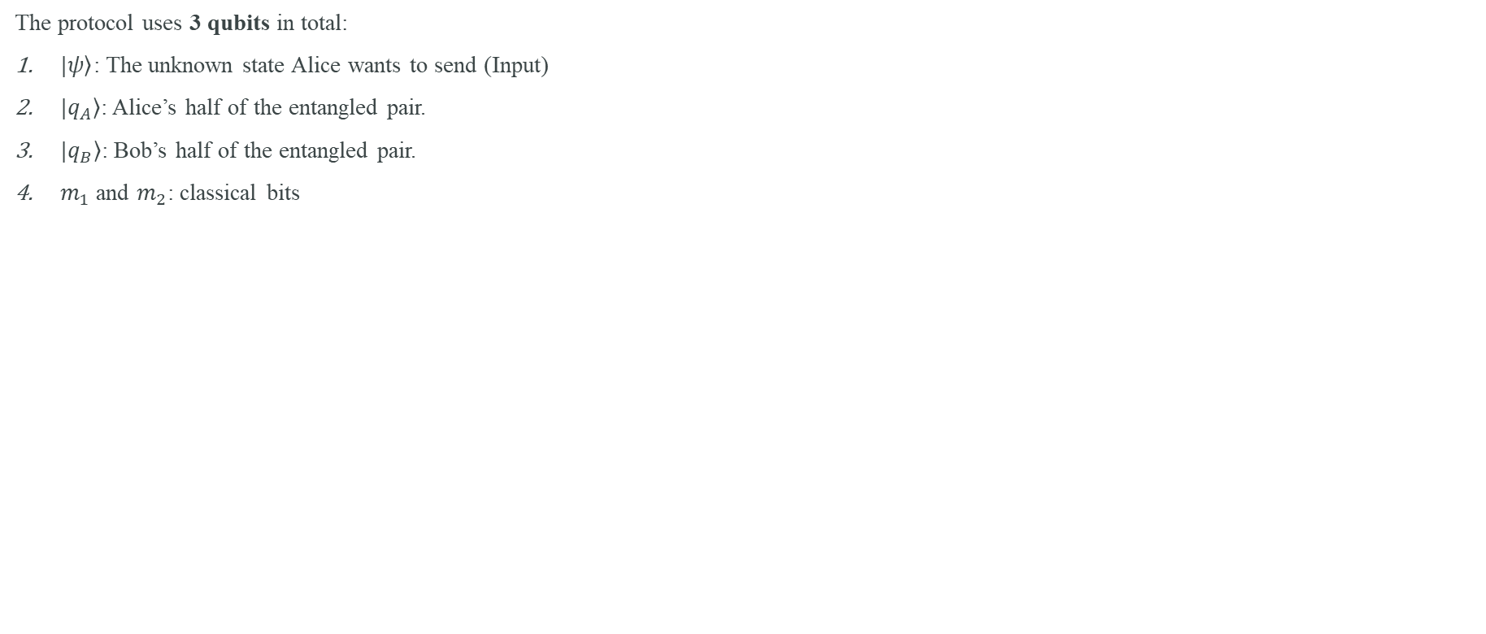
The Quantum Teleportation Circuit
The protocol uses 3 qubits in total:
$\left.|ψ\right\rangle$: The unknown state Alice wants to send (Input)
$\left.|q_{A}\right\rangle$: Alice’s half of the entangled pair.
$\left.|q_{B}\right\rangle$: Bob’s half of the entangled pair.
$m_{1}$ and $m_{2}$: classical bits

Slide 17
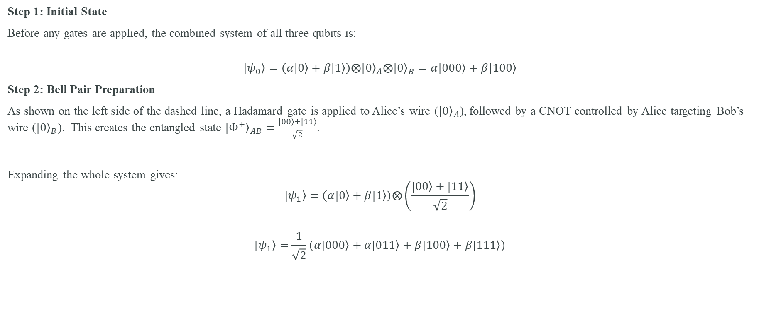
The step-by-step mathematical breakdown of Quantum Teleportation Circuit - I
Step 1: Initial State
Before any gates are applied, the combined system of all three qubits is:
$$\left.|ψ_{0}\right\rangle =\left(α\left.|0\right\rangle +β\left.|1\right\rangle \right)⨂{\left.|0\right\rangle }_{A}⨂{\left.|0\right\rangle }_{B}=α\left.|000\right\rangle +\left.β|100\right\rangle$$
Step 2: Bell Pair Preparation
As shown on the left side of the dashed line, a Hadamard gate is applied to Alice’s wire (${\left.|0\right\rangle }_{A}$), followed by a CNOT controlled by Alice targeting Bob’s wire (${\left.|0\right\rangle }_{B}$). This creates the entangled state ${\left.|Φ^{+}\right\rangle }_{AB}=\frac{\left.|00\right\rangle +\left.|11\right\rangle }{\sqrt{2}}$.
Expanding the whole system gives:
$$\left.|ψ_{1}\right\rangle =\left(α\left.|0\right\rangle +β\left.|1\right\rangle \right)⨂\left(\frac{\left.|00\right\rangle +\left.|11\right\rangle }{\sqrt{2}}\right)$$
$$\left.|ψ_{1}\right\rangle =\frac{1}{\sqrt{2}}\left(α\left.|000\right\rangle +α\left.|011\right\rangle +β\left.|100\right\rangle +β\left.|111\right\rangle \right)$$

Slide 18
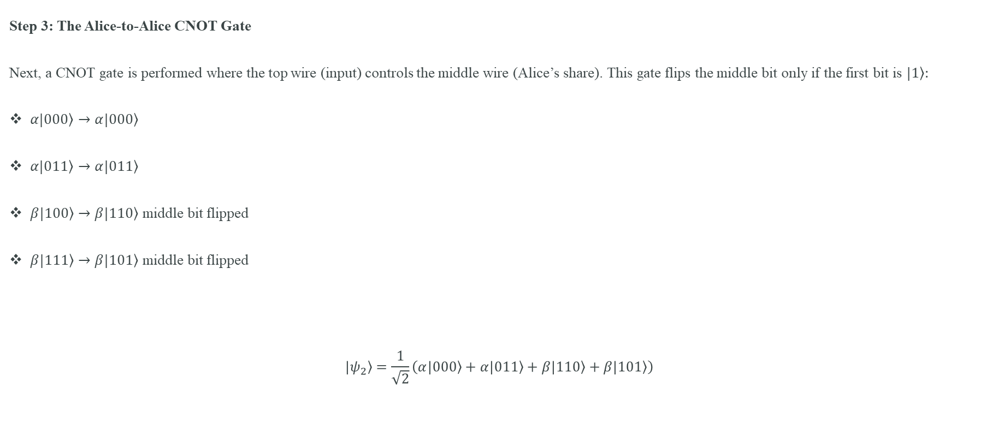
The step-by-step mathematical breakdown of Quantum Teleportation Circuit - II
Step 3: The Alice-to-Alice CNOT Gate
Next, a CNOT gate is performed where the top wire (input) controls the middle wire (Alice’s share). This gate flips the middle bit only if the first bit is $\left.|1\right\rangle :$
$α\left.|000\right\rangle →α\left.|000\right\rangle$
$α\left.|011\right\rangle →α\left.|011\right\rangle$
$\left.β|100\right\rangle →β\left.|110\right\rangle$ middle bit flipped
$\left.β|111\right\rangle →β\left.|101\right\rangle$ middle bit flipped
$$\left.|ψ_{2}\right\rangle =\frac{1}{\sqrt{2}}\left(α\left.|000\right\rangle +α\left.|011\right\rangle +β\left.|110\right\rangle +β\left.|101\right\rangle \right)$$

Slide 19
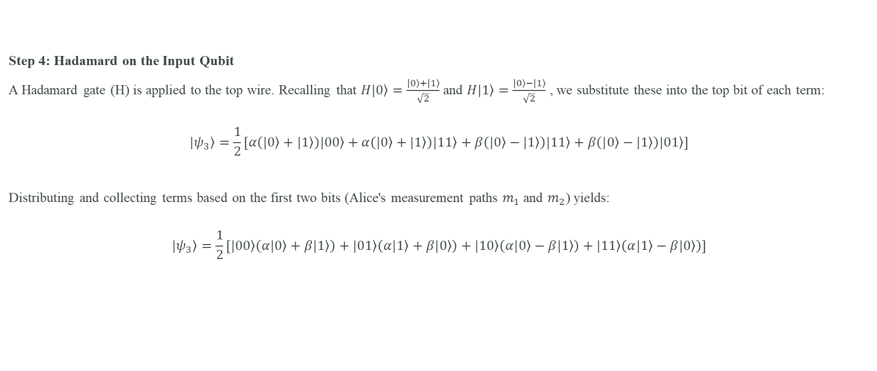
The step-by-step mathematical breakdown of Quantum Teleportation Circuit - III
Step 4: Hadamard on the Input Qubit
A Hadamard gate (H) is applied to the top wire. Recalling that $H\left.|0\right\rangle =\frac{\left.|0\right\rangle +\left.|1\right\rangle }{\sqrt{2}}$ and $H\left.|1\right\rangle =\frac{\left.|0\right\rangle −\left.|1\right\rangle }{\sqrt{2}}$ , we substitute these into the top bit of each term:
$$\left.|ψ_{3}\right\rangle =\frac{1}{2}\left[α\left(\left.|0\right\rangle +\left.|1\right\rangle \right)\left.|00\right\rangle +α\left(\left.|0\right\rangle +\left.|1\right\rangle \right)\left.|11\right\rangle +β\left(\left.|0\right\rangle −\left.|1\right\rangle \right)\left.|11\right\rangle +β\left(\left.|0\right\rangle −\left.|1\right\rangle \right)\left.|01\right\rangle \right]$$
Distributing and collecting terms based on the first two bits (Alice's measurement paths $m_{1}$ and $m_{2}$) yields:
$$\left.|ψ_{3}\right\rangle =\frac{1}{2}\left[\left.|00\right\rangle \left(α\left.|0\right\rangle +β\left.|1\right\rangle \right)+\left.|01\right\rangle \left(α\left.|1\right\rangle +β\left.|0\right\rangle \right)+\left.|10\right\rangle \left(α\left.|0\right\rangle −β\left.|1\right\rangle \right)+\left.|11\right\rangle \left(α\left.|1\right\rangle −β\left.|0\right\rangle \right)\right]$$

Slide 20
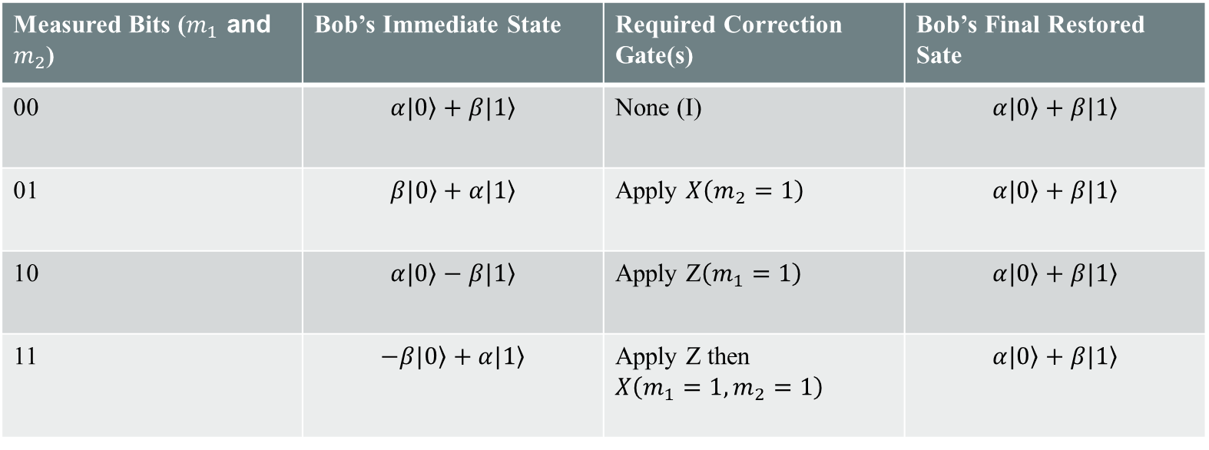
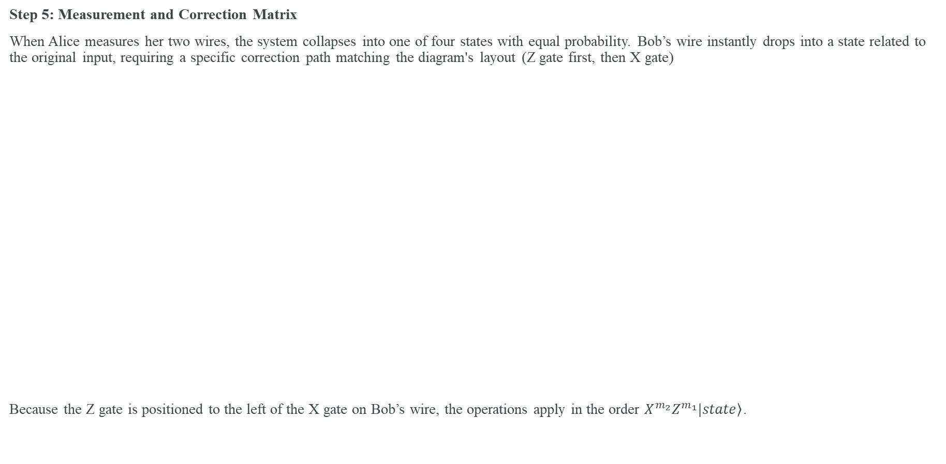
The step-by-step mathematical breakdown of Quantum Teleportation Circuit - IV
Step 5: Measurement and Correction Matrix
When Alice measures her two wires, the system collapses into one of four states with equal probability. Bob’s wire instantly drops into a state related to the original input, requiring a specific correction path matching the diagram's layout (Z gate first, then X gate)
Because the Z gate is positioned to the left of the X gate on Bob’s wire, the operations apply in the order $X^{m_{2}}Z^{m_{1}}\left.|state\right\rangle$.
Measured Bits ($m_{1}$ and $m_{2}$) | Bob’s Immediate State | Required Correction Gate(s) | Bob’s Final Restored Sate
00 | $$α\left.|0\right\rangle +β\left.|1\right\rangle$$ | None (I) | $$α\left.|0\right\rangle +β\left.|1\right\rangle$$
01 | $$β\left.|0\right\rangle +α\left.|1\right\rangle$$ | Apply $X\left(m_{2}=1\right)$ | $$α\left.|0\right\rangle +β\left.|1\right\rangle$$
10 | $$α\left.|0\right\rangle −β\left.|1\right\rangle$$ | Apply Z$\left(m_{1}=1\right)$ | $$α\left.|0\right\rangle +β\left.|1\right\rangle$$
11 | $$−β\left.|0\right\rangle +α\left.|1\right\rangle$$ | Apply Z then $X\left({m_{1}=1, m}_{2}=1\right)$ | $$α\left.|0\right\rangle +β\left.|1\right\rangle$$

Slide 21
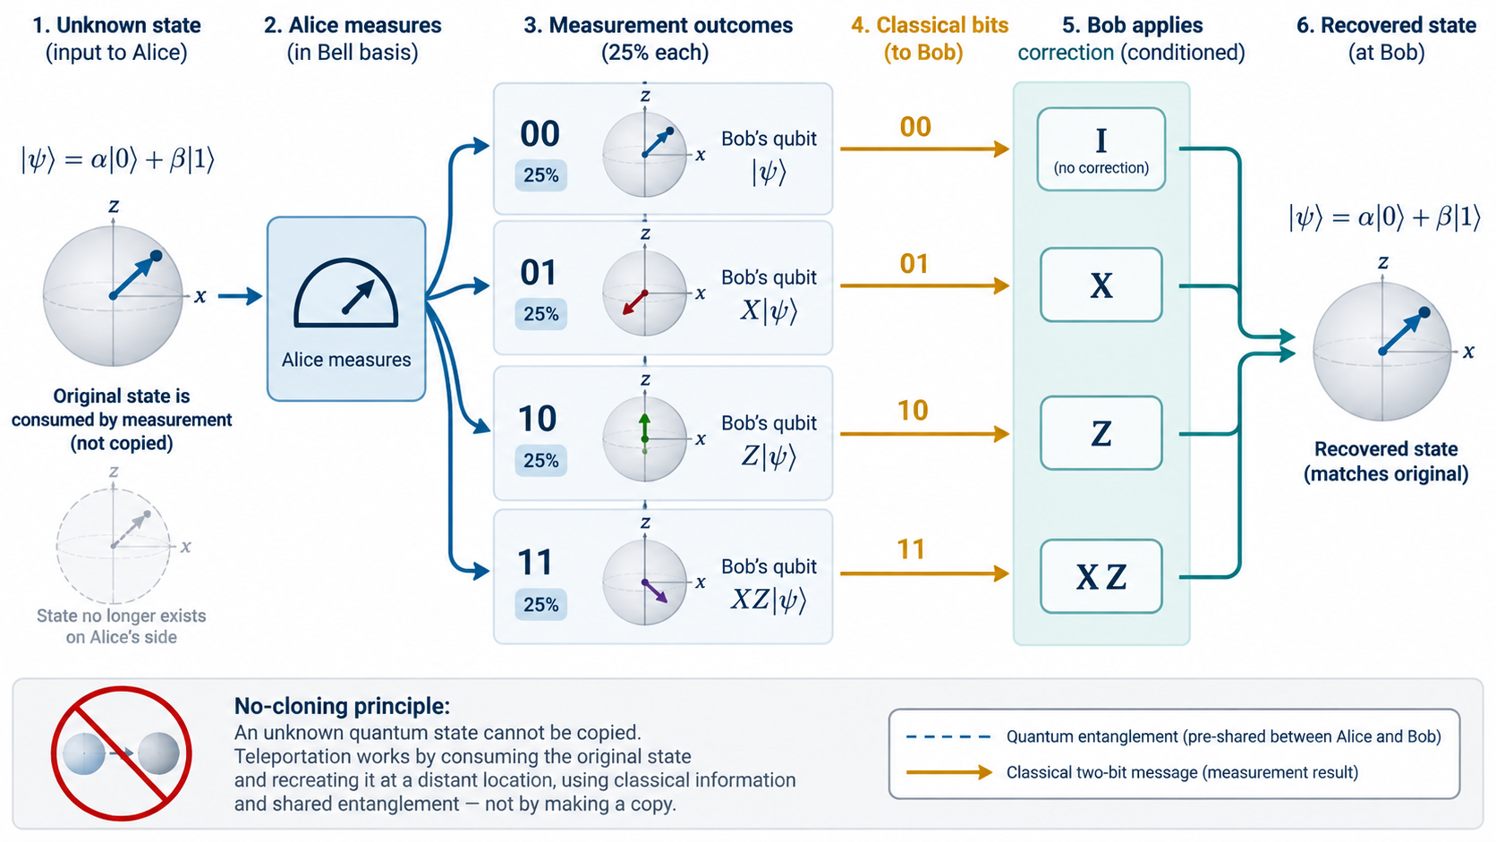

Slide 22
Teleportation misconceptions
Teleportation does not transmit a particle instantaneously.
Entanglement alone does not carry a controllable message.
Alice does not measure α and β.
Bob cannot complete the protocol without Alice’s classical bits.
The Bell pair is consumed; it is not a reusable communication wire.

Slide 23
Why teleportation matters
Moves quantum states between locations or subsystems without moving the original carrier.
Forms a primitive for quantum networks and repeaters.
Enables gate teleportation and measurement-based approaches.
Provides a clean example of entanglement as an operational information resource.

Slide 24
From time/space domain to frequency domain
A signal can be described by its sample values or by how much of each frequency it contains.
The Fourier transform changes representation; it does not create new information.
Discrete Fourier Transform (DFT) is the finite-dimensional transform for N discrete samples.
Quantum Fourier Transform (QFT) is the quantum unitary with the same Fourier matrix structure, acting on amplitudes.

Slide 25
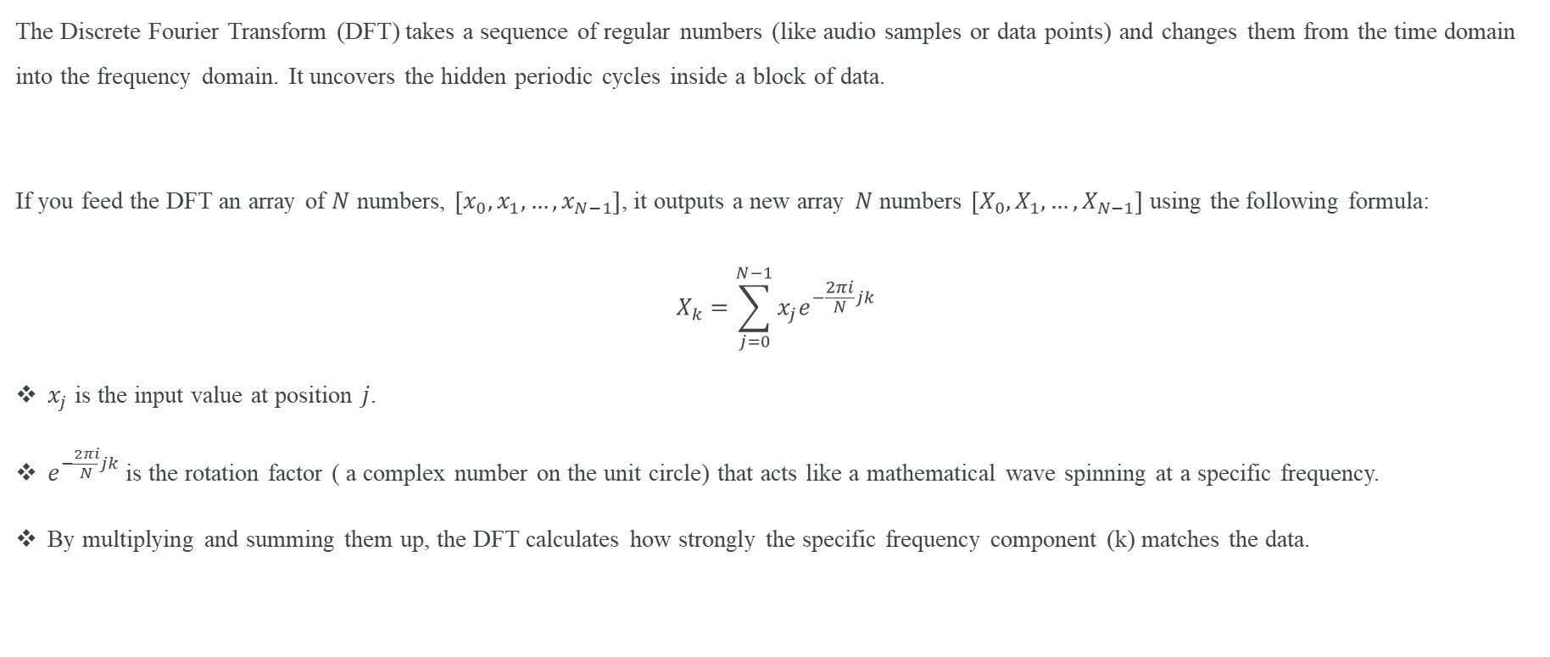
The Classical Baseline: Discrete Fourier Transform (DFT)
The Discrete Fourier Transform (DFT) takes a sequence of regular numbers (like audio samples or data points) and changes them from the time domain into the frequency domain. It uncovers the hidden periodic cycles inside a block of data.
If you feed the DFT an array of $N$ numbers, $\left[x_{0}, x_{1},…, x_{N−1}\right]$, it outputs a new array $N$ numbers $\left[X_{0}, X_{1},…, X_{N−1}\right]$ using the following formula:
$$X_{k}=\sum_{j=0}^{N−1}{x_{j}e^{−\frac{2πi}{N}jk}}$$
$x_{j}$ is the input value at position $j$.
$e^{−\frac{2πi}{N}jk}$ is the rotation factor ( a complex number on the unit circle) that acts like a mathematical wave spinning at a specific frequency.
By multiplying and summing them up, the DFT calculates how strongly the specific frequency component (k) matches the data.

Slide 26
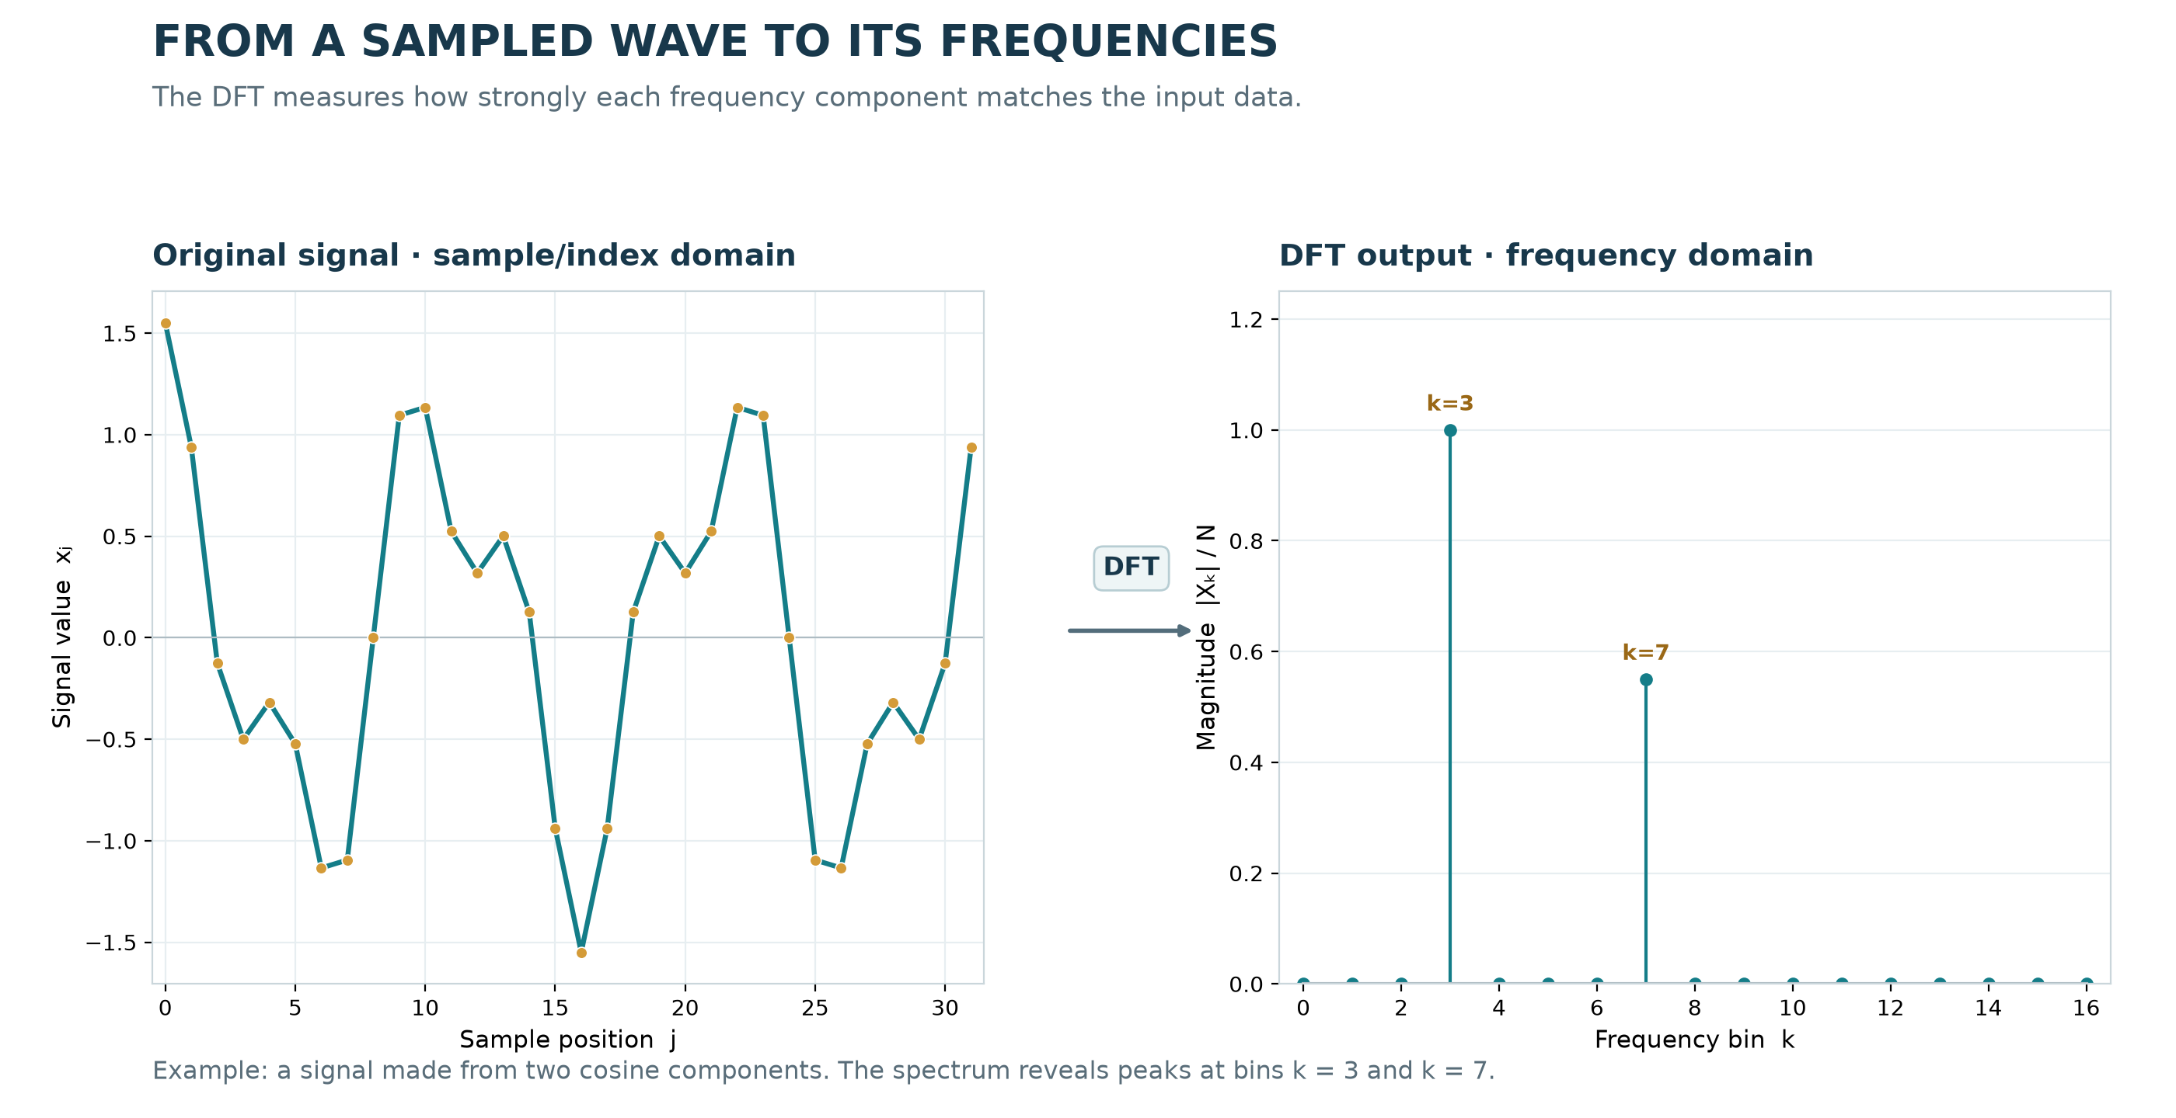

Slide 27
Why introduce DFT before QFT?
The QFT uses the same family of complex exponentials as the DFT.
Understanding roots of unity makes QFT phase rotations less mysterious.
But the input/output interpretation is fundamentally different: classical data values versus quantum amplitudes.
This distinction prevents the common misconception that a QFT simply prints a classical FFT spectrum.

Slide 28
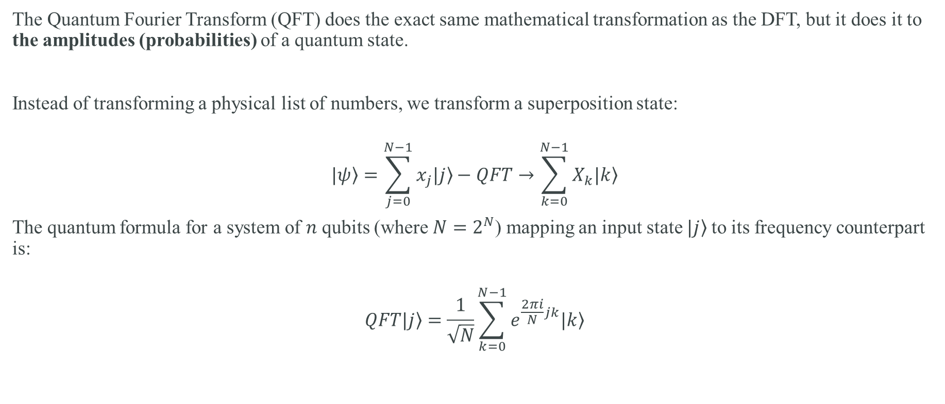
Quantum Fourier Transform (QFT)
The Quantum Fourier Transform (QFT) does the exact same mathematical transformation as the DFT, but it does it to the amplitudes (probabilities) of a quantum state.
Instead of transforming a physical list of numbers, we transform a superposition state:
$$\left.|ψ\right\rangle =\sum_{j=0}^{N−1}{x_{j}\left.|j\right\rangle }−QFT→\sum_{k=0}^{N−1}{X_{k}\left.|k\right\rangle }$$
The quantum formula for a system of $n$ qubits (where $N=2^{N}$) mapping an input state $\left.|j\right\rangle$to its frequency counterpart is:
$$QFT\left.|j\right\rangle =\frac{1}{\sqrt{N}}\sum_{k=0}^{N−1}{e^{\frac{2πi}{N}jk}\left.|k\right\rangle }$$

Slide 29
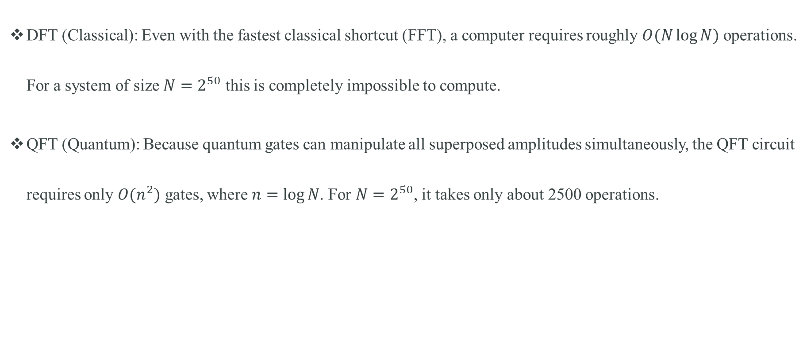
The Difference: Exponential Speedup
DFT (Classical): Even with the fastest classical shortcut (FFT), a computer requires roughly $O(N\log{N})$ operations. For a system of size $N=2^{50}$ this is completely impossible to compute.
QFT (Quantum): Because quantum gates can manipulate all superposed amplitudes simultaneously, the QFT circuit requires only $O(n^{2})$ gates, where $n=\log{N}$. For $N=2^{50}$, it takes only about 2500 operations.

Slide 30
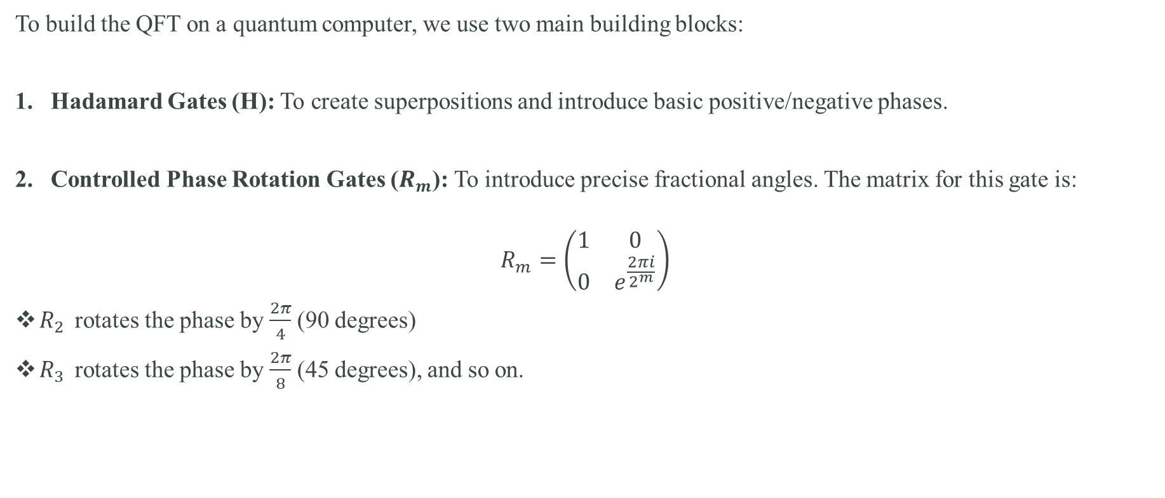
The QFT Circuit Schematic
To build the QFT on a quantum computer, we use two main building blocks:
Hadamard Gates (H): To create superpositions and introduce basic positive/negative phases.
Controlled Phase Rotation Gates ($R_{m}$): To introduce precise fractional angles. The matrix for this gate is:
$$R_{m}=\left(\begin{matrix}1 & 0 \\ 0 & e^{\frac{2πi}{2^{m}}}\end{matrix}\right)$$
$R_{2 }$ rotates the phase by $\frac{2π}{4}$ (90 degrees)
$R_{3 }$ rotates the phase by $\frac{2π}{8}$ (45 degrees), and so on.

Slide 31
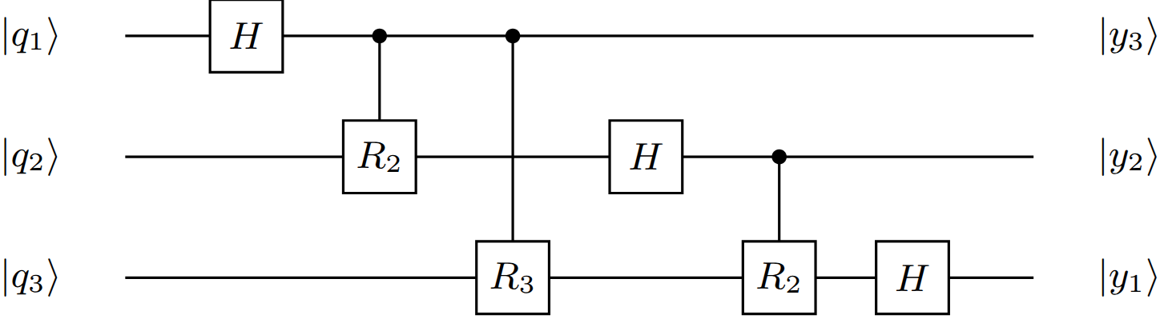
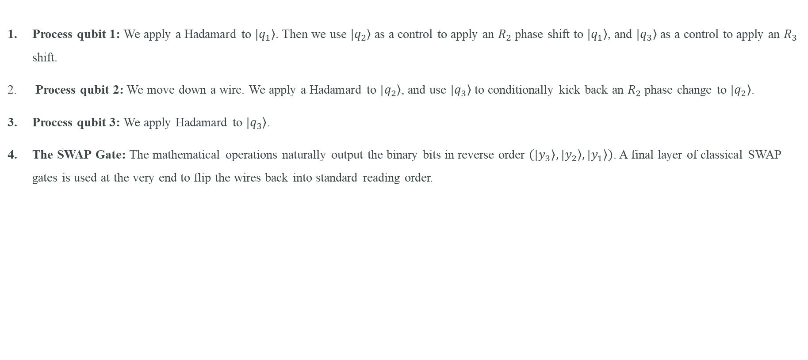
Step-by-Step QFT Circuit Logic
Process qubit 1: We apply a Hadamard to $\left.|q_{1}\right\rangle$. Then we use $\left.|q_{2}\right\rangle$ as a control to apply an $R_{2}$ phase shift to $\left.|q_{1}\right\rangle$, and $\left.|q_{3}\right\rangle$as a control to apply an $R_{3}$ shift.
Process qubit 2: We move down a wire. We apply a Hadamard to $\left.|q_{2}\right\rangle$, and use $\left.|q_{3}\right\rangle$ to conditionally kick back an $R_{2}$ phase change to $\left.|q_{2}\right\rangle$.
Process qubit 3: We apply Hadamard to $\left.|q_{3}\right\rangle$.
The SWAP Gate: The mathematical operations naturally output the binary bits in reverse order $\left(\left.|y_{3}\right\rangle ,\left.|y_{2}\right\rangle ,\left.|y_{1}\right\rangle \right)$. A final layer of classical SWAP gates is used at the very end to flip the wires back into standard reading order.

Slide 32
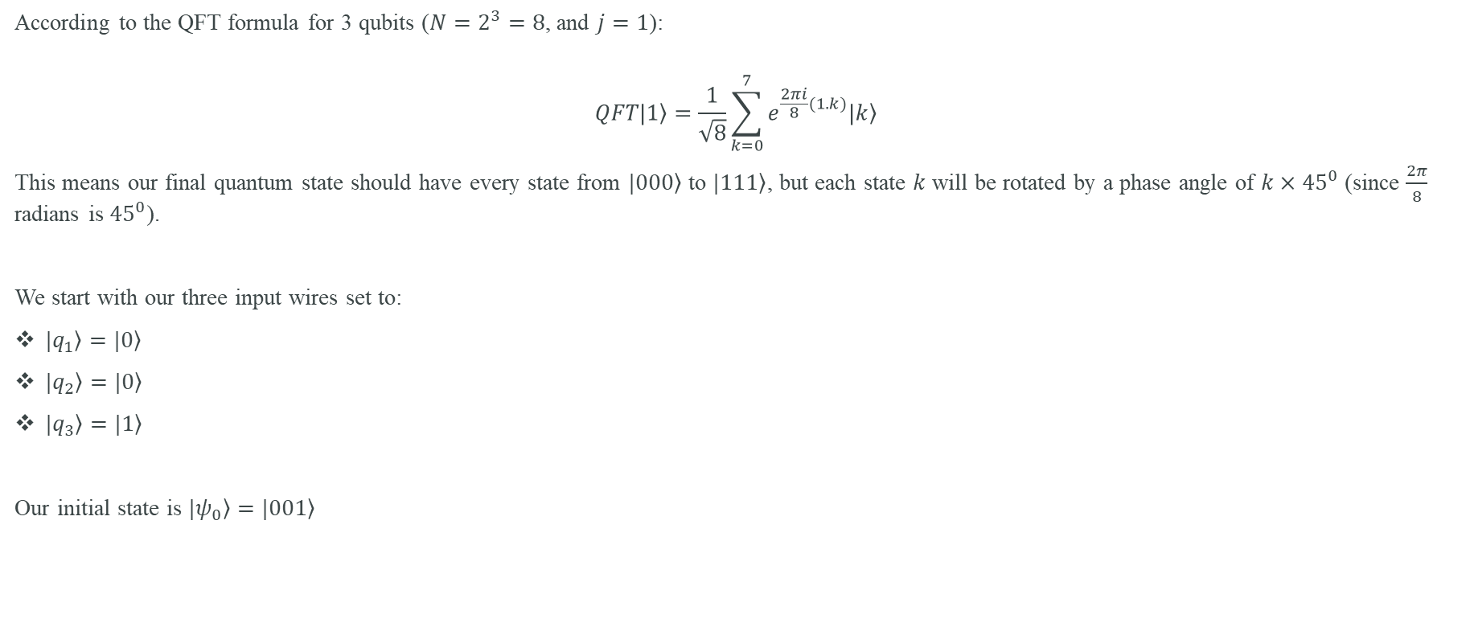
The Mathematical Goal
According to the QFT formula for 3 qubits ($N=2^{3}=8$, and $j=1$):
$$QFT\left.|1\right\rangle =\frac{1}{\sqrt{8}}\sum_{k=0}^{7}{e^{\frac{2πi}{8}(1.k)}\left.|k\right\rangle }$$
This means our final quantum state should have every state from $\left.|000\right\rangle$ to $\left.|111\right\rangle$, but each state $k$ will be rotated by a phase angle of $k×{45}^{0}$ (since $\frac{2π}{8}$ radians is ${45}^{0}$).
We start with our three input wires set to:
$\left.|q_{1}\right\rangle =\left.|0\right\rangle$
$\left.|q_{2}\right\rangle =\left.|0\right\rangle$
$\left.|q_{3}\right\rangle =\left.|1\right\rangle$
Our initial state is $\left.|ψ_{0}\right\rangle =\left.|001\right\rangle$

Slide 33
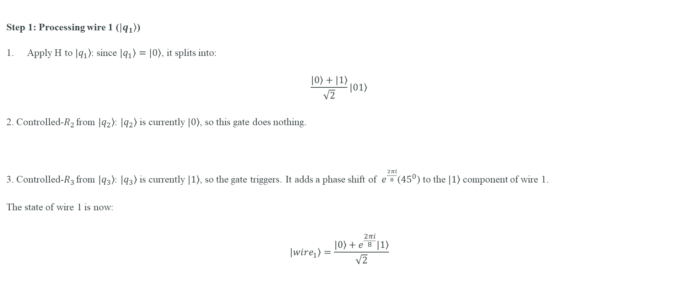
Step-by-Step Circuit Walkthrough - I
Step 1: Processing wire 1 ($\left.|q_{1}\right\rangle$)
Apply H to $\left.|q_{1}\right\rangle$: since $\left.|q_{1}\right\rangle =\left.|0\right\rangle$, it splits into:
$$\frac{\left.|0\right\rangle +\left.|1\right\rangle }{\sqrt{2}}\left.|01\right\rangle$$
2. Controlled-$R_{2}$ from $\left.|q_{2}\right\rangle$: $\left.|q_{2}\right\rangle$ is currently $\left.|0\right\rangle$, so this gate does nothing.
3. Controlled-$R_{3}$ from $\left.|q_{3}\right\rangle$: $\left.|q_{3}\right\rangle$ is currently $\left.|1\right\rangle$, so the gate triggers. It adds a phase shift of $e^{\frac{2πi}{8}}$(${45}^{0}$) to the $\left.|1\right\rangle$ component of wire 1.
The state of wire 1 is now:
$$\left.|{wire}_{1}\right\rangle =\frac{\left.|0\right\rangle +e^{\frac{2πi}{8}}\left.|1\right\rangle }{\sqrt{2}}$$

Slide 34
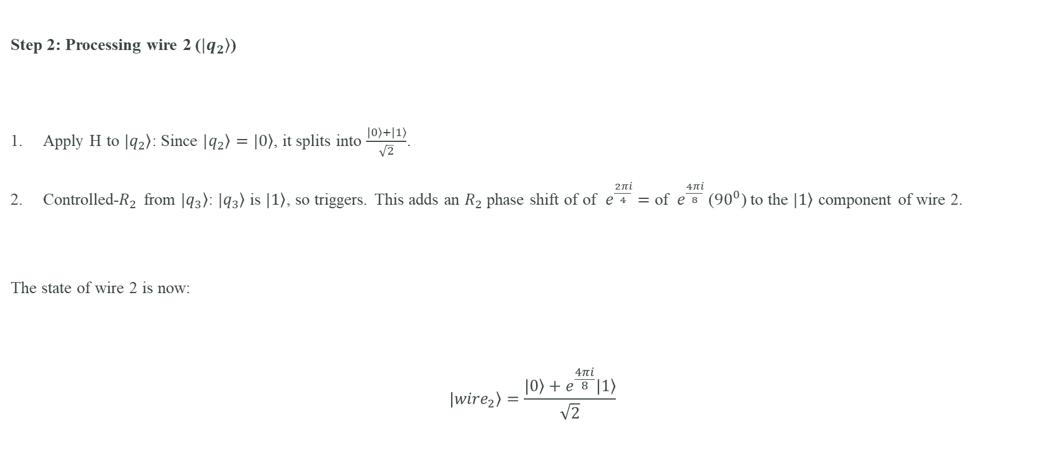
Step-by-Step Circuit Walkthrough - II
Step 2: Processing wire 2 ($\left.|q_{2}\right\rangle$)
Apply H to $\left.|q_{2}\right\rangle$: Since $\left.|q_{2}\right\rangle =\left.|0\right\rangle$, it splits into $\frac{\left.|0\right\rangle +\left.|1\right\rangle }{\sqrt{2}}$.
Controlled-$R_{2}$ from $\left.|q_{3}\right\rangle$: $\left.|q_{3}\right\rangle$ is $\left.|1\right\rangle$, so triggers. This adds an $R_{2}$ phase shift of of $e^{\frac{2πi}{4}}=\text{of }e^{\frac{4πi}{8}}$ (${90}^{0}$) to the $\left.|1\right\rangle$ component of wire 2.
The state of wire 2 is now:
$$\left.|{wire}_{2}\right\rangle =\frac{\left.|0\right\rangle +e^{\frac{4πi}{8}}\left.|1\right\rangle }{\sqrt{2}}$$

Slide 35
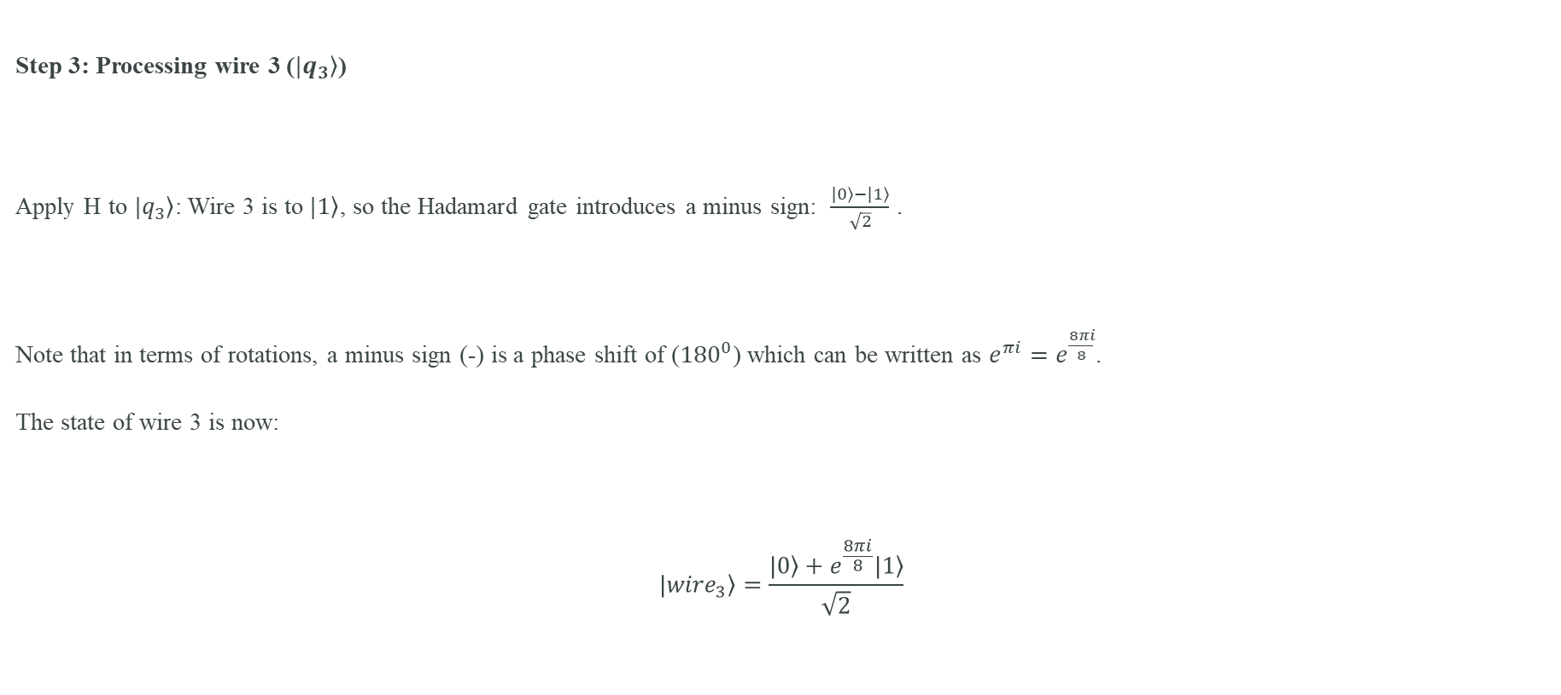
Step-by-Step Circuit Walkthrough - III
Step 3: Processing wire 3 ($\left.|q_{3}\right\rangle$)
Apply H to $\left.|q_{3}\right\rangle$: Wire 3 is to $\left.|1\right\rangle$, so the Hadamard gate introduces a minus sign: $\frac{\left.|0\right\rangle −\left.|1\right\rangle }{\sqrt{2}}$ .
Note that in terms of rotations, a minus sign (-) is a phase shift of (${180}^{0}$) which can be written as $e^{πi}=e^{\frac{8πi}{8}}$.
The state of wire 3 is now:
$$\left.|{wire}_{3}\right\rangle =\frac{\left.|0\right\rangle +e^{\frac{8πi}{8}}\left.|1\right\rangle }{\sqrt{2}}$$

Slide 36
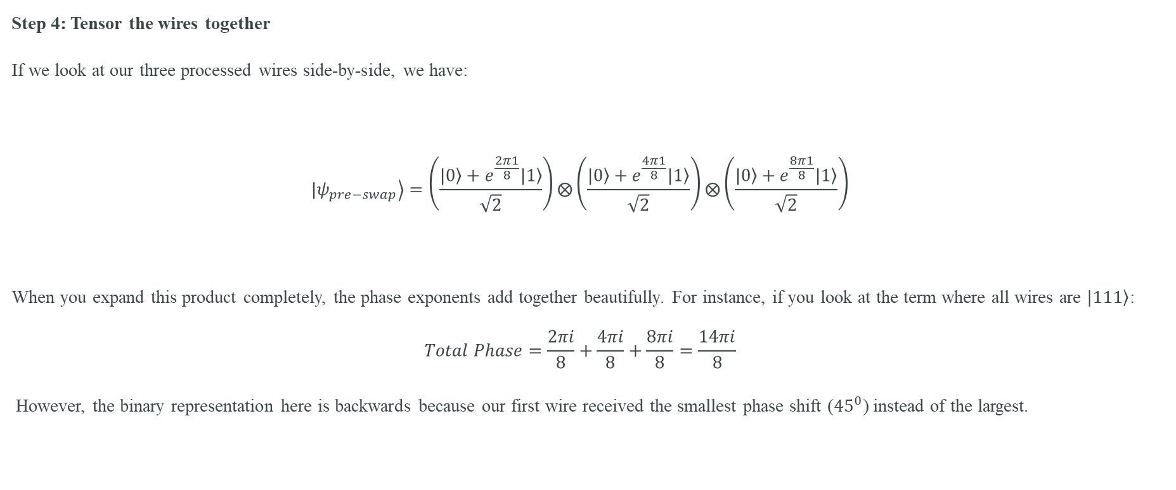
Step-by-Step Circuit Walkthrough - IV
Step 4: Tensor the wires together
If we look at our three processed wires side-by-side, we have:
$$\left.|ψ_{pre−swap}\right\rangle =\left(\frac{\left.|0\right\rangle +e^{\frac{2π1}{8}}\left.|1\right\rangle }{\sqrt{2}}\right)⨂\left(\frac{\left.|0\right\rangle +e^{\frac{4π1}{8}}\left.|1\right\rangle }{\sqrt{2}}\right)⨂\left(\frac{\left.|0\right\rangle +e^{\frac{8π1}{8}}\left.|1\right\rangle }{\sqrt{2}}\right)$$
When you expand this product completely, the phase exponents add together beautifully. For instance, if you look at the term where all wires are $\left.|111\right\rangle$:
$$Total Phase=\frac{2πi}{8}+\frac{4πi}{8}+\frac{8πi}{8}=\frac{14πi}{8}$$
However, the binary representation here is backwards because our first wire received the smallest phase shift (${45}^{0}$) instead of the largest.

Slide 37
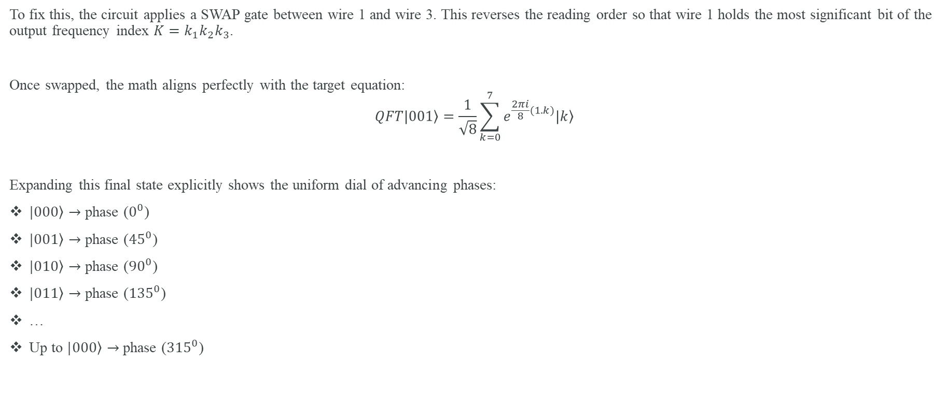
Step-by-Step Circuit Walkthrough - V
To fix this, the circuit applies a SWAP gate between wire 1 and wire 3. This reverses the reading order so that wire 1 holds the most significant bit of the output frequency index $K=k_{1}k_{2}k_{3}$.
Once swapped, the math aligns perfectly with the target equation:
$$QFT\left.|001\right\rangle =\frac{1}{\sqrt{8}}\sum_{k=0}^{7}{e^{\frac{2πi}{8}(1.k)}\left.|k\right\rangle }$$
Expanding this final state explicitly shows the uniform dial of advancing phases:
$\left.|000\right\rangle →$ phase ($0^{0}$)
$\left.|001\right\rangle →$ phase (${45}^{0}$)
$\left.|010\right\rangle →$ phase (${90}^{0}$)
$\left.|011\right\rangle →$ phase (${135}^{0}$)
…
Up to $\left.|000\right\rangle →$ phase (${315}^{0}$)

Slide 38
Common QFT misconceptions
QFT is not automatically an exponential-speed replacement for FFT.
You cannot measure and read all transformed amplitudes in one run.
Quantum algorithms arrange the post-QFT state so a small number of measurements reveal a useful global property.
Relative phase is central: equal output probabilities can still hide very different quantum states.

Slide 39
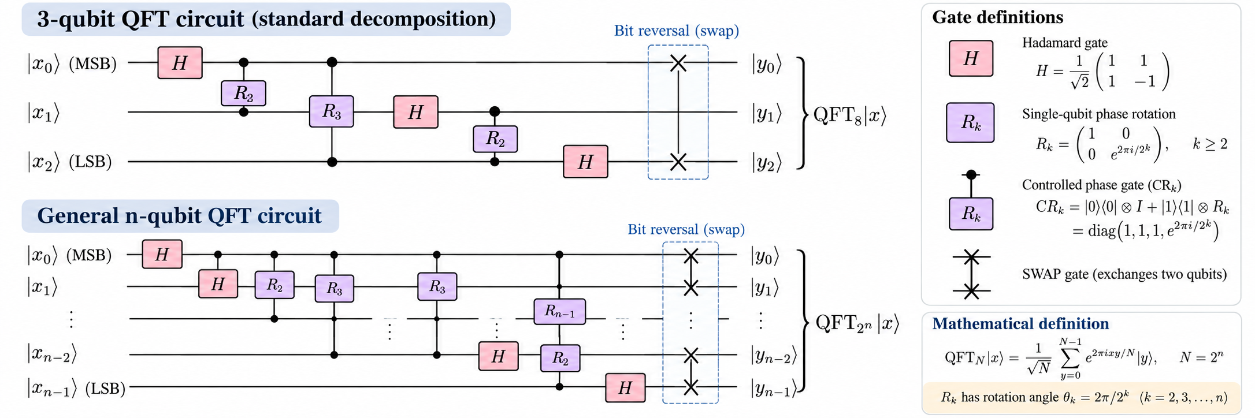

$$QFT\left.|x_{0}x_{1}…x_{n−1}\right\rangle =\frac{1}{2^{\frac{n}{2}}}⊗_{j=0}^{n−1}\left[\left.|0\right\rangle +e^{2πi\left(0.x_{j}x_{j+1}…x_{n−1}\right)\left.|1\right\rangle }\right]$$

