Slide 1
Quantum Computing
Foundation of Quantum Computing

Slide 2
The Birth of Quantum Information Processing
Year | Pioneer | Contribution
1980 | Paul Benioff | First quantum-mechanical model of computation.
1981 | Richard Feynman | Proposed using quantum systems to simulate nature more efficiently than classical computers.
1985 | David Deutsch | Formulated the concept of a universal quantum computer and quantum gates.
1992 | David Deutsch & Richard Jozsa | First algorithm showing a quantum advantage over classical computation.
1994 | Peter Shor | Factoring algorithm that threatened classical cryptography.
1996 | Lov Grover | Quadratic speedup for unstructured search problems.
Notes:
This slide shows how the field of quantum computing evolved from a theoretical idea into a scientific discipline.
The journey began in 1980 when Paul Benioff introduced the first quantum-mechanical model of computation. A year later, Richard Feynman realized that nature itself is quantum mechanical and proposed that quantum systems could simulate physical processes far more efficiently than classical computers.
In 1985, David Deutsch introduced the concept of a universal quantum computer and laid the foundation for quantum logic gates. The first evidence of a quantum computational advantage came in 1992 with the Deutsch–Jozsa algorithm, developed by Deutsch and Richard Jozsa.
The field gained major attention in 1994 when Peter Shor developed an algorithm capable of efficiently factoring large numbers, threatening widely used cryptographic systems. Just two years later, Lov Grover introduced a quantum search algorithm that provides a quadratic speedup for searching unstructured data.
Together, these pioneering contributions established the theoretical foundations of quantum information processing and inspired the development of the quantum computers being built today.

Slide 3
A New Question That Changed Computing
The Classical View
How can we build a faster computer? Faster processors, More memory, Better architectures, Parallel computation.
Moore's Law: the number of transistors on a microchip doubles roughly every two years, while costs are halved.
The Quantum Revolution
What if information itself obeys the laws of quantum mechanics?
Superposition → Massive state representation
Entanglement → Non-classical correlations
Interference → Amplification of correct solutions
Quantum Evolution → Computation through physical dynamics
Feynman's Challenge (1981):
“Nature isn't classical... and if you want to make a simulation of nature, you'd better make it quantum mechanical.”
Notes:
This slide describes the fundamental question that gave birth to quantum computing.
For decades, classical computing focused on a simple goal: how can we build a faster computer? The solutions were faster processors, larger memory, better architectures, and parallel computation. This progress was driven by Moore's Law, which predicted that the number of transistors on a chip would roughly double every two years while costs decreased.
However, in the early 1980s, researchers began asking a different question: What if information itself follows the laws of quantum mechanics? This idea led to a completely new model of computation.
In quantum systems, superposition allows information to exist in multiple states simultaneously. Entanglement creates correlations that have no classical equivalent. Interference helps amplify correct answers and suppress incorrect ones. Instead of computation being a sequence of logical steps, quantum algorithms exploit the natural evolution of quantum systems to process information.
This shift was captured by Richard Feynman's famous challenge in 1981: "Nature isn't classical... and if you want to make a simulation of nature, you'd better make it quantum mechanical." That insight transformed quantum mechanics from a theory of physics into a new paradigm for computation.

Slide 4
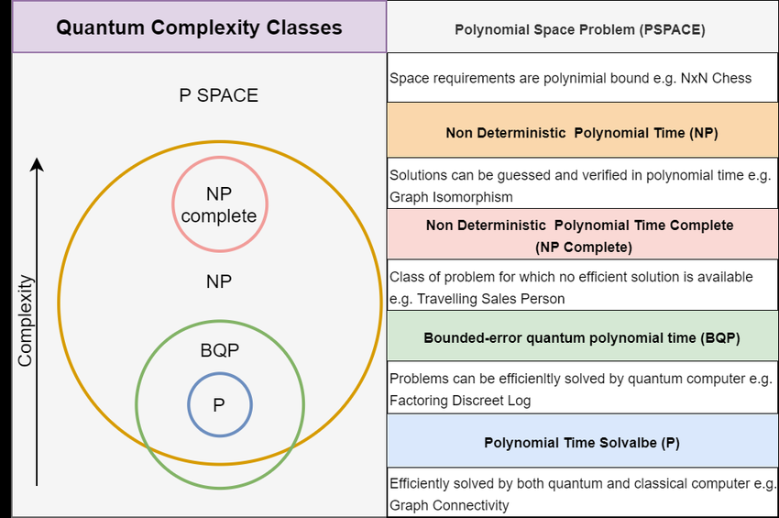
Complexity Advantage of Quantum Algorithms
Classical computers: P and NP classes
Quantum computers: BQP class (Bounded-Error Quantum Polynomial)
Quantum algorithms → exponential speedups
Example: factoring (Shor), search (Grover)
Notes:
This slide explains why quantum computing has attracted so much attention from computer scientists.
In classical computing, problems are often categorized into complexity classes such as P, which contains problems that can be solved efficiently, and NP, which contains problems whose solutions can be verified efficiently. Many important real-world problems become extremely difficult as their size grows.
Quantum computing introduces a new complexity class called BQP, or Bounded-Error Quantum Polynomial Time. This class contains problems that a quantum computer can solve efficiently with a high probability of obtaining the correct answer.
The power of quantum computing comes from exploiting superposition, entanglement, and interference to process information in ways that classical computers cannot. For certain problems, this can provide dramatic computational advantages.
Two famous examples are Shor's algorithm, which can factor large integers exponentially faster than the best known classical methods, and Grover's algorithm, which provides a quadratic speedup for searching unstructured databases.
Importantly, quantum computers do not speed up every problem. However, for specific tasks in cryptography, chemistry, optimization, and materials science, they may solve problems that would take classical supercomputers impractically long periods of time, making quantum advantage one of the most exciting areas of modern computing.

Slide 5
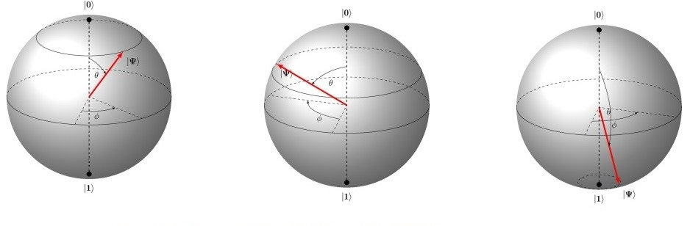
Quantum Computing Foundations
Qubits: superposition (0 & 1 simultaneously)
Entanglement: correlated states across distance
Density Matrix: represents quantum states, including uncertainty and mixed states
Quantum Gates: unitary operations that transform quantum states
Quantum Channels: model noise, decoherence, and information transfer
Parallelism: explore many states at once
Measurement: collapses quantum state to a classical outcome
Notes:
This slide introduces the fundamental concepts that make quantum computing possible.
The basic unit of quantum information is the qubit. Unlike a classical bit that is either 0 or 1, a qubit can exist in a superposition, meaning it can represent both states simultaneously until measured.
Qubits can also become entangled, creating strong correlations between particles even when they are physically separated. To mathematically describe quantum systems, we use the density matrix, which represents both pure quantum states and mixed states that contain uncertainty or environmental noise.
Quantum information is manipulated using quantum gates, which are reversible unitary operations that transform quantum states. In real systems, information also passes through quantum channels, which model communication, noise, decoherence, and interactions with the environment.
Together, superposition and entanglement enable a form of quantum parallelism, allowing a quantum system to explore many possible states simultaneously. However, when we perform a measurement, the quantum state collapses and produces a classical outcome that we can observe.
These concepts form the foundation of quantum algorithms, quantum communication, and quantum error correction.

Slide 6
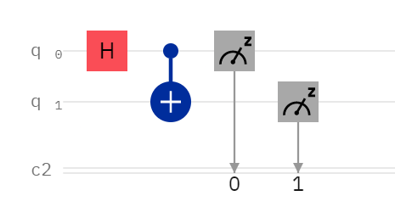
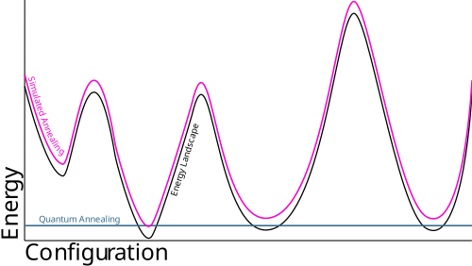
Paradigms to Quantum Computing
Quantum computing harnesses three key quantum phenomena:
  Superposition – Qubits can exist in multiple states simultaneously
  Entanglement – Qubits become correlated in such a way that the state of one instantly influences another
  Interference – Quantum amplitudes can reinforce or cancel out outcomes, improving probability of correct results
Two Main Types of Quantum Computing:
  Gate-Based Quantum Computing
  Uses quantum logic gates (like classical circuits) to build complex algorithms
  Quantum Annealing
  Solves optimization problems by finding low-energy states of a system
Gate Model
Quantum Annealing

Slide 7
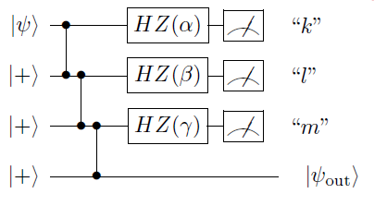
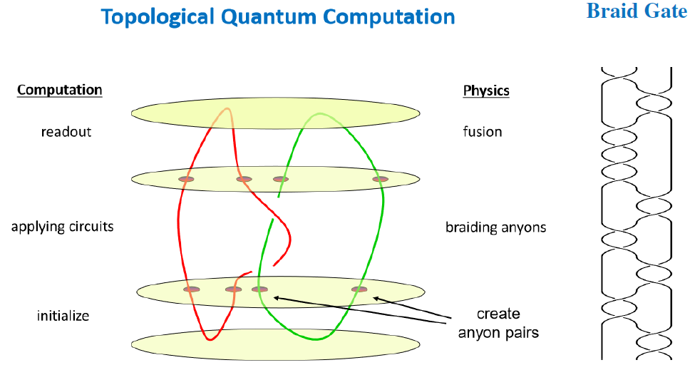
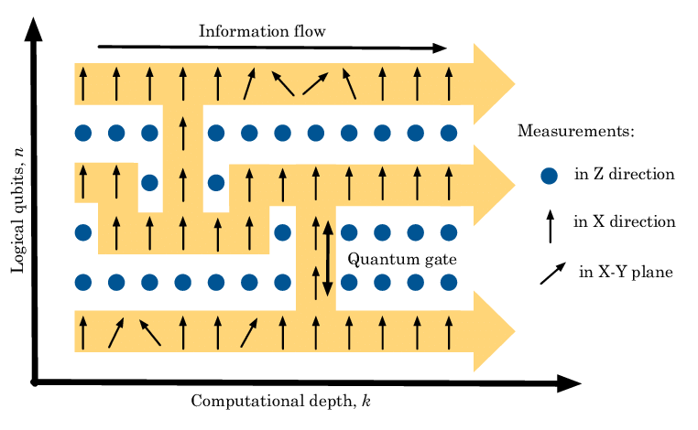
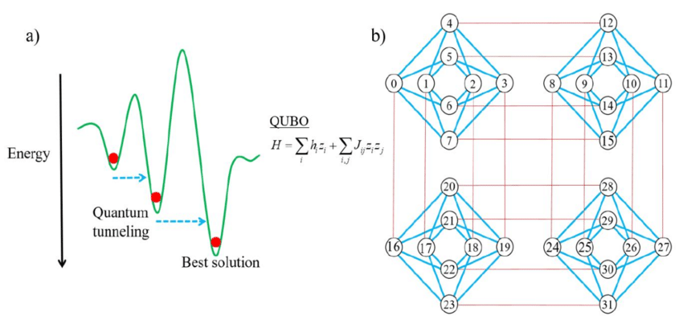
Quantum Computation Models
Circuit-based quantum computation is the most well-known, executing algorithms through sequences of quantum gates.
One-way quantum computation works by preparing an entangled state and then performing a series of measurements.
Adiabatic quantum computation evolves the system slowly into the solution state.
Topological quantum computation aims to be more resistant to errors by encoding information in topological properties.

Slide 8
Quantum Computation Models Comparison
Model | Main Idea | Strengths | Weaknesses | Implementation Requirements | Platform
Circuit-Based | Apply quantum gates to qubits in sequence | Universal, flexible, compatible with most algorithms, well-studied | Sensitive to decoherence, needs error correction, hard to scale | High-fidelity qubits, fast gates, measurement/reset | IBM Quantum, Google Sycamore, Rigetti
One-Way (MBQC) | Prepare large entangled state, then measure adaptively | Can prepare entanglement beforehand, some error correction advantages | Large cluster state creation is hard, one-time use of qubits, less intuitive | Large-scale cluster state generation, adaptive measurement | Photonic MBQC setups, optical lattices
Adiabatic | Slowly evolve from initial Hamiltonian to problem Hamiltonian | Good for optimization, robust to some noise, simpler control | Not always efficient for all problems, speed depends on energy gap | Tunable analog quantum systems, cryogenics | D-Wave systems
Topological | Use braiding of anyons to perform computation | Intrinsic fault tolerance, decoherence-resistant | Needs exotic matter, experimental proof of universality missing | Topological superconductors, fractional quantum Hall systems | Microsoft’s StationQ research

Slide 9
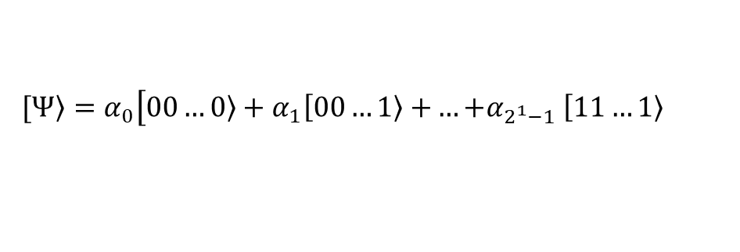
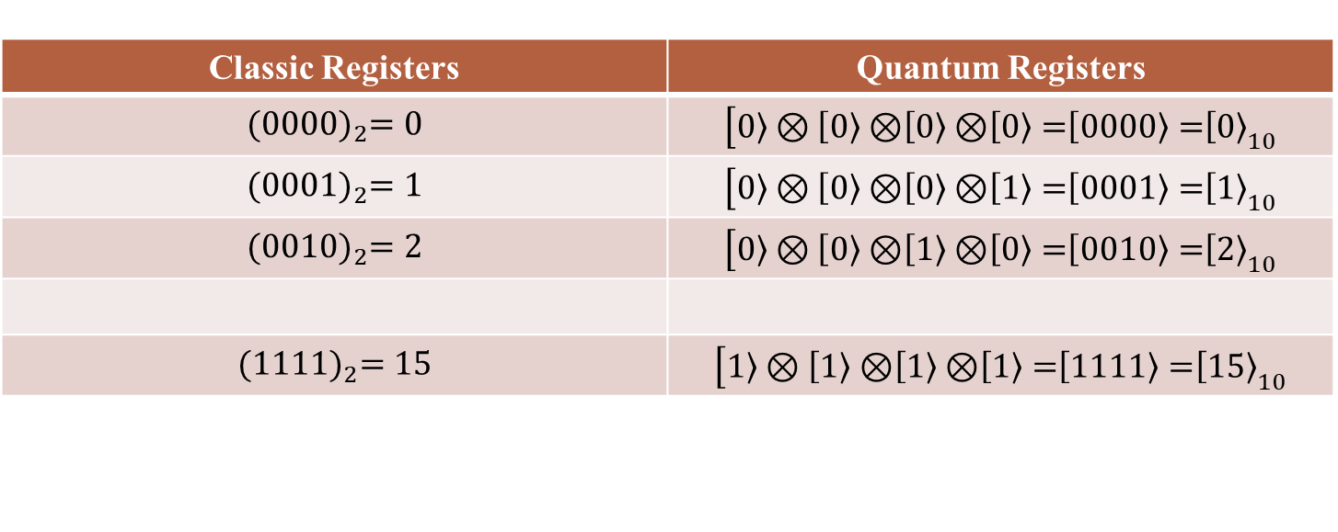
Classical Register VS Quantum Register
Classic Registers | Quantum Registers
$${(0000)}_{2}=0$$ | $$\left[\left.0\right\rangle ⊗\left[\left.0\right\rangle ⊗\right.\left[\left.0\right\rangle ⊗\right.\left[\left.0\right\rangle =\right.\right.\left[\left.0000\right\rangle =\right.{\left[\left.0\right\rangle \right.}_{10}$$
$${(0001)}_{2}=1$$ | $$\left[\left.0\right\rangle ⊗\left[\left.0\right\rangle ⊗\right.\left[\left.0\right\rangle ⊗\right.\left[\left.1\right\rangle =\right.\right.\left[\left.0001\right\rangle =\right.{\left[\left.1\right\rangle \right.}_{10}$$
$${(0010)}_{2}=2$$ | $$\left[\left.0\right\rangle ⊗\left[\left.0\right\rangle ⊗\right.\left[\left.1\right\rangle ⊗\right.\left[\left.0\right\rangle =\right.\right.\left[\left.0010\right\rangle =\right.{\left[\left.2\right\rangle \right.}_{10}$$
$${(1111)}_{2}=15$$ | $$\left[\left.1\right\rangle ⊗\left[\left.1\right\rangle ⊗\right.\left[\left.1\right\rangle ⊗\right.\left[\left.1\right\rangle =\right.\right.\left[\left.1111\right\rangle =\right.{\left[\left.15\right\rangle \right.}_{10}$$
.
.
.
.
.
.
Superposition of multiple-qubit basis states:
$$\left.[Ψ\right\rangle =α_{0}\left[\left.00…0\right\rangle +α_{1}\left[\left.00…1\right\rangle +\right.…{+α}_{2^{1}−1}\left[\left.11…1\right\rangle \right.\right.$$
A system of n qubits can simultaneously exist in a superposition of 2ⁿ basis states — enabling massive parallelism in computation.

Slide 10
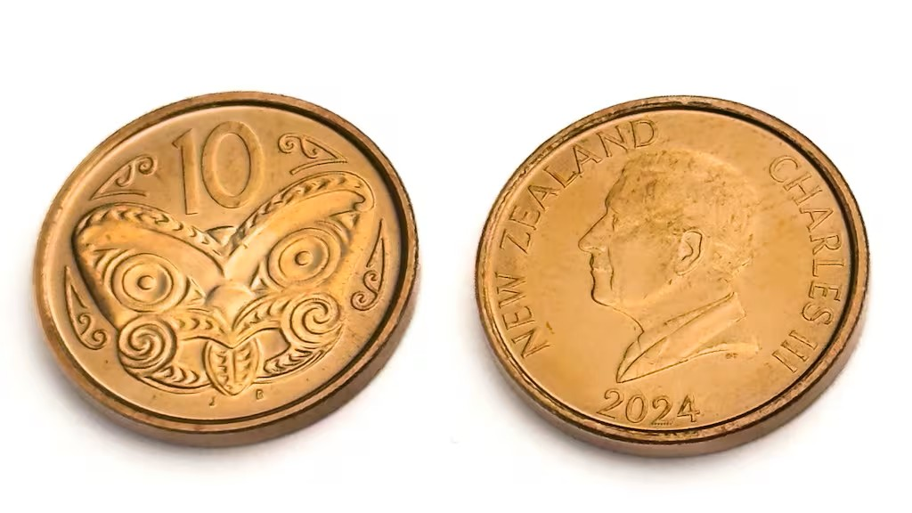
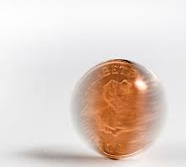
State and Superposition
Classical Computing
  Bits are the basic unit of information
  Each bit is always in a definite state: 0 or 1 (but never both)
  Follows deterministic logic
Quantum Computing
  Qubits are the quantum counterpart of bits
  A qubit can exist in a superposition: a linear combination of |0⟩ and |1⟩ at the same time
  Represented as:
  |ψ⟩ = α|0⟩ + β|1⟩, where |α|² + |β|² = 1
  Enables parallel computation across many states

Slide 11
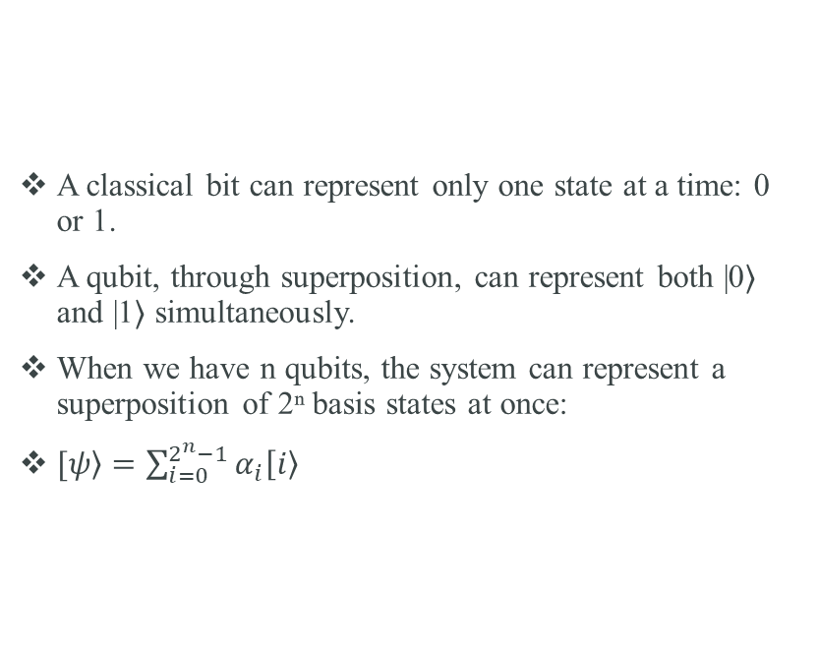
Quantum Parallelism
A classical bit can represent only one state at a time: 0 or 1.
A qubit, through superposition, can represent both |0⟩ and |1⟩ simultaneously.
When we have n qubits, the system can represent a superposition of 2ⁿ basis states at once:
$\left.[ψ\right\rangle =\sum_{i=0}^{2^{n}−1}{α_{i}\left[\left.i\right\rangle \right.}$

Slide 12
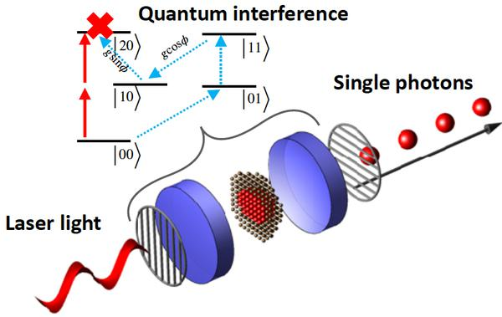
Quantum Interference – Strengthening the Right Answers
Quantum systems behave like waves and state of a qubit is a point on the surface of the sphere.
Quantum gates rotate the state vector.
Interference is the outcome of multiple rotations.
When qubit states interfere, their amplitudes can:
  Add up (constructive interference)
  Cancel out (destructive interference)
Used to amplify correct solutions and suppress wrong ones.
Essential in quantum algorithms like Grover’s search.

Slide 13
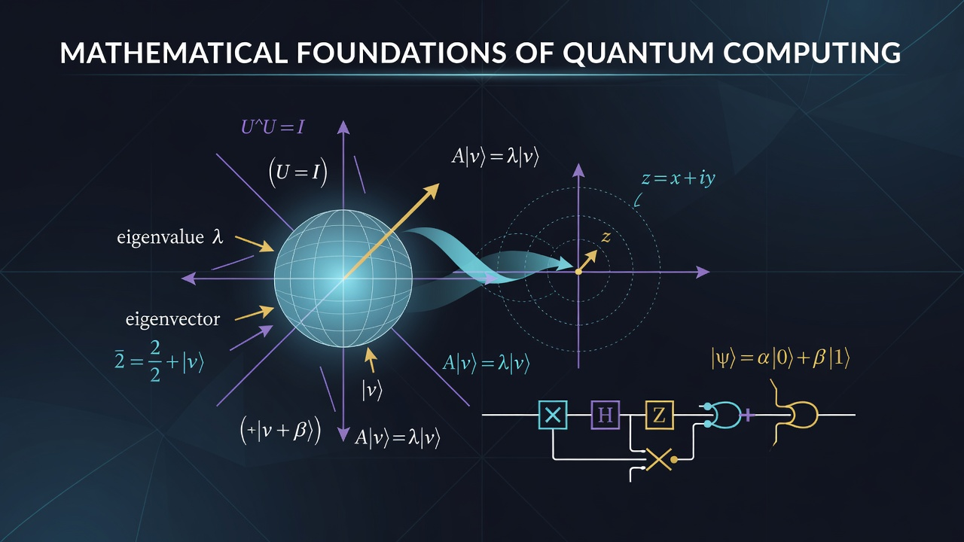

Slide 14
Why is Mathematics the Language of Quantum Computing?
Classical Computer
  Stores information as bits
  Uses 0 or 1
  Uses Boolean algebra
Quantum Computer
  Stores information as qubits
  Uses superposition
  Uses complex numbers
  Uses vectors
  Quantum mechanics relies fundamentally on complex numbers because they provide the cleanest mathematical language to describe wave interference and continuous changes over time simultaneously. While classical physics uses real numbers to measure static quantities (like a weight or position), the subatomic world acts like a shifting network of waves.

Slide 15
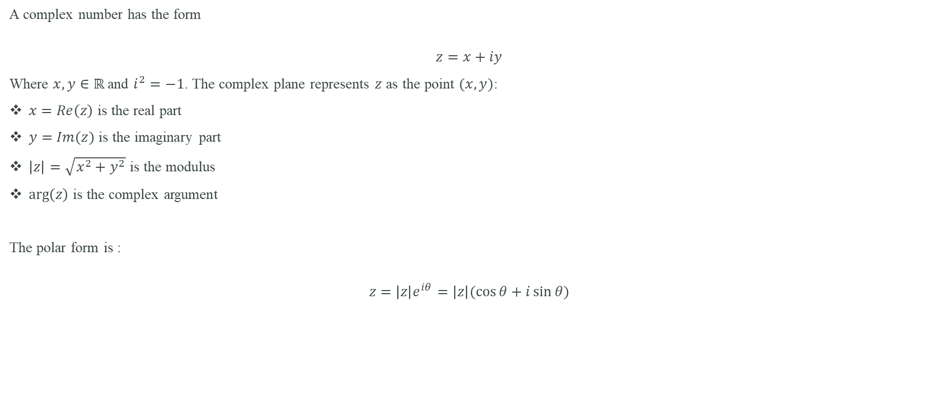
Complex numbers
A complex number has the form
$$z=x+iy$$
Where $x,y∈ℝ$ and $i^{2}=−1$. The complex plane represents $z$ as the point $(x,y)$:
$x=Re\left(z\right)$ is the real part
$y=Im(z)$ is the imaginary part
$\left|z\right|=\sqrt{x^{2}+y^{2}}$ is the modulus
$\arg\left(z\right)$ is the complex argument
The polar form is :
$$z=\left|z\right|e^{iθ}=\left|z\right|(\cos{θ}+i\sin{θ})$$

Slide 16
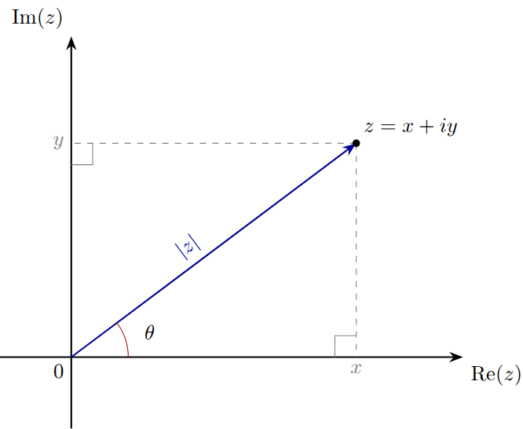

Slide 17
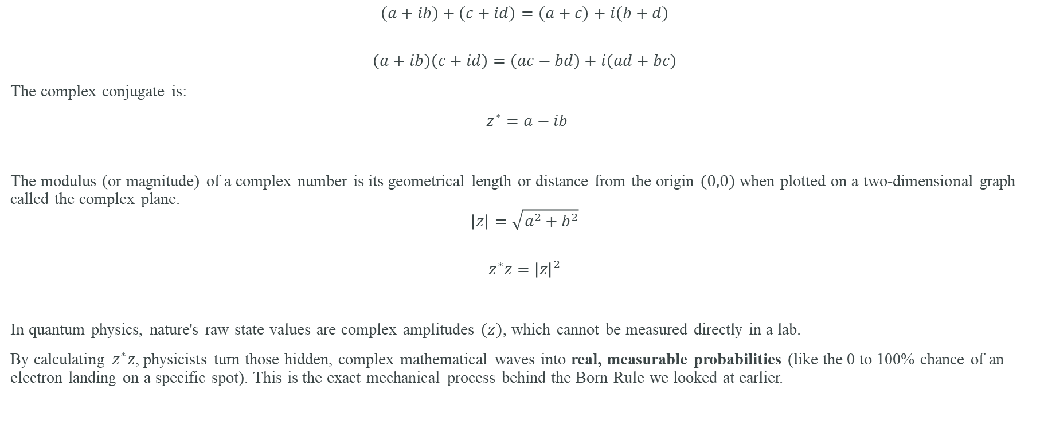
Algebra of complex numbers
$$\left(a+ib\right)+\left(c+id\right)=\left(a+c\right)+i\left(b+d\right)$$
$$\left(a+ib\right)\left(c+id\right)=\left(ac−bd\right)+i\left(ad+bc\right)$$
The complex conjugate is:
$z^{∗}=a−ib$
The modulus (or magnitude) of a complex number is its geometrical length or distance from the origin $(0,0)$ when plotted on a two-dimensional graph called the complex plane.
$$\left|z\right|=\sqrt{a^{2}+b^{2}}$$
$$z^{∗}z={\left|z\right|}^{2}$$
In quantum physics, nature's raw state values are complex amplitudes $(z)$, which cannot be measured directly in a lab.
By calculating $z^{∗}z$, physicists turn those hidden, complex mathematical waves into real, measurable probabilities (like the 0 to 100% chance of an electron landing on a specific spot). This is the exact mechanical process behind the Born Rule we looked at earlier.

Slide 18
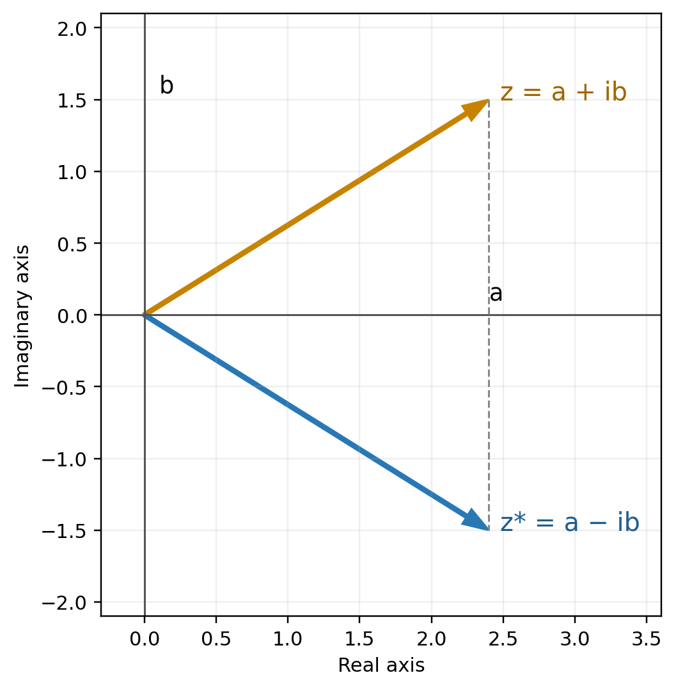
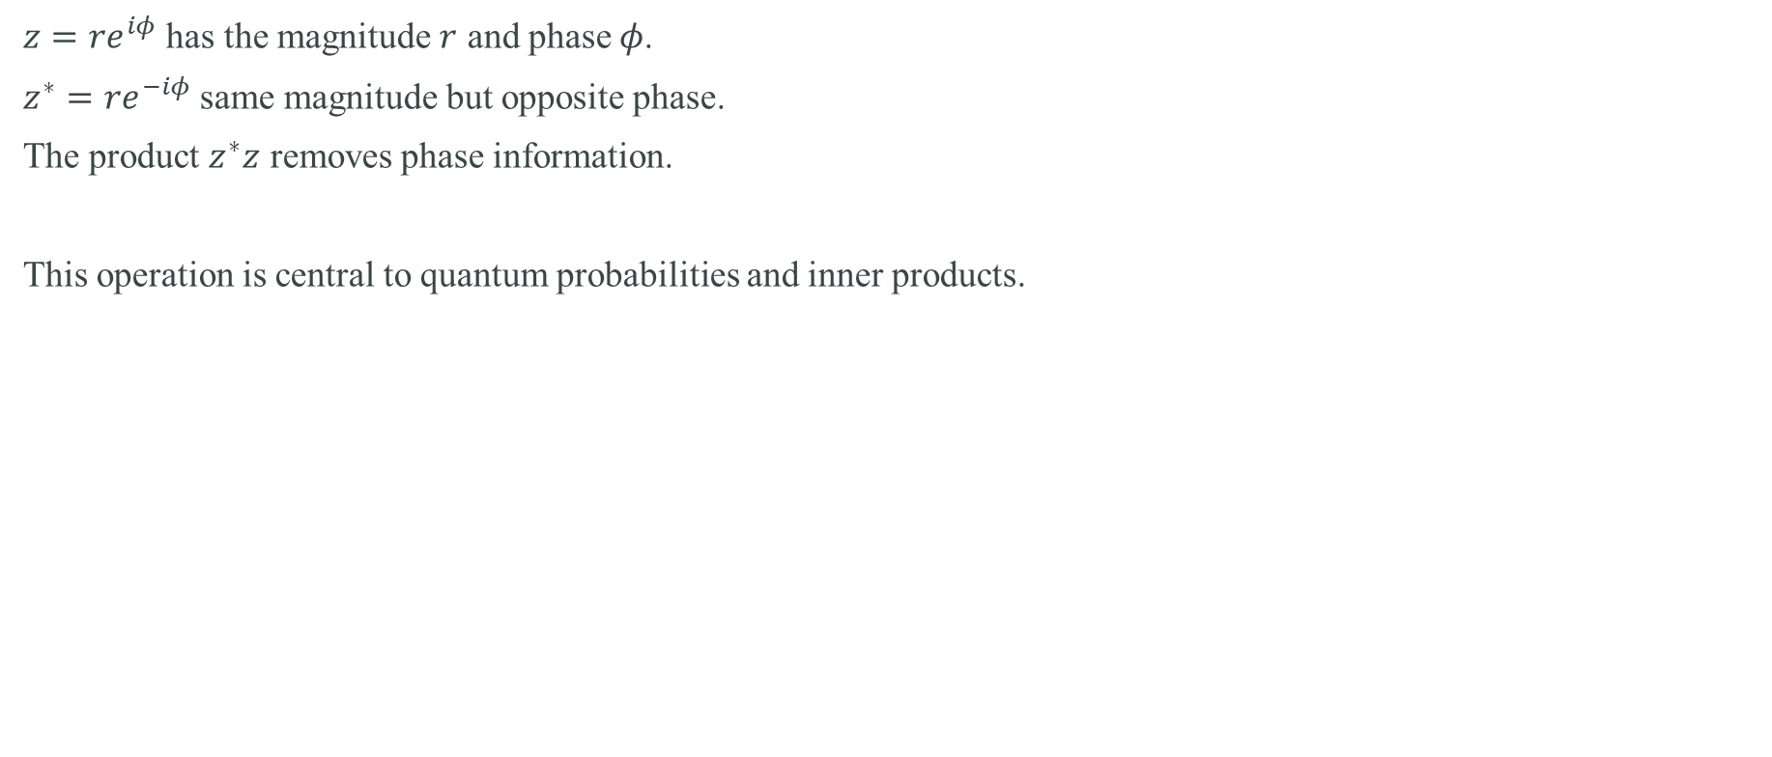
Geometric meaning of conjugation
$z={re}^{iφ}$ has the magnitude $r$ and phase $φ$.
$z^{∗}={re}^{−iφ}$ same magnitude but opposite phase.
The product $z^{∗}z$ removes phase information.
This operation is central to quantum probabilities and inner products.

Slide 19
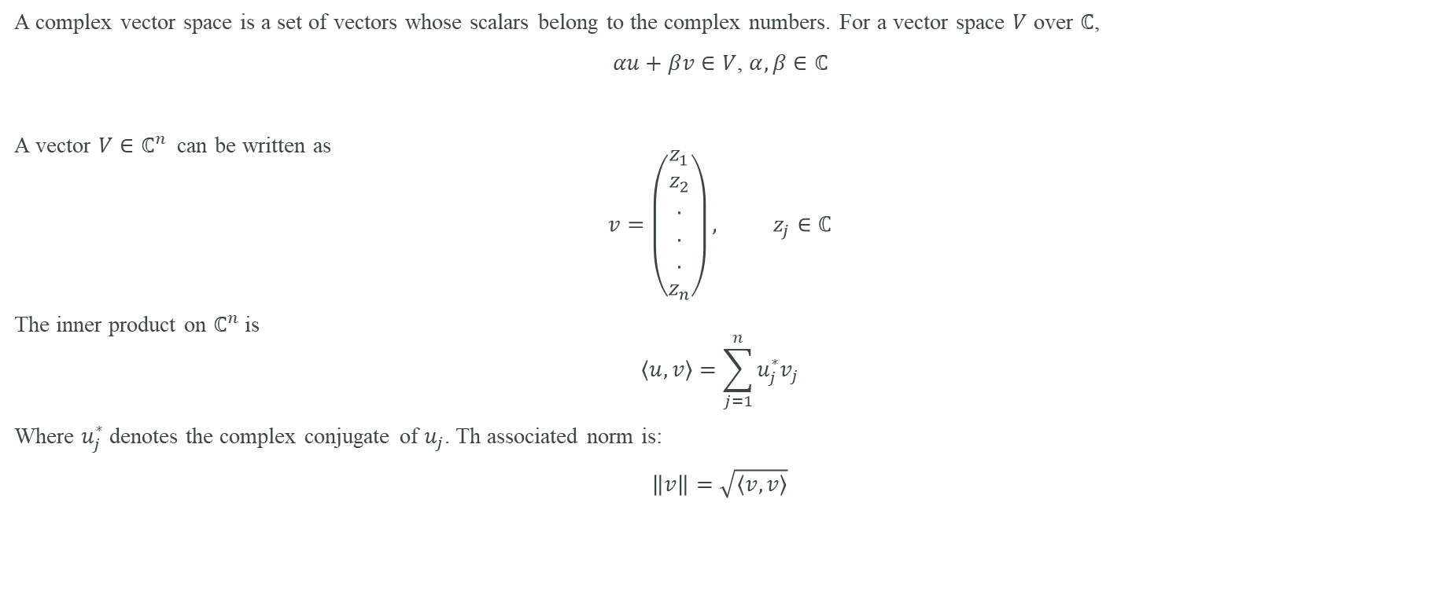
Complex vector spaces
A complex vector space is a set of vectors whose scalars belong to the complex numbers. For a vector space $V$ over $ℂ$,
$αu+βv∈V$, $α,β∈ℂ$
A vector $V∈ℂ^{n}$ can be written as
$$v=\left(\begin{aligned}z_{1} \\ z_{2} \\ . \\ . \\ . \\ z_{n}\end{aligned}\right), z_{j}∈ℂ$$
The inner product on $ℂ^{n}$ is
$$\left\langle u,v\right\rangle =\sum_{j=1}^{n}{u_{j}^{∗}v_{j}}$$
Where $u_{j}^{∗}$ denotes the complex conjugate of $u_{j}$. Th associated norm is:
$\left\|v\right\|=\sqrt{\left\langle v,v\right\rangle }$

Slide 20
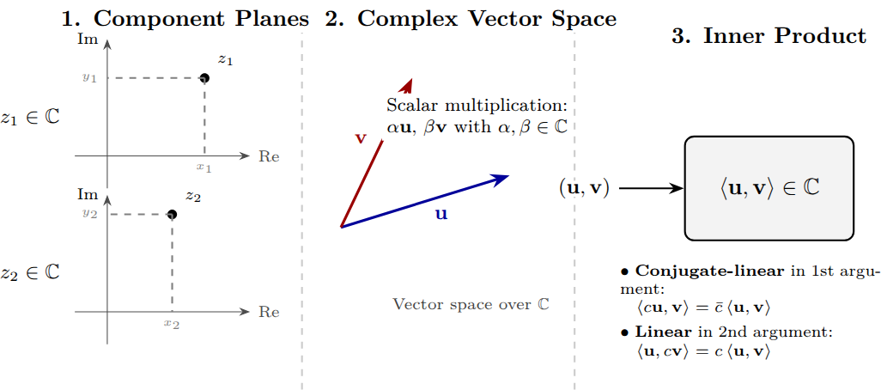

Slide 21
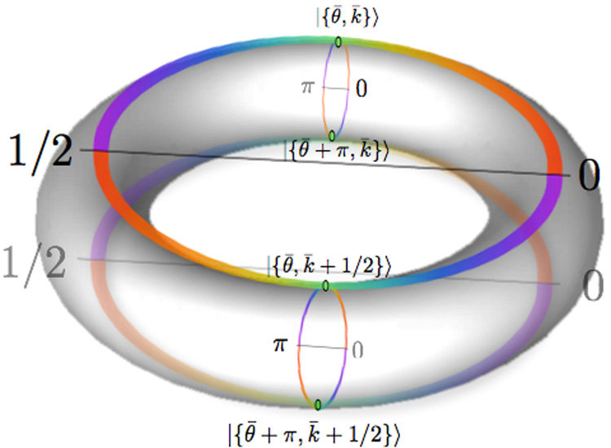
Hilbert Space – The Quantum Stage
A mathematical space for all possible quantum states.
Each qubit lives in a 2D complex vector space.
With n qubits, Hilbert space has 2ⁿ dimensions.
Quantum algorithms navigate this high-dimensional space.
Powerful for parallelism and pattern recognition.

Slide 22
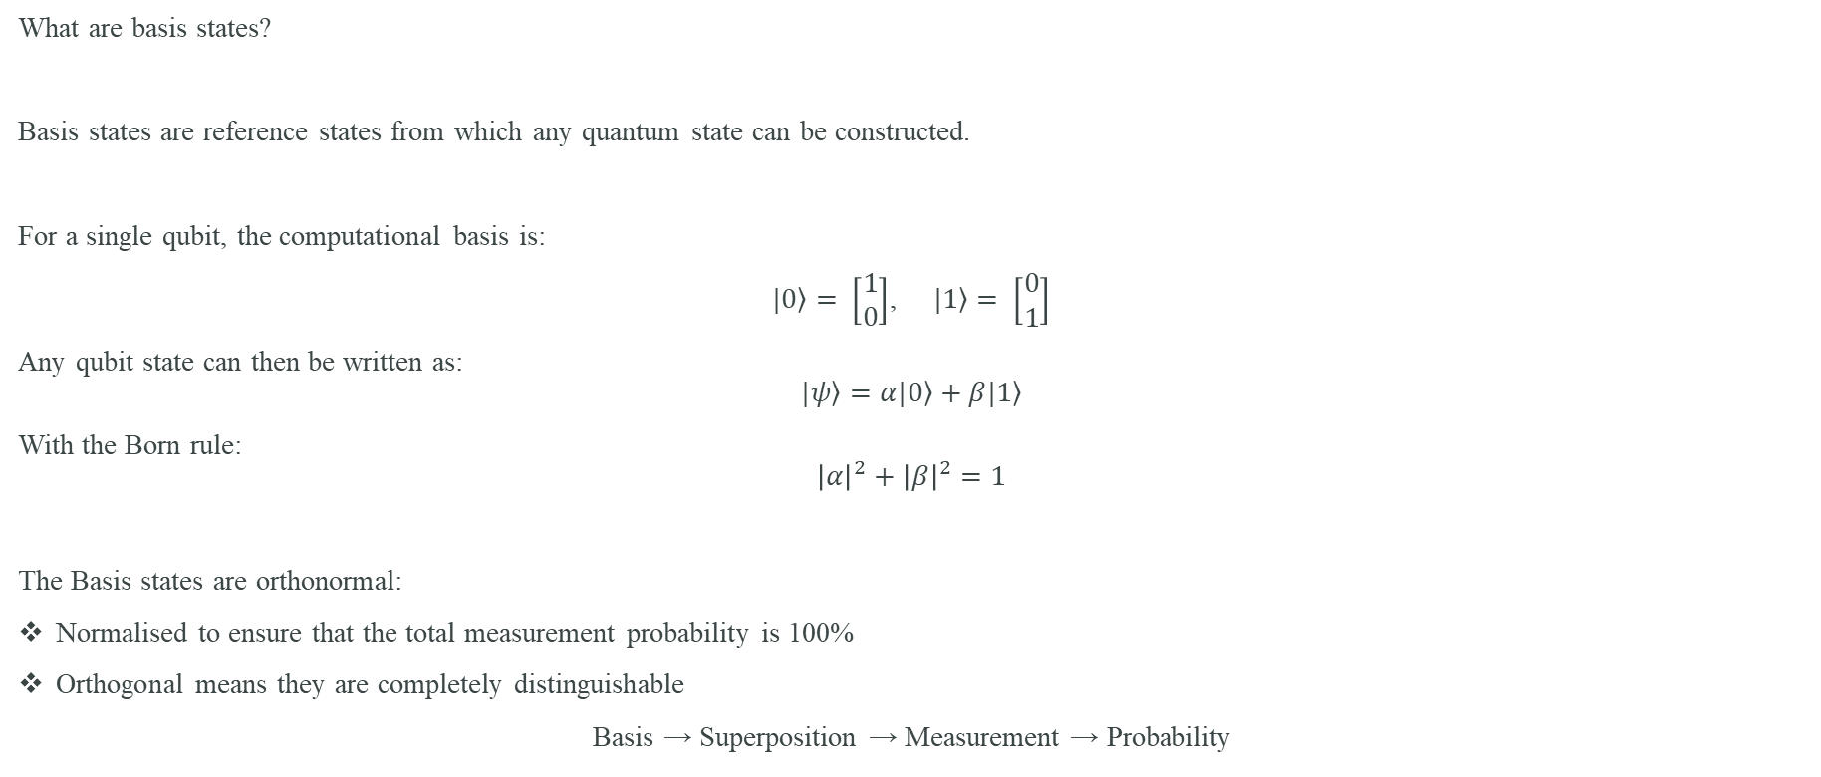
Quantum Basis States and Orthonormality
What are basis states?
Basis states are reference states from which any quantum state can be constructed.
For a single qubit, the computational basis is:
$\left.|0\right\rangle = \left[\begin{matrix}1 \\ 0\end{matrix}\right]$, $\left.|1\right\rangle = \left[\begin{matrix}0 \\ 1\end{matrix}\right]$
Any qubit state can then be written as:
$$\left.|ψ\right\rangle =α\left.|0\right\rangle +β\left.|1\right\rangle$$
With the Born rule:
$${\left|α\right|}^{2}+{\left|β\right|}^{2}=1$$
The Basis states are orthonormal:
Normalised to ensure that the total measurement probability is 100%
Orthogonal means they are completely distinguishable
Basis → Superposition → Measurement → Probability

Slide 23
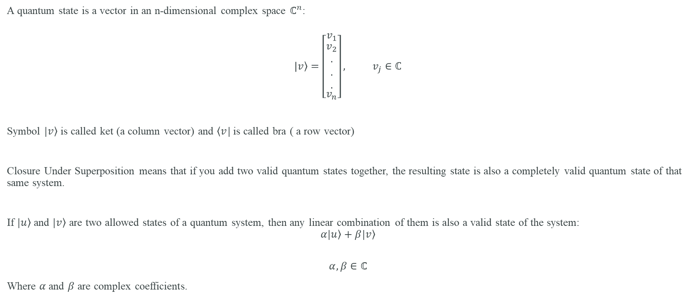
Quantum States as Vectors in a Complex Vector Space
A quantum state is a vector in an n-dimensional complex space $ℂ^{n}$:
$$\left.|v\right\rangle =\left[\begin{matrix}v_{1} \\ \begin{aligned}v_{2} \\ . \\ . \\ .\end{aligned} \\ v_{n}\end{matrix}\right], v_{j}∈ℂ$$
Symbol $\left.|v\right\rangle$ is called ket (a column vector) and $\left\langle v\right.|$ is called bra ( a row vector)
Closure Under Superposition means that if you add two valid quantum states together, the resulting state is also a completely valid quantum state of that same system.
If $\left.|u\right\rangle$ and $\left.|v\right\rangle$ are two allowed states of a quantum system, then any linear combination of them is also a valid state of the system:
$$α\left.|u\right\rangle +\left.β|v\right\rangle$$
$$α,β∈ℂ$$
Where $α$ and $β$ are complex coefficients.

Slide 24
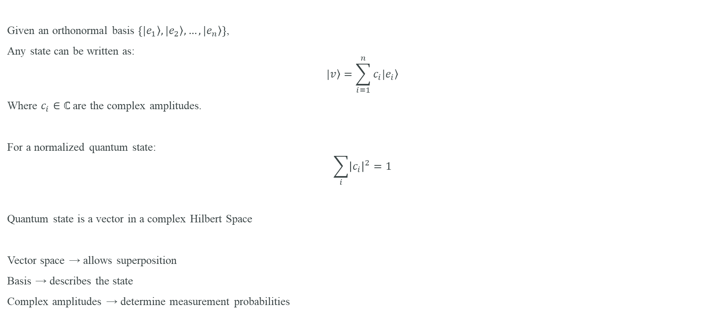
Quantum States as Vectors in a Complex Vector Space II
Given an orthonormal basis $\left\{\left.|e_{1}\right\rangle ,\left.|e_{2}\right\rangle , …,\left.|e_{n}\right\rangle \right\}$,
Any state can be written as:
$$\left.|v\right\rangle =\sum_{i=1}^{n}{c_{i}\left.|e_{i}\right\rangle }$$
Where $c_{i}∈ℂ$ are the complex amplitudes.
For a normalized quantum state:
$$\sum_{i}{{\left|c_{i}\right|}^{2}}=1$$
Quantum state is a vector in a complex Hilbert Space
Vector space → allows superposition
Basis → describes the state
Complex amplitudes → determine measurement probabilities

Slide 25
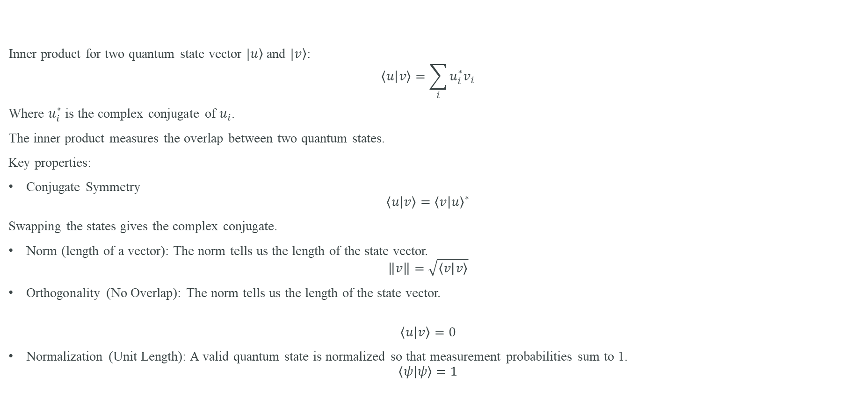
Inner Product, Norm & Orthogonality
Inner product for two quantum state vector $\left.|u\right\rangle$ and $\left.|v\right\rangle$:
$$\left\langle u | v\right\rangle =\sum_{i}{u_{i}^{∗}v_{i}}$$
Where $u_{i}^{∗}$ is the complex conjugate of $u_{i}$.
The inner product measures the overlap between two quantum states.
Key properties:
Conjugate Symmetry
$$\left\langle u | v\right\rangle ={\left\langle v | u\right\rangle }^{∗}$$
Swapping the states gives the complex conjugate.
Norm (length of a vector): The norm tells us the length of the state vector.
$$\left\|v\right\|=\sqrt{\left\langle v | v\right\rangle }$$
Orthogonality (No Overlap): The norm tells us the length of the state vector.
$$\left\langle u | v\right\rangle =0$$
Normalization (Unit Length): A valid quantum state is normalized so that measurement probabilities sum to 1.
$$\left\langle ψ | ψ\right\rangle =1$$

Slide 26
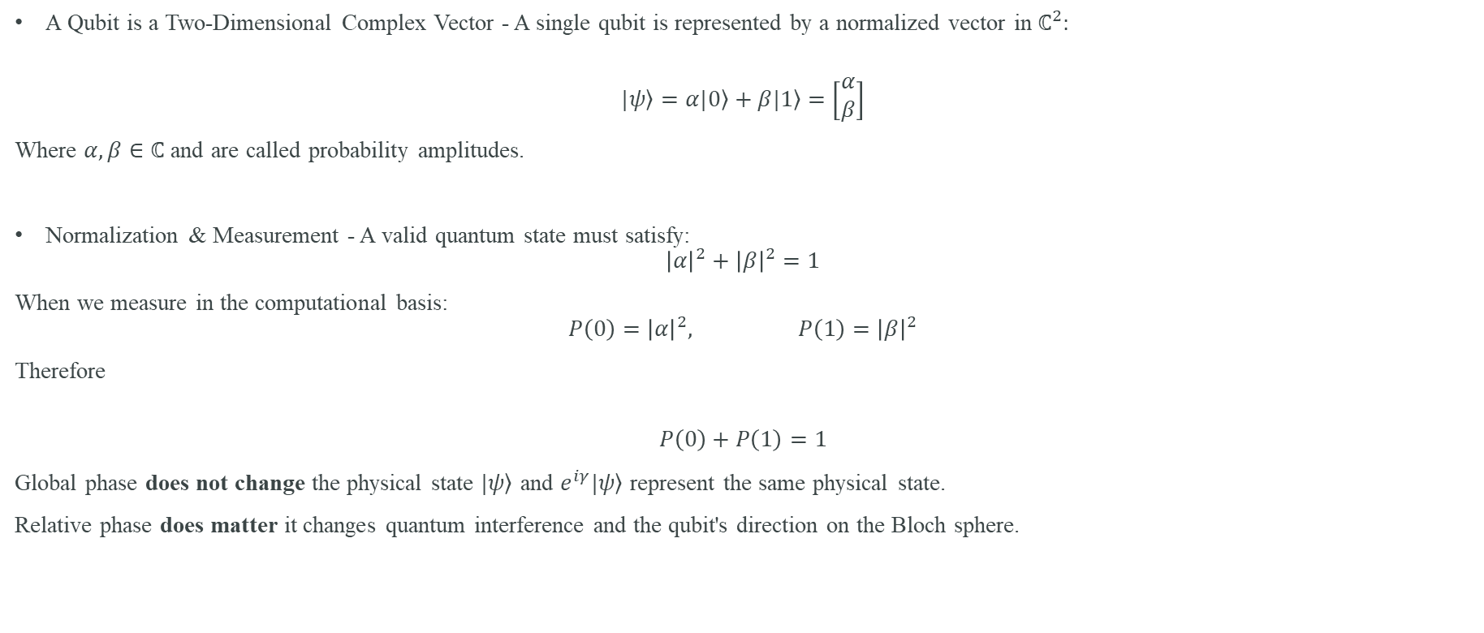
Qubits as Vectors in $ℂ^{2}$
A Qubit is a Two-Dimensional Complex Vector - A single qubit is represented by a normalized vector in $ℂ^{2}:$
$$\left.|ψ\right\rangle =α\left.|0\right\rangle +β\left.|1\right\rangle =\left[\begin{matrix}α \\ β\end{matrix}\right]$$
Where $α,β∈ℂ$ and are called probability amplitudes.
Normalization & Measurement - A valid quantum state must satisfy:
$${\left|α\right|}^{2}+{\left|β\right|}^{2}=1$$
When we measure in the computational basis:
$$P\left(0\right)={\left|α\right|}^{2}, P\left(1\right)={\left|β\right|}^{2}$$
Therefore
$$P\left(0\right)+P\left(1\right)=1$$
Global phase does not change the physical state $\left.|ψ\right\rangle$ and $e^{iγ}\left.|ψ\right\rangle$ represent the same physical state.
Relative phase does matter it changes quantum interference and the qubit's direction on the Bloch sphere.

Slide 27
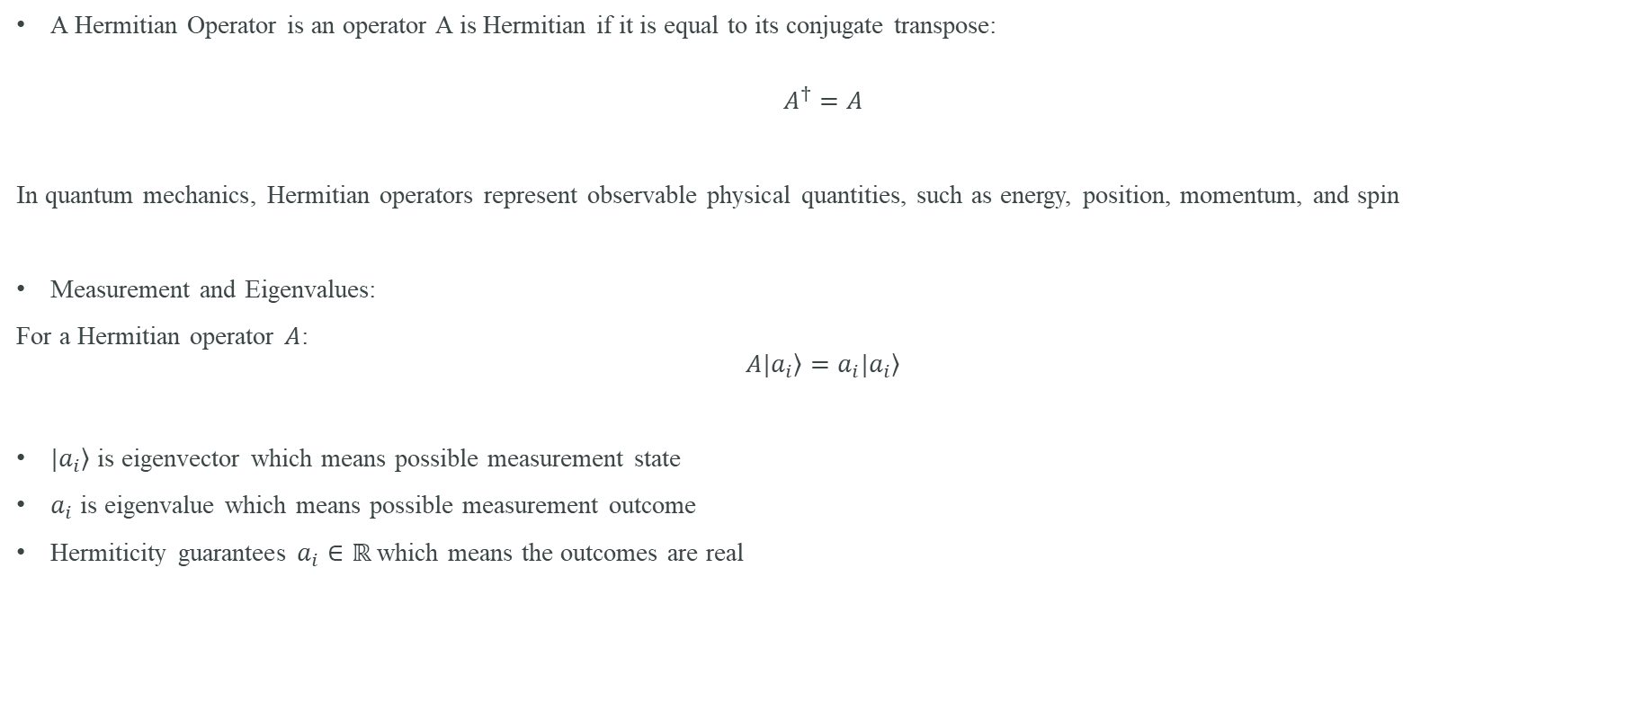
Hermitian Operators and Quantum Observables
A Hermitian Operator is an operator A is Hermitian if it is equal to its conjugate transpose:
$$A^{†}=A$$
In quantum mechanics, Hermitian operators represent observable physical quantities, such as energy, position, momentum, and spin
Measurement and Eigenvalues:
For a Hermitian operator $A$:
$$A\left.|a_{i}\right\rangle =a_{i}\left.|a_{i}\right\rangle$$
$\left.|a_{i}\right\rangle$ is eigenvector which means possible measurement state
$a_{i}$ is eigenvalue which means possible measurement outcome
Hermiticity guarantees $a_{i}∈ℝ$ which means the outcomes are real

Slide 28
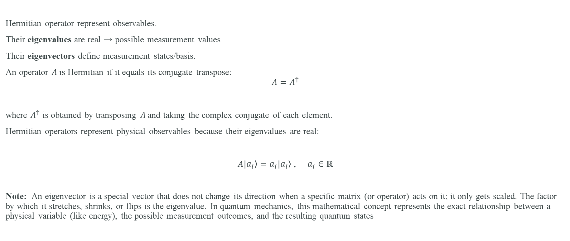
Hermitian Operators and Measurements
Hermitian operator represent observables.
Their eigenvalues are real → possible measurement values.
Their eigenvectors define measurement states/basis.
An operator $A$is Hermitian if it equals its conjugate transpose:
$$A=A^{†}$$
where $A^{†}$ is obtained by transposing $A$and taking the complex conjugate of each element.
Hermitian operators represent physical observables because their eigenvalues are real:
$A\left.|a_{i}\right\rangle =a_{i}\left.|a_{i}\right\rangle$ , $a_{i}∈ℝ$
Note: An eigenvector is a special vector that does not change its direction when a specific matrix (or operator) acts on it; it only gets scaled. The factor by which it stretches, shrinks, or flips is the eigenvalue. In quantum mechanics, this mathematical concept represents the exact relationship between a physical variable (like energy), the possible measurement outcomes, and the resulting quantum states

Slide 29
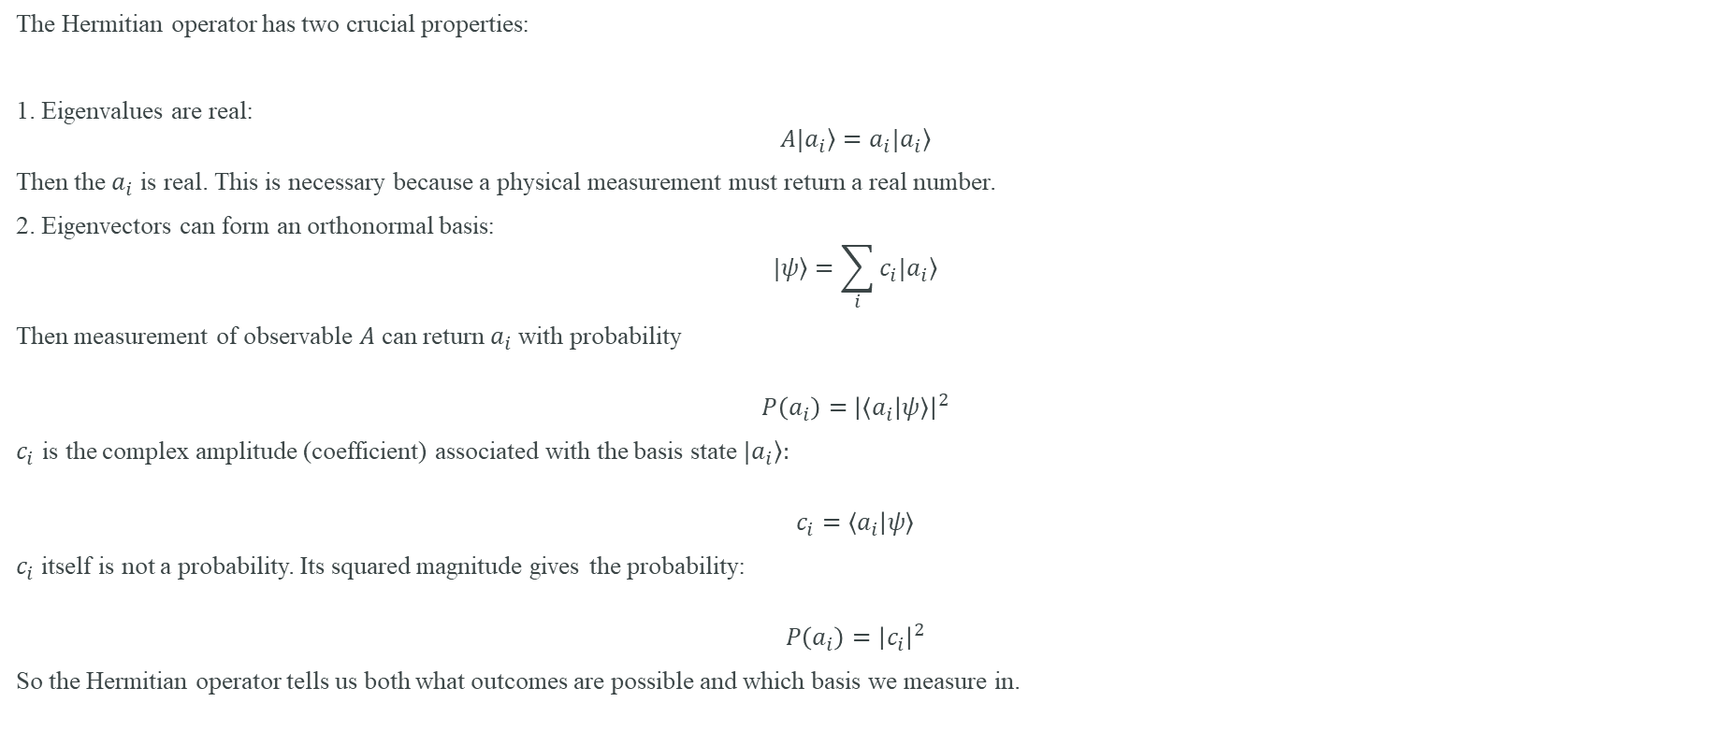
Hermitian operators properties
The Hermitian operator has two crucial properties:
1. Eigenvalues are real:
$$A\left.|a_{i}\right\rangle =a_{i}\left.|a_{i}\right\rangle$$
Then the $a_{i}$ is real. This is necessary because a physical measurement must return a real number.
2. Eigenvectors can form an orthonormal basis:
$$\left.|ψ\right\rangle =\sum_{i}{c_{i}\left.|a_{i}\right\rangle }$$
Then measurement of observable $A$ can return $a_{i}$with probability
$$P\left(a_{i}\right)={\left|\left\langle a_{i} | ψ\right\rangle \right|}^{2}$$
$c_{i}$ is the complex amplitude (coefficient) associated with the basis state $\left.|a_{i}\right\rangle :$
$$c_{i}=\left\langle a_{i} | ψ\right\rangle$$
$c_{i}$itself is not a probability. Its squared magnitude gives the probability:
$$P\left(a_{i}\right)={\left|c_{i}\right|}^{2}$$
So the Hermitian operator tells us both what outcomes are possible and which basis we measure in.

Slide 30
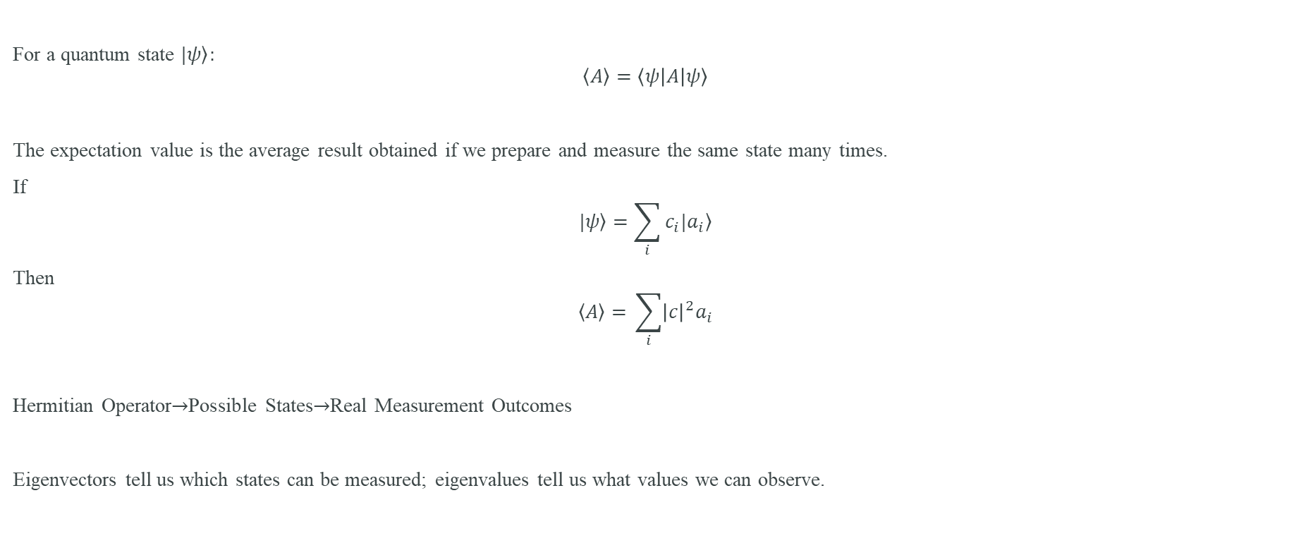
Measurement and Expectation Value
For a quantum state $\left.|ψ\right\rangle :$
$$\left\langle \left.A\right\rangle =\left\langle ψ | A | ψ\right\rangle \right.$$
The expectation value is the average result obtained if we prepare and measure the same state many times.
If
$$\left.|ψ\right\rangle =\sum_{i}{c_{i}\left.|a_{i}\right\rangle }$$
Then
$$\left\langle \left.A\right\rangle =\right. \sum_{i}{{\left|c\right|}^{2}a_{i}}$$
Hermitian Operator$→$Possible States$→$Real Measurement Outcomes
Eigenvectors tell us which states can be measured; eigenvalues tell us what values we can observe.

Slide 31
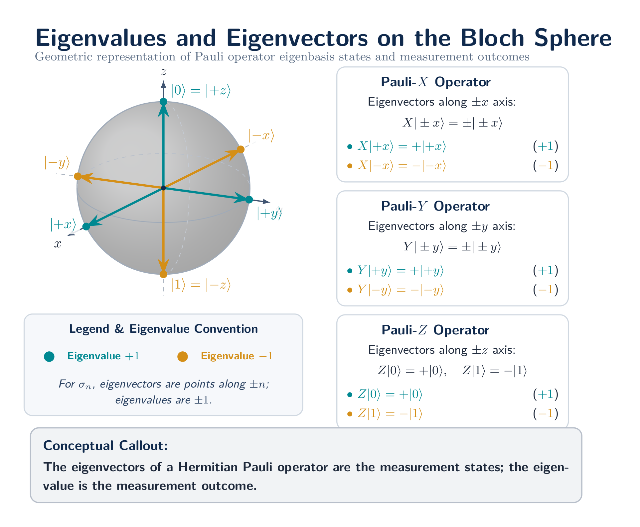

Slide 32
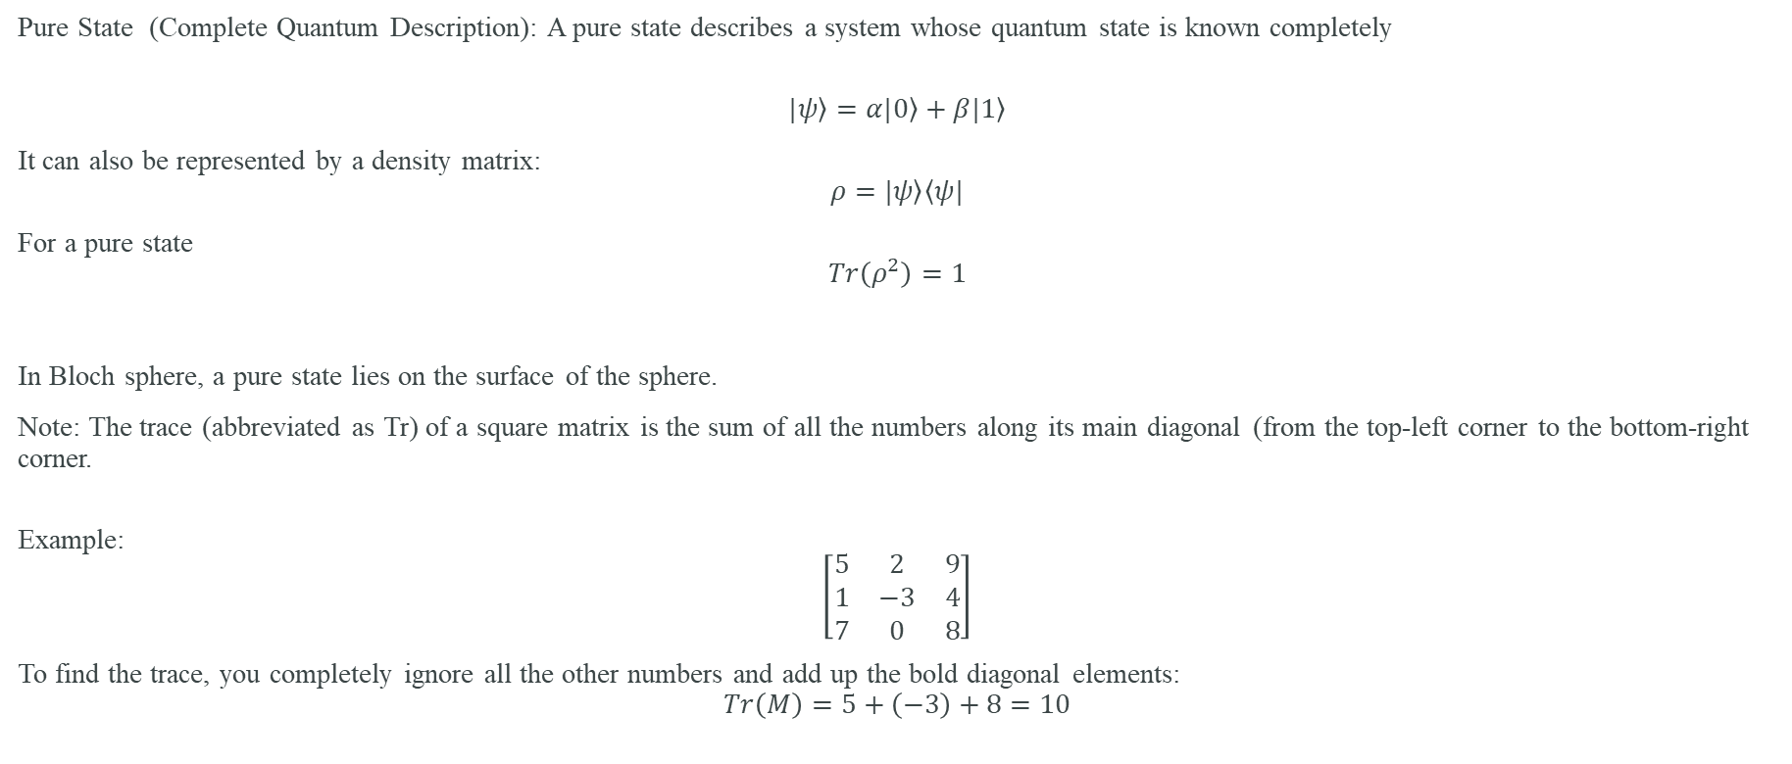
Pure States
Pure State (Complete Quantum Description): A pure state describes a system whose quantum state is known completely
$$\left.|ψ\right\rangle =α\left.|0\right\rangle +β\left.|1\right\rangle$$
It can also be represented by a density matrix:
$$ρ=\left.|ψ\right\rangle \left\langle ψ|\right.$$
For a pure state
$$Tr\left(ρ^{2}\right)=1$$
In Bloch sphere, a pure state lies on the surface of the sphere.
Note: The trace (abbreviated as Tr) of a square matrix is the sum of all the numbers along its main diagonal (from the top-left corner to the bottom-right corner.
Example:
$$\left[\begin{matrix}5 & 2 & 9 \\ 1 & −3 & 4 \\ 7 & 0 & 8\end{matrix}\right]$$
To find the trace, you completely ignore all the other numbers and add up the bold diagonal elements:
$$Tr\left(M\right)=5+\left(−3\right)+8=10$$

Slide 33
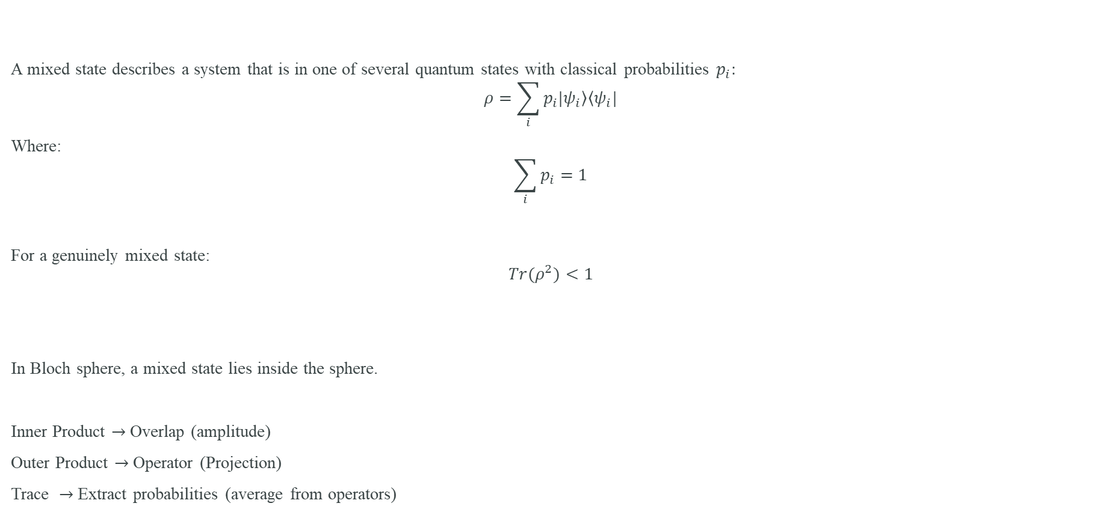
Mixed State or Statistical Mixture
A mixed state describes a system that is in one of several quantum states with classical probabilities $p_{i}:$
$$ρ=\sum_{i}{p_{i}\left.|ψ_{i}\right\rangle \left\langle ψ_{i}|\right.}$$
Where:
$$\sum_{i}{p_{i}}=1$$
For a genuinely mixed state:
$$Tr(ρ^{2})<1$$
In Bloch sphere, a mixed state lies inside the sphere.
Inner Product $→$Overlap (amplitude)
Outer Product $→$ Operator (Projection)
Trace $→$ Extract probabilities (average from operators)

Slide 34
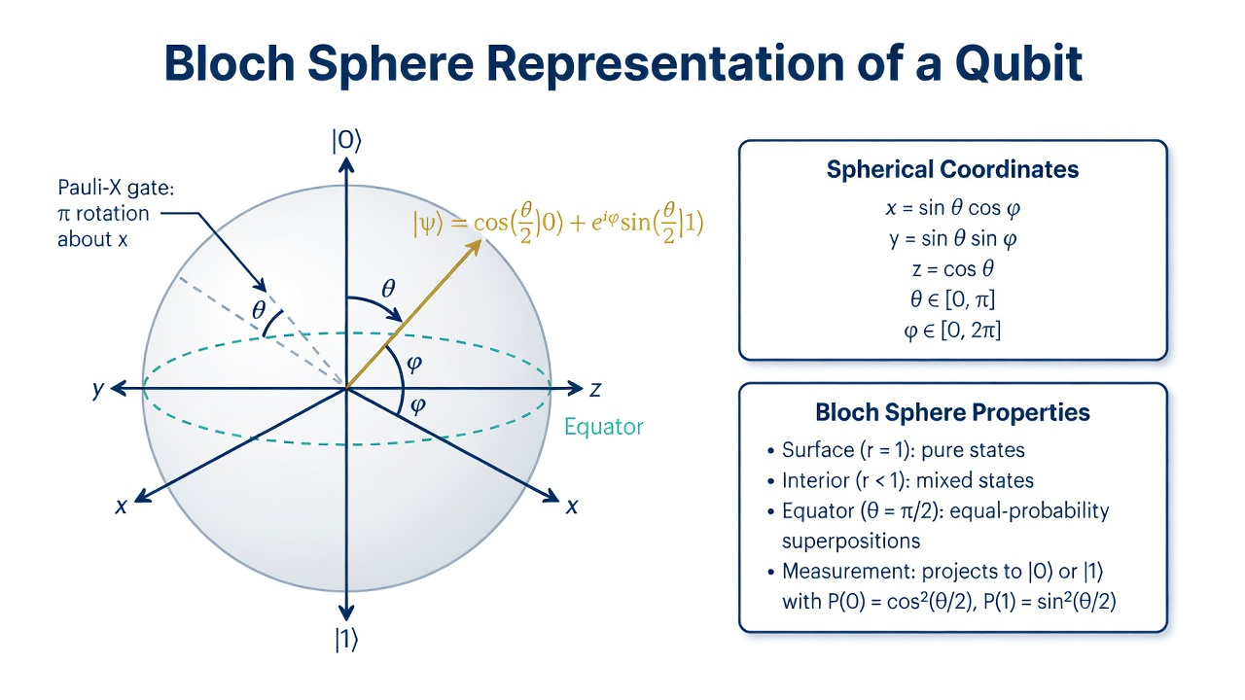

Slide 35
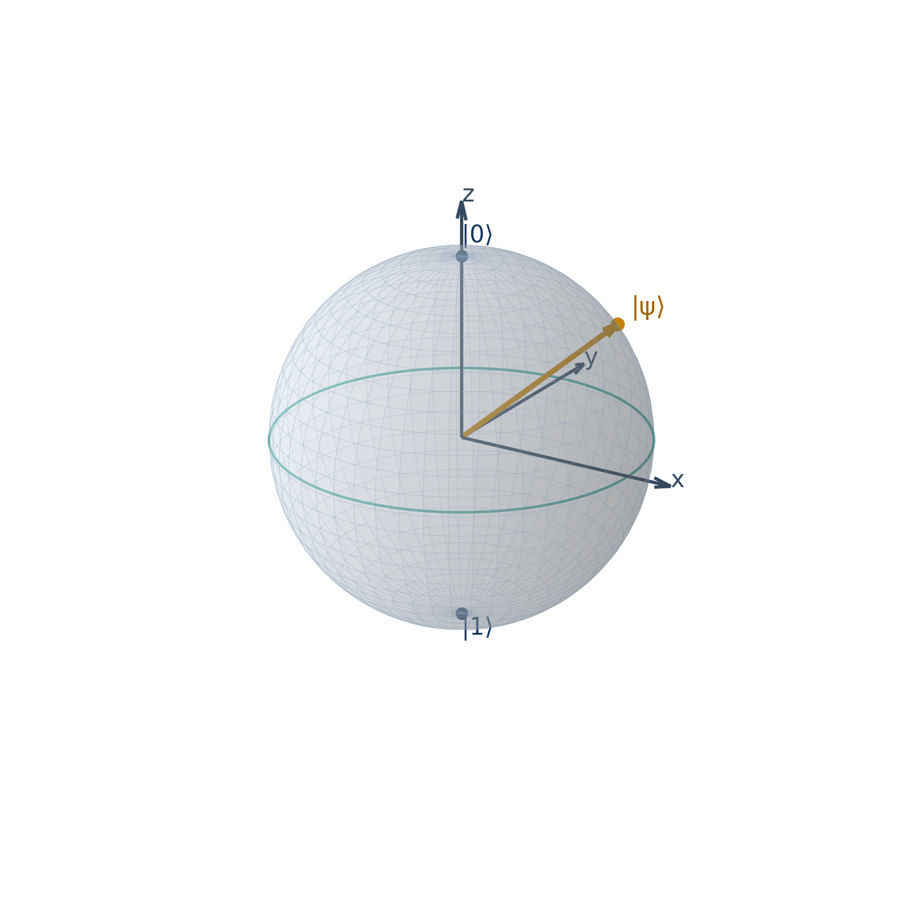
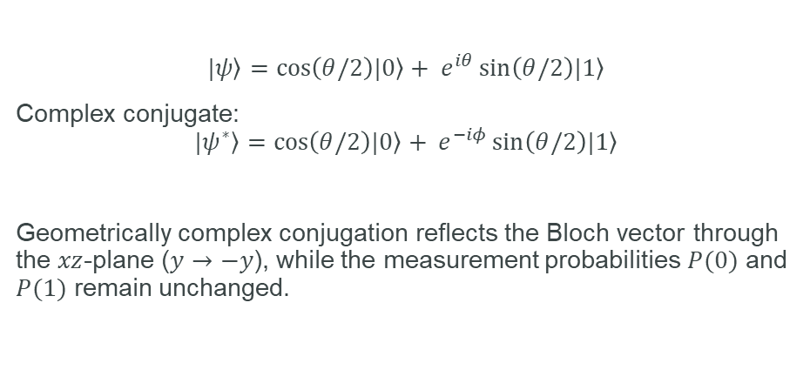
$$\left.|ψ\right\rangle =\cos\left(θ/2\right)\left.|0\right\rangle + e^{iθ}\sin\left(θ/2\right)\left.|1\right\rangle$$
Complex conjugate:
$$\left.|ψ^{∗}\right\rangle =\cos\left(θ/2\right)\left.|0\right\rangle + e^{−iφ}\sin\left(θ/2\right)\left.|1\right\rangle$$
Geometrically complex conjugation reflects the Bloch vector through the $xz$-plane ($y→−y$), while the measurement probabilities $P(0)$ and $P(1)$ remain unchanged.

Slide 36
The Bloch Sphere – Visualizing a Qubit
A qubit isn’t just 0 or 1 — it lives on a 3D sphere.
Any point on the sphere = a valid qubit state.
The north pole is |0⟩, south is |1⟩.
Superposition states live on the surface.
Used to visualize quantum gates as rotations.

Slide 37
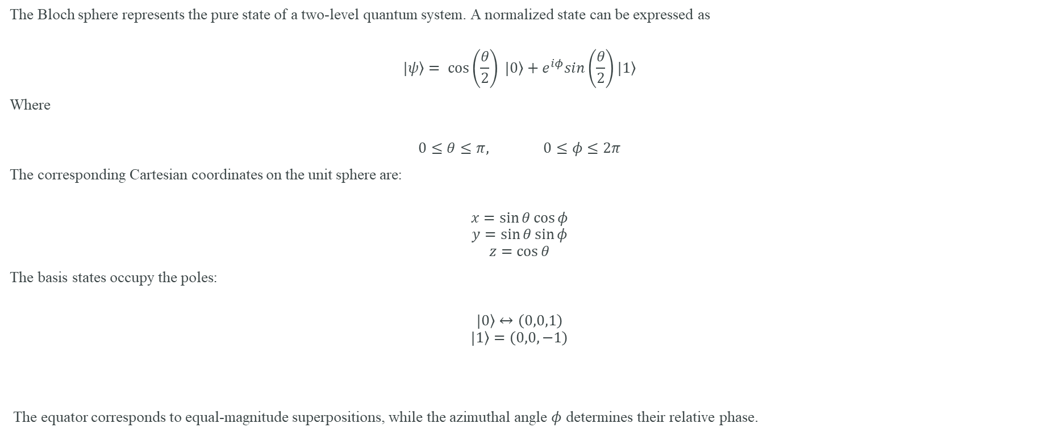
The Bloch sphere
The Bloch sphere represents the pure state of a two-level quantum system. A normalized state can be expressed as
$$\left.|ψ\right\rangle = \cos\left(\frac{θ}{2}\right) \left.|0\right\rangle +e^{iφ}sin\left(\frac{θ}{2}\right)\left.|1\right\rangle$$
Where
$$0≤θ≤π, 0≤φ≤2π$$
The corresponding Cartesian coordinates on the unit sphere are:
$$x=\sin{θ\cos{φ}}$$
$$y=\sin{θ\sin{φ}}$$
$$z=\cos{θ}$$
The basis states occupy the poles:
$$\left.|0\right\rangle ↔\left(0,0,1\right)$$
$$\left.|1\right\rangle =\left(0,0,−1\right)$$
The equator corresponds to equal-magnitude superpositions, while the azimuthal angle $φ$ determines their relative phase.

Slide 38
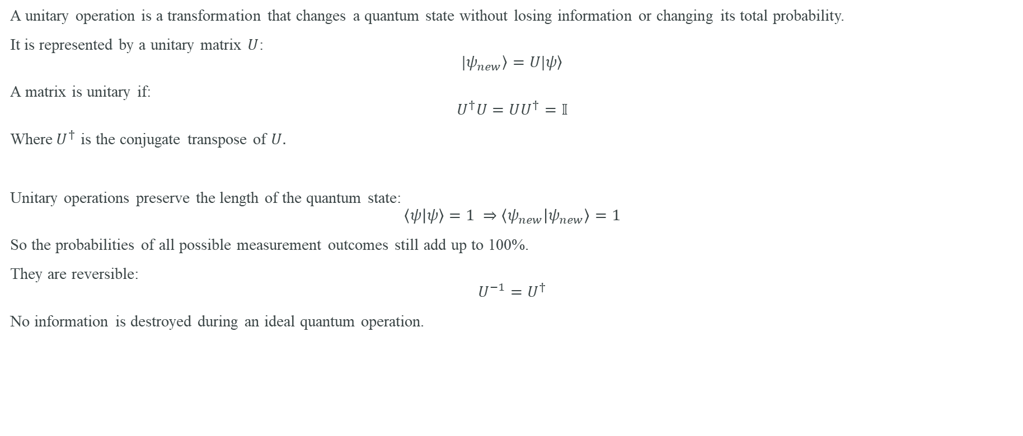
Unitary Operations — How Quantum States Evolve
A unitary operation is a transformation that changes a quantum state without losing information or changing its total probability.
It is represented by a unitary matrix $U$:
$$\left.|ψ_{new}\right\rangle =U\left.|ψ\right\rangle$$
A matrix is unitary if:
$$U^{†}U=UU^{†}=𝕀$$
Where$U^{†}$ is the conjugate transpose of $U.$
Unitary operations preserve the length of the quantum state:
$$\left\langle ψ | ψ\right\rangle =1 ⇒\left\langle ψ_{new} | ψ_{new}\right\rangle =1$$
So the probabilities of all possible measurement outcomes still add up to 100%.
They are reversible:
$$U^{−1}=U^{†}$$
No information is destroyed during an ideal quantum operation.

Slide 39
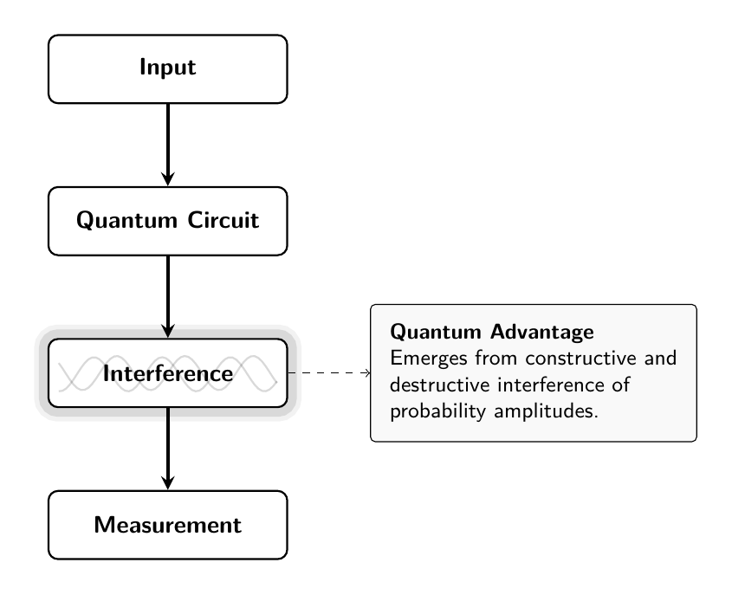
Quantum Processing

Slide 40
Manipulating Quantum Information: The Language of Quantum Computation
Quantum Gates: Operations on Quantum States
Unlike classical logic gates, quantum gates do not simply switch bits between 0 and 1.
They perform unitary transformations that control:
  Probability amplitudes
  Relative phases
  Entanglement between qubits
  Quantum interference patterns
Universal Gate Sets: A small collection of gates can approximate any quantum algorithm to arbitrary precision.
Common Universal Gate Set:
{H,T,CNOT}
Notes:
This slide introduces the language used to control and process quantum information: quantum gates.
In classical computers, logic gates such as AND, OR, and NOT simply manipulate bits between the states 0 and 1. Quantum gates work differently. They perform unitary transformations on qubits, changing the quantum state while preserving its total probability.
These operations allow us to control the probability amplitudes of quantum states, adjust their relative phases, create entanglement between qubits, and engineer quantum interference that amplifies correct solutions while suppressing incorrect ones.
Just as classical circuits are built from a small set of logic gates, quantum computers can be built from a universal gate set. A universal gate set is a small collection of quantum gates capable of approximating any quantum algorithm to arbitrary precision.
One of the most common universal gate sets is {H, T, CNOT}. The Hadamard gate, or H gate, creates superposition. The T gate introduces a controlled quantum phase, enabling more complex operations. The CNOT gate entangles qubits and forms the foundation of multi-qubit quantum circuits.
Together, these gates provide the building blocks from which all quantum algorithms are constructed.

Slide 41
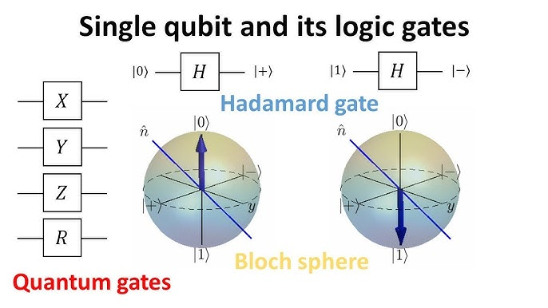
Quantum Gates: Building Blocks of Quantum Circuits
Quantum gates are the fundamental operations applied to qubits — just like logic gates (AND, OR, NOT) in classical computing.
But unlike classical gates, quantum gates are reversible and operate on superpositions.
Key Properties of Quantum Gates
  Represented as unitary matrices
  Preserve the total probability (norm of state = 1)
  Can operate on one or multiple qubits
  Enable operations like rotation, flipping, entanglement

Slide 42
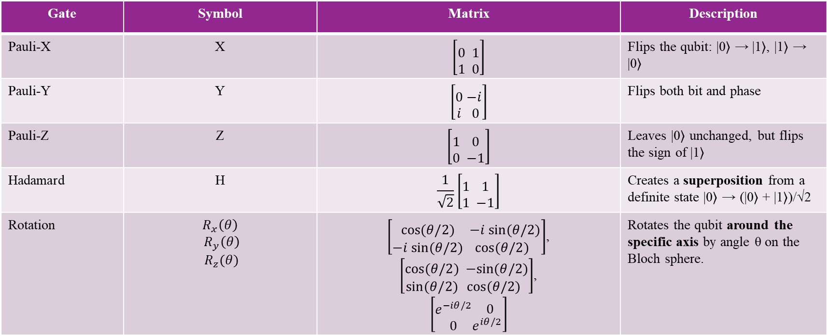
Common Quantum Gates
Gate | Symbol | Matrix | Description
Pauli-X | X | $$\left[\begin{aligned} \\ 0 \\ 1\end{aligned}\begin{aligned} \\ 1 \\ 0\end{aligned}\right]$$ | Flips the qubit: |0⟩ → |1⟩, |1⟩ → |0⟩
Pauli-Y | Y | $$\left[\begin{aligned} \\ 0 \\ i\end{aligned}\begin{aligned} \\ −i \\ 0\end{aligned}\right]$$ | Flips both bit and phase
Pauli-Z | Z | $$\left[\begin{aligned} \\ 1 \\ 0\end{aligned}\begin{aligned} \\ 0 \\ −1\end{aligned}\right]$$ | Leaves |0⟩ unchanged, but flips the sign of |1⟩
Hadamard | H | $$\frac{1}{\sqrt{2}}\left[\begin{aligned} \\ 1 \\ 1\end{aligned}\begin{aligned} \\ 1 \\ −1\end{aligned}\right]$$ | Creates a superposition from a definite state |0⟩ → (|0⟩ + |1⟩)/√2
Rotation | $$R_{x}\left(θ\right)$$ $R_{y}\left(θ\right)$ $R_{z}(θ)$ | $\left[\begin{aligned} \\ cos⁡(θ/2) \\ −i sin⁡(θ/2)\end{aligned}\begin{aligned} \\ −i sin⁡(θ/2) \\ cos⁡(θ/2)\end{aligned}\right]$, $\left[\begin{aligned} \\ cos⁡(θ/2) \\ sin⁡(θ/2)\end{aligned}\begin{aligned} \\ −sin⁡(θ/2) \\ cos⁡(θ/2)\end{aligned}\right]$, $$\left[\begin{aligned} \\ e^{−iθ/2} \\ 0\end{aligned}\begin{aligned} \\ 0 \\ e^{iθ/2}\end{aligned}\right]$$ | Rotates the qubit around the specific axis by angle θ on the Bloch sphere.

Slide 43
Fundamental Quantum Gates
Gate | Function
X | Quantum NOT (bit flip)
Y | Bit flip + phase rotation
Z | Phase rotation
H (Hadamard) | Creates superposition
CNOT | Creates entanglement and conditional operations
Quantum computation is not about storing information differently; it is about controlling how probability amplitudes evolve and interfere.
This ability to engineer interference is the source of quantum computational advantage.

Slide 44
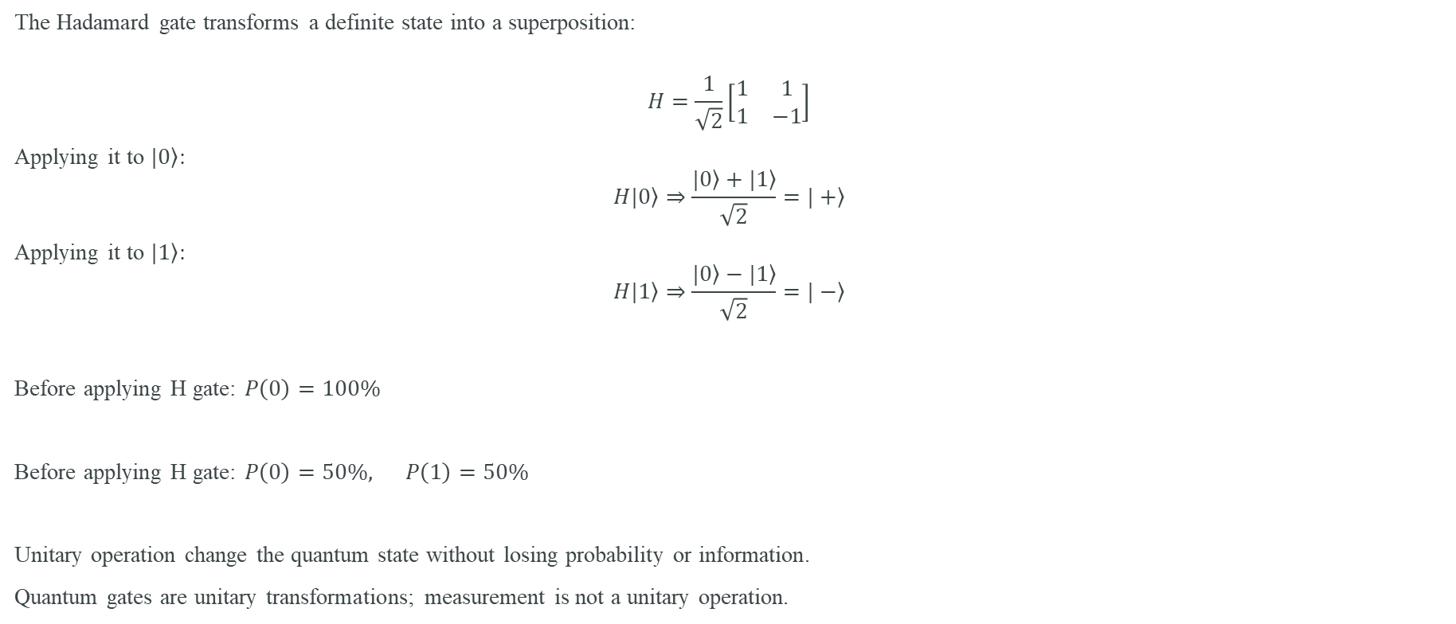
Example — The Hadamard Gate
The Hadamard gate transforms a definite state into a superposition:
$$H=\frac{1}{\sqrt{2}}\left[\begin{matrix}1 & 1 \\ 1 & −1\end{matrix}\right]$$
Applying it to $\left.|0\right\rangle :$
$$\left.H|0\right\rangle ⇒\frac{\left.|0\right\rangle +\left.|1\right\rangle }{\sqrt{2}}=\left.|+\right\rangle$$
Applying it to $\left.|1\right\rangle :$
$$\left.H|1\right\rangle ⇒\frac{\left.|0\right\rangle −\left.|1\right\rangle }{\sqrt{2}}=\left.|−\right\rangle$$
Before applying H gate: $P\left(0\right)=100\%$
Before applying H gate: $P\left(0\right)=50\%, P\left(1\right)=50\%$
Unitary operation change the quantum state without losing probability or information.
Quantum gates are unitary transformations; measurement is not a unitary operation.

Slide 45
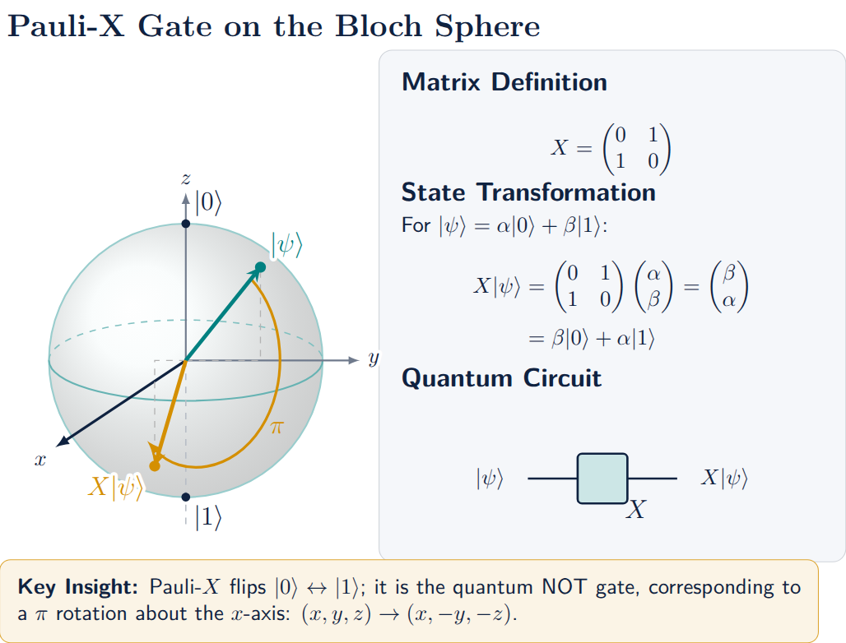

Slide 46
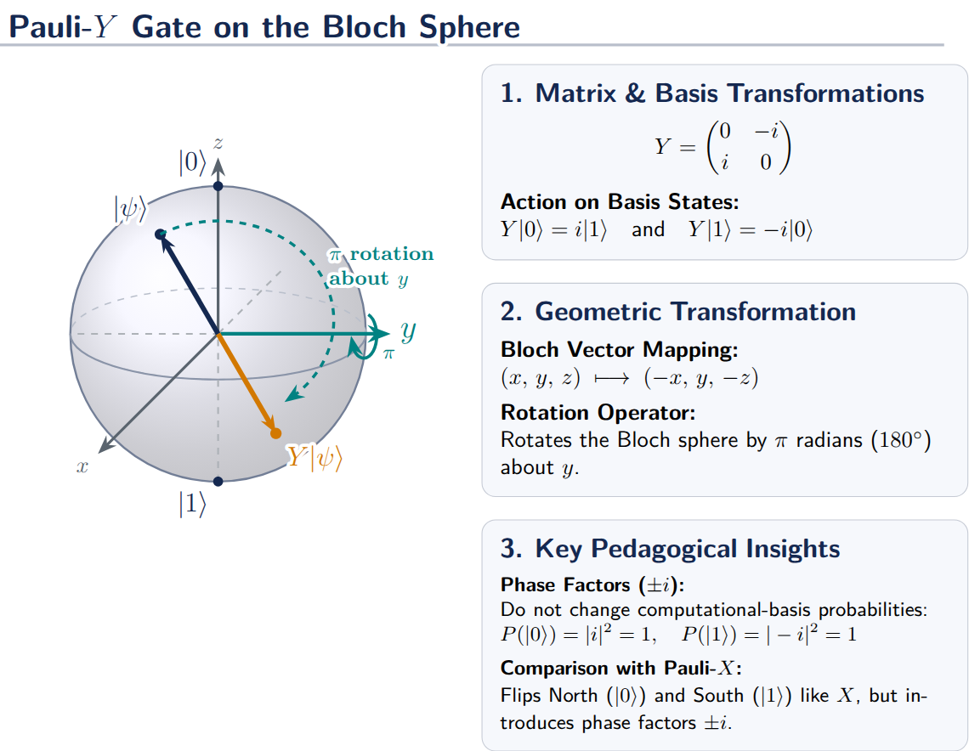

Slide 47
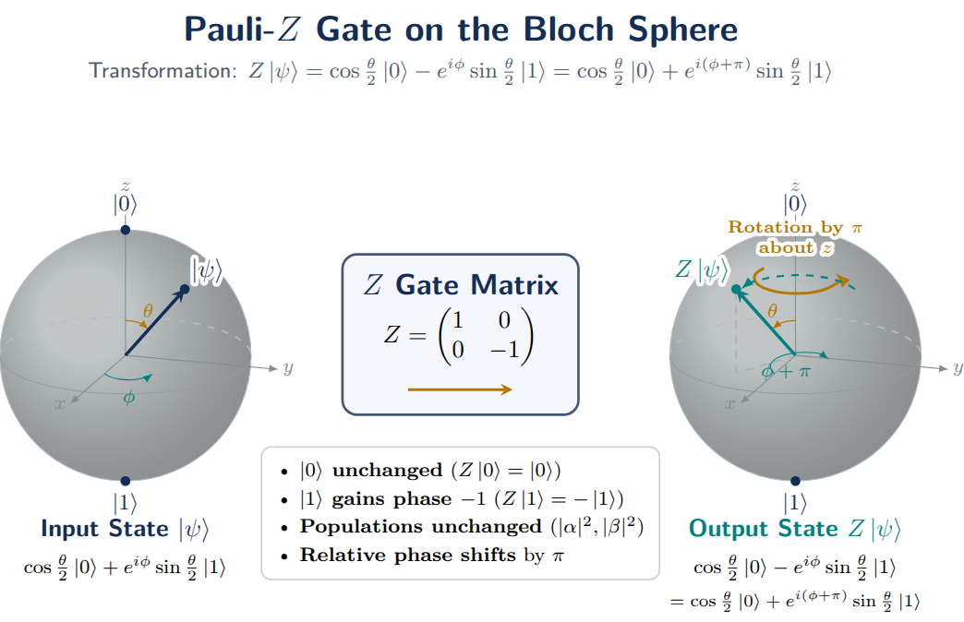

Slide 48
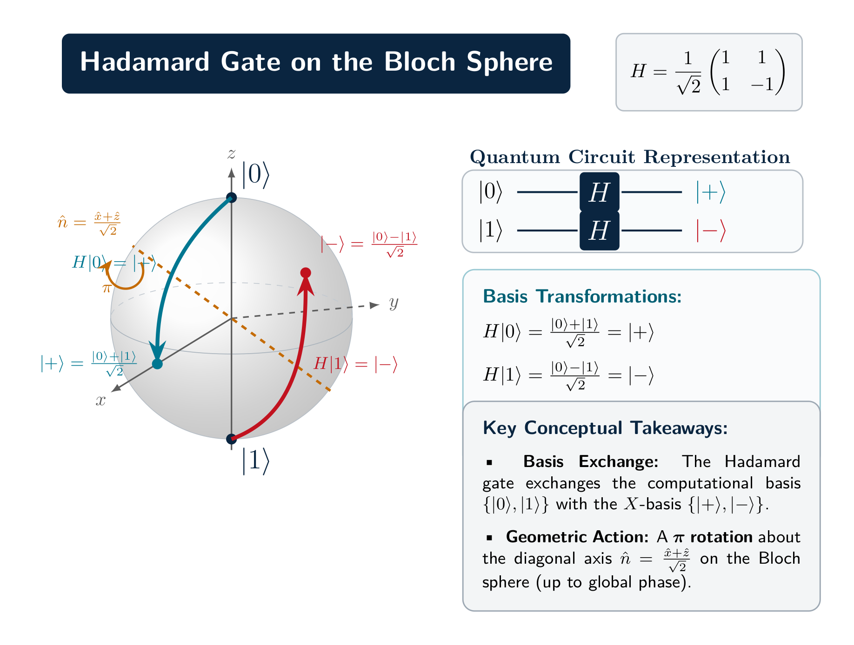

Slide 49
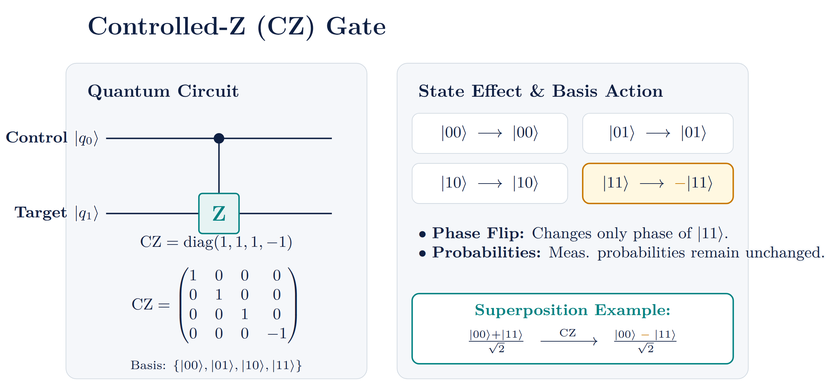

Slide 50
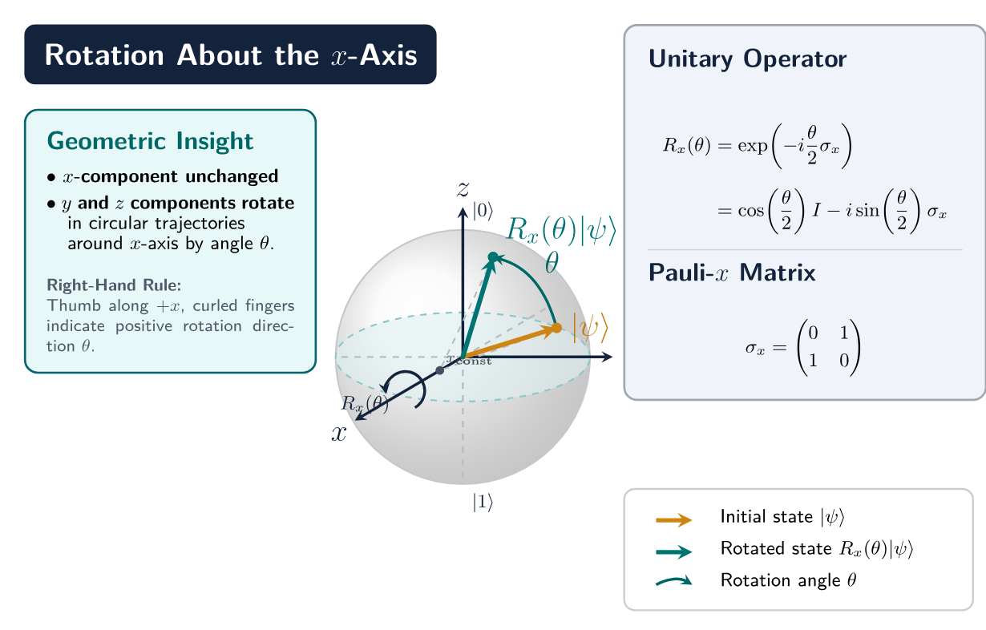

Slide 51


Slide 52


Slide 53


Slide 54


Slide 55


Slide 56


Demonstrating Entanglement using C-NOT gate, Bell State
Quantum C-NOT gate (uses the Pauli-X gate and is a two-qubit gate)
  The quantum CNOT gate has two inputs, and thus two outputs. The target input is negated only if the control input is set to 1. If the control input is 0, the gate has no effect. The control qubit is not changed by the gate.
Bell States
  Special maximally entangled states of two qubits.
  Most common example: $\left.[Φ^{+}\right\rangle = \frac{1}{\sqrt{2}}(|\left.00\right\rangle +|\left.11\right\rangle )$
  Cannot be separated into individual qubit states → true entanglement.
Entanglement
  A quantum correlation between particles.
  Measuring one qubit instantly affects the other, no matter the distance.
  Essential for quantum communication, teleportation, and many algorithms.

Slide 57


Example: Creating a Bell State Step-by-Step
Step 1) Hadamard gate on the first qubit
Step 2) CNOT gate (control: qubit 1, target: qubit 2) Entanglement
1. initial state: $[\left.ψ\right\rangle =[\left.00\right\rangle =\left[\begin{aligned}1 \\ 0 \\ 0 \\ 0\end{aligned}\right]$
2. Apply Hadamard to first qubit: $H⊗I=\frac{1}{\sqrt{2}}\left[\begin{aligned}1 \\ 0 \\ 1 \\ 0\end{aligned}\begin{aligned}0 \\ 1 \\ 0 \\ 1\end{aligned}\begin{aligned}1 \\ 0 \\ −1 \\ 0\end{aligned}\begin{aligned}0 \\ 1 \\ 0 \\ 1\end{aligned}\right]$ ➔$[\left.ψ\right\rangle =\frac{1}{2}([\left.00\right\rangle +[\left.10\right\rangle )$
3. Apply the 4x4 CNOT matrix to the result above:
$$CNOT.(\frac{1}{2}([\left.00\right\rangle +\left[\left.10\right\rangle \right)=\frac{1}{2}([\left.00\right\rangle +[\left.11\right\rangle )$$

Slide 58
Quantum Entanglement: Correlation Beyond Classical Physics
What is Entanglement?
Two or more qubits become part of a single quantum state, such that the state of each qubit cannot be described independently of the others.
Role in State Preparation
Start with ∣00⟩
Apply a Hadamard (H) gate to qubit 1
Apply a CNOT gate between qubits
The information is now stored in the joint state of both qubits rather than in either qubit individually.
Notes:
Entanglement occurs when two or more qubits become part of a single quantum state, meaning the state of each qubit can no longer be described independently. Instead, the information is stored in the relationship between the qubits.
A simple example starts with two qubits in the state |00⟩. First, we apply a Hadamard gate to the first qubit, creating a superposition. The system becomes a combination of |00⟩ and |10⟩. Next, we apply a CNOT gate, using the first qubit as the control and the second as the target. This transforms the system into the entangled Bell state.
At this point, neither qubit has its own independent state. If we measure one qubit and obtain 0, the other will also be 0. If we measure one and obtain 1, the other will also be 1.
The key idea is that the information is no longer stored in either qubit individually—it is stored in the joint quantum state of the two-qubit system. This ability to create and manipulate correlations is a fundamental resource behind quantum algorithms, quantum communication, and quantum error correction.

Slide 59
Quantum Entanglement Role in Quantum Algorithms
Role in System Evolution
Operations on one qubit affect the evolution of the entire entangled system.
Quantum algorithms exploit entanglement to represent and process correlations across many states simultaneously.
Entanglement enables quantum error correction, quantum simulation, and quantum speedups.
Role in Measurement
Measuring one qubit immediately determines the correlated outcome of the other.
For the Bell state:
Measure first qubit = 0 → second qubit = 0
Measure first qubit = 1 → second qubit = 1
Individual measurements appear random (50% probability each), but joint
Superposition creates multiple possibilities. Entanglement links those possibilities together, allowing quantum systems to encode and manipulate information collectively rather than independently.
Notes:
This slide explains why entanglement is such a powerful resource in quantum computing.
When qubits become entangled, they form a single quantum system. As a result, operations applied to one qubit can influence the evolution of the entire system. Quantum algorithms exploit this property to represent and process complex correlations across many quantum states simultaneously, enabling capabilities that are difficult or impossible to achieve classically.
Entanglement plays a central role in many quantum technologies, including quantum error correction, quantum simulation, and the speedups offered by certain quantum algorithms. It allows information to be distributed across multiple qubits rather than being stored locally in a single one.
Entanglement also produces unique measurement behavior. Consider the Bell state (∣00⟩+∣11⟩)/
2
​
. If we measure the first qubit and obtain 0, the second qubit will also be 0. If we obtain 1, the second qubit will also be 1. Each outcome is individually random, with a 50% probability, but the results are perfectly correlated.
A useful way to think about it is this: superposition creates multiple possibilities, while entanglement links those possibilities together. This allows quantum systems to encode and manipulate information collectively as a unified quantum state rather than as a collection of independent qubits, which is one of the key sources of quantum computational power.

Slide 60
Quantum Computing Challenges in the Circuit-Based Model
Decoherence – Loss of quantum properties due to environmental interaction, limiting computation time. Requires extreme isolation and error suppression.
Quantum Error Correction (QEC) – Protects data without direct measurement but demands thousands of physical qubits per logical qubit.
High-Fidelity Operations – Gates must exceed ~99.9% accuracy; imperfections increase error-correction burden.
Scalability – Adding qubits while maintaining quality is difficult due to wiring, cryogenics, and control complexity.
Gate Speed vs. Coherence Time – Operations must be fast enough to finish before decoherence without sacrificing fidelity.
Crosstalk & Control Errors – Unwanted qubit interactions and calibration drift cause correlated, harder-to-fix errors.
Readout Errors – Measurement inaccuracies distort results, requiring repetition and statistical correction.

Slide 61
Quantum Hardware
  Quantum hardware is defined by the physical technology used to create and control qubits. As physical qubit counts reach the thousands, the focus is shifting to logical qubits; error-corrected, highly reliable computational units built from multiple physical qubits.
  The leading hardware technologies:
  Superconducting Circuits
  Trapped Ions
  Neutral Atoms
  Photonics
  Topological
  Quantum Annealing

Slide 62


Slide 63
Superconducting Circuits
  Mechanism: Uses microscopic superconducting circuits featuring Josephson junctions on silicon chips. These act as artificial atoms and are manipulated using precise microwave pulses. The systems must be kept in dilution refrigerators at temperatures colder than deep space (near absolute zero).
  Current Bit Count: Physical systems range from 133 up to 1,100+ physical qubits (e.g., IBM's Condor). State-of-the-art processors like Google's Willow utilize around 105 to 1,000 physical qubits to actively run error-correction grids.
  Key Players: IBM, Google Quantum AI, and Rigetti Computing.
Notes:
One of the leading approaches to building quantum computers is superconducting circuits. In this technology, tiny superconducting electrical circuits are fabricated on silicon chips and contain special components called Josephson junctions. These circuits behave like artificial atoms and serve as quantum bits, or qubits.
To control the qubits, scientists use extremely precise microwave pulses that manipulate their quantum states. Because superconductivity only occurs at very low temperatures, these processors must operate inside dilution refrigerators cooled to just a fraction of a degree above absolute zero—colder than outer space.
Today, superconducting quantum processors contain anywhere from around 100 to more than 1,000 physical qubits. Examples include IBM's Condor processor and Google's Willow architecture, which use large numbers of qubits to explore quantum error correction, a critical step toward reliable quantum computing.
The major organizations driving this technology forward include IBM, Google Quantum AI, and Rigetti Computing. Their goal is to scale these systems into fault-tolerant quantum computers capable of solving real-world scientific and industrial problems.

Slide 64
Trapped Ions
  Mechanism: Holds individual, charged atoms (ions) in a vacuum using electromagnetic fields. The quantum states of these ions are manipulated and measured using highly focused laser beams.
  Current Bit Count: Systems generally feature between 36 to 64 algorithmic qubits. These are known for high gate fidelities (exceeding 99.99%) and long coherence times.
  Key Players: IonQ and Quantinuum.
Notes:
Another major quantum computing technology is trapped ions. In this approach, individual charged atoms, called ions, are suspended in a vacuum using carefully controlled electromagnetic fields. These ions naturally act as qubits because their internal energy states can represent quantum information.
Scientists manipulate and read the qubits using highly focused laser beams. The lasers perform quantum logic operations, create entanglement between ions, and measure the final quantum states. Because the ions are isolated from much of their environment, they can maintain their quantum properties for relatively long periods of time.
Current trapped-ion systems typically contain between 36 and 64 algorithmic qubits. Although these systems have fewer qubits than many superconducting processors, they are known for their exceptional performance, with gate fidelities often exceeding 99.99% and very long coherence times. This makes them one of the most accurate quantum computing platforms available today.
The leading companies developing trapped-ion quantum computers are IonQ and Quantinuum. Their focus is on building highly reliable quantum processors that can scale while maintaining the precision required for practical quantum applications.

Slide 65
Neutral Atoms
  Mechanism: Suspends and traps neutral atoms (such as rubidium or strontium) in a vacuum using arrays of laser beams called "optical tweezers". This allows for highly flexible reconfigurable 2D and 3D geometries and excellent scalability.
  Current Bit Count: This modality boasts some of the highest physical qubit counts, scaling from several hundred to over 1,200 physical qubits in commercial systems, with modular architectures pushing past 6,000
  Key Players: QuEra Computing and Pasqal.
Notes:
Neutral atom quantum computing is one of the fastest-growing approaches to building large-scale quantum computers. In this technology, individual neutral atoms, such as rubidium or strontium, are trapped in a vacuum using highly focused laser beams known as optical tweezers. Each trapped atom acts as a qubit.
A major advantage of this approach is flexibility. The optical tweezers can move atoms into different arrangements, allowing researchers to create reconfigurable two-dimensional and three-dimensional qubit architectures. This makes it possible to design quantum processors that are highly adaptable for different algorithms and experiments.
Neutral atom systems are also extremely promising for scalability. Current commercial platforms already operate with several hundred to more than 1,200 physical qubits, and modular designs are being developed that could support thousands of qubits, potentially exceeding 6,000 in the future.
Because of their combination of flexibility, scalability, and relatively straightforward qubit arrangement, neutral atom platforms are considered strong candidates for future fault-tolerant quantum computers.
The leading companies in this area are QuEra Computing and Pasqal, both of which are developing large-scale quantum systems based on optical tweezer technology.

Slide 66
Photonics
  Mechanism: Uses particles of light (photons) as qubits. The photons travel through integrated optical circuits and optical fibers. This system has the advantage of potentially working at or near room temperature and utilizing standard silicon chip manufacturing techniques (CMOS).
  Current Bit Count: Modalities scale into tens to thousands of engineered optical nodes depending on the multiplexed architecture.
  Key Players: PsiQuantum and Xanadu.
Notes:
Photonic quantum computing uses particles of light, called photons, as qubits. Instead of storing information in superconducting circuits or trapped atoms, quantum information is encoded into properties of light, such as polarization, phase, or the path a photon takes through an optical circuit.
The photons travel through integrated optical chips and optical fibers, where optical components such as beam splitters and phase shifters perform quantum operations. One of the biggest advantages of this approach is that photons interact very weakly with their environment, helping preserve quantum information and reducing the need for extreme cooling.
Unlike many other quantum technologies, photonic systems can potentially operate at or near room temperature and can leverage existing semiconductor manufacturing techniques, including CMOS processes used in the classical electronics industry. This offers a promising pathway toward large-scale production.
Current photonic quantum systems range from tens to thousands of engineered optical nodes, depending on the architecture and multiplexing techniques used to generate and manipulate photons efficiently.
The leading companies developing photonic quantum computers are PsiQuantum and Xanadu. Their vision is to build scalable, fault-tolerant quantum computers by harnessing the unique properties of light.

Slide 67
Topological
  Mechanism: Stores and manipulates quantum information using engineered exotic particles called "anyons". These qubits are theoretically inherently protected from environmental noise at the hardware level, dramatically simplifying error correction.
  Current Bit Count: This is an experimental, bleeding-edge architecture; demonstrations feature smaller processor arrays (e.g., 8 physical qubits) engineered to form highly robust logical qubits.
  Key Players: Microsoft.
Notes:
Topological quantum computing is one of the most ambitious approaches to building quantum computers. Instead of relying on conventional qubits, it aims to store and process quantum information using exotic quantum states and particles known as anyons. These particles can emerge in specially engineered materials under extreme quantum conditions.
The key idea is that quantum information is encoded in the topology, or global structure, of the system rather than in a fragile local property. Because of this, the information is theoretically protected from many sources of environmental noise. As a result, topological qubits could be far more stable than other qubit technologies and may require significantly less error correction.
This potential built-in protection is the main reason topological quantum computing has attracted so much attention. If successful, it could dramatically reduce one of the biggest challenges in quantum computing: maintaining reliable quantum states long enough to perform complex calculations.
Today, this technology remains highly experimental. Current demonstrations involve small processor arrays, often consisting of only a few physical qubits, designed to create highly robust logical qubits and test the underlying physics.
The primary organization pursuing this approach is Microsoft, which is investing heavily in the development of topological qubits as a possible path toward large-scale fault-tolerant quantum computers.

Slide 68
Quantum Annealing
  Mechanism: A specialized, non-gate-based architecture that uses qubits to find the lowest-energy state of a given configuration, making it uniquely optimized for solving complex optimization and math problems rather than general computation.
  Current Bit Count: Can scale to thousands of physical qubits. For example, the Advantage2 system runs 4,400 physical qubits.
  Key Players: D-Wave Quantum
Notes:
Quantum annealing is a specialized form of quantum computing designed primarily for solving optimization problems. Unlike gate-based quantum computers, which execute sequences of quantum logic operations, quantum annealers search for the lowest-energy configuration of a system. Many real-world optimization problems—such as scheduling, logistics, portfolio optimization, and resource allocation—can be translated into this type of energy-minimization problem.
The process begins by placing the qubits in an initial quantum state and then gradually changing the system's energy landscape. Through quantum effects, including tunneling, the system explores many possible solutions and ideally settles into the configuration with the lowest energy, which corresponds to the optimal or near-optimal answer.
One of the major advantages of quantum annealing is scale. Current systems can contain thousands of physical qubits. For example, the Advantage2 platform operates with approximately 4,400 physical qubits, making it one of the largest quantum hardware platforms available today.
However, quantum annealers are not universal quantum computers. They are highly specialized machines optimized for certain classes of optimization and combinatorial problems rather than general-purpose quantum algorithms.
The leading company in this field is D-Wave Quantum, which has pioneered commercial quantum annealing systems and continues to explore practical applications in industry and scientific research.

Slide 69

Quantum Computing: Today and the Near Future

Slide 70

Recent Milestones in Quantum Error Correction
  Recent Milestones:
  Google demonstrated logical qubits that improve as the system scales.
  IBM published quantum LDPC error-correction roadmaps for reducing overhead.
  Microsoft and NQCP are pursuing topological qubits designed for inherent fault tolerance.
  Neutral-atom platforms are showing promising scalability for future error-corrected systems.
Long-Term Goal (2030s):
Notes:
This slide highlights some of the most significant recent breakthroughs in quantum computing.
Google recently demonstrated logical qubits whose performance improves as more physical qubits are added, an important milestone showing that error correction can scale effectively. IBM has published roadmaps based on quantum LDPC codes, which aim to dramatically reduce the number of physical qubits needed for error correction, making large-scale quantum computers more practical.
At the same time, Microsoft and the Niels Bohr Institute's NQCP program are pursuing topological qubits, a radically different approach designed to provide built-in protection against errors at the hardware level. If successful, this could greatly simplify fault-tolerant quantum computing.
Meanwhile, neutral-atom quantum platforms continue to demonstrate impressive scalability, with systems already reaching hundreds to thousands of qubits. Their flexible architectures make them strong candidates for future error-corrected quantum computers.
Together, these achievements show that the field is moving beyond simply increasing qubit counts and is now making measurable progress toward reliable, fault-tolerant, and commercially useful quantum computing.

