Slide 1
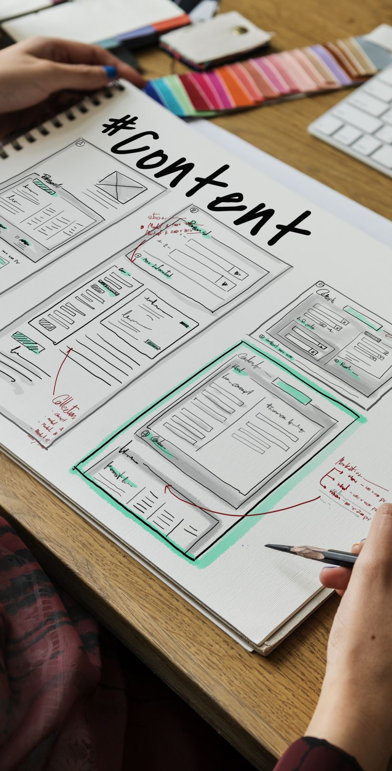
Django by Building Web Apps
Yoobee Colleges

Slide 2
Outline:
Goal: Learn Django based on practical project
Tools: Python ≥ 3.9, Django ≥ 5, VS Code, GitHub
Learning Outcomes:
Create and run Django apps
Build forms and connect to databases
Use templates and static files (HTML/CSS)
Deploy a web app online

Slide 3
Django
Django is a high-level Python web framework that encourages rapid development and clean design.
• Open-source and free (pip install Django)
• Built on Python
• Includes tools for database, templates, authentication
• Follows Model–View–Template (MVT) pattern

Slide 4
Django vs Flask
• Django: Full-featured, includes ORM (Object Relational Mapping), admin panel, authentication, templates.
• Flask: Lightweight, minimalistic, great for smaller apps.
Django is ideal for large projects; Flask is for flexibility and learning.

Slide 5

Installing Django
Step 1: Install pip (Python package manager)
To check installation:
python -m django --version

Slide 6

Understanding Project Structure
• manage.py – command-line utility
• mysite/__init__.py – marks folder as a package
• settings.py – configuration file
• urls.py – URL definitions
• wsgi.py – server interface

Slide 7
What is Django vs Flask?
Django is a high-level Python web framework that encourages rapid development and clean, pragmatic design. It follows the "batteries-included" philosophy, meaning it provides a wide array of built-in features and tools for common web development tasks, such as an Object-Relational Mapper (ORM), an administrative interface, user authentication, and URL routing. This makes it well-suited for building complex, data-driven web applications and saves developers from having to integrate separate components manually.
Flask, on the other hand, is a lightweight Python web micro-framework. Unlike Django, it provides only the bare essentials for web development, leaving developers free to choose and integrate the specific tools and libraries they need for their project. Flask's minimalist design makes it ideal for smaller applications, APIs, and projects where fine-grained control over components and customization are prioritized.

Slide 8
Getting Started with Django
Topics:
• Install Django and understand project structure
  URLs, Views, Templates
Example Project: Hello Django
Displays “Welcome <name> to Django!”
Example Code:
  from django.http import HttpResponse
  def home(request, username):
  return HttpResponse(f"Welcome {username} to Django!")

Slide 9
Project: BMI Calculator with Django
Concepts:
• Forms, POST requests, and Template rendering
• Passing user input to backend logic
Example:
User enters height & weight → app calculates BMI
bmi = round(weight / (height**2), 2)
Output: Underweight / Normal / Overweight

Slide 10
References with Help Links
See help link:
  https://docs.djangoproject.com/en/5.2/intro/tutorial01/
See video : https://www.youtube.com/watch?v=8K52HRoA4Sc
Install: https://pypi.org/project/Django/

Slide 11

Q/A?

