Slide 1

Decorators
Farah Younas

Slide 2
Agenda
Introduction to Decorators
Function Decorators
Class Decorators
Decorators in Practice
Advanced Topics in Decorators
Conclusion

Slide 3
Decorators
Decorators are essentially functions that can modify or enhance the behavior of other functions or classes.
A type of metaprogramming that allows you to modify code at runtime, rather than at compile-time.
Useful in situations where you need to add functionality to existing code, or when you want to create more flexible and reusable code.
In Python, decorators are denoted by the '@' symbol followed by the decorator function name.

Slide 4
Decorators
Why are Decorators Useful in Python?
More efficient and maintainable code by reducing repetition and clutter in your main codebase.
Simplify common tasks such as logging, timing, or input validation, allowing you to focus on the core logic of your program.
Help you to create more flexible and reusable code by separating out functionality into modular pieces

Slide 5
Decorators
How do Decorators Work in Python?
Decorators work by wrapping the original function or class with another function that modifies its behavior.
When a decorator is applied to a function, it takes the original function as an argument and returns a new function that wraps it.
Decorator functions can take arguments and return functions, allowing you to create flexible and reusable decorators.
You can also apply multiple decorators to a single function or class, allowing you to combine different functionalities in a modular way.
Note: decorators can have performance implications, especially if you apply them to functions that are called frequently or have large inputs.

Slide 6
Function Decorators
Function decorators are a powerful tool in Python that allow you to modify or enhance the behavior of functions at runtime

Slide 7
Function Decorators
Decorating Functions With the @ Symbol
@ symbol followed by the decorator function name.
This syntax is called "pie syntax," because the decorator functions are stacked on top of each other like a pie.
Allows you to separate out the function's behavior from the decorator's behavior.
When a decorator is applied to a function, the decorator function takes the original function as an argument and returns a new function that wraps it.
The decorator function is essentially a higher-order function that takes a function as an argument and returns a new function that modifies its behavior

Slide 8
Function Decorators
Writing Your Own Function Decorators
Function decorators are simply functions that take a function as an argument and return a new function that wraps the original function.
This can be useful when you need to add functionality to existing code, or when you want to create more flexible and reusable code.
To write your own function decorator, you need to define a function that takes a function as an argument and returns a new function that wraps the original function.
This new function can add any functionality that you want.

Slide 9
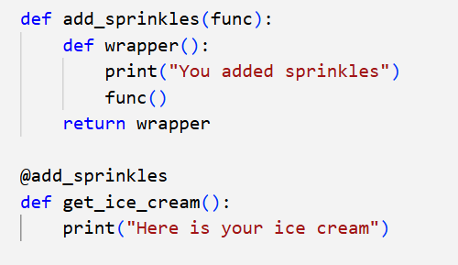
Writing Your Own Function Decorators

Slide 10
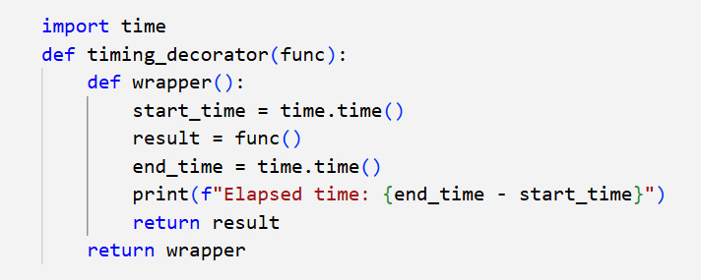
Writing Your Own Function Decorators

Slide 11
Applying Multiple Decorators to a Single Function
You can also apply multiple decorators to a single function in Python.
When you apply multiple decorators, the function is wrapped by each decorator in turn, from the inside out.
This can be useful when you need to apply multiple types of functionality to a function.
To apply multiple decorators to a single function, you simply stack them on top of each other using the @ syntax.

Slide 12
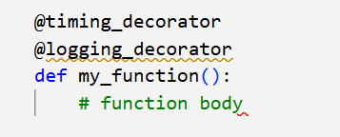
Applying Multiple Decorators to a Single Function
In this case, the my_function function is first wrapped by the logging_decorator function, which adds logging functionality, and then wrapped by the timing_decorator function, which adds timing functionality

Slide 13
Decorators with Arguments
To do this, you need to define a decorator function that takes arguments, and then return a new function that takes a function as an argument and returns a new function that wraps the original function.
This can be useful when you need to customize the behaviour of a decorator for different use cases.

Slide 14
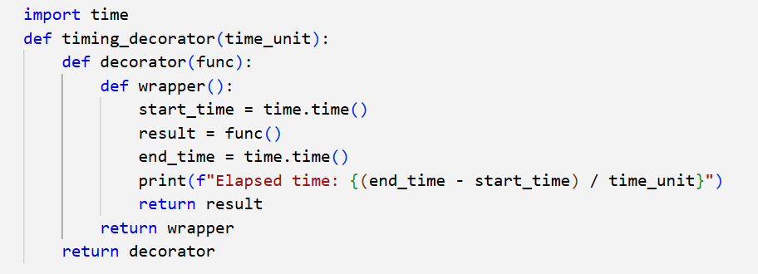
Decorators with Arguments

Slide 15
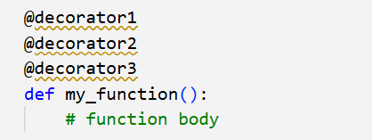
Chaining Decorators
In addition to applying multiple decorators to a single function, you can also chain decorators together.
Decorator chaining allows you to apply multiple decorators to a single function in a specific order.
To chain decorators together, you can simply apply each decorator to the previous decorator's result using the @ syntax. For example, to chain three decorators together, you might write

Slide 16
Class Decorators
Class decorators are similar to function decorators, but they allow you to modify or enhance the behavior of classes at runtime.

Slide 17
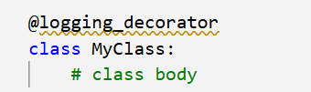
Decorating Classes with the @ Symbol
The @ symbol can also be used to apply decorators to classes in Python.
When a decorator is applied to a class, the decorator function takes the original class as an argument and returns a new class that wraps it.
In this case, the MyClass class is wrapped by the logging_decorator function, which adds logging functionality.

Slide 18
Decorators in Python
Decorator classes are defined by implementing the __call__ method, which allows instances of the class to be called like functions.
Decorator classes are useful when you need to maintain state across multiple calls to the decorated function or when you want to reuse the same decorator across multiple functions.

Slide 19
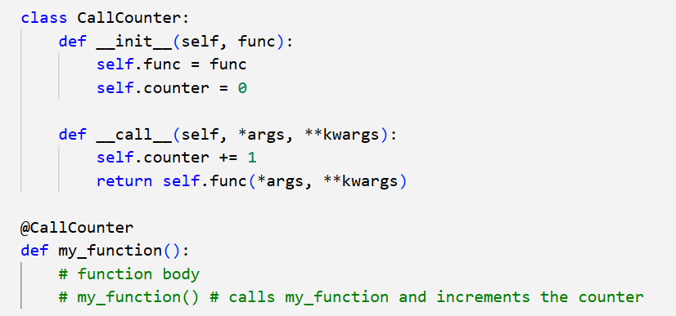
Decorators in Python

Slide 20
Writing Your Own Class Decorators
Class decorators are simply functions that take a class as an argument and return a new class that wraps the original class.
This can be useful when you need to add functionality to existing classes, or when you want to create more flexible and reusable code.
To write your own class decorator, you need to define a function that takes a class as an argument and returns a new class that wraps the original class.
This new class can add any functionality that you want, such as logging or validation.

Slide 21
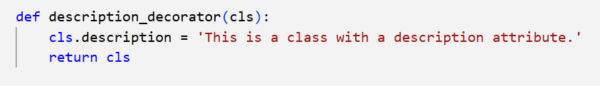
Writing Your Own Class Decorators
This decorator function takes a class as an argument, wraps it in a new class that adds a description attribute, and returns the new class.
You can then apply this decorator to any class that you want to add a 'description' attribute to.

Slide 22
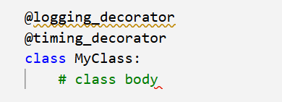
Applying Multiple Decorators to a Single Class
To apply multiple decorators to a single class, you simply stack them on top of each other using the @ syntax.

