Slide 1
Mathematical Tools for Quantum Computing
Complex numbers, vectors, inner products and probability amplitudes

Slide 2
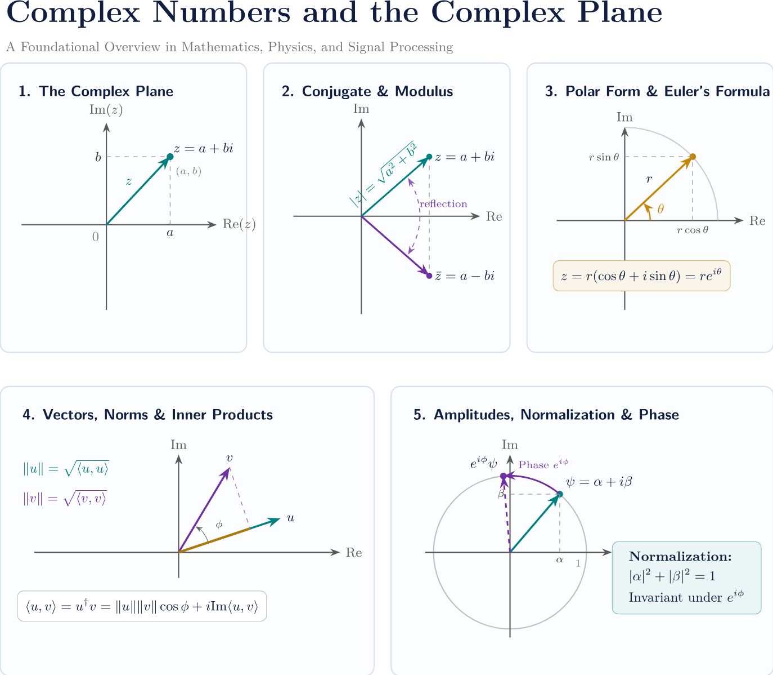
Roadmap for Today
Complex numbers and the complex plane
Conjugate, modulus, polar form and Euler formula
Vectors, norms and inner products
Probability amplitudes, normalization and phase
Worked examples and exercises

Slide 3
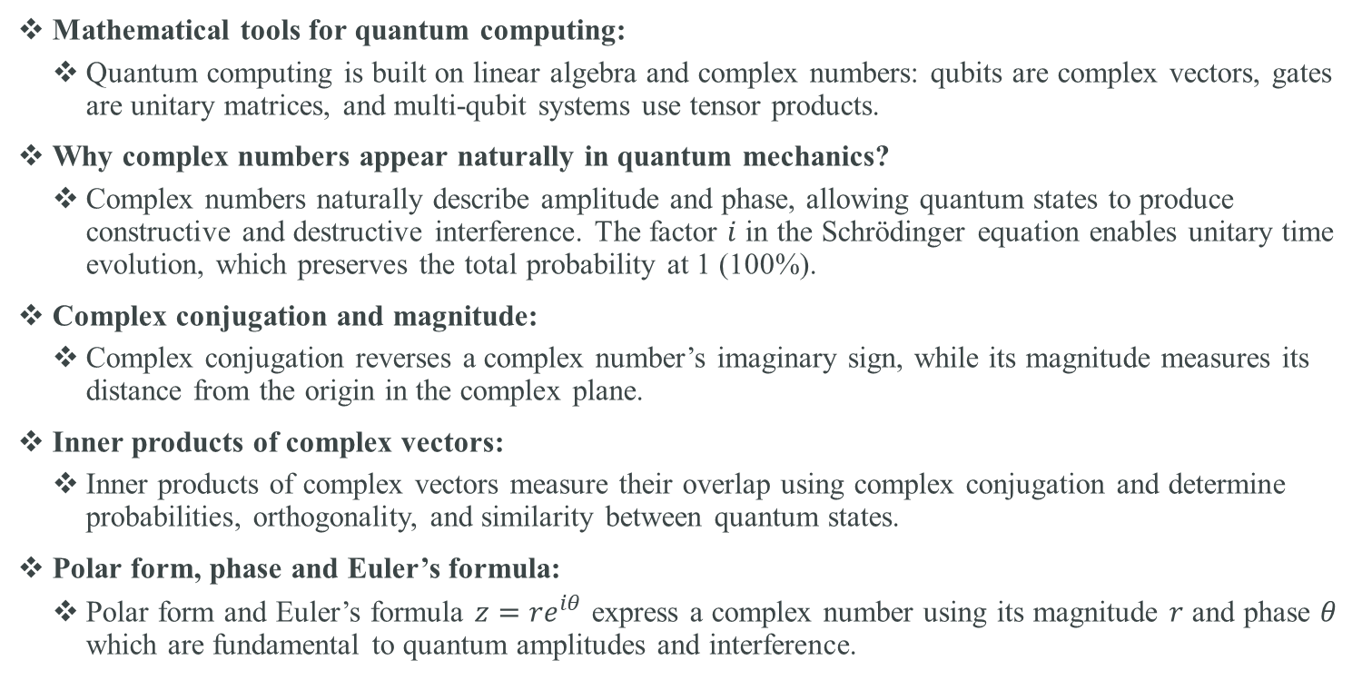
Complex Numbers and the Inner Product
Mathematical tools for quantum computing:
  Quantum computing is built on linear algebra and complex numbers: qubits are complex vectors, gates are unitary matrices, and multi-qubit systems use tensor products.
Why complex numbers appear naturally in quantum mechanics?
  Complex numbers naturally describe amplitude and phase, allowing quantum states to produce constructive and destructive interference. The factor $i$ in the Schrödinger equation enables unitary time evolution, which preserves the total probability at 1 (100%).
Complex conjugation and magnitude:
  Complex conjugation reverses a complex number’s imaginary sign, while its magnitude measures its distance from the origin in the complex plane.
Inner products of complex vectors:
  Inner products of complex vectors measure their overlap using complex conjugation and determine probabilities, orthogonality, and similarity between quantum states.
Polar form, phase and Euler’s formula:
  Polar form and Euler’s formula $z=re^{iθ}$ express a complex number using its magnitude $r$ and phase $θ$ which are fundamental to quantum amplitudes and interference.

Slide 4
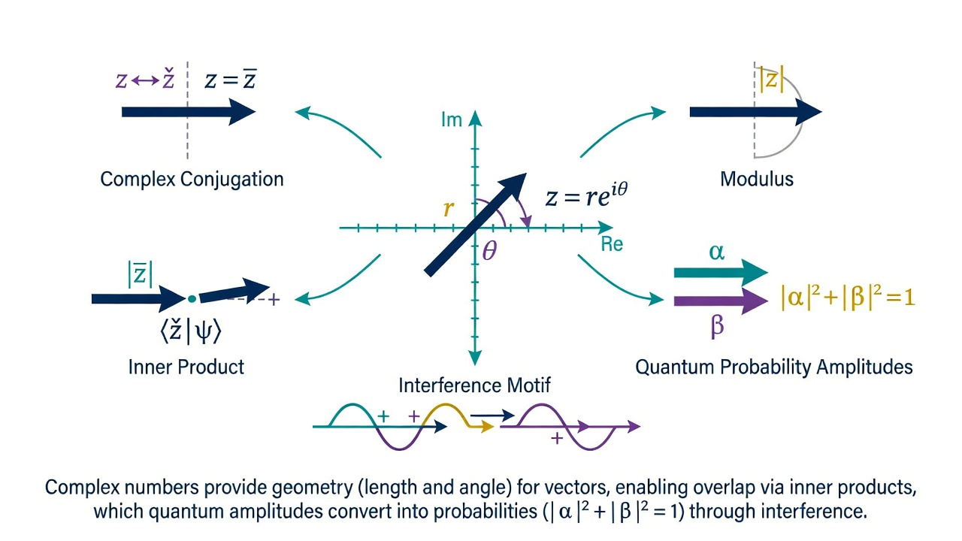

Slide 5
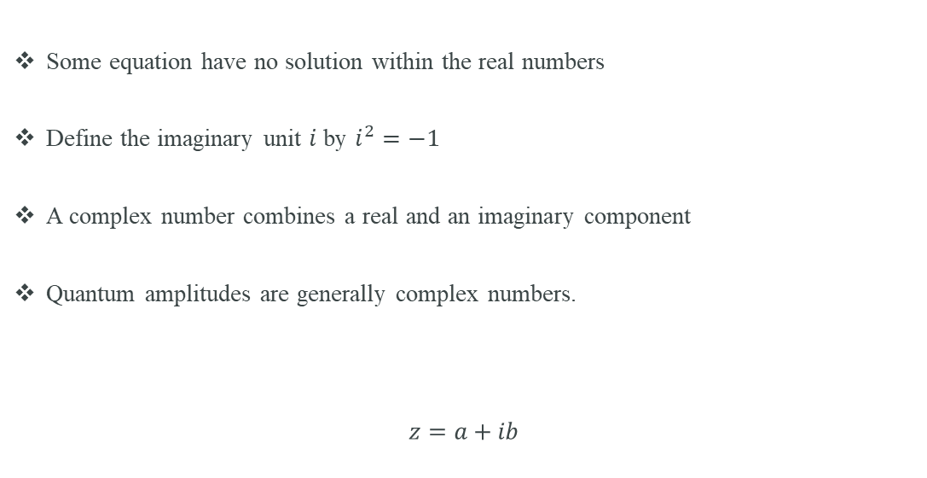
Why do we need complex numbers?
Some equation have no solution within the real numbers
Define the imaginary unit $i$ by $i^{2}=−1$
A complex number combines a real and an imaginary component
Quantum amplitudes are generally complex numbers.
$$z=a+ib$$

Slide 6
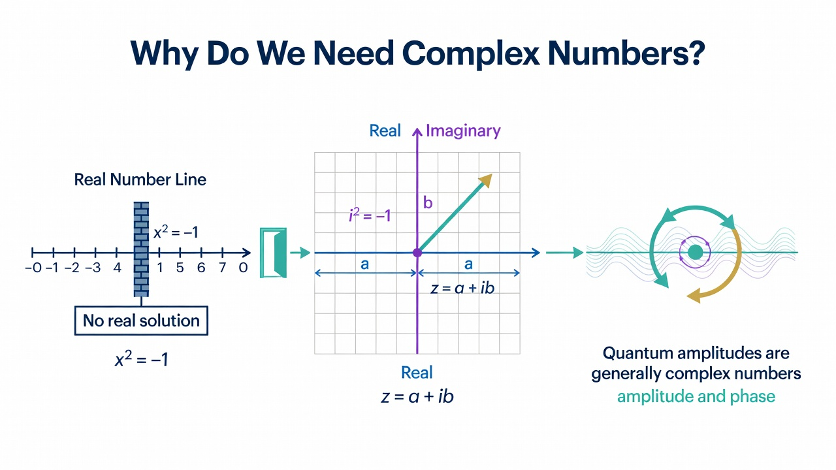

Slide 7
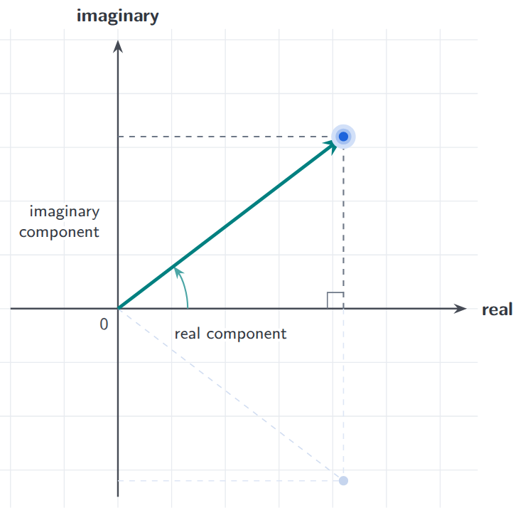
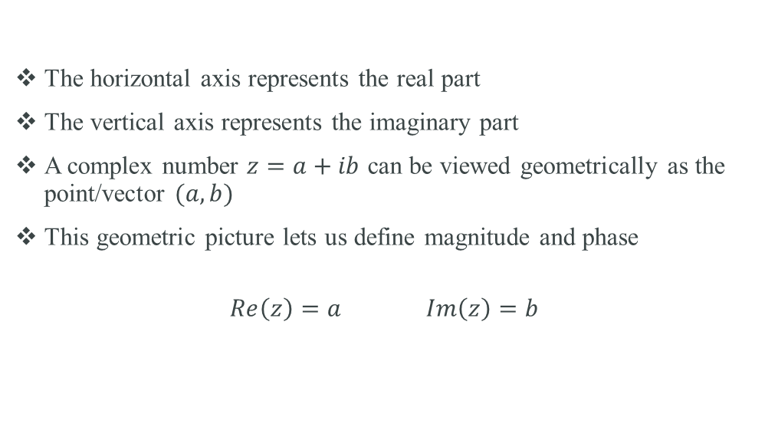
The complex plane
The horizontal axis represents the real part
The vertical axis represents the imaginary part
A complex number $z=a+ib$ can be viewed geometrically as the point/vector $(a,b)$
This geometric picture lets us define magnitude and phase
$$Re\left(z\right)=a Im\left(z\right)=b$$

Slide 8
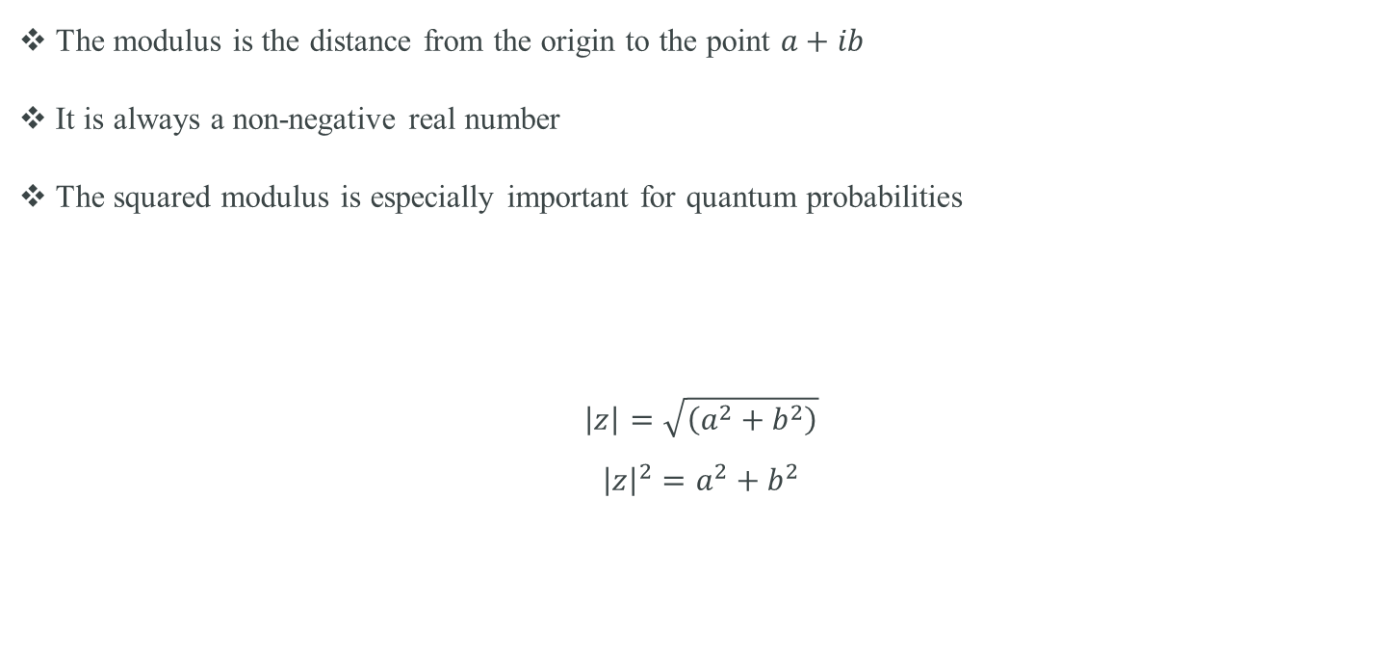
Magnitude (modulus) of a complex number
The modulus is the distance from the origin to the point $a+ib$
It is always a non-negative real number
The squared modulus is especially important for quantum probabilities
$$\left|z\right|=\sqrt{\left(a^{2}+b^{2}\right)}$$
$${\left|z\right|}^{2}=a^{2}+b^{2}$$

Slide 9
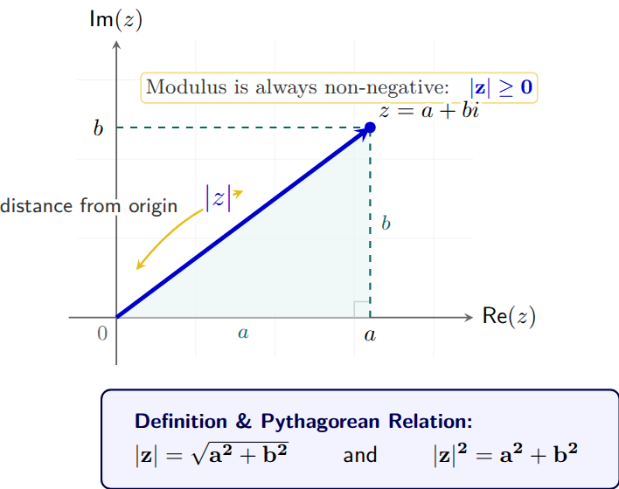

Slide 10
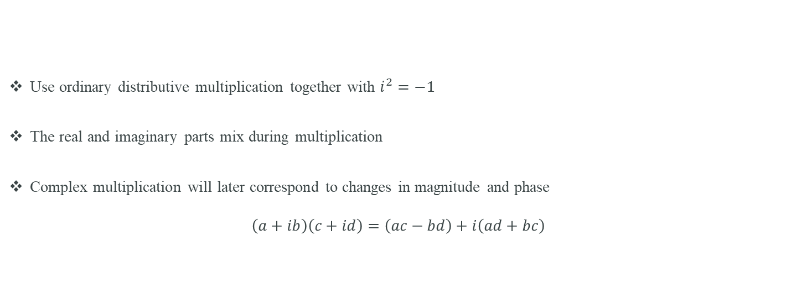
Multiplying complex numbers
Use ordinary distributive multiplication together with $i^{2}=−1$
The real and imaginary parts mix during multiplication
Complex multiplication will later correspond to changes in magnitude and phase
$$\left(a+ib\right)\left(c+id\right)=\left(ac−bd\right)+i\left(ad+bc\right)$$

Slide 11
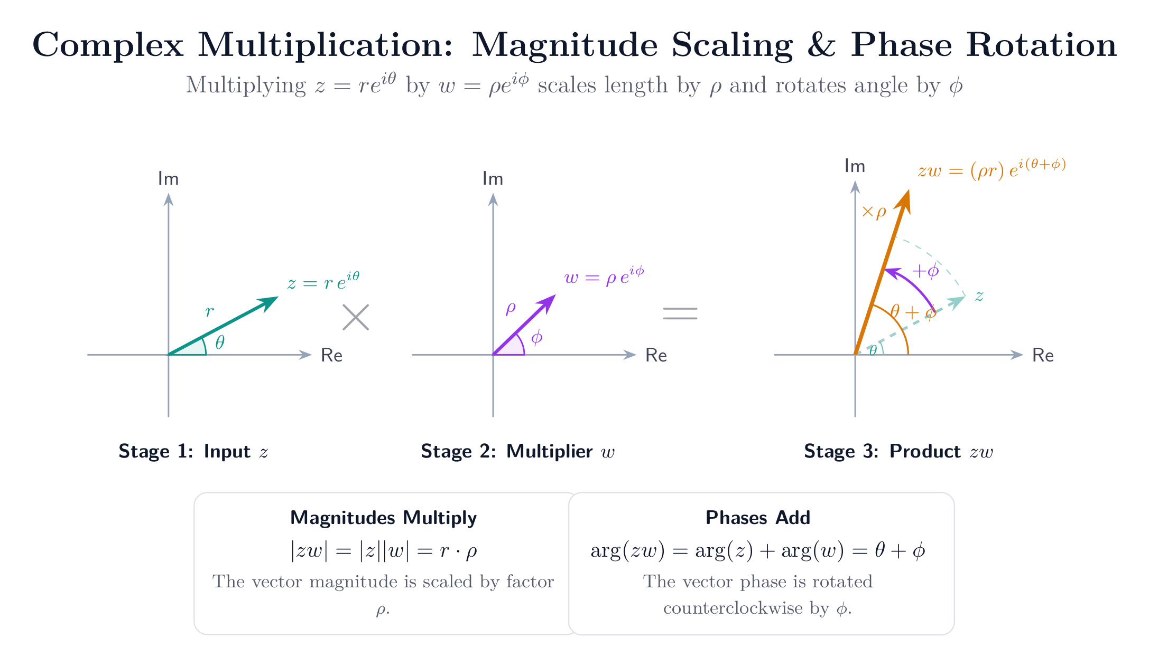

Slide 12
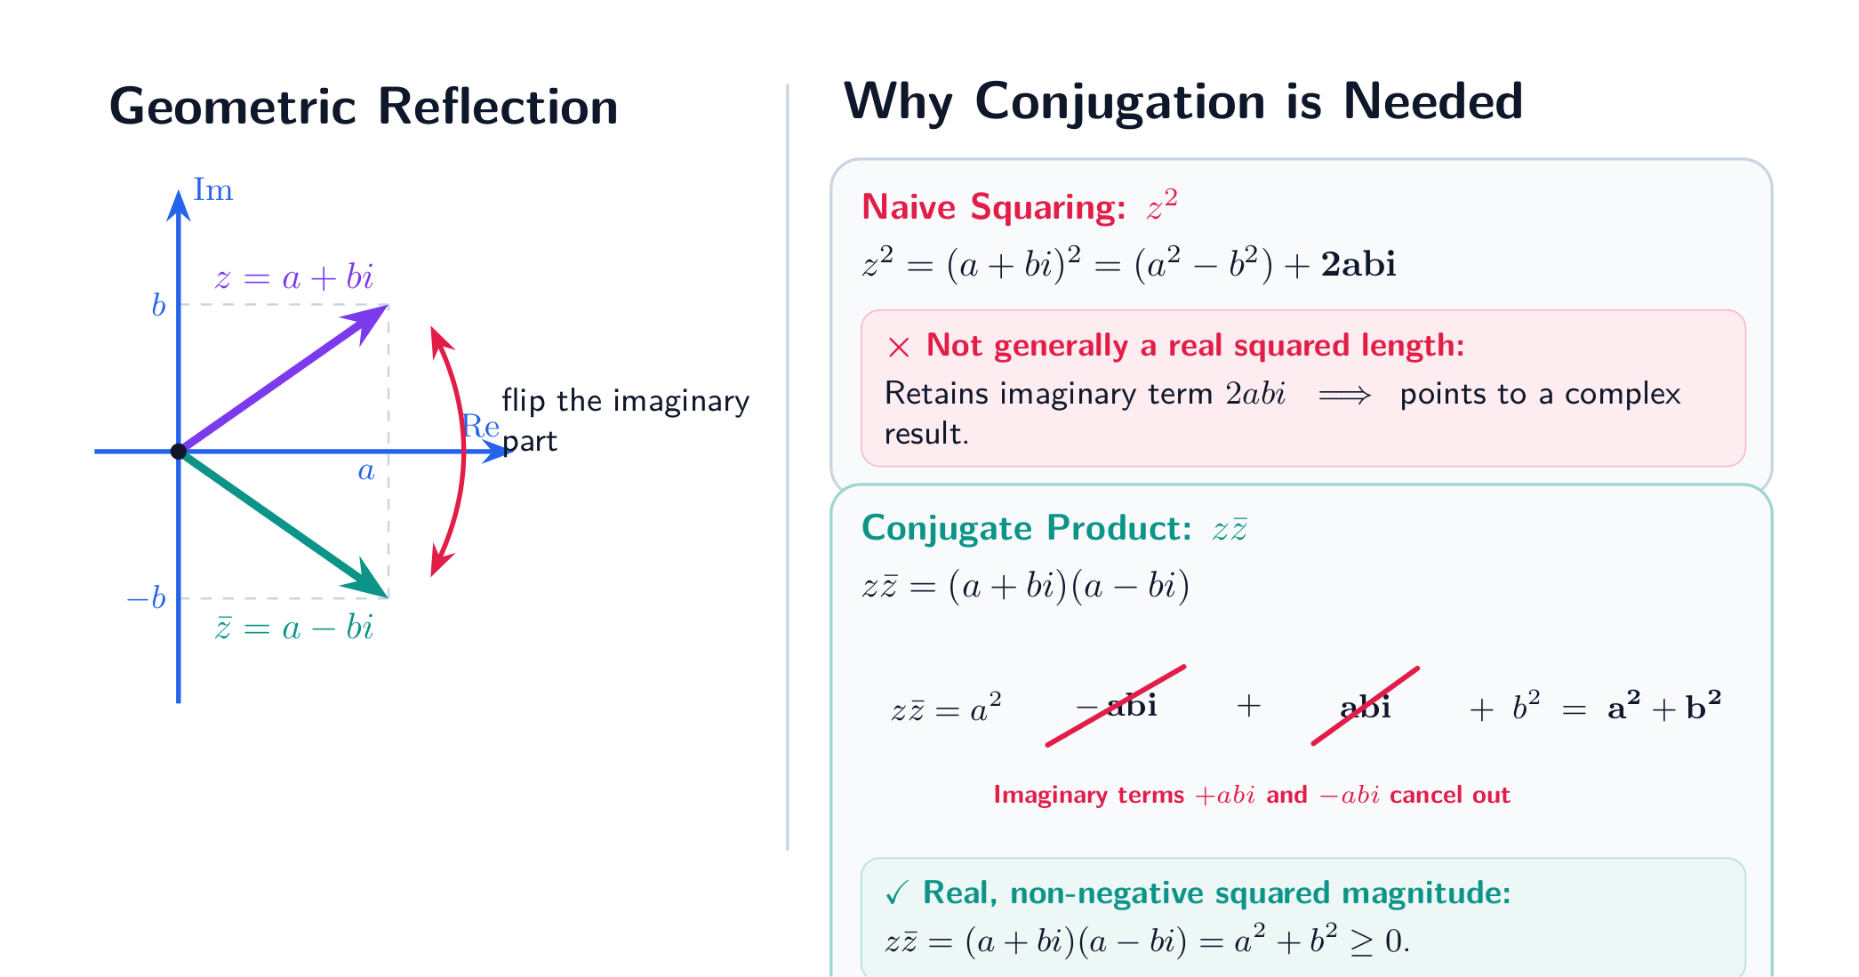
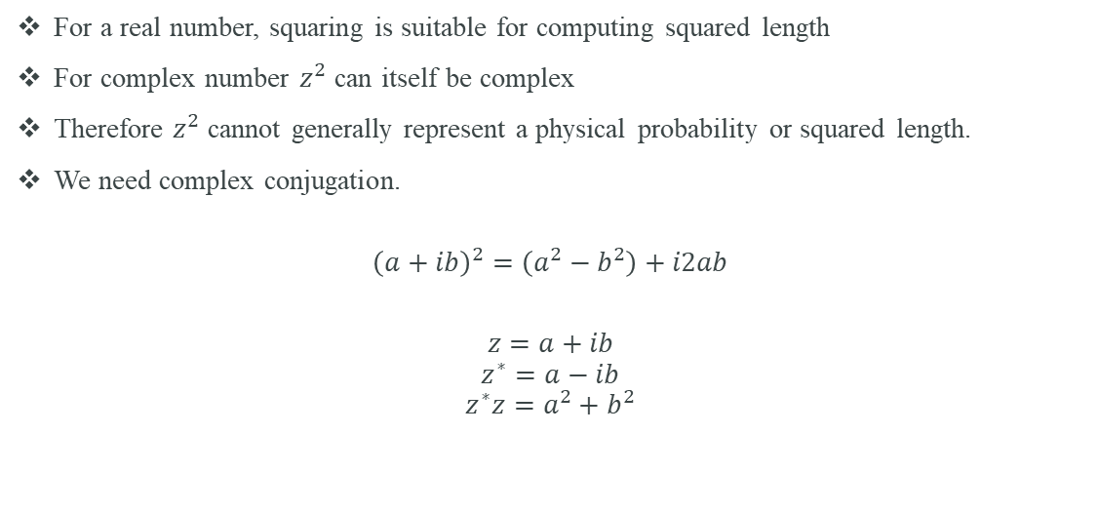
The problem with $z^{2}$
For a real number, squaring is suitable for computing squared length
For complex number $z^{2}$ can itself be complex
Therefore $z^{2}$ cannot generally represent a physical probability or squared length.
We need complex conjugation.
$${\left(a+ib\right)}^{2}=\left(a^{2}−b^{2}\right)+i2ab$$
$$z=a+ib$$
$$z^{∗}=a−ib$$
$$z^{∗}z=a^{2}+b^{2}$$

Slide 13
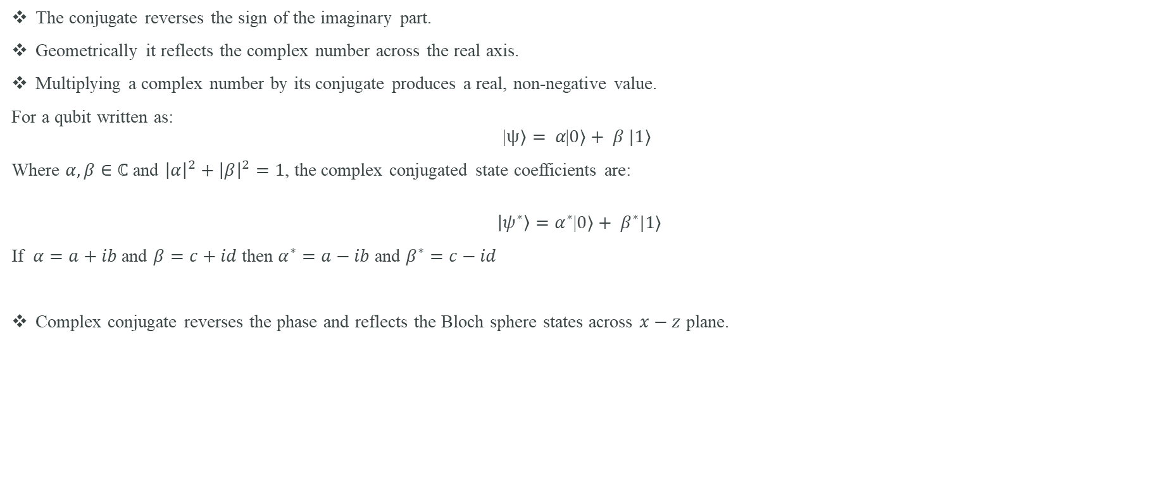
Complex conjugate
The conjugate reverses the sign of the imaginary part.
Geometrically it reflects the complex number across the real axis.
Multiplying a complex number by its conjugate produces a real, non-negative value.
For a qubit written as:
$$\text{|}ψ〉= α\text{|}0〉+ β |1⟩$$
Where $α,β∈ℂ$ and ${\left|α\right|}^{2}+{\left|β\right|}^{2}=1$, the complex conjugated state coefficients are:
$$\left|ψ^{∗}\right\rangle =α^{∗}\text{|}0〉+ β^{∗}|1⟩$$
If $α=a+ib$ and $β=c+id$ then $α^{∗}=a−ib$ and $β^{∗}=c−id$
Complex conjugate reverses the phase and reflects the Bloch sphere states across $x−z$ plane.

Slide 14
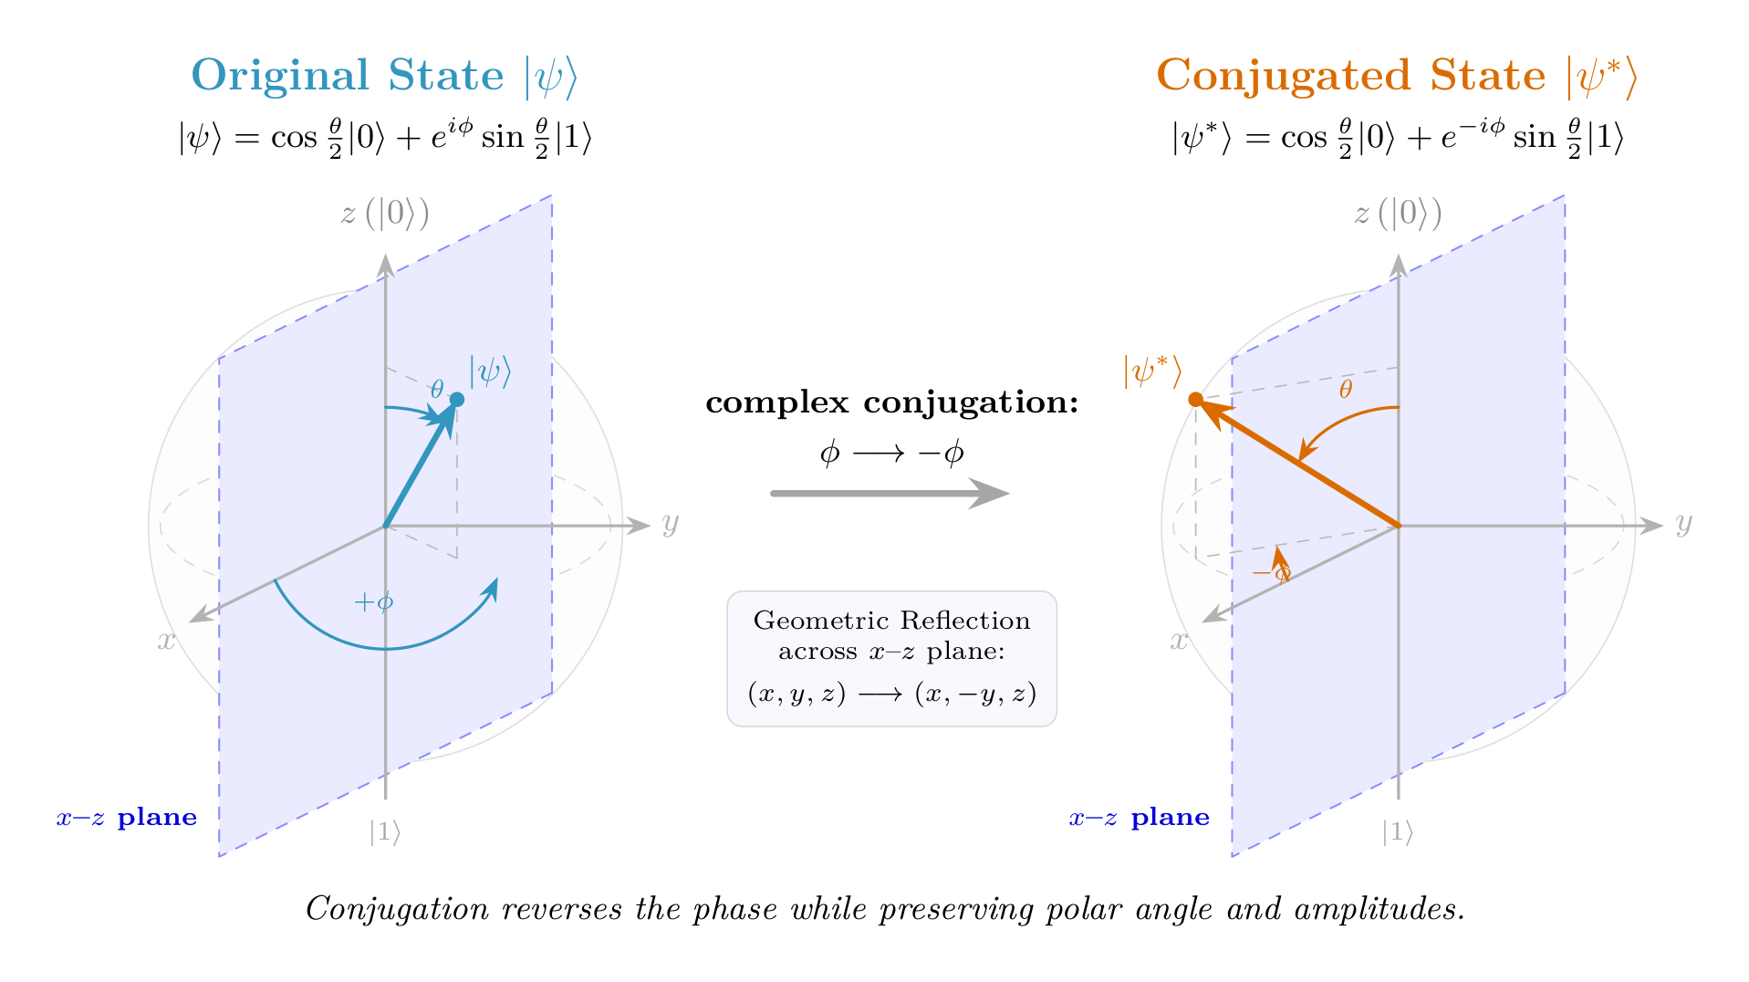

Slide 15
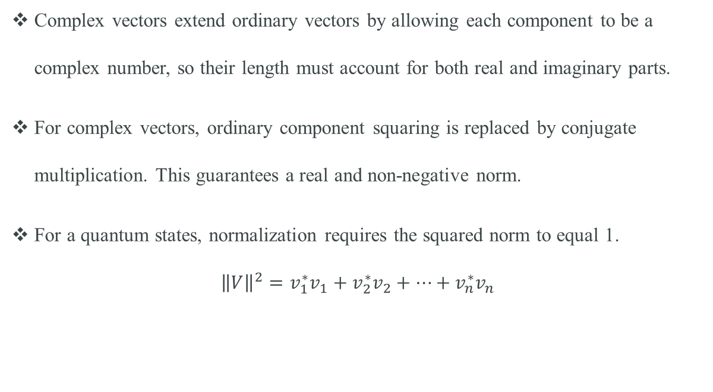
Norm of a complex vector
Complex vectors extend ordinary vectors by allowing each component to be a complex number, so their length must account for both real and imaginary parts.
For complex vectors, ordinary component squaring is replaced by conjugate multiplication. This guarantees a real and non-negative norm.
For a quantum states, normalization requires the squared norm to equal 1.
$${\left\|V\right\|}^{2}=v_{1}^{∗}v_{1}+v_{2}^{∗}v_{2}+…+v_{n}^{∗}v_{n}$$

Slide 16
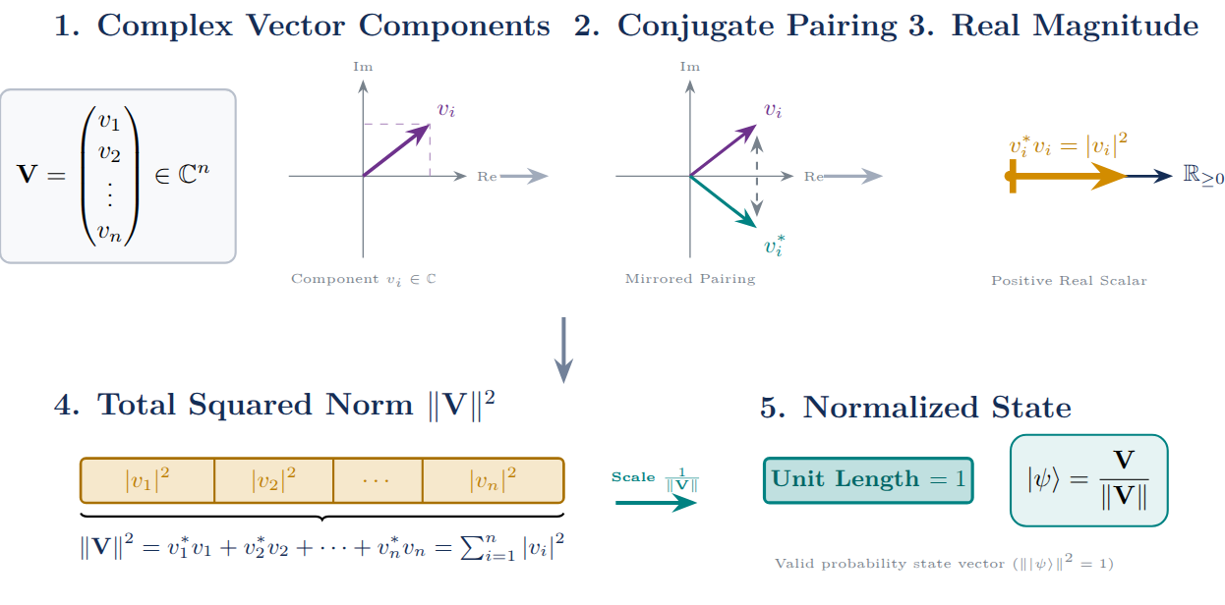

Slide 17
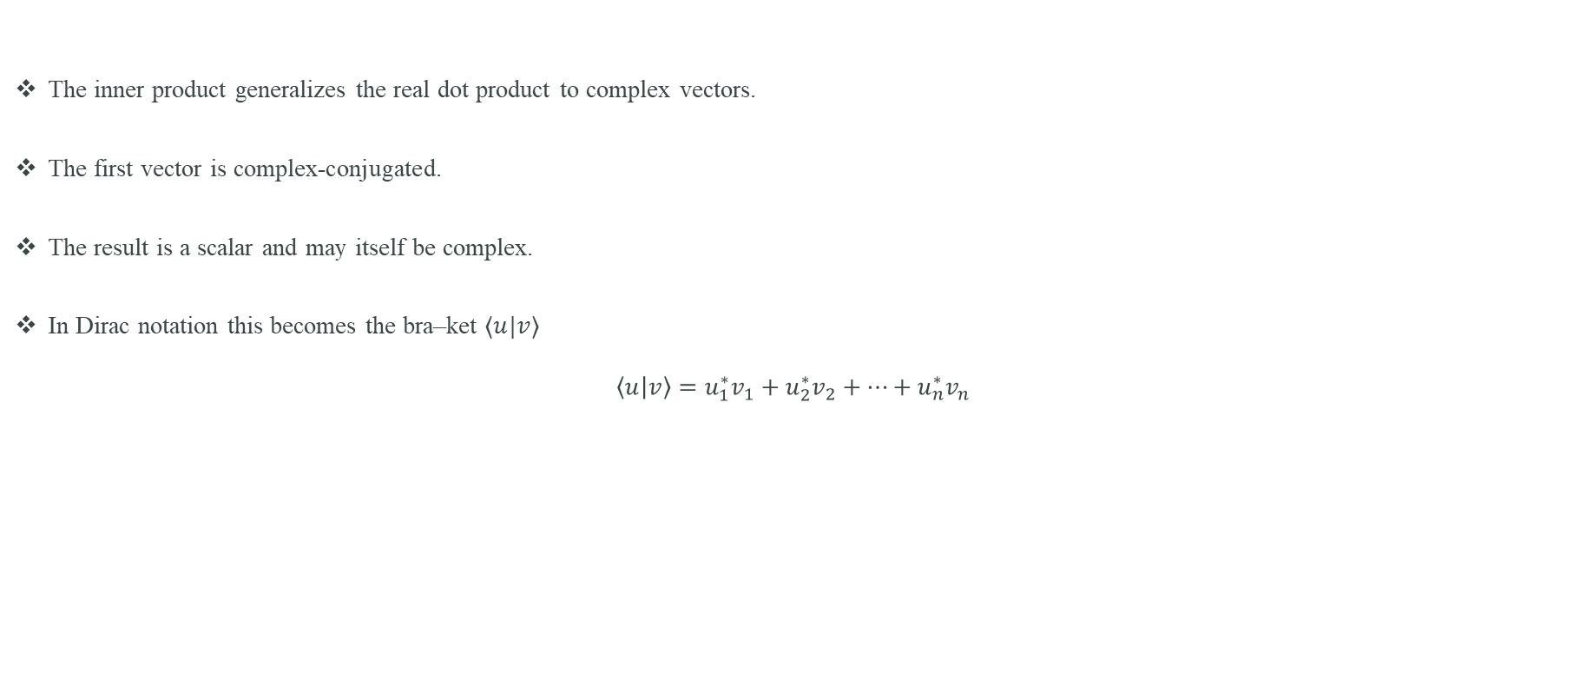
Inner Product
The inner product generalizes the real dot product to complex vectors.
The first vector is complex-conjugated.
The result is a scalar and may itself be complex.
In Dirac notation this becomes the bra–ket $⟨u|v⟩$
$$\left\langle u | v\right\rangle =u_{1}^{∗}v_{1}+u_{2}^{∗}v_{2}+…+u_{n}^{∗}v_{n}$$

Slide 18
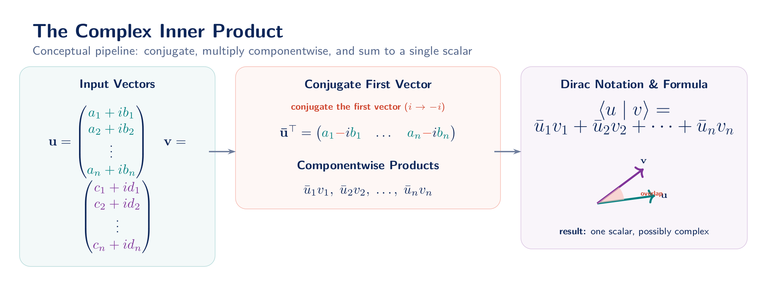

Slide 19
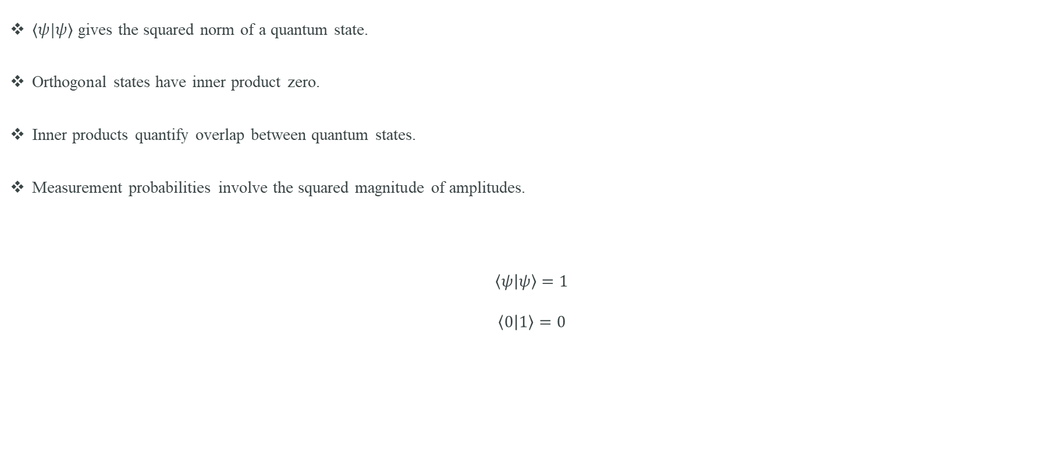
Inner product in quantum mechanics
$⟨ψ|ψ⟩$ gives the squared norm of a quantum state.
Orthogonal states have inner product zero.
Inner products quantify overlap between quantum states.
Measurement probabilities involve the squared magnitude of amplitudes.
$$\left\langle ψ | ψ\right\rangle =1$$
$$\left\langle 0 | 1\right\rangle =0$$

Slide 20
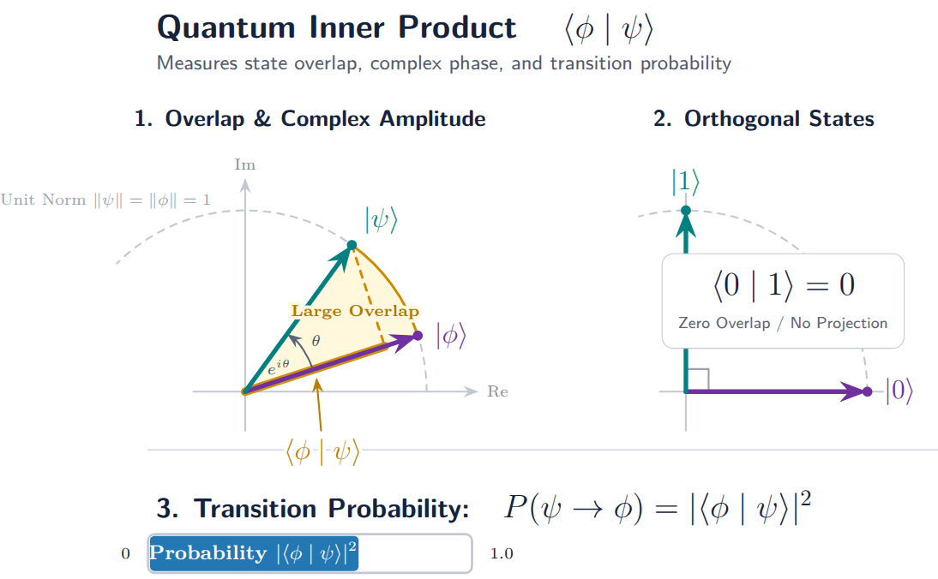

Slide 21
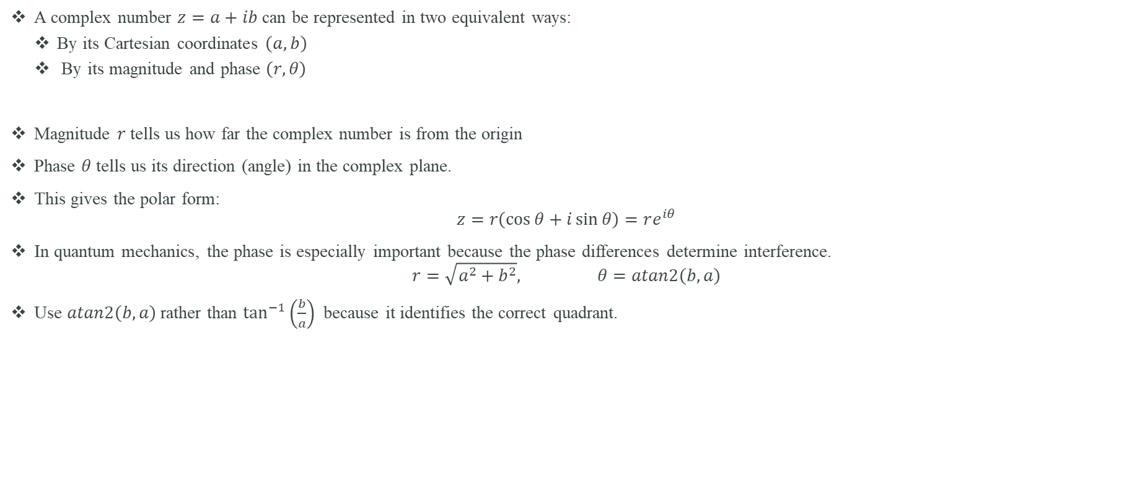
Polar representation: Magnitude and phase
A complex number $z=a+ib$ can be represented in two equivalent ways:
  By its Cartesian coordinates $\left(a,b\right)$
  By its magnitude and phase $\left(r,θ\right)$
Magnitude $r$ tells us how far the complex number is from the origin
Phase $θ$ tells us its direction (angle) in the complex plane.
This gives the polar form:
$$z=r\left(\cos{θ}+i\sin{θ}\right)=re^{iθ}$$
In quantum mechanics, the phase is especially important because the phase differences determine interference.
$$r=\sqrt{a^{2}+b^{2}}, θ=atan2\left(b,a\right)$$
Use $atan2\left(b,a\right)$rather than $\tan^{−1}\left(\frac{b}{a}\right)$ because it identifies the correct quadrant.

Slide 22
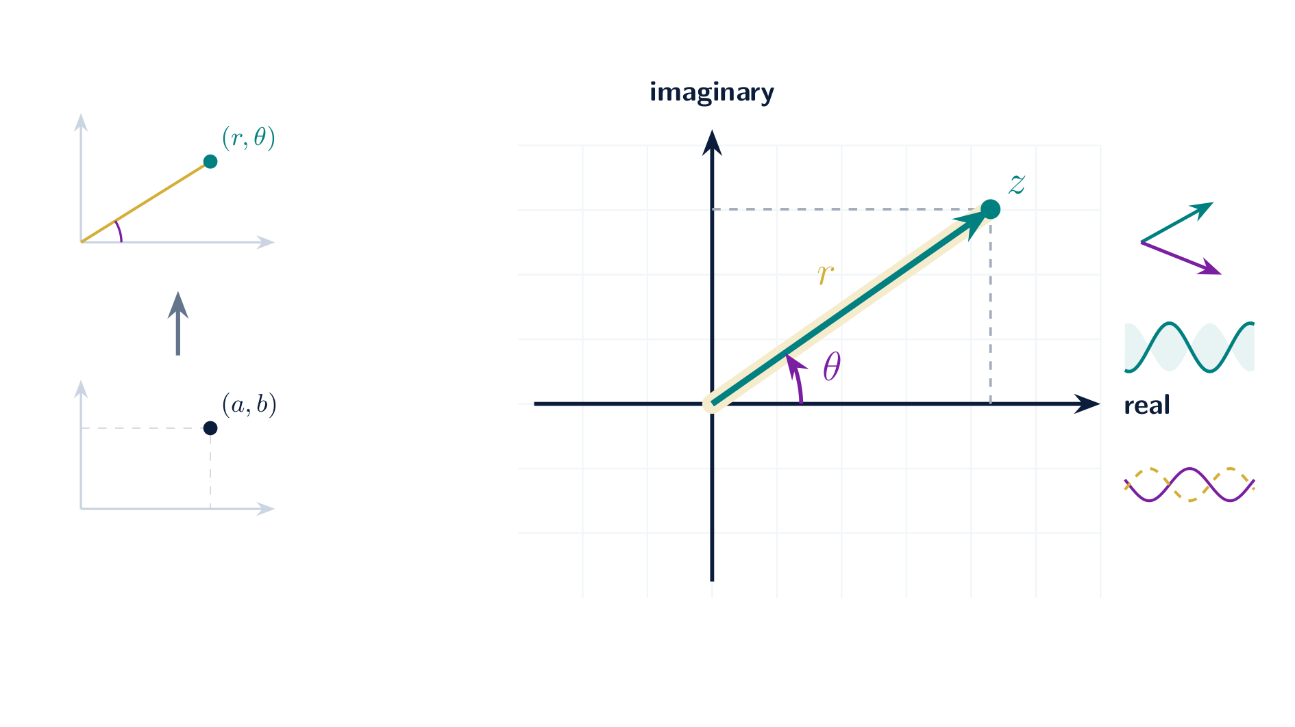

Slide 23
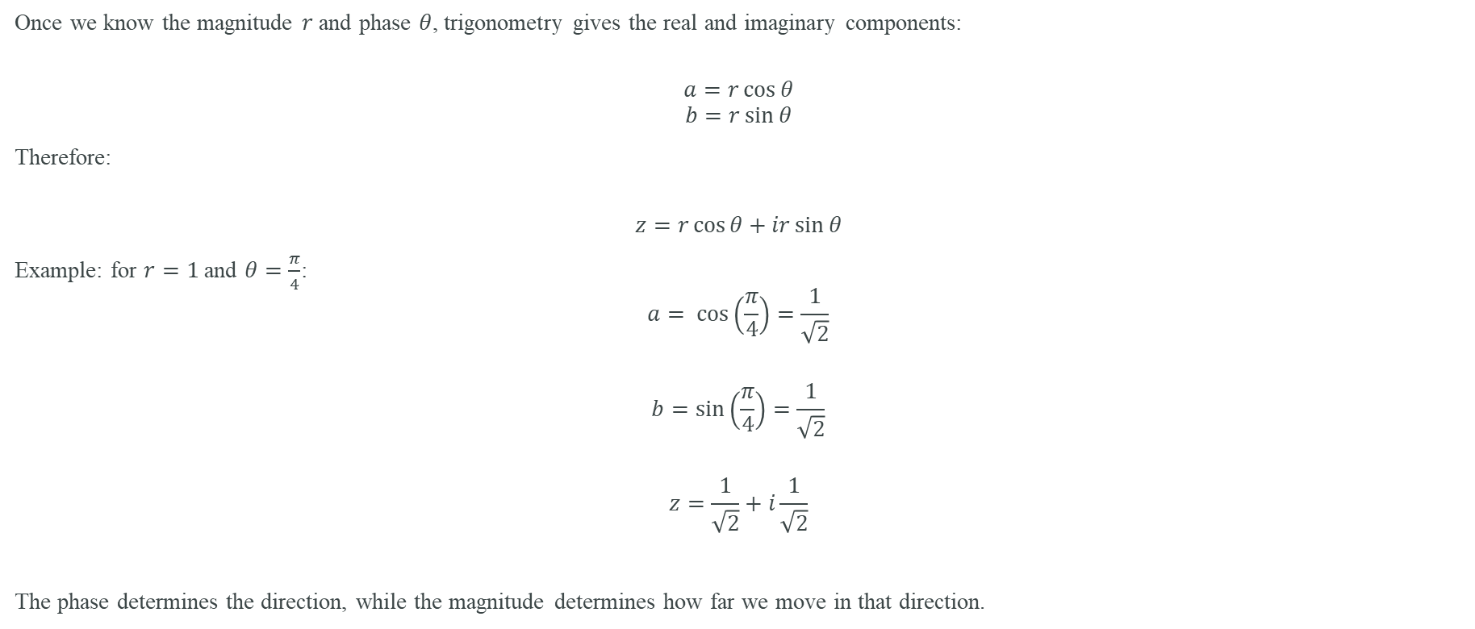
Converting Between Cartesian and Polar Form
Once we know the magnitude $r$ and phase $θ$, trigonometry gives the real and imaginary components:
$$a=r\cos{θ}$$
$$b=r\sin{θ}$$
Therefore:
$$z=r\cos{θ}+ir\sin{θ}$$
Example: for $r=1$and $θ=\frac{π}{4}$:
$$a= \cos\left(\frac{π}{4}\right)=\frac{1}{\sqrt{2}}$$
$$b=\sin\left(\frac{π}{4}\right)=\frac{1}{\sqrt{2}}$$
$$z=\frac{1}{\sqrt{2}}+i\frac{1}{\sqrt{2}}$$
The phase determines the direction, while the magnitude determines how far we move in that direction.

Slide 24
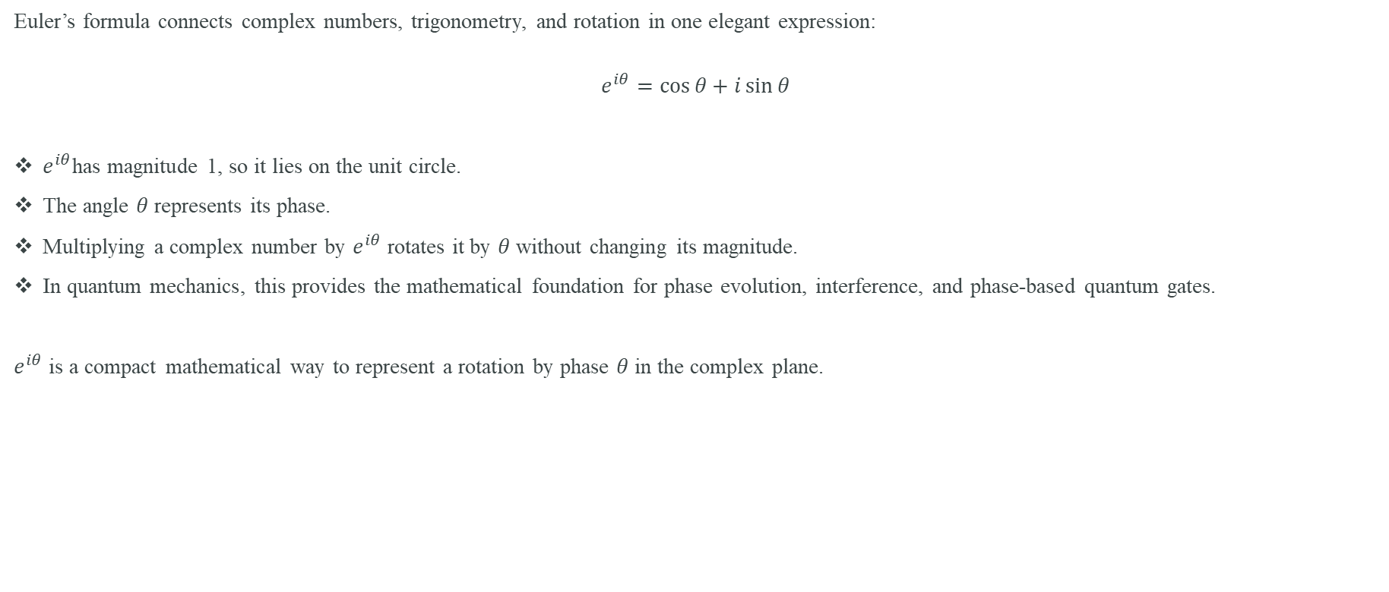
Euler’s Formula: From Phase to Rotation
Euler’s formula connects complex numbers, trigonometry, and rotation in one elegant expression:
$$e^{iθ}=\cos{θ}+i\sin{θ}$$
$e^{iθ}$has magnitude 1, so it lies on the unit circle.
The angle $θ$ represents its phase.
Multiplying a complex number by $e^{iθ}$ rotates it by $θ$ without changing its magnitude.
In quantum mechanics, this provides the mathematical foundation for phase evolution, interference, and phase-based quantum gates.
$e^{iθ}$ is a compact mathematical way to represent a rotation by phase $θ$ in the complex plane.

Slide 25
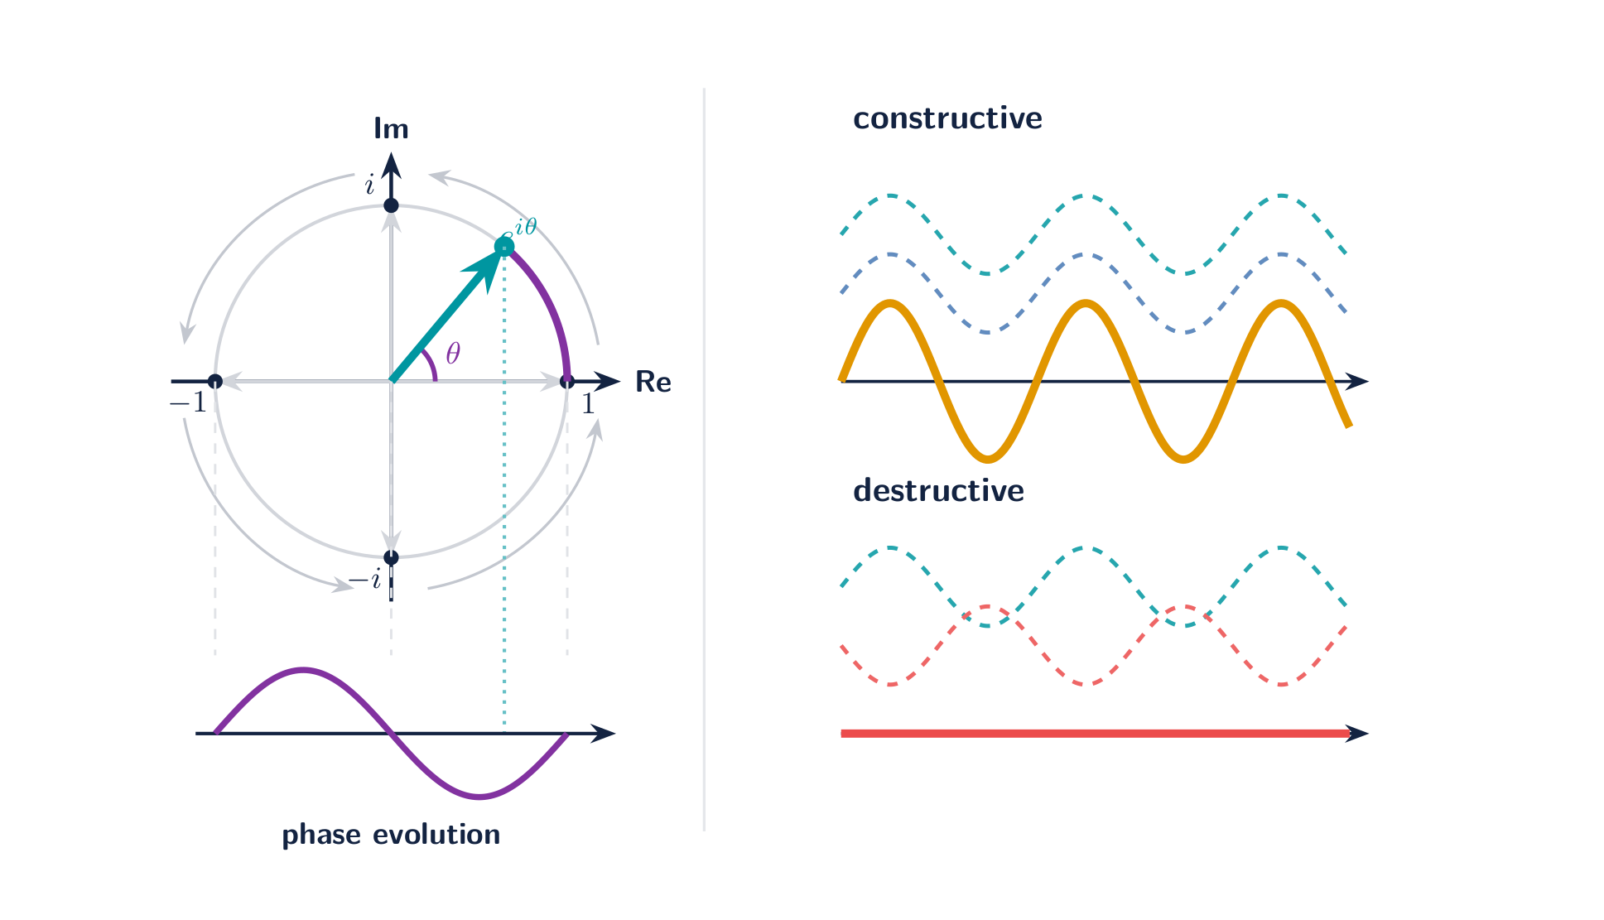

Slide 26
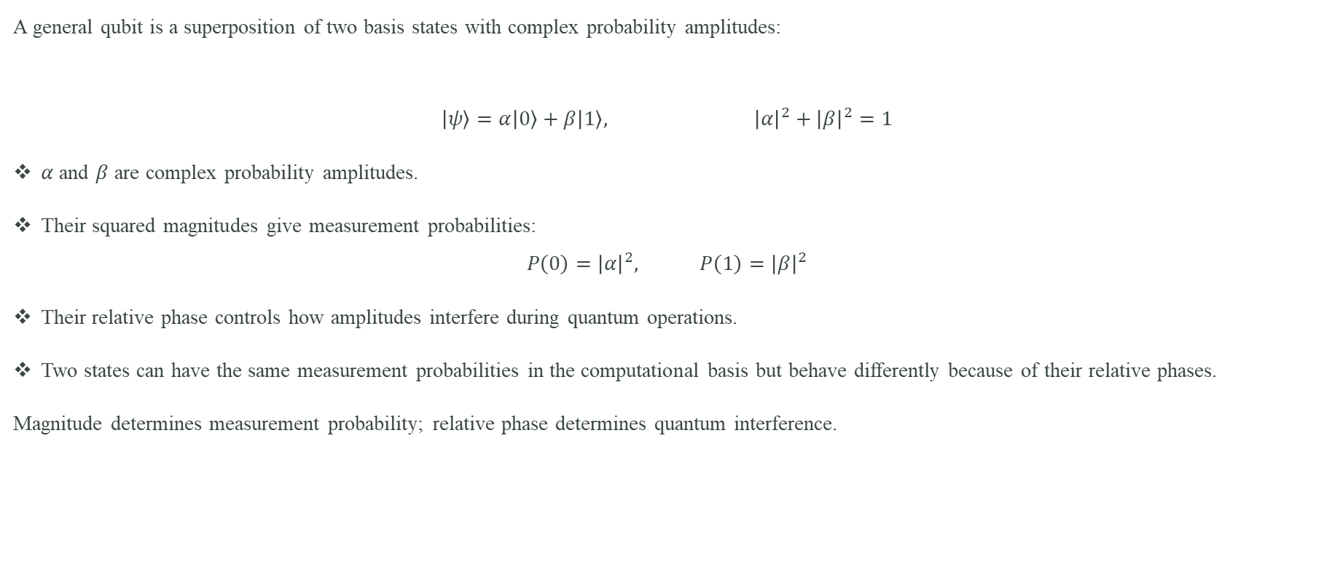
Complex Numbers in a Qubit
A general qubit is a superposition of two basis states with complex probability amplitudes:
$$\left|ψ\right\rangle =α\left|0\right\rangle +β\left|1\right\rangle , {\left|α\right|}^{2}+{\left|β\right|}^{2}=1$$
$α$ and $β$ are complex probability amplitudes.
Their squared magnitudes give measurement probabilities:
$$P\left(0\right)={\left|α\right|}^{2}, P\left(1\right)={\left|β\right|}^{2}$$
Their relative phase controls how amplitudes interfere during quantum operations.
Two states can have the same measurement probabilities in the computational basis but behave differently because of their relative phases.
Magnitude determines measurement probability; relative phase determines quantum interference.

Slide 27
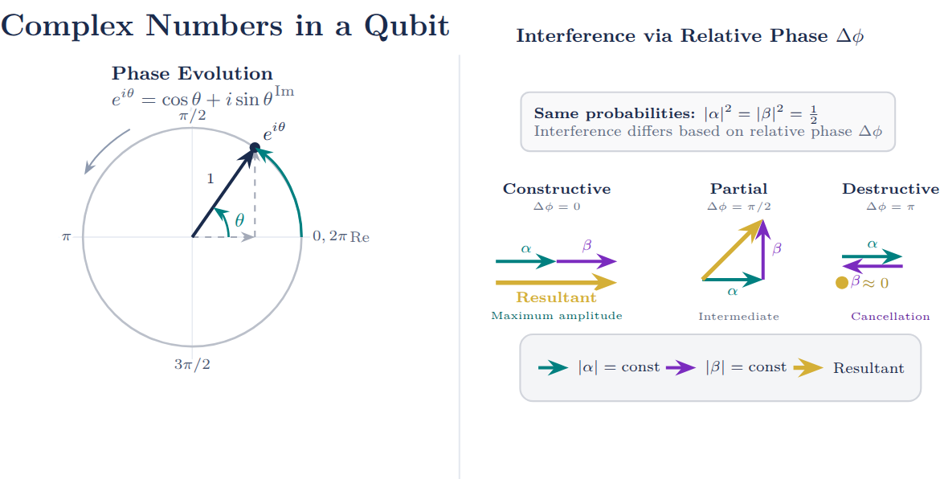

Slide 28
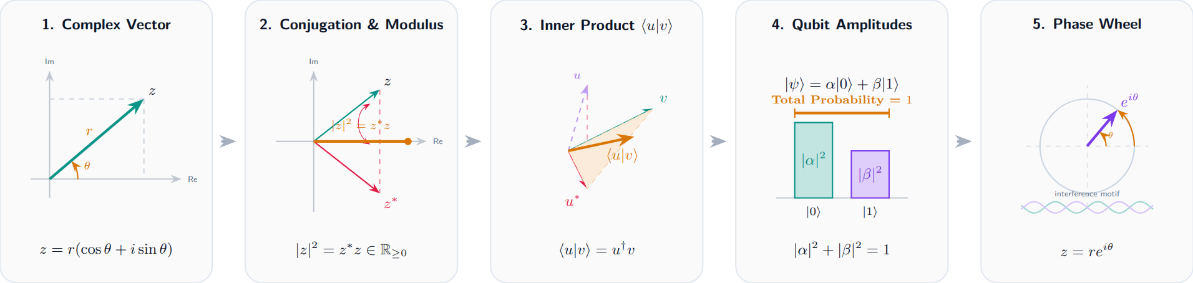
Quantum Complex geometry and phase

Slide 29
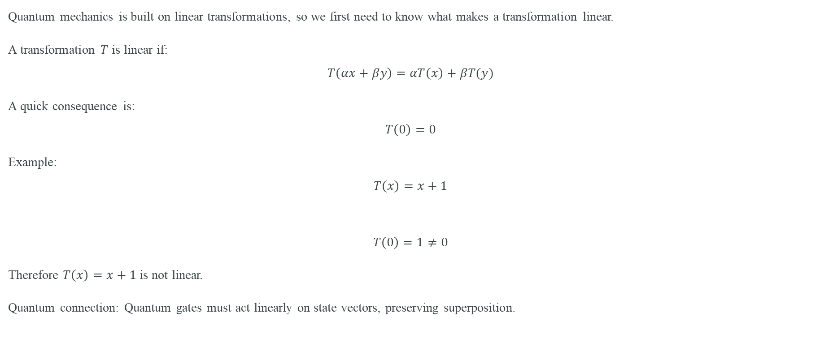
Linearity: The Structure Behind Quantum Operations
Quantum mechanics is built on linear transformations, so we first need to know what makes a transformation linear.
A transformation $T$ is linear if:
$$T\left(αx+βy\right)=αT\left(x\right)+βT(y)$$
A quick consequence is:
$$T\left(0\right)=0$$
Example:
$$T\left(x\right)=x+1$$
$$T\left(0\right)=1≠0$$
Therefore $T\left(x\right)=x+1$ is not linear.
Quantum connection: Quantum gates must act linearly on state vectors, preserving superposition.

Slide 30
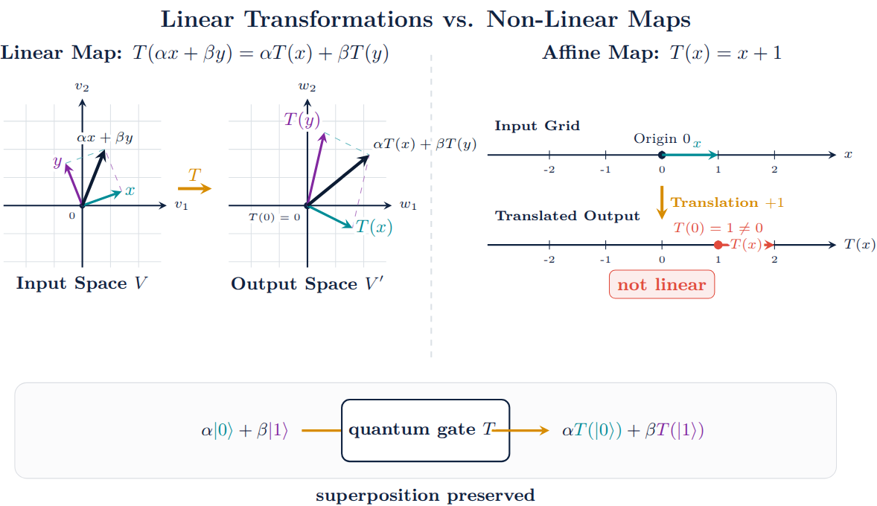

Slide 31
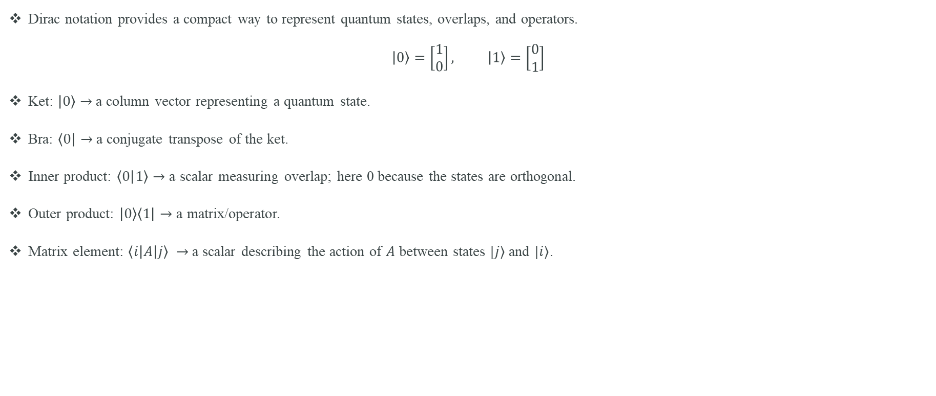
Dirac Notation: From States to Operators
Dirac notation provides a compact way to represent quantum states, overlaps, and operators.
$$\left|0\right\rangle =\left[\begin{matrix}1 \\ 0\end{matrix}\right], \left|1\right\rangle =\left[\begin{matrix}0 \\ 1\end{matrix}\right]$$
Ket: $\left|0\right\rangle$ $→$ a column vector representing a quantum state.
Bra: $\left\langle 0\right|→$ a conjugate transpose of the ket.
Inner product: $\left\langle 0 | 1\right\rangle →$ a scalar measuring overlap; here 0 because the states are orthogonal.
Outer product: $\left|0\right\rangle \left\langle 1\right|→$ a matrix/operator.
Matrix element: $\left\langle i | A | j\right\rangle →$ a scalar describing the action of $A$ between states $|j⟩$ and $|i⟩$.

Slide 32
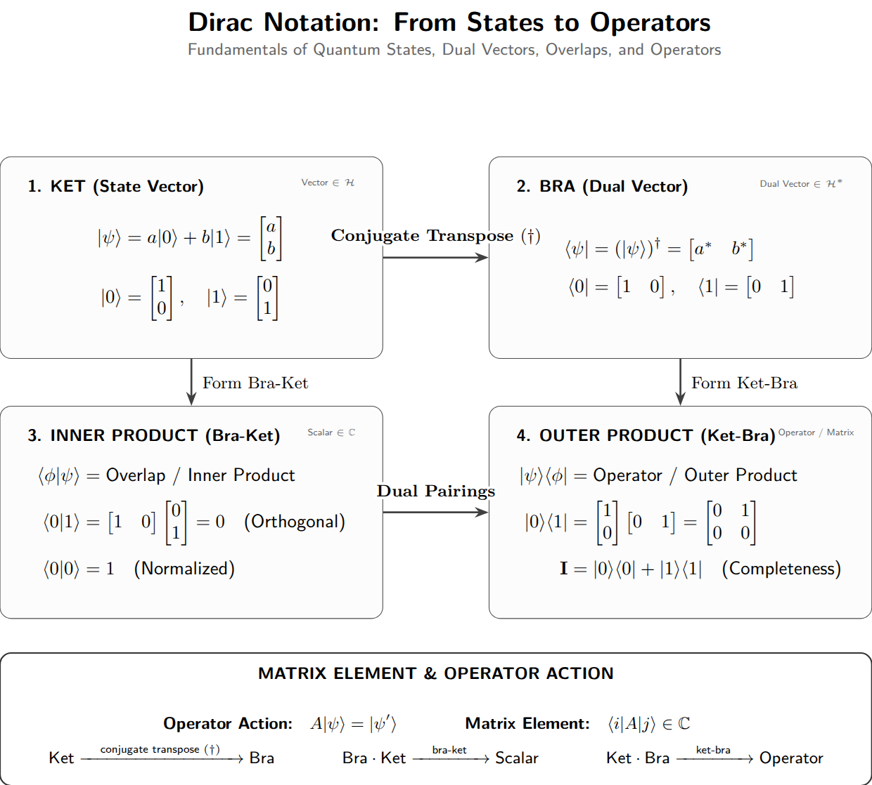

Slide 33
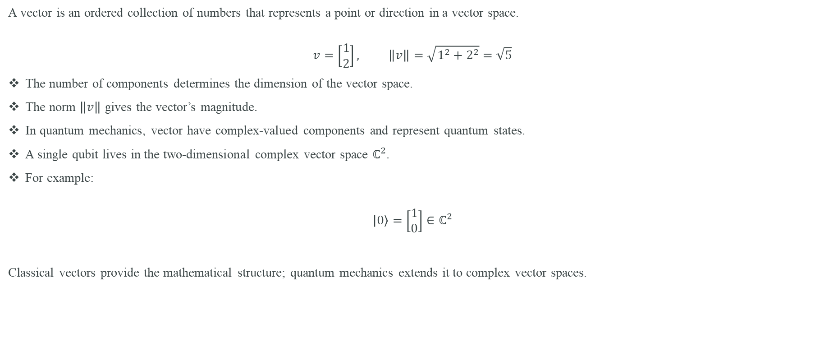
From Vectors to Quantum States
A vector is an ordered collection of numbers that represents a point or direction in a vector space.
$$v=\left[\begin{matrix}1 \\ 2\end{matrix}\right], \left\|v\right\|=\sqrt{1^{2}+2^{2}}=\sqrt{5}$$
The number of components determines the dimension of the vector space.
The norm $\left\|v\right\|$ gives the vector’s magnitude.
In quantum mechanics, vector have complex-valued components and represent quantum states.
A single qubit lives in the two-dimensional complex vector space $ℂ^{2}$.
For example:
$$\left|0\right\rangle =\left[\begin{matrix}1 \\ 0\end{matrix}\right]∈ℂ^{2}$$
Classical vectors provide the mathematical structure; quantum mechanics extends it to complex vector spaces.

Slide 34
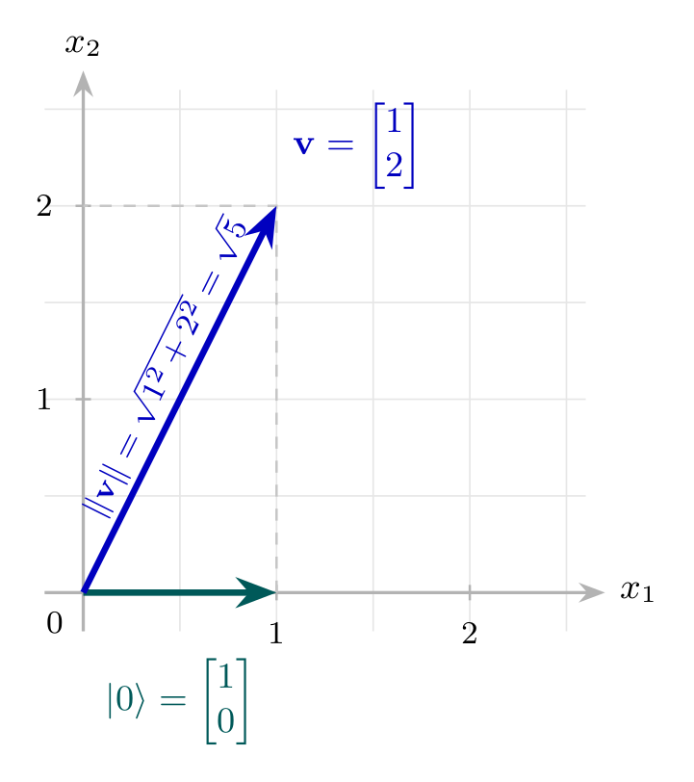

Slide 35
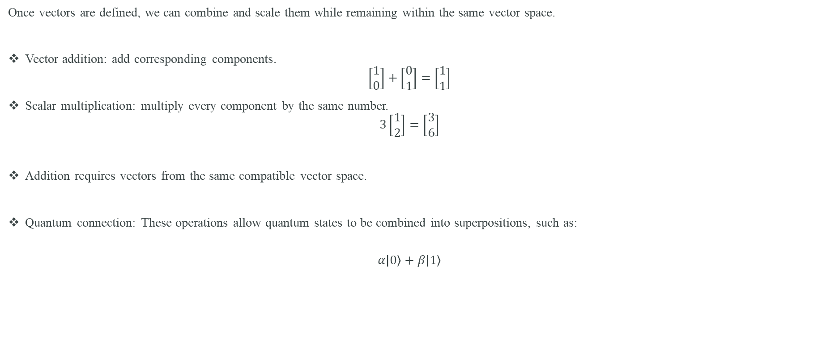
Basic operations and vectors
Once vectors are defined, we can combine and scale them while remaining within the same vector space.
Vector addition: add corresponding components.
$$\left[\begin{matrix}1 \\ 0\end{matrix}\right]+\left[\begin{matrix}0 \\ 1\end{matrix}\right]=\left[\begin{matrix}1 \\ 1\end{matrix}\right]$$
Scalar multiplication: multiply every component by the same number.
$$3\left[\begin{matrix}1 \\ 2\end{matrix}\right]=\left[\begin{matrix}3 \\ 6\end{matrix}\right]$$
Addition requires vectors from the same compatible vector space.
Quantum connection: These operations allow quantum states to be combined into superpositions, such as:
$$α\left|0\right\rangle +β\left|1\right\rangle$$

Slide 36
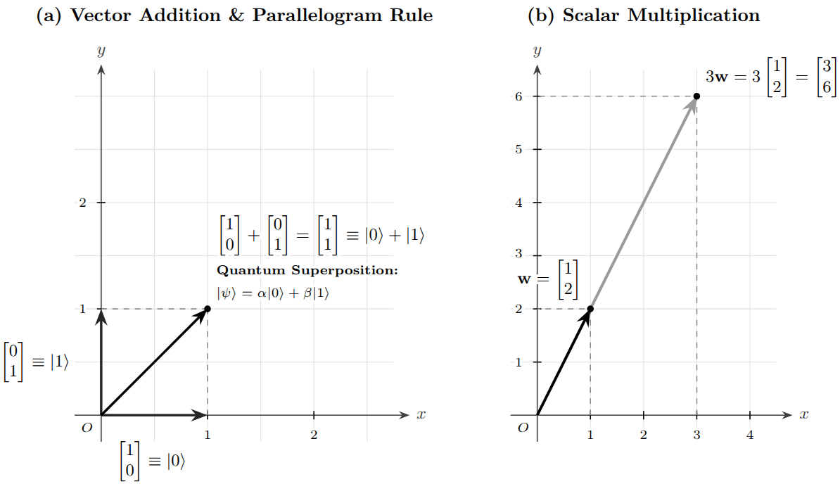

Slide 37
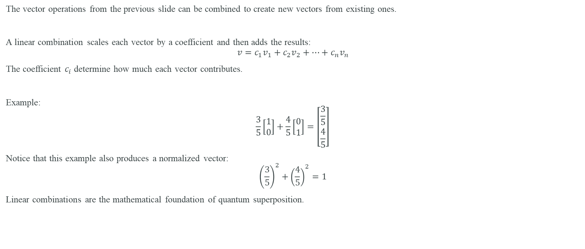
Linear Combinations: Building New Vectors
The vector operations from the previous slide can be combined to create new vectors from existing ones.
A linear combination scales each vector by a coefficient and then adds the results:
$$v=c_{1}v_{1}+c_{2}v_{2}+…+c_{n}v_{n}$$
The coefficient $c_{i}$ determine how much each vector contributes.
Example:
$$\frac{3}{5}\left[\begin{matrix}1 \\ 0\end{matrix}\right]+\frac{4}{5}\left[\begin{matrix}0 \\ 1\end{matrix}\right]=\left[\begin{matrix}\frac{3}{5} \\ \frac{4}{5}\end{matrix}\right]$$
Notice that this example also produces a normalized vector:
$${\left(\frac{3}{5}\right)}^{2}+{\left(\frac{4}{5}\right)}^{2}=1$$
Linear combinations are the mathematical foundation of quantum superposition.

Slide 38
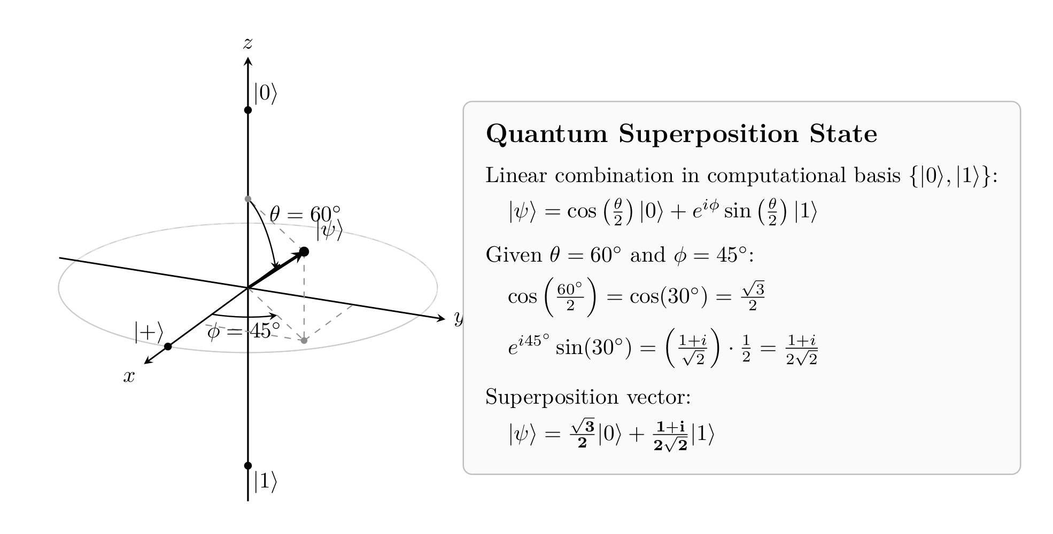

Slide 39
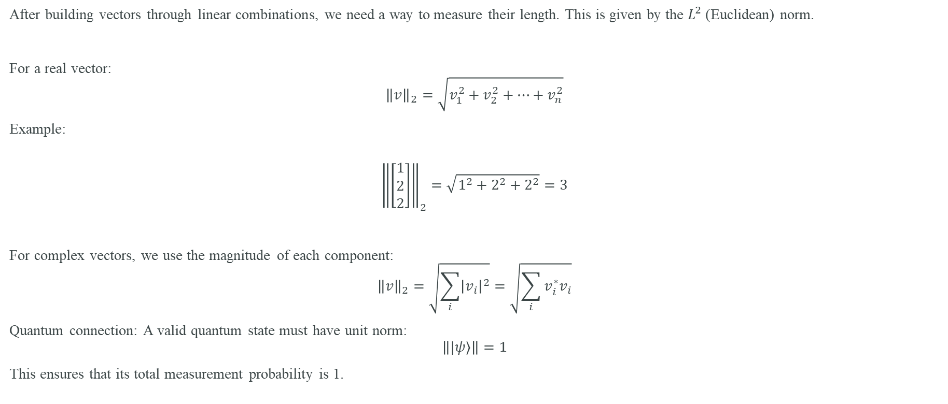
Vector Norm: Measuring the Length of a State
After building vectors through linear combinations, we need a way to measure their length. This is given by the $L^{2}$(Euclidean) norm.
For a real vector:
$${\left\|v\right\|}_{2}=\sqrt{v_{1}^{2}+v_{2}^{2}+…+v_{n}^{2}}$$
Example:
$${\left\|\left[\begin{matrix}1 \\ 2 \\ 2\end{matrix}\right]\right\|}_{2}=\sqrt{1^{2}+2^{2}+2^{2}}=3$$
For complex vectors, we use the magnitude of each component:
$${\left\|v\right\|}_{2}=\sqrt{\sum_{i}{{\left|v_{i}\right|}^{2}}}=\sqrt{\sum_{i}{v_{i}^{∗}v_{i}}}$$
Quantum connection: A valid quantum state must have unit norm:
$$\left\||ψ⟩\right\|=1$$
This ensures that its total measurement probability is 1.

Slide 40
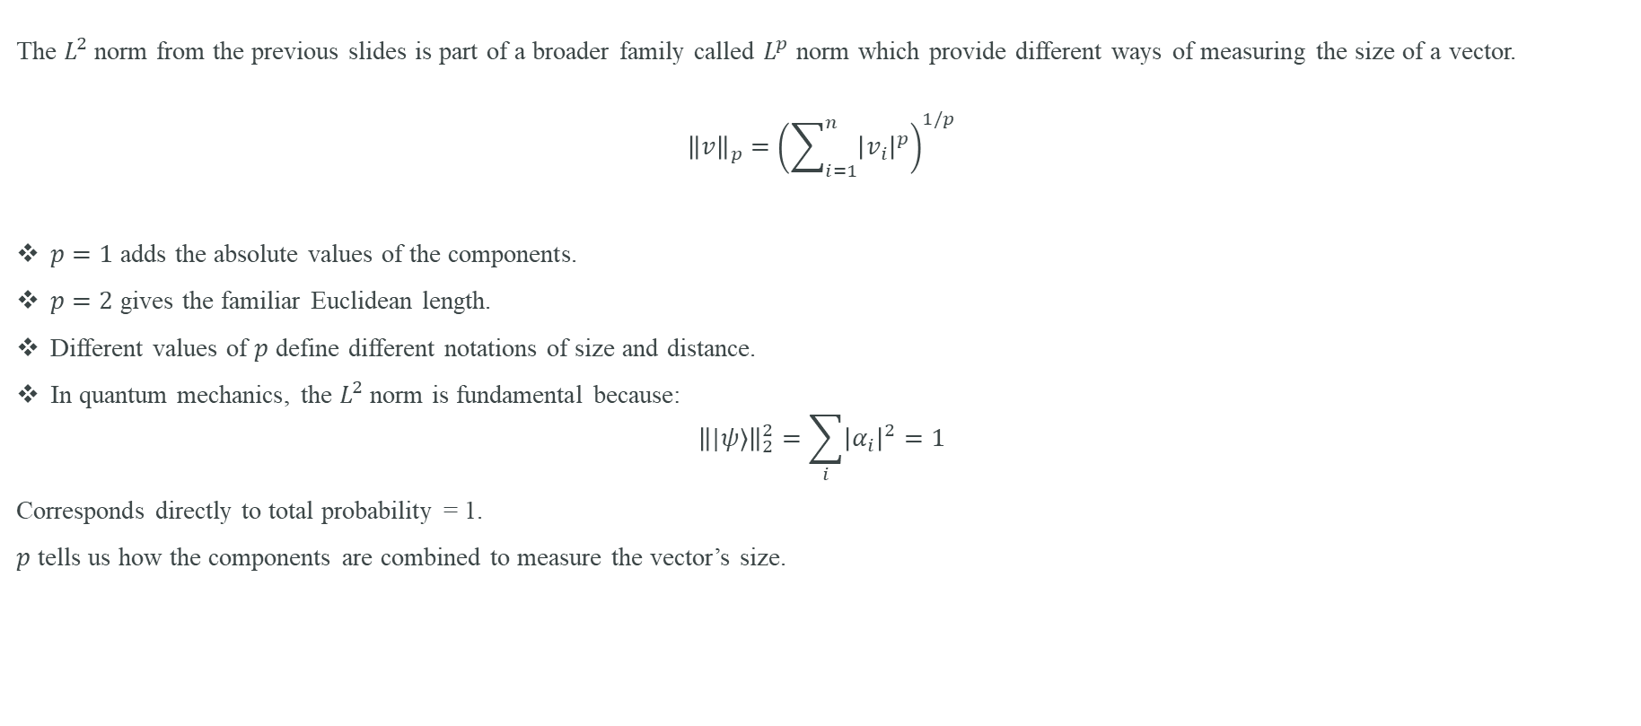
$L^{p}$Norms: Different Ways to Measure Vector Size
The $L^{2}$ norm from the previous slides is part of a broader family called $L^{p}$ norm which provide different ways of measuring the size of a vector.
$${\left\|v\right\|}_{p}={\left(\sum_{i=1}^{n}{{\left|v_{i}\right|}^{p}}\right)}^{1/p}$$
$p=1$ adds the absolute values of the components.
$p=2$ gives the familiar Euclidean length.
Different values of $p$ define different notations of size and distance.
In quantum mechanics, the $L^{2}$ norm is fundamental because:
$${\left\||ψ⟩\right\|}_{2}^{2}=\sum_{i}{{\left|α_{i}\right|}^{2}}=1$$
Corresponds directly to total probability = 1.
$p$ tells us how the components are combined to measure the vector’s size.

Slide 41
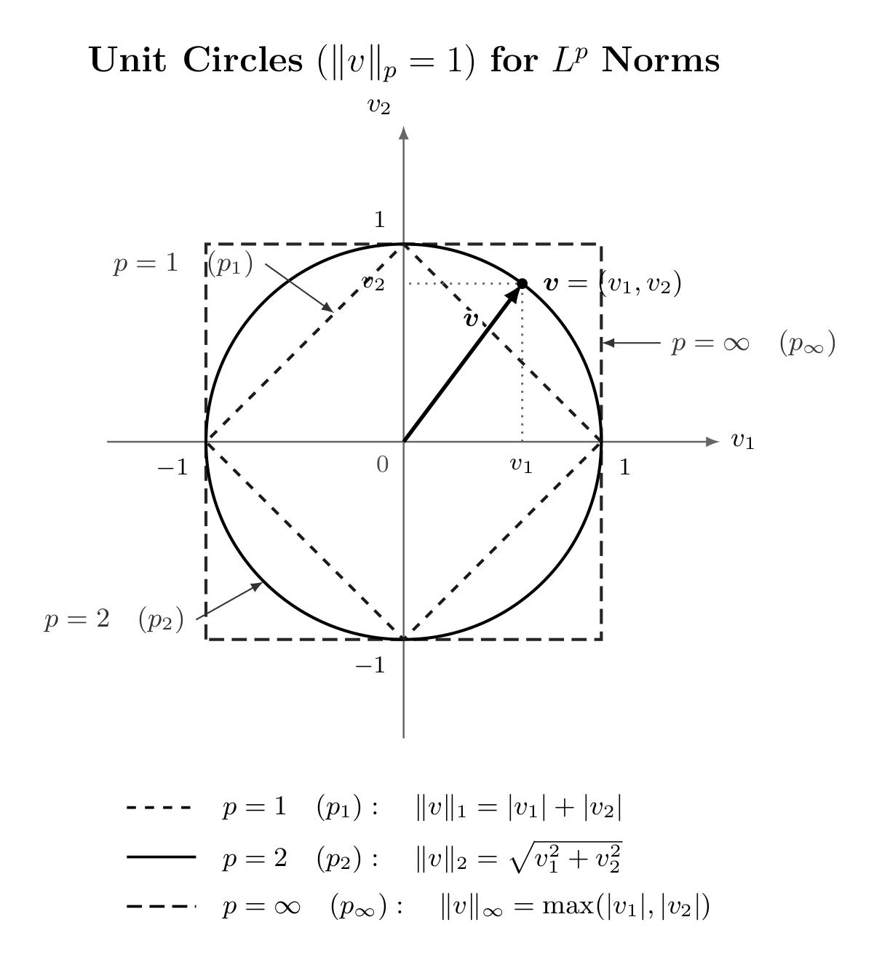

Slide 42
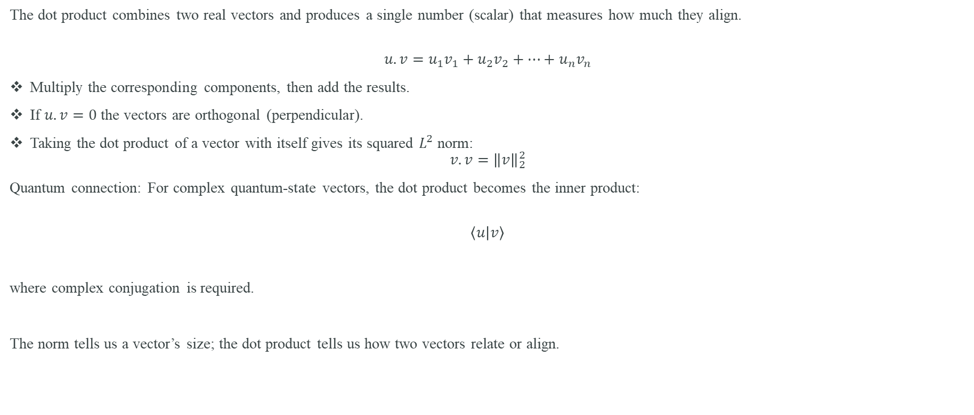
Dot Product: From Vectors to a Scalar
The dot product combines two real vectors and produces a single number (scalar) that measures how much they align.
$$u.v=u_{1}v_{1}+u_{2}v_{2}+…+u_{n}v_{n}$$
Multiply the corresponding components, then add the results.
If $u.v=0$ the vectors are orthogonal (perpendicular).
Taking the dot product of a vector with itself gives its squared $L^{2}$ norm:
$$v.v={\left\|v\right\|}_{2}^{2}$$
Quantum connection: For complex quantum-state vectors, the dot product becomes the inner product:
$$\left\langle u | v\right\rangle$$
where complex conjugation is required.
The norm tells us a vector’s size; the dot product tells us how two vectors relate or align.

Slide 43
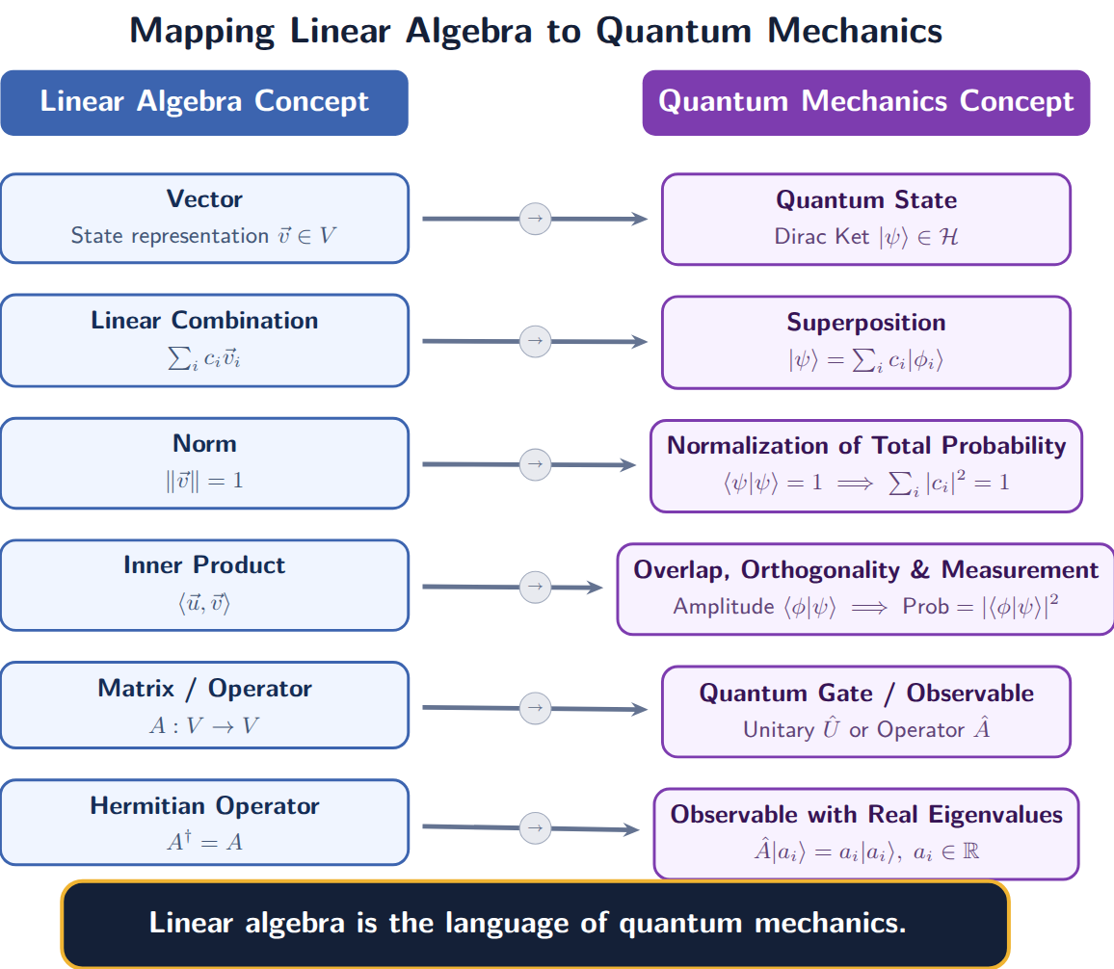

Slide 44
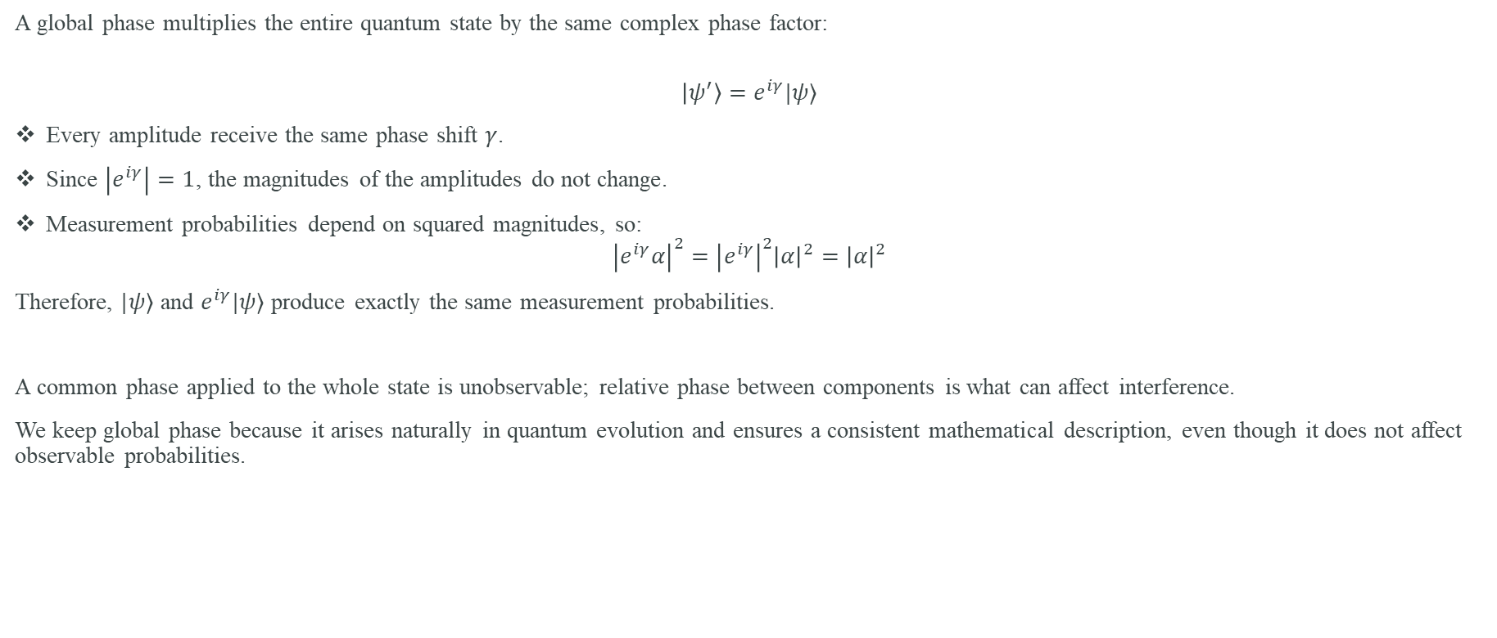
Global Phase: Why It Does Not Affect Measurement
A global phase multiplies the entire quantum state by the same complex phase factor:
$$\left|ψ^{′}\right\rangle =e^{iγ}|ψ⟩$$
Every amplitude receive the same phase shift $γ$.
Since $\left|e^{iγ}\right|=1$, the magnitudes of the amplitudes do not change.
Measurement probabilities depend on squared magnitudes, so:
$${\left|e^{iγ}α\right|}^{2}={\left|e^{iγ}\right|}^{2}{\left|α\right|}^{2}={\left|α\right|}^{2}$$
Therefore, $|ψ⟩$ and $e^{iγ}|ψ⟩$ produce exactly the same measurement probabilities.
A common phase applied to the whole state is unobservable; relative phase between components is what can affect interference.
We keep global phase because it arises naturally in quantum evolution and ensures a consistent mathematical description, even though it does not affect observable probabilities.

Slide 45
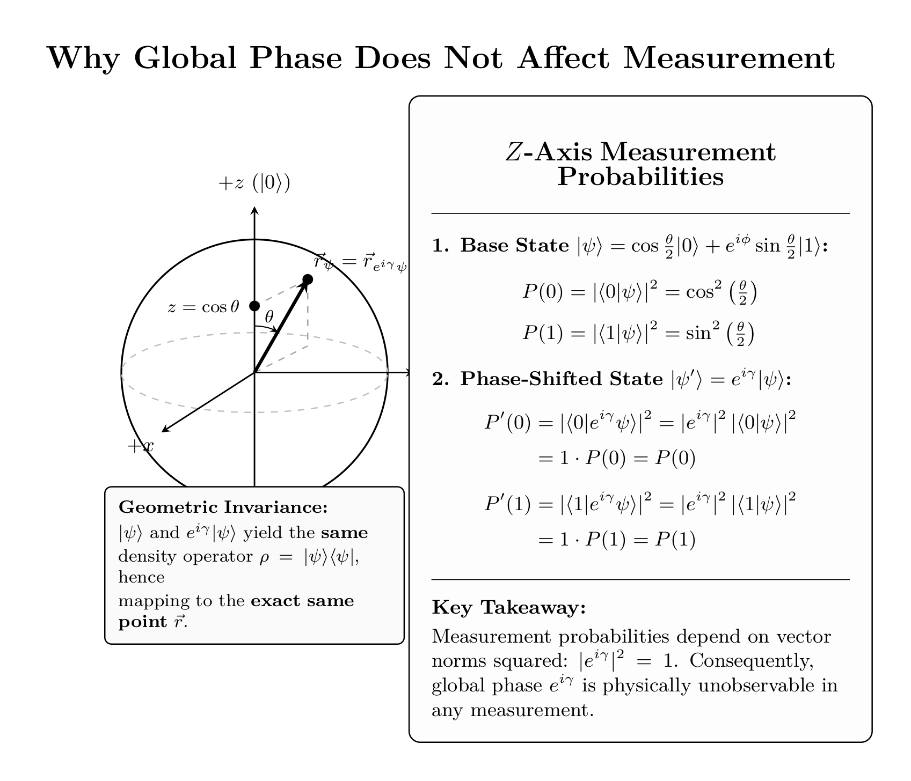

Slide 46
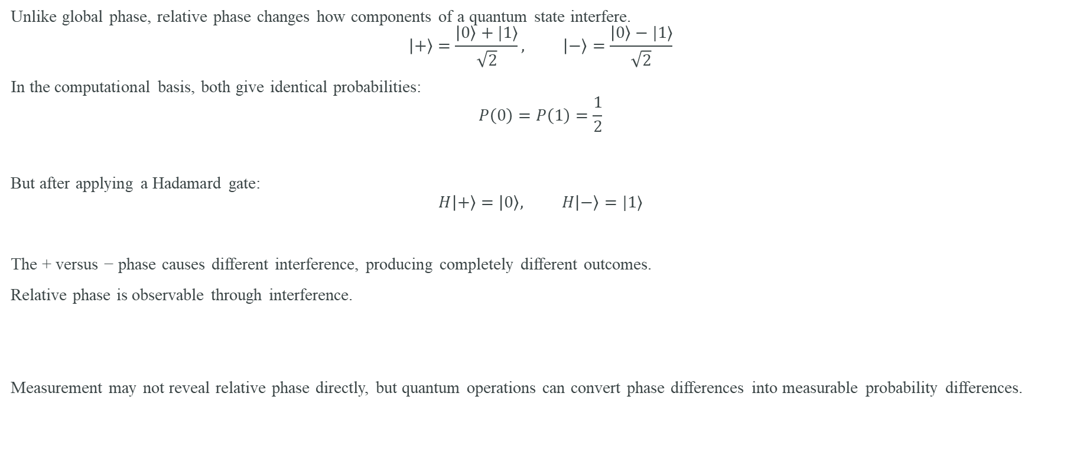
Relative Phase: Why It Matters
Unlike global phase, relative phase changes how components of a quantum state interfere.
$$\left|+\right\rangle =\frac{\left|0\right\rangle +|1⟩}{\sqrt{2}}, \left|−\right\rangle =\frac{\left|0\right\rangle −|1⟩}{\sqrt{2}}$$
In the computational basis, both give identical probabilities:
$$P\left(0\right)=P\left(1\right)=\frac{1}{2}$$
But after applying a Hadamard gate:
$$H\left|+\right\rangle =\left|0\right\rangle , H\left|−\right\rangle =|1⟩$$
The + versus − phase causes different interference, producing completely different outcomes.
Relative phase is observable through interference.
Measurement may not reveal relative phase directly, but quantum operations can convert phase differences into measurable probability differences.

Slide 47


