Slide 1
Deutsch–Jozsa Algorithm & Simon’s Periodicity
Oracle problems, interference, hidden structure, and Qiskit

Slide 2
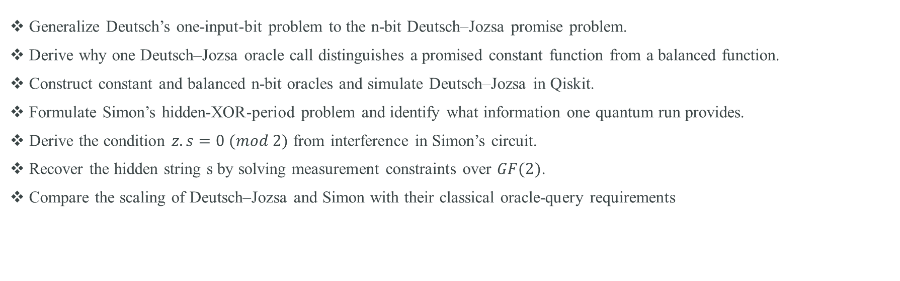
Week 8 Learning Objectives
Generalize Deutsch’s one-input-bit problem to the n-bit Deutsch–Jozsa promise problem.
Derive why one Deutsch–Jozsa oracle call distinguishes a promised constant function from a balanced function.
Construct constant and balanced n-bit oracles and simulate Deutsch–Jozsa in Qiskit.
Formulate Simon’s hidden-XOR-period problem and identify what information one quantum run provides.
Derive the condition $z.s=0 (mod 2)$ from interference in Simon’s circuit.
Recover the hidden string s by solving measurement constraints over $GF(2)$.
Compare the scaling of Deutsch–Jozsa and Simon with their classical oracle-query requirements

Slide 3
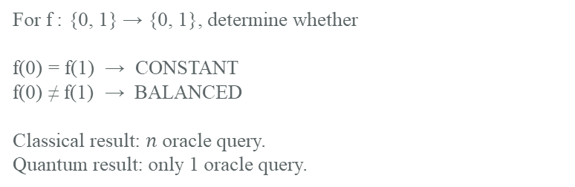

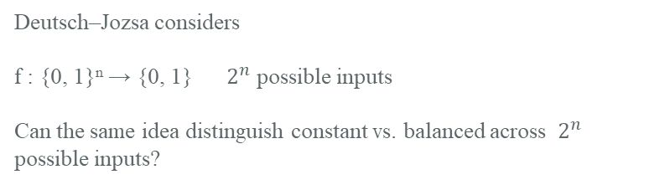
RECAP: FROM DEUTSCH TO DEUTSCH–JOZSA
Last week: one query revealed a global property. This week: scale the idea.
1
Deutsch’s algorithm
2
This week: scale and extend
For f : {0, 1} → {0, 1}, determine whether
f(0) = f(1) → CONSTANT
f(0) ≠ f(1) → BALANCED
Classical result: $n$ oracle query.
Quantum result: only 1 oracle query.
Deutsch–Jozsa considers
f : {0, 1}ⁿ → {0, 1} $2^{n}$ possible inputs
Can the same idea distinguish constant vs. balanced across $2^{n}$ possible inputs?
THE CORE PATTERN
SUPERPOSITION
$$U_{f}$$
PHASE KICKBACK
INTERFERENCE
MEASUREMENT
We do not learn every value of f. Interference reveals structure.

Slide 4
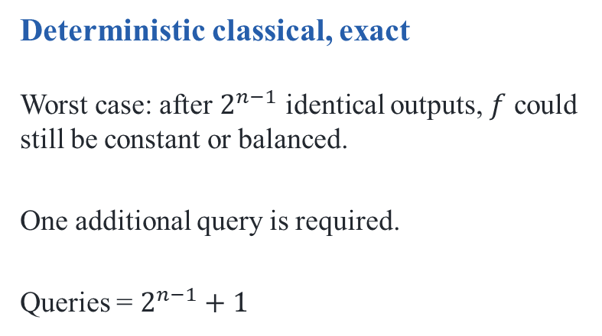
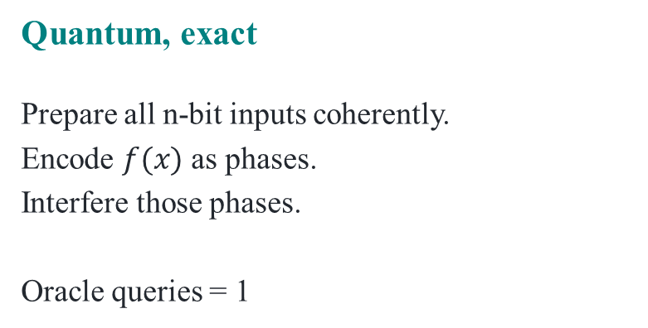
Why the generalization is interesting
Deutsch gave a 2-versus-1 query comparison; Deutsch–Jozsa scales that separation.
Deterministic classical, exact
Worst case: after $2^{n−1}$ identical outputs, $f$ could still be constant or balanced.
One additional query is required.
Queries = $2^{n−1}+1$
Quantum, exact
Prepare all n-bit inputs coherently.
Encode $f(x)$ as phases.
Interfere those phases.
Oracle queries = 1
Important scope: this is an exact deterministic query-complexity comparison—not a claim that every implementation has exponential wall-clock speedup.

Slide 5
Deutsch–Jozsa: the promise problem
We are promised that the function is either constant or balanced.
$$f:{\left\{0,1\right\}}^{n}→\left\{0,1\right\}$$
CONSTANT
BALANCED
$f\left(x\right)=0$for every $x$
Exactly half of the $2^{n}$ inputs give 0
or
and exactly half give 1.
$f\left(x\right)=1$ for every $x$
all outputs identical
equal numbers of 0s and 1s
PROMISE = one of these two cases is guaranteed. The algorithm is not meant for arbitrary Boolean functions.

Slide 6
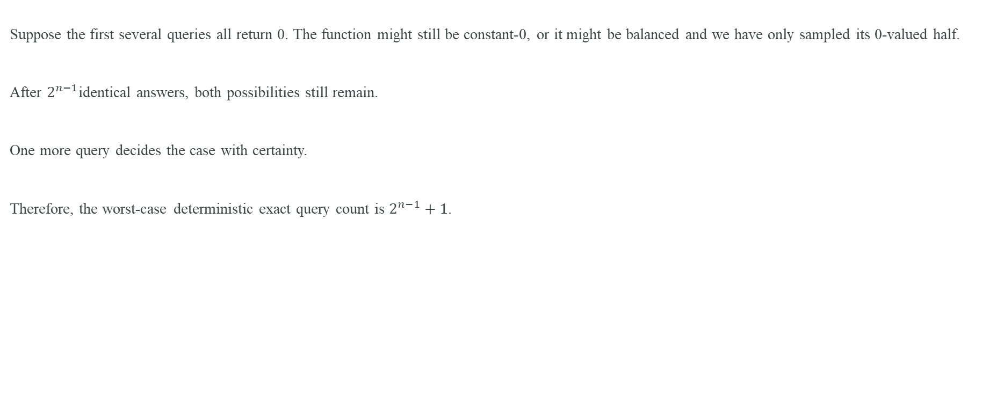
Classical reasoning for Deutsch–Jozsa
Suppose the first several queries all return 0. The function might still be constant-0, or it might be balanced and we have only sampled its 0-valued half.
After $2^{n−1}$identical answers, both possibilities still remain.
One more query decides the case with certainty.
Therefore, the worst-case deterministic exact query count is $2^{n−1}+1$.

Slide 7
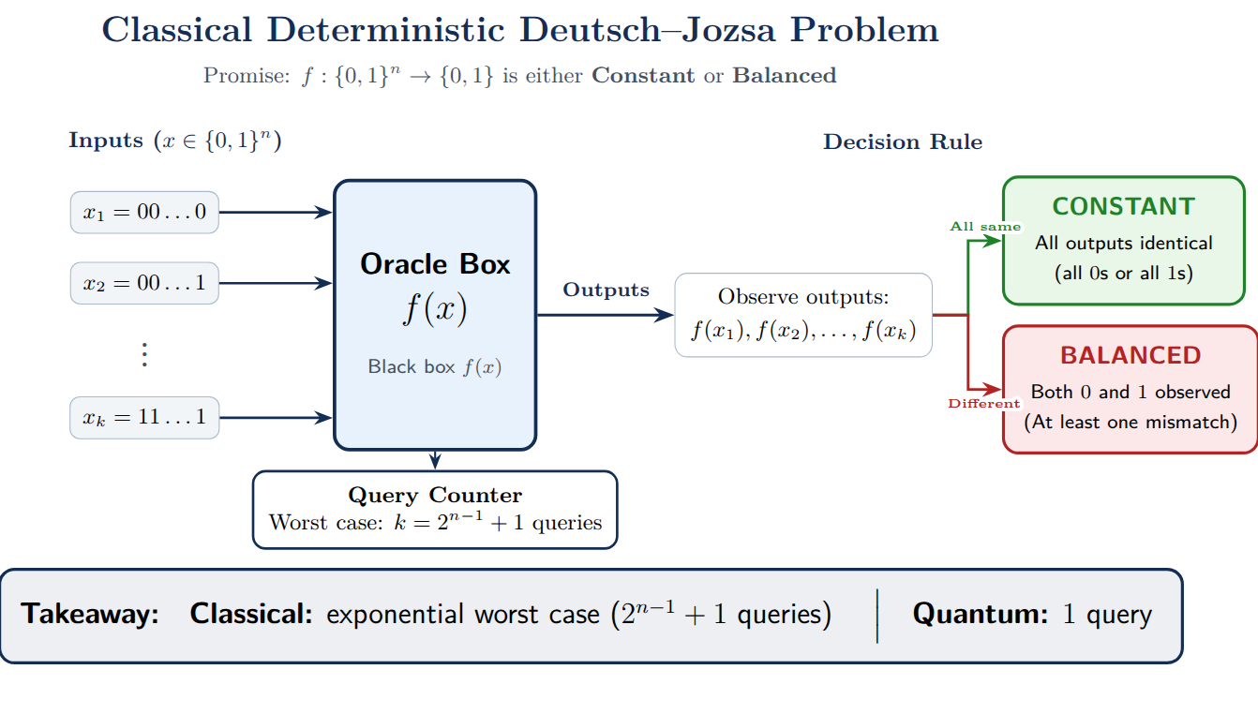

Slide 8


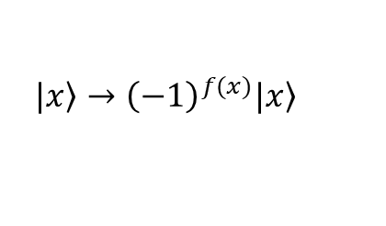

Deutsch–Jozsa circuit: the whole algorithm
The input register is transformed, queried once, and measured after interference.
q₀
|0⟩
H
H
M
|0⟩
$$U_{f}$$
q₁
H
H
M
⋮
⋮
one oracle
query
H⋯
H⋯
a
|1⟩
H
$$H^{\left\{⊗n\right\}}$$
oracle
$$H^{\left\{⊗n\right\}}$$
measure q₀…qₙ₋₁
Input register: |0ⁿ⟩ Ancilla: |1⟩ Only the input register is measured.
$$\left.|x\right\rangle →{\left(−1\right)}^{f(x)}\left.|x\right\rangle$$
Phase Kickback

Slide 9

Classical reasoning for Deutsch–Jozsa
$$\left.|ψ_{0}\right\rangle ={\left.|0\right\rangle }^{\left\{⊗n\right\}}\left.|1\right\rangle$$
$$\left.|ψ_{1}\right\rangle =\left(\frac{1}{\sqrt{2^{n}}}\right)\sum_{x∈{\left\{0,1\right\}}^{n}}{\left.|x\right\rangle \left.|−\right\rangle }$$
In Deutsch, the query register contained |0⟩ and |1⟩. Here it contains every n-bit basis state |x⟩.
For n=3, the superposition contains 000,001,010,011,100,101,110,111.
The new challenge is not creating superposition; it is arranging the 2ⁿ phase contributions so a global property survives measurement.

Slide 10

Oracle action at scale: one phase for every input x
$$\left.U_{f}|x\right\rangle |\left.−\right\rangle ={\left(−1\right)}^{f(x)}\left.|x\right\rangle |\left.−\right\rangle$$
$$\left.|ψ_{2}\right\rangle =\left(\frac{1}{\sqrt{2^{n}}}\right)\sum_{x∈{\left\{0,1\right\}}^{n}}{\left.{\left(−1\right)}^{f(x)}|x\right\rangle \left.|−\right\rangle }$$
Constant f
All 2ⁿ amplitudes acquire the same sign.
Relative phase pattern is unchanged.
Balanced f
Exactly half acquire + and half − signs.
A structured relative-phase pattern is created.

Slide 11

Step 3 — phase kickback through the oracle
$$\left.U_{f}|x\right\rangle |\left.−\right\rangle ={\left(−1\right)}^{f(x)}\left.|x\right\rangle |\left.−\right\rangle$$
If f(x)=0, the phase is +1: the |x⟩ amplitude keeps its sign.
If f(x)=1, the phase is −1: the |x⟩ amplitude changes sign.
The ancilla returns to |−⟩, so the function value is not read from the ancilla; it has been encoded as relative phase in the input register.
$$\left.|ψ_{2}\right\rangle =\left(\frac{1}{\sqrt{2^{n}}}\right)\sum_{x∈{\left\{0,1\right\}}^{n}}{\left.{\left(−1\right)}^{f(x)}|x\right\rangle \left.|−\right\rangle }$$

Slide 12
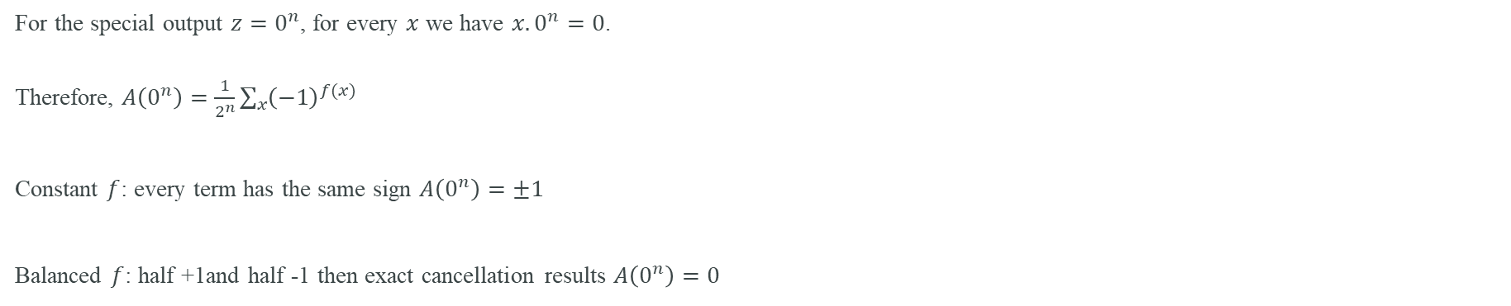
Why the second Hadamard reveals the answer
$$H^{\left\{⊗n\right\}}\left.|x\right\rangle =\left(\frac{1}{\sqrt{2^{n}}}\right)\sum_{z∈{\left\{0,1\right\}}^{n}}{\left.{\left(−1\right)}^{x.z}|z\right\rangle }$$
$$A(z)=\left(\frac{1}{2^{n}}\right)\sum_{x∈{\left\{0,1\right\}}^{n}}{{\left(−1\right)}^{f\left(x\right)+x.z}}$$
For the special output $z=0^{n}$, for every $x$ we have $x.0^{n}=0$.
Therefore, $A\left(0^{n}\right)=\frac{1}{2^{n}}\sum_{x}{{\left(−1\right)}^{f(x)}}$
Constant $f$: every term has the same sign $A\left(0^{n}\right)=±1$
Balanced $f$: half +1and half -1 then exact cancellation results $A\left(0^{n}\right)=0$

Slide 13
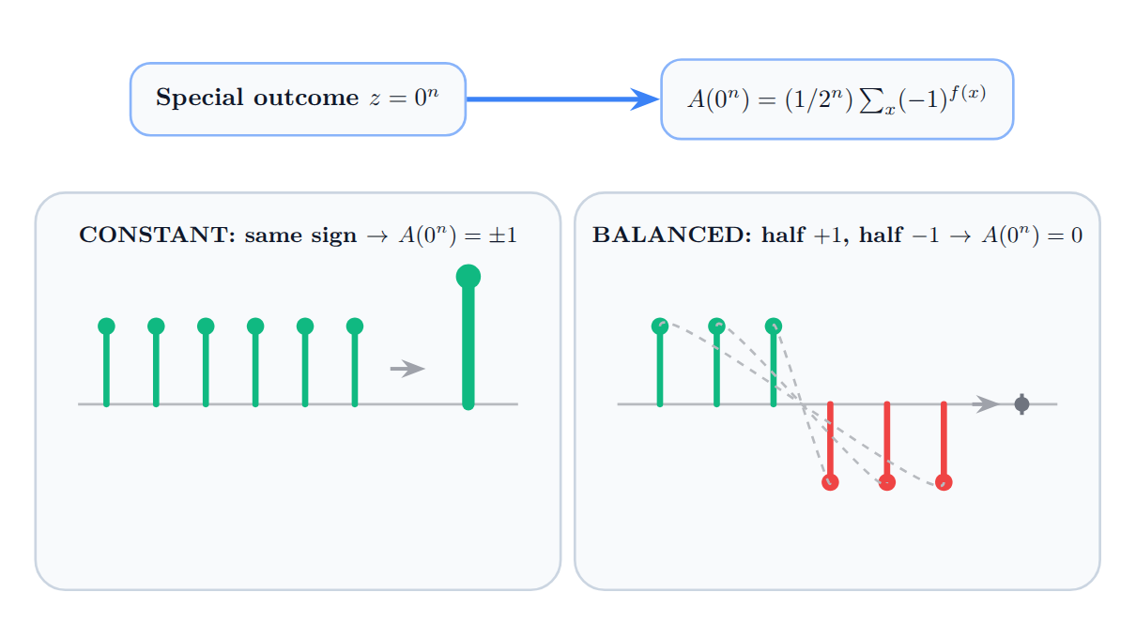

Slide 14
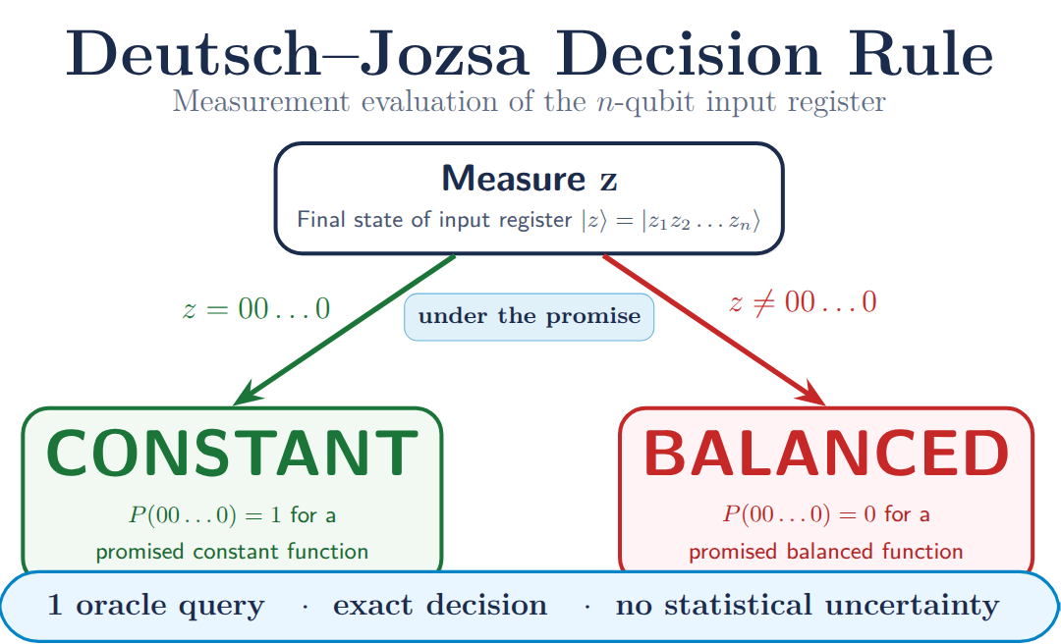

Slide 15
Worked example: n = 2
Constant example
f(x)=0
Phase pattern:
00:+
01:+
10:+
11:+
After final H⊗² → |00⟩
Balanced example
f(x)=x₀
Phase pattern:
00:+
01:−
10:+
11:−
After interference → nonzero output
Important point
The oracle does not reveal four classical function values.
It creates a phase pattern across amplitudes.
The final Hadamards transform that pattern into a measurable global property.

Slide 16
Deutsch–Jozsa in Qiskit: build example oracles
from qiskit import QuantumCircuit
def constant_oracle(n, value=0):
qc = QuantumCircuit(n + 1)
if value == 1:
qc.x(n) # y -> y XOR 1
return qc.to_gate(label="Uf")
def balanced_parity_oracle(n):
# f(x) = x0 XOR x1 XOR ... XOR x(n-1)
qc = QuantumCircuit(n + 1)
for q in range(n):
qc.cx(q, n) # XOR each input bit into ancilla
return qc.to_gate(label="Uf")

Slide 17
Deutsch–Jozsa in Qiskit: algorithm circuit
from qiskit import QuantumCircuit
def deutsch_jozsa(n, oracle):
qc = QuantumCircuit(n + 1, n)
qc.x(n) # ancilla |0> -> |1>
qc.h(range(n + 1)) # inputs -> uniform superposition; ancilla -> |->
qc.append(oracle, range(n + 1)) # ONE oracle query
qc.h(range(n)) # interference on input register
qc.measure(range(n), range(n))
return qc
n = 3
qc_const = deutsch_jozsa(n, constant_oracle(n, 0))
qc_bal = deutsch_jozsa(n, balanced_parity_oracle(n))
print(qc_bal.draw())

Slide 18
Deutsch–Jozsa simulation and interpretation
from qiskit_aer import AerSimulator
sim = AerSimulator()
for name, qc in [("constant", qc_const), ("balanced", qc_bal)]:
result = sim.run(qc, shots=1024).result()
counts = result.get_counts()
print(name, counts)
# Ideal expectation:
# constant -> {'000': 1024}
# balanced -> no '000' outcome for a valid balanced oracle
On an ideal simulator, the promise gives a deterministic classification.
On noisy hardware, nonzero counts may appear even for the constant circuit; then the experiment becomes a noisy implementation of an exact ideal algorithm.
Do not infer 'balanced' from one noisy nonzero shot without accounting for device error.

Slide 19
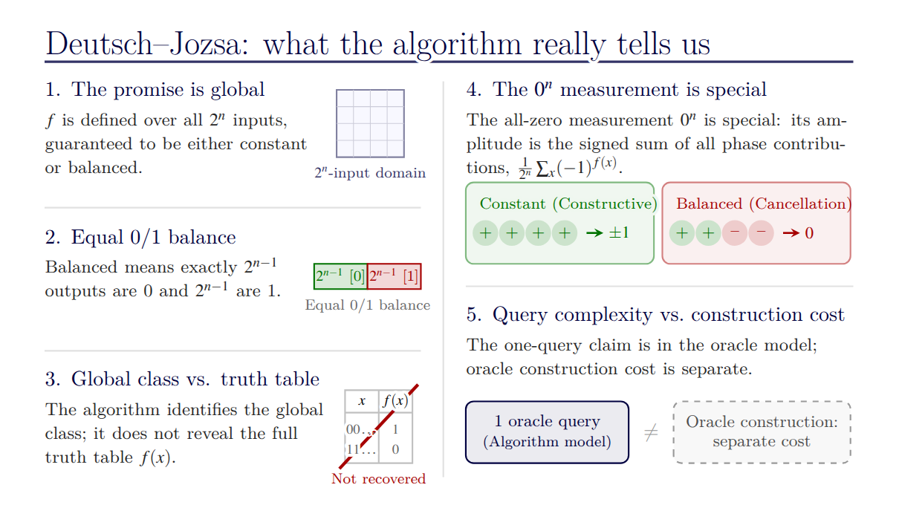

Slide 20
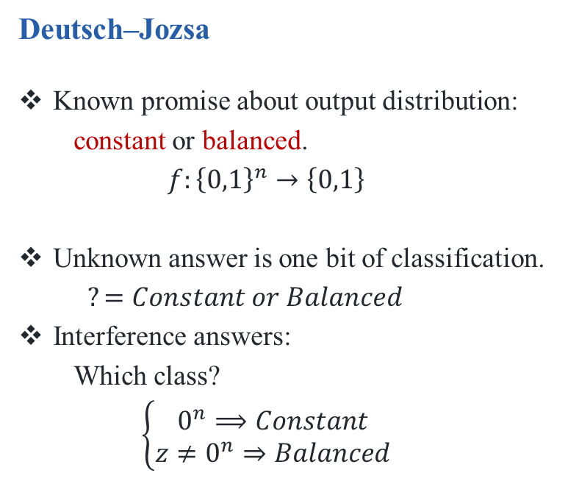
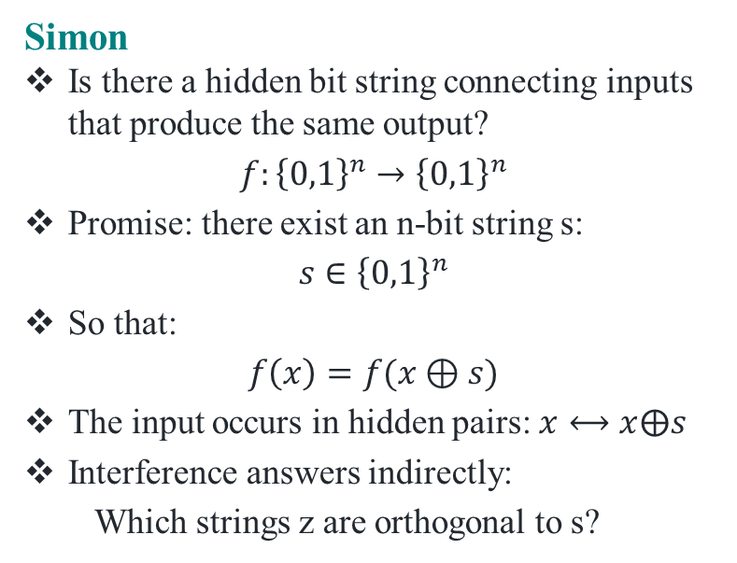
From Classification to Hidden Structure: Why Simon Is Different
Deutsch–Jozsa
Known promise about output distribution:
  constant or balanced.
  $$f:{\left\{0,1\right\}}^{n}→\left\{0,1\right\}$$
Unknown answer is one bit of classification.
$?=Constant or Balanced$
Interference answers:
  Which class?
  $$\left\{\begin{aligned}0^{n}⟹Constant \\ z≠0^{n}⇒Balanced\end{aligned}\right.$$
Simon
Is there a hidden bit string connecting inputs that produce the same output?
$$f:{\left\{0,1\right\}}^{n}→{\left\{0,1\right\}}^{n}$$
Promise: there exist an n-bit string s:
$$s∈{\left\{0,1\right\}}^{n}$$
So that:
$$f\left(x\right)=f(x⊕s)$$
The input occurs in hidden pairs: $x⟷x⨁s$
Interference answers indirectly:
  Which strings z are orthogonal to s?
Deutsch–Jozsa asks WHAT TYPE of function? Simon asks WHAT HIDDEN PATTERN connects its inputs?

Slide 21
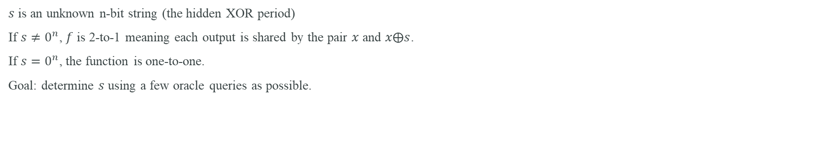
Simon’s periodicity problem: precise statement
f : {0,1}ⁿ → {0,1}ⁿ
f(x)=f(y) ⇔ y = x ⊕ s
$s$is an unknown n-bit string (the hidden XOR period)
If $s≠0^{n}$, $f$ is 2-to-1 meaning each output is shared by the pair $x$ and $x⨁s$.
If $s=0^{n}$, the function is one-to-one.
Goal: determine $s$ using a few oracle queries as possible.

Slide 22
Concrete Simon example: hidden string s = 101
Pair 1
000 ⊕ 101 = 101
Therefore f(000) = f(101)
Pair 2
001 ⊕ 101 = 100
Therefore f(001) = f(100)
Pair 3
010 ⊕ 101 = 111
Therefore f(010) = f(111)
Pair 4
011 ⊕ 101 = 110
Therefore f(011) = f(110)
The function values themselves can be arbitrary; the algorithm exploits the pairing structure, not the numerical pattern of the outputs.

Slide 23
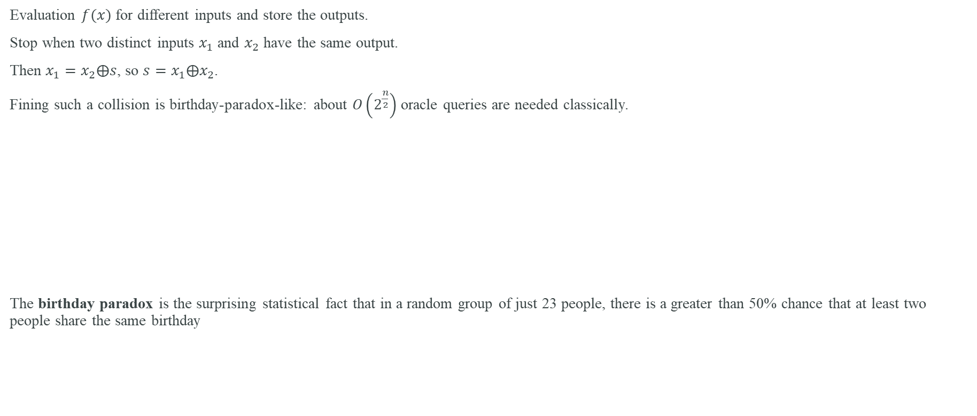
Classical approach to Simon: search for a collision
Evaluation $f(x)$ for different inputs and store the outputs.
Stop when two distinct inputs $x_{1}$ and $x_{2}$ have the same output.
Then $x_{1}=x_{2}⨁s$, so $s=x_{1}⨁x_{2}$.
Fining such a collision is birthday-paradox-like: about $O\left(2^{\frac{n}{2}}\right)$ oracle queries are needed classically.
The birthday paradox is the surprising statistical fact that in a random group of just 23 people, there is a greater than 50% chance that at least two people share the same birthday
$f(x_{1})$=$f\left(x_{2}\right)⇒s=x_{1}⨁x_{2}$

Slide 24
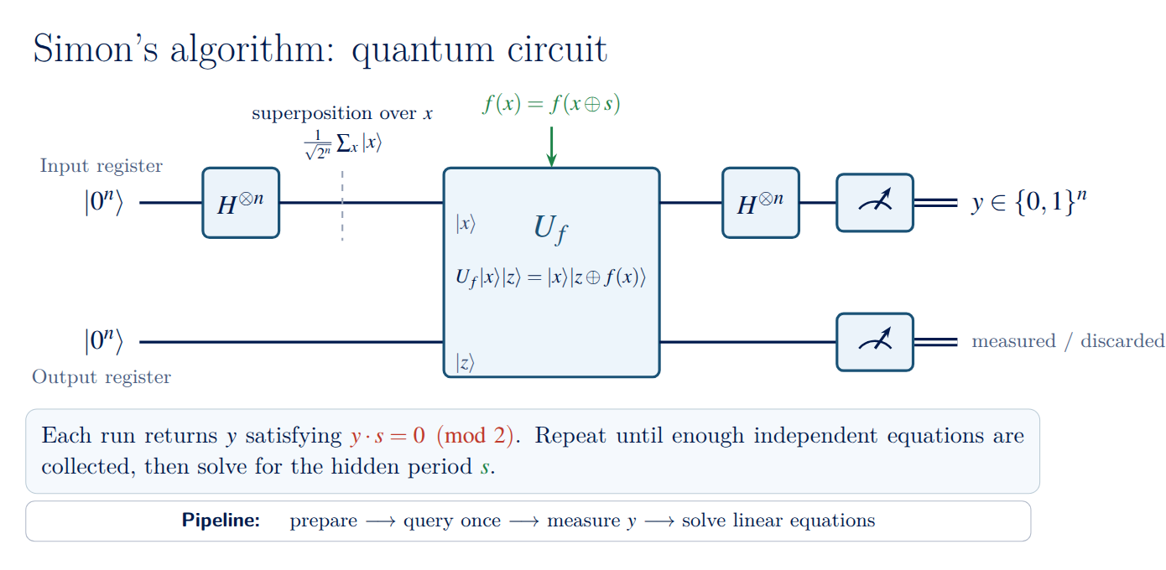

Slide 25
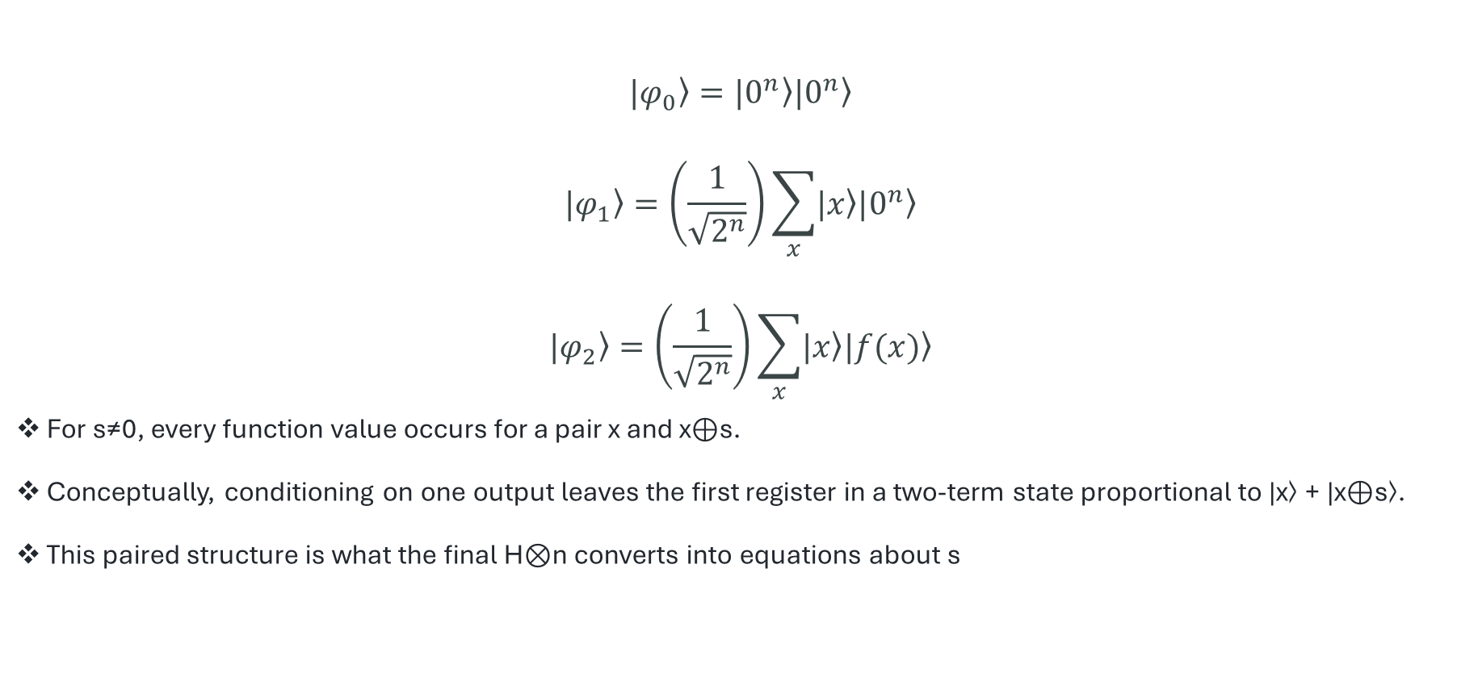
Simon state evolution: before the final Hadamards
$$\left.|φ_{0}\right\rangle =\left.|0^{n}\right\rangle \left.|0^{n}\right\rangle$$
$$\left.|φ_{1}\right\rangle =\left(\frac{1}{\sqrt{2^{n}}}\right)\sum_{x}{\left.|x\right\rangle \left.|0^{n}\right\rangle }$$
$$\left.|φ_{2}\right\rangle =\left(\frac{1}{\sqrt{2^{n}}}\right)\sum_{x}{\left.|x\right\rangle \left.|f(x)\right\rangle }$$
For s≠0, every function value occurs for a pair x and x⊕s.
Conceptually, conditioning on one output leaves the first register in a two-term state proportional to |x⟩ + |x⊕s⟩.
This paired structure is what the final H⊗n converts into equations about s

Slide 26
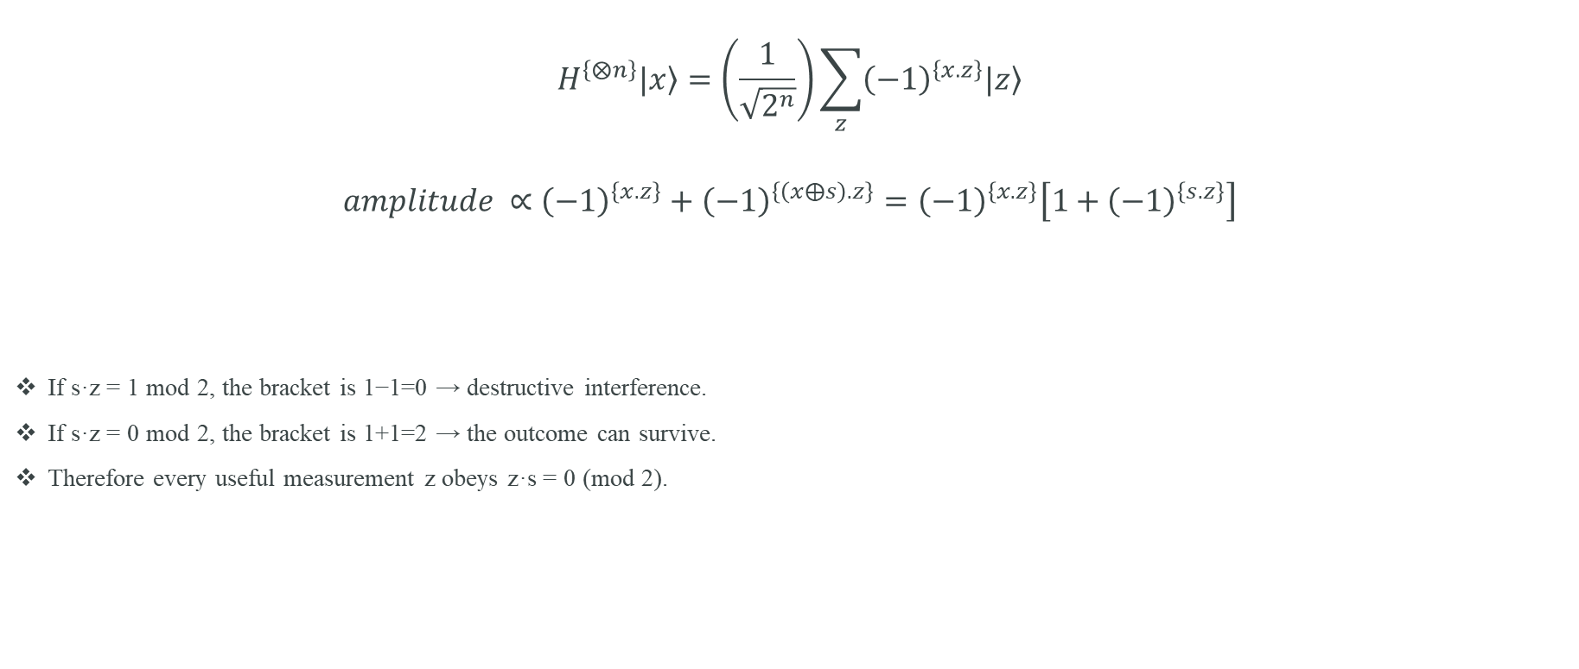
The key derivation: why measured z satisfies z·s = 0
$$H^{\left\{⨂n\right\}}\left.|x\right\rangle =\left(\frac{1}{\sqrt{2^{n}}}\right)\sum_{z}{{\left(−1\right)}^{\left\{x.z\right\}}\left.|z\right\rangle }$$
$$amplitude ∝{\left(−1\right)}^{\left\{x.z\right\}}+{\left(−1\right)}^{\left\{\left(x⨁s\right).z\right\}}={\left(−1\right)}^{\left\{x.z\right\}}\left[1+{\left(−1\right)}^{\left\{s.z\right\}}\right]$$
If s·z = 1 mod 2, the bracket is 1−1=0 → destructive interference.
If s·z = 0 mod 2, the bracket is 1+1=2 → the outcome can survive.
Therefore every useful measurement z obeys z·s = 0 (mod 2).

Slide 27
From quantum samples to a classical linear system
Example: n=3
Suppose measurements give:
z₁ = 010
z₂ = 101
Each gives z·s=0 mod 2.
Equations
010·s = s₁ = 0
101·s = s₂ ⊕ s₀ = 0
Solve over GF(2), not ordinary real arithmetic.
Recover s
Independent equations reduce the possible hidden strings.
Collect roughly n−1 independent constraints, then find the nonzero vector in their null space.
Verify candidate s with the oracle if needed.

Slide 28
Simon in Qiskit: example oracle for s = 11
from qiskit import QuantumCircuit
# Example function:
# f(00)=f(11)=00
# f(01)=f(10)=11
# This has hidden XOR period s=11.
def simon_oracle_s11():
qc = QuantumCircuit(4) # x0,x1 | y0,y1
# y0 = x0 XOR x1 ; y1 = x0 XOR x1
qc.cx(0, 2); qc.cx(1, 2)
qc.cx(0, 3); qc.cx(1, 3)
return qc.to_gate(label="Uf")
def simon_circuit():
qc = QuantumCircuit(4, 2)
qc.h([0, 1])
qc.append(simon_oracle_s11(), [0,1,2,3])
qc.h([0, 1])
qc.measure([0,1], [0,1])
return qc

Slide 29
Simon simulation: interpret the samples
from qiskit_aer import AerSimulator
from collections import Counter
qc = simon_circuit()
counts = AerSimulator().run(qc, shots=1024).result().get_counts()
print(counts)
# For s = 11, valid z satisfy:
# z·s = z0 XOR z1 = 0
# therefore z ∈ {00, 11}
# 00 gives no new information.
# 11 gives the equation s0 XOR s1 = 0.
# Together with the promise s != 00 in this 2-to-1 example,
# the hidden period is s = 11.
For larger n, repeat the quantum circuit until enough linearly independent z vectors are collected, then perform Gaussian elimination modulo 2.

Slide 30
Deutsch–Jozsa vs Simon: comparison
Feature
Deutsch–Jozsa
Simon
Problem
Classify f
Find hidden XOR period s
Promise
constant or balanced
f(x)=f(x⊕s), 2-to-1 for s≠0
Quantum output
decision in one run
linear constraint z·s=0 per run
Quantum queries
1
O(n)
Classical exact / best known oracle behavior
2ⁿ⁻¹+1 deterministic exact
O(2ⁿ/²) collision search
Main mechanism
phase kickback + interference
periodic pairing + interference + GF(2) solving
Historical role
early exact query separation
key precursor to Shor-style period finding

Slide 31
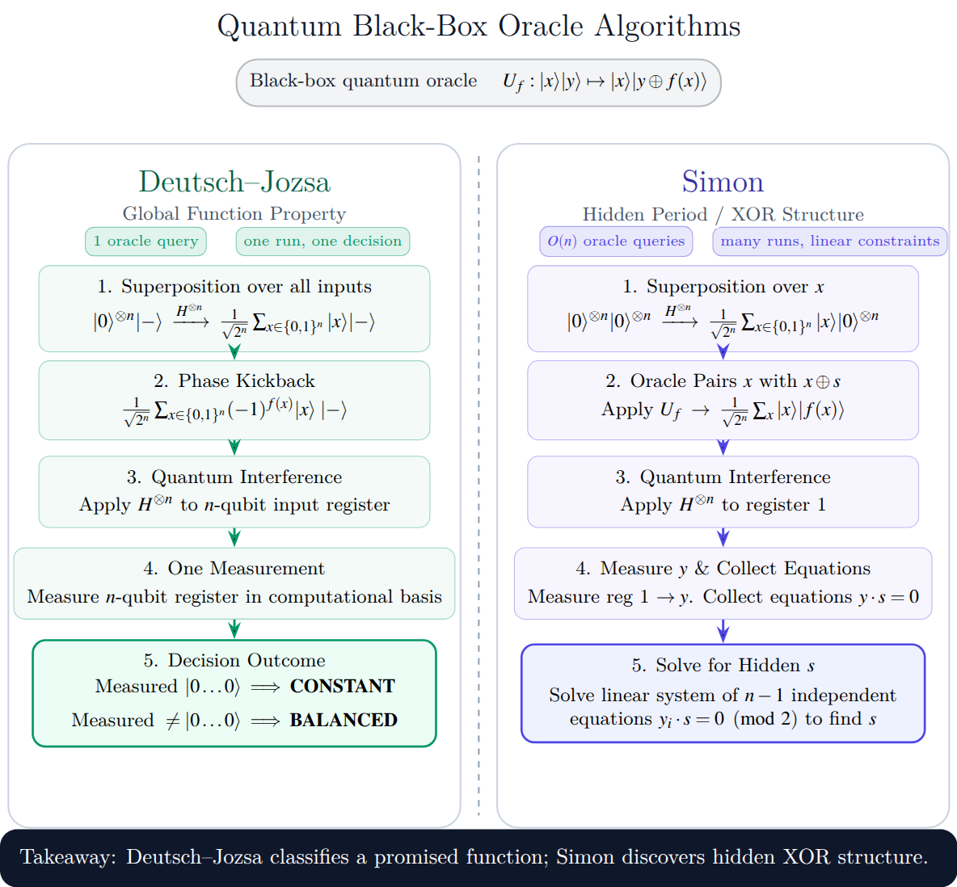

Slide 32
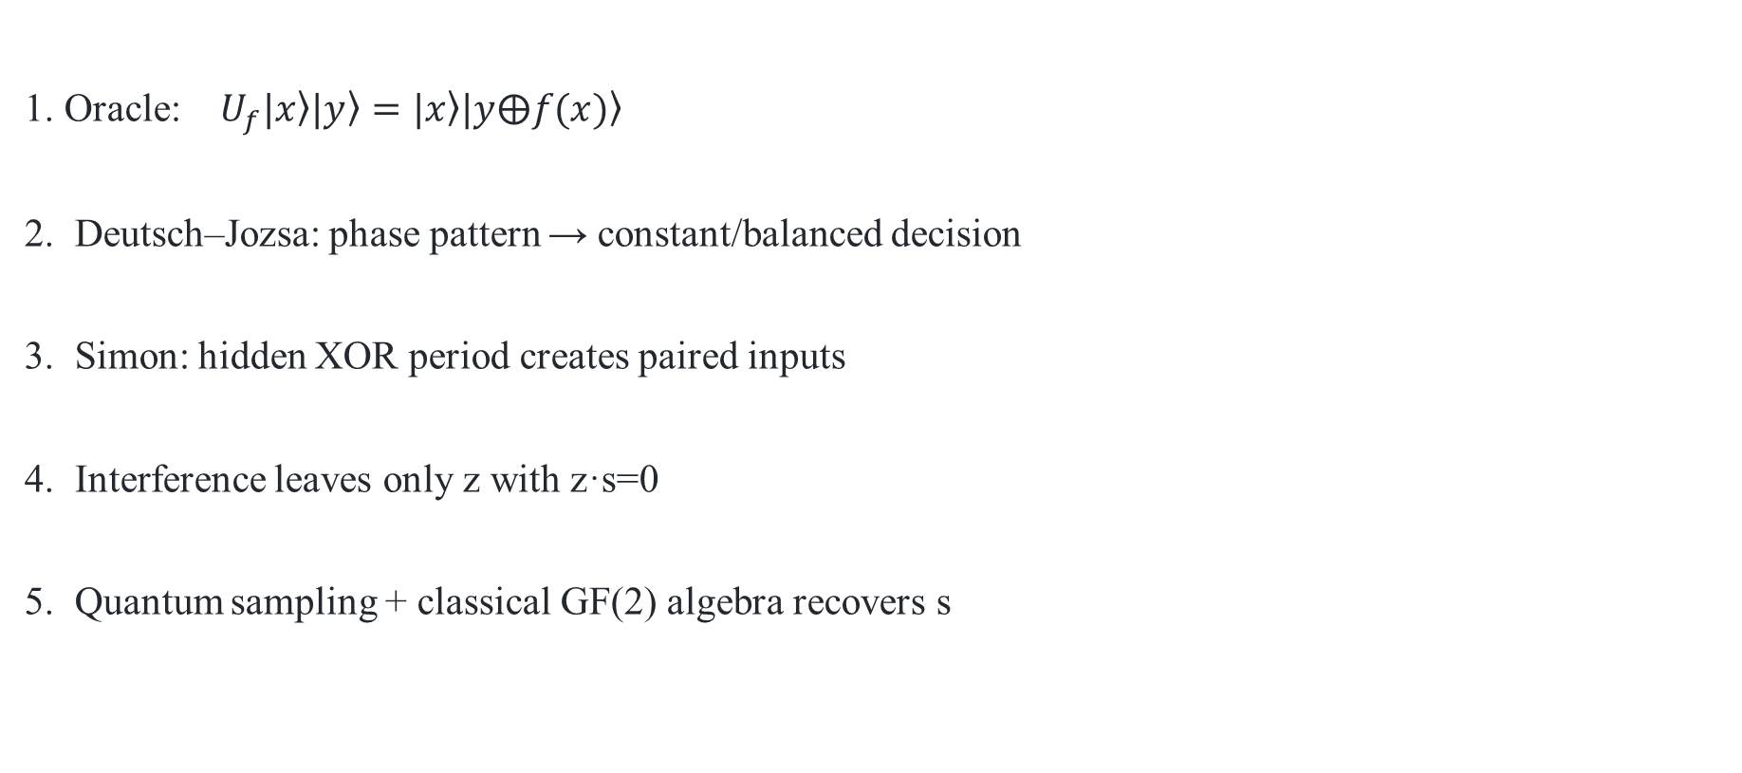
Five ideas to remember
1. Oracle: $U_{f}\left.|x\right\rangle \left.|y\right\rangle =\left.|x\right\rangle \left.|y⨁f(x)\right\rangle$
2. Deutsch–Jozsa: phase pattern → constant/balanced decision
3. Simon: hidden XOR period creates paired inputs
4. Interference leaves only z with z·s=0
5. Quantum sampling + classical GF(2) algebra recovers s

