Slide 1
Software Development Methodologies
From Waterfall to Agile: how teams organise the work of building software

Slide 2
Learning outcomes
1
2
3
Describe
Compare
Select
the main software development methodologies and the ideas behind them
plan-driven and agile approaches on change, risk, delivery and customer involvement
a suitable methodology for a given project context and justify the choice

Slide 3
The software development life cycle
1
Requirements
2
Design
3
Implementation
What must the system do?
How will it be structured?
Write and integrate the code
4
Testing
5
Deployment
6
Maintenance
Does it meet the requirements?
Release to real users
Fix, adapt and improve
A methodology decides how these activities are arranged in time

Slide 4
Plan-driven models
Waterfall, V-Model, iterative and incremental, Spiral

Slide 5
Waterfall
Requirements
Design
Implementation
Sequential: each phase is completed and signed off before the next begins. Feedback to an earlier phase is slow and costly.
Testing
Operation & maintenance

Slide 6
Waterfall: when does it fit?
Strengths
Weaknesses
Simple, easy to manage and audit
Clear milestones and documentation
Works with fixed-price contracts
Late testing finds problems late
Hard to change requirements
Users see working software last
Best when: requirements are stable and well understood, or heavy regulation demands documentation.

Slide 7
V-Model
Requirements
Acceptance testing
System design
System testing
Architecture design
Integration testing
Module design
Unit testing
Coding
Dashed lines: each test level verifies the matching design level, planned at the start

Slide 8
Iterative vs Incremental
Iterative
Incremental
v1
v2
v3
Login
Booking
Payment
Build a rough version of the whole system, then refine it with each pass.
Deliver the system in slices, each complete and usable, until it is whole.

Slide 9
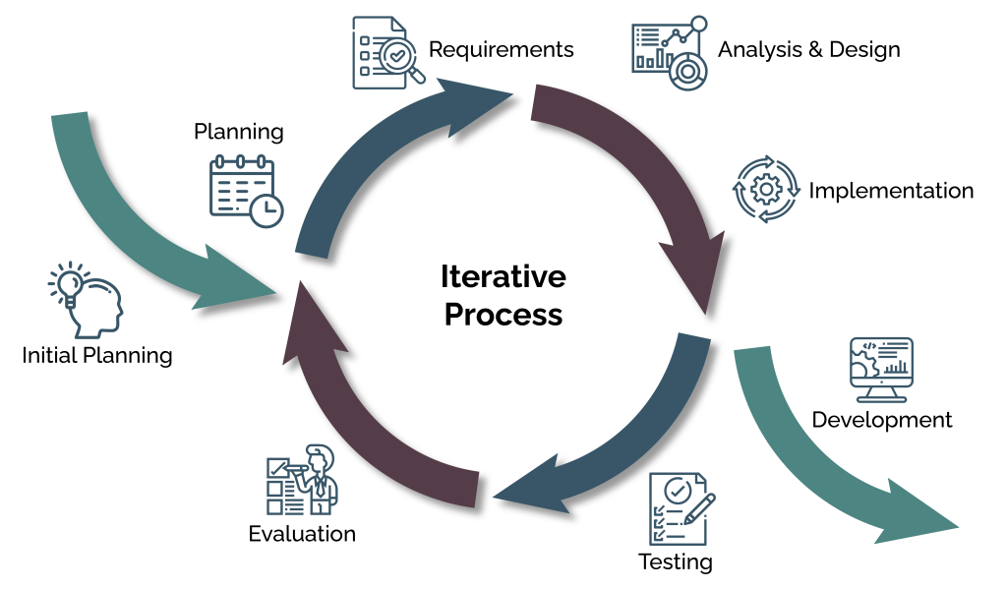
Iterative Model

Slide 10
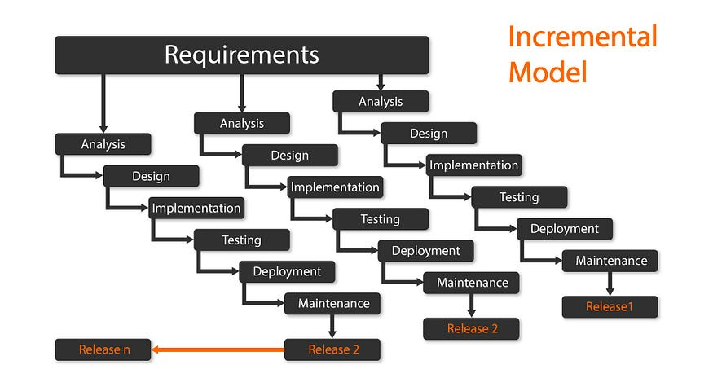

Slide 11
Spiral model
1 Determine objectives
2 Identify and resolve risks
Goals, alternatives and constraints
Prototype or analyse the biggest risks
Risk drives each loop
4 Plan the next loop
3 Develop and test
Review the results and plan ahead
Build and verify this increment

Slide 12
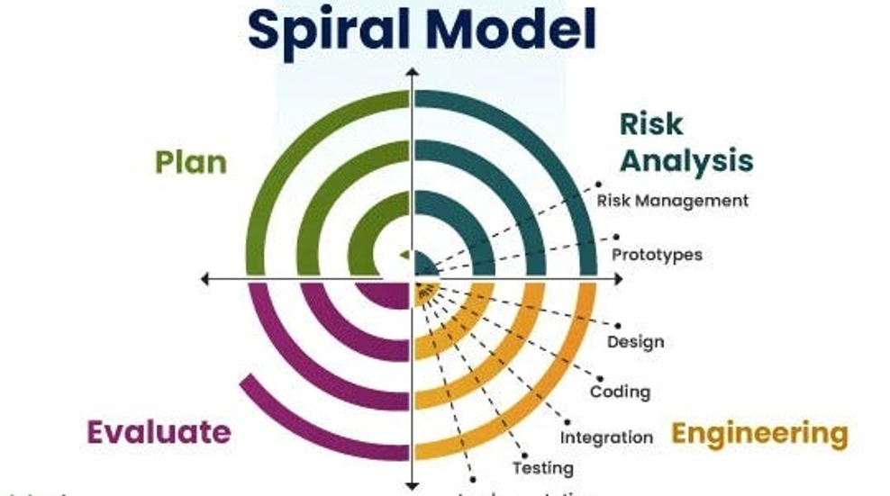

Slide 13
Agile methods
Manifesto, Scrum, Kanban, XP, Lean and DevOps

Slide 14
The Agile Manifesto (2001)
Individuals and interactions
Working software
over processes and tools
over comprehensive documentation
Customer collaboration
Responding to change
over contract negotiation
over following a plan
Seventeen practitioners agreed these four values and twelve supporting principles. The items on the right still matter, the items on the left matter more.

Slide 15
Scrum: the Sprint cycle
Product Backlog
Sprint Planning
Sprint
Sprint Review
Sprint Retrospective
≤ 1 month
15 min
Every Sprint
Sprint length, fixed in advance
Daily Scrum for the Developers
ends with a usable Increment

Slide 16
Scrum: who, when, what
Accountabilities
Events
Artifacts
Product Owner
Scrum Master
Developers
Sprint Planning
Daily Scrum
Sprint Review
Sprint Retrospective
Product Backlog
Sprint Backlog
Increment
One Scrum Team, no sub-teams.
All held inside the Sprint.
Commitments: Product Goal, Sprint Goal, Definition of Done.

Slide 17
Kanban
To do
In progress
Review
Done
Visualise the workflow
Limit work in progress (WIP)
Manage flow and make policies explicit
Improve continuously
WIP limit 2
WIP limit 2
Reports
Search
Login
Signup
Profile
Payment
Help

Slide 18
Extreme Programming (XP)
Pair programming
Test-driven development
Continuous integration
Two developers, one workstation
Write the test, then the code
Merge and build many times a day
Small releases
Refactoring
On-site customer
Ship working software often
Improve design without changing behaviour
Fast answers about requirements
XP values: communication, simplicity, feedback, courage and respect

Slide 19
Lean and DevOps
Lean software development
DevOps
Eliminate waste
Amplify learning
Decide as late as possible
Deliver as fast as possible
Shared ownership of build and run
Automated build, test and deployment (CI/CD)
Infrastructure as code
Monitoring and fast feedback

Slide 20
Choosing a methodology
Comparison, selection factors and a short activity

Slide 21
Side-by-side comparison
 | Waterfall | Spiral | Scrum | Kanban
Requirements | Fixed up front | Evolve, risk-driven | Evolve each Sprint | Evolve continuously
Delivery | One release at the end | Prototype per loop | Increment each Sprint | Continuous flow
Change | Costly | Planned each loop | Welcome between Sprints | Any time, within WIP
Customer | Start and end | Review each loop | Product Owner, daily | On demand
Best for | Stable, regulated work | Large, high-risk projects | Complex, changing products | Support and operations

Slide 22
Selection factors
Favours plan-driven
Favours agile
Requirements
Stable and well understood
Uncertain or changing
Risk
Low and well known
High: new technology or market
Customer
Limited access to users
Available throughout
Regulation
Strict audit and sign-off
Light-touch
Team
Large or contract-based
Small, self-organising
Hybrid is common: agile delivery inside plan-driven governance.

Slide 23
Activity: pick a methodology
A
B
C
Firmware for a hospital infusion pump. The regulator requires full traceability.
A start-up building a consumer app. Nobody knows yet what users will pay for.
A bank support team handling a steady stream of bug fixes and requests.
In pairs (5 min): choose a methodology for each case, and name one risk of your choice

Slide 24
Key takeaways
1
There is no single best methodology: fit the process to the context
2
Plan-driven models suit stable, regulated work; agile suits uncertainty
3
Spiral adds risk management; Scrum, Kanban and XP are different agile tools
4
Hybrid approaches are common in practice

Slide 25
References
Anderson, D. J. (2010). Kanban: Successful evolutionary change for your technology business. Blue Hole Press.
Beck, K. (1999). Extreme programming explained: Embrace change. Addison-Wesley.
Beck, K., et al. (2001). Manifesto for agile software development. agilemanifesto.org
Boehm, B. W. (1988). A spiral model of software development and enhancement. IEEE Computer, 21(5), 61-72.
Poppendieck, M., & Poppendieck, T. (2003). Lean software development: An agile toolkit. Addison-Wesley.
Royce, W. W. (1970). Managing the development of large software systems. Proceedings of IEEE WESCON, 1-9.
Schwaber, K., & Sutherland, J. (2020). The Scrum Guide. scrumguides.org
Sommerville, I. (2016). Software engineering (10th ed.). Pearson.
Notes:
Reading list for further study.

