Slide 1
From Quantum Gates to Quantum Algorithms
Quantum Algorithms with a Focus on Deutsch’s Algorithm

Slide 2
From Quantum Building Blocks to a Complete Algorithm
So far, we have learned the language of quantum computation.
So far, we have learned:
Today:
Combine these ideas into our first complete quantum algorithm.
Qubits and superposition
Tensor products
Quantum gates
Hadamard gate
Qubits
Gates
Interference
Measurement
CNOT and controlled operations
Measurement
q₀
H
⌁
Global and relative phase
q₁
+
⌁
Key question: How do simple operations create an algorithm?
2

Slide 3
Learning Objectives
By the end of this session, students should be able to:
DEUTSCH
1
Explain the Deutsch problem.
6
Explain phase kickback.
2
Define constant and balanced Boolean functions.
Explain the role of interference.
7
3
Explain what a quantum oracle is.
8
Implement and simulate Deutsch's algorithm in Qiskit.
4
Construct $U_{f}$
9
Compare classical and quantum query complexity.
5
Follow the quantum state through the Deutsch circuit.
From problem definition to quantum implementation: understand, derive, simulate, and compare.
2

Slide 4
What Is a Quantum Algorithm?
Yanofsky & Mannucci give the basic pattern:
Classical
initial state
Superposition
Unitary
operations
Measurement
This pattern appears repeatedly in:
Deutsch
Deutsch–Jozsa
Simon
Grover
Shor
Key idea
A quantum algorithm is not simply classical computation performed on qubits.
It deliberately manipulates amplitudes and phases so that interference reveals useful information.
3

Slide 5
Deutsch's Problem
A deceptively simple question with a quantum advantage.
Consider a Boolean function
We cannot inspect the
internal definition of f
f : {0, 1} → {0, 1}
The function accepts one bit and returns one bit.
BLACK BOX
Our task
We access f only through queries.
CONSTANT
BALANCED
f(0) = f(1)
f(0) ≠ f(1)
This is precisely the problem introduced in §6.1
4

Slide 6
The Four Possible Functions
For a one-bit Boolean function, the possibilities are completely determined by f(0) and f(1).
Function
f(0)
f(1)
Type
Classify by comparing outputs
f₀
0
0
Constant
Constant
f(0) = f(1)
f₁
0
1
Balanced
f₂
1
0
Balanced
Balanced
f(0) ≠ f(1)
f₃
1
1
Constant
Exactly two of the four functions are constant, and two are balanced.
5

Slide 7
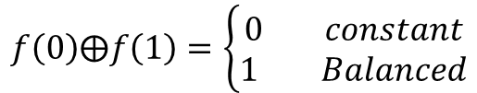
Important: What Are We Trying to Learn?
Deutsch's algorithm targets a global property—not individual outputs.
Not the individual values
The global property we want
f(0)
f(1)
f(0) ⊕ f(1)
Because:
$$f\left(0\right)⨁f\left(1\right)=\left\{\begin{aligned}0 constant \\ 1 Balanced\end{aligned}\right.$$
This distinction is central to understanding Deutsch's algorithm.
6

Slide 8
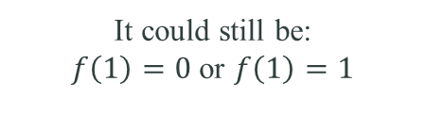

Classical Approach
A black-box function requires enough queries to determine its global behavior.
Suppose $f$ is a black box.
Can we decide yet?
The second query is necessary
First query:
Query f(1)
f(0)
NO
Suppose the result is:
It could still be:
$f\left(1\right)=0$ or $f\left(1\right)=1$
f(1) = 0
f(1) = 1
f(0) = 0
CONSTANT
BALANCED
Yanofsky's decision tree requires two evaluations.
7

Slide 9
Classical Query Complexity
How many times must we call the black-box function?
Classically
Quantum mechanically
2 evaluations
1 oracle evaluation
deterministic setting
advantage
Deutsch’s algorithm
Important terminology
Query complexity
= number of calls to the black-box function
Deutsch's algorithm demonstrates a quantum advantage in query complexity.
8

Slide 10
MAKING A CLASSICAL FUNCTION QUANTUM
Why Can't We Simply Use $f(x)$?
Quantum mechanics requires transformations that preserve information.
Quantum evolution must be:
But an ordinary function may lose information:
UNITARY
preserves inner products
0
0
f
Two inputs → one output
REVERSIBLE
preserves information
1
0
0 → 0 and 1 → 0 is irreversible
Therefore, we need a reversible quantum representation of f.
9

Slide 11
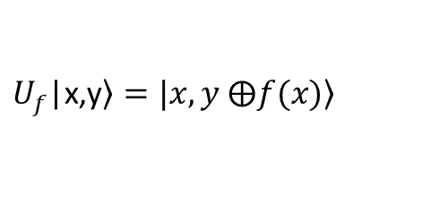

MAKING A CLASSICAL FUNCTION QUANTUM
The Quantum Oracle
A reversible way to embed a classical function into a quantum circuit.
Introduce a second qubit y.
|x, y⟩
$$U_{f}$$
|x, y ⊕ f(x)⟩
where ⊕ means XOR.
$U_{f}$|$\left.\text{x,y}\right\rangle =|\left.x,y ⨁f(x)\right\rangle$
First qubit x
is preserved
Second qubit y
becomes y ⊕ f(x)
This makes the computation reversible.
10

Slide 12
MAKING A CLASSICAL FUNCTION QUANTUM
Understanding the Oracle
The oracle either leaves the target qubit unchanged or flips it.
Case 1: f(x) = 0
Case 2: f(x) = 1
y ⊕ 0 = y
y ⊕ 1 = ȳ
|x, y⟩ → |x, y⟩
|x, y⟩ → |x, ȳ⟩
No change
Second qubit flips
Therefore, U_f behaves like:
Apply X to the second qubit
when
f(x) = 1
otherwise, do nothing.
11

Slide 13
What Gates Can Represent the Four Oracles?
Each Boolean function corresponds to a different reversible oracle circuit.
Function
f(x)
Oracle behavior
constant 0
0
I
constant 1
1
X on y
balanced
x
CNOT
balanced
1 ⊕ x
CNOT + X
Important
CNOT is one possible oracle:
Deutsch's algorithm is not a CNOT gate.
f(x) = x
Algorithm = preparation + Hadamards + oracle + interference + measurement
12

Slide 14
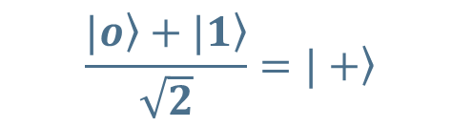
WHY SUPERPOSITION ALONE IS NOT ENOUGH
First Quantum Idea: Superposition
Create both computational paths—but learn why that is only the beginning.
Prepare
Apply H
Superposition
$$\frac{\left.|o\right\rangle +\left.|1\right\rangle }{\sqrt{2}}=\left.|+\right\rangle$$
|0⟩
H
The first qubit now contains:
But superposition alone is not enough.
input path |0⟩
The two computational paths must interact
so that interference can reveal information.
input path |1⟩
Key transition: superposition → interference
13

Slide 15
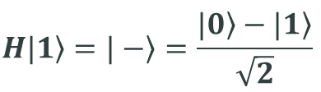

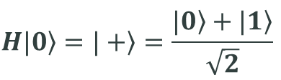
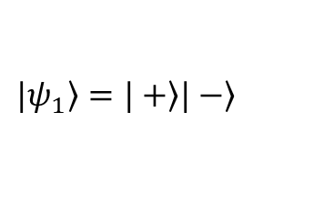
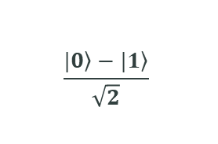
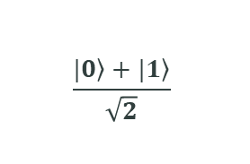
PHASE KICKBACK
Preparing the Second Qubit
Deutsch’s algorithm begins with a carefully chosen two-qubit state.
Initial state
First qubit
Second qubit
|0⟩ |1⟩
$$H\left.|0\right\rangle =\left.|+\right\rangle =\frac{\left.|0\right\rangle +\left.|1\right\rangle }{\sqrt{2}}$$
$$H\left.|1\right\rangle =\left.|−\right\rangle =\frac{\left.|0\right\rangle −\left.|1\right\rangle }{\sqrt{2}}$$
The two eigenstates are:
$$\frac{\left.|0\right\rangle +\left.|1\right\rangle }{\sqrt{2}}$$
$$\frac{\left.|0\right\rangle −\left.|1\right\rangle }{\sqrt{2}}$$
Therefore:
|+⟩
|−⟩
$$\left.|ψ_{1}\right\rangle =\left.|+\right\rangle \left.|−\right\rangle$$
$$\left.|ψ_{1}\right\rangle =\frac{\left.|0\right\rangle +\left.|1\right\rangle }{\sqrt{2}}⊗\frac{\left.|0\right\rangle −\left.|1\right\rangle }{\sqrt{2}}$$
14

Slide 16



PHASE KICKBACK
Why Prepare the Ancilla as |−⟩?
The |−⟩ state turns a bit flip into a measurable phase change.
Start
Apply X
Factor out −1
$$\left.|−\right\rangle =\frac{\left.|0\right\rangle −\left.|1\right\rangle }{\sqrt{2}}$$
$$X\left.|−\right\rangle =\frac{\left.|1\right\rangle −\left.|0\right\rangle }{\sqrt{2}}$$
$$X\left.|−\right\rangle =−\frac{\left.|0\right\rangle −\left.|1\right\rangle }{\sqrt{2}}$$
Therefore:
|−⟩ is an eigenstate of X
X|−⟩ = −|−⟩
eigenvalue = −1
This sign change is the mechanism behind phase kickback.
15

Slide 17


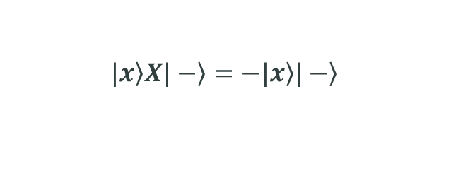
PHASE KICKBACK
Phase Kickback
The oracle converts the function value into a phase on the input qubit.
$$U_{f}\left.|x\right\rangle \left.|−\right\rangle$$
If f(x) = 0
If f(x) = 1
No X is applied
Apply X to ancilla
$$\left.|x\right\rangle \left.|−\right\rangle$$
$$\left.|x\right\rangle X\left.|−\right\rangle =−\left.|x\right\rangle \left.|−\right\rangle$$
$$U_{f}\left.|x\right\rangle \left.|−\right\rangle ={(−1)}^{f(x)}\left.|x\right\rangle \left.|−\right\rangle$$
The function value has become a phase — the essential phase-kickback mechanism.
16

Slide 18

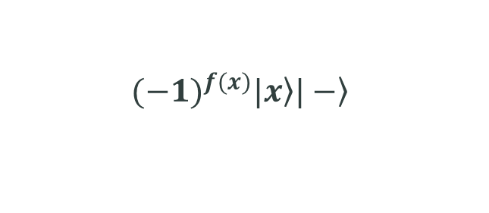
PHASE KICKBACK
What Has Actually Been Kicked Back?
The ancilla stays fixed while the phase moves onto the query register.
Before oracle
After oracle
|x⟩ |−⟩
$${(−1)}^{f(x)}\left.|x\right\rangle \left.|−\right\rangle$$
Ancilla remains
Query register receives
|−⟩
$${(−1)}^{f(x)}$$
Information about $f(x)$ is encoded in the relative phases of the query register.
That is why it is called: phase kickback
17

Slide 19

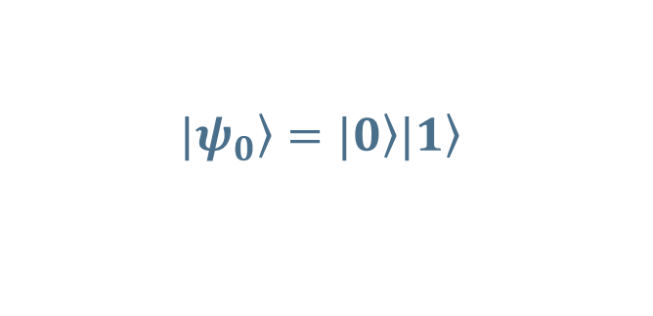
FULL MATHEMATICAL DERIVATION
Step 1: Initial State
Initialize the two-qubit system before applying the Hadamards.
Vector form:
Initialize:
$$\left.|01\right\rangle =\left[\begin{aligned}0 \\ 1 \\ 0 \\ 0\end{aligned}\right]$$
$$\left.|ψ_{0}\right\rangle =\left.|0\right\rangle \left.|1\right\rangle$$
Apply Hadamards:
Prepare the algorithm
H ⊗ H
H ⊗ H applied to |01⟩
18

Slide 20
FULL MATHEMATICAL DERIVATION
Step 2: Create Superposition
The Hadamard create two input paths and a phase-sensitive ancilla.
$$\left.|ψ_{1}\right\rangle =\frac{\left.|0\right\rangle +\left.|1\right\rangle }{\sqrt{2}}⨂\frac{\left.|0\right\rangle −\left.|1\right\rangle }{\sqrt{2}}$$
Expand:
$$\left.|ψ_{1}\right\rangle =\frac{1}{2}\left(\left.|00\right\rangle −\left.|01\right\rangle +\left.|10\right\rangle −\left.|11\right\rangle \right)$$
Input register
Ancilla register
|0⟩ and |1⟩ both present
Relative minus signs encode phase
Now the oracle is called once.
19

Slide 21


FULL MATHEMATICAL DERIVATION
Step 3: Apply $U_{f}$
Phase kickback transfers the function values onto the query register.
$$\left.|ψ_{2}\right\rangle =\frac{{(−1)}^{f(0)}\left.|0\right\rangle +{(−1)}^{f(1)}\left.|1\right\rangle }{\sqrt{2}}⊗\left.|−\right\rangle$$
The key phase factors are:
For input 0
For input 1
$${(−1)}^{f(0)}$$
$${(−1)}^{f(1)}$$
The answer is encoded in the relationship between these two phases.
20

Slide 22

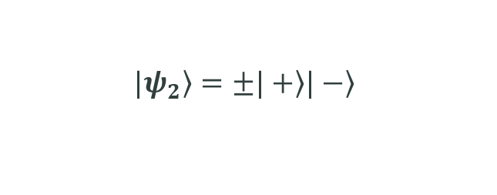
FULL MATHEMATICAL DERIVATION
Constant Function
Equal function values produce equal phases—only a global sign remains.
If $f\left(0\right)=f(1)$, then the two signs are equal.
First qubit
After oracle
$$\frac{\left.|0\right\rangle +\left.|1\right\rangle }{\sqrt{2}}=\left.|+\right\rangle$$
$$\left.|ψ_{2}\right\rangle =±\left.|+\right\rangle \left.|−\right\rangle$$
Apply H: H|+⟩ = |0⟩
Constant → 0
The overall ± sign is a global phase and does not affect the measurement.
21

Slide 23

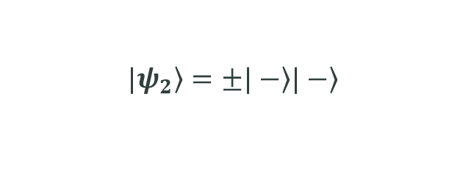
FULL MATHEMATICAL DERIVATION
Balanced Function
Opposite function values produce opposite phases.
If $f(0)≠f(1)$, then the two signs are opposite.
First qubit
After oracle
$$\frac{\left.|0\right\rangle −\left.|1\right\rangle }{\sqrt{2}}=\left.|−\right\rangle$$
$$\left.|ψ_{2}\right\rangle =±\left.|−\right\rangle \left.|−\right\rangle$$
Apply H: H|−⟩ = |1⟩
Balanced → 1
The final Hadamard separates the two cases: constant → |0⟩, balanced → |1⟩.
22

Slide 24

PART VII · INTERFERENCE
Why Does the Final Hadamard Matter?
The final Hadamard converts hidden relative phase into a measurable probability.
Computational-basis measurement detects |α|² — not the sign of α.
$${\left|\frac{1}{\sqrt{2}}\right|}^{2}={\left|−\frac{1}{\sqrt{2}}\right|}^{2}=\frac{1}{2}$$
Constructive outcome
|+⟩ —H→ |0⟩
Destructive outcome
|−⟩ —H→ |1⟩
Recombining the alternatives makes a global property of $f(x)$ observable.
23

Slide 25

PART VII · INTERFERENCE
The Complete Deutsch Circuit
One oracle call, followed by interference and a single measurement.
q₀
|0⟩
H
H
M
$$U_{f}$$
q₁
|1⟩
H
|01⟩ → (H ⊗ H)|01⟩ → $U_{f}$ → (H ⊗ I) → Measure q₀
q₀ = 0 ⇒ constant
q₀ = 1 ⇒ balanced
24

Slide 26
PART VIII · THE MAIN RESULT
What Does Deutsch's Algorithm Calculate?
One quantum query reveals a global property of the function.
Final first-qubit state: |f(0) ⊕ f(1)⟩
up to an irrelevant global phase
Measurement returns: f(0) ⊕ f(1)
Output 0
Output 1
f(0) = f(1) ⇒ constant
f(0) ≠ f(1) ⇒ balanced
25

Slide 27
PART VIII · THE MAIN RESULT
From Deutsch to Deutsch–Jozsa
The algorithmic pattern scales from one input bit to many.
Superposition → Oracle → Phase kickback → Relative phase → Interference → Measurement
The key lesson is not merely fewer queries—it is how a change of basis changes the question.
Deutsch
Deutsch–Jozsa · Week 8
f : {0,1} → {0,1}
f : {0,1}ⁿ → {0,1}
Deutsch–Jozsa: 1 oracle evaluation vs. classical exact: 2ⁿ⁻¹ + 1 evaluations
26

