Slide 1

Artificial Intelligence
Introduction

Slide 2
Course Contents
Applications
Image Processing
Image Segmentation & Classification
Speech Processing
Pattern Recognition
Text Mining
Bio-metrics
Robotics

Slide 3
Image Processing
Computer Vision: Image processing techniques are used in computer vision to enable machines to "see" and understand the visual world. This includes tasks such as object detection, image segmentation, and face recognition.
Medical Imaging: Image processing is used in medical imaging to analyze medical images such as X-rays, CT scans, and MRI scans. This can include tasks such as identifying tumors, measuring the size of organs, and detecting abnormalities.
Autonomous Systems: Image processing is used in autonomous systems such as self-driving cars and drones to
interpret visual information and make decisions about navigation and control.
Surveillance: Image processing is used in surveillance systems to automatically detect and track people or vehicles.
Robotics: Image processing is used in robotics to enable robots to perceive and understand their environment.
Augmented Reality: Image processing is used in Augmented Reality to process and analyze real-world images and add
virtual elements to them.
Image compression and enhancement: To improve the quality and reduce the size of images for storage and transmission.

Slide 4
Text Mining
Sentiment analysis: Analyzing text data to determine the overall sentiment or emotion expressed, such as positive, negative, or neutral. This can be used to understand customer opinions about a product or service, or to monitor public sentiment about a particular topic.
Topic modeling: Identifying the main topics discussed in a collection of text documents, such as news articles or social media posts. This can be used to understand what people are talking about, or to group similar documents together for further analysis.
Named Entity Recognition (NER): Identifying and extracting specific entities such as people, locations, and organizations from text data. This can be used to create structured data from unstructured text, such as populating a database with information about people and organizations mentioned in news articles.
Text classification: Automatically categorizing text data into predefined categories, such as spam or not spam, or positive or negative sentiment.
Text summarization: Creating a condensed summary of a long text document or multiple documents to quickly understand
the main points.
Text clustering: Grouping text documents based on their similarity, so that similar documents are in the same cluster.
Text generation: Generating new text that is similar in style or content to a given input text.

Slide 5
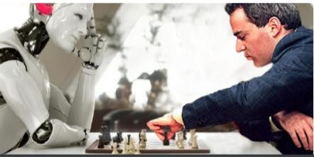
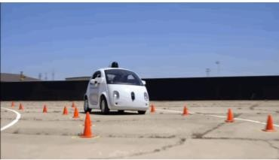
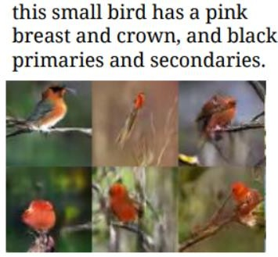
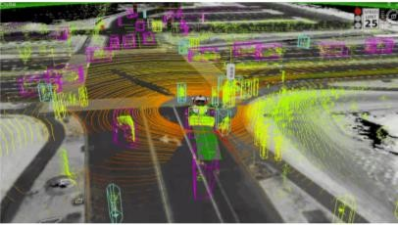
Applications
Drive Car
Play Chess
Text to Image Generation

Slide 6
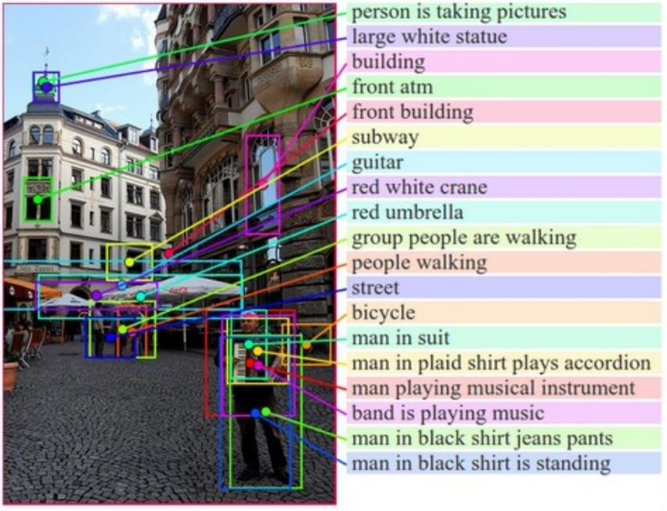
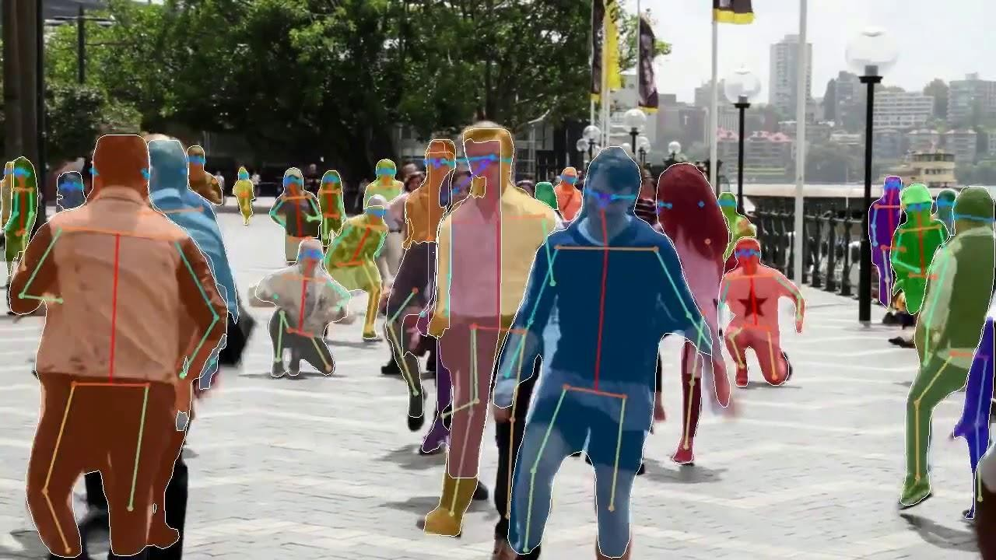

Applications
Image Understanding
Video Games
Video Games
Human Pose Estimation

Slide 7
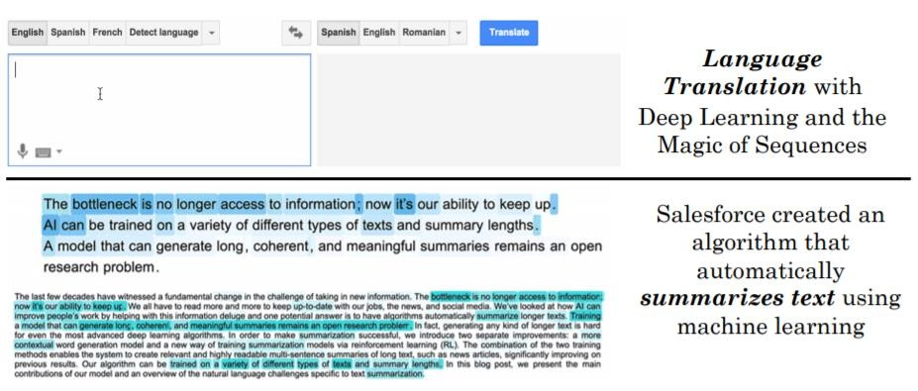

Applications
Text Generation
Recommend Movies
Others:
https://medium.com/@ageitgey/machine-learning-is-fun-part-5-language-translation-with-deep-learning-and-the-magic-of-sequences-2ace0acca0aa

Slide 8
Definition of AI
There are no clear consensus on the definition of AI
Here’s one from John McCarthy, (He coined the phrase AI in 1956) - see http:// www. formal. Stanford. EDU/ jmc/ whatisai/)
Q. What is artificial intelligence?
A. It is the science and engineering of making intelligent machines, especially intelligent computer programs. It is related to the similar task of using computers to understand human intelligence.
Q. Yes, but what is intelligence?
A. Intelligence is the computational part of the ability to achieve goals in the world. Varying kinds and degrees of intelligence occur in people, many animals and some machines.

Slide 9
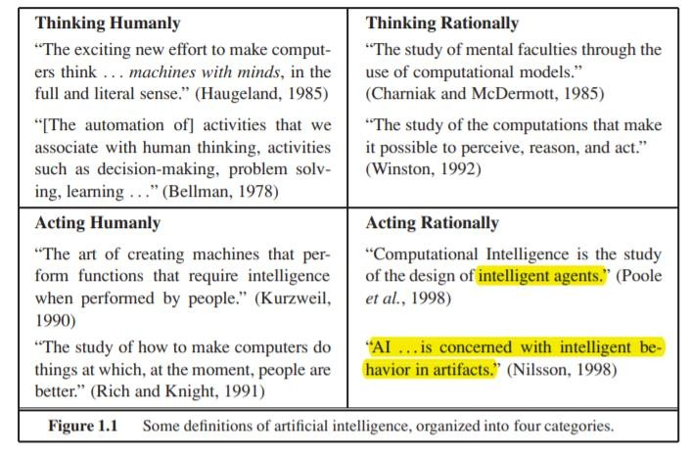
Definition of AI
“The art of creating machines that perform functions that require intelligence when performed by people” (Kurzweil, 1990).
“The branch of computer science that is concerned with the automation of intelligent behavior.” (Luger and Stublefield, 1993)

Slide 10
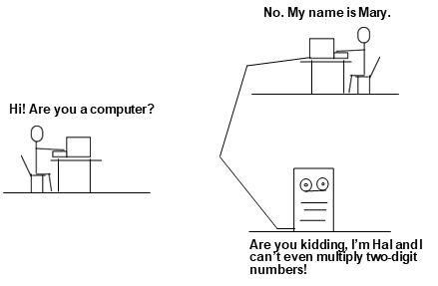
Acting Humanly: Turing Test
If the response of a computer to an unrestricted textual natural- language conversation cannot be distinguished from that of a human being then it can be said to be intelligent.
Computer need following capabilities:
Natural Language Processing
Knowledge Representation
Automated Reasoning
Machine Learning
Loebner Prize: Current contest for restricted form of the Turing test.

Slide 11
Acting Humanly: Turing Test
When we say AI should "act humanly," we mean that AI systems should mimic human behavior and actions. This involves understanding and replicating human gestures, actions, and responses. Examples include:
Speech recognition and synthesis to enable machines to communicate like humans.
Natural language processing to understand and generate human language.
Computer vision to recognize objects, scenes, and people in a similar way to humans.

Slide 12
Thinking Humanly: Cognitive Modeling
This aspect refers to creating AI systems that simulate human cognitive processes and thought patterns. This involves understanding how humans think, reason, learn, and solve problems, and then emulating these processes in machines. Examples include:
Cognitive architectures that model human-like reasoning and decision- making processes.
Emulating human learning mechanisms in machine learning algorithms, like reinforcement learning inspired by behavioral psychology.

Slide 13
Thinking Humanly: Cognitive Modeling
Method must not just exhibit behavior sufficient to fool a human judge but must do it in a way demonstrably analogous to human cognition.
Requires detailed matching of computer behavior and timing to detailed measurements of human subjects gathered in psychological experiments.
Cognitive Science: Interdisciplinary field (AI, psychology, linguistics, philosophy, anthropology) that tries to form computational theories of human cognition.

Slide 14
Acting Rationally:
When we say AI should "act rationally," we mean that AI systems should make decisions based on logical reasoning and optimal strategies. This may lead to decisions that are not necessarily similar to human decisions but are logically sound. Examples include:
Game-playing AI that searches for optimal moves in games like chess and Go.
Automated reasoning systems that prove mathematical theorems or analyze logical arguments.

Slide 15
Acting Rationally: The Rational Agent Approach
Agent
It is just something that acts
Rational Agent
The one that acts as to achieve the best outcome or, when there is uncertainty, the best expected outcome
The rational agent approach is based on the assumption that the agent is rational, meaning it is logical, consistent and unbiased in its decision making

Slide 16
Thinking Rationally: The “law of thought”
approach
This aspect refers to developing AI systems that utilize formal rules of logic to reach conclusions. This involves creating systems that can perform tasks that require formal reasoning and deduction. Examples include:
Expert systems that use rule-based reasoning to diagnose medical conditions or provide legal advice.
Automated theorem proving systems that prove mathematical theorems based on logical principle.

Slide 17
Homework
Readings
CH 1

