Slide 1
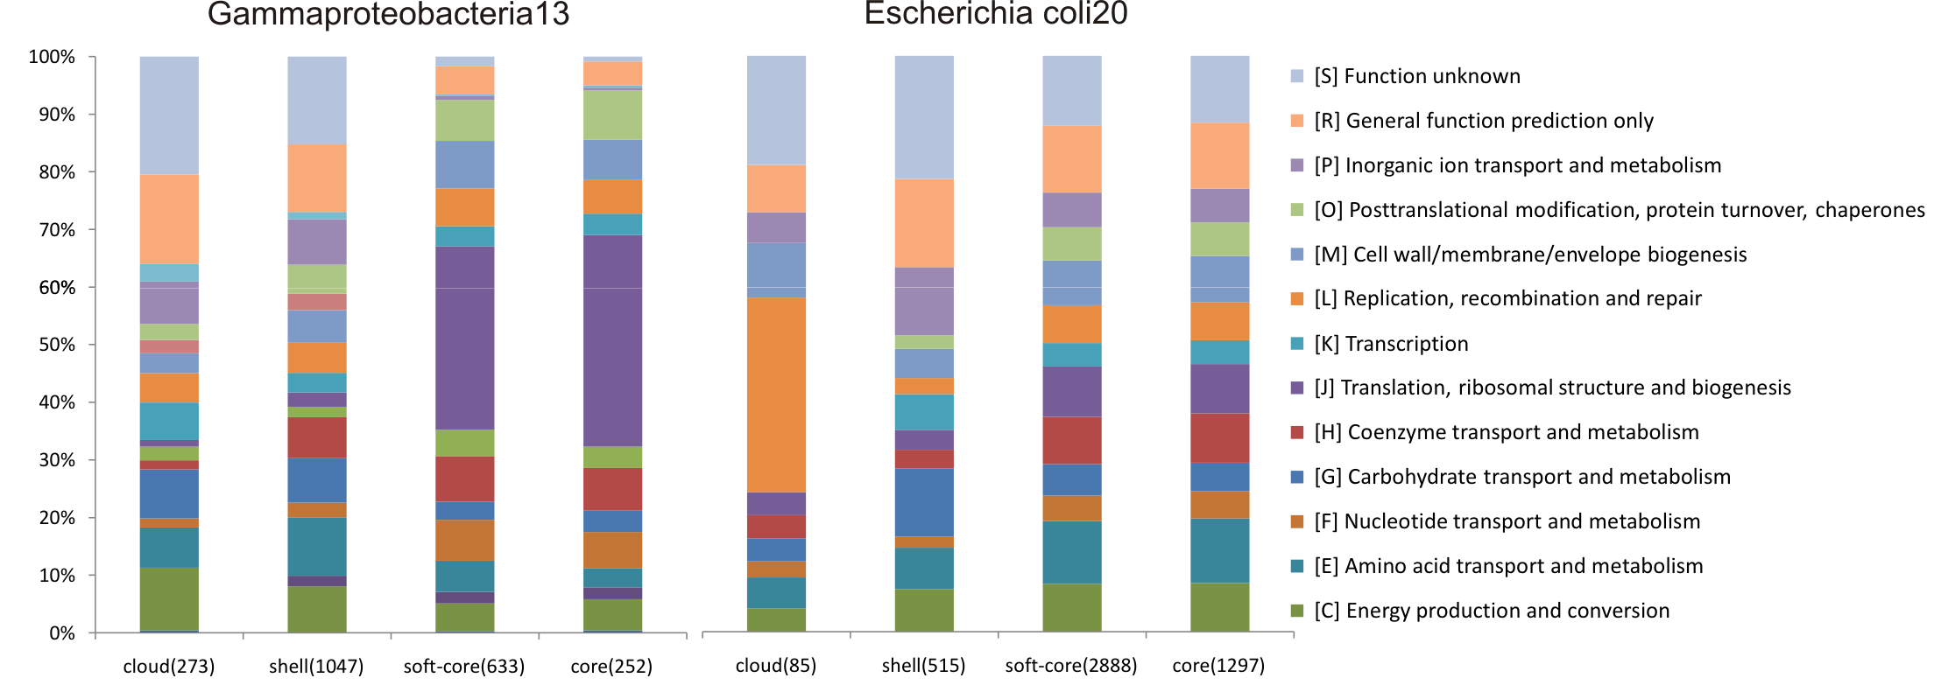
Notes:
There are differences regarding the functional annotations of core and accessory protein sequences.

