Slide 1


电场天线仿真进展
——有效长度的方向
王健、陈悦宁、杨艺飞
2021/1/6

Slide 2
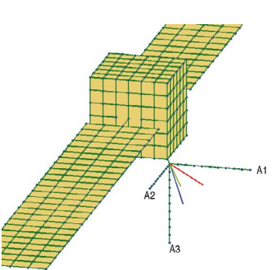
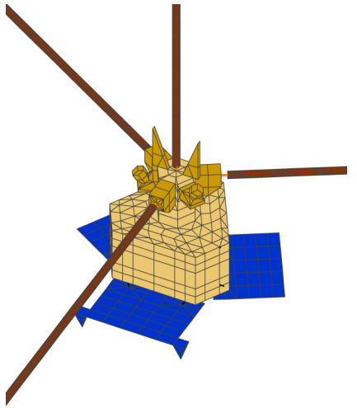
天线仿真建模工具：
①Wire-grid
4NEC2 (graphical user interface for (4) Numerical Electromagnetics Code, version 2)
ASAP (Antenna Scatterers Analysis Program) Fortran Code
②Patch-grid
FEKO (德语FEldberechnung bei Korpern mit beliebiger Oberflache的缩写) 任意复杂电磁场计算
G. Fischer
M.Sampl,2012

Slide 3

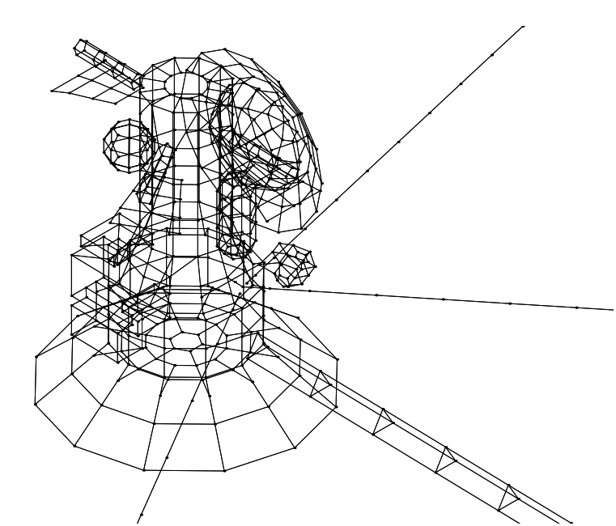
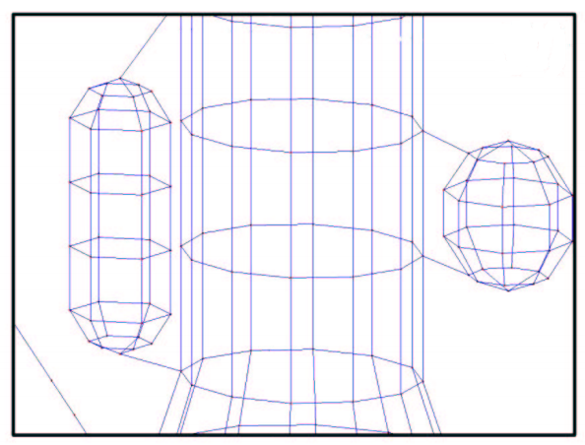
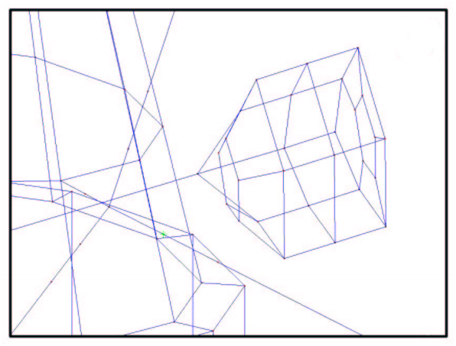
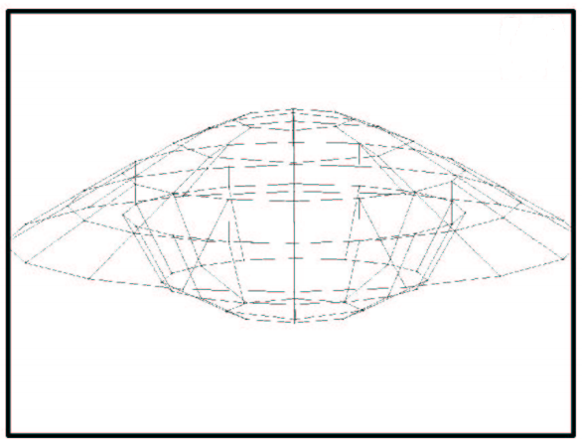
Wire-grid of Cassini spacecraft
● Our antenna is actually emitting radio waves but due to the Reciprocal Theorem we directly get the effective antenna length vectors for a receiving antenna.
● 探究Cassini不同部件及位置对电场天线有效长度的影响。
tanks
Cosmic Dust Analyzer(CDA)
Huygens Probe
G. Fischer

Slide 4
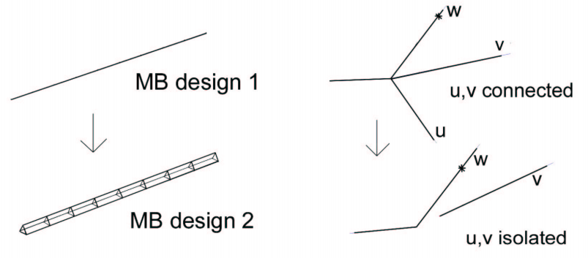
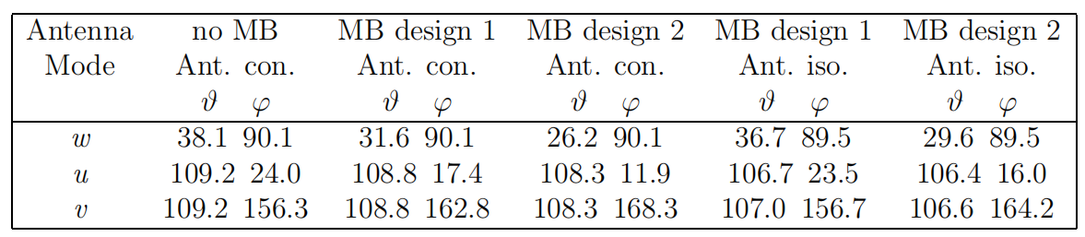
Important wire–grid modifications
● the magnetometer boom (MB)：
a simple line → a more realistic design
● All three RPWS antennas connected → isolate u,v antennas from the spacecraft body.
G. Fischer

Slide 5
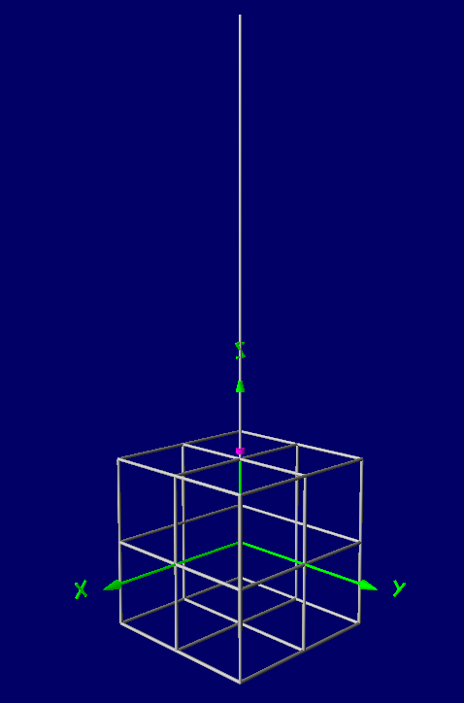
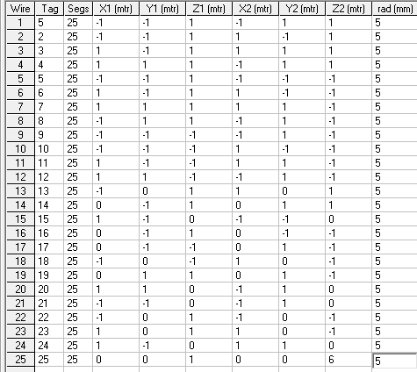
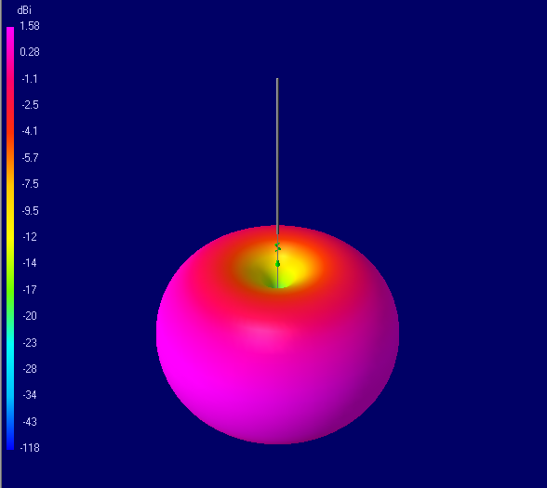
Wire-grid Model1 based on 4NEC2
Spacecraft:2*2*2m
Antenna: l=5m; d=5mm

Slide 6
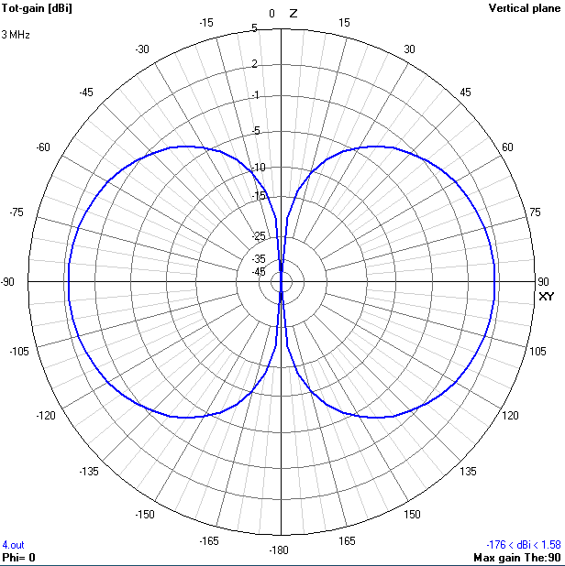
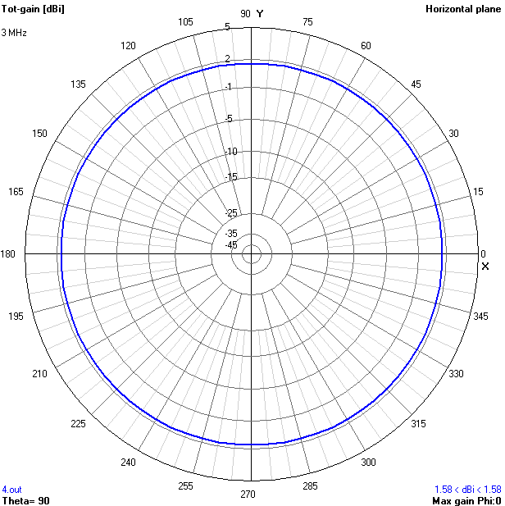
Wire-grid Model1 based on 4NEC2
● The reception properties of short linear antennas can be described by the so-called effective length vector which is pointing along the direction of minimum gain in the toroidal radiation pattern.
Z
Y
XY
X
有效长度的方向没有发生变化。

Slide 7
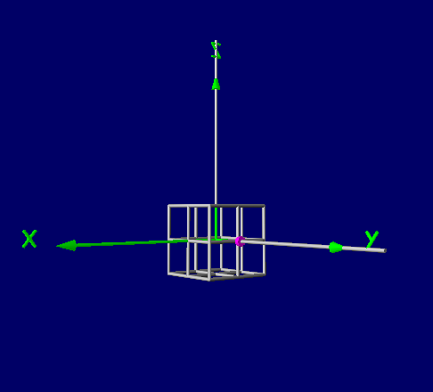
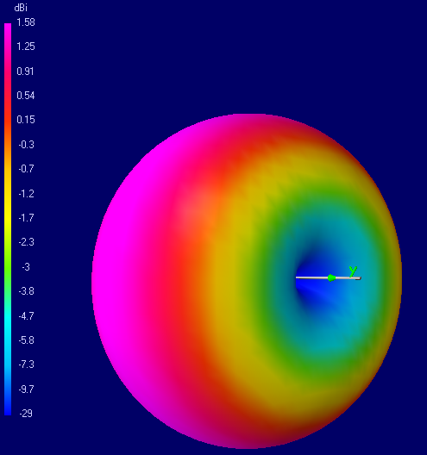
Model 2
Spacecraft:2*2*2m
2 Antennas: l=5m; d=5mm

Slide 8
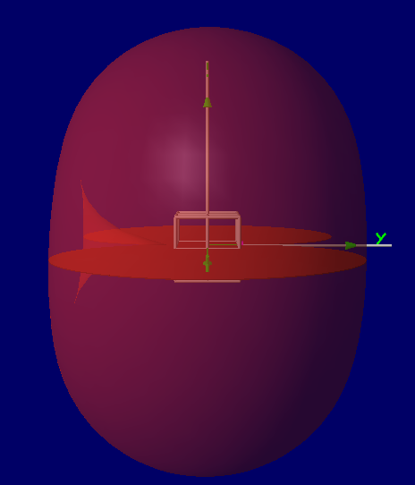
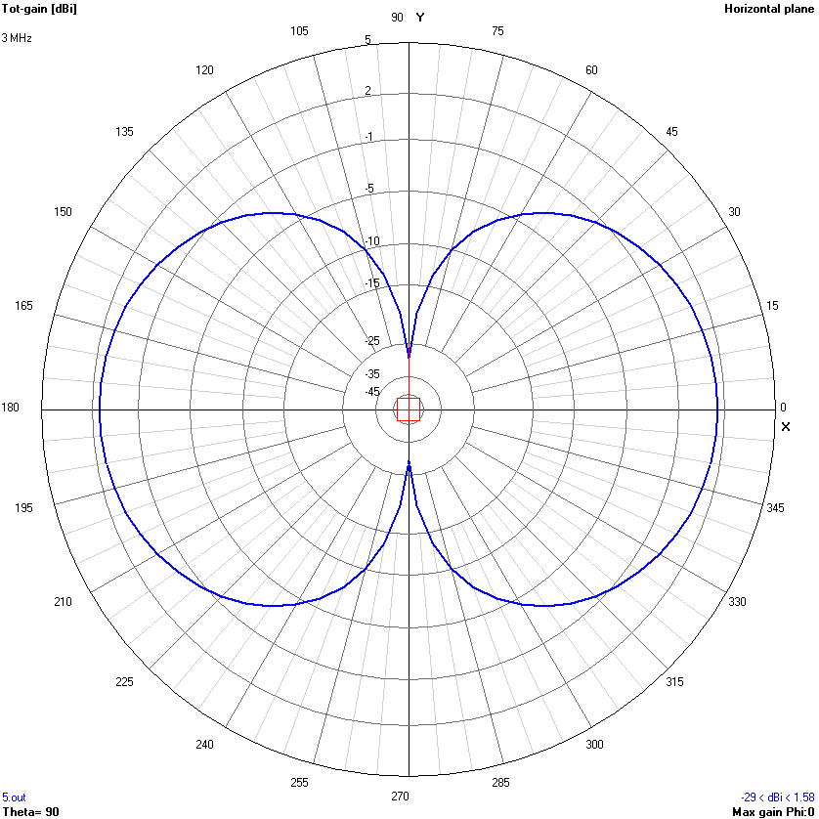
Model 2
水平截面(XY平面)
Y
X
有效长度的方向在水平面(XY平面)上无倾斜

Slide 9
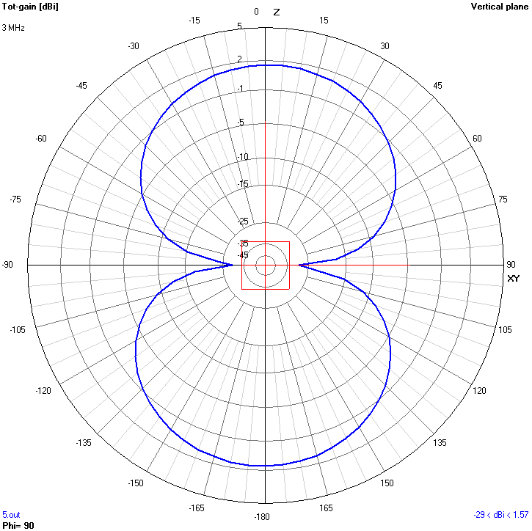
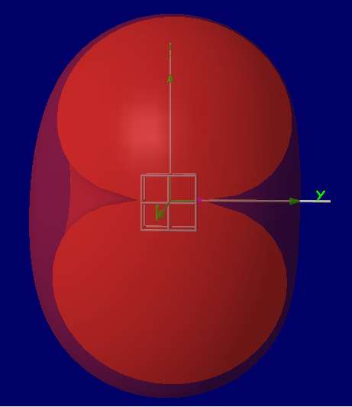
Model 2
竖直截面(YZ平面)
Z
β
XY
有效长度的方向在竖直面(YZ平面)上, 向-Z方向倾斜α°

Slide 10
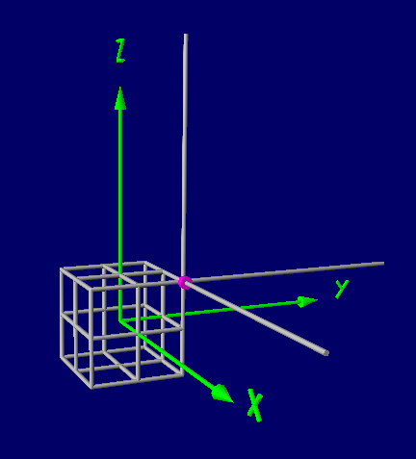
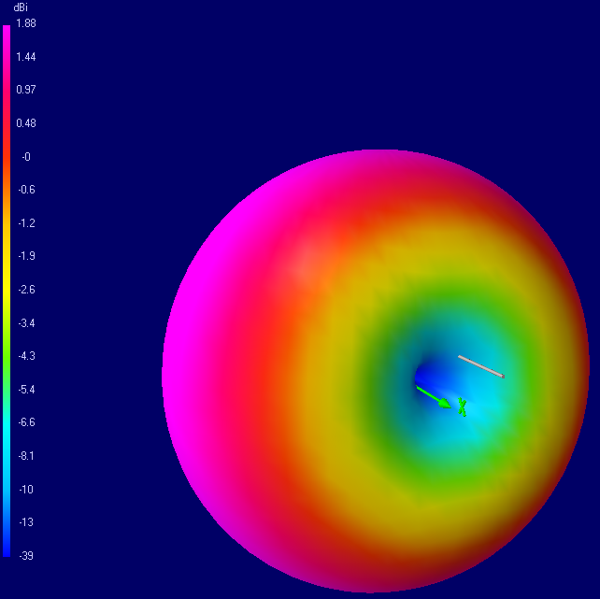
Model 3
Spacecraft:2*2*2m
3 Antennas: l=5m; d=5mm

Slide 11
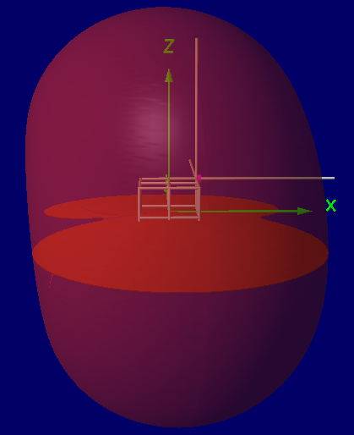
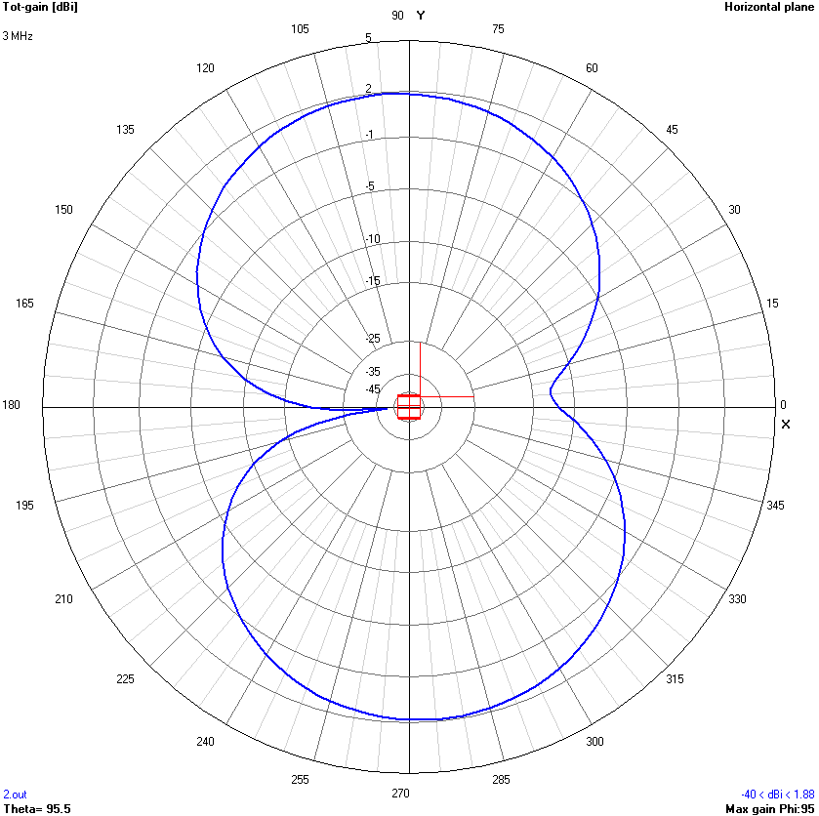
Model 3
水平截面(XY平面)
Y
α
X
有效长度的方向在水平面(XY平面)上向+Y方向上倾斜α°

Slide 12
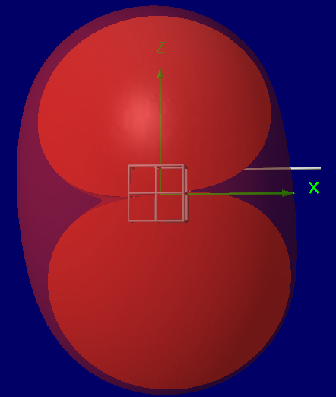
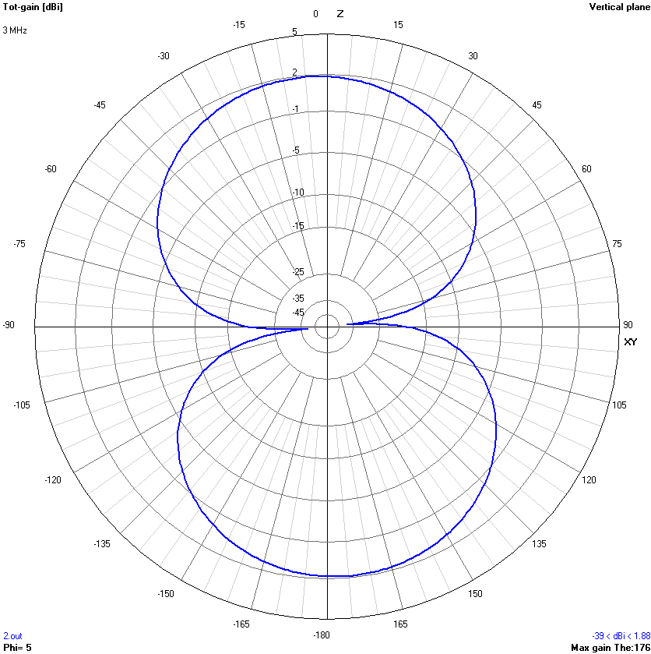
Model 3
竖直截面(YZ平面)
Z
β
XY
有效长度的方向在竖直面(YZ平面)上向+Z方向上倾斜β°

Slide 13
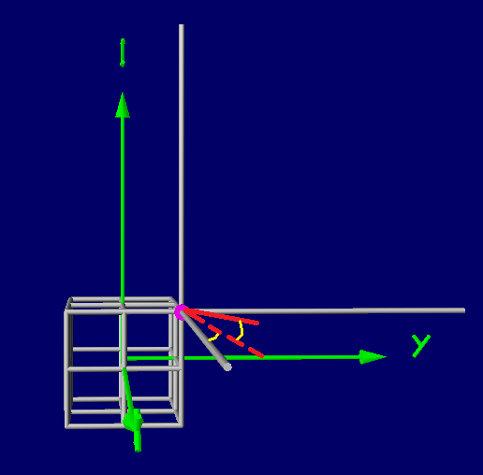
Model 3：the effective length
α
β

Slide 14
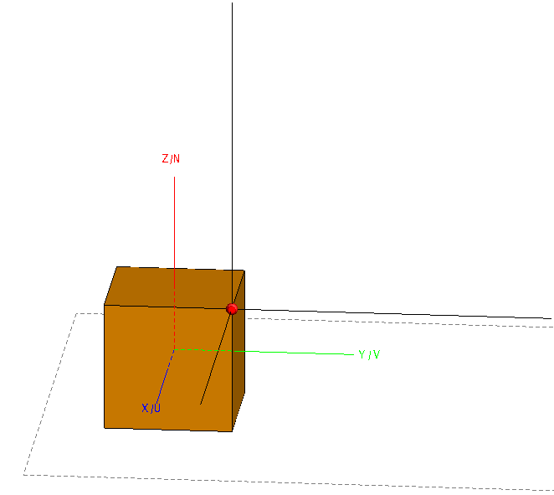
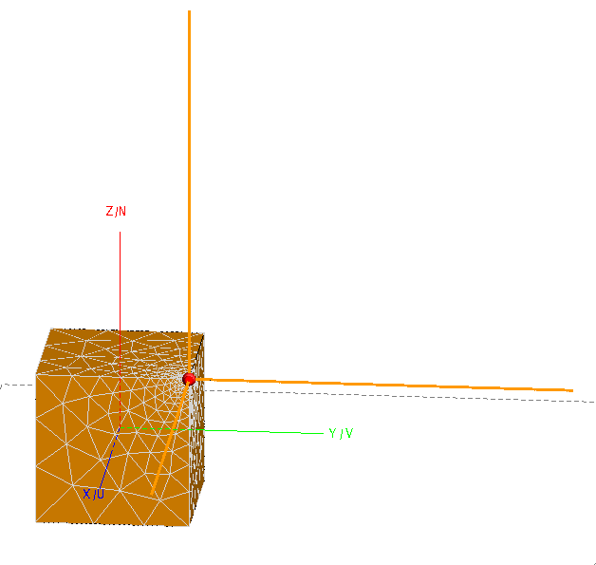
Patch-grid model based on FEKO
● Wire-grid representations of the simulation model are inappropriate, since they result in significant inaccuracies, especially for the small cylindrical sensors.
Spacecraft:2*2*2m
Antenna: l=5m; d=5mm

Slide 15
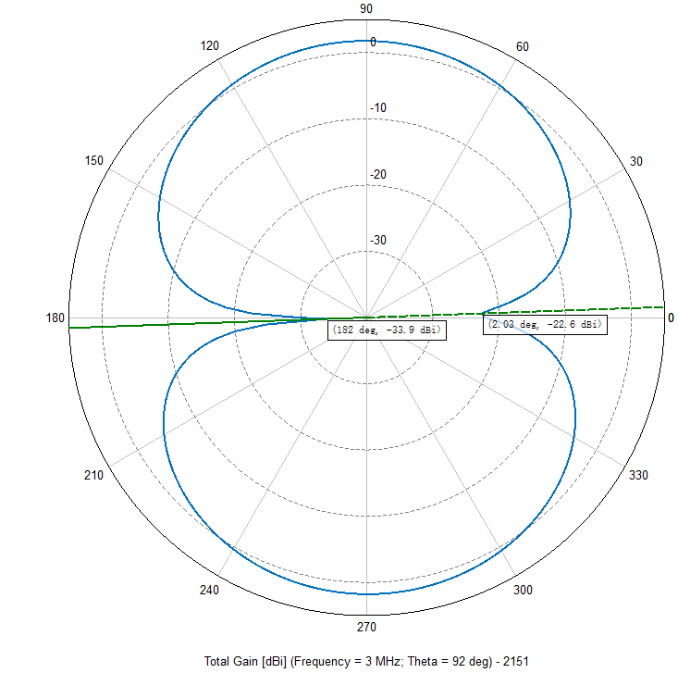
Direction of effective length
水平截面(XY平面)
4NEC2
FEKO
Y
α
X

Slide 16
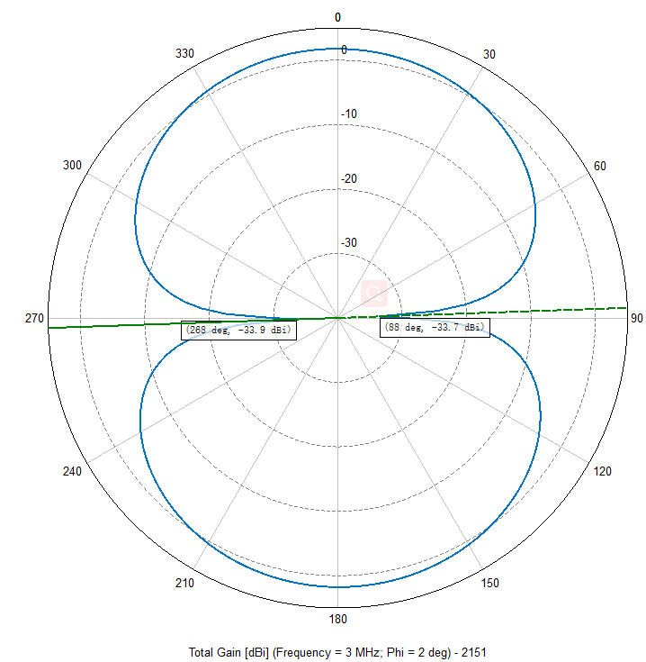
Direction of effective length
4NEC2
竖直截面(YZ平面)
FEKO
Z
β
XY
两个模型的结果有所差异！

Slide 17
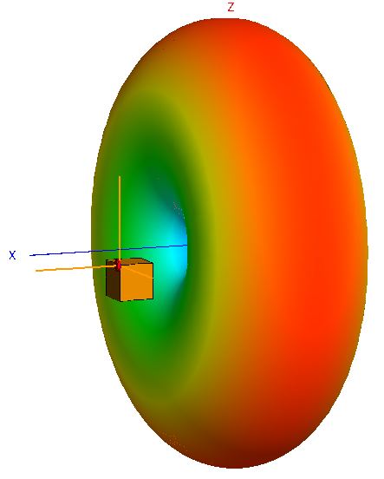
Direction of effective length
疑问：模型的位置不同，辐射图的中心都在坐标原点？？？

Slide 18
Thank You!!!

