Slide 1
电场天线频率响应函数对天线尺寸等参数的依赖 ——由频率范围确定天线最佳长度
张闻雨 刘润逸
2021.3.19

Slide 2
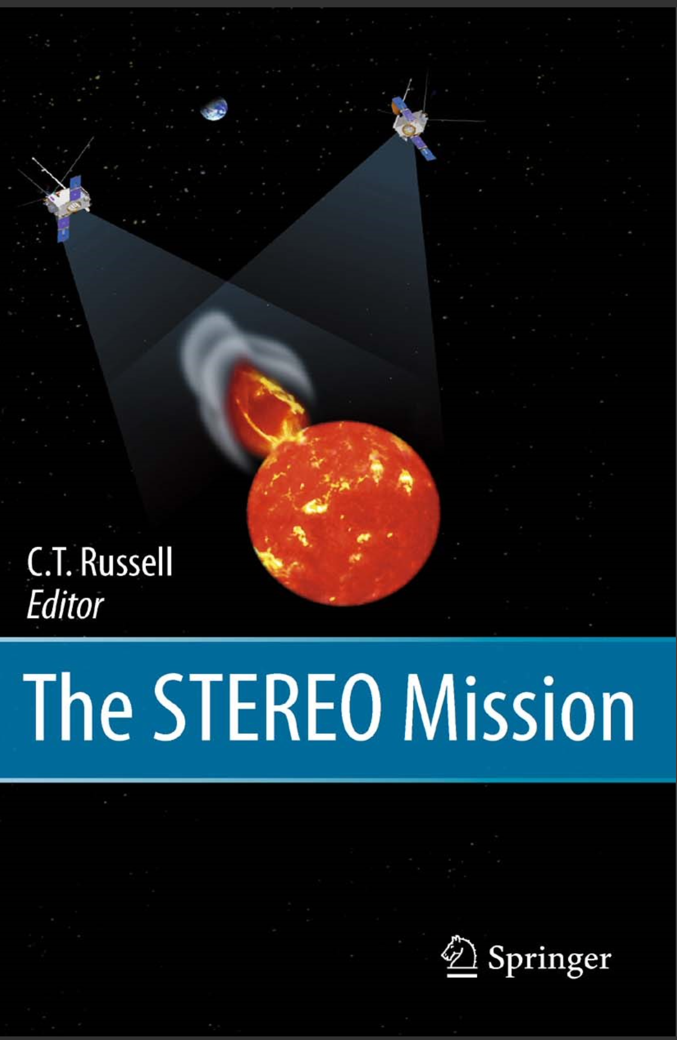
另一篇文章（书）
Bale, S., Ullrich, R., Goetz, K., Alster, N., Cecconi, B., Dekkali, M., Lingner, N., Macher, W., Manning, R., McCauley, J., Monson, S., Oswald, T., and Pulupa, M.: The Electric Antennas for the STEREO/WAVES Experiment, Space Sci. Rev., 136, 529–547, doi:10.1007/s11214-007-9251-x, 2008.

Slide 3
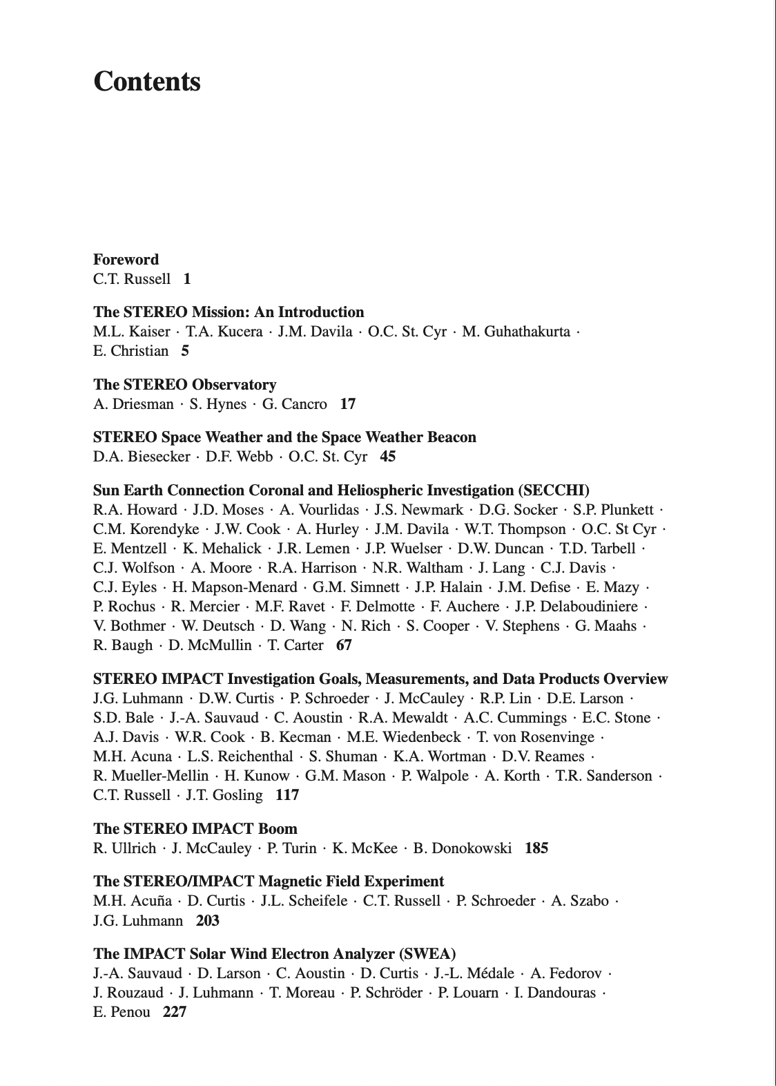
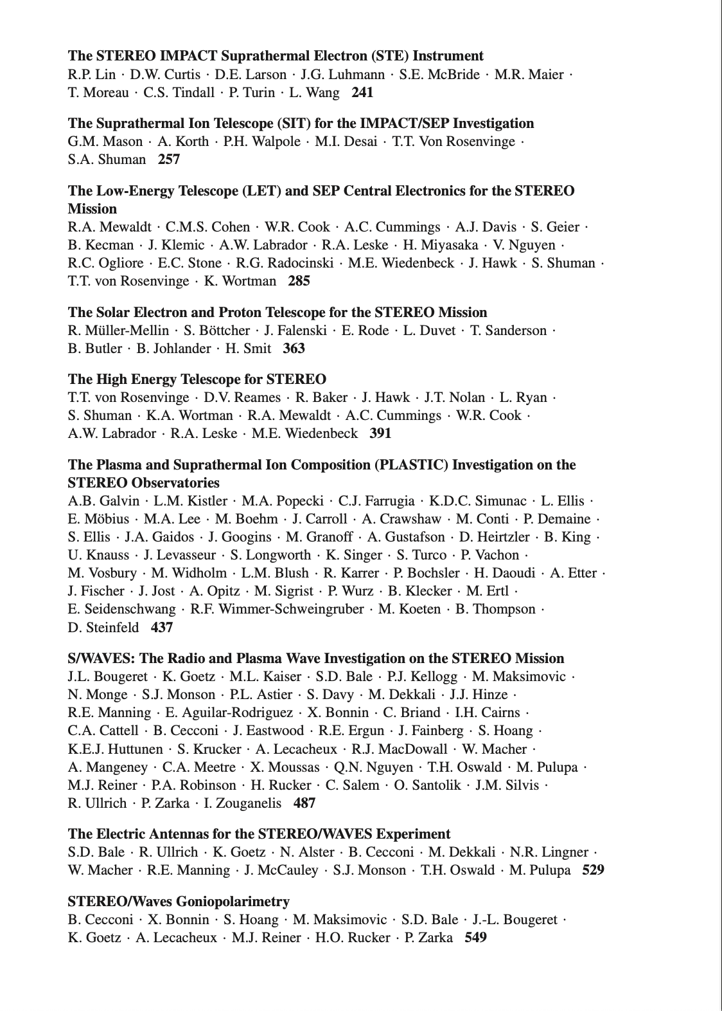
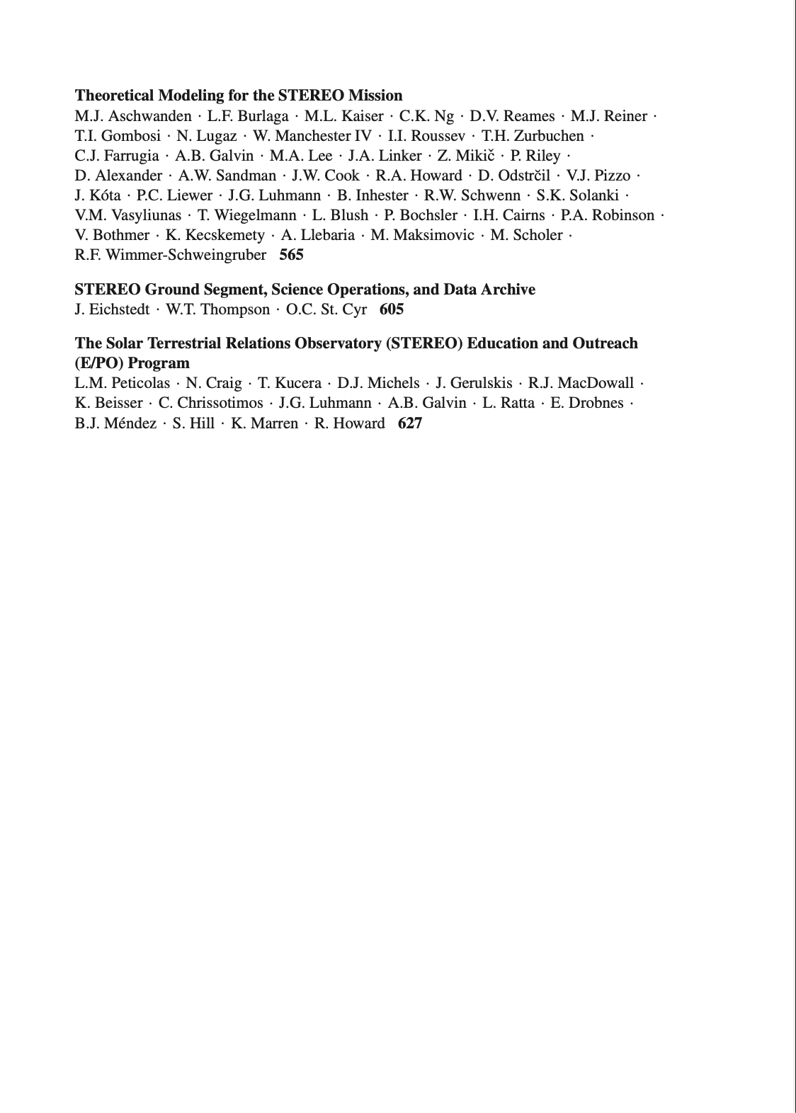

THE STEREO MISSION

Slide 4
STEREO 基本任务
The STEREO mission has as its primary science goal the study of the generation, evolu- tion, and propagation of Coronal Mass Ejections (CMEs).
Another science goal for STEREO/WAVES is the measurement in situ of the plasma waves involved in the plasma radiation process and collisionless shock physics.

Slide 5
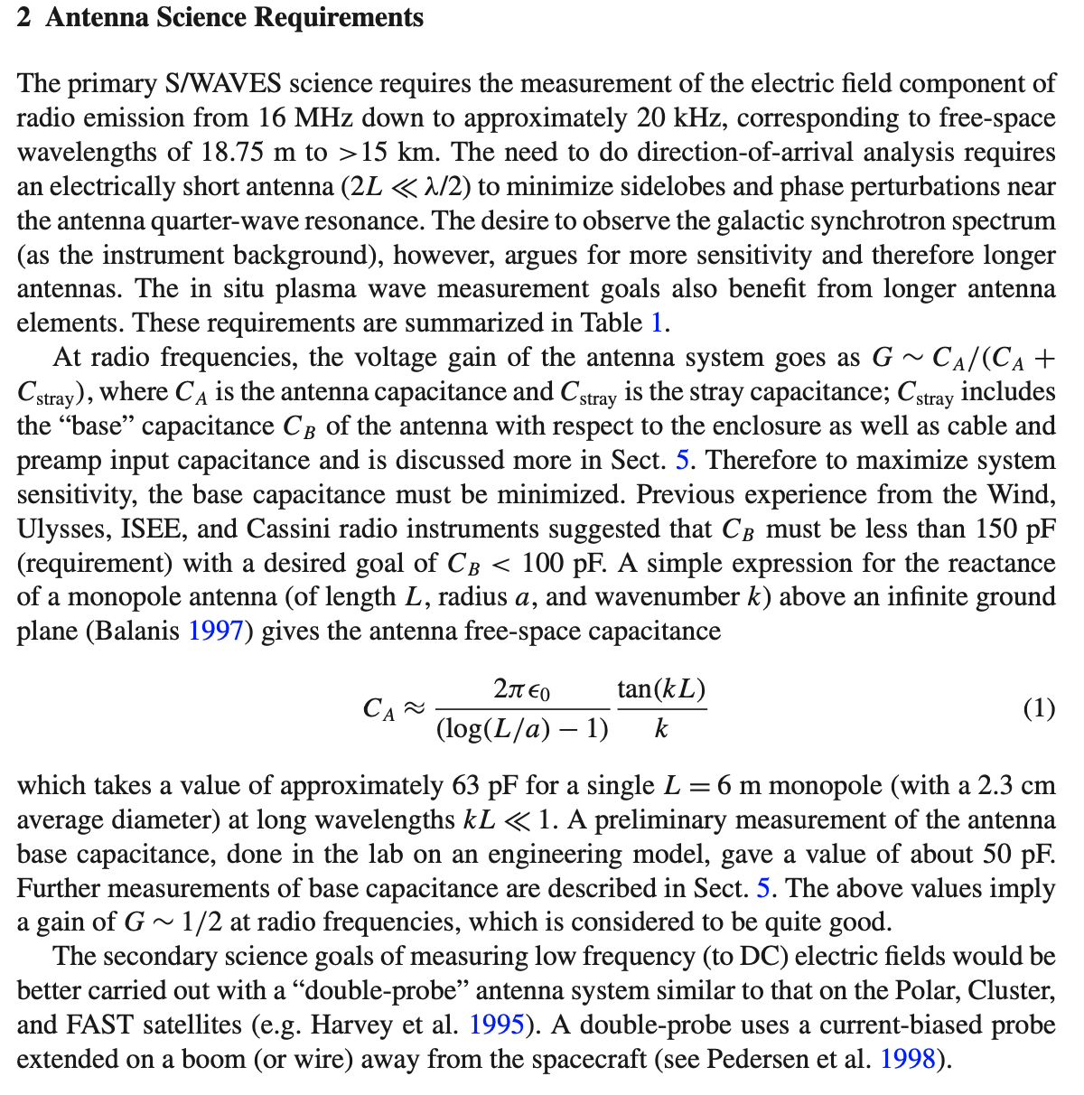
the voltage gain of the antenna system goes as
G ∼ C_{A}/(C_{A} + C_{stray})
C_{A} : the antenna capacitance
C_{stray} : the stray capacitance
1. the “base” capacitance C_{B} of the antenna with respect to the enclosure
2. Cc cable and C_{pa} preamp input capacitance

Slide 6


C_{A}
A simple expression for the reactance of a monopole antenna (of length L, radius a, and wavenumber k) above an infinite ground plane (Balanis 1997) gives the antenna free-space capacitance
C_{A}
$$\frac{\text{2}πεo}{\log\left(\frac{L}{a}\right)−1}∗\frac{tan⁡(kL)}{k}$$
C_{A} 的值取决于信号的波数k（即有关于信号的频率）
同时也取决于天线长度L、天线半径a
$$≈$$

Slide 7
C_{c} C_{pa}
?
Cable and preamp-input capacitance are measured easily in the lab: for S/WAVES, cable capacitance is approximately C_{c} ≈ 13 pF and the measured input capacitance of the preamps is C_{pa} ≈ 22 pF.

Slide 8
C_{B}
The capacitance was measured at the SMA connector on the antenna box using a BK Precision 878 LCR meter (operating at 1 kHz). 天线与基底导体板垂直放置
Following this measurement, the antenna was lowered, 1 m of stacer was cut from the end, the length and diameter were measured, and it was suspended and tested again. This process was repeated until only 14 cm of the stacer antenna extended beyond the base of the deployment unit.

Slide 9
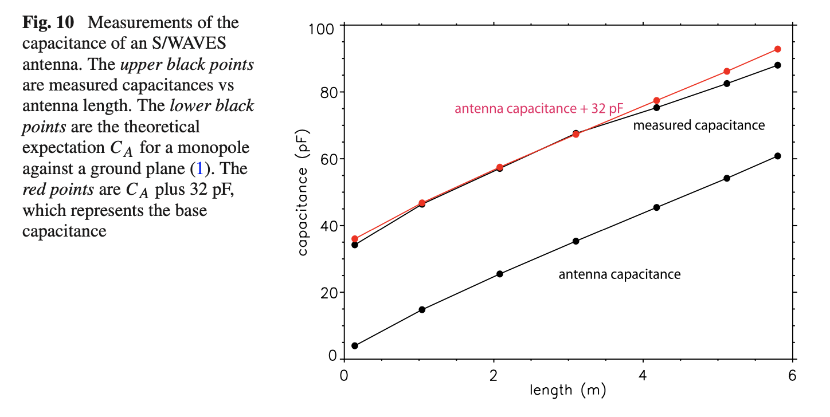
C_{B}

Slide 10
G
These measurements suggest a value of C_{B} ≈ 32 pF for the base capacitance. C_{A} takes a value of approximately 63 pF for a single L = 6 m monopole (with a 2.3 cm average diameter) at long wavelengths kL ≪ 1. Then the total stray capacitance of an antenna unit is :
C_{stray} ≈ C_{B} + C_{c} + C_{pa} ≈ 32 pF + 13 pF + 22 pF = 67 pF
which gives an antenna gain of approximately :
G ≈ C_{A}/(C_{A} + C_{stray}) ≈ 1/2. which is considered to be quite good.

Slide 11
Next mission
Figure out how to measure C_{B} C_{c} C_{pa} in the lab
?

