Slide 1

HPCC Hack Challenge March 2024
12/03/24 -13/03/24
Avinash Anish

Slide 2

TEAM INTRODUCTION
Avinash Anish
1st Semester,
Computer Science - Cybersecurity
RVCE

Slide 3

INTRODUCTION
Safe Haven
Many travelers find themselves on occasion in a strange land and a strange city, sometimes without their control.
Without knowing the risks and dangers in that area, sometimes a tourist can suddenly be in a dangerous situation.
What can we do as developers to help prevent this?
This year’s challenge will analyze different social factors by area such as poverty, unemployment, and many other factors to assess the risk for the traveler in a strange land and find a safe haven
The goal of the challenge is to answer two questions:
1. Analysis of social factors in an area (unemployment, education, poverty, and population) and identify it as a "Hot Spot".
2. Provide additional information to the traveler to help find “safe haven” resources in their area (fire and police stations, hospitals, churches, food banks, etc.)
City and County Data has been collected from all 50 US states. In addition, many public datasets have also been gathered and cleaned.

Slide 4
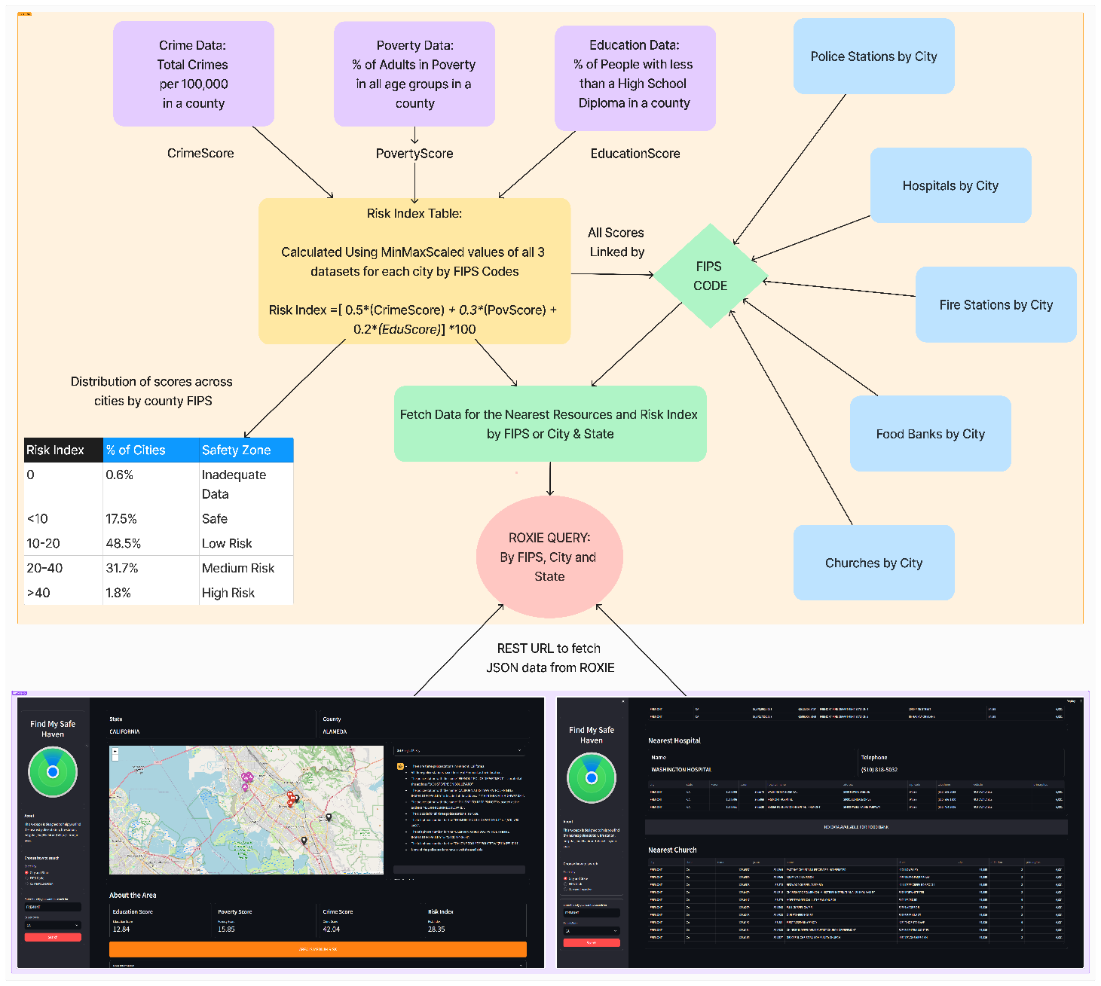
APPROACH
Calculated a Risk Index Score for each city by analyzing 3 social factors –
Total Crimes per 100,000 in a county - CrimeScore
% of Adults with less than a High School Diploma - EduScore
% of People in all age groups living in poverty - PovertyScore
Linked all resources such as police stations, hospitals, fire stations, food banks and churches in cities to Risk Index Table by FIPS Code
Delivered the data to user using a ROXIE query which fetches data by FIPS Code or City & State using a REST URL
Display the Risk Index Score to user along with the nearest resources using a website, FindMySafeHaven

Slide 5
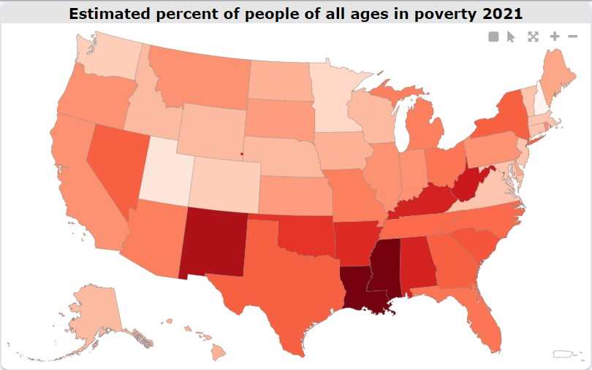
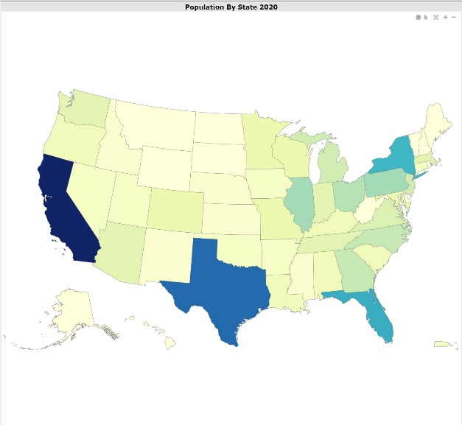
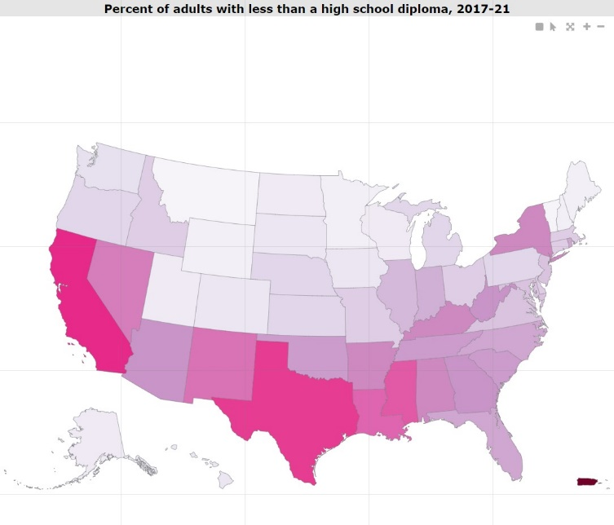
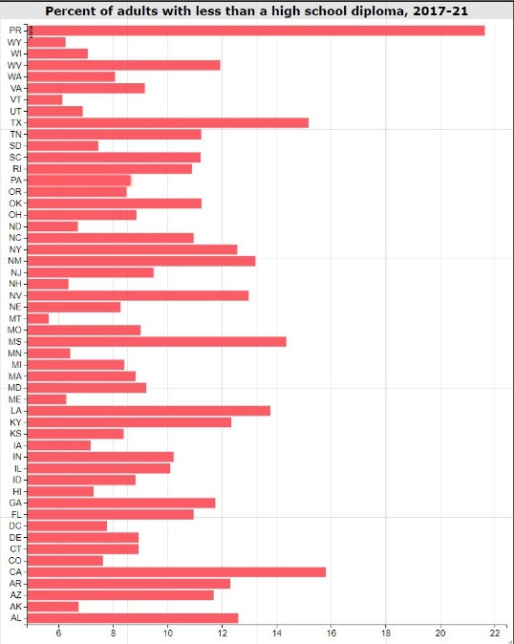
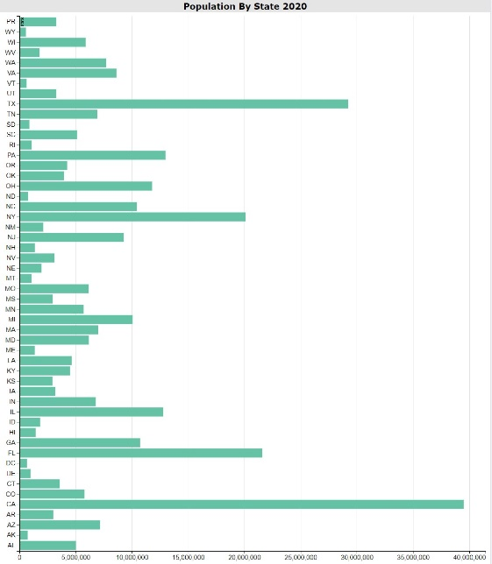
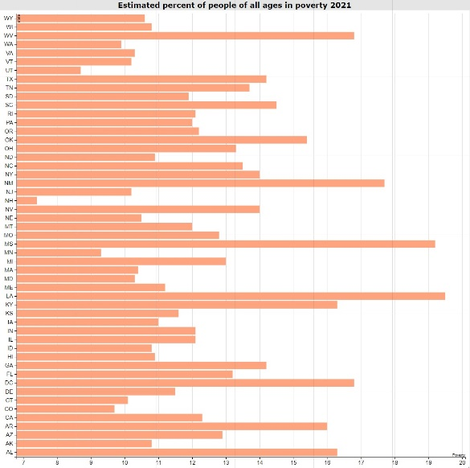
VISUALIZATION
Workunit ID: W20240313-185501
Workunit ID: W20240313-185151
Workunit ID: W20240313-184919

Slide 6
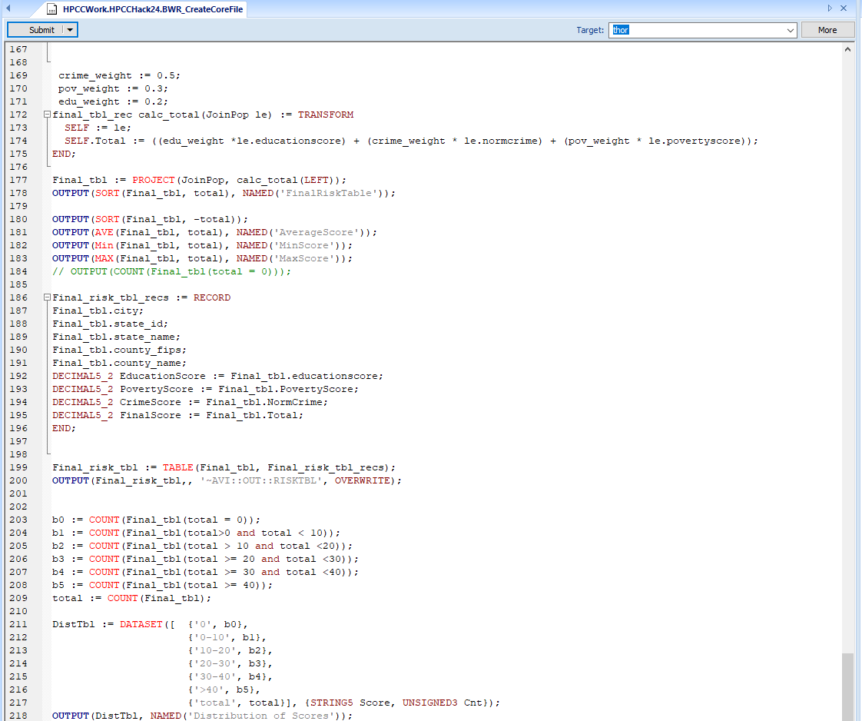
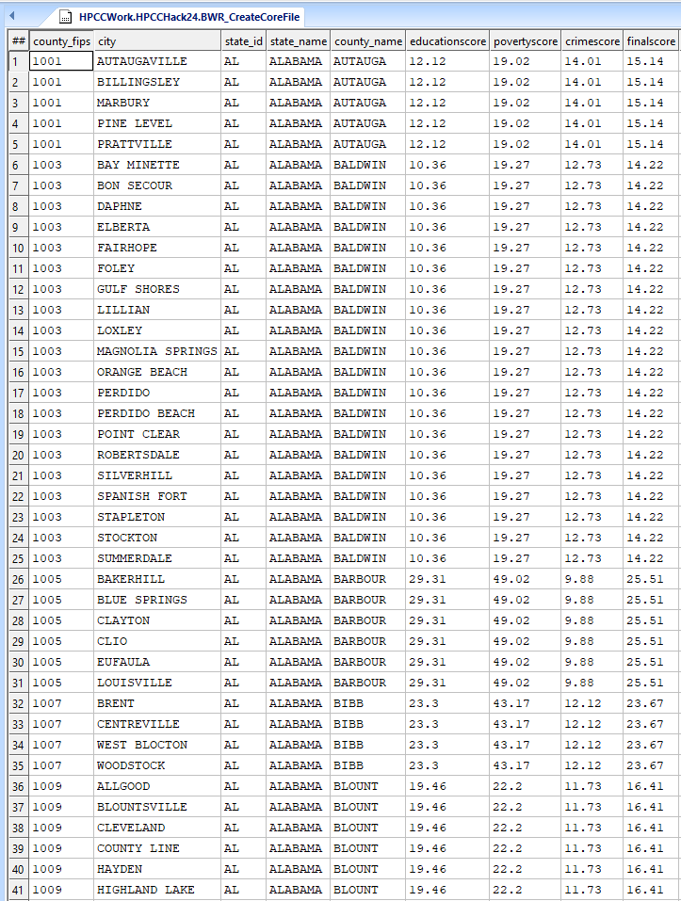
CREATING RISK FILE AND CLEANING RESOURCES DATASETS
Risk File Workunit ID: W20240313-184134
Police Stations: W20240313-190307
Hospitals: W20240313-190608
Fire Stations: W20240313-190650
FoodBanks: W20240313-190738

Slide 7
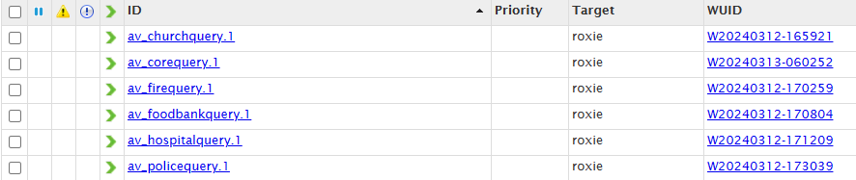
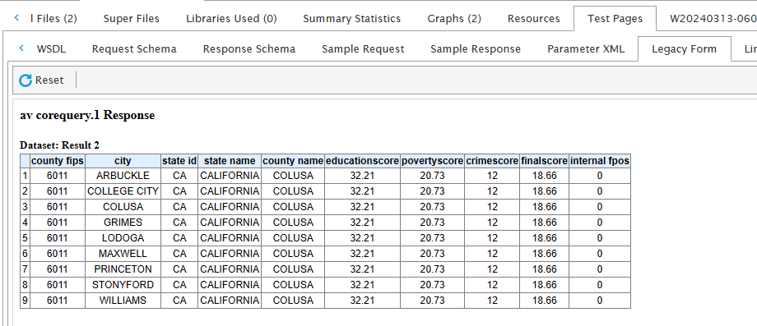
DELIVERY THROUGH ROXIE QUERY

Slide 8
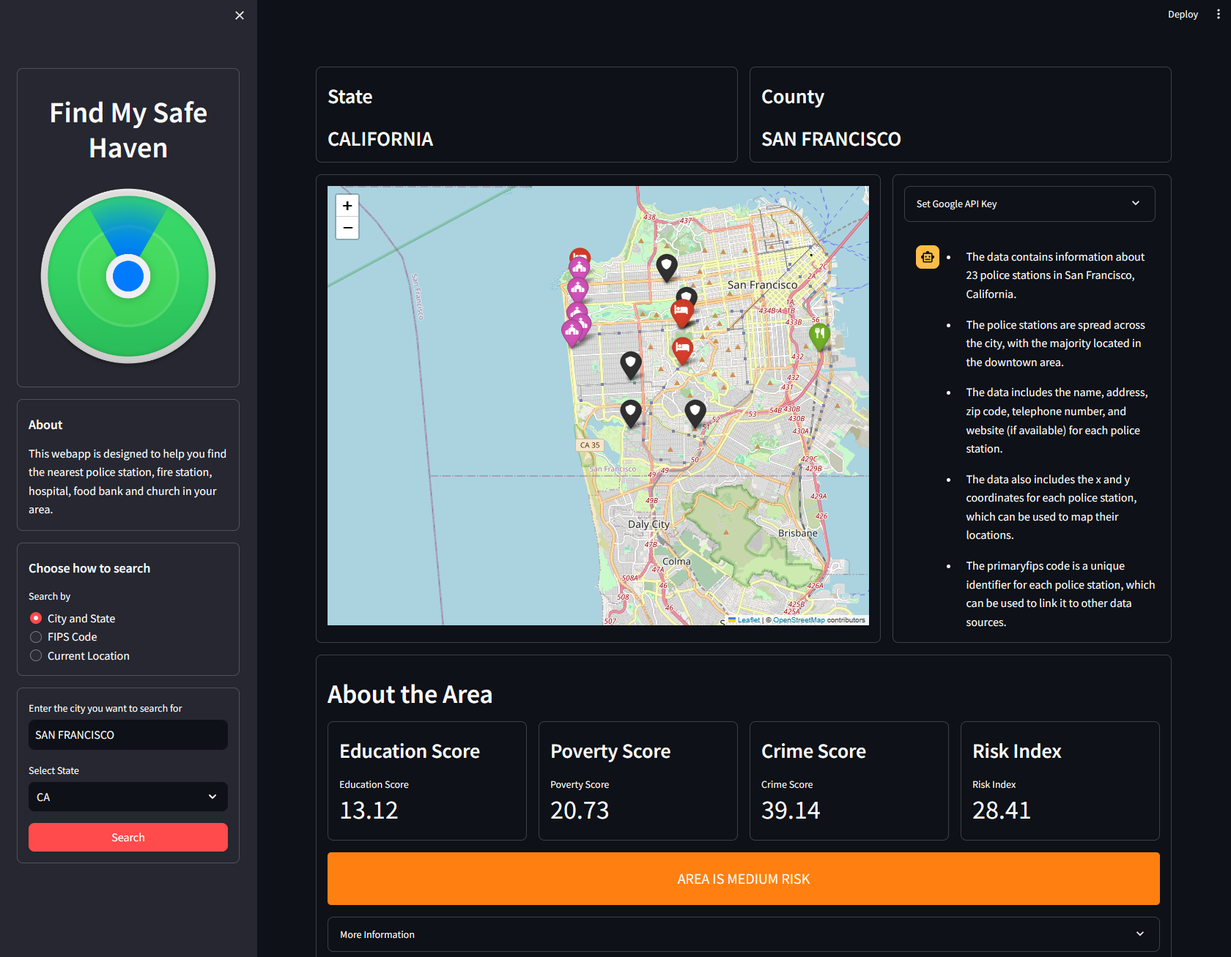
https://findmysafehaven.streamlit.app/
FindMySafeHaven Website -
Delivered the data to user using a ROXIE query which fetches data by FIPS Code or City & State using a REST URL
User can enter their location either using their current city and state or the FIPS Code
Website displays all the nearby resources in the city such as police stations, fire stations, food banks, hospitals and churches on a map using latitude and longitude data from the query
Additionally, shows all the other data fetched in tables and displays the Risk Index and classifies the Area as a Low, Medium or High Risk Area
Chatbot summarizes all the available nearby resources using Google’s Gemini LLM

