Slide 1

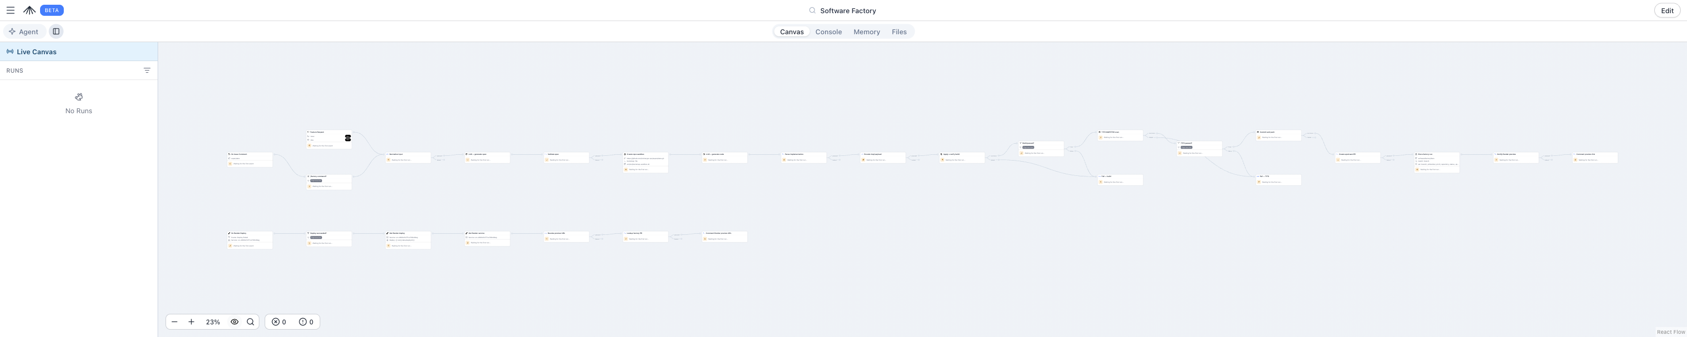
SUPERPLANE NYC HACKATHON · BUILD YOUR OWN SOFTWARE FACTORY
SuperPlane Software Factory
A vague idea or GitHub issue in — a working, security-gated PoC out.
Idea / Issue
→
LLM Spec
→
Sandbox Build
→
MAESTRO Gate
→
PR + Live Preview
Team Cubiczan · Production-grade, open-source, governed agentic AI · software-factory-246a.onrender.com

Slide 2
THE PROBLEM
Shipping features is manual — and "let an agent do it" adds new risk
⏱
Feature production is slow & hands-on
⚠
Agentic factories create new attack surface
Idea → spec → code → review → deploy stitched by hand
Every handoff loses context and time
PoCs for backlog issues rarely get built
Agents that write & ship code = an agentic-AI system
Prompt injection becomes a code-execution path
Tool access becomes lateral movement — SAST never modeled this
Our bet: automate the whole loop on SuperPlane — and put an agentic-AI threat model in the gate before any PR.
www.cubiczan.com

Slide 3
WHAT WE BUILT
An end-to-end factory, fully on the SuperPlane canvas
→
→
→
→
1
Intake
2
Spec
3
Build
4
Secure
5
Ship
Feature Request or /factory on an issue
LLM writes & validates a spec
Daytona sandbox implements + build gate
TITO · MAESTRO threat gate (critical = blocked)
PR + Render preview, live URL on the PR
Each stage validates the previous one — a failed gate never produces a PR.
SuperPlane canvas — 28 nodes across the five stages
www.cubiczan.com

Slide 4
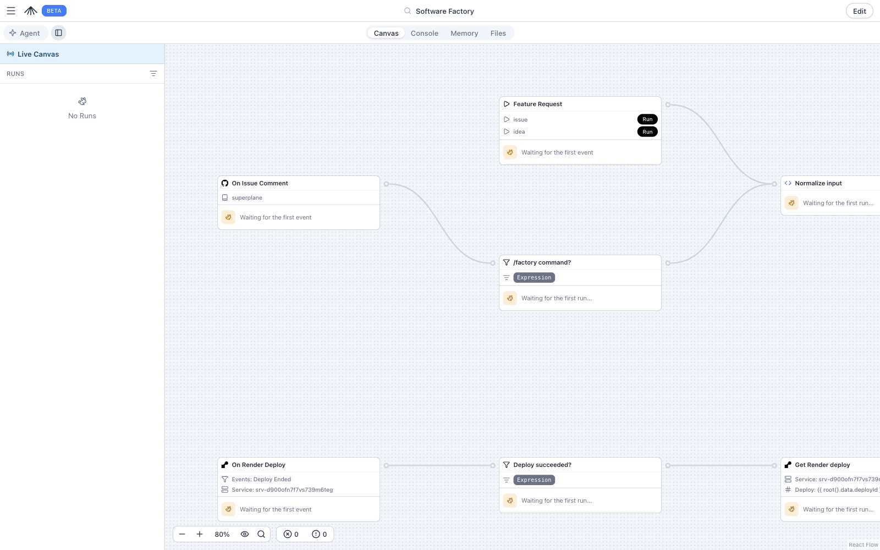
HOW IT WORKS
SuperPlane is the orchestration backbone
◆
SuperPlane
Full pipeline, gates & human approval on one canvas
✦
OpenAI
LLM spec + implementation generation
▣
Daytona
Sandbox clone, code write, build verify
🛡
TITO · MAESTRO
Agentic-AI threat gate before any PR
▲
Render
Live PoC / PR preview hosting
Intake detail — triggers & input normalization
www.cubiczan.com

Slide 5
THE DIFFERENTIATOR
A MAESTRO security gate, in the loop
The factory is itself an agentic-AI system. TITO (Threat In, Threat Out) runs the CSA MAESTRO seven-layer threat model — plus STRIDE-LM and MITRE ATT&CK — gating the change at two points:
MAESTRO — 7 layers
1
Foundation Models prompt injection, jailbreak
Pre-PR (in-pipeline): sandbox scan blocks critical findings before a PR exists Per-PR (CI): tito-maestro.yml, fail-on: critical, + threat-diff
2
Data & Knowledge RAG / embedding poisoning
3
Agent Frameworks reasoning-loop abuse
4
Tooling & Integration tool poisoning, MCP attacks
"Trust-boundary validation between layers is the most common, most dangerous gap."
5
Agent Communication trust violations, spoofing
6
Deployment & Infra container escape, exhaustion
7
Ecosystem & Governance compliance, provenance
Layers 1–4 are where this factory lives — and where the gate focuses.
www.cubiczan.com

Slide 6
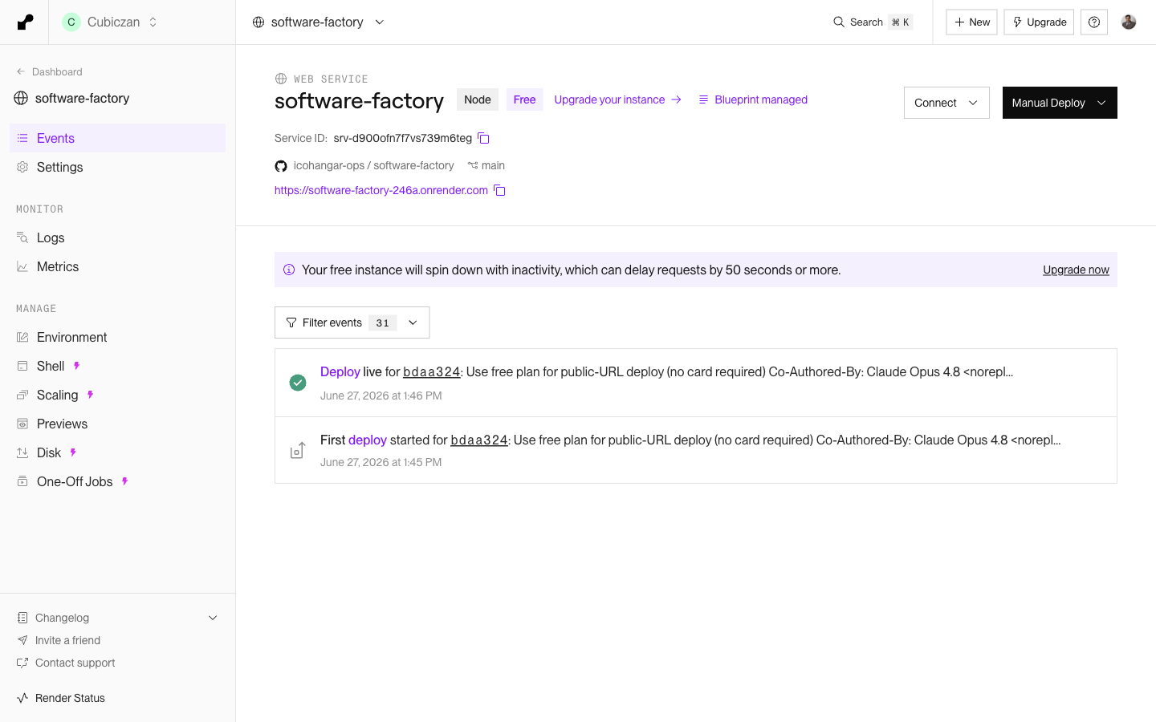
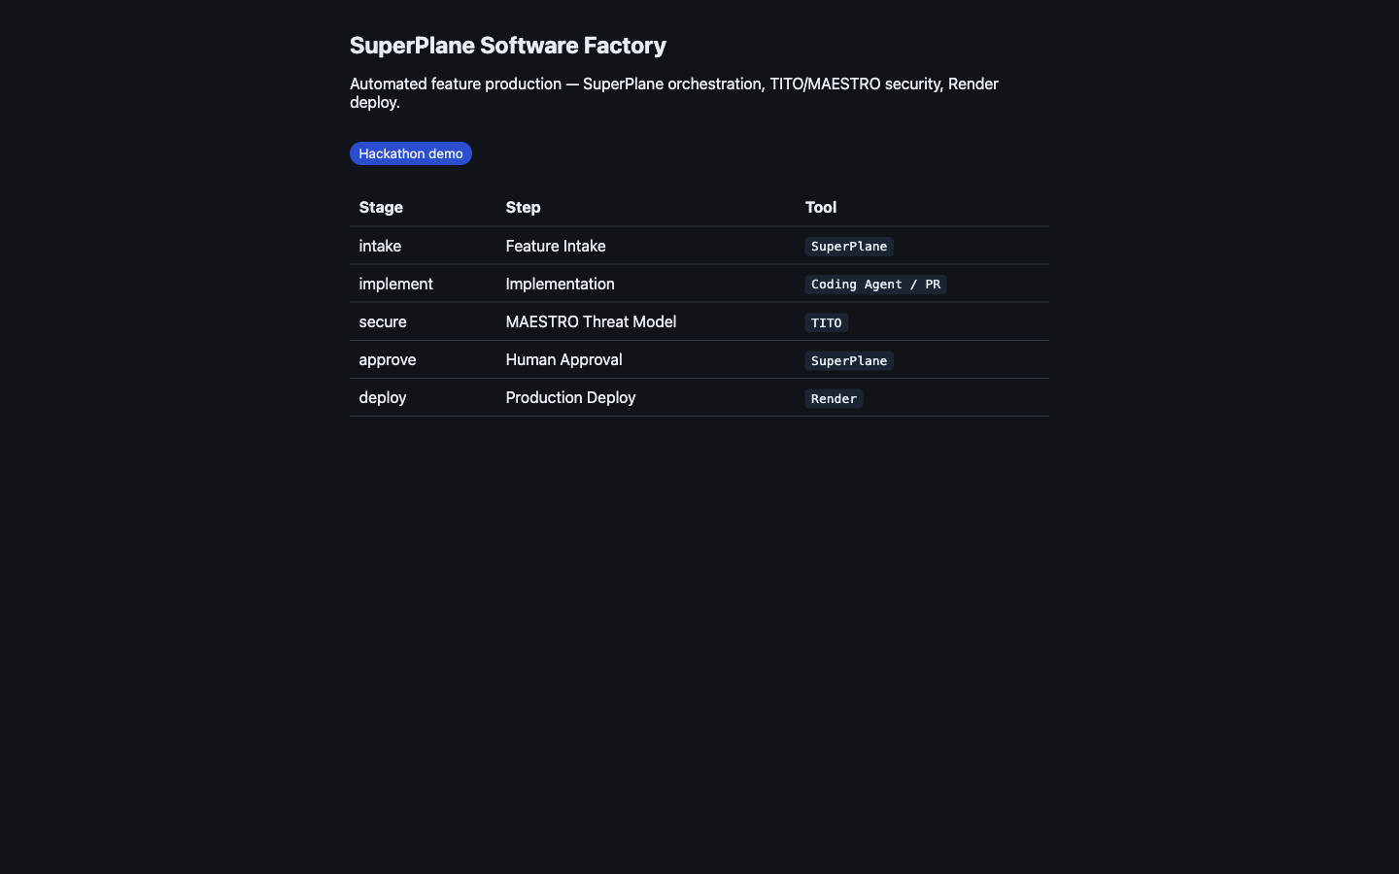
IT RUNS
Live on Render, deployed from the factory
Render service — Deployed, free instance
The deployed PoC — software-factory-246a.onrender.com
28
0 / 0
5
3
canvas nodes
errors / warnings
tools orchestrated
repo mirrors

Slide 7
FEEDBACK
Building with SuperPlane
✓ What worked
⚠ 3 biggest issues
→ Suggestions
Canvas made a complex multi-tool agentic pipeline legible
Integrations (GitHub/OpenAI/Daytona/Render) wired in one place
Gates + human approval as first-class nodes
Draft → publish is opaque (no drafts publish; publish = canvas update w/o --draft-id)
Integration & service IDs hand-patched into canvas.yaml; stale values persist
Weak edit-time feedback — secret/integration nodes show no clear state
First-class drafts publish + live-vs-draft diff
Native param substitution (canvas update --set key=val)
Node errors that name the missing integration/secret
One-click canvas export for docs
www.cubiczan.com

Slide 8
SuperPlane Software Factory
Idea → spec → code → MAESTRO gate → live PR preview, orchestrated end-to-end on SuperPlane.
↗
SuperPlane app app.superplane.com → Software Factory
↗
Live demo software-factory-246a.onrender.com
↗
GitHub github.com/icohangar-ops/software-factory
↗
Codeberg codeberg.org/cubiczan/software-factory
Cubiczan · Production-grade, open-source, governed agentic AI · www.cubiczan.com

