Slide 1


FLOSS
no… not the one your dentist recommends
Peter Parthimos
Carmelo Scribano

Slide 2

What is FLOSS?
FLOSS isn’t just a method of maintaining proper dental hygiene, it’s also a way of maintaining proper software hygiene.
FLOSS (also sometimes just called FOSS) is an acronym standing for Free/Libre and Open-Source Software.
This man is probably developing some FLOSS

Slide 3
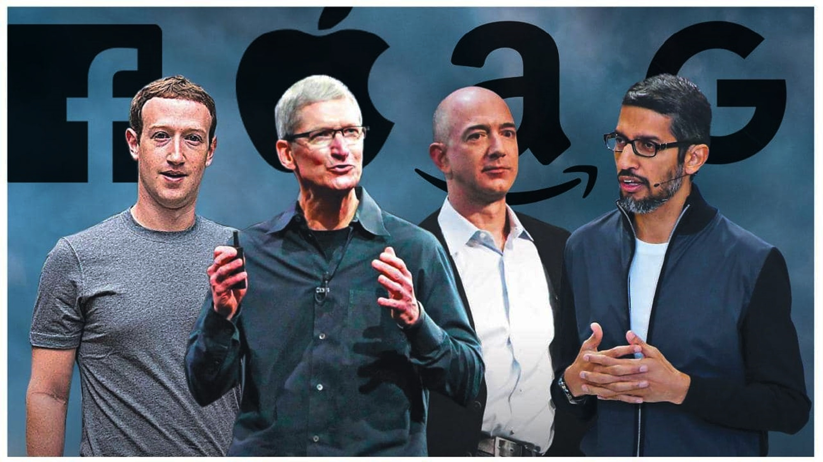
So… Why should I use FLOSS?
Why should you use FLOSS?! That’s the most dumdum question I’ve ever heard!
Just for you, we’re gonna go through some of the reasons why you should abandon your corporate overlords and join the side of freedom.
These are the corporate overlords. Well… maybe not Jeff anymore but you get the idea.

Slide 4

Free!
So you just emptied your entire bank account on Dogecoin and now you’re broke. Unfortunately, while you wait for it to pay off you still have responsibilities, and you need to use Microsoft Office.
Luckily for you, you can spend that $79 on more DOGE and use Libre Office instead!
(“Free” is actually supposed to refer to the freedom to change the code, but we’ll get to that next)
$DOGE

Slide 5

Libre
Let’s be honest, we all know that software is filled with data trackers even when the company says it isn’t.
Or have you ever wished that a piece of software had an extra feature that you wanted?
Great news! Using FLOSS, you can access all the source code and modify it however you want! You’re also able to verify that there’s no nasty trackers selling your information off to China!
This man can finally add some extra features to his favorite software!

Slide 6

Open-Source
Open-source means that anybody can access and contribute to the source code of the application.
Let’s say you created those extra features and now you want to make them an official part of the software. Because of open-source software, you can!
Now you can let everybody know how great you are for fixing a bug in a software that many people use!
John here just had a bug fix added to the official source-code of his favorite project. Good job John!

Slide 7
In Summary
FLOSS is a magical thing that enriches the programming community by allowing anybody to access and contribute to tools that people use every day.
Learning to use and benefit from FLOSS will be a great advantage for the future, and just in case you forgot what it stands for, here’s a reminder:
F - Free
L - Libre
O - Open
S - Source
S - Software

Slide 8



Thank you!
Any Questions?
This work is licensed under the Creative Commons Attribution-ShareAlike 4.0 International License. To view a copy of this license, visit https://creativecommons.org/licenses/by-sa/4.0/.

