Slide 1
Program Name
Repl.it or Ideone.com Repository Link:
File to mark: https://ideone.com/jSI1Su
⚠ The 🕷️ debugging and 📋testing slides are required to pass the assessment.

Slide 2
Useful Shortcuts
<win><shift><s> - Takes a screenshot
<win>< . > - Insert emoji (windows button and full stop)
<ctrl><d> - Duplicate a slide / text box / etc
In VSCode
<ctrl>+/ Comment / uncomment code
<tab> Indent code
<shift><tab> Unindent code

Slide 3
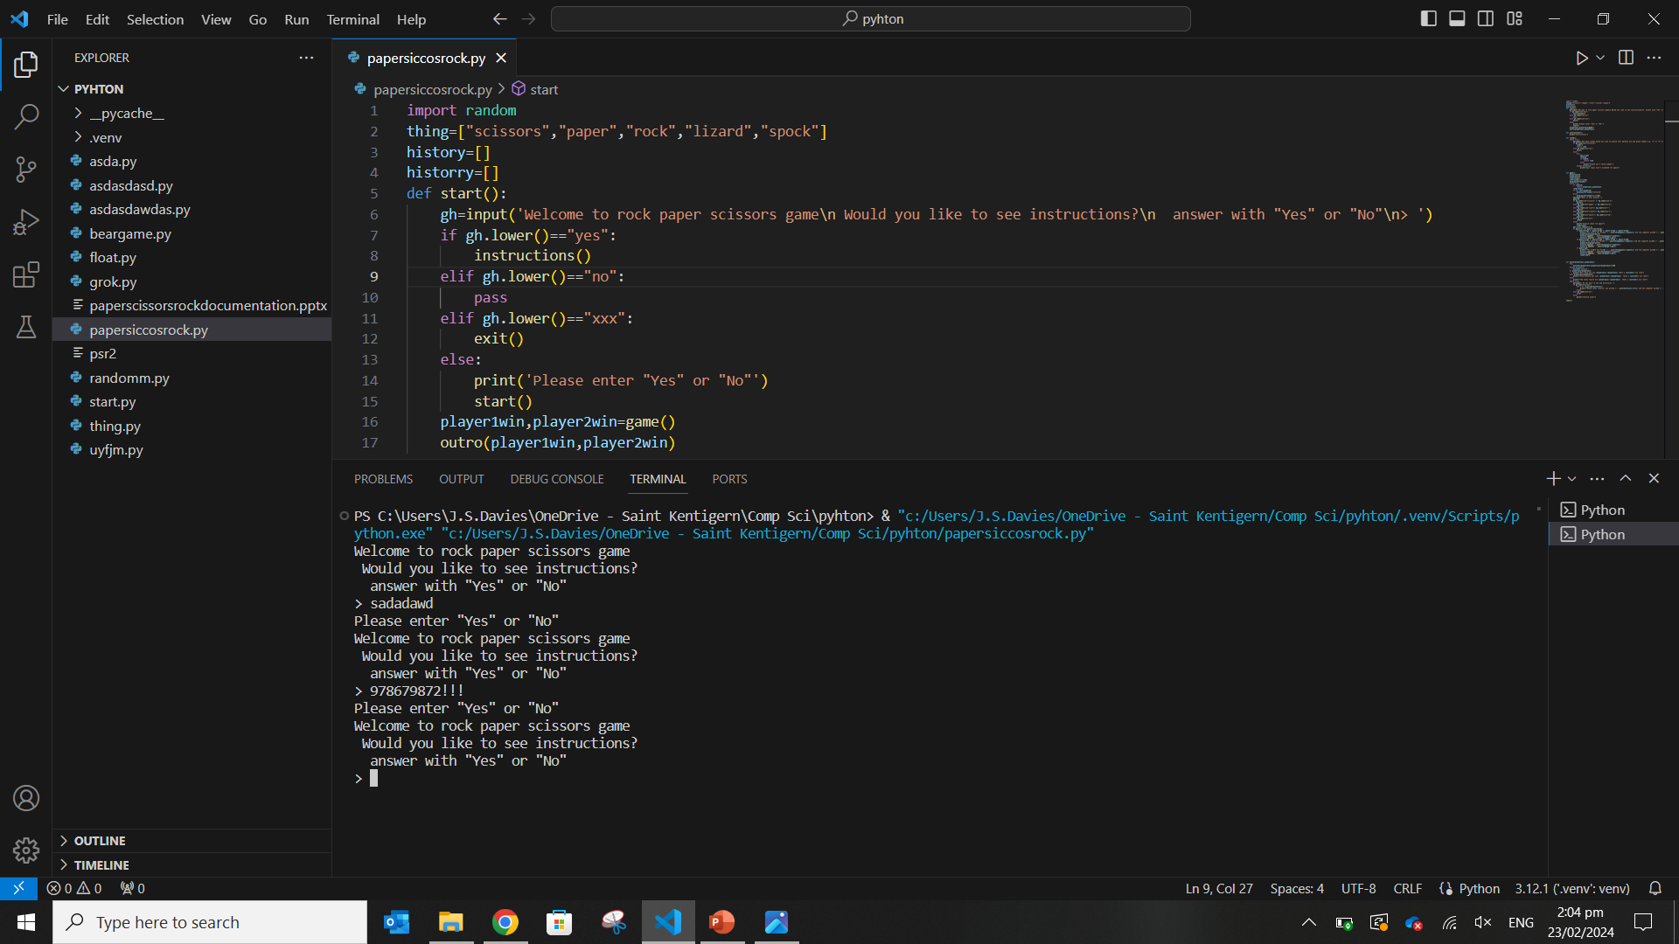
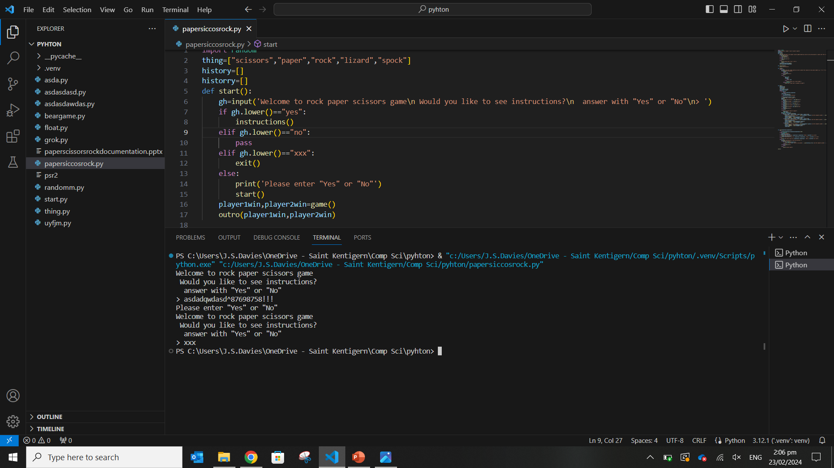
📋 Test Plan Template <<DUPLICATE ME>>
Test Case | Expected Values
Would you like instructions Yes | instructions
Would you like instructions No | Skip directly to amount or rounds
Would you like instructions xxx | Exit program
Would you like instructions random | Invalid input and ask again

Slide 4
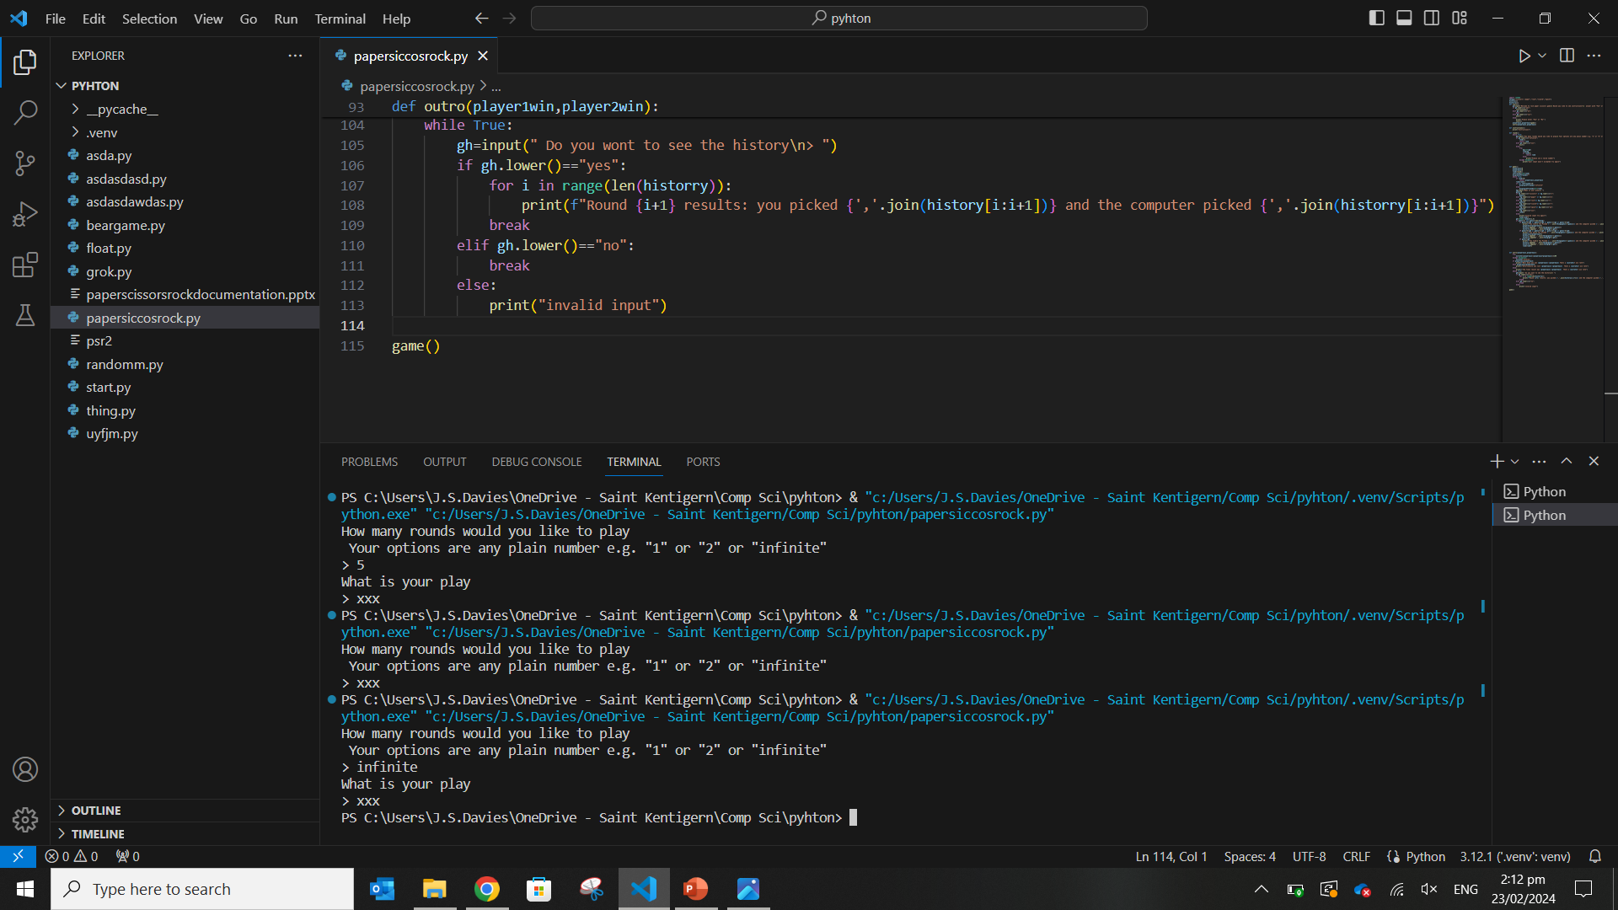
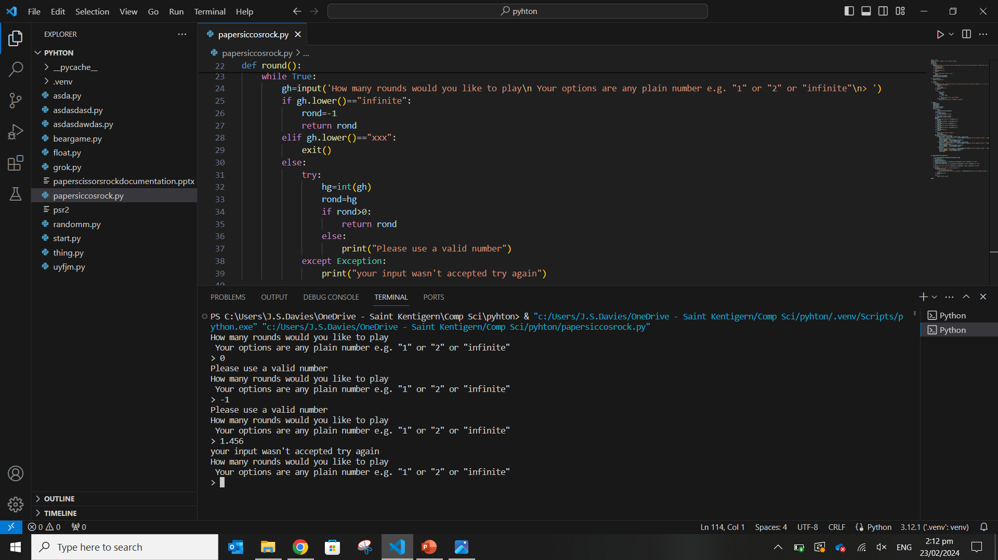
📋 Test Plan Template <<DUPLICATE ME>>
Test Case | Expected Values
How many rounds plain number | Moves onto game and plays that number of rounds
How many rounds xxx | Exits program
How many rounds infinite | Goes onto program and play infinitely until ended
How many rounds 0 | Invalid try again
How many rounds -1 | Invalid try again
How many rounds random letters | Invalid try again
How many rounds floating point number | Invalid try again

Slide 5
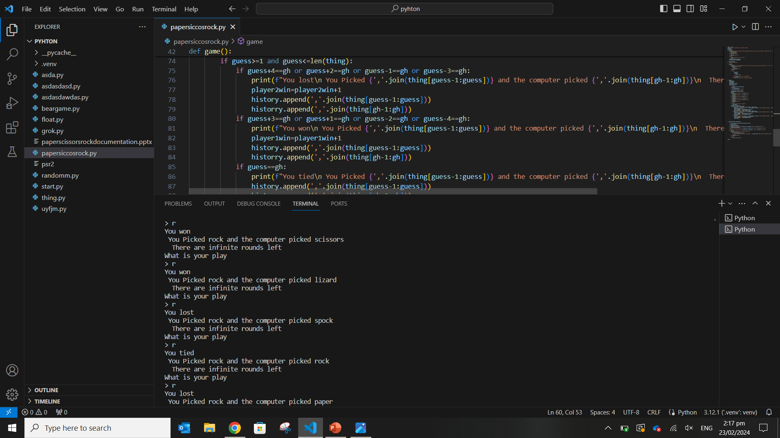
📋 Test Plan Template <<DUPLICATE ME>>
Test Case | Expected Values
Rock vs rock | You tied
Rock vs paper | You lost
Rock vs scissors | You won
Rock vs lizard | You won
Rock vs spock | You lost

Slide 6
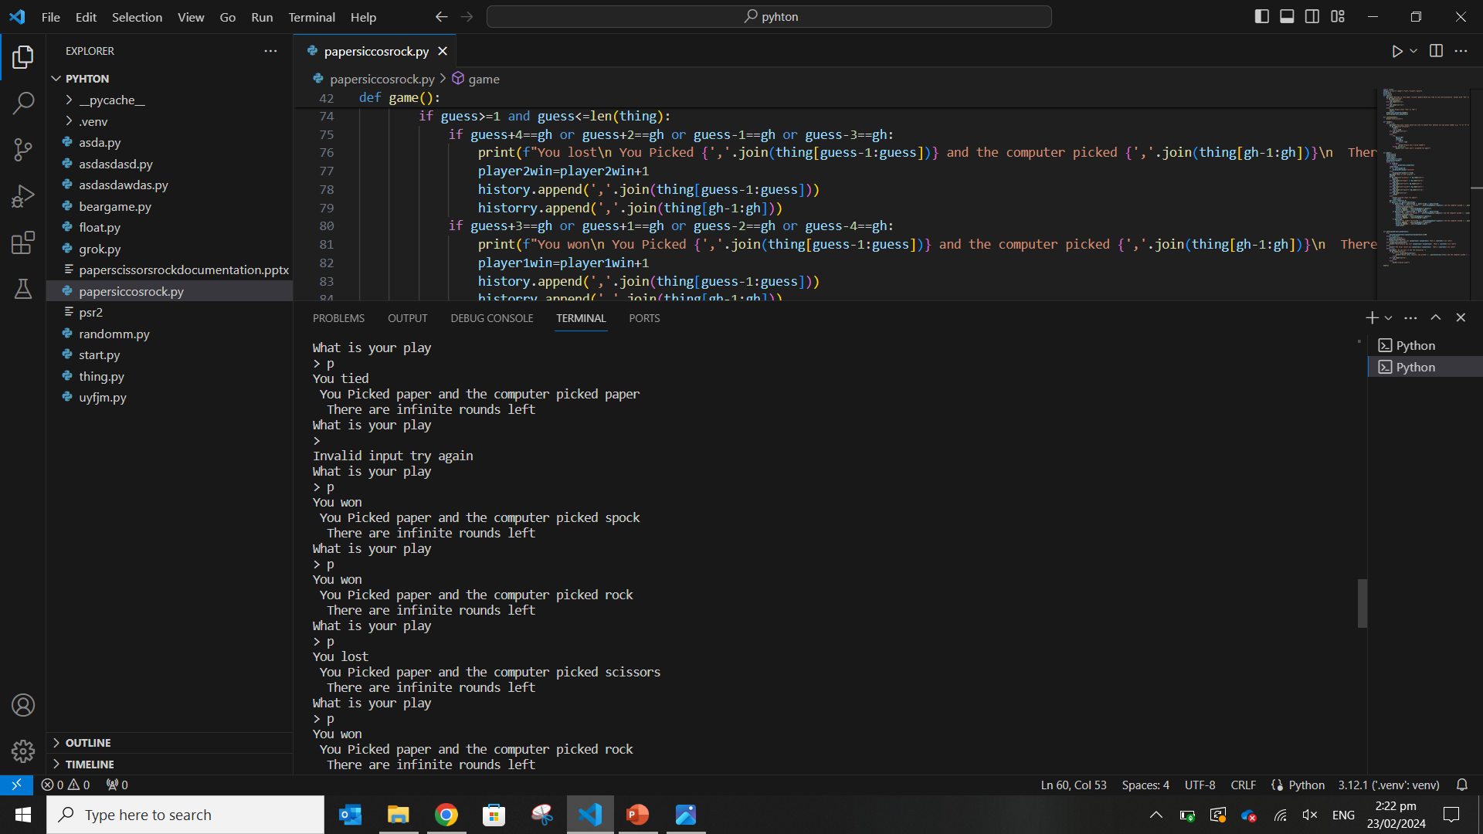
📋 Test Plan Template <<DUPLICATE ME>>
Test Case | Expected Values
paper vs rock | You won
paper vs paper | You tied
paper vs scissors | You lost
paper vs lizard | You lost
paper vs spock | You won

Slide 7
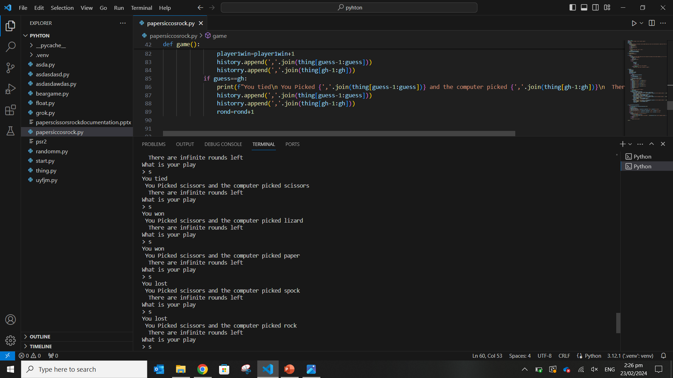
📋 Test Plan Template <<DUPLICATE ME>>
Test Case | Expected Values
scissors vs rock | You lost
scissors vs paper | You won
scissors vs scissors | You tied
scissors vs lizard | You won
scissors vs spock | You lost

Slide 8

📋 Test Plan Template <<DUPLICATE ME>>
Test Case | Expected Values
lizard vs rock | You lost
lizard vs paper | You won
lizard vs scissors | You lost
lizard vs lizard | You tied
lizard vs spock | You won

Slide 9

📋 Test Plan Template <<DUPLICATE ME>>
Test Case | Expected Values
spock vs rock | You won
spock vs paper | You lost
spock vs scissors | You won
spock vs lizard | You won
spock vs spock | You tied

Slide 10
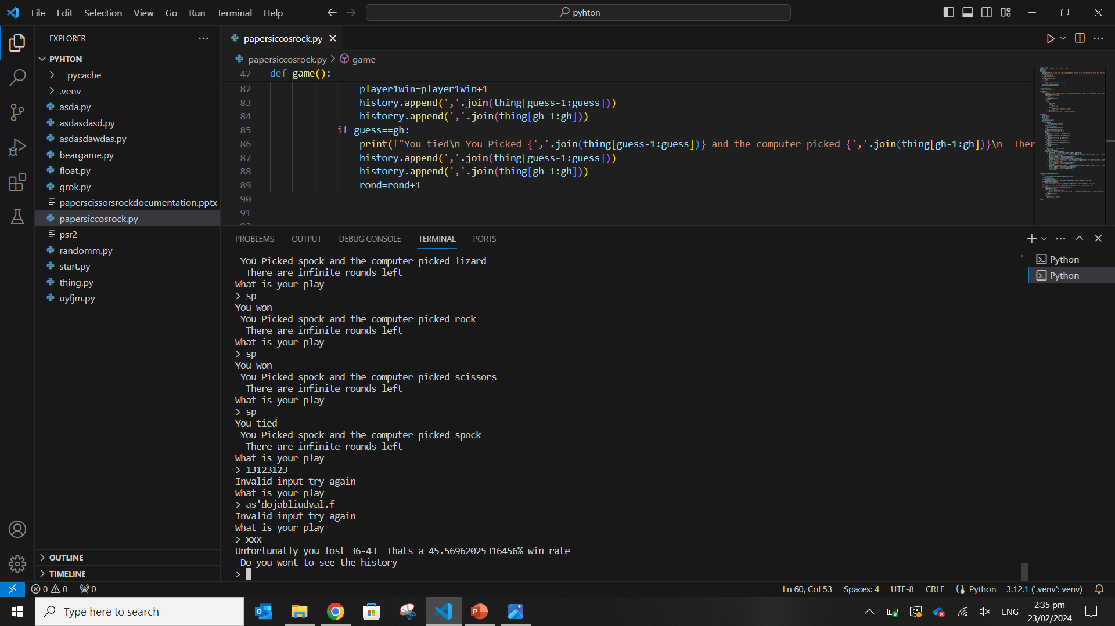
📋 Test Plan Template <<DUPLICATE ME>>
Test Case | Expected Values
Random input | Ask again
xxx | End game and go to history
number | Ask agian

Slide 11
📋 Test Plan Template <<DUPLICATE ME>>
Test Case | Expected Values

Slide 12
📋 Test Plan Template <<DUPLICATE ME>>
Test Case | Expected Values

Slide 13
📋 Test Plan Template <<DUPLICATE ME>>
Test Case | Expected Values

Slide 14
📋 Test Plan Template <<DUPLICATE ME>>
Test Case | Expected Values

Slide 15
📋 Test Plan Template <<DUPLICATE ME>>
Test Case | Expected Values

Slide 16
🕷️ Debugging Slide <<DUPLICATE ME>>
Replace this text with a brief explanation of what you did. Remember to include screenshots of the broken and fixed code (we only need the lines that you changed).

Slide 17
The next slides are examples!😎
Please remove the next slides when submitting your documentation for assessment AS92004 – create a program

