Slide 1

Linux Operating System
許 富 皓

Slide 2
Intel x86 Architecture

Slide 3
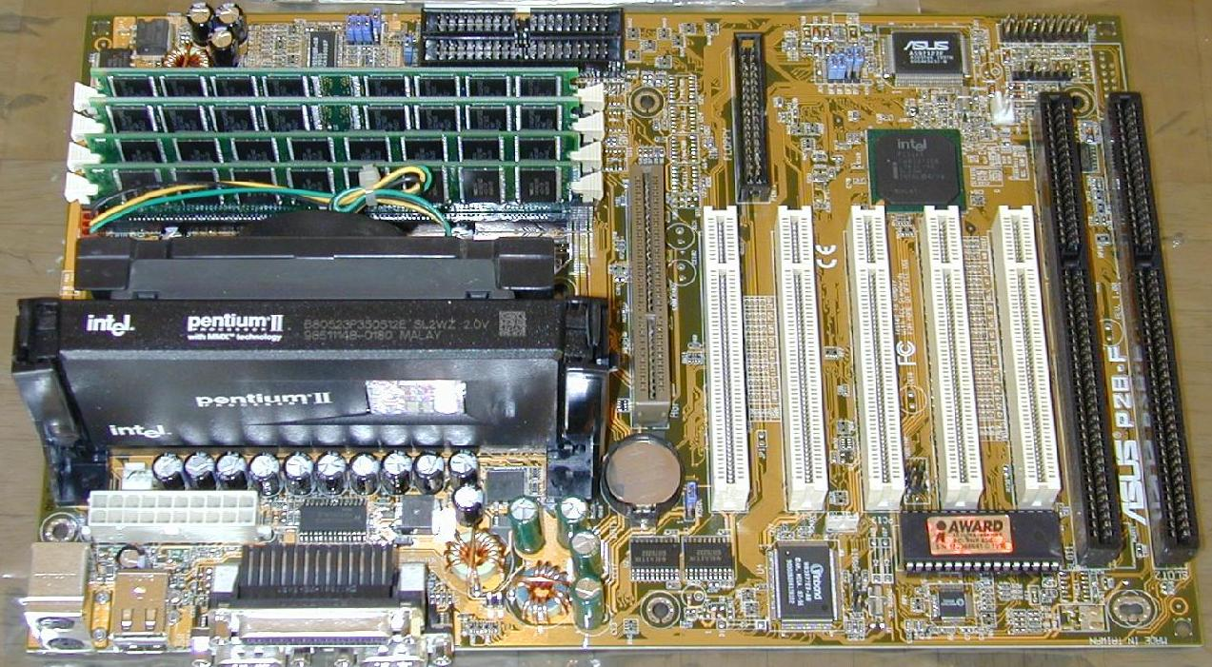
The Motherboard of a Computer

Slide 4
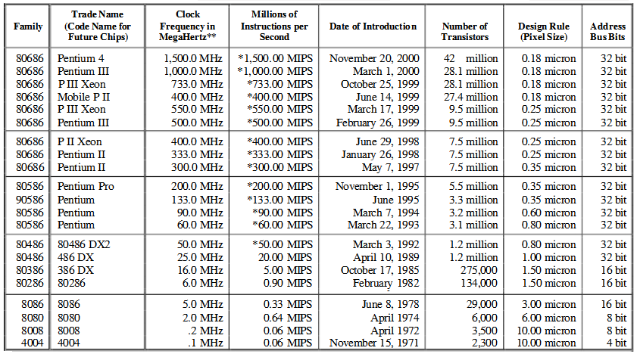
Evolution of Intel Microprocessors _{[Steve Gilhea]}

Slide 5
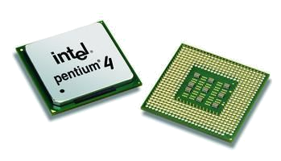
An Intel Pentium 4 Processor

Slide 6
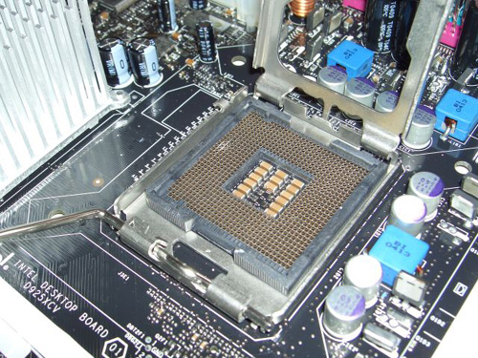
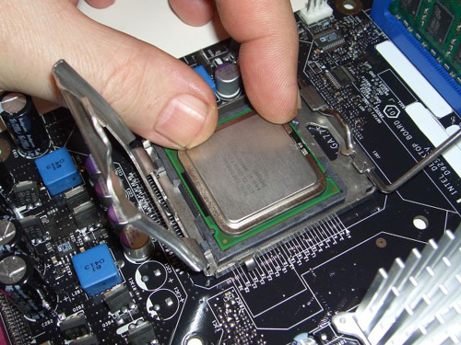
Install a Processor

Slide 7
Intel 64 _{[H. Wiklicky]}
Formerly known as EM64T or IA32e or x86-64 or x64
64-bit extended instruction set based on x86 processor architecture
Originally by AMD
Can also run 32-bit application on a 32-bit operating system
Backward compatibility which is the key to the success of Intel x86 processor

Slide 8
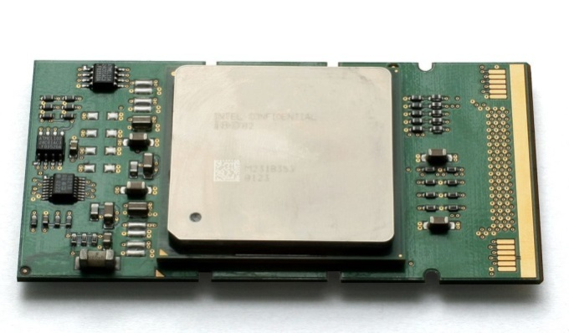
IA-64 _{[H. Wiklicky]}
Based on an entirely different architecture
Only Intel Itanium processor employs this
No backward compatibility with the IA-32 software
Originally incorporated hardware emulation to the 32-bit application but now relying on software emulation
Itanium 2 processor

Slide 9
Intel 64 vs. IA-64 _{[H. Wiklicky]}
Two different instruction sets and architectures

Slide 10
64-bit Intel Processors _{[wikipedia]}
Architecture | Processor | Released Date
x64 Pentium | Pentium 4F | February 20, 2005
 | Pentium D | 2005
 | Pentium Dual-Core | January 21, 2007
x64 Intel Core | Intel Core 2 | July 27, 2006
 | Core i3 | January, 2010
 | Core i5 | September 8, 2009
 | Core i7 | November 17, 2008
IA64 | Itanium | May 29, 2001
 | Itanium 2 | July 2002

Slide 11
Intel x86 Registers

Slide 12
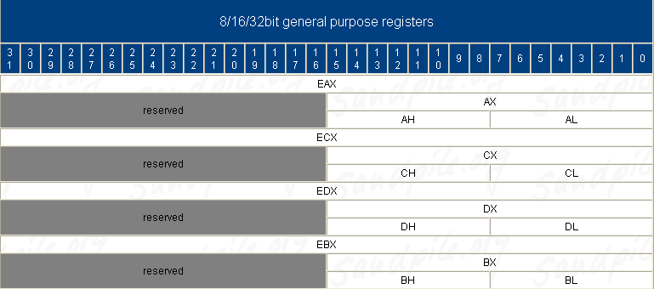
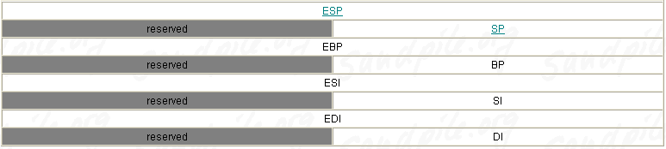
General Purpose Registers

Slide 13
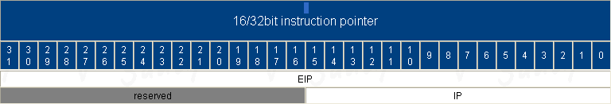
Instruction Pointer

Slide 14
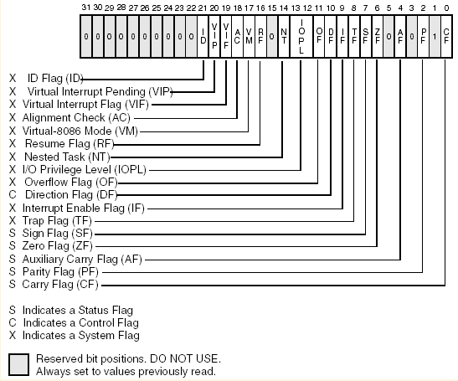
EFLAG Register

Slide 15
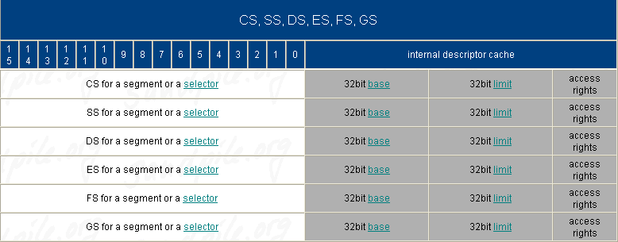
Segment Registers
non-programmable part

Slide 16
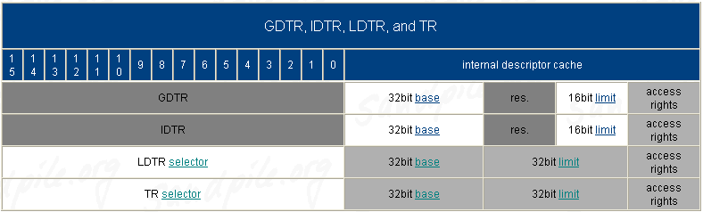
Table Registers (System Address Registers)

Slide 17
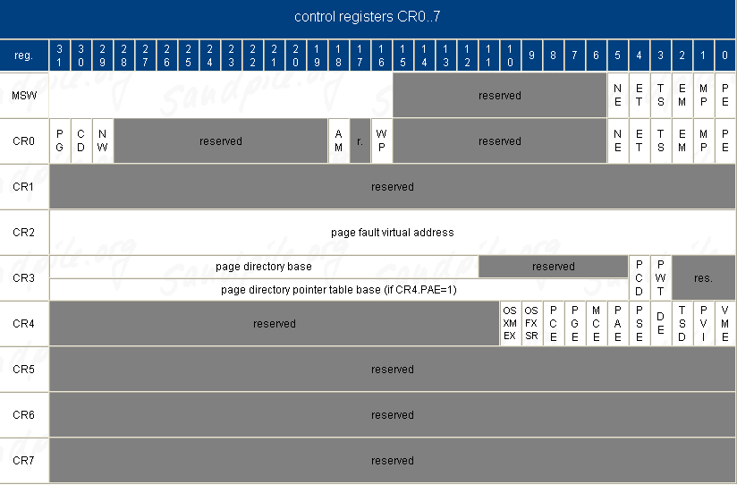
Control Registers

Slide 18
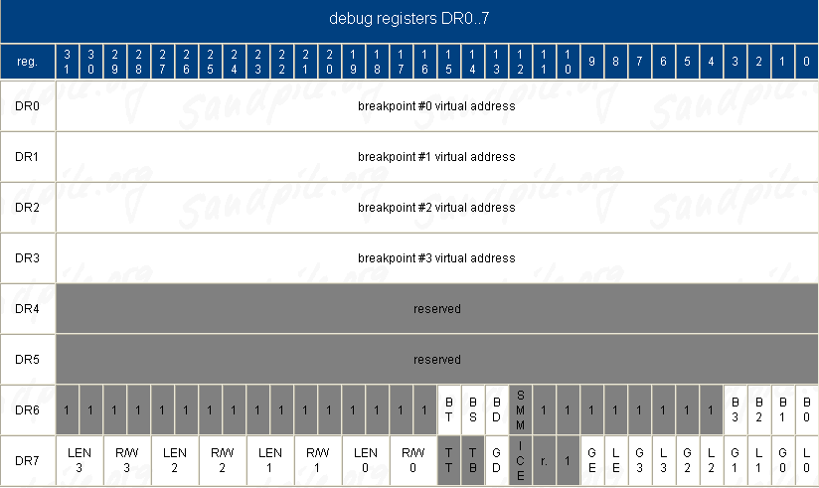
Debug Registers

Slide 19
x86-64

Slide 20
X86-64 _{[wikipedia]}
x86-64 (also known as x64, x86_64 and AMD64) is the 64-bit version of the x86 instruction set.
The original specification was created by AMD, and has been implemented by AMD, Intel, and VIA.

Slide 21
Aliases of X86-64 _{[wikipedia]}
Prior to launch, "x86-64" and "x86_64" were used to refer to the instruction set.
Upon release, AMD named it AMD64.
Intel initially used the names IA-32e and EM64T before finally settling on Intel 64 for their implementation.

Slide 22
Compatibility Features of X86-64 _{[wikipedia]}
x86-64 is fully backwards compatible with 16-bitand 32-bit x86 code.
Because the full x86 16-bit and 32-bit instruction sets remain implemented in hardware without any intervening emulation, existing x86 executables run with no compatibility or performance penalties.

Slide 23
Intel x86-64 Registers

Slide 24
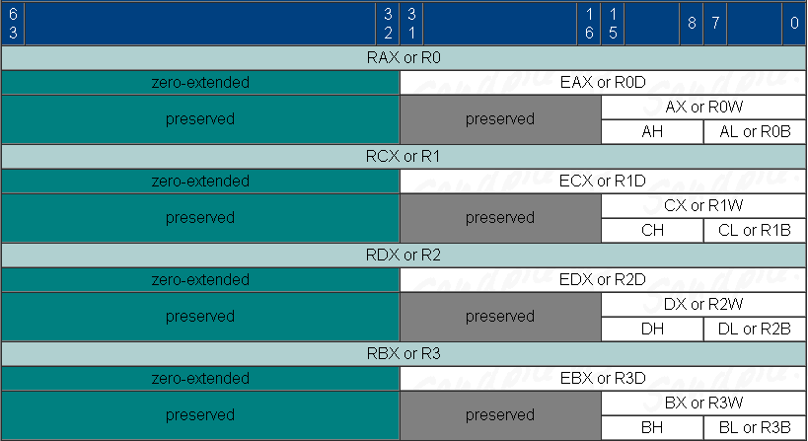
Traditional General Purpose Registers (1) _{[sandpile]}

Slide 25
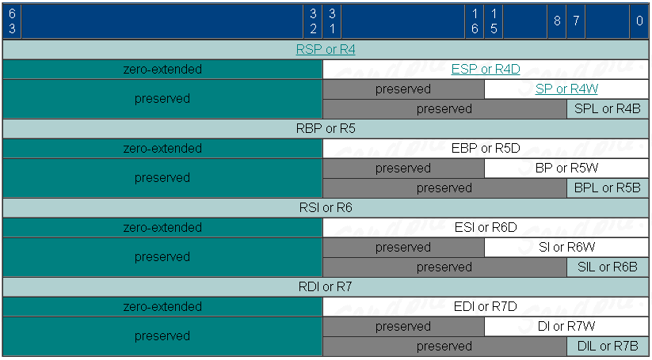
Traditional General Purpose Registers (2) _{[sandpile]}

Slide 26
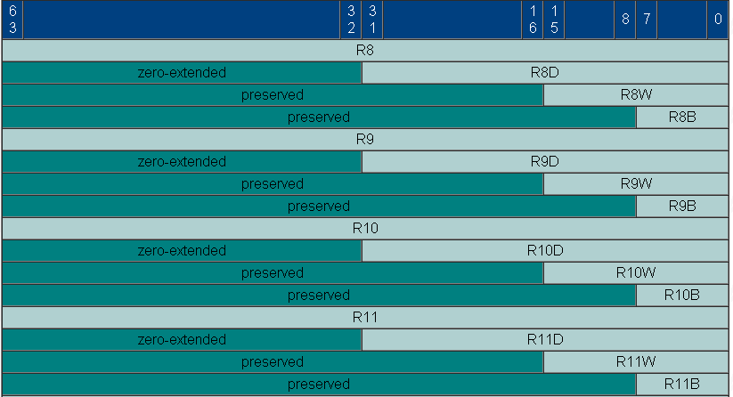
Traditional General Purpose Registers (3) _{[sandpile]}

Slide 27
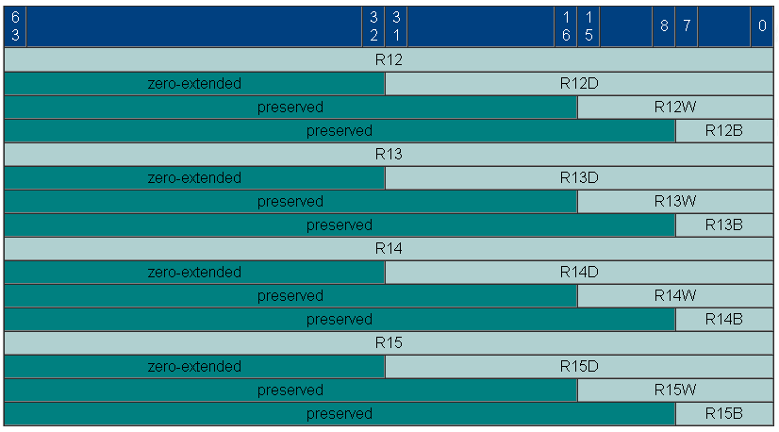
Traditional General Purpose Registers (4) _{[sandpile]}

Slide 28
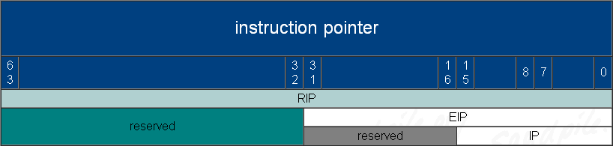
Instruction Pointer _{[sandpile]}

Slide 29
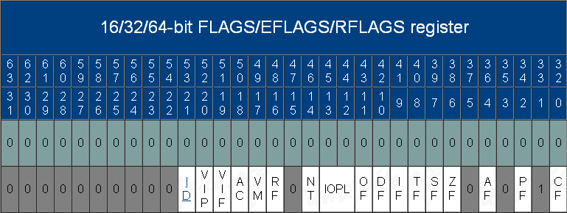
rFLAGS _{[sandpile]}

Slide 30
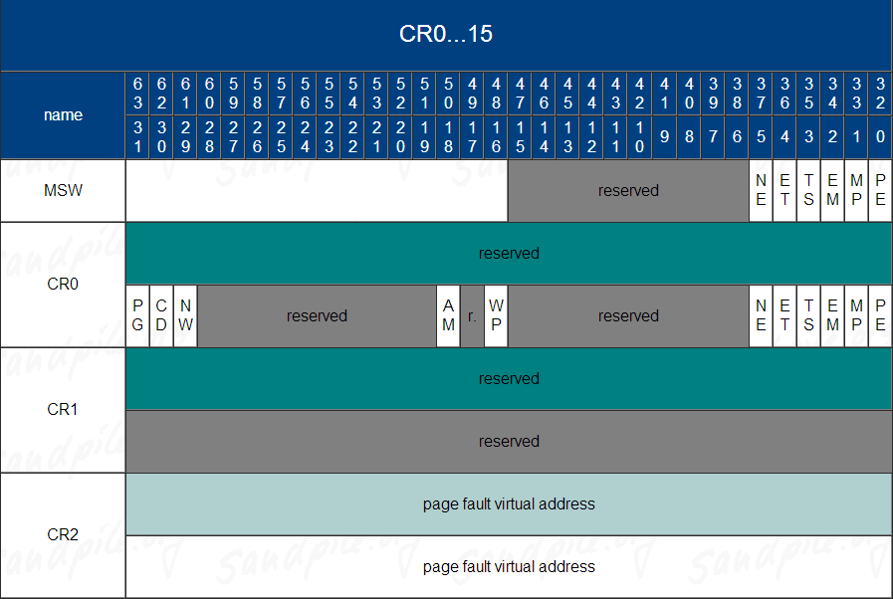
Control Registers (1) _{[sandpile]}

Slide 31
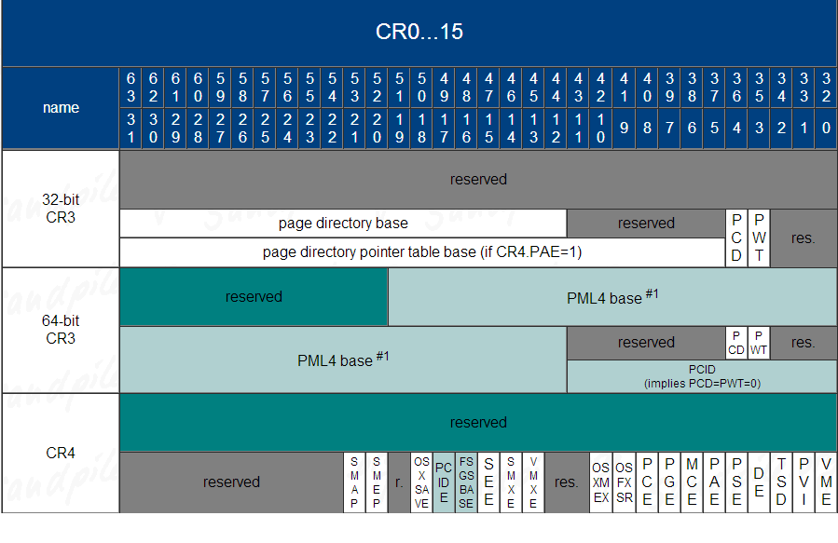
Control Registers (2) _{[sandpile]}

Slide 32
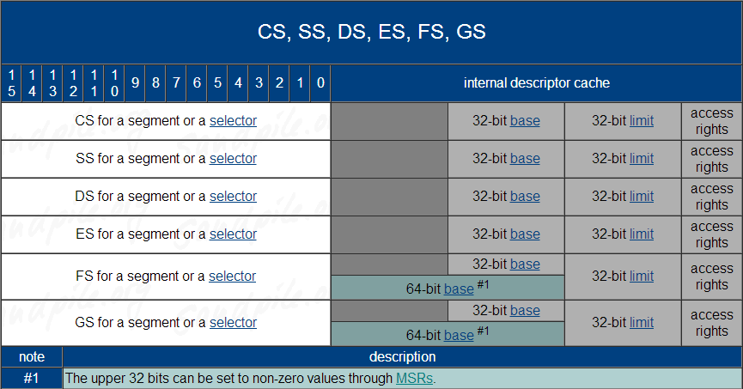
Segment Registers _{[sandpile]}

Slide 33
IA 32
Real Mode
vs.
Protected Mode

Slide 34
Real Mode and Protected Mode
When an IA32 processor is powered up or reset, it is in real mode.
All modern IA32 operating systems use protected mode; however, when the computer boots, it starts up in real mode, so the part of the operating system responsible for switching into protected mode must operate in the real mode environment.
Instruction Set
16-bit registers (real mode) vs. 16/32-bit registers (protected mode)

Slide 35
Addressing in Real Mode
segment register × 16+offset → physical address.
Using 16-bit offsets implicitly limits the CPU to 64k (=2¹⁶) segment sizes.
No protection: program can load anything into segment register.

Slide 36
Addressing in Protected Mode
selector:offset (logical address)
Segmentation Unit
linear address
Paging Unit
physical address

Slide 37
Interrupts in Real Mode
At the start of physical memory lies the real-mode Interrupt Vector Table (IVT).
The IVT contains 256 real-mode pointers for all of the real-mode Interrupt Service Routines (ISRs).
Real-mode pointers are 32-bits wide, formed by a 16-bit segment offset followed by a 16-bit segment address. The IVT has the following layout:
0 0x0000 [[offset][segment]]
1 0x0004 [[offset][segment]]
2 0x0008 [[offset][segment]]
... ... ...
255 0x03FC [[offset][segment]]

Slide 38
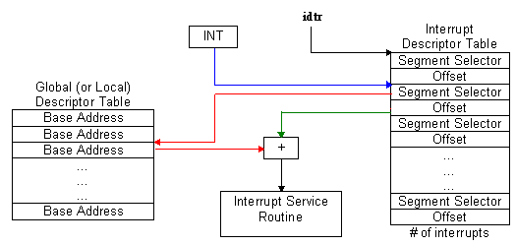
Interrupts in Protected Mode

Slide 39
How to Switch to Protected Mode
load GDTR with the pointer to the GDT-table.
disable interrupts ("cli")
load IDTR with the pointer to the IDT
set the PE-bit in the CR0 or MSW register.
make a far jump to the code to flush the PIQ.
  Prefetch Input Queue (PIQ): pre-loading machine code from memory into this queue
initialize TR with the selector of a valid TSS.
optional: load LDTR with the pointer to the LDT-table.

Slide 40
Long Mode/IA-32e Mode _{[Intel]}

Slide 41
IA-32e Mode (i.e. Long Mode)
In IA-32e mode, the processor supports two sub-modes:
  compatibility mode
  and
  64-bit mode.

Slide 42
64-bit Mode
64-bit mode provides
  64-bit linear addressing
  and
  support for physical address space larger than 64 GBytes.

Slide 43
Compatibility Mode
Compatibility mode allows most legacy protected-mode applications to run unchanged.

Slide 44
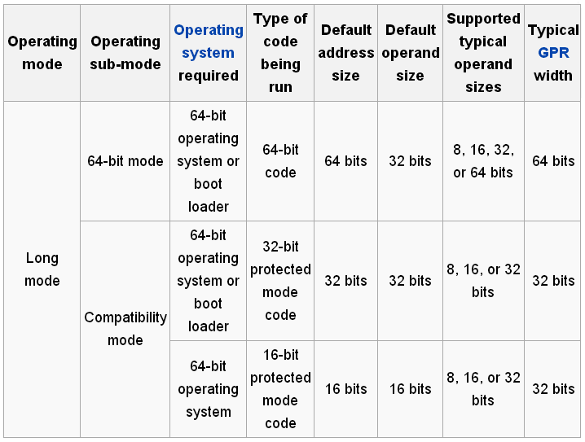
Sub-Modes of IA-32e Mode _{[wikipedia]}

Slide 45
Real Mode to Protected Mode
The processor is placed in real-address mode following power-up or a reset.
The PE flag in control register CR0 then controls whether the processor is operating in real-mode or protected mode.

Slide 46
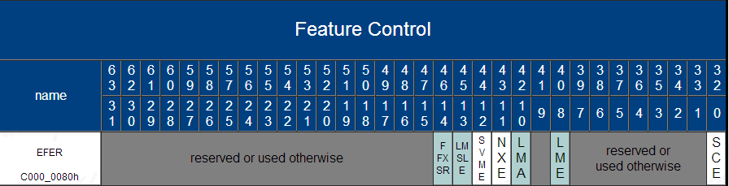
IA32_EFER
On systems that support IA-32e mode (i.e. long mode), the extended feature enable register (IA32_EFER) is available.
This model specific register controls activation of IA-32e mode and other IA-32e mode operations.

Slide 47
Protected Mode to IA-32e Mode
The processor enters into IA-32e mode from protected mode by
  enabling paging
  and
  setting the LME bit (IA32_EFER.LME[bit 8]).

Slide 48
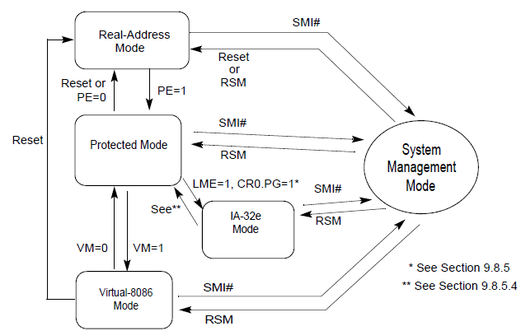
Transitions Among the Processor’s Operating Modes

Slide 49
Endian Order
Depending on which computing system you use, you will have to consider the byte order in which multi-byte numbers are stored, particularly when you are writing those numbers to a file.
The two orders are called Little Endian and Big Endian.

Slide 50
Little Endian (1)
"Little Endian" means that the low-order byte of the number is stored in memory at the lowest address, and the high-order byte at the highest address. (The little end comes first.)
For example, a 4 byte long int
Byte3 Byte2 Byte1 Byte0
will be arranged in memory as follows:
Base Address+0 Byte0
Base Address+1 Byte1
Base Address+2 Byte2
Base Address+3 Byte3
Intel processors (those used in PC's) use "Little Endian" byte order.

Slide 51
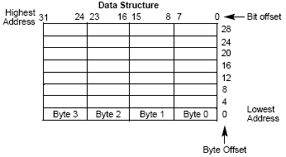
Little Endian (2)

Slide 52
Big Endian
Big Endian" means that the high-order byte of the number is stored in memory at the lowest address, and the low-order byte at the highest address. (The big end comes first.)
Base Address+0 Byte3
Base Address+1 Byte2
Base Address+2 Byte1
Base Address+3 Byte0
Motorola processors (those used in Mac's) use "Big Endian" byte order.

Slide 53
Linux Source Code Tree Overview

Slide 54
Linux Source Code Tree
/
sbin
usr
bin
home
root
…
local
bin
src
…
Linux-3.9
…
Documentation
arch
drivers
fs
include
init
ipc
kernel
lib
mm
net
scripts
Makefile Readme …

Slide 55
Top-Level Files or Directories (1)
Makefile
  This file is the top-level Makefile for the whole source tree. It defines a lot of useful variables and rules, such as the default gcc compilation flags.
Documentation/
  This directory contains a lot of useful (but often out of date) information about configuring the kernel, running with a ramdisk, and similar things.
  The help entries corresponding to different configuration options are not found here, though - they're found in Kconfig files in each source directory.

Slide 56
Top-Level Files or Directories (2)
arch/
  All the architecture specific code is in this directory and in the include/asm-<arch> directories. Each architecture has its own directory underneath this directory.
    For example, the code for a PowerPC based computer would be found under arch/ppc.
  You will find low-level memory management, interrupt handling, early initialization, assembly routines, and much more in these directories.

Slide 57
Top-Level Files or Directories (3)
drivers/
  As a general rule, code to run peripheral devices is found in subdirectories of this directory. This includes video drivers, network card drivers, low-level SCSI drivers, and other similar things.
    For example, most network card drivers are found in drivers/net.
  Some higher level code to glue all the drivers of one type together may or may not be included in the same directory as the low-level drivers themselves.

Slide 58
Top-Level Files or Directories (4)
fs/
  Both the generic filesystem code (known as the VFS, or Virtual File System) and the code for each different filesystem are found in this directory.
    Your root filesystem is probably an ext2 filesystem; the code to read the ext2 format is found in fs/ext2.

Slide 59
Top-Level Files or Directories (5)
include/
  Most of the header files included at the beginning of a .c file are found in this directory.
  Architecture specific include files are in asm-<arch> .
    Part of the kernel build process creates the symbolic link from asm to asm-<arch>, so that #include <asm/file.h> will get the proper file for that architecture without having to hard code it into the .c file .
  The other directories contain non-architecture specific header files. If a structure, constant, or variable is used in more than one .c file , it should be probably be in one of these header files.

Slide 60
Top-Level Files or Directories (6)
init/
  This directory contains the files main.c, version.c.
  version.c defines the Linux version string.
  main.c can be thought of as the kernel "glue."
    function start_kernel

Slide 61
Top-Level Files or Directories (7)
ipc/
  "IPC" stands for "Inter-Process Communication". It contains the code for shared memory, semaphores, and other forms of IPC.
kernel/
  Generic kernel level code that doesn't fit anywhere else goes in here. The upper level system call code is here, along with the printk() code, the scheduler, signal handling code, and much more. The files have informative names, so you can type ls kernel/ and guess fairly accurately at what each file does.

Slide 62
Top-Level Files or Directories (8)
lib/
  Routines of generic usefulness to all kernel code are put in here. Common string operations, debugging routines, and command line parsing code are all in here.
mm/
  High level memory management code is in this directory. Virtual memory (VM) is implemented through these routines, in conjunction with the low-level architecture specific routines usually found in arch/<arch>/mm/.
  Early boot memory management (needed before the memory subsystem is fully set up) is done here, as well as memory mapping of files, management of page caches, memory allocation, and swap out of pages in RAM (along with many other things).

Slide 63
Top-Level Files or Directories (9)
net/
  The high-level networking code is here (e.g. socket.c).
  The low-level network drivers pass received packets up to and get packets to send from this level, which may pass the data to a user-level application, discard the data, or use it in-kernel, depending on the packet.
    The net/core directory contains code useful to most of the different network protocols, as do some of the files in the net/ directory itself.
  Specific network protocols are implemented in subdirectories of net/.
    For example, IP (version 4) code is found in the directory net/ipv4.
scripts/
  This directory contains scripts that are useful in building the kernel, but does not include any code that is incorporated into the kernel itself. The various configuration tools keep their files in here, for example.

Slide 64
System Boot up

Slide 65
start_kernel()
Initialize
  the scheduler,
  memory zones,
  the buddy system allocators,
  the final version of IDT,
  the TASKLET_SOFTIRQ, HI_SOFTIRQ,
  the system data,
  the system time,
  the slab allocator,
  … and so on.
Create Process 1 – the init process.

Slide 66
The init Process
The kernel thread for process 1 is created by invoking the kernel_thread( ) function to execute kernel function kernel_init.
In turn, this kernel thread executes the /sbin/init program.

Slide 67
Computer Architecture

Slide 68
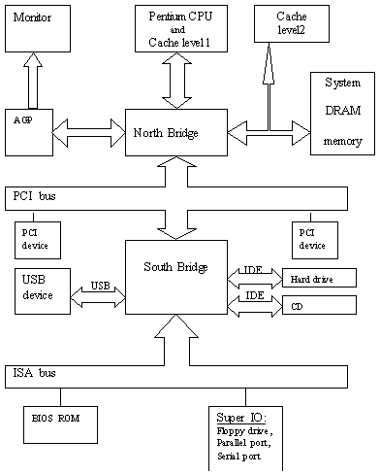
Computer Architecture

Slide 69
x32 Calling Conventions

Slide 70

Stack Frame
G(int a)
{
H(3);
add_g:
}
H( int b)
{ char c[100];
int i=0;
while((c[i++]=getch())!=EOF)
{
}
}
G’s stack frame
b
4 bytes
4 bytes
return address add_g
H’s stack
frame
address of G’s
frame point
C[99]
0xabc
Z
Y
X
0xabb
Input String: xyz
0xaba
C[0]
4 bytes
i

Slide 71
x64 Calling Conventions _{[Hirzel]}

Slide 72
Argument Passing
If the function has more than 6 arguments, then arguments 0 . . . 5 get passed in registers %rdi, %rsi, %rdx, %rcx, %r8, and %r9, and arguments 6 . . . n − 1 get passed on the stack.
If the function has at most 6 arguments, all arguments get passed in registers.

Slide 73
After a Caller Pushes Arguments, before It Makes a Function Call
first caller local variable
rest caller local variables
and
temporaries
arg[n-1]
arg[n-2]
…
arg[7]
arg[6]
high address
%rbp-8
%rbp-frame size
8 bytes
%rsp+8*(n-7)
8 bytes
8 bytes
%rsp+8
8 bytes
%rsp
low address

Slide 74

Right after a Callee Finishes Its Function Prologue
arg[n-1]
arg[n-2]
…
arg[7]
arg[6]
return address
caller %rbp
first callee local variable
rest callee local variables
and
temporaries
high address
%rbp+8*(n-5)
8 bytes
8 bytes
8 bytes
%rbp+24
8 bytes
%rbp+16
8 bytes
%rbp+8
8 bytes
%rbp
8 bytes
%rbp-8
%rbp-frame size
low address

Slide 75
Caller-Save Registers
The caller must save values of caller-save registers before it makes the call, as they may be lost when the callee overwrites them.
In other words, caller-save registers “belong to” the callee.

Slide 76
Callee-Save Registers
The callee must save values of callee-save registers in the prologue sequence and restore them in the epilogue sequence, as the caller may expect that their value after the return is the same as before the call.
In other words, callee-save registers “belong to” the caller.

Slide 77
Callee-Save Register vs. Caller-Save Register
Registers %rbp, %rbx, and %r12 thru %r15 belong to the caller (are callee-save registers)
All remaining registers belong to the callee (are caller-save registers).

Slide 78
Save or not Save ?
However, it is often not necessary to save and restore registers, since they may not hold live values.
For example, consider the caller-save register %rdx. If the caller does not keep a value in %rdx across a call, it does not need to save and restore %rdx.

Slide 79
Introduction

Slide 80
GNU (Linux) Operating System
Linux Kernel
+
system programs (e.g. compilers, loaders, linkers, and shells)
+
system utilities (commands)
+
libraries
+
graphical desktops (e.g. X window).

Slide 81
Unix Family
Linux
System V Release 4 (SVR4), developed by AT&T (now owned by the SCO Group);
the 4.4 BSD release from the University of California at Berkeley (4.4BSD);
Digital Unix from Digital Equipment Corporation (now Hewlett-Packard);
AIX from IBM;
HP-UX from Hewlett-Packard;
Solaris from Sun Microsystems;
Mac OS X from Apple Computer, Inc.

Slide 82
Linux OS Distrubution
Red Hat
  Fedora
SuSE
Slackware
Debian
  Ubuntu
Mint
Mandrake
Knoppix

Slide 83
Hardware Dependency (1)
Linux supports a broad range of platforms and hardware.
  alpha
    Hewlett-Packard's Alpha workstations
  arm
    ARM processor-based computers and embedded devices
  cris
    "Code Reduced Instruction Set" CPUs used by Axis in its thin-servers, such as web cameras or development boards

Slide 84
Hardware Dependency (2)
  i386
    IBM-compatible personal computers based on 80 x 86 microprocessors
  ia64
    Workstations based on Intel 64-bit Itanium microprocessor
  m68k
    Personal computers based on Motorola MC680 x 0 microprocessors
  mips
    Workstations based on MIPS microprocessors
  mips64
    Workstations based on 64-bit MIPS microprocessors

Slide 85
Hardware Dependency (3)
  parisc
    Workstations based on Hewlett Packard HP 9000 PA-RISC microprocessors
  ppc
    Workstations based on Motorola-IBM PowerPC microprocessors
  s390
    32-bit IBM ESA/390 and zSeries mainframes
  s390 x
    IBM 64-bit zSeries servers
  sh
    SuperH embedded computers developed jointly by Hitachi and STMicroelectronics
  sparc
    Workstations based on Sun Microsystems SPARC microprocessors
  sparc64
    Workstations based on Sun Microsystems 64-bit Ultra SPARC microprocessors

Slide 86
Operating System Objectives
Interact with the hardware components, servicing all low-level programmable elements included in the hardware platform.
  In a modern OS like Linux, the above functionality is provided by the Linux kernel.
  A user program can not directly operate on a hardware.
Provide an execution environment to the applications that run on the computer system (the so-called user programs).

Slide 87
The Kernel
The kernel itself is not a process, it provides various functions that various processes may need.
Besides, it also provides functions to manage the resources of the whole system, such as
  memory
  disk
  CPU
  … and so on.
Furthermore, it is also responsible for the process management.

Slide 88
IA32 Process Address Space Layout

Slide 89
Address Space of A Process
The total address space of a Linux process could be 4 Giga bytes.
The address range of the first 3 Giga bytes (0x00000000 ~ 0x BFFFFFFF) is called the user address space.
The address range of the fourth Giga bytes (0xC0000000 ~ 0x FFFFFFFF) is called the kernel address space.

Slide 90
Address Space
A set of addresses.
or
The union of the memory cells whose addresses constitute an address space.

Slide 91
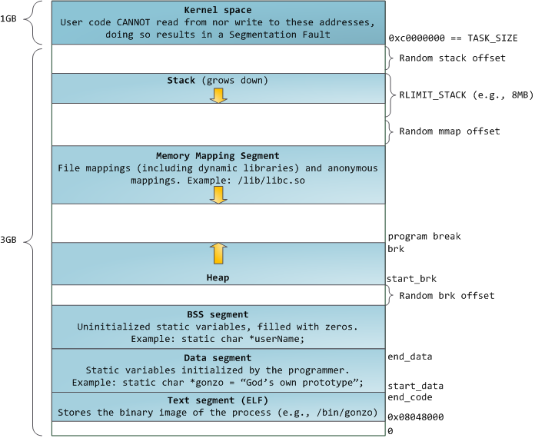
IA32 Linux Process Address Space Layout _{[Gustavo Duarte]}

Slide 92
x64 Process Address Space Layout _{[Grigorenko]}

Slide 93
Linux Memory Layout (64-bit)
The x86_64 processor memory management unit supports up to 48-bit virtual addresses (256TB = 2⁴⁸).
  https://www.kernel.org/doc/ols/2001/x86-64.pdf

Slide 94
Canonical Form Addresses _{[wikipedia]}
The AMD specification requires that bits 48 through 63 of any virtual address must be copies of bit 47 (in a manner akin to sign extension), or the processor will raise an exception.

Slide 95
Two Address Ranges _{[wikipedia]}
The “canonical form” of addresses creates two ranges to use these 48 bits:
  0x through 0x00007FFF'FFFFFFFF
  and
  From 0xFFFF8000'00000000 through 0xFFFFFFFF'FFFFFFFF.
Thus providing two 128TB spaces.

Slide 96
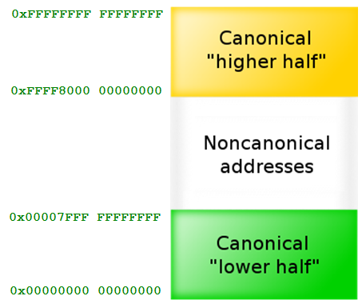
Current 48-bit Implementation _{[wikipedia]}

Slide 97
User Address Space and Kernel Address Space
Starting in kernel 2.6.11, the user space gets the lower half, i.e. up to 128TB, and the kernel the other half:
  https://www.kernel.org/doc/Documentation/x86/x86_64/mm.txt

Slide 98
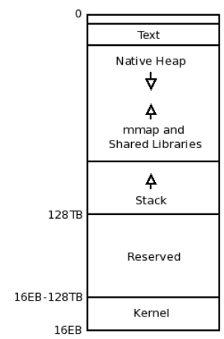
Process Address Space Layout

Slide 99
Execution Mode of IA32

Slide 100
Execution Mode of IA32
Even though 80x86 microprocessors have four different execution states, all standard Unix kernels use only
  kernel mode
  and
  user mode.
Different modes represent different privileges.
A process could be in user mode or in kernel mode, but can not in both modes simultaneously.

Slide 101
Execution Modes vs. Address Space – User Mode & User Address Space
The following components of a process are stored in the user address space of the process:
  user-level functions
  variables
  user-level data
  library functions
  the heap
  the user-level stack
A process could access these entities when it is either in user mode or kernel mode.

Slide 102
Execution Modes vs. Address Space – Kernel Mode & Kernel Address Space
The following components are stored in the kernel address space and could be accessed only when a process (thread) is in kernel mode.
  Kernel data
  Kernel functions
  each process’s kernel-level stack

Slide 103
Execution Modes vs. Address Space – (3)
The contents of the user address space of different processes maybe are different; however, the contents of all processes’ kernel address space are the same.

Slide 104
Mode Switch
A process in user mode can not access kernel data or functions directly. In order to do so, it must utilize a system call to change its mode to kernel mode and to get the service.
A process in kernel mode can access data and functions in its user address space.
A process usually executes in user mode and switches to kernel mode only when requesting a service provided by it. When the kernel satisfied the request, it puts the process back in user mode.

Slide 105
Kernel Threads
Always run in kernel mode in the kernel address space.
Not interact with users.
Not require terminal devices, such as monitors and keyboard.
Usually are created during system startup and killed when the system is shut down.

Slide 106
Uniprocessors vs. Multiprocessing
If multiprocessing is provided on a uniprocessor system, then, even though multiple processes may exist at the system at the same time, at any instant, only one process can be executed.

Slide 107
Context Switch (Process Switch)
The kernel uses context switch to make the CPU to change its execution from one process to another process.
Only the kernel component, scheduler, can perform a context switch.
When will a context switch happen?
  system calls.
  Interrupts.
  …

Slide 108
Activation of Kernel Routines
System calls.
Exceptions.
Interrupts.
Kernel thread.

Slide 109
Interrupt vs. Exception
Interrupt – Asynchronous
Exception – Synchronous (on behalf of the process that causes the exception)
  Divided by zero
  Page fault
  Invalid OP or address

Slide 110
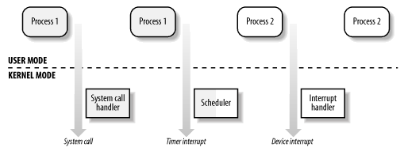
Transitions between User and Kernel Mode
Interrupt Handler
system call
timer interrupt
device interrupt

Slide 111
Process Descriptor
Inside the kernel, each process is represented by a process descriptor.
Each process descriptor consists of two parts.
  The process-related data, such as
    all the registers,
    page tables,
    virtual memory,
    open files,
    … and so on. (used for context switch)
  The process’s kernel-level stack.

Slide 112
Reentrant Kernels
Several processes maybe executing in kernel mode at the same time.
  On uniprocessor systems, only one process can progress, but many can be blocked in kernel mode when
    waiting for CPU
    or
    the completion of some I/O operation.

Slide 113
Reentrant Functions
Functions that only modify local variables, not global variables.
Nonreentrant functions are used with locking mechanisms to ensure that only one process can execute a nonreentrant function at a time.

Slide 114
Interrupts
When a hardware interrupt occurs, a reentrant kernel is able to suspend the current running process even if that process is in kernel mode.
The interrupt handler and interrupt service routine use current process’s kernel stack as their own stack.

Slide 115
Kernel Control Path
The sequence of instructions executed by the kernel to handle
  a system call,
  an exception,
  or
  an interrupt.

Slide 116
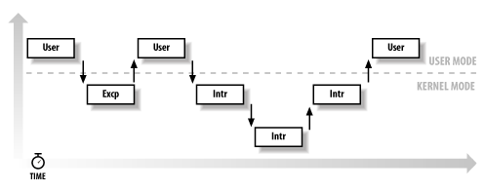
Interleaving of Kernel Control Paths

